Slide 1

Covid Lung Analysis
Caston Stack
4/14/2021

Slide 2

Introduction
The Novel Coronavirus outbreak of 2019 (COVID-19 or COVID) is a disease caused by SARS-CoV-2 that has taken the world by storm causing widespread shutdown within 2020 and into 2021
The precursor to COVID-19 was a different acute respiratory coronavirus, SARS-CoV-1 that was identified in 2003
Both diseases are transmissible through respiratory droplets causing respiratory distress often through a dry cough that leads to pneumonia and other scarring of the lung tissue
As the long-term effects of COVID-19 are widely unknown at this time, aside from reduction of lung efficacy and increased scar tissue within the lungs, being able to properly diagnose the disease prior to advanced disease is crucial
A chest X-Ray has been shown to be a noninvasive medical test that can help diagnose COVID-19, or pneumonia related to COVID-19.

Slide 3
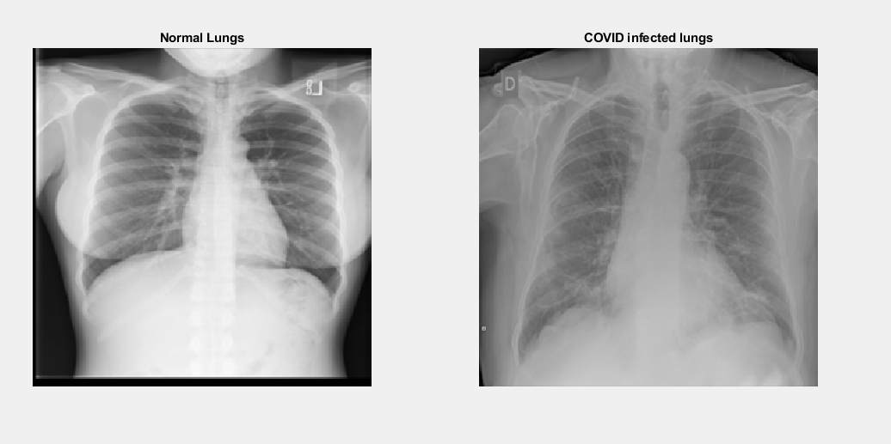
Objectives & Method
A dataset of 200 chest x-rays from a public database provided by Kaggle.com will be what we perform analysis on.
100 X-Rays from Covid Patients
100 X-Rays from Healthy Lung Patients
By converting the images into 299x299 matrices with the opacity being the value of each pixel, on a scale from 0-255 (the larger the number the darker the pixel), we can run principal component analysis and subsequently feed that data into decision trees and neural networks to use machine learning to identify positive Covid-19 patients from X-Rays of their lungs

Slide 4
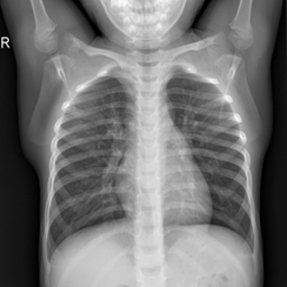
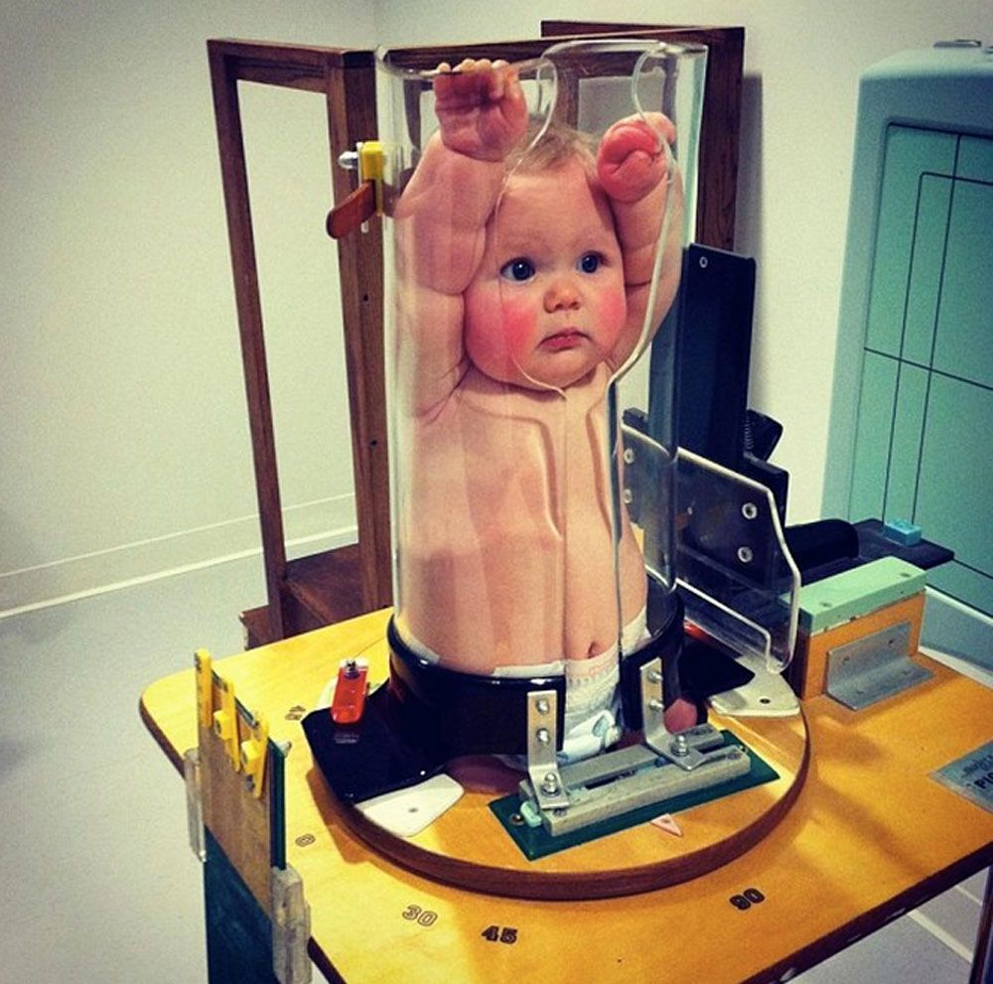
Methodology pitfall
On analysis of this dataset, the quality of the x-ray as well as the age of those whom the x-rays are taken of can drastically change results from dataset to dataset
With the ‘normal’ x-ray dataset, nearly 95% of the x-rays between number 1 and 1400 are of babies.
This could drastically throw off data as infant bone density could be lower than an adult and the opacity of baby lung tissue could be less due to not having exposure to other respiratory
This x-ray shows the patient with their arms above their head. This is uncommon for older patients, and is how infants get x-rays taken
This is what it looks like when an infant gets an x-ray

Slide 5
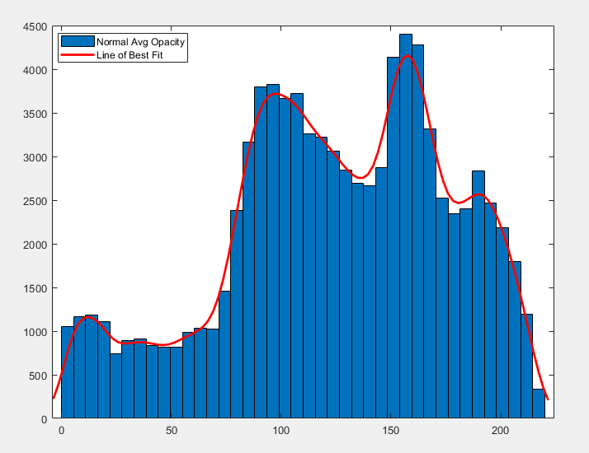
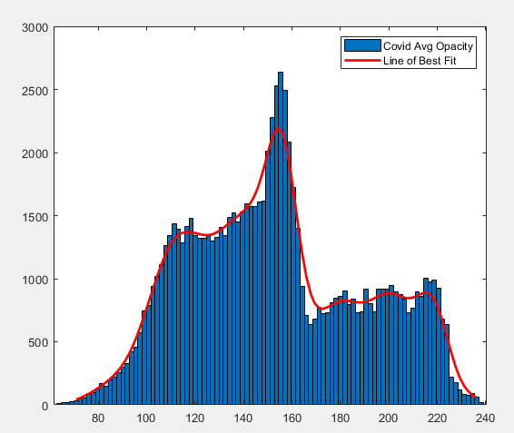
Distributions
The above histogram and lines of fit yield two interesting results. The normal lung x-rays appear to have a bimodal distribution with local maxima around 110 and 165 and a shelf (area with near zero slope) between 0-80. The Covid lung x-rays appear unimodal with maximum around 150 and a shelf between 165-220.
This indicates that the normal lung x-rays are generally less opaque (have more darks spots), indicating less scarring and fibroids within the tissue.

Slide 6
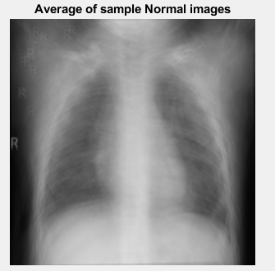
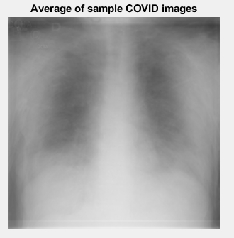
Summary Statistics
 | Normal Lung Opacity | Covid Lung Opacity
Min | 0 | 0
Mean | 153.399 | 124.789
Median | 173 | 145
Max | 255 | 255
Std | 63.447 | 58.784
Variance | 4025.5091 | 3455.582
This box is the average normal lung opacity
This box is the average covid lung opacity
This box is the median normal lung opacity
This box is the median covid lung opacity
The above boxes are on a greyscale indicating the respective opacities of the mean and median of both patient groups. The below are the respective mean images.
Looking at the raw numbers, the normal lung opacity appears to be less opaque with a greater variance in that opacity. The higher median also indicates that healthier lung tissues should be less opaque than lung tissue from a covid positive patient.

Slide 7
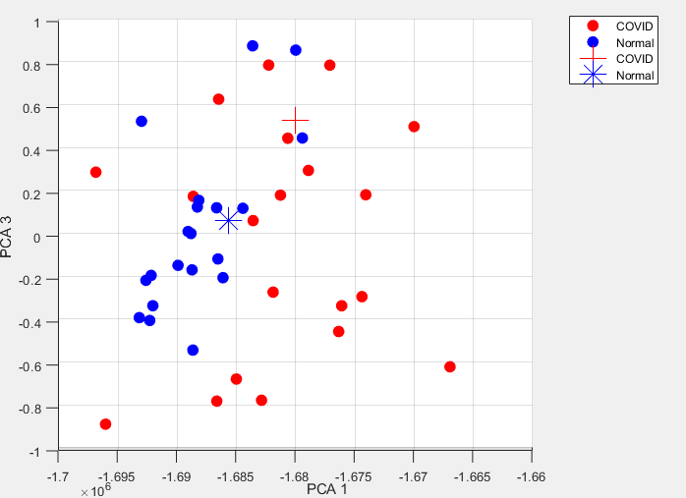
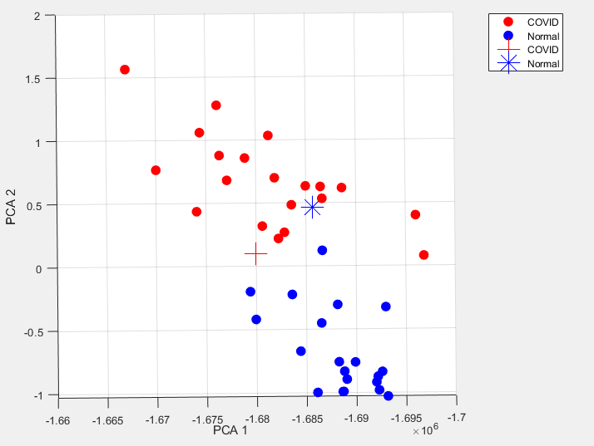
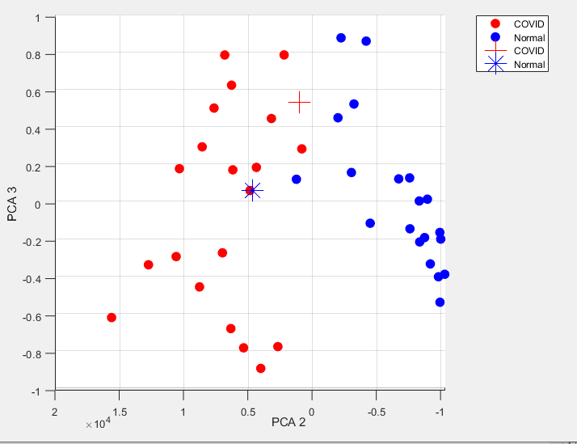
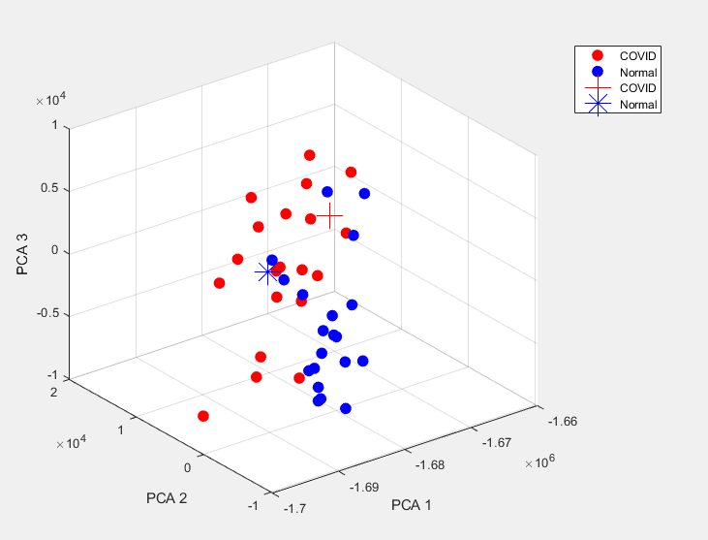
Principal Component Analysis
After running PCA on the data and plotting the first 3 principal components, we find that the 2nd principal component has large correlation to a given x-ray exhibiting COVID. Both the 1st and 3rd principal components do not appear to have a large correlation between magnitude of the PC and COVID or normal x-rays.
Using Predictive Modeling, we can feed in training and test data from the PCA values to attempt classification of x-rays.

Slide 8
Classifications

Slide 9
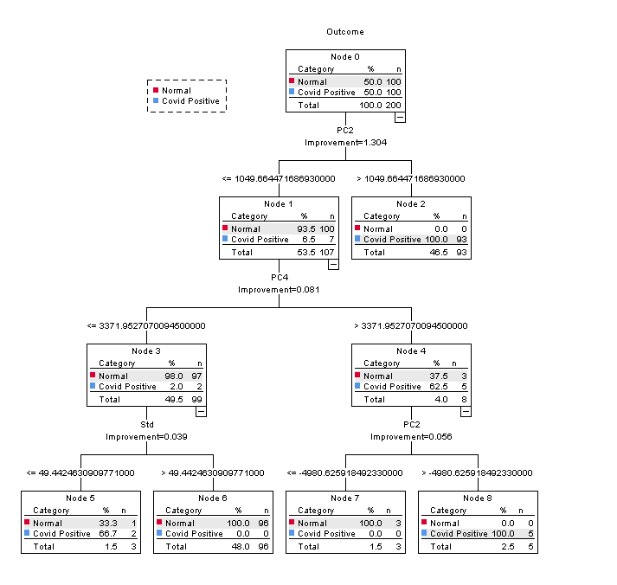
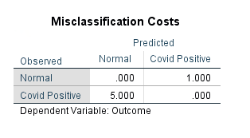
Classification Tree Models
For my classification tree, I chose to penalize Type I Error heavier due to the ramification of doing so
If a patient comes in and gets a chest x-ray that shows that they have COVID, but our classification decides they do not, we would rather increase our chance of the ‘false positives’ than let someone who is ill go home and develop worse disease or spread the disease within the community

Slide 10
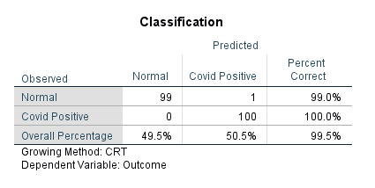
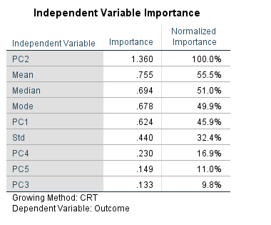
Classification Tree Models
Our model reached 99.5% accuracy, only misclassifying a single normal chest x-ray as covid positive.
Looking at our variable importance, the bottom right chart validates the 2d and the 3d images on the PCA that the 2nd principal component is a driving factor on the classification of a normal or a COVID x-ray

Slide 11
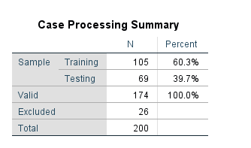
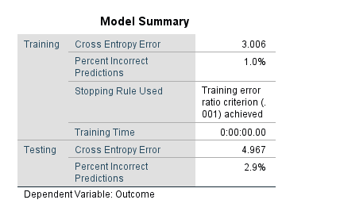
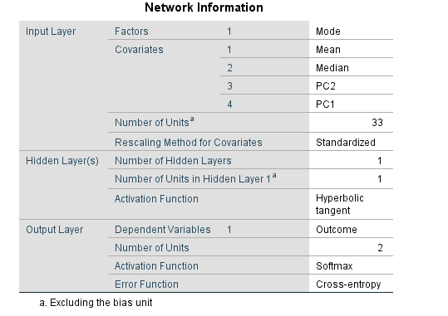
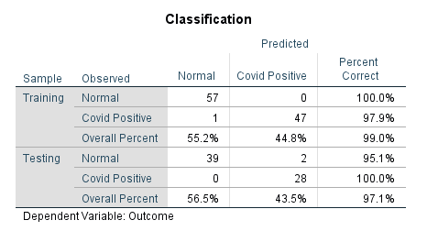
Neural Network
When building my Multilayer Perceptron neural network, when including all of the variables, SPSS overfits the network resulting in 100% accuracy in both the training and the testing results. Only using the most important variables from the Decision Tree – Mean, Median, Mode, PC1, PC2, a more simple network can be created. The summary of the network are to the left.
Although the net is more simplified, there are still indications of overfitting. The chart below show a 97.1% accuracy on classification on the test data.

Slide 12
Summary
Overall, splitting up this subset of data is not a good representation of the population and more than likely results in highly skewed models and summary statistics. Setting that aside, the methods to analyze and classify this data can still be useful.
The decision tree models are incredibly easy to follow. They are effectively logical flow diagrams that can be followed by “If criteria is met, go down this path.” A big draw back is the ability to have interpretable data in relation back to the original question. If classification has a variable of “weights”, that is easier to interpret than a variable with “secondary principal component” values.
The neural network biggest benefit is that the result set is able to ‘learn’ as it goes. By adjusting weights and/or activation functions, better fits can be made as more data is ‘learned.’ The result set is also easy to interpret for classification problems. The biggest draw back to neural networks is the black box effect. Given all the weights within the NN, it has no interpretable quality to it. Neural networks are also incredibly prone to overfitting models to the data.
With COVID-19 x-ray classification problems, the decision tree would be the best way to go. Leveraging AI to read x-ray image data in real time as well as following decision tree logic would enhance the speed to consider additional testing and/or treating active disease. It would also help remediate the human aspect of a lab technician manually reading an x-ray. AI may be able to detect additional areas of interest faster on an x-ray than a lab tech, however due to misclassification and Type I error, AI may have to resign to assisting lab techs and not replace them at this point in time.

Slide 13
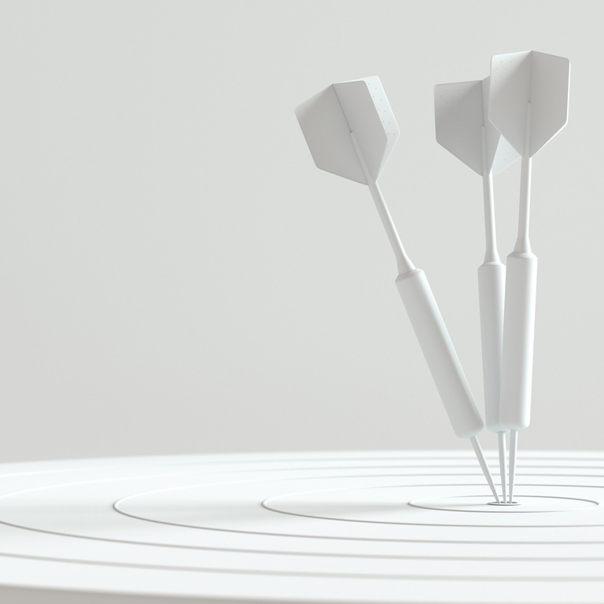
Thank you

Slide 14
Sources
https://www.cdc.gov/coronavirus/2019-ncov/global-covid-19/global-response.html
https://en.wikipedia.org/wiki/Severe_acute_respiratory_syndrome_coronavirus
Stack, Brianna (almost) MD
Carlin, Carissa ASCP

