Slide 1



④
③
Signal
generator
PD
PC
DAQ Cards
Transimpedence amplifier
and Filter
①
②
Polarizer
Pump
Laser
VA
EOM
BS
Target

Slide 2
②
Signal
generater
PD
PC
DAQ Cards
Transimpedence amplifier
and Filter
①
Polarizer
Pump
Laser
VA
EOM
BS
Target

Slide 8
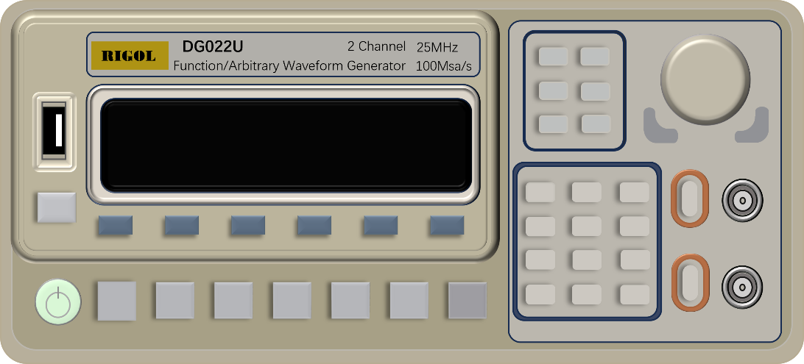
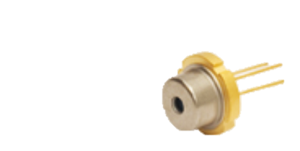
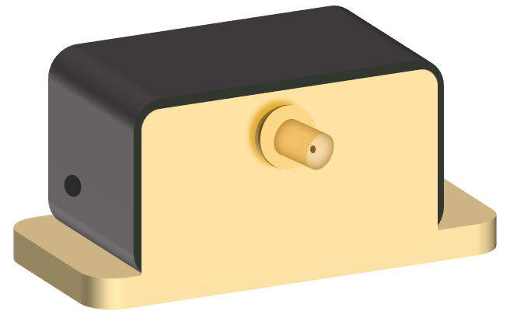
②
Oscilloscope
Computer
Volage Amplifier
Signal generator
①
Transimpedence amplifier and Filter
PD&LD
VA
P
EOM
Target

Slide 9
PD&LD
EOM
Target

Slide 10
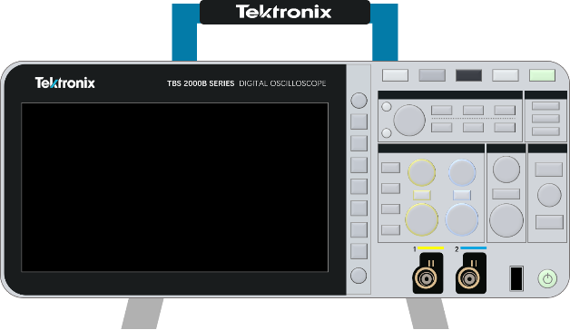

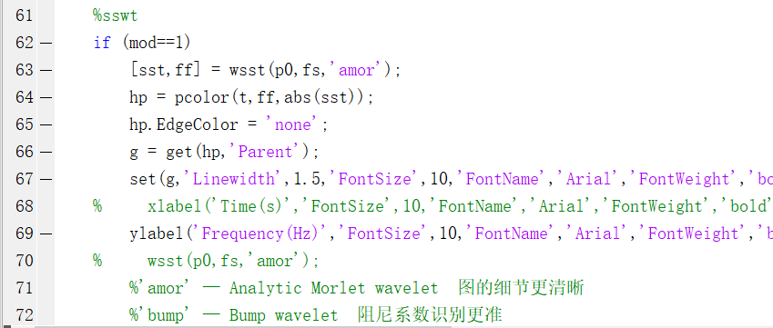
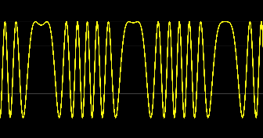
Oscilloscope
Computer
Signal generator
Transimpedence amplifier and Filter
PD&LD
VA
Target

Slide 11
RIGOL
DG022U
2 Channel
25MHz
Function/Arbitrary Waveform Generator
100Msa/s

Slide 13
THORLABS
HIGH VOLTAGE AMPLIFIER
HVA200
INPUT
MONITOR
HV OUTPUT
POWER
ON
OUTPUT
ON
DCBIAS
CONTROL
OUTPUT
±10V MAX
ENABLE
POWER
±10V MAX
-20:1
±200V MAX
100 MA MAX

Slide 14
3800
1000
：五孔插座
IP
：网络插座
IP
IP
IP
IP
IP
IP
1500
2100
1200
1200
1300
1700
1000

Slide 17
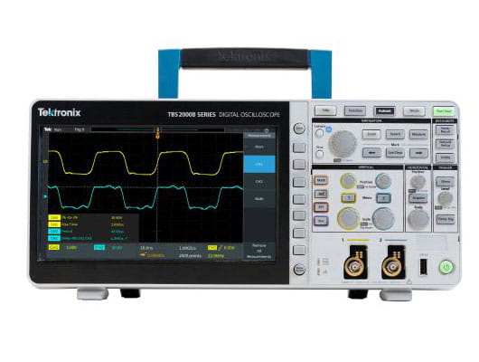
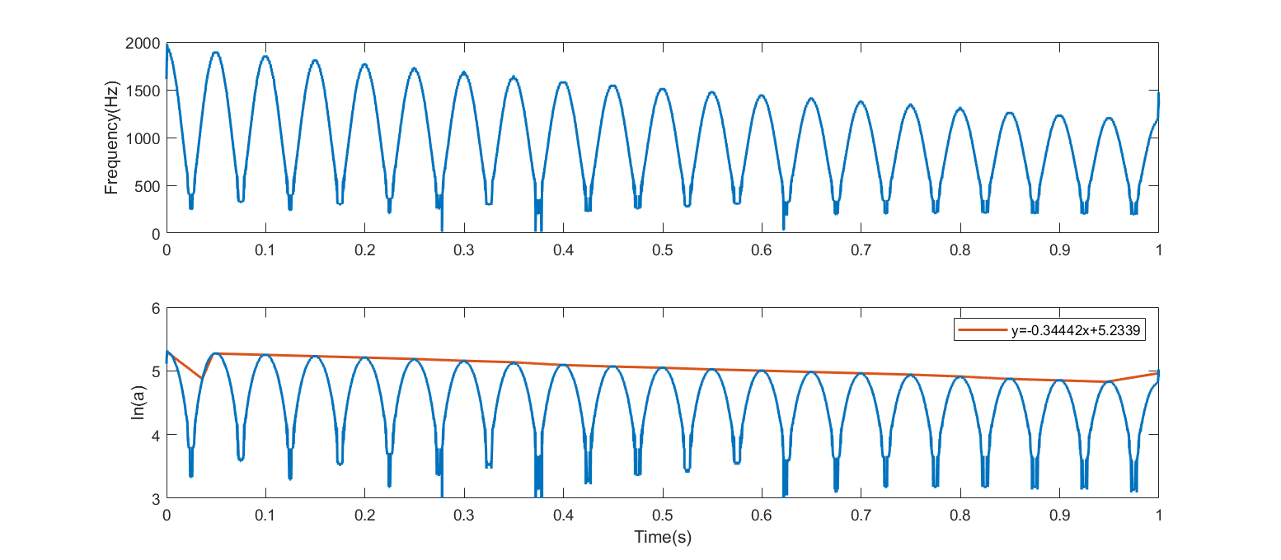



Slide 18
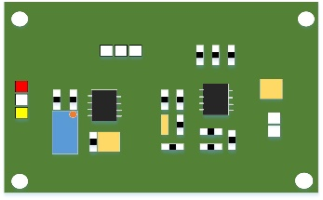

Signal processing circuitry
Damping vibration
PD LD
VA
Oscillograph
Computer

Slide 19
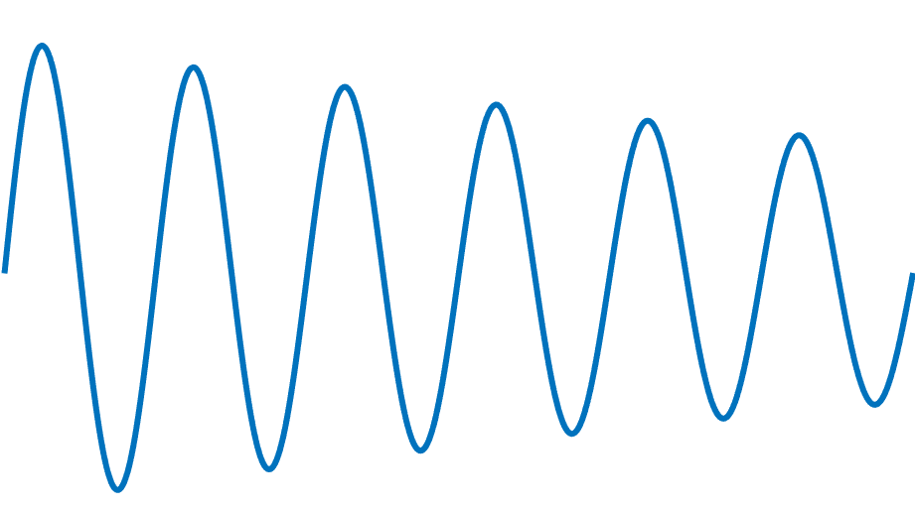
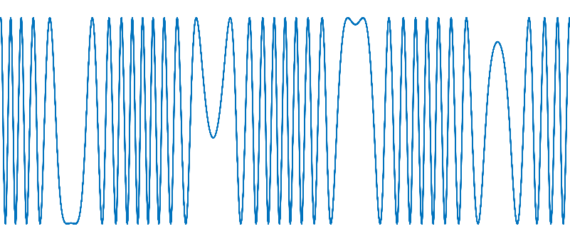
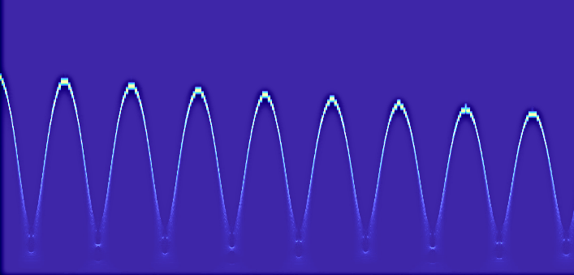
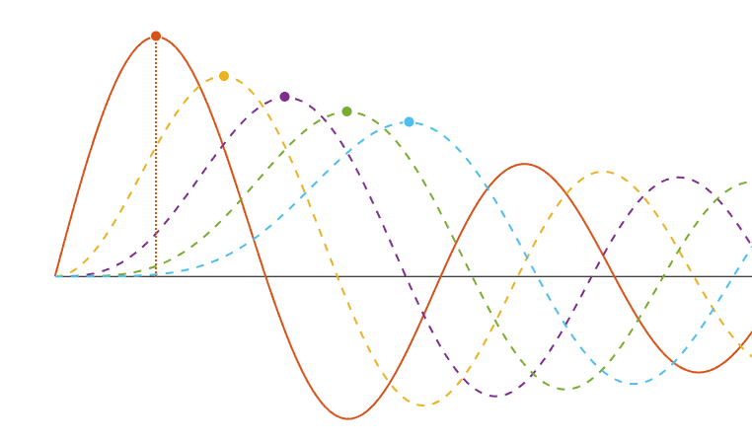
Damping vibration
OFI signal
Time frequency diagram
SSWT
FFT
J_{n}(x)
x
Fitting
Bessel function

Slide 20
