Slide 1
Homepi
Architectural overview

Slide 2




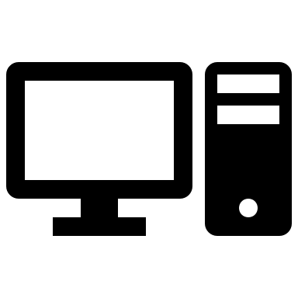
Push notify
Raspi controlled via Private Portal.
Media center can be controlled via Remote or Mobile.
TV
Sync / new Task
Wunderlist
Trello
Raspi
Sync
Portal
New content check
Media content
Home network
Public internet

