Slide 1
“Competitive Analysis” Through Topic Modeling

Slide 2
Background and Problem Statement
The VP of US eCommerce at Transcend (a Taiwanese electronics company) has witnessed sales for its SD card on Amazon eroding from 2013 to 2015 (the “present”). The VP says that while star score has increased, sales have been dropping. The VP claims that to his knowledge, Transcend has been the sales leader on Amazon since it joined Amazon in 2010.
He has approached your team to diagnose what may be going on in the Amazon ecosystem, and to start with competitive analysis.

Slide 3
The Data
The data comes from Julian McAuley’s curated Amazon Review Dataset: http://jmcauley.ucsd.edu/data/amazon/
- Over 1.6 million reviews for electronics products from May 1996 – July 2014
- Features include: Amazon ASIN number (i.e. product /product family ID), review text, star rating score, review date

Slide 4
Part 1: Find Competitor Products
Problem:
- The VP of eCommerce has not given us a list of competitors
- We do not have a taxonomy of competitors, nor do we have product names / product families
Resource:
-We do have product ID’s and free form text that we can leverage

Slide 5
Part 1: Find Competitor Products (cont.)
Step 1: Read in csv file of all electronics reviews
Step 2: Filter for reviews containing “sd” only
Step 3: Sort by the most popular products in the “sd” card candidates group
Step 4: Get the list of candidate ASINs for sd card
Candidates: 'B007WTAJTO', 'B00E3W15P0', 'B000VX6XL6', 'B002MAPRYU', 'B004G6002M', 'B004W2JKWG', 'B002WE6D44', 'B007P4VOWC’

Slide 6
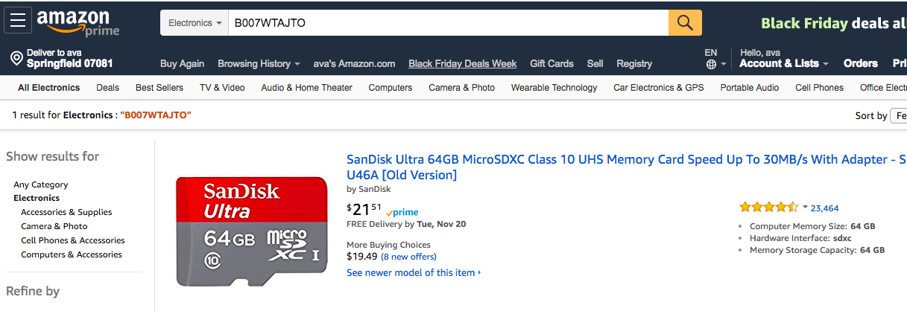
Part 1: Find Competitor Products (cont.)
Step 5: Search for each ASIN on Amazon

Slide 7
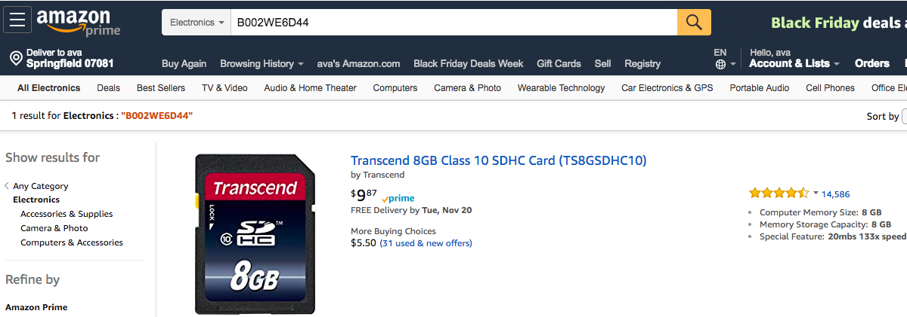
Part 1 Synthesis
ASIN #1, ‘B007WTAJTO’ is a SanDisk MicroSD card. It has 4914 total reviews.
ASIN # 7, ‘B002WE6D44‘ is a Transcend SD card. It has 2813 total reviews.

Slide 8
Project Scope:
Upon hearing this the VP of Sales says he wants to learn more about the Sandisk product in particular. He wants to know about the relative strengths, weakness, and anything else about the two products that can be learned.

Slide 9
Part 2: Summary Statistics
Sandisk Micro SD Card:
Number of reviews: 4914
Star score (mean): 4.59
Star score (standard deviation): 1.00
Transcend SD Card:
Number of reviews: 2813
Star score (mean): 4.66
Star score (standard deviation): 0.88
Synthesis:
It seems as though the Transcend SD card is marginally preferred and more consistently so than the Sandisk memory card.
Nonetheless, the Sandisk card seems more popular.

Slide 10
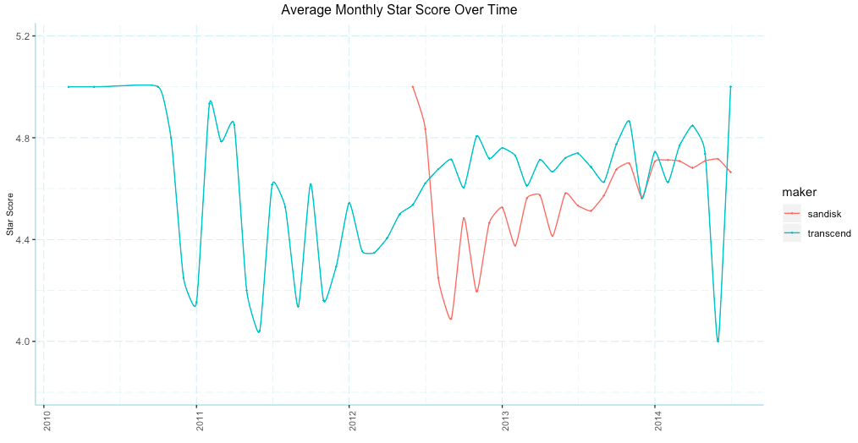
Part 2: Summary Statistics
Synthesis:
We see that Sandisk seems to have entered Amazon in mid-2012. Perhaps the entry by Sandisk has caused revenue for Transcend to erods.

Slide 11
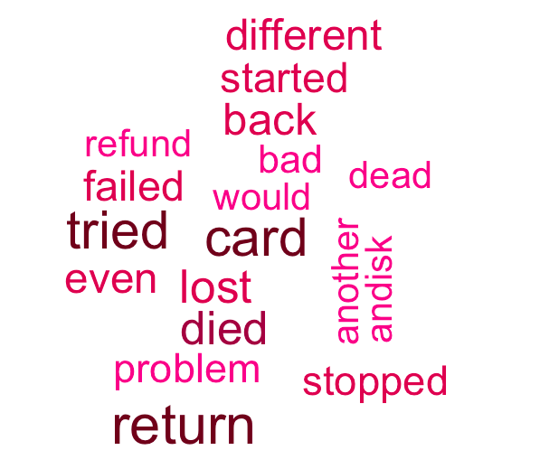
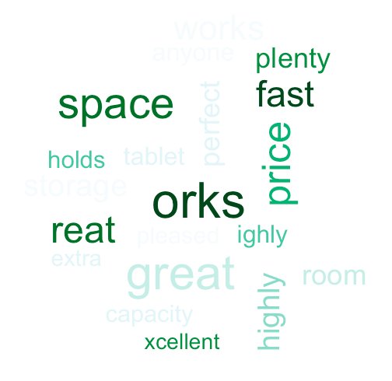
Part 3: Sandisk Sentiment Word Clouds
Top 20 words correlated with low and high star score respectively after filtering ~60% least infrequent words

Slide 12
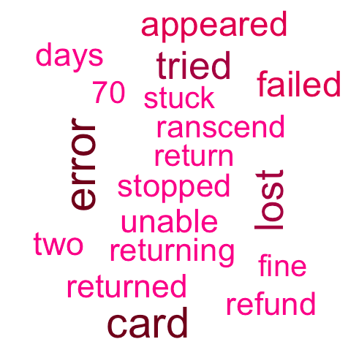
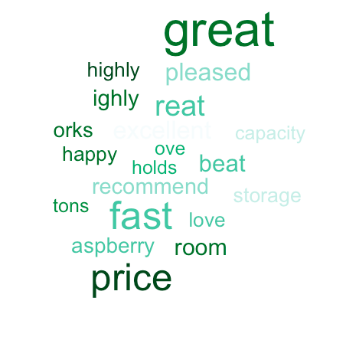
Part 3: Transcend Sentiment Word Clouds
Top 20 words correlated with low and high star score respectively after filtering ~60% least infrequent words

Slide 13
Part 3: Sentiment Word Clouds Synthesis
It is difficult to judge any overwhelming weaknesses / strengths from the top 20 negative / positively correlated words
We can surmise is common sense: that customers usually are generally happy when the cards function fast and are cheap (evidenced in the transcend wordcloud).
Customers are generally upset if the cards are failing, thus causing them to return the product.

Slide 14
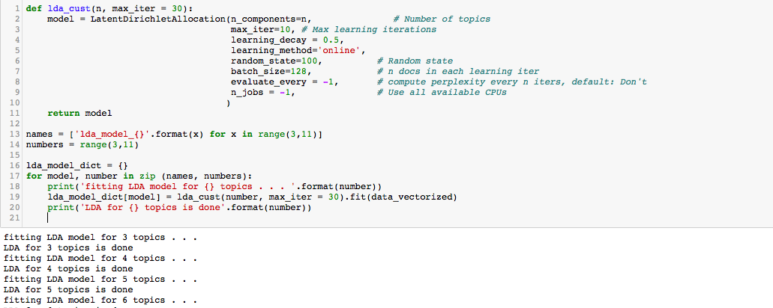
Part 4: Competitive Analysis Through Topic Modeling
We will try to assess in what areas either competitor has relative strengths / weaknesses through topic modeling. Step 1: Fit LDA topic models for numbers of topics from 3-10 on the combined corpus for both sandisk and transcend

Slide 15
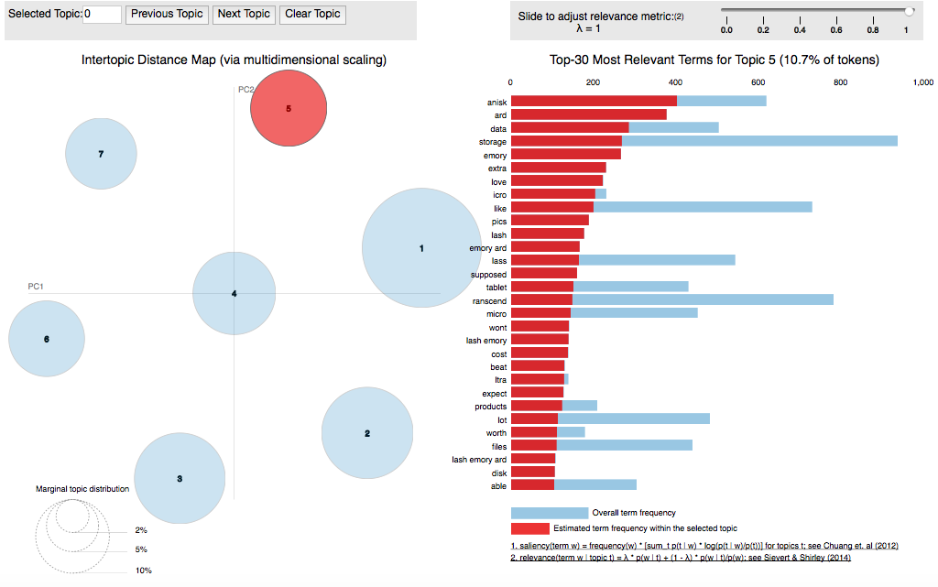
Part 4: Competitive Analysis Through Topic Modeling
Step 2: Use pyLDAvis to investigate each of the models to see which model is the easiest to interpret (unable to do in R, but we could suggest 7 topics for use by students)

Slide 16
Part 4: Competitive Analysis Through Topic Modeling
Seven topics are chosen
Group 1: Phone/Problems
Group 2: Great / Price / Happy
Group 3: Speed / Camera / Video
Group 4: Samsung / Movies/ Music
Group 5: Memory / Love
Group 6: Photos
Group 7: Camera / Video

Slide 17
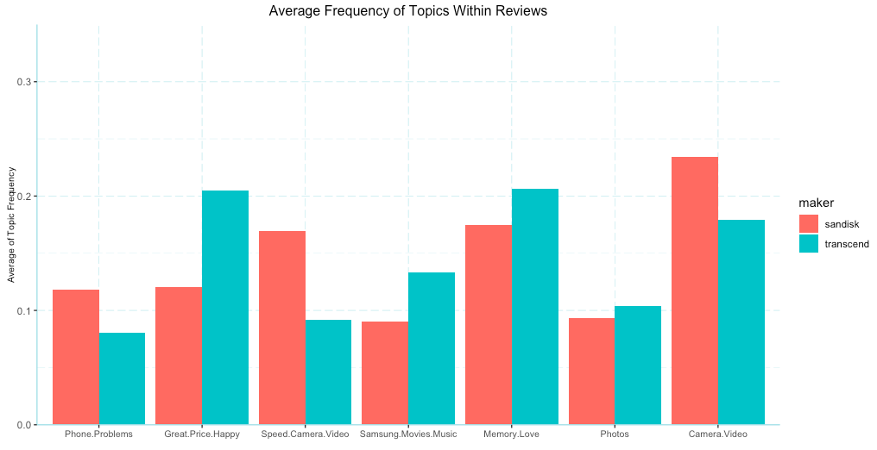
Part 4: Competitive Analysis Through Topic Modeling

Slide 18
Part 4: Competitive Analysis Through Topic Modeling (Takeaways)
Suggestion: The VP should consider developing or acquiring microSD card technology if Transcend has not already, and promote the use of Transcend cards for other types of electronics.
It may be the case that because Sandisk is a microSD card, it can be used in more electronics than Transcend. At the same time, the Sandisk microSD cards may be more expensive and prone to errors than the Transcend cards due to the small card sizes. Sandisk has more frequent topic representation in topics pertaining to other electronics, specifically cameras / videos, suggesting that it may be more compatible or used more often with other camera and video electronics.
- Phone/Problems
- Speed / Camera / Video
- Camera / Video
Transcend has a higher representation with the Samsung topic as well as other topics around functionality, suggesting it may be used less often in other types of electronics. However, it potentially has higher price and functionality value than the Sandisk card.
- Great / Happy / Price
- Samsumg / Movies / Music
-Memory / Love

Slide 19
Appendix: Topic Distributions over Time

Slide 20
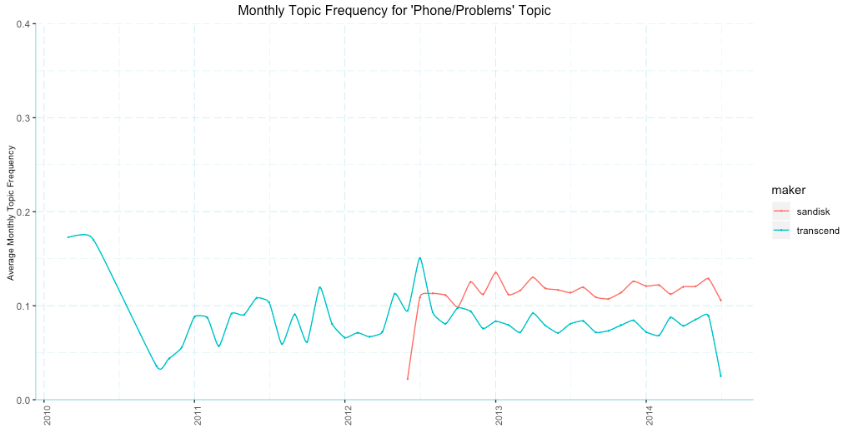
Appendix: Topic Distributions over Time

Slide 21
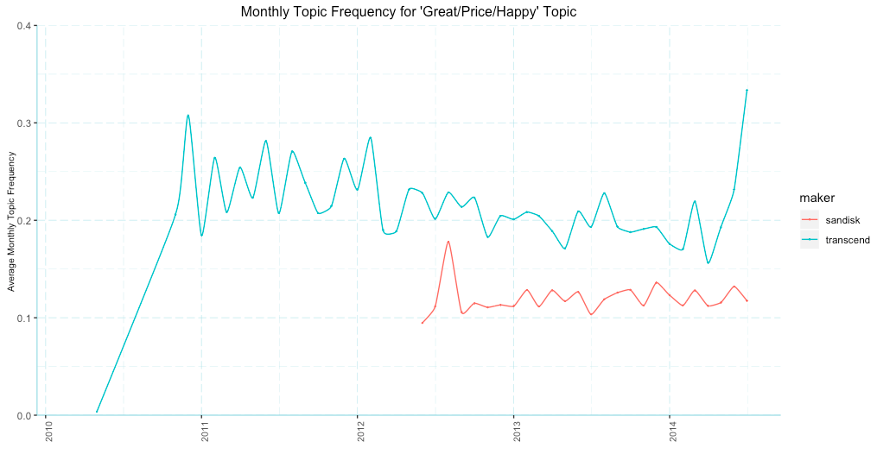
Appendix: Topic Distributions over Time

Slide 22
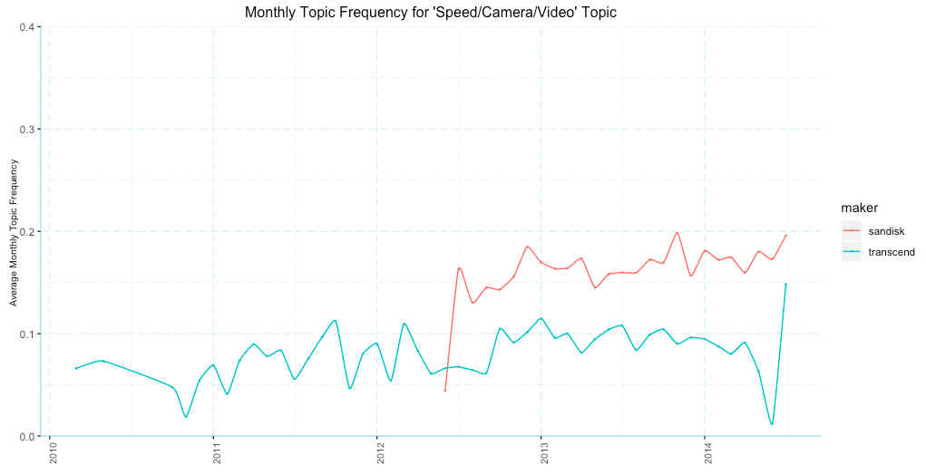
Appendix: Topic Distributions over Time

Slide 23
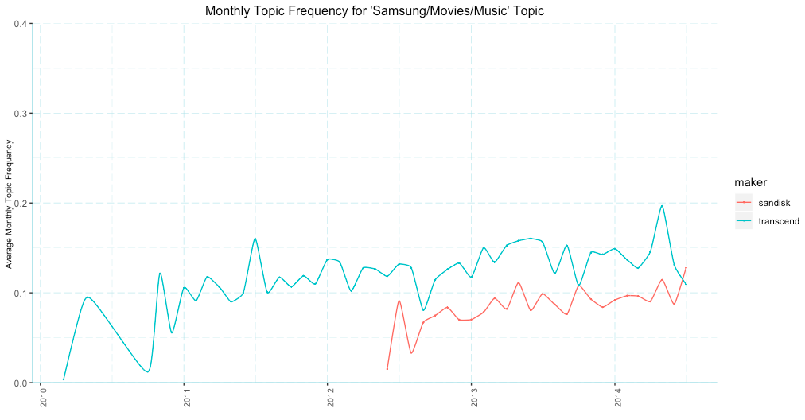
Appendix: Topic Distributions over Time

Slide 24
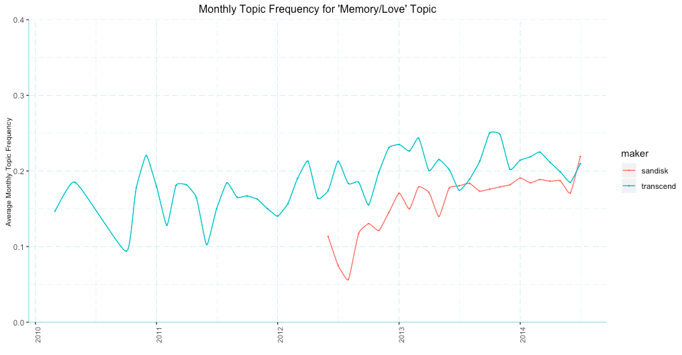
Appendix: Topic Distributions over Time

Slide 25
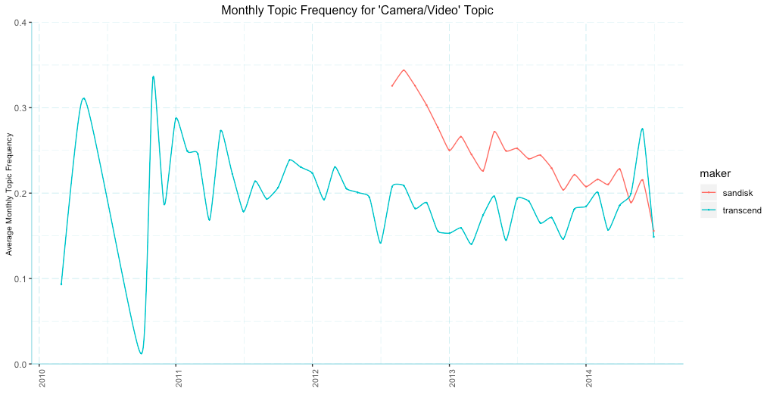
Appendix: Topic Distributions over Time

Slide 26
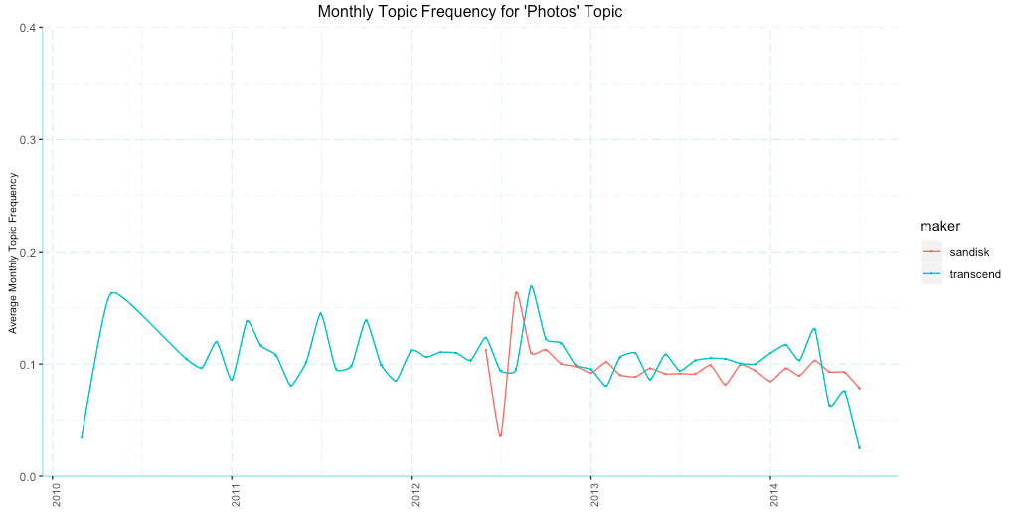
Appendix: Topic Distributions over Time

