Slide 1

Company_name
Company_sector

Slide 2

Company_name
Investment Thesis
Industry Overview
Company Analysis
Competitors
Recommendation
Company_logo
2

Slide 3
Investment Thesis

Slide 4
Company_name
Investment Thesis:
Company_summary
Recommendation: Buy Current price: ≅$11.96 Price Target: ≅$50
Hold Period: 2-5 years 318% Upside Potential
Catalysts
Risks
Operating in emerging markets, so increased macroeconomic growth opportunities
Operating through four separate companies in differing markets, thus benefiting from increased levels of scale.
Relatively new entrant into the market, thus significant room for growth.
GFG’s platforms and business operations are built for scale, will be especially fruitful in Latin America and the Asian Pacific region.
Expanding their value-added fashion products in areas such as media services, end-to-end fulfilment, and white label e-commerce.
Increased geopolitical risk and higher levels of governance compliance requirements.
Fashion industry is defined by incredible competition.
GFG is in the process of moving a number of key distribution centres, could be impacted by COVID.
Currently operating at a net loss to re-invest into its technology and fulfillment assets.
Possible implementation of direct and indirect taxes on e-commerce markets to protect high street stores (already being considered in the UK).
4

Slide 5
II. Industry Overview

Slide 6
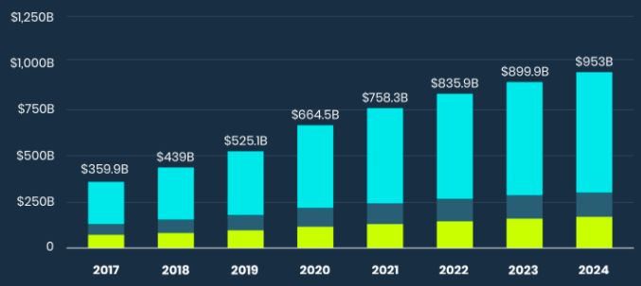
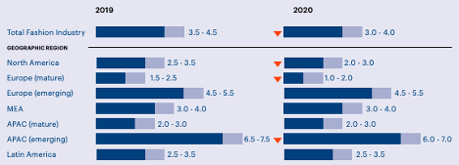
Company_name
Industry Overview
Drivers behind Growth
The meteoric growth in e-commerce worldwide is evident throughout the pandemic. The e-commerce fashion industry is currently valued at $664.5 billion and is expected to reach $1 trillion by 2025, representing around 8.6% of growth per year.
Worldwide consumers have increased their online shopping by 68% since the beginning of the pandemic (Harvard College Consulting Group).
GFG estimates fashion e-commerce only accounts for about 6 percent of total sales in its markets, compared to 15 percent in Europe and 20 percent in the US.
Growing income inequality has seen people moving away from luxury, brand name goods and the sourcing of reasonable alternatives from foreign suppliers.
Growth has lagged in the emerging markets GFG serves, this slower recovery is due to less effective fiscal policy, reduced access to the COVID vaccine, and other macro-economic trends related to COVID.
Market Share
Industry Growth
6

Slide 7
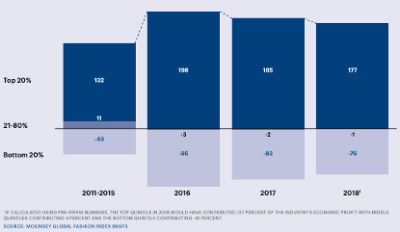
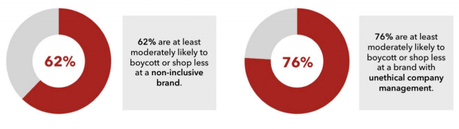
Company_name
Industry Overview
Industry Trends
Shrinking ownership of the Top 20%
Digital Land Grab
Not only has there been shifts to e-commerce as a result of COVID, but increased reliance on digital forms of marketing, especially to consumers in Gen-Z.
Shifted Product Demand
Individuals care less about the history and status of the goods that they purchase and look more at the quality, design, and widespread appeal of products.
Value-based Consumerism
Increased access to digital media and greater scrutiny on injustices means brands face greater calls for social justice and corporate accountability.
Cross-Border Challenges
New global market has disrupted existing supply routes, bringing hitherto unknown Asian suppliers into the e-commerce market.
Boycotting Non-Inclusive Brands
7

Slide 8
III. Company Analysis

Slide 9
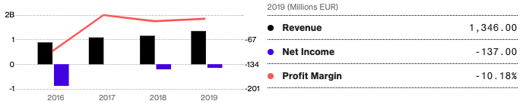

Company_name
Company Analysis
The company was originally set up in 2014 in a consolidation led by German ecommerce investor Rocket Internet and its largest investor swedish investment company Kinnevik.
“GFG will be focused on capturing the massive growth opportunity of fashion e-commerce in emerging markets. Each of the business units will be able to build on the original Rocket platform and continue to leverage knowledge and expertise gained across 23 countries,” said Oliver Samwer, CEO of Rocket Internet
Samwer is has been the CEO for rocket since 2014; and is behind the spectacular rise of european online fashion retailer Zalando.
Management
GFG has two co-Ceo’s of their own brand: Patrick Schmidt and Christian Barchewitz. Each holding their positions since 2018 restructuring before their IPO.
The company employs 13’000 employees each strategically positioned within the markets they serve
“We have spent the last 10 years building very localized solutions, ones that are different in every end market,” Barchewitz said.
Share Price Performance
Financials
GFG was only just IPO’d in July of 2019, priced at around €5/share
Currently trades around €12/share
9
Notes:
Zalando generated roughly 6.84 billion euros in revenue in 2019, which was an increase on the previous year at 5.39 billion euros. Ten years earlier Zalando had recorded 6 million euros.
We are confident in GFG’s ability using rockets leadership to

Slide 10
Company_name
Company Analysis
Strategy:
Global Fashion Group’s strategy is predominantly focused around securing top line growth. In order to achieve this objective management have instigated several initiatives that are segment tailored and focused around industry trends.
GFG has been intentionally making a loss over the past 5 years to reinvest into delivery and supply channels. This proved wise, as in 2020 the company easily managed to soak up the extra demand in e-commerce and made an adjusted EBITDA of €10 million, despite no plans to make a profit until at least 2022.
Macroeconomic Developments
Category and Segment expansion
Significant growth opportunities in the markets they operate within will lead to real top-line growth.
Factors such as increased levels of urbanisation, increases in disposable incomes, increasing customer engagement with digital media, and improved last-mile delivery capabilities will account for a lot of this growth.
Significant room for GFG to expand its range of fashion & lifestyle categories across its regions and thus grow its market share.
Management plans to expand all of these categories by adding relevant brands and growing assortment width.
Capital Raise November 2020
Expansion of Value-added Fashion Services
GFG raised an additional €120 Million in November 2020, in order to further fuel its expansion
The company placed 16.5 Million new shares, priced at €7.30/share
The company stated it would use the extra capital to continue to finance its mid-term strategy
Offering services in media augmentation, end-to-end fulfillment solutions and white label ecommerce solutions for third party brands.
This involves offering their e-commerce solutions to other companies and allowing them to sell their goods through this.
10

Slide 11
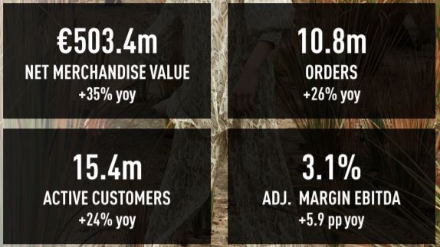
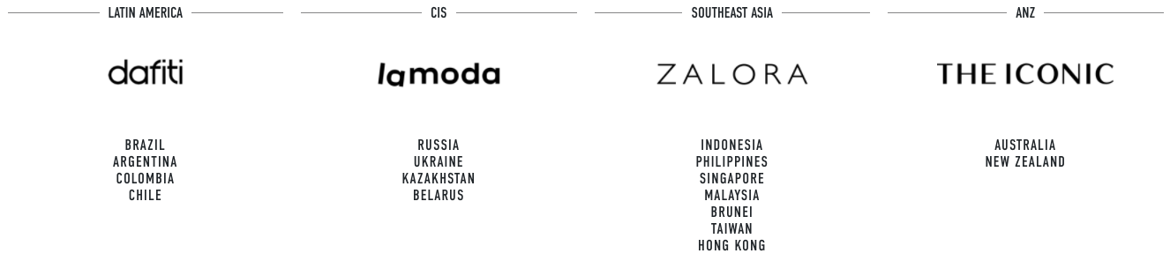
Company_name
Company Analysis
Segmentation:
Revenue Segmentation
FY2019 Revenue Growth Contribution
GFG is a consolidation of four different e-commerce brands operating in emerging markets, these include: Dafiti (Latin America), La Moda (CIS), Zalora (South-East Asia), and The Iconic (ANZ)
GFG tallied up some of those: 10 fulfillment centers, over 35 different payment methods — including setting up digital wallets and accepting cash on delivery — customer service support in 11 different languages and making 20 percent of deliveries with its own dedicated fleets.
The company has also done things like set up drop-off points and in Latin America, established its own fleet of bike couriers.
Serving emerging markets, and entering the ecommerce space the way GFG and its brands have is a very cost intensive operation, explaining why it has taken GFG so long to turn a profit.
Very strong q3 2020 result worldwide:
Operating Markets:
11

Slide 12
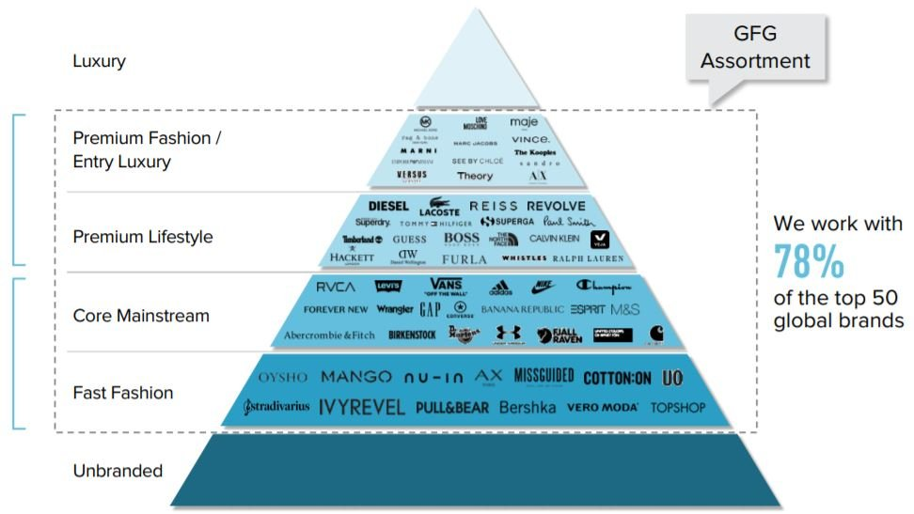
Company_name
Company Analysis
Brand Segmentation:
12

Slide 13
Company_name
Company Analysis
Company Guidance:
Revenue
Gross Profit
In a 2020 outlook, GFG expected to achieve constant currency Net Merchandise Value ("NMV") growth of around 25%, giving just over €1.9 billion NMV and €1.3 billion of revenue.
Announced a €10.3 million profit in Q3, presenting a €2.9 million loss for 2020 YTD, with a €10 million profit expected for the year.
This compared to a -€9.1 million in Q3 2019, showing the spare capacity within the GFG supply chains.
Expects to turn first profit in 2023.
Active Customers
Debt to Equity Ratio
Saw an active customers growth of 24.2% in 2020.
This compared to a 15% growth in 2019.
The expected active customer growth until 2024 has been put at 17%.
GFG has managed to keep a very low debt-equity ratio despite not being profitable.
Debt currently only represents 2% of total equity
This number is still only expected to rise to 5% by 2023, before falling.
Capex
Dividends
Capex investment will be around €45 million for 2021.
This number is expected to go up to around €60 million as GFG expands its white e-commerce capabilities.
Not expecting to begin delivering dividends until 2023 as still reinvesting profits into R&D.
13

Slide 14
IV. Competitors

Slide 15
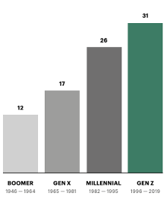
Company_name
Competitors
Main Competitors
Competitor 1: TECH STYLE FASHION GROUP
Based in california, serving emerging markets, retails and produces own brands
Revenue: $315 Million
Employs 1500 people
Competitor 2: BORN GROUP
Based in NYC Aimed at helping independent brands grow through online marketing and brand strategy services
Serves many other industries other than fashion
Revenue $340 Million
Competitor 3: ASOS
Based in Uk, serves developed markets, moving strategically into emerging markets
Revenue: $3 Billion
Employs 4755 people
Competitor 4: BOOHOO:
Based in Manchester UK
Group holds a portfolio of “innovative fashion” style and quality conscientious brands.
Over half products are produced and sourced in the UK
Generated over £1 Billion in sales since founding
Generational response to Eco-Friendly Clothing
Why GFG?
Operating in faster growing markets
Younger company that is not linked to ‘fast fashion’, allowing it to better respond to consumer shifts
Well constructed e-commerce operations, with fulfilment centres in strategic parts of the world, allowing for white e-commerce business
Still expanding into market categories and segments, significant room for future growth compared to these more established companies.
15

Slide 16
VI. Recommendation

Slide 17
Company_name
Recommendation
Macroeconomic Growth
Operating in the fastest growing economies of an already fast growing industry
Serious exogenous growth factors
Potential to Expand
Reinvestment in previous years has given GFG the possibility to expand not only in the fashion industry but also in white label e-commerce
BUY
Purchase 150 @ €11.96 = $1,794
Holding period = 3-5 years

