Slide 1
MONTE CARLO PATH TRACING
Alexandre Sincennes
Sajini Peechankottil Manikandan
Vincent Guanzhou Liu
Bernie Ramirez

Slide 2
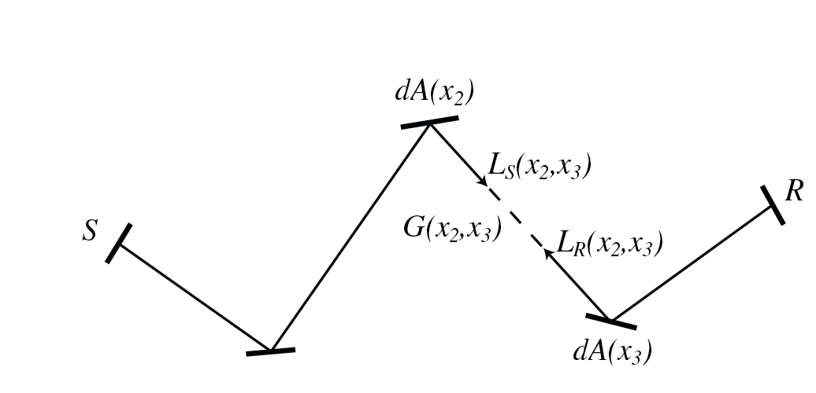
What is Monte Carlo Path Tracing?
GLOBAL illumination: consider all the geometry in the scene
Simulates travel of light via rays
Rays hit surfaces & are reflected
Can do diffuse & specular reflection,
refraction
Unlike real light, rays go out of cam
& and end in a light source (more efficient)

Slide 3
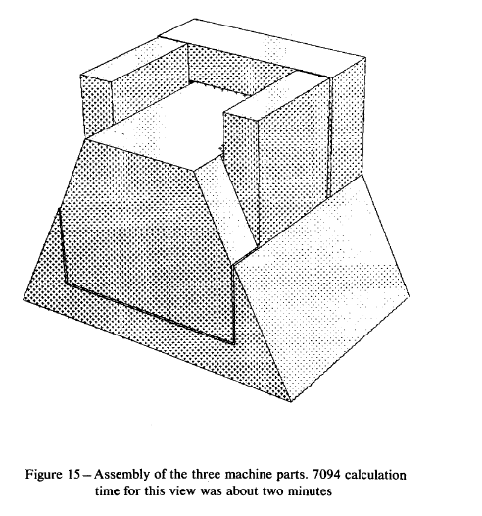
Precursors
Arthur Appel 1968: eye rays & shadow rays

Slide 4
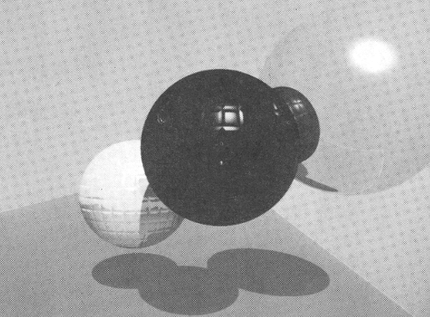
Precursors
Arthur Appel 1968: eye rays & shadow rays
Turner Whitted 1979: refraction, reflection rays

Slide 5
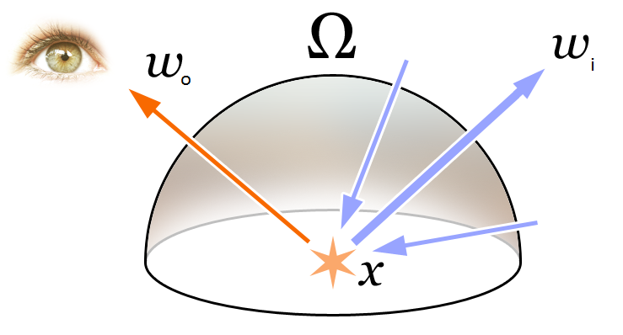
Next Step: J. Kayija & Rendering Eqn
Light is emitted light + integral over hemisphere of incoming light

