Slide 1
MONTE CARLO PATH TRACING
Alexandre Sincennes
Sajini Peechankottil Manikandan
Vincent Guanzhou Liu
Bernie Ramirez

Slide 2
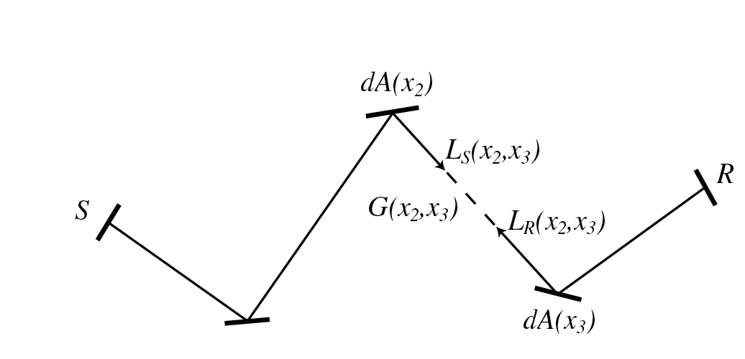
What is Monte Carlo Path Tracing?
GLOBAL illumination: consider all the geometry in the scene
Simulates travel of light via rays
Rays hit surfaces & are reflected
Can do diffuse & specular reflection,
refraction
Unlike real light, rays go out of cam
& and end in a light source (more efficient)

Slide 3
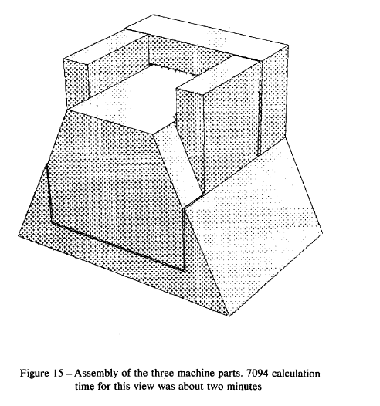
Precursors
Arthur Appel 1968: eye rays & shadow rays

Slide 4
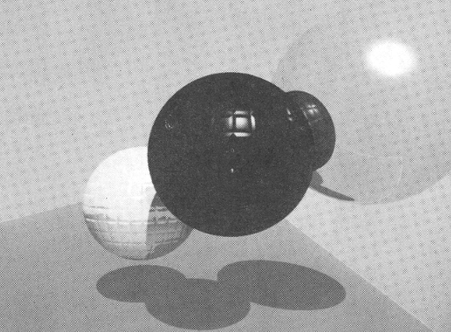
Precursors
Arthur Appel 1968: eye rays & shadow rays
Turner Whitted 1979: refraction, reflection rays

Slide 5
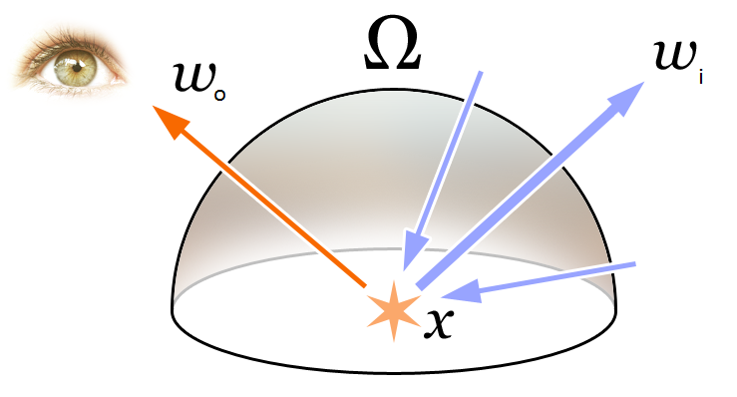
Next Step: J. Kayija & Rendering Eqn
Light is emitted light + integral over hemisphere of incoming light

Slide 6
The Algorithm
Generate a ray from the camera (position x,y, horizontal and vertical fields of view u,v), passing through the image plane, with weight = 1
Find the point of intersection with the nearest surface
Determine whether the surface is a light source or not (as indicated by a special coefficients for light emittance)
if it is a light source, return weight * light
if not, weight *= (Ks+Kd+Ka)/3 and randomly scatter a new ray according to a probability density function (pdf) approximating its bidirectional reflectance distribution function (brdf), and go to step 2

Slide 7
The Probability Density Function (pdf)
Our choice: Random Uniform: choose any ray going out of the hemisphere

Slide 8
Application Architecture
Uses assignment application, but:
Doesn’t render tri by tri: ray caster takes whole geometry
Kd,Ka,Ks per vertex rather than a global
Vertex property for determining surface that emits light

Slide 9
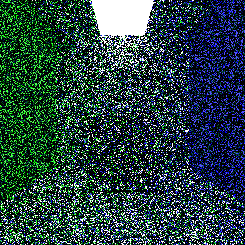
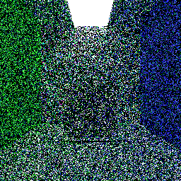
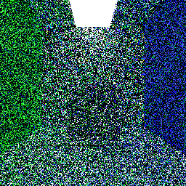
Results (s→samples, d→depth)
1S, 1D, 26s
1S, 4D, 34s
1S, 16D, 36s

Slide 10
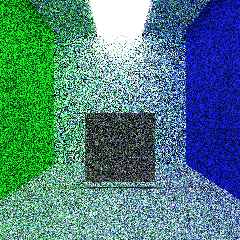
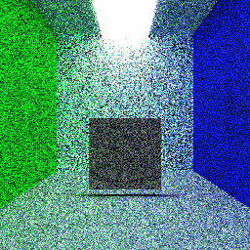
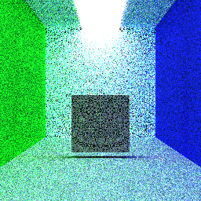
Results (s→samples, d→depth)
10S, 1D, 5m42s
20S, 1D, 11m26s
40S, 4D, 23m25s

Slide 11
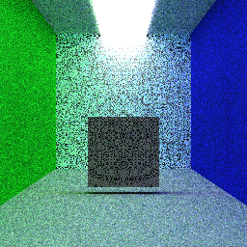
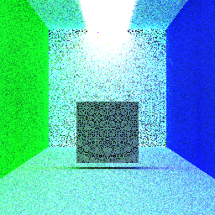

Results (s→samples, d→depth)
100S, 1D, 26s, 42m10s
Multithread: 2m52s
100S, 16D, 42m10s
Multithread: 2m59s
200S, 16D, Multithread: 5m53s

Slide 12
Observations
Strange solid black artifacting that persists at s=200, d=16
Runtime for values of d converges
Runtime for values of s is linear
Multithreading is effective! 25x reduction using 25 threads
Increasing d brightens image (biased)

Slide 13
Further Work
Use GPU rather than CPU
Specular reflection (mirror) & refraction (transparency)
Better approaches to ray intersection than brute force, such as binary space partitioning or bounding volumes
Use Russian Roulette rather than determined depth d
Unbiased

