Slide 1
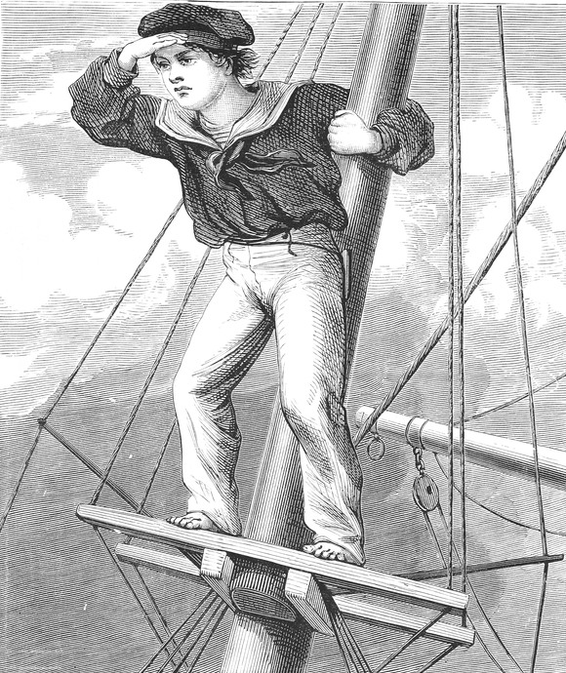
Lecture 4: Search informed by lookahead heuristics: Greedy Search, A*
Mark Hasegawa-Johnson, January 2020
With some slides by Svetlana Lazebnik, 9/2016
Distributed under CC-BY 3.0
Title image: By Harrison Weir - From reuseableart.com, Public Domain, https://commons.wikimedia.org/w/index.php?curid=47879234

Slide 2

Outline of lecture
Search heuristics
Greedy best-first search: minimum h(n)
A* optimal search: $f(n)=h(n)+g(n)$, where $h(n)≤d(n)$

Slide 3
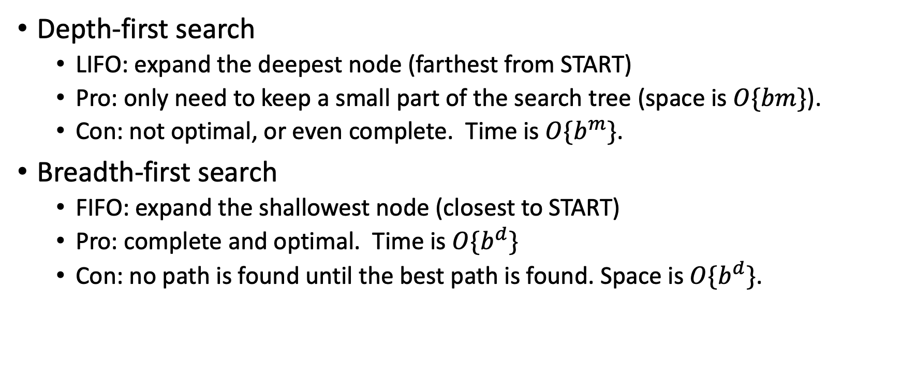
Review: DFS and BFS
Depth-first search
LIFO: expand the deepest node (farthest from START)
Pro: only need to keep a small part of the search tree (space is $O\{bm\}$).
Con: not optimal, or even complete. Time is $O\{b^{m}\}$.
Breadth-first search
FIFO: expand the shallowest node (closest to START)
Pro: complete and optimal. Time is $O\{b^{d}\}$
Con: no path is found until the best path is found. Space is $O\{b^{d}\}$.

Slide 4
Why don’t we just measure…
Instead of FARTHEST FROM START (DFS):
why not choose the node that’s CLOSEST TO GOAL?

Slide 5
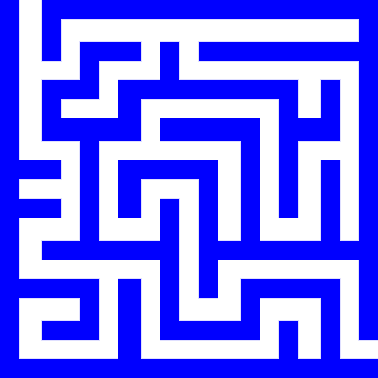
Why not choose the node CLOSEST TO GOAL?
Answer: because we don’t know which node that is!!
Example: which of these two is closest to goal?
Start state
Goal state

Slide 6
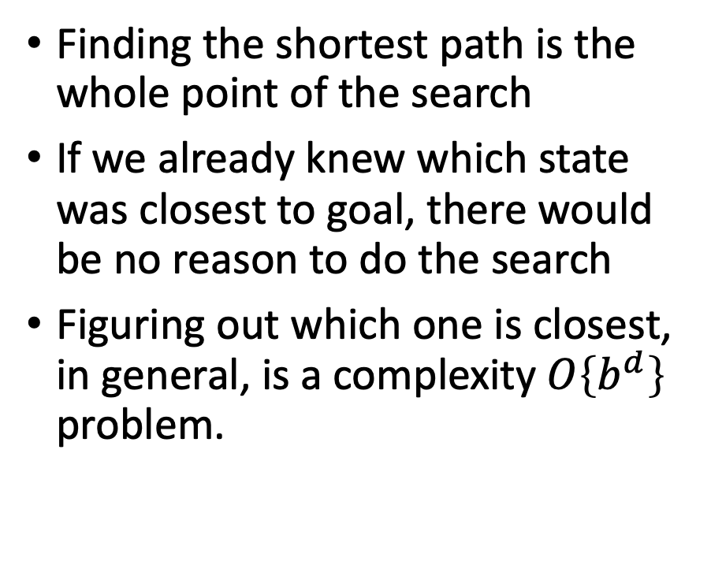
We don’t know which state is closest to goal
Finding the shortest path is the whole point of the search
If we already knew which state was closest to goal, there would be no reason to do the search
Figuring out which one is closest, in general, is a complexity $O\left\{b^{d}\right\}$ problem.
Start state
Goal state

Slide 7
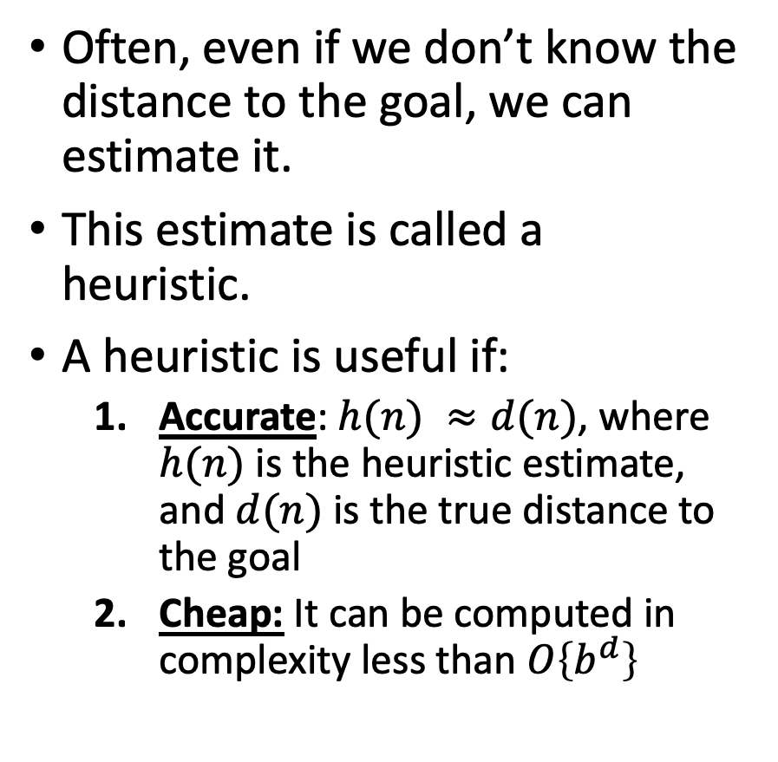
Search heuristics: estimates of distance-to-goal
Often, even if we don’t know the distance to the goal, we can estimate it.
This estimate is called a heuristic.
A heuristic is useful if:
Accurate: $h(n) ≈d(n)$, where $h(n)$ is the heuristic estimate, and $d(n)$ is the true distance to the goal
Cheap: It can be computed in complexity less than $O\left\{b^{d}\right\}$
Start state
Goal state

Slide 8


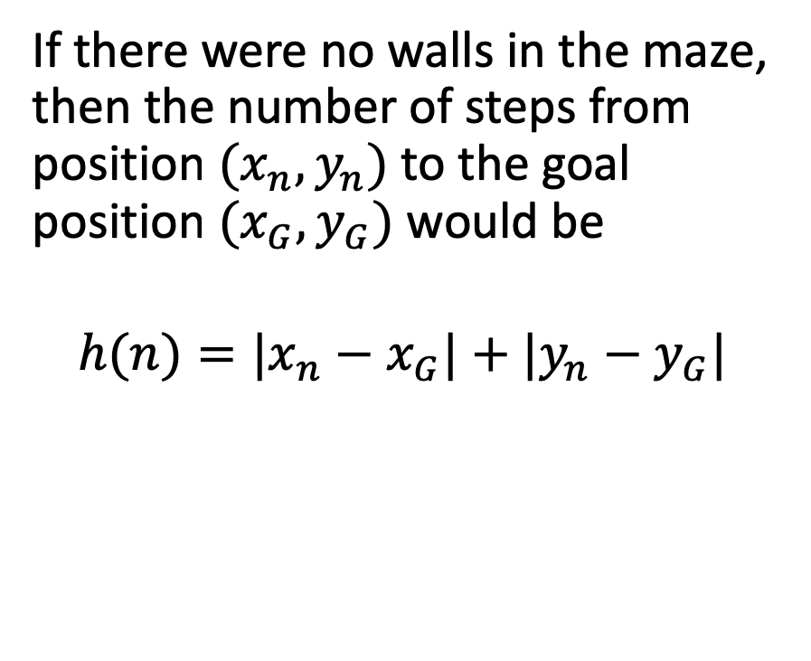



Example heuristic: Manhattan distance
If there were no walls, this would be the path to goal: straight down, then straight right.
If there were no walls in the maze, then the number of steps from position $(x_{n},y_{n})$ to the goal position $(x_{G},y_{G})$ would be
$$h(n)=|x_{n}−x_{G}|+|y_{n}−y_{G}|$$
Start state
$$y_{n}$$
$$y_{G}$$
Goal state
$$x$$
$$x_{n}$$
$$x_{G}$$

Slide 9

Outline of lecture
Search heuristics
Greedy best-first search: minimum h(n)
A* optimal search: $f(n)=h(n)+g(n)$, where $h(n)≤d(n)$

Slide 10
Greedy Best-First Search
Instead of FARTHEST FROM START (DFS):
why not choose the node whose
HEURISTIC ESTIMATE
indicates that it might be
CLOSEST TO GOAL?

Slide 11
Greedy Search Example
According to the Manhattan distance heuristic, these two nodes are equally far from the goal, so we have to choose one at random.
Start state
Goal state

Slide 12
Greedy Search Example
If our random choice goes badly, we might end up very far from the goal.
= states in the explored set
= states on the frontier
Start state
Goal state

Slide 13
The problem with Greedy Search
Having gone down a bad path, it’s very hard to recover, because now, the frontier node closest to goal (according to the Manhattan distance heuristic) is this one:
Start state
Goal state

Slide 14
The problem with Greedy Search
That’s not a useful path…
Start state
Goal state

Slide 15
The problem with Greedy Search
Neither is that one…
Start state
Goal state

Slide 16
What went wrong?

Slide 17

Outline of lecture
Search heuristics
Greedy best-first search: minimum h(n)
A* optimal search: $f(n)=h(n)+g(n)$, where $h(n)≤d(n)$

Slide 18
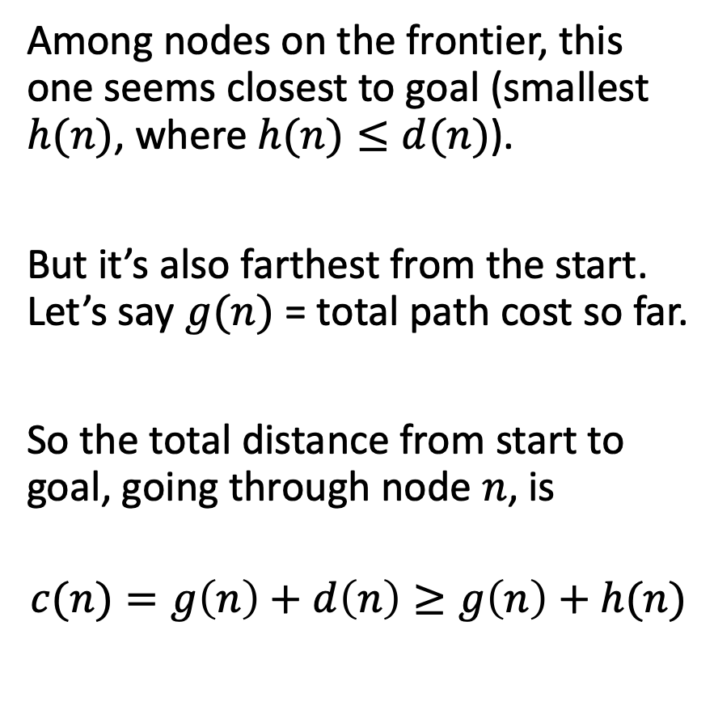
The problem with Greedy Search
Among nodes on the frontier, this one seems closest to goal (smallest $h(n)$, where $h(n)≤d(n)$).
But it’s also farthest from the start. Let’s say $g(n)$ = total path cost so far.
So the total distance from start to goal, going through node $n$, is
$$c(n)=g\left(n\right)+d\left(n\right)≥g\left(n\right)+h(n)$$
Start state
Goal state

Slide 19
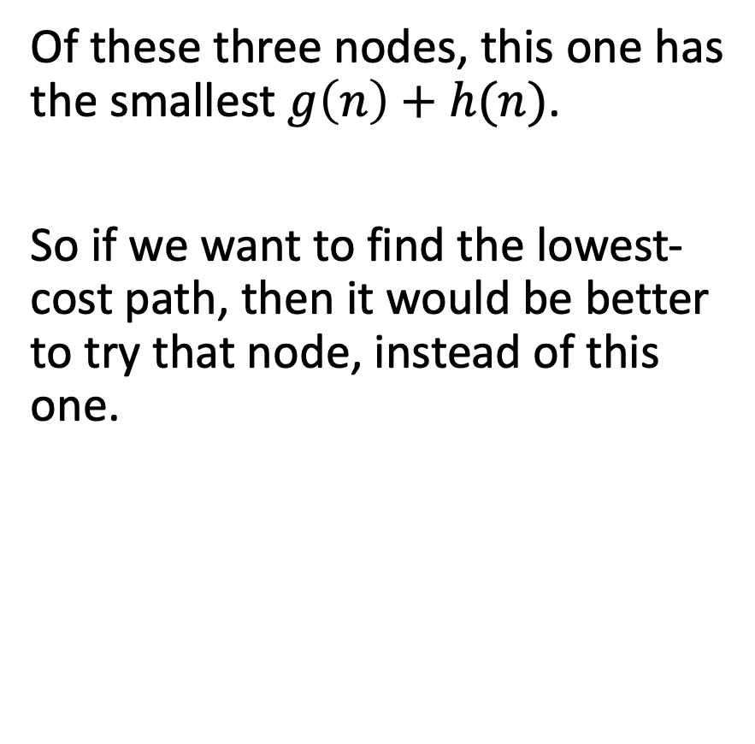
The problem with Greedy Search
Of these three nodes, this one has the smallest $g\left(n\right)+h(n)$.
So if we want to find the lowest-cost path, then it would be better to try that node, instead of this one.
Start state
Goal state

Slide 20
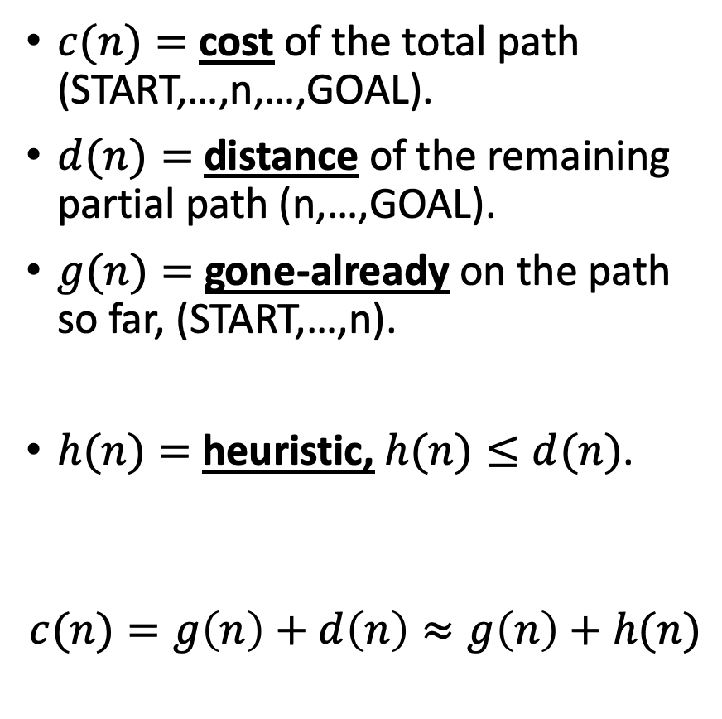
A* notation
$c(n)=$ cost of the total path (START,…,n,…,GOAL).
$d(n)=$ distance of the remaining partial path (n,…,GOAL).
$g(n)=$ gone-already on the path so far, (START,…,n).
$h(n)=$ heuristic, $h(n)≤d(n)$.
$$c(n)=g\left(n\right)+d\left(n\right)≈g\left(n\right)+h(n)$$
Start state
Goal state

Slide 21

Smart Greedy Search
In fact, let’s back up. Already, at this point in the search, this node has the smallest $g\left(n\right)+h(n)$.
Start state
Goal state

Slide 22
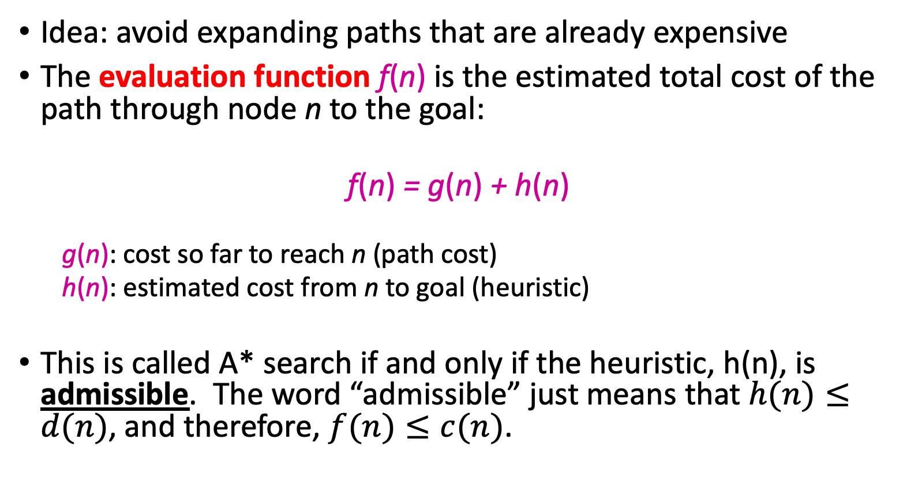
“Almost-A* Search”
Idea: avoid expanding paths that are already expensive
The evaluation function f(n) is the estimated total cost of the path through node n to the goal:
f(n) = g(n) + h(n)
g(n): cost so far to reach n (path cost)
h(n): estimated cost from n to goal (heuristic)
This is called A* search if and only if the heuristic, h(n), is admissible. The word “admissible” just means that $h(n)≤d(n)$, and therefore, $f(n)≤c(n)$.
Notes:
Dates back to 1968

Slide 23

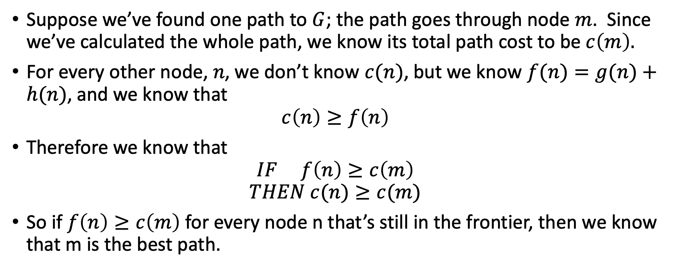


Admissible heuristic
$$c\left(m\right)$$
m
S
G
n
$$g\left(n\right)$$
$$≥h\left(n\right)$$
Suppose we’ve found one path to $G$; the path goes through node $m$. Since we’ve calculated the whole path, we know its total path cost to be $c\left(m\right).$
For every other node, $n$, we don’t know $c(n)$, but we know $f(n)=g(n)+h(n)$, and we know that
$$c\left(n\right)≥f\left(n\right)$$
Therefore we know that
$$IF f\left(n\right)≥c\left(m\right)$$
$$THEN c(n)≥c(m)$$
So if $f\left(n\right)≥c\left(m\right)$ for every node n that’s still in the frontier, then we know that m is the best path.

Slide 24
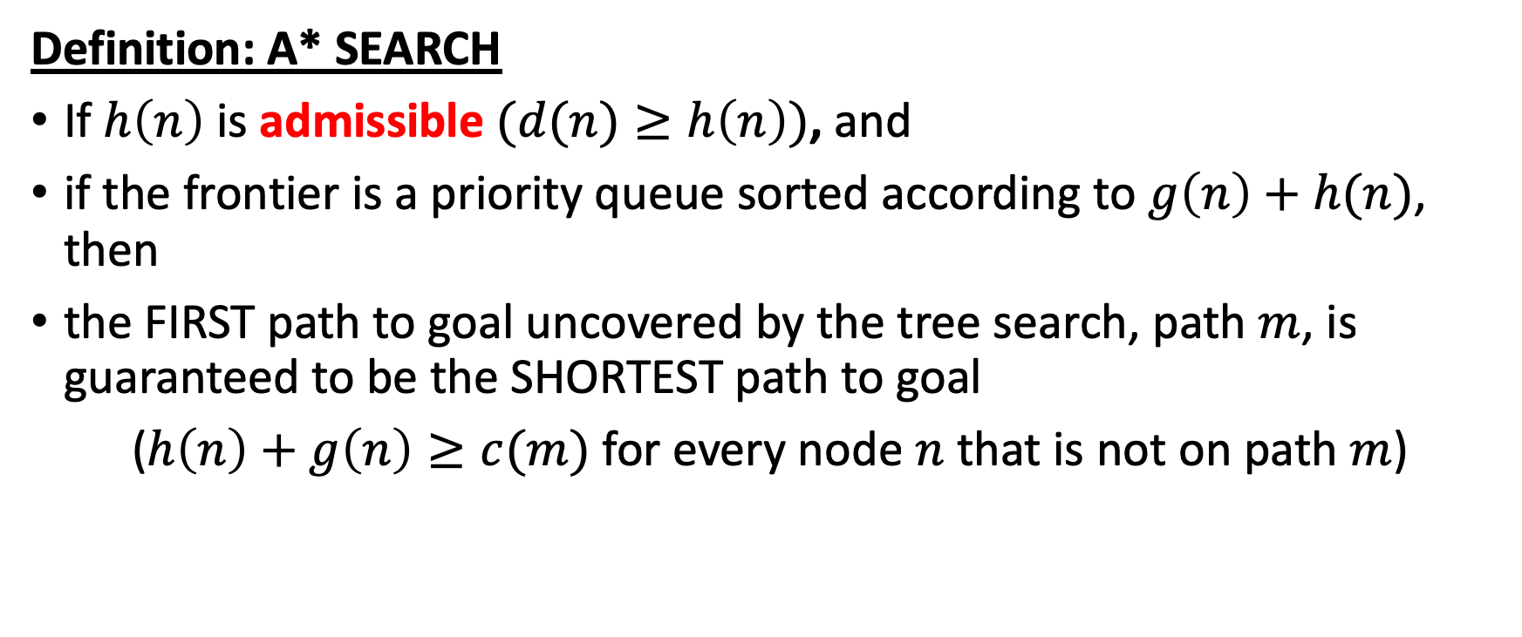
A* Search
$$c\left(m\right)$$
m
S
G
n
$$g\left(n\right)$$
$$≥h\left(n\right)$$
Definition: A* SEARCH
If $h\left(n\right)$ is admissible $(d(n)≥h\left(n\right))$, and
if the frontier is a priority queue sorted according to $g\left(n\right)+h(n)$, then
the FIRST path to goal uncovered by the tree search, path $m$, is guaranteed to be the SHORTEST path to goal
($h\left(n\right)+g\left(n\right)≥c(m)$ for every node $n$ that is not on path $m$)

Slide 25
BFS vs. A* Search The heuristic h(n)=Manhattan distance favors nodes on the main diagonal. Those nodes all have the same g(n)+h(n), so A* evaluates them first.
Source: Wikipedia

Slide 26
Example A* Search: Manhattan Distance
Manhattan distance is guaranteed to be less than or equal to the true path to goal
Therefore, “smart greedy” search with Manhattan distance heuristic = A* Search

