Slide 1
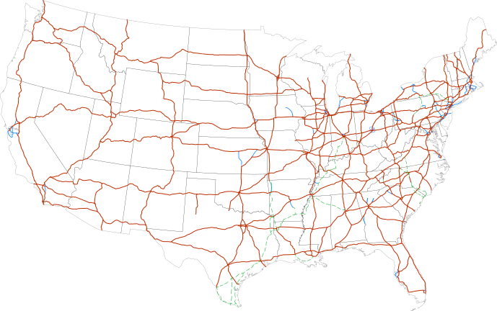
CS440/ECE 448 Lecture 2: Search Intro
Slides by Svetlana Lazebnik, 9/2016
Modified by Mark Hasegawa-Johnson, 1/2020

Slide 2
Outline of today’s lecture
How to turn ANY problem into a SEARCH problem:
Initial state, goal state, transition model
Actions, path cost
General algorithm for solving search problems
First data structure: a frontier list
Second data structure: a search tree
Third data structure: a “visited states” list

Slide 3

Search
We will consider the problem of designing goal-based agents in fully observable, deterministic, discrete, static, known environments
Start state
Goal state

Slide 4
Search
We will consider the problem of designing goal-based agents in fully observable, deterministic, discrete, known environments
The agent must find a sequence of actions that reaches the goal
The performance measure is defined by (a) reaching the goal and (b) how “expensive” the path to the goal is
We are focused on the process of finding the solution; while executing the solution, we assume that the agent can safely ignore its percepts (static environment, open-loop system)

Slide 5
Search problem components
Initial state
Actions
Transition model
What state results from performing a given action in a given state?
Goal state
Path cost
Assume that it is a sum of nonnegative step costs
The optimal solution is the sequence of actions that gives the lowest path cost for reaching the goal
Initial
state
Goal state

Slide 6
Knowledge Representation: State
State = description of the world
Must have enough detail to decide whether or not you’re currently in the initial state
Must have enough detail to decide whether or not you’ve reached the goal state
Often but not always: “defining the state” and “defining the transition model” are the same thing

Slide 7
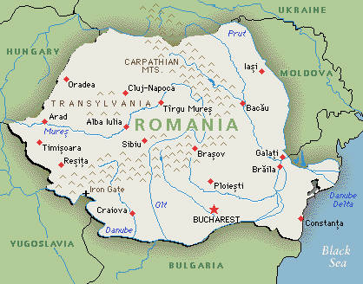
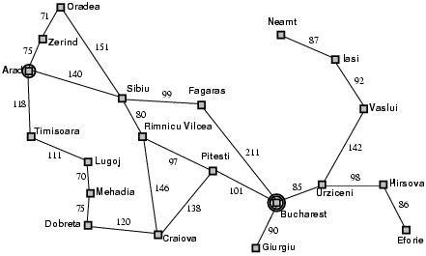
Example: Romania
On vacation in Romania; currently in Arad
Flight leaves tomorrow from Bucharest
Initial state
Arad
Actions
Go from one city to another
Transition model
If you go from city A to city B, you end up in city B
Goal state
Bucharest
Path cost
Sum of edge costs (total distance traveled)

Slide 8
State space
The initial state, actions, and transition model define the state space of the problem
The set of all states reachable from initial state by any sequence of actions
Can be represented as a directed graph where the nodes are states and links between nodes are actions
What is the state space for the Romania problem?

Slide 9
Traveling Salesman Problem
Goal: visit every city in the United States
Path cost: total miles traveled
Initial state: Champaign, IL
Action: travel from one city to another
Transition model:. when you visit a city, mark it as “visited”

Slide 10
Complexity of the State Space
State Space of Romania problem: size = # cities
State space is linear in the size of the world
A search algorithm that examines every possible state is reasonable
State Space of Traveling Salesman problem: size = 2^(#cities)
State space is exponential in the size of the world
A search algorithm that examines every possible state is unreasonable

Slide 11
Outline of today’s lecture
How to turn ANY problem into a SEARCH problem:
Initial state, goal state, transition model
Actions, path cost
General algorithm for solving search problems
First data structure: frontier (a set)
Second data structure: a search tree (a directed graph)
Third data structure: explored (a dictionary)

Slide 12
First data structure: Frontier Set
Frontier set = set of states that you know how to reach, but you haven’t yet tested to see what comes next after those states
Initially: FRONTIER = { initial_state }
First step in the search: figure out which states you can reach from the initial_state, add them to the FRONTIER

Slide 13
Search step 0
Frontier = { Arad }

Slide 14
Search step 1
Frontier = { Sibiu, Timisoara, Zerind }

Slide 15
Second data structure: Search Tree
Tree = directed graph of nodes
Node = ( world_state, parent_node, path_cost )

Slide 16
Search step 0
Frontier: { Arad }
Tree:
Arad, 0

Slide 17
Search step 1
Frontier: { Sibiu, Zerind, Timisoara }
Tree:
Arad, 0
Sibiu, 140
Timisoara, 118
Zerind, 75

Slide 18
Tree Search: Basic idea
SEARCH for an optimal solution
Maintain a frontier of unexpanded states, and a tree showing all known paths
At each step, pick a state from the frontier to expand:
Check to see whether or not this state is the goal state. If so, DONE!
If not, then list all of the states you can reach from this state, add them to the frontier, and add them to the tree
BACK-TRACE: go back up the tree; list, in reverse order, all of the actions you need to perform in order to reach the goal state.
ACT: the agent reads off the sequence of necessary actions, in order, and does them.

Slide 19
Search Tree
“What if” tree of sequences of actions and outcomes
The root node corresponds to the starting state
The children of a node correspond to the successor states of that node’s state
A path through the tree corresponds to a sequence of actions
A solution is a path ending in the goal state
Nodes vs. states
A state is a representation of the world, while a node is a data structure that is part of the search tree
Node has to keep pointer to parent, path cost, possibly other info
Starting state
Action
Successor state
…
…
…
…
Goal state

Slide 20
Nodes vs. States
State = description of the world
Must have enough detail to decide whether or not you’re currently in the initial state
Must have enough detail to decide whether or not you’ve reached the goal state
Often but not always: “defining the state” and “defining the transition model” are the same thing
Node = a point in the search tree
Knows the ID of its STATE
Knows the ID of its PARENT NODE
Knows the COST of the path
Starting state
Action
Successor state
…
…
…
…
Goal state

Slide 21
Search step 1
Frontier: { Sibiu, Zerind, Timisoara }
Tree:
Arad, 0
Sibiu, 140
Timisoara, 118
Zerind, 75

Slide 22
Search step 2 Expand Sibiu
Frontier: { Sibiu, Zerind, Timisoara }
Tree:
Arad, 0
Sibiu, 140
Timisoara, 118
Zerind, 75

Slide 23
Search step 2 Expanded Sibiu
Frontier: { Zerind, Timisoara, Oradea, Arad,
Rimnicu Vilcea, Fagaras }
Tree:
Arad, 0
Sibiu, 140
Timisoara, 118
Zerind, 75
Oradea, 291
Arad, 280
Rimnicu Vilcea, 220
Fagaras, 239

Slide 24
Tree Search: Computational Complexity
Without an EXPLORED set
b = “branching factor” = max # states you can reach from any given state
d = “depth” = # layers in the tree (# moves that you have made)
Without an explored set: complexity = O{b^d}
Solution: keep track of the states you have explored
When you expand a state, you get the list of its possible child states
ONLY IF a child state is not already explored, put it on the frontier, and put it on the explored set.
Result: complexity = min(O{b^d}, O{# possible world states})

Slide 25
Search step 0
Frontier: { Arad }
Explored: { Arad }
Tree:
Arad, 0

Slide 26
Search step 1
Frontier: { Sibiu, Zerind, Timisoara }
Explored: { Arad, Sibiu, Zerind, Timisoara }
Arad, 0
Sibiu, 140
Timisoara, 118
Zerind, 75

Slide 27
Search step 2
Frontier: { Zerind, Timisoara, Oradea, Rimnicu Vilcea, Fagaras }
Explored: { Arad, Sibiu, Zerind, Timisoara, Oradea, Rimnicu Vilcea, Fagaras }
Arad, 0
Sibiu, 140
Timisoara, 118
Zerind, 75
Oradea, 291
Rimnicu Vilcea, 220
Fagaras, 239

Slide 28
Search step 3: expand Zerind
Frontier: { Zerind, Timisoara, Oradea, Rimnicu Vilcea, Fagaras }
Explored: { Arad, Sibiu, Zerind, Timisoara, Oradea, Rimnicu Vilcea, Fagaras }
Arad, 0
Sibiu, 140
Timisoara, 118
Zerind, 75
Oradea, 291
Rimnicu Vilcea, 220
Fagaras, 239

Slide 29
Search step 3: we can reach Oradea with a total path cost of only 75+71=146
Frontier: { Zerind, Timisoara, Oradea, Rimnicu Vilcea, Fagaras }
Explored: { Arad, Sibiu, Zerind, Timisoara, Oradea, Rimnicu Vilcea, Fagaras }
Arad, 0
Sibiu, 140
Timisoara, 118
Zerind, 75
Oradea, 291
Rimnicu Vilcea, 220
Fagaras, 239

Slide 30
Third data structure: Explored Dictionary
Explored = dictionary mapping from state ID to path cost
If we find a new path to the same state, with HIGHER COST, then we ignore it
If we find a new path to the same state, with LOWER COST, then we expand the new path

Slide 31
Search step 3: we can reach Oradea with a total path cost of only 75+71=146
Frontier: { Zerind:75, Timisoara:118, Oradea:291, Rimnicu Vilcea:220, Fagaras:239 }
Explored: { Arad:0, Sibiu:140, Zerind:75, Timisoara:118, Oradea:291, Rimnicu Vilcea:220, Fagaras:239 }
Arad, 0
Sibiu, 140
Timisoara, 118
Zerind, 75
Oradea, 291
Rimnicu Vilcea, 220
Fagaras, 239

Slide 32
Search step 3: expanded Zerind
Frontier: { Timisoara:118, Oradea:146, Rimnicu Vilcea:220, Fagaras:239 }
Explored: { Arad:0, Sibiu:140, Zerind:75, Timisoara:118, Oradea:146, Rimnicu Vilcea:220, Fagaras:239 }
Arad, 0
Sibiu, 140
Timisoara, 118
Zerind, 75
Rimnicu Vilcea, 220
Fagaras, 239
Oradea, 146

Slide 33
Tree Search: Basic idea
At each step, pick a state from the frontier to expand:
Check to see whether or not this state is the goal state. If so, DONE! If not, then for each child:
Check to see whether this child is already in the explored set with a LOWER COST. If so, ignore it. If not:
Add it to the frontier, to the tree, and to the explored dict.
Complexity = min(O{b^d}, O{# possible world states}).
Next time: how can we limit d?

