Slide 1
One Day Come Across Python
Seven Lju
Sep, 2016
Notes:
One Learning Day, Come Across Python
OLD CAP

Slide 2
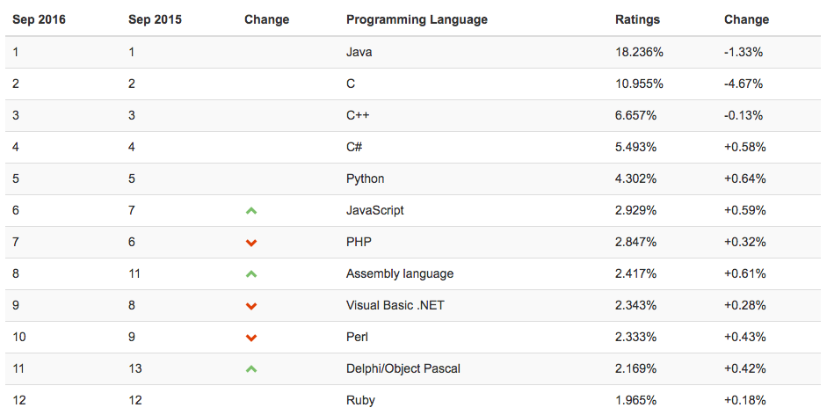
Languages
C / C++
Java
JavaScript
Ruby
Go
Notes:
Lazy => generate op, less code than c
Prototype => garbage less mature than java
BigProject =? Micro op, native extension
Java
Basic (Interpreter) => Visual Basic (VM) => .Net (IL VM)
Functional: no control flow keyword, and, or, lambda, map, filter, reduce
http://www.ibm.com/developerworks/library/l-prog/index.html
https://docs.python.org/2/howto/functional.html
https://docs.python.org/dev/howto/functional.html
https://github.com/tensorflow/tensorflow

Slide 3

Born and Growth
Guido van Rossum (Dutch)
1991, Python
2000, Python 2.0
2008, Python 3.0
Notes:
Pain of utf8 (string unicode and string byte)
CPython, Pypy, IronPython, Jython
https://us.pycon.org/2016/schedule/talks/
https://us.pycon.org/2016/schedule/presentation/1945/ networking without os

Slide 4
Basic and Advanced
Package management: import
Encapsulation: def, class, with
Control flow: if … elif … else, for … in …, while, break, continue, return, pass
Error handle: try, except, final
Coroutine: yield
Data type:
- None, Number(0, -1), String(””, ‘’, “”” “””, ‘’’ ‘’’),
- Tuple( (a1, a2, …) ), List( [a1, a2, a3] ), Dict( {k1: v1, k2:v2, …} )
Notes:
Command: dir
Index: arr[1:], arr[:], arr[-1], arr[start:end:step]
String, list, dict, file, re
Str, bytearray, bytes, list, tuple, set, fronzenset, dict, int, float, complex, bool, ellipsis
Closure:
f and when you want to remove unwanted loops of references, you can often use the weakref module in Python's standard library.
If and when you want to exert more direct control (or perform debugging, see what exactly is happening) regarding cyclical garbage collection, use the gc module in Python's standard library.
Dynamic Type
Object-oriented, Imperative, Functional

Slide 5
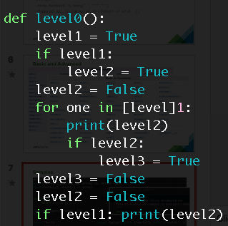
Indentation

Slide 6
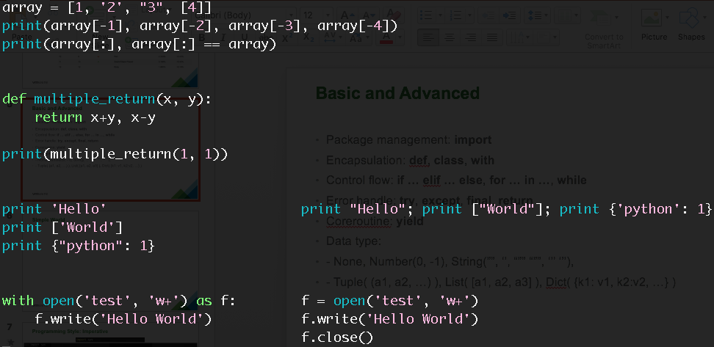
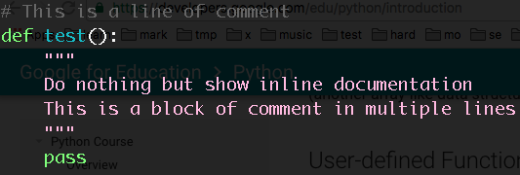
Basic

Slide 7
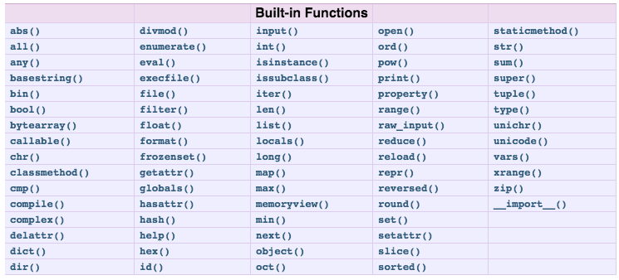
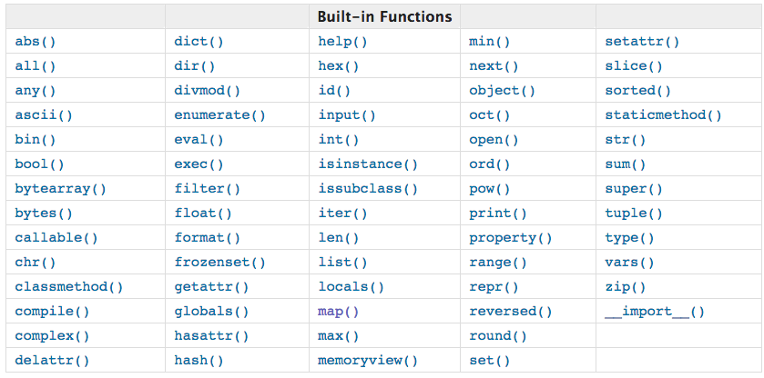
Basic and Advanced
Notes:
https://docs.python.org/2/library/index.html
https://docs.python.org/3/library/index.html

Slide 8
Task 1: Print out integer arguments from command line
edit a Python file args.py
`import sys`; then get arguments via sys.argv; it is a list and each element is string
use search engine to find the solution how to check if it is a valid string for representing an integer
print all integer arguments
use kinds of methods to this task
for an instance:
python args.py 0 a 0a a0 1-1 1.1
Output: 0
Notes:
Search engine is your friend, Google-oriented, Stackoverflow-oriented

Slide 9
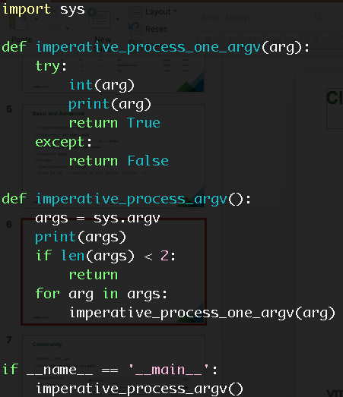
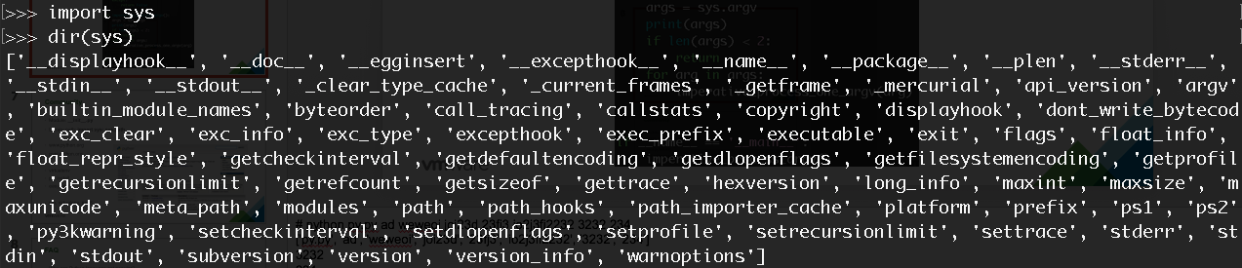
Programming Style: Imperative
Notes:
def ➔ function; import, if, for, try, except, return; print, len, __name__, sys, dir
# python py.py ad weweoi joi23d 23fj3 io2j3fi2232 3232 234
['py.py', 'ad', 'weweoi', 'joi23d', '23fj3', 'io2j3fi2232', '3232', '234']
3232
234

Slide 10
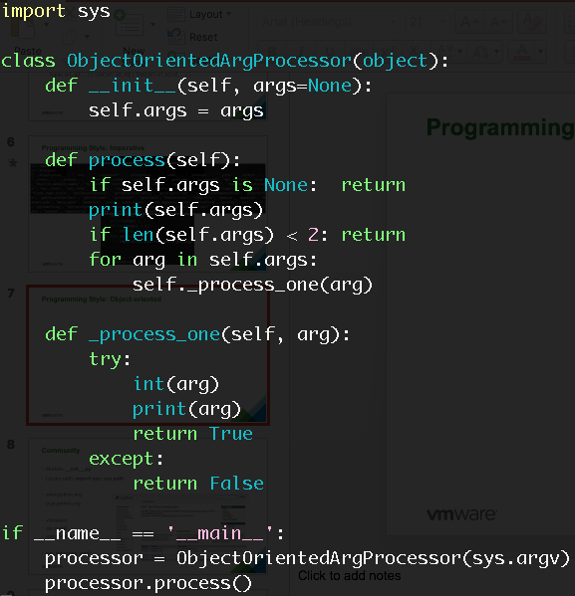
Programming Style: Object-oriented
Notes:
class → class; __init__, object, self
https://github.com/vmware/pyvmomi-community-samples

Slide 11
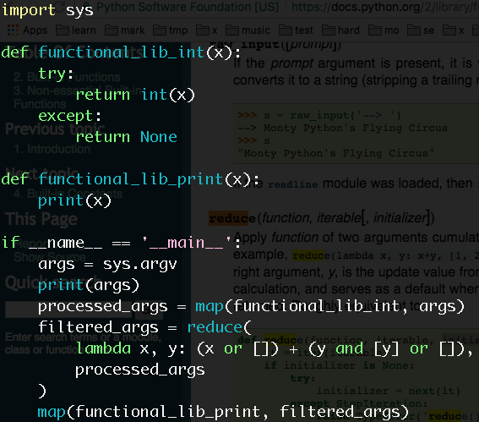
Programming Style: Functional
Notes:
and, or, lambda; map, reduce
distributed, atomic

Slide 12
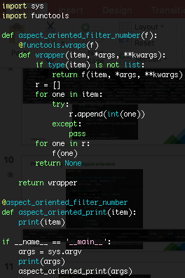
Programming Style: Aspect-oriented

Slide 13
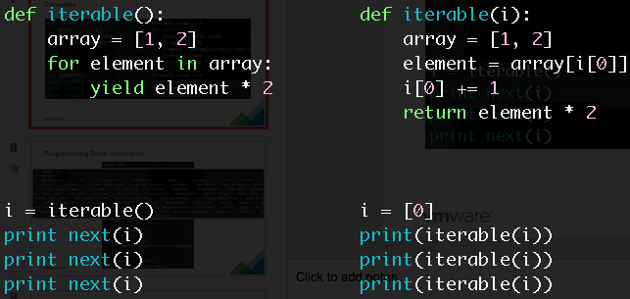
Coroutine
Notes:
Open JavaScript style

Slide 14
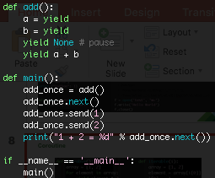
Coroutine
Notes:
Python 3:
https://docs.python.org/3/library/asyncio-task.html
import asyncio
async def compute(x, y):
print("Compute %s + %s ..." % (x, y))
await asyncio.sleep(1.0)
return x + y
async def print_sum(x, y):
result = await compute(x, y)
print("%s + %s = %s" % (x, y, result))
loop = asyncio.get_event_loop()
loop.run_until_complete(print_sum(1, 2))
loop.close()

Slide 15
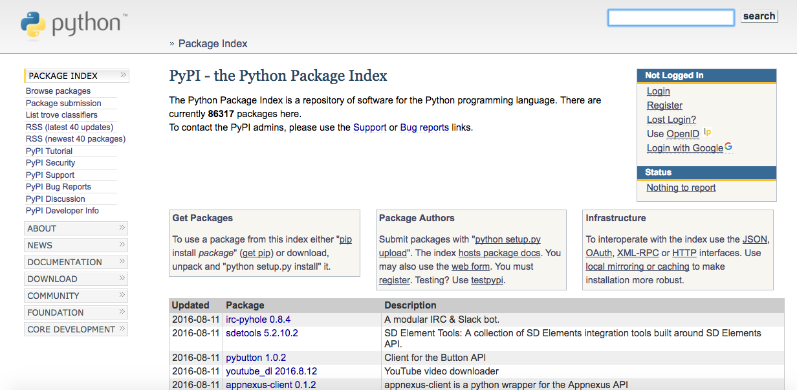
Community
Module: __init__.py
Library path: import sys; sys.path
www.python.org
pypi.python.org
pip install
easy_install

Slide 16
FAQ
Why can Python language get popular?
A: In simple word, people use and like it. Every programming language has its features. If most of people feel comfortable and accept it, then it becomes popular. Python can make coding clean and efficient.
What kind of projects can Python language deal with?
A: Whatever you want, even to write operating system (absolutely it requires that we need a Python native-code compiler to get more fancy performance improvement).

Slide 17
More practice
Basic
cd target_path
python -m SimpleHTTPServer / python -m http.server
virtualenv env
source env/bin/activate
pip install requests beautifulsoup
Advance
settrace
swig python-c connector
wget python.tar.gz
tar zxf python.tar.gz
vi Setup.dist
./configure
make
Notes:
https://docs.python.org/2/extending/extending.html

Slide 18
Task 2: [Team Work] Tokenize Python scripts
[team] divide into 2 teams.
file reader: `f = open(sys.argv[1], ‘r’); text = f.read(); f.close()`.
get help via dir(text); use search engine to learn functions about string.
present algorithms.
Team A: design an algorithm to get all string constants and comments. E.g. “hi”, ‘\’’, “””oops”””, “\”quote\””, # this is one line comment.
Team B: design an algorithm to get all function names and identify it is definition or invocation of a function with level info. E.g. def b(): def a():, a is definition at Level 1 (b.level=0, a.level=1); def b(): a(), a now is invocation at Level 1.
Team A + B: cooperate with each other to conquer the issue: inside_string is neither definition nor invocation in a multiple line string `“”” def inside_string(): pass “””`
Notes:
Search engine is your friend, Google-oriented, Stackoverflow-oriented

