Slide 1
Email phishing
Prepared by: Internship Team
Date: 03.09.2025

Slide 2
Overall Flow
Extract Header and Body
Extract Header and Body
Intent Detector
Input
Parser
Normalizer
Tone Analyzer
Scoring Engine
Banner
Selector
.eml format
Grammar Check
.eml format
Remove signatures
Remove reply-chain
Clean text
Remove signatures
Remove reply-chain
Clean text
API Response
Banner Injection
Transformer
Stack

Slide 3
Input & Preprocessing
.eml file → Parser → Normalizer
Header → From, Return-Path, Others
Body → Plaintext (HTML → text)
Clean text: Remove signatures, disclaimers, links, emojis

Slide 4
AI Analysis Flow
Intent Detector - Extracts the most important words influencing each detected phishing intent
Tone/Emotion Analyzer - Analyzes the tone and emotion of the message
Grammar/Fluency Checker - Grammar correctness and text fluency

Slide 5
Mail structure

Slide 6
Header Analysis
What to extract?
From → must match Return-Path
Subject
Received headers → read bottom to top (last = source, first = destination)
What to Verify in Received?
Source IP → check in reputation/blacklist databases
Hostname → should align with From domain or reverse DNS lookup
Received order → look for unusual/unknown intermediate servers
Timestamps → spot abnormal delays (botnets often show inconsistent timing)

Slide 7
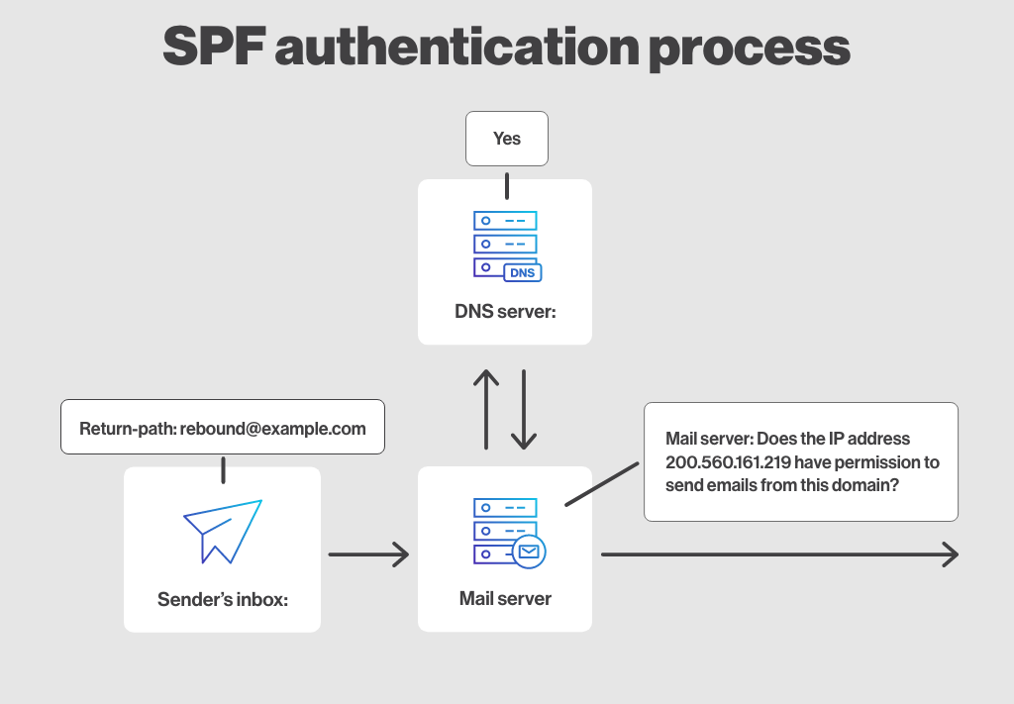
SPF (Sender Policy Framework)
Specifies in DNS which servers can send email for your domain; helps prevent spoofing by checking the sender's IP.
Receiving servers check the sender’s IP against the SPF record during SMTP handshake.
Results can be pass, fail, softfail, or neutral, influencing spam filtering decisions.
Helps prevent spoofing but doesn’t protect the integrity of the message body.

Slide 8
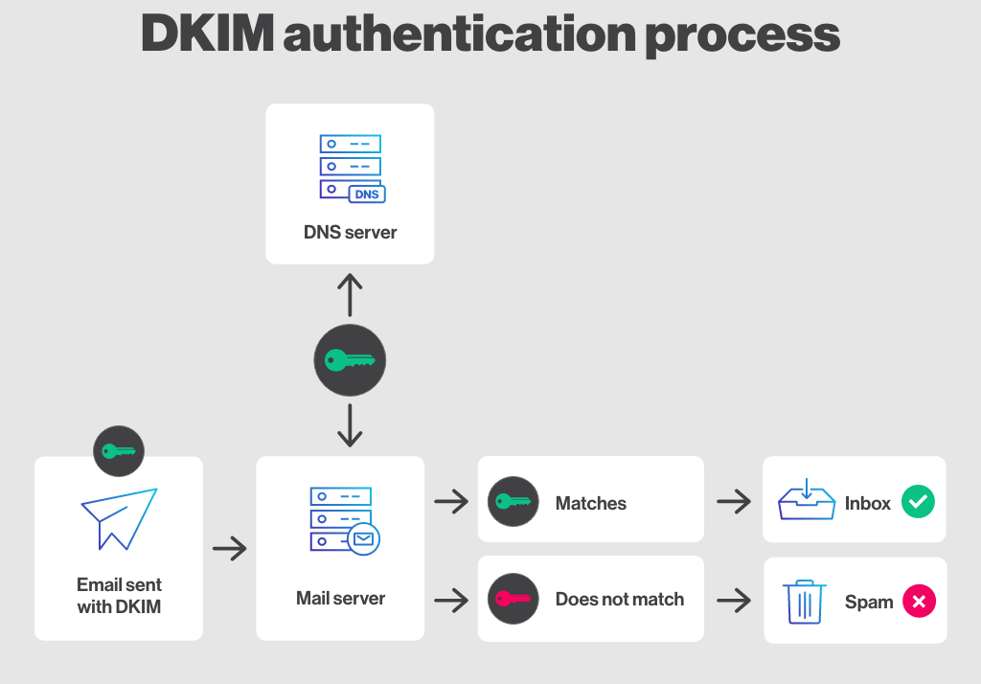
DKIM (DomainKeys Identified Mail)
Adds a cryptographic signature to email headers and body, created with the sender’s private key.
The recipient’s server verifies the signature using the sender’s public key published in DNS.
Ensures message integrity (detects if headers or body were altered in transit).
Provides domain-level authentication but doesn’t guarantee the sender’s identity alone.

Slide 9
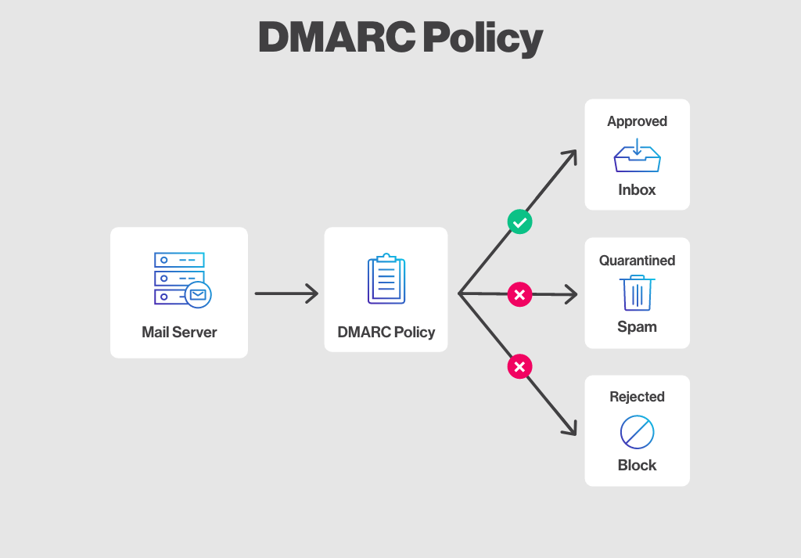
DMARC (Domain-based Message Authentication, Reporting & Conformance)
Builds on SPF and DKIM, requiring domain alignment between the “From” header and authenticated domain.
Domain owners publish a DNS TXT record specifying the DMARC policy (none, quarantine, reject).
Helps receiving servers decide how to handle emails failing SPF/DKIM checks.
Provides reporting (aggregate and forensic) so domain owners can monitor spoofing attempts.

Slide 10
Key Differences: Phishing vs. Safe Email
Area | Email 1 – “Confidential Update” (phishing/test) | Email 2 – “Welcome to OPSWAT - HR Training” (safe) | Why it matters ?
Sender (From) | Human Resources HR@opswat.com | Ioana Marta ioana.marta@opswat.com | Phish: generic role; Safe: real person
Reply-To | HR.17xyia4n@opswat.employeeportal.net-login.com (different and suspicious) | identical to From | Reply-To mismatch, fake domain

Slide 11
Key Differences: Phishing vs. Safe Email
Area | Email 1 – “Confidential Update” (phishing/test) | Email 2 – “Welcome to OPSWAT - HR Training” (safe) | Why it matters ?
Subject | “Confidential Update” (vague, confidential) | “Welcome to OPSWAT - HR Training” | Phish: vague subject; Safe: clear HR topic
Authentication | SPF = pass, DKIM = none, DMARC = fail, compauth = fail | SPF = pass, DKIM = none, DMARC = pass | DMARC fail = strong phish signal; pass = trusted

Slide 12
NLP/ML for Phishing detection

Slide 13
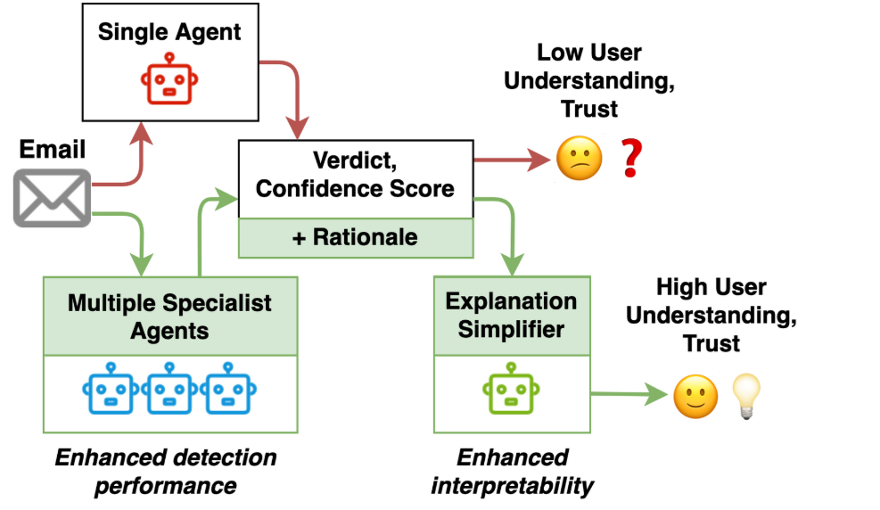
Arhitecture preview :

Slide 14
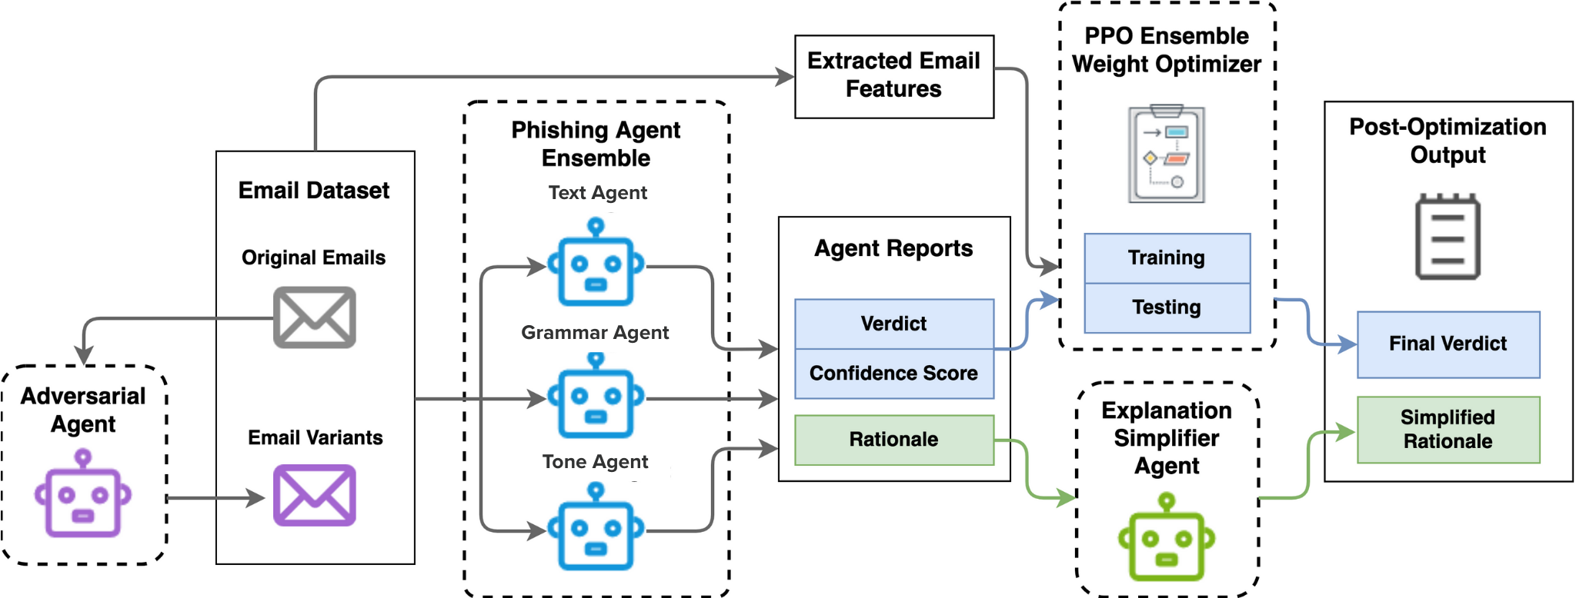

Slide 15
Intent Classification (MiniLM)
Compact Transformer for Fast Text Classification :
Performs semantic classification of emails into relevant categories (e.g., payment_request, credential_harvest, giftcard, vendor_invoice, etc.)
Supports multi-label classification (an email can belong to multiple categories simultaneously)
Trained on labeled email datasets for high domain-specific accuracy
Outputs intent labels along with their associated probabilities
Link: https://arxiv.org/pdf/2002.10957

Slide 16
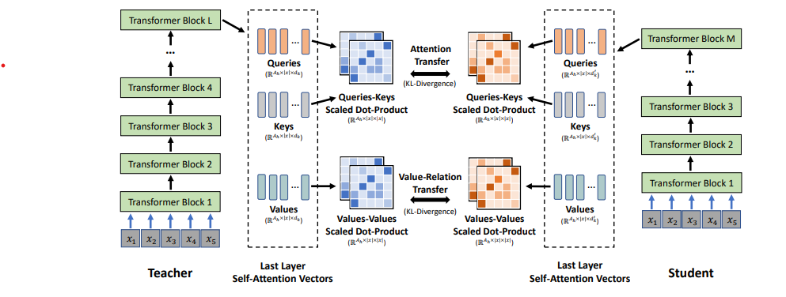

Slide 17
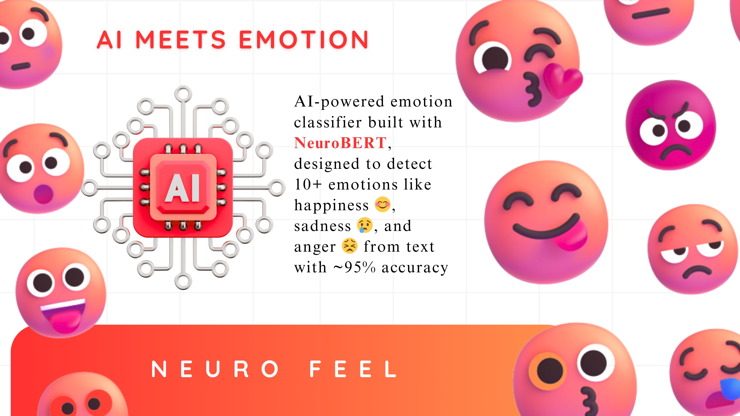
Tone / Sentiment Analysis (boltuix/NeuroFeel)
Detects emotions and manipulative tones in text - e.g. urgency, fear, authority, flattery -and outputs labels with confidence scores. It can capture both subtle emotional states and persuasive intent, making it useful for analyzing emails.
Link : https://huggingface.co/boltuix/NeuroFeel

Slide 18
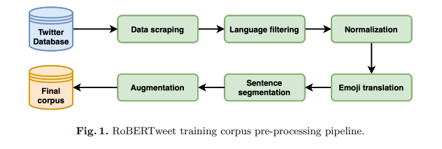
Grammar Classification and Pattern Recognition
The model analyzes text to evaluate how well it follows English grammar and punctuation rules, producing a score that indicates the percentage of correctness. It can also be fine-tuned to estimate the likelihood that a specific person authored the text, based on their writing style. For this purpose, we plan to use MiniLM (with fine-tuning), BERTweet (pre-trained on informal language) or agentlans/snowflake-arctic-xs-grammar-classifier.
Link: https://arxiv.org/pdf/2306.06598

Slide 19
Risk & Response
Scoring: RiskScore = w1*Intent + w2*Tone + w3*Grammar (example)
Banner selection:
⚠️ Suspicious: Payment Request
🚨 High Risk: Credential Theft
API Response (JSON): risk score + banner + optional explanation

Slide 20
Market & Competitors

Slide 21
Competitors
Specific features:
Egress Defend:
automated training
Proofpoint:
Nexus (AI ensemble platform)
Supernova (Behavioral detection engine)
Darktrace/Email:
"Self-Learning AI"
"Pattern of life"
Abnormal Security
Advanced user behavior
Defense in depth
Features used by other companies:
Common features:
Multi-strategy detection
Risk score and labeling
UI (banners and buttons)
Protection policies
Feedback loop
M365 integrations
Cloud architecture and scalability
Anti-spoofing
Social graph
Approximate string matching

Slide 22
Common features
Multi-strategy detection:
Standard checks: SPF/DKIM/DMARC, IP/domain reputation, domain age
NLP/NLU/LLM: language analysis, tone, intent (urgency, fraud, payment request, etc.)
Behavior/identity analysis
Threat Intelligence
Link and attachment analysis: URL rewrite, time-of-click checks, sandboxing
Risk score:
Aggregated score from the many models used
Different levels of risk based on the obtained score + labeling

Slide 23
Common features
UI:
Banners (based on risk score)
Button for false positive/negative reports
Protection policies:
Quarantine / blocking
Configurable policies, whitelisting, VIP roles
Feedback loop:
User reports feed back into the training loop
Allows false positive/negative reduction through self-correction
Cloud architecture and scalability:
Cloud-native / SaaS
AWS / Azure / GCP
Small latency (only a few seconds)
Anti-spoofing:
Domain look-alikes & new domains
Approximate string matches
Social graphs:
Relationships between users: frequence, writing style
Deviations from the "pattern of life"

Slide 24
Specific features
Proofpoint
Nexus platform:
LLMs - detects payments & urgency in BEC
Generative AI – detects subtle variations in links / content
Threat Intelligence – integrates compromised account indices in real-time
Relationship graph – maps relations between users to catch anomalies
Machine learning – traditional models for unknown threats
Computer vision – infected attachments, QRs, fake pages
Supernova Behavioral Engine:
Analyzes communication behavior between users
Stops non-malware threats like BEC, supplier fraud
Minimizes false positives through contextual detection
Delivers smart in-email banners

Slide 25
Specific features
Abnormal Security
Tech Stack:
Python, Django and GO ( golang )
Cloud / Infra / Container – AWS, ECS, Docker, Azure, Terraform
Databases / Storage – MySQL, PostgreSQL, Redis (cache)
ML / NLP – BERT, ensemble models, LLMs
Training style:
Hybrid training: mix between supervised and unsupervised models
Feature extractor & pipelines
Retraining and feedback loop
Resistance to adversary ML

Slide 26
Thank you!

