Slide 1
Reliable, Repeatable, & Automated: PowerShell for DBAs
Chrissy LeMaire @cl netnerds.net
dbatools.io
Rob Sewell @sqldbawithbeard sqldbawithAbeard.com

Slide 2
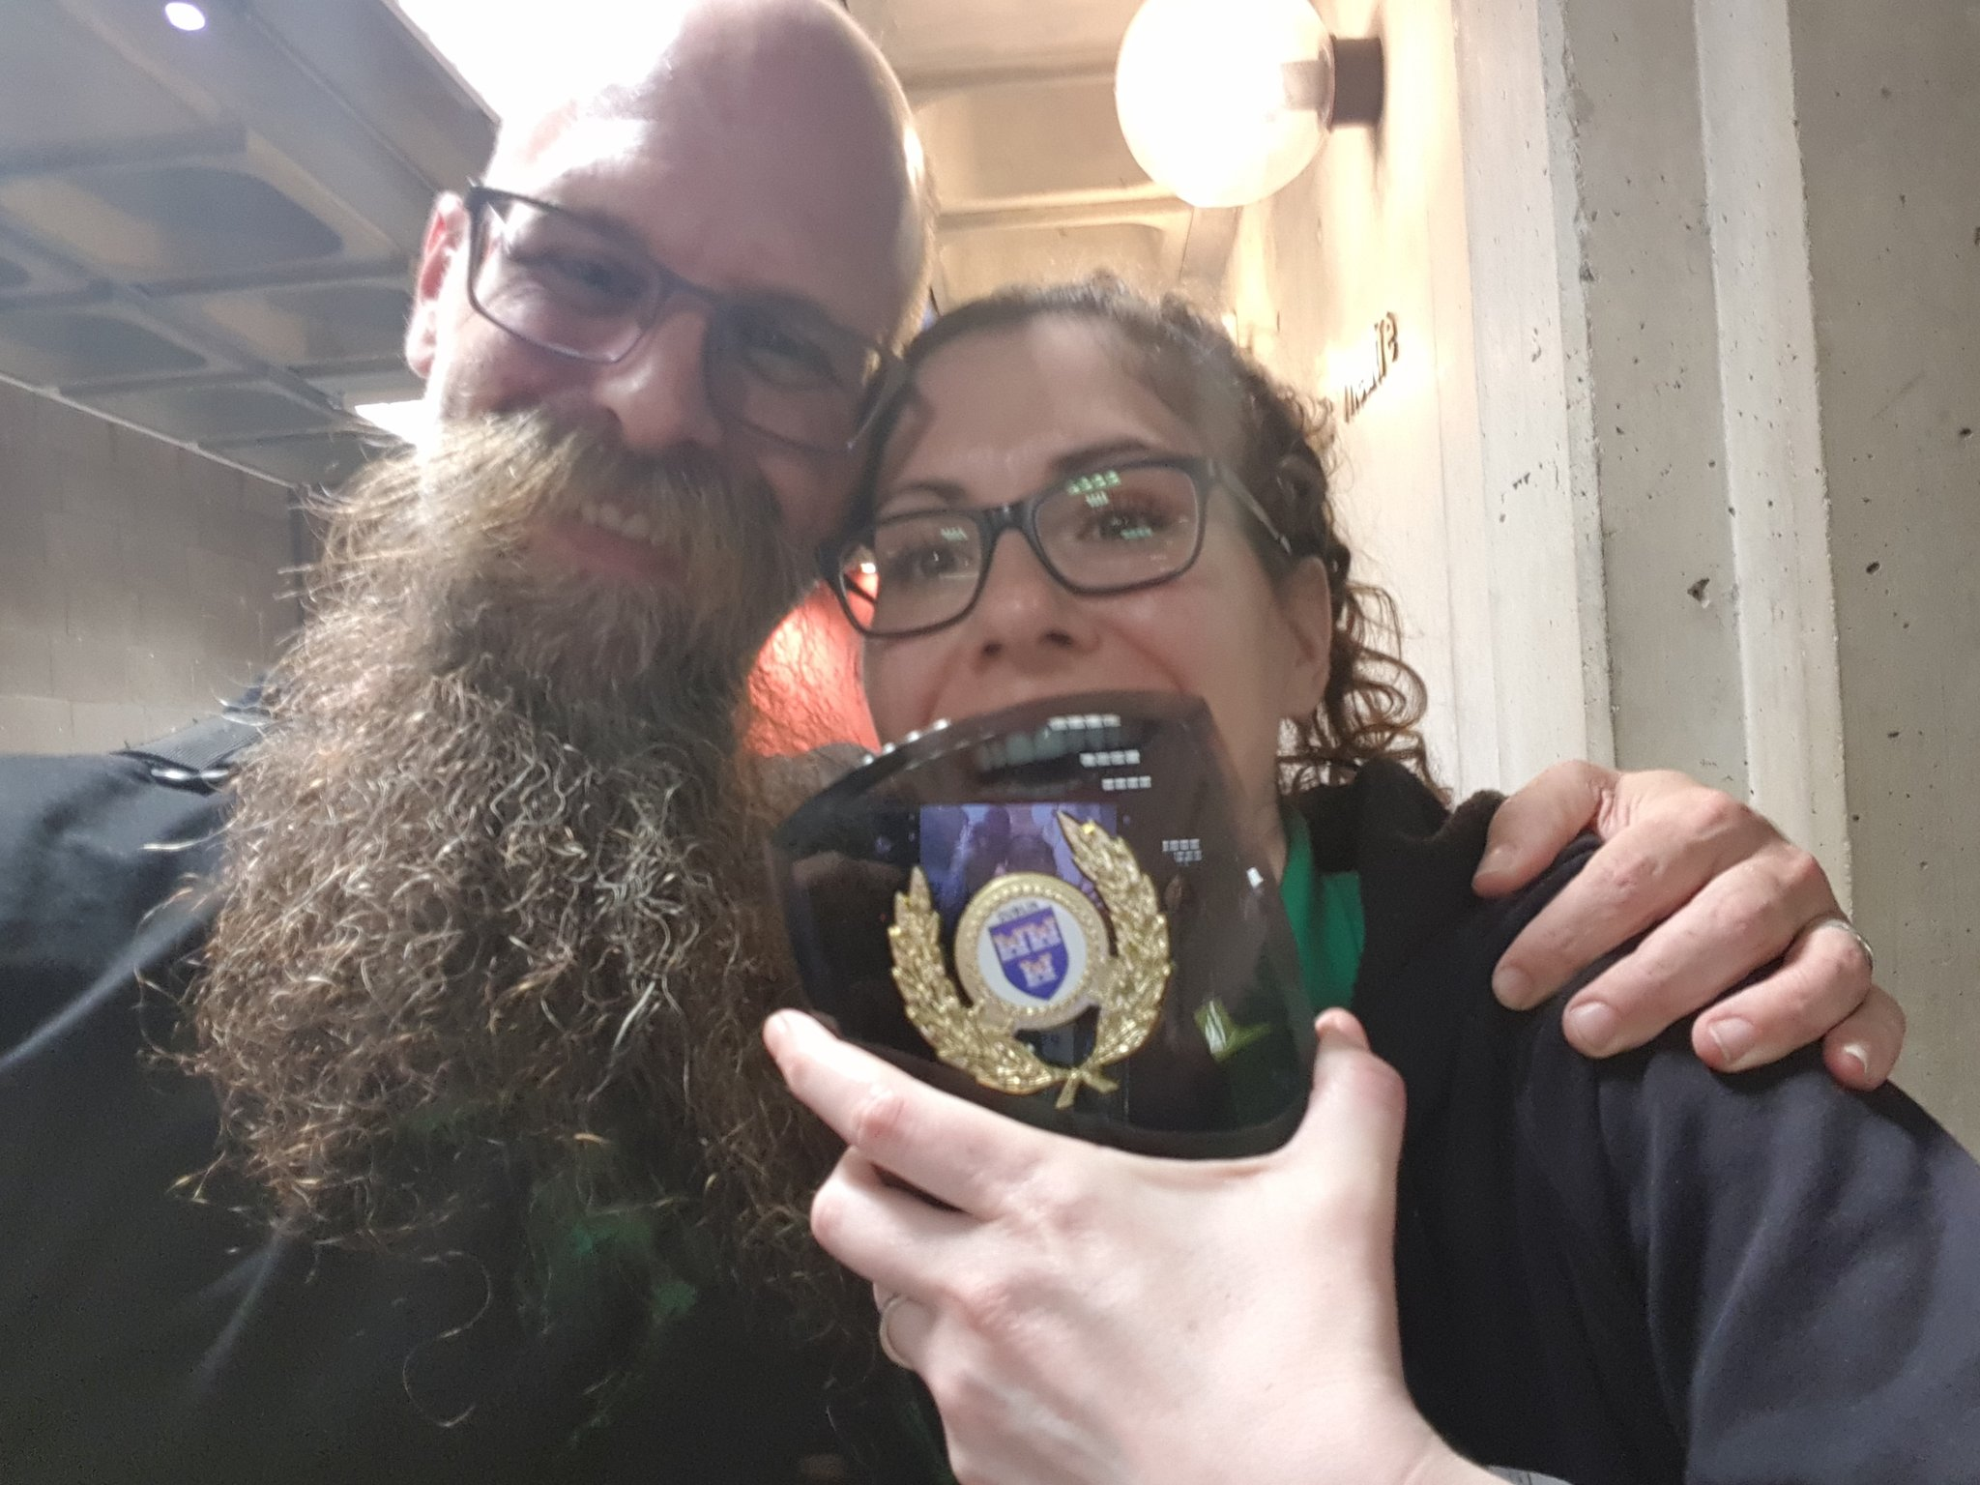
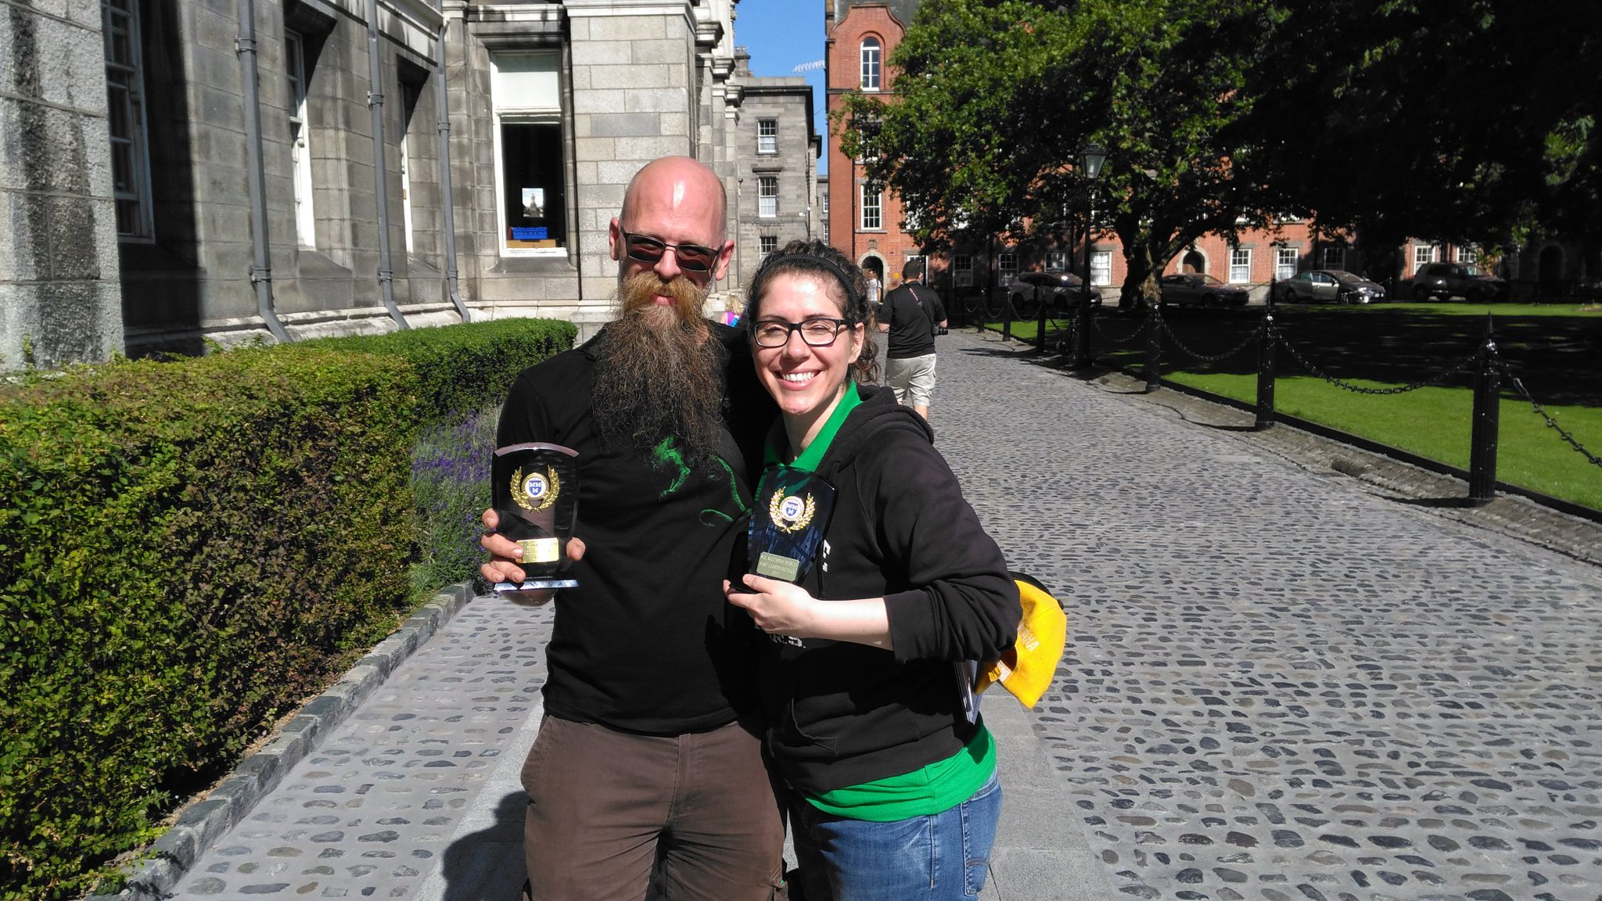
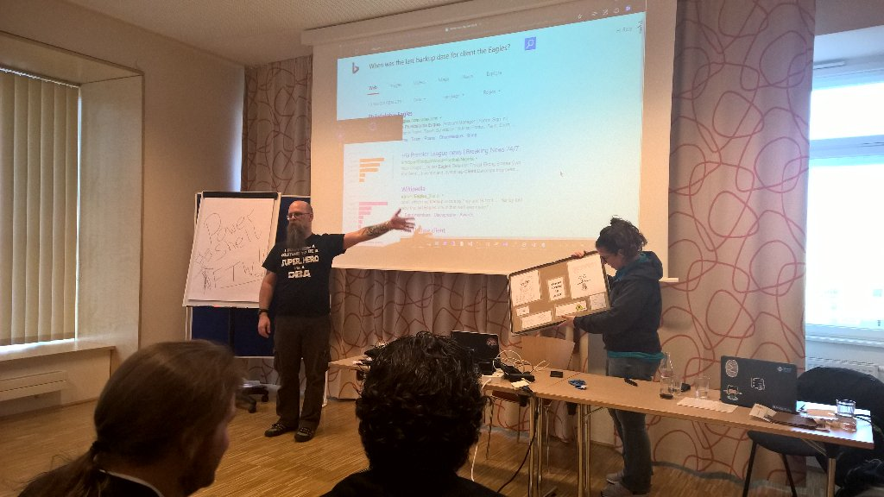
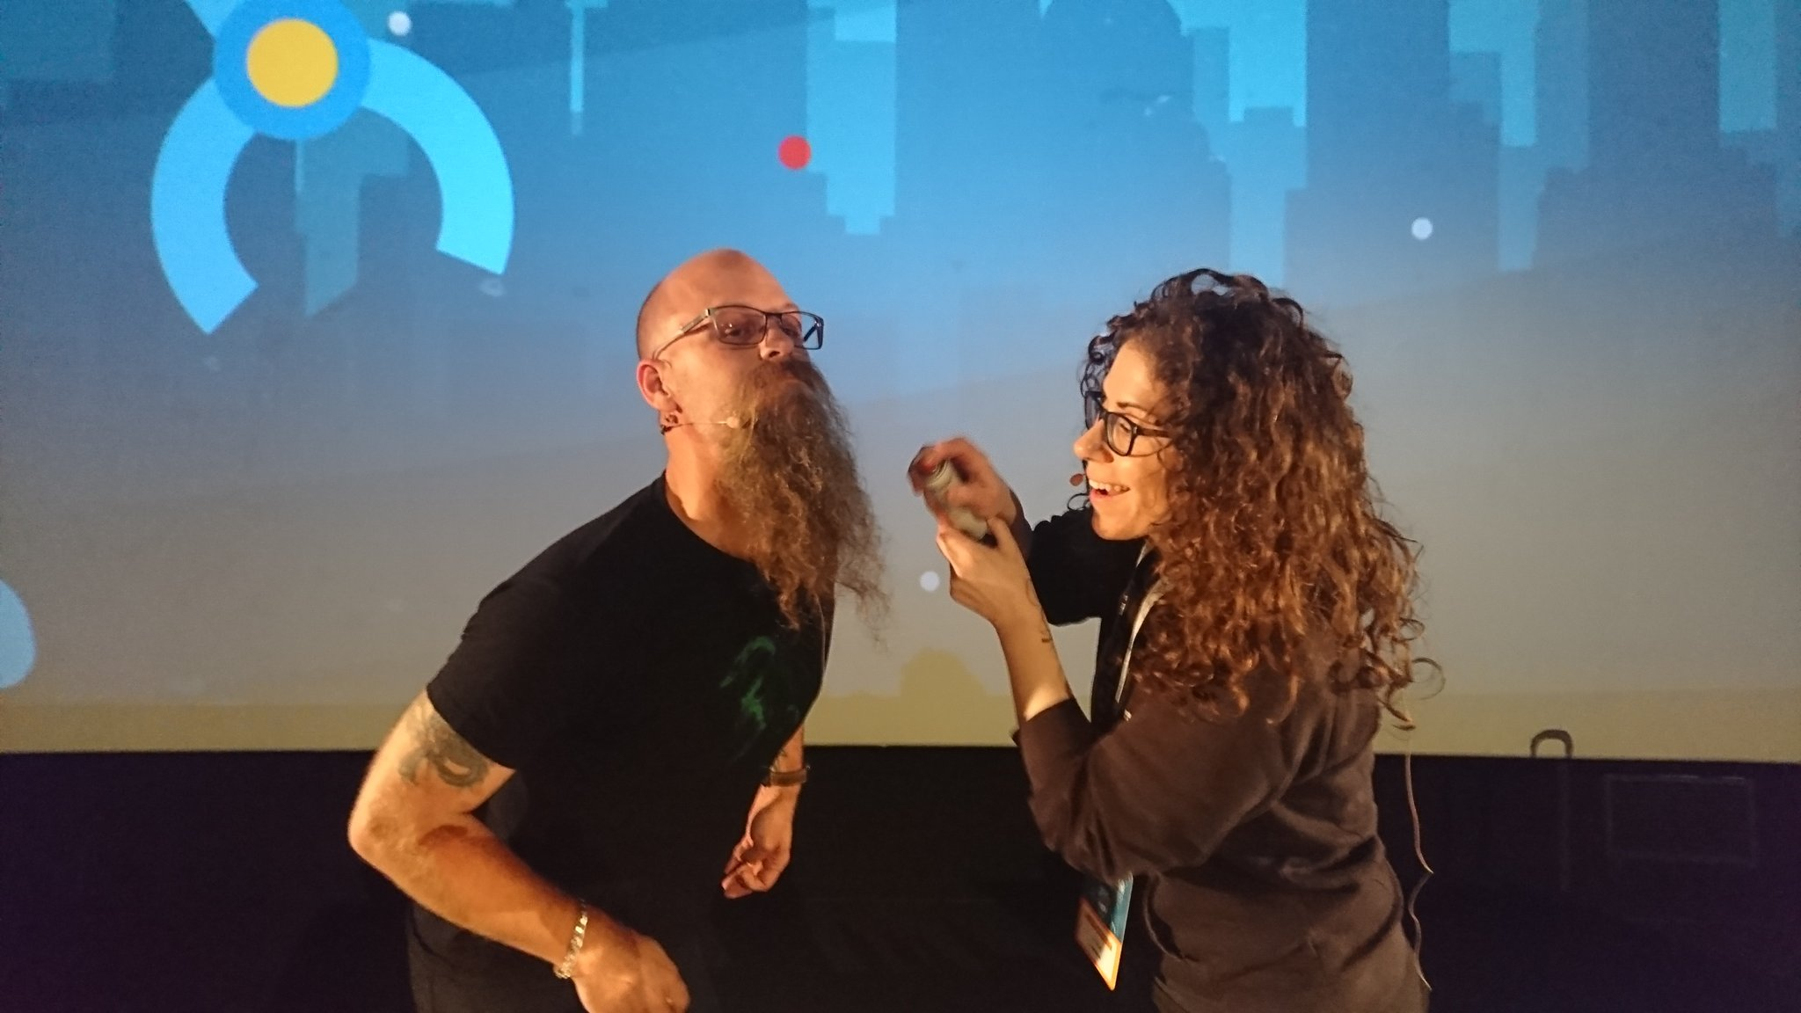
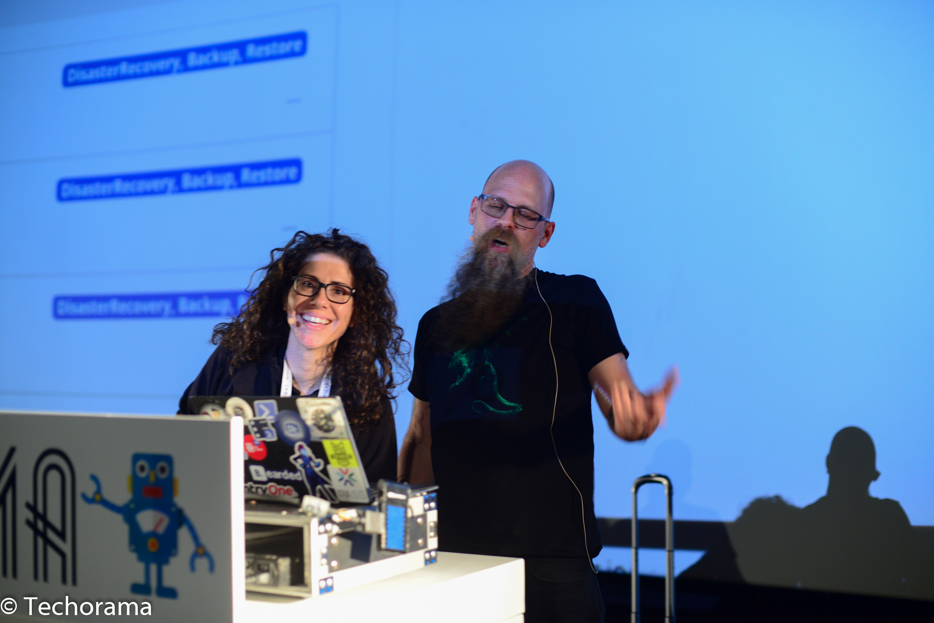
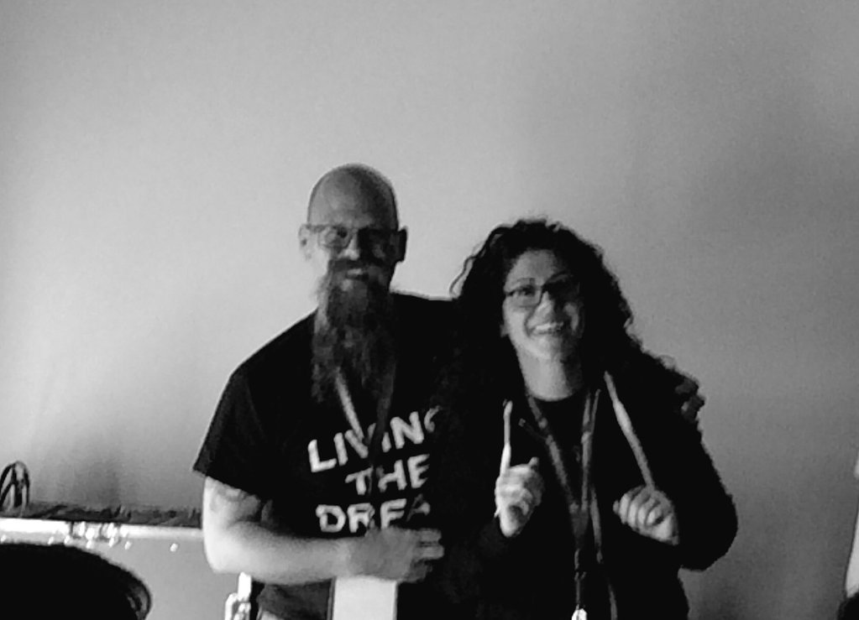
Who Are We?
Chrissy LeMaire - @cl
PowerShell MVP
Creator of dbatools.io
Belgian PowerShell UG, PSConf.eu organizer
DBA with General Dynamics IT at NATO Spec Ops HQ
Best Speaker Lightning Talk and Overall SQL Saturday Dublin
Rob Sewell - @sqldbawithbeard
PowerShell MVP
Contributor to many PowerShell open source projects
PASS PowerShell VG, PSConf.eu organiser
PowerShell Consultant and Trainer
Half a Best Speaker SQL Saturday Dublin!

Slide 3
Who Are You?
Calling: DBA, Developer, DevOps Engineer
Skill Level: Beginner to Advanced PowerShell
Interests: Automation and Testing

Slide 4
Who Are You?
Calling: DBA, Developer, DevOps Engineer
Skill Level: Beginner to Advanced PowerShell
Interests: Automation and Testing
OK maybe testing isn’t an interest YET but it will be!

Slide 5
What Will You Learn?
Magic!*
Notes:
Its used for unit testing or TDD but can also be used to validate an environment. Comes with Windows 10 or install from the gallery with Install-Module Pester

Slide 6
What Will You Learn?
Magic!*
* Not really Magic but it will seem like that to others!
Notes:
Its used for unit testing or TDD but can also be used to validate an environment. Comes with Windows 10 or install from the gallery with Install-Module Pester

Slide 7
What Will You Learn?
PowerShell is perfect for your SQL environments and processes
Building tests to validate your environment & code is easy and fun
Notes:
Its used for unit testing or TDD but can also be used to validate an environment. Comes with Windows 10 or install from the gallery with Install-Module Pester

Slide 8
Topics
Automation
dbatools
PowerShell
Pester for TDD
Pester for audits! US DISA, EU GDPR, etc
Pester for Environment Validation
Integrating with CI and CD tooling
DevOps Galore

Slide 9
Topics
Automation
dbatools
PowerShell
Pester for TDD
Pester for audits! US DISA, EU GDPR, etc
Pester for Environment Validation
Integrating with CI and CD tooling
DevOps Galore

Slide 10
Come and Join Us For The Day
Register Now
sqlps.io/bitsreg
Notes:
Its used for unit testing or TDD but can also be used to validate an environment. Comes with Windows 10 or install from the gallery with Install-Module Pester

Slide 11
Come and Join Us For The Day
Register Now
sqlps.io/bitsreg
Notes:
Its used for unit testing or TDD but can also be used to validate an environment. Comes with Windows 10 or install from the gallery with Install-Module Pester

