Slide 1

EDAB2714 – Assignment 3
Alexander Leak
2024404382
Links
Looker Studio Dashboard
GitHub Repository
Reduced Dataset

Slide 2
Overview of the Original Dataset
What its about
The Soweto Subsistence dataset is a study on what determines purchase intention for a specific grocery store.
To determine Purchase Intention questions were asked in the categories:
Empathy
Convenience
Price Sensitivity
Environment
Quality
Trust
Value
A Brief Description of Features
Personal Information
Variables like
Age
Gender
Employment Status
Education Level
were prompted
Question Categories
All categories on the left had a set of questions ranging from 3 to 6.
Purchase Intention
Four questions were asked which formed the predictor variable.
One of the questions was on retention(PI3) which will be the focus
*All variables followed a five point Lickert Scale (Strongly Disagree – Strongly Agree) or was a Boolean variable (1 or 2)*

Slide 3
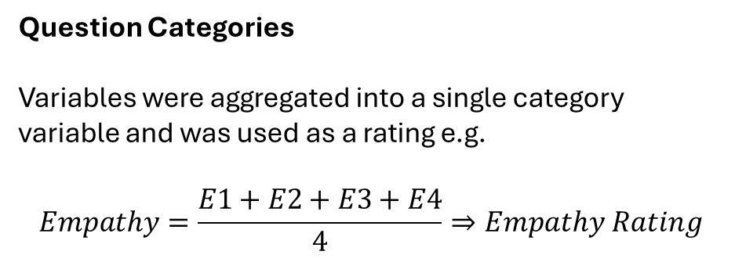
Overview of the Transformed Dataset
Descriptive Variables
Target Variable
Personal Information
Variables were decoded from numbers into strings, e.g.
Customer Retention
One of the Purchase Intention variables (PI3) were decoded into strings:
Employment Status:
1 | Employed
2 | Unemployed
1 | No Returning
2 | Probably not Returning
3 | Unsure
4 | Probably Returning
5 | Returning
Question Categories
Variables were aggregated into a single category variable and was used as a rating e.g.
$$Empathy=\frac{E1+E2+E3+E4}{4}⇒Empathy Rating$$

Slide 4
Core Question
What are the Generational Trends in Customer Retention?
Why this Question?
Each Generation has different generic values which can influence whether they’ll churn or not. Older generations may have negative views on today’s product quality compared to the past or younger generations may have a higher degree of brand loyalty because they grew up with the current grocery stores already in place.
With this in mind, quality and brand loyalty (PI2) will be given special attention to identify if there is a trend.
Education Level and Employment status will also be considered but in less detail.
What’s out of scope?
Sex
The goal is to target a specific group of the population regardless of sex. All chosen variables had more than 2 categories except for Employment Status due to the South African context.
Shopping Frequency
The degree of customer retention is not important for this study. Only whether the person plans to come back or not.
Regular Customer
There is a direct correlation between being a regular customer and retention. If plans are made for modelling, the would introduce multicollinearity, therefore is excluded

Slide 5
Methodology
Overall Project Methodology
The dataset was connected to a Jupyter Notebook.
Three Data Dictionaries were created. Two for pre-transformation and one post transformation.
EDA was done one selected important features.
The project folder was uploaded to GitHub and the Looker Studio dashboard was created.
EDA Methodology
Datasets were grouped and aggregated based on the visualization intended.
Plotnine and Hcharts (R ) was used to create the graphs.
Based on the visualization, further analysis were done if a point of interest was detected.

Slide 6
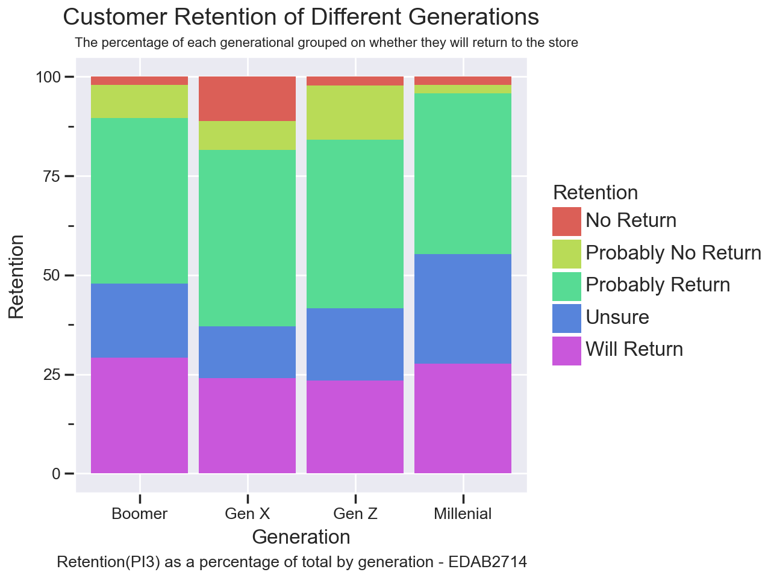
Generational Trends
The problematic Generations
15% of Gen Z answered Unfavourably
18 % of Gen X answered Unfavourably
These generations should be focused on to increase customer retention.
The well represented Generations
All groups had similar favourable answers but different unfavourable answers.
Focus should be placed on Gen X specifically to increase customer retention among the No Return and Probably No Return categories.

Slide 7
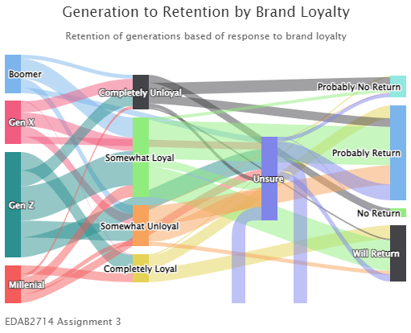
Generational Trends
Analysis of Chart
54% of millennials has some or complete brand loyalty.
52% of Boomers were somewhat loyal but nobody answered completely loyal.
18 % of Boomers has no or little loyalty
15% of Gen Z has no or little loyalty
The trend follows retention which reinforces these are the generations that should be focused on.

Slide 8
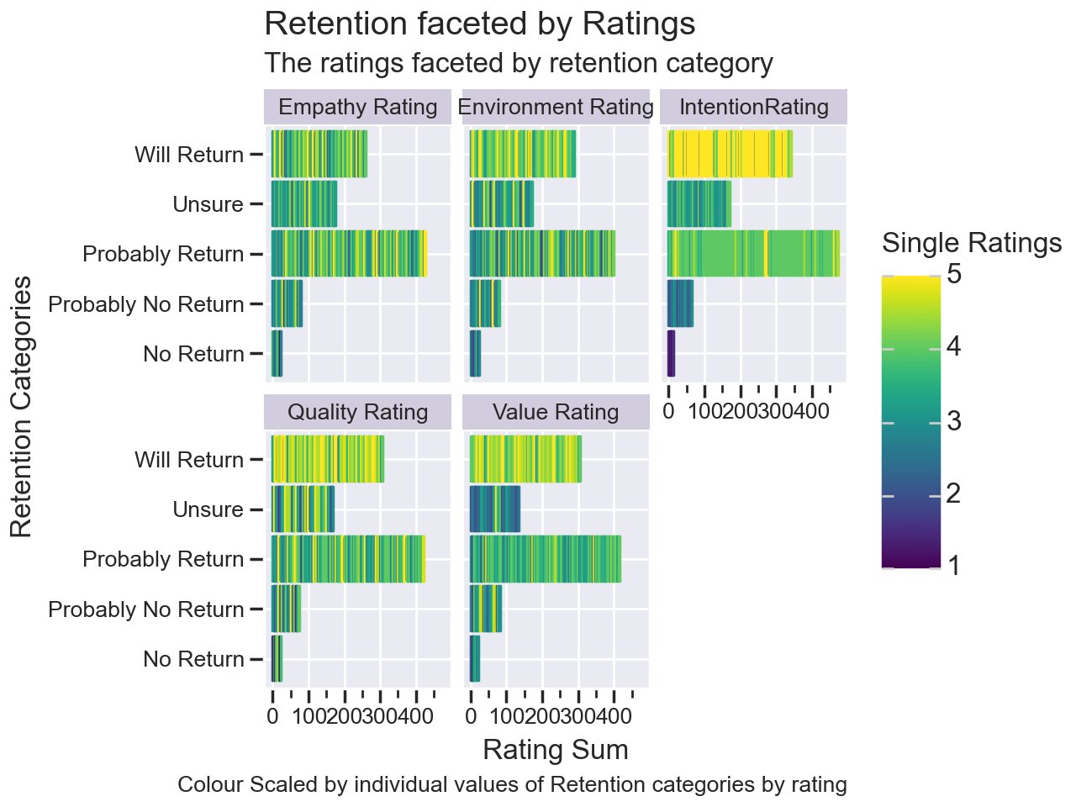
Retention Trends
Analysis of Chart
Majority of Intention Ratings show high retention showing a clear trend.
Unsure customers show low value rating scores but average or above ratings for other categories.
Value Rating should be focused on to increase retention rates.

Slide 9
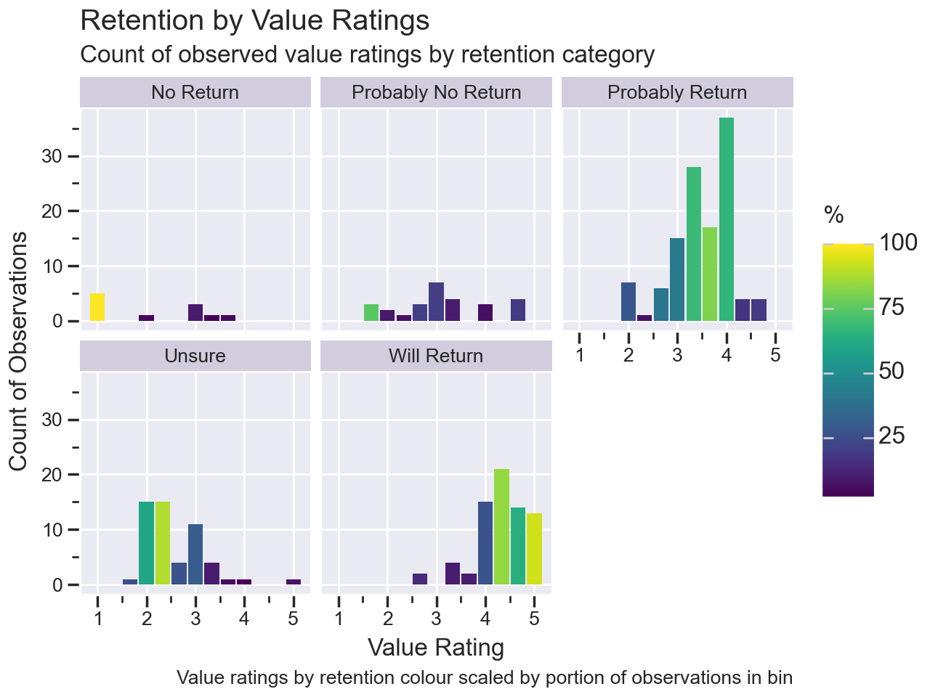
Retention Trends
Analysis of Chart
The unsure category having majority unfavourable value ratings is due to the high percentage of ratings between 1.75 and 2.5.
Most observations in Probably Return is between 3 and 4 indicating that many people are unsure of the quality but still have favourable retention.
We can conclude that even though people are unsure of quality, they will continue visiting the store until they are sure.
*this may indicate that shopping frequency may be a good variable to use to analyse how value ratings change between frequent and infrequent visitors*

Slide 10
Recommendations and Further Steps
Increase Participation for Gen Z and Gen X
Collect and analyse product data
Branding which specifically targets Gen Z and Gen X can be beneficial.
Analyse most bought products by generation and increase targeted marketing and focused product strategies
E.g. Stationery is mostly bought by Gen Z so market it with “back to school” or higher quality products for young professionals.
Determine the impact of products on the value rating. If certain staple products are of a lower perceived value than others, it can weigh down the overall store value rating.
E.g. Cheap feeling packaging for semi-durable goods can make the product “feel cheap” and of lesser value.
Analyse shopping frequency with product data
Promote the Brand to the Fence Sitters
How much a product is bought will change the value rating after the customer refines their opinions on it. Often bought products by recurring customers can indicate if the perceived value changes or remains the same.
Most customers are still unsure about brand loyalty and consequently on returning. Provide benefits for brand loyalty thus incentivizing it.

Slide 11
^{Thank}
^{You}

