Slide 1
Prototype demo: data, baselines and uncertainty
Adaptive graph-space uncertainty modelling for ML interatomic potentials · 23 October 2026
Notes:
Today covers three things: what the MD17 data looks like, how the five Phase 1 baseline models compare under one fair protocol, and what we learned from Phase 2 (BLIP), including this week's attempt to fix its uncertainty and why it didn't work yet.

Slide 2
Where the project stands
Three phases, all benchmarked on MD17 ethanol through one shared training and scoring harness
1
2
3
Phase 1 · Deterministic baselines
Phase 2 · BLIP, stochastic weights
Phase 3 · Graph-space stochasticity
Complete
Uncertainty not yet useful
Started
Five architectures trained and scored under one locked protocol. Best energy error 0.054 kcal/mol.
Gives a confidence estimate, but it is far too narrow. This week's fix made training stable; we think we know why calibration is still off.
The novel contribution. First model draft committed on 22 October; it will be scored by the same harness.
Data → Phase 1 bake-off → Phase 2 results → next steps
Notes:
Phase 1 is done: five standard architectures, trained and scored the same way. Phase 2 is BLIP, which adds a confidence estimate. It trains and predicts, but its confidence isn't trustworthy yet. Phase 3 is our novel contribution, moving the randomness from the weights into the graph itself. It started this week.

Slide 3
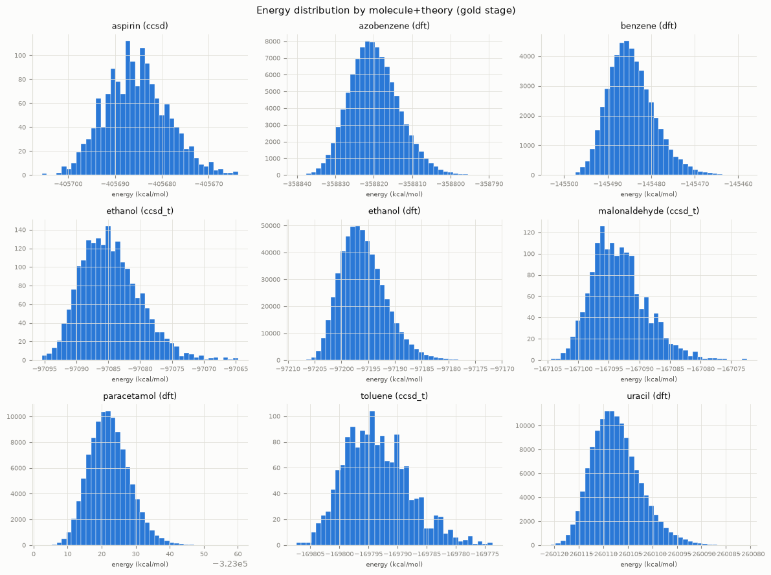
MD17 is clean enough to train on as-is
Energy distributions for all nine gold-stage datasets: single-peaked, with no outlier clusters
9
datasets: 8 molecules, with ethanol at two levels of theory (DFT and CCSD(T))
555,092
ethanol DFT frames, the dataset every model in this deck is trained and tested on
0
anomalies beyond what the pipeline's own NaN, shape and unit checks already catch; forces look the same
Notes:
Shijin's EDA checked every gold dataset before training. Each one has a single, bell-shaped energy distribution, no strange second peaks and no clusters of outliers. Force magnitudes behave the same way. So the data didn't need any cleaning beyond the automated checks already in the pipeline. Everything that follows uses ethanol at DFT level: 555,092 frames.

Slide 4
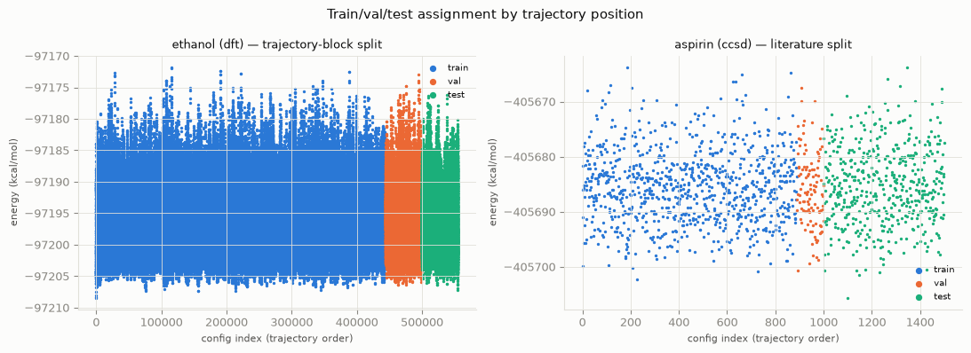
Train, validation and test are separate stretches of the trajectory
Neighbouring MD frames are near-duplicates, so a random split would leak copies of training data into the test set
Train · 444,074 frames
Validation · 55,509
Test · 55,509
No interleaving: the test block is never seen in training
Notes:
MD17 is a molecular dynamics trajectory, so frame 1,000 and frame 1,001 are almost the same structure. If we shuffled frames randomly, the test set would be full of near-copies of training frames and every error would look better than it really is. Instead the split uses contiguous blocks: train first, then validation, then test. The left panel shows ethanol; the right shows aspirin's literature split. No colours interleave.

Slide 5
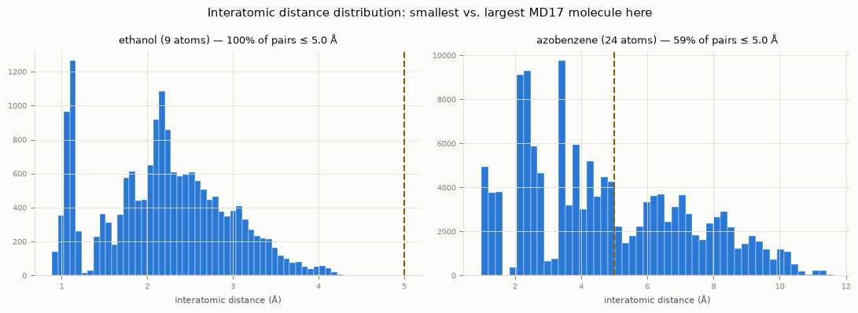
The 5 Å cutoff links every atom pair in small molecules
For 9-atom ethanol the neighbour graph is complete; the cutoff only starts pruning at around 20 atoms
Molecule | Atoms | Pairs ≤ 5 Å
Ethanol | 9 | 100%
Benzene | 12 | 98%
Toluene | 15 | 92%
Paracetamol | 20 | 73%
Azobenzene | 24 | 59%
Why it matters: MD22 systems reach 370 atoms. The same 5 Å default would prune those graphs heavily, possibly into disconnected pieces, so the cutoff has to be chosen deliberately before any model is trained on MD22.
Notes:
Every model builds a graph by connecting atoms closer than 5 ångströms. For ethanol, every atom is within 5 Å of every other, so the graph is fully connected and the cutoff does nothing. It only starts removing edges for bigger molecules: azobenzene keeps 59% of pairs. That's fine for MD17, but MD22 goes up to 370 atoms, so this default needs a deliberate check before we use it there.

Slide 6
Five architectures, one locked protocol
Only each model's own architecture differs; the benchmark refuses any run that breaks the shared settings
MPNN
385k parameters
SchNet
62k parameters
PaiNN
588k parameters
PhysNet
809k parameters
DimeNet++
279k parameters
Same data
Same training
Same scoring
Ethanol DFT; the same fixed 10,000 training and 5,000 validation frames for every model
Batch 32, Adam at 5×10⁻⁴, loss MSE(E) + 100·MSE(F), seed 42, up to 200 epochs
All 55,509 test frames, scored once per model, only through evaluate.py
Provably the same test data
Traceable runs
Why a subset
A fingerprint of the test data is stored with every score; mismatched runs are refused
Each run records its git commit, full config, frames used and hardware
Profiling showed the full 444k-frame split would take about 32 hours for PaiNN alone on CPU
Notes:
Before this harness, each model had been trained differently: different subsets, losses, even a different dataset for DimeNet++. Those numbers couldn't be compared. Now every model gets exactly the same frames, the same training recipe and the same scoring code. The benchmark script checks this automatically and refuses to put a run in the table if anything differs, including the exact test data, via a fingerprint. We train on a 10,000-frame subset because the full training split would take about 32 hours for PaiNN alone on CPU.

Slide 7
PaiNN and DimeNet++ lead; SchNet trails on both measures
Mean absolute error on all 55,509 test frames, lower is better
One seed per model. PaiNN and DimeNet++ are 0.002 kcal/mol apart on energy and swap order on forces: treat them as tied.
Notes:
These are the Phase 1 results from the retrained runs of 19 October. DimeNet++ and PaiNN are clearly ahead of the other three, and SchNet is clearly behind on both energy and forces. But DimeNet++ and PaiNN are within two thousandths of a kcal/mol on energy and swap places on forces, with one training run each. I wouldn't call a winner between them yet.

Slide 8
How far to trust the ranking
Large gaps are real; small ones need repeat runs before anyone ranks them
1
One training seed per model
46%
There is no estimate yet of run-to-run spread, and the rerun on the left shows it can be large.
change in SchNet's energy error when retrained with the identical config and seed on a different machine
2
Stopped at the 200-epoch cap
Four of the five models had their best epoch at 199 or 200. Longer training would likely lower errors and could reorder close models.
0.117 → 0.171 kcal/mol
3
Different model sizes
From 62k (SchNet) to 809k (PhysNet) parameters. Each model is compared at its own configured size.
Notes:
This is the QA view of the table. When Alex retrained all five models on 19 October with exactly the same settings but on a different machine, SchNet's energy error moved by 46%. So the large gaps, like SchNet against the rest, are real. Small gaps, like PaiNN against DimeNet++, are within what a single rerun can move. Also, four of the five models were still improving when they hit the 200-epoch cap, and the models are different sizes. We'll add repeat seeds before ranking the close ones in the report.

Slide 9
BLIP: the same backbone, with stochastic weights
Many noisy forward passes give a prediction and a spread; the spread is the confidence estimate
Mean
→ predicted energy and forces
Atom positions
z, R for one structure
MPNN backbone
message-passing weights carry Gaussian noise
20 passes
each with fresh noise
Spread
→ how sure the model is
What a useful confidence estimate does
Calibrated: a 90% interval contains the true value about 90% of the time.
Informative: the model is less sure exactly where its errors are larger, so it can flag structures to recheck with DFT.
Notes:
BLIP keeps the same MPNN backbone as Phase 1 but makes its weights random: every forward pass samples slightly different weights. We run each structure 20 times. The average is the prediction; how much the 20 answers disagree is the uncertainty. For materials discovery that uncertainty is the point: it should tell us which predictions to trust and which structures need an expensive DFT check. For that it has to be calibrated and it has to track the actual error.

Slide 10
First BLIP run: less accurate, and overconfident
Trained with the standard MSE loss for 200 epochs, on the same data and scoring path as Phase 1
2×
12%
~6×
the energy error of its own MPNN backbone (0.158 vs 0.078 kcal/mol)
of true energies fall inside BLIP's 95% interval; a calibrated model would catch 95%
narrower predicted spread than the actual error (0.028 vs 0.158 kcal/mol)
Why: MSE rewards accurate averages but never compares the predicted spread with the actual error, so nothing pushes the uncertainty to be honest. The planned fix was to train on a likelihood loss (NLL) that does.
This run was trained from uncommitted code and needs a rerun. Uncertainty metric definitions are provisional until Dongxiao signs them off.
Notes:
Alex's first real BLIP run. Accuracy is about twice as bad as the plain MPNN on energy, which is expected to some degree because the noise acts as a regulariser. The bigger problem is the confidence. Its 95% intervals only contain the true energy 12% of the time, because the spread it predicts is about six times smaller than its real error. That's not a bug in the code: the MSE loss simply never asks the model to get its uncertainty right. So the plan was to switch to a likelihood loss.

Slide 11
The NLL fix: training is now numerically stable
BLIP trains on MSE for 20 epochs, then switches to a likelihood loss that also scores its uncertainty
Before the fix
After the fix
~10⁸
783 → 255
loss at the switch to the likelihood loss; training blew up
validation loss across the switch at epoch 21; all 200 epochs completed
How: a variance floor, set from the model's own validation error at the switch, is added to every predicted variance so the loss can't divide by almost zero. Keep an eye on that floor: it matters on the next two slides.
Notes:
The likelihood loss divides the squared error by the predicted variance. Right after the MSE warm-up, BLIP's variance was close to zero, so the loss exploded to around 10 to the 8. Alex's fix adds a floor to the variance, set from the validation error at the moment of the switch. That works: the run went straight through the switch and finished all 200 epochs.

Slide 12
But NLL training made the confidence worse, not better
Share of true energies inside each predicted interval: the bars should reach the target line
Metric | MSE | NLL
Energy MAE | 0.158 | 0.172 | worse
Force MAE | 0.206 | 0.195 | better
Energy ECE | 0.70 | 0.77 | worse
Energy Spearman | 0.005 | 0.003 | ≈ same
Force Spearman | 0.27 | 0.30 | better
Energy spread | 0.028 | 0.013 | worse
ECE: 0 is perfectly calibrated. Spearman: +1 means uncertainty tracks error. MAE in kcal/mol and kcal/mol/Å. Both runs scored on the same test data with 20 passes.
Notes:
The aim of the likelihood loss was to widen BLIP's intervals until they matched its real error. The opposite happened. The 95% interval now contains the true energy 2% of the time instead of 12%, the predicted spread halved, and the calibration error got worse. Energy accuracy also got a little worse, while force accuracy improved slightly. Spearman barely moved. Both runs were scored on identical test data, so this is a fair comparison.

Slide 13
Likely cause: the variance floor drowns out the real error
Read from the committed run records; Dongxiao is checking it before we act on it
1
The loss stops seeing the error
~600×
The logged energy loss settles at 2.46, within 0.001 of the floor's own constant 0.5·ln(2π·21.78). The actual error adds almost nothing.
2
So it shrinks the model's own spread
the energy variance floor (21.8) compared with the model's actual squared error at the end of training (0.036)
With total variance already above the error, the gradient pushes BLIP's uncertainty down: predicted spread halved and coverage fell to 2%.
3
And energy loses weight
Set once at epoch 20, never updated
Energy gets about 3× less weight relative to forces than under MSE, matching energy error rising while force error fell.
The fix stopped the crash by making the loss nearly inert. Next: a floor that is small relative to the error, or one that decays after the switch.
Notes:
This is from the run records, not a rerun, so treat it as the leading explanation until Dongxiao confirms it. The floor was set from the validation error at epoch 20, when the model was still poor: 21.8. By the end the real squared error is about 0.036, so the floor is roughly 600 times too big. With a floor that size, the loss is almost a constant: the logged value settles at the floor's own term, to within a thousandth. The model's own uncertainty can only make the loss worse by growing, so training shrinks it. That explains every number on the previous slide. The fix is to keep the floor small relative to the current error, or let it decay after the switch.

Slide 14
Next steps
Phase 3 needs a calibrated Phase 2 baseline to be compared against
1
Fix the variance floor
2
Sign off the uncertainty metrics
Keep it small relative to the error, or decay it after the switch. Then rerun BLIP from a clean commit on the newly merged harness.
Dongxiao confirms the ECE binning, NLL versus CRPS, and the correlation convention.
3
Repeat seeds for close models
4
Phase 3: graph-space stochasticity
Settle PaiNN against DimeNet++ before ranking them in the report.
First model draft is committed. It will be scored by the same harness against Phases 1 and 2.
Open data question: choose the cutoff radius deliberately before any model is trained on MD22.
Notes:
Four things next. First, fix the floor and rerun BLIP from a clean commit. Second, Dongxiao signs off the uncertainty metric definitions, which are still provisional. Third, repeat seeds so we can say whether PaiNN or DimeNet++ is genuinely better. Fourth, Phase 3 has started and will be scored by the same harness, so all three phases end up in one comparable table.

