Slide 1



More Than a White Picket Fence:
How Home Features Influence Sale Price
Yvonne Renard, Alex Teboul, Sara Elkasevic

Slide 2


Why is it important to understand how Sale Price is affected by the features of a home?
2 Benefits of this Research:
More informed homeowners can better price their properties to sell.
More informed buyers can identify value in properties to ensure they’re getting their money’s worth compared to other buyers.
...In the midst of growing economic uncertainty and concerns over the housing market, a better understanding of home value can help homeowners and investors alike.

Slide 3
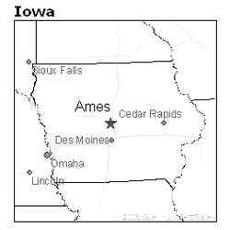

Introduction - Dataset
Our goal was to discover the underlying factors driving Sale Prices in the Ames Housing Dataset and determine the extent to which we could predict prices based on the features of a home.
Ames Housing Dataset
2930 observations of homes in Ames, Iowa
79 explanatory variables of home features
*Sale Price*

Slide 4
Literature Review
Performance of Multiple Linear Regression and Non-Linear Neural Networks and Fuzzy Logic Techniques in Modeling House Prices by: Siti Amari and Gurudeo Anand Tularam
Uses: Linear Stepwise Multivariate Regression, Neural Networks, and Adaptive Neuro-Fuzzy
Neural networks are non-linear data-driven methods
Forecasting House Prices in OECD Economies by: N.Kundan Kishor and Hardik A. Marfatia
Uses: Forecast Combination Methods
Allows for macroeconomic changes over time and across countries
Property Renovations and Their Impact on House Price Index Construction by: A. N. Bogin and W. M. Doerner
Uses: Ordinary Least Squares Estimator
Introduces renovation control and fixed effects for HPI estimations

Slide 5
Methods / Research Questions
Summary Statistics
Principal Component Analysis
Common Factor Analysis
Random Forest
Linear Multivariate Regression
What are the most important features of (and their marginal effects) on home prices in Ames, Iowa?
 | min. | max. | median | mean
Sale Price ($) | 12,789 | 755,000 | 160,000 | 180,796
Lot Area (sq ft) | 1,300 | 215,245 | 9,436 | 10,148
Bedrooms | 0 | 8 | 3 | -
Full Bathrooms | 0 | 4 | 2 | -
Fireplaces | 0 | 4 | 1 | -
Overall Quality | 1 | 10 | 6 | -
Garage Cars | 0 | 5 | 2 | -

Slide 6
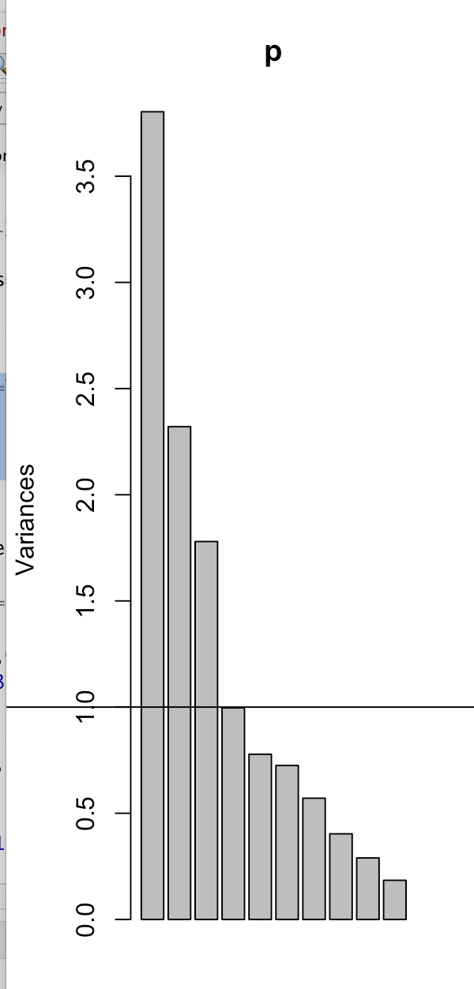
Principal Component Analysis
PCA analysis was done on numerical variables using a varimax rotation
Three components were the most optimal and explained the most variance
Bartlett’s Test of Sphericity → p-value < 2.22e-16
KMO Sampling Adequacy → 0.83

Slide 7
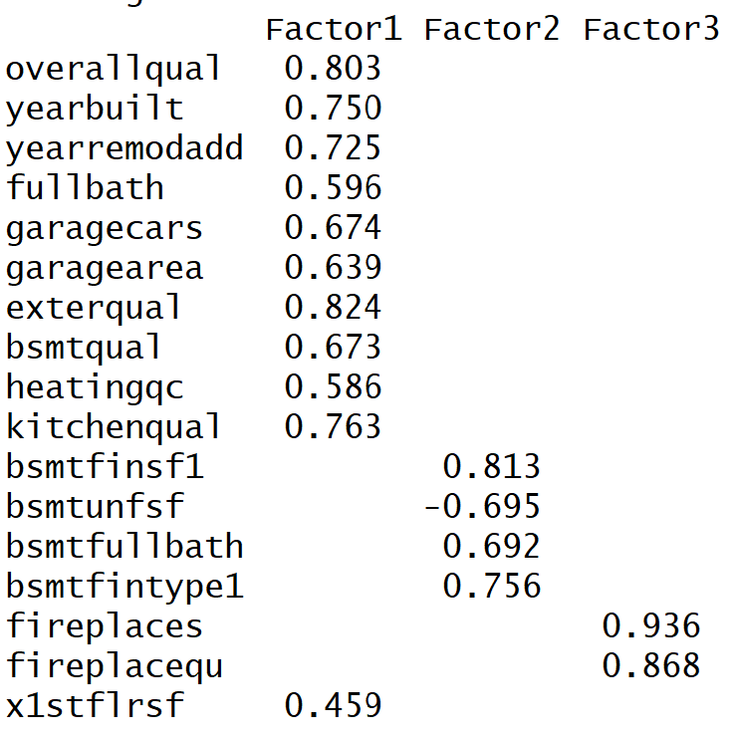
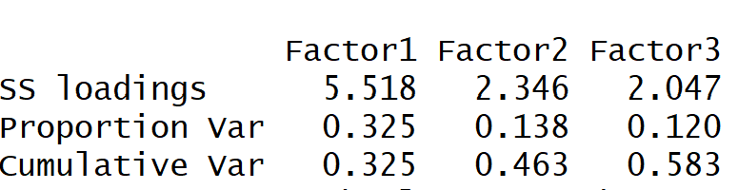
Common Factor Analysis
What we did:
Ran CFA with varimax rotation on our numeric variables to better understand factors at play in our dataset:
Factor 1: Quality, Age, Size, and Quantity
Factor 2: Basement
Factor 3: Fireplaces
Conclusions:
58.3% Cumulative Variance
Newer, Larger homes → Higher Quality Ratings
Basement variables could be consolidated.

Slide 8
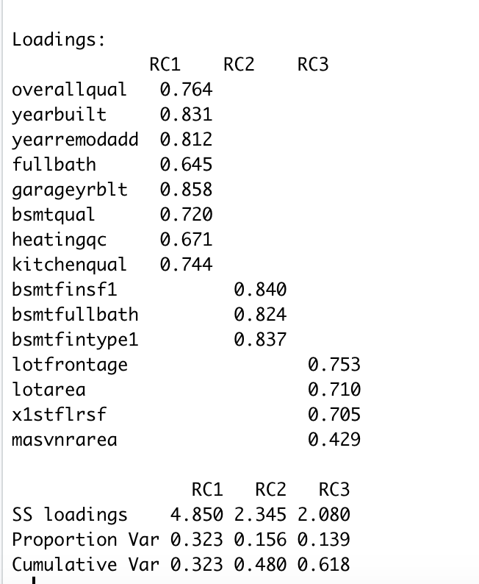
PCA Results
Component 1
Year Built → 0.831
Year Remodeled → 0.812
Garage Year Built → 0.858
Component 2
Finished Square footage of Basement → 0.840
Component 3
Lot Frontage → 0.753
Lot Area → 0.710
Cumulative Variance of 62%

Slide 9
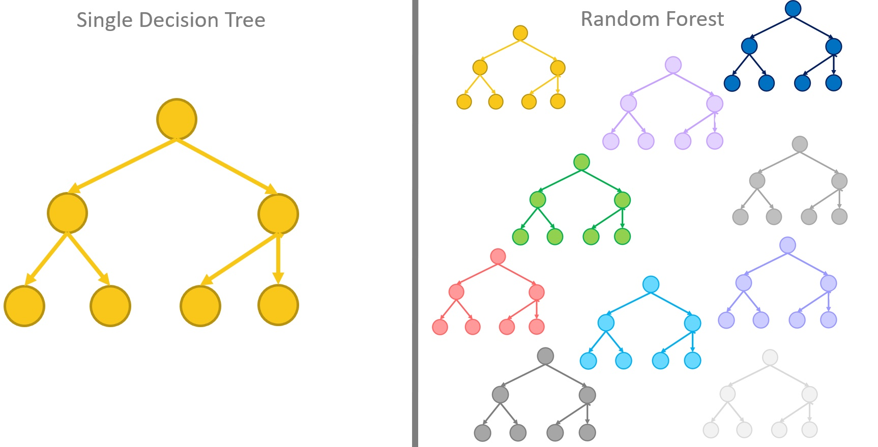
Random Forest - Sale Price Classification
What we did:
We split Sale Price into 4 equally sized groups:
Low (<$129,499)
Low Middle ($129,500 - $160,000)
High Middle ($160,001 - $213,500)
High (>$213,501)
Subset of 54 numeric home feature variables → Train/Test Split (70/30)
Train Random Forest classifier
Test RF classifier & Report Results
How it works:
500 Decision Trees predict Low, Low Middle, High Middle, or High for each home based on the 54 variables. Trees split on Impurity. We want homogenous nodes. RF Majority Vote.
1 home with 54 feature variables
Predicted Sale Price: Low (<$129,499)
Low
Low
Low
Low Middle
Low

Slide 10
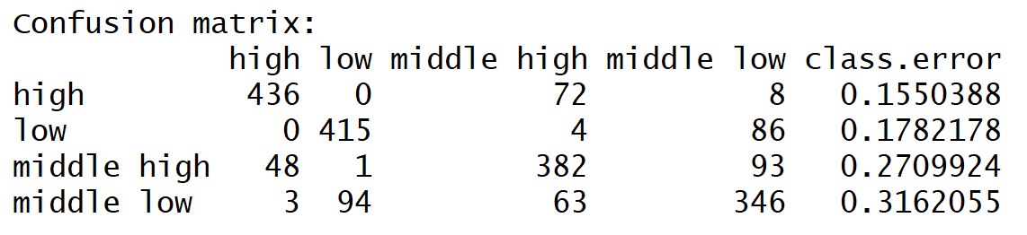
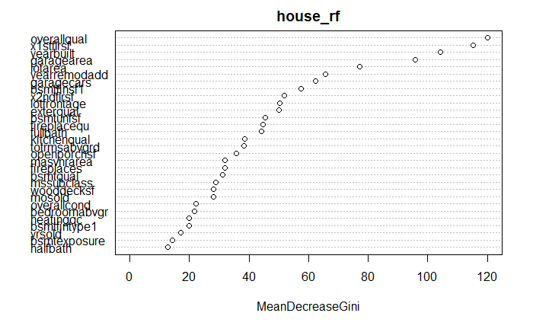
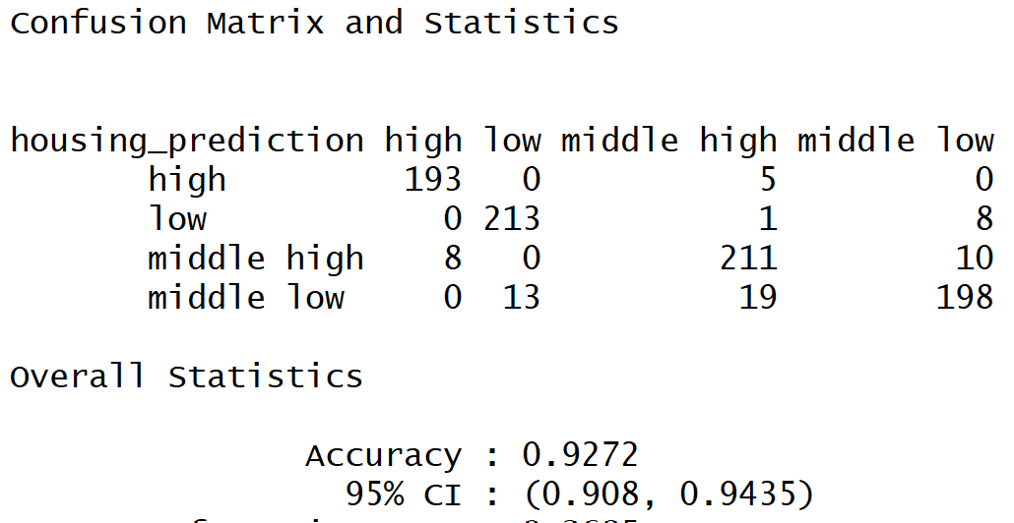
Random Forest Results
5 Important Variables in the RF Model: 1. Overall Quality 2. 1st floor square footage 3. Year Built 4. Lot Area 5. Year Remodeled
Training Set:
Testing Set: 92.7% Accuracy

Slide 11
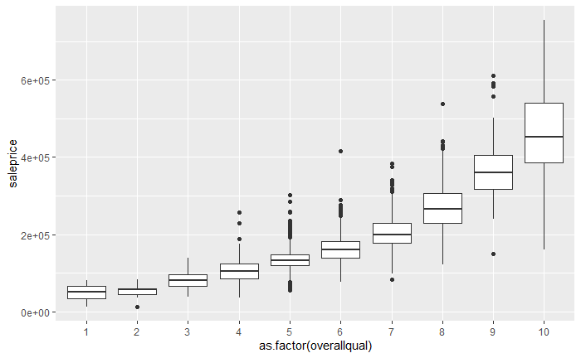
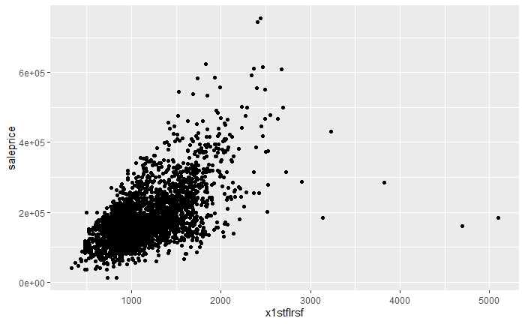
Important 2 Variables in Random Forest
SalePrice v. Overall Quality
SalePrice v. 1st Floor Square Footage

Slide 12
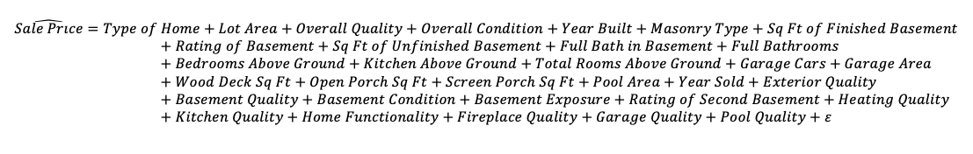
Backward Stepwise
Multivariate Linear Regression
Assumptions:
House Sale price is linearly related with independent variables
No severe multicollinearity exists
There are no influential outliers
Errors are homoscedastic and not autocorrelated

Slide 13
Results
Overall Quality | 11,680*** | (786.3)
Year Built | 120.4*** | (34.39)
Kitchen Quality | 9,409*** | (1,346)
Total Rooms Above Ground | 1,977** | (756.9)
Full Bathroom | 3,254* | (1,582)
Rating of 2nd Finished Basement | 31.47*** | (5.228)
Basement Full Bathroom | 6,767*** | (1,499)
Garage Size (cars) | 6,471*** | (1,840)
Screen Porch (sq ft) | 53.59*** | (10.38)
Intercept | 1,358,000 | (872,400)
Significant codes: 0 ‘***’ 0.001 ‘**’ 0.01 ‘*’ 0.05 ‘.’
Negative Coefficients:
Bedrooms above ground
Kitchen above ground
Open porch (sq ft)
Pool area
Year sold
Basement condition
Garage quality
Adjusted R-Squared: 85.39%

Slide 14
Conclusions
The condition of the home and its newness is significant in determining how high a house is priced.
Size is an important feature in determining price as well. The more square footage there is, the higher the price will be.
A limitation in this analysis is that the data was collected between 2006 and 2010, and thus data may have been affected by the financial crisis of the time.
Further research can include more features related to distances to the city center for example or more macroeconomic data such as percent of population that are family households. This would help build a more detailed analysis.

Slide 15
References
Amri S., & Tularam G.A. (2012) Performance of Multiple Linear Regression and Nonlinear Neural Networks and Fuzzy Logic Techniques in Modelling House Prices. Journal of Mathematics and Statistics 2012, 8 (4), 419-434.
Bogin, A.N., & Doerner, W.M. (2019) Property Renovations and Their Impact on House Price Index Construction. Journal of Real Estate Research: 2019, 41( 2), 249-283.
Kishor, K.N., & Marfatia, H.A. (2016) Forecasting House Prices in OECD Economies. Journal of Forecasting, 37(2), 170-190.
Thank you!

Slide 16
Q&A

