Slide 1
Ham or Spam?

Slide 2
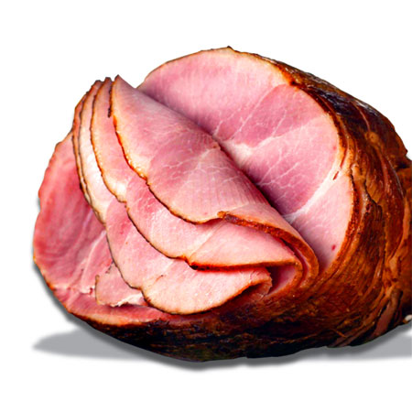
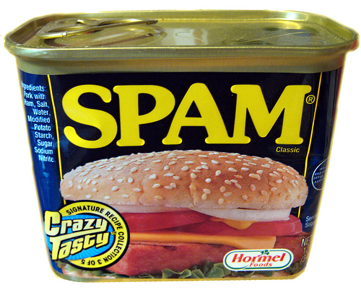
Imagine 20% of your email is Spam…

Slide 3

… your default guess should be Ham

Slide 4
What if I told you the Subject was…
Subject: Nigerian Diamonds!!! From: prince94623@spammermail.org Dear friend, Based on the further explicit investment information about your country from my research i wish to invest in your country under your supervision.

Slide 5


Nigerian
Nigerian
Diamonds
Diamonds
!!!
!!!

Slide 6
Ham
Nigeria
Ham
Spam
Ham
Spam
Spam
Nigeria

Slide 7
Bayes Theorem
Proba (email is Spam, if contains “Nigeria”) =
P (email contains “Nigeria”, if Spam) x P (email is Spam)
P (email contains “Nigeria”)

Slide 8
This can be used to classify text
P(Spam|“Nigeria”) = P(“Nigeria”|Spam) x P(Spam) / P(“Nigeria”)
P(Ham|“Nigeria”) = P(“Nigeria”|Ham) x P(Ham) / P(“Nigeria”)
If P(Spam) > P(Ham), it’s “Crazy Tasty” Spam
Note: we can actually ignore P(“Nigeria”) to make a decision

Slide 9
Bayes Theorem weights 2 components
P(Spam|“Nigeria”) = P(“Nigeria”|Spam) x P(Spam)
How likely is it that I observe the word “Nigeria” in a Spam email?
How likely is it that an email is Spam, “in general”

Slide 10
Naïve Bayes Classifier
Break text into Tokens (“Nigeria”, “Diamond”, …)
Compute the probability that text is Ham or Spam, given presence/absence of each Token
Combine probabilities into one number
P(Spam|Tokens)=
P(T1|Spam)xP(T2|Spam)x … xP(Tn|Spam) x P(Spam) / P(Tokens)

Slide 11
Your mission
Figure out if SMS is Spam or Ham given a Token
Use existing implementation to build a basic classifier
Use your brains to make a better classifier
Project/guided script available at
www.github.com/c4fsharp/dojo-ham-or-spam

