Slide 1
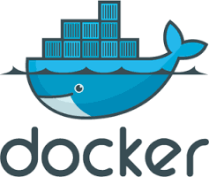
Introduction to Docker
March 2016

Slide 2
What is Docker?
An open platform for developing, deploying and running services with Linux containers.
Process and full file system isolation.
‘Light weight VM’... (but not VM!)
Docker virtualize the host machine’s services.
Bundles up services, apps, programs in a standard way.
Deploy your bundles(Containers) to different machines.

Slide 3
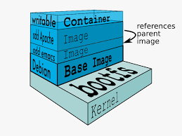
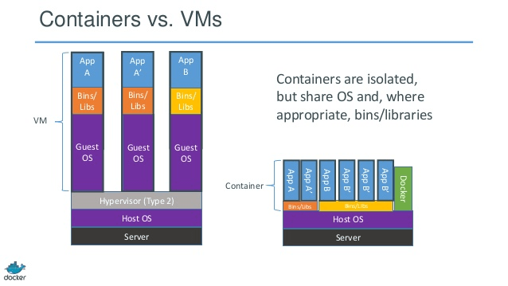

Slide 4
Basic Terms
Docker Image : Static filesystem, potentially with a parent image.
Docker Container : An writable instance of an image. Hosting more then one processes.
To programming metaphor, think of an image as a class and container as a instance.
Containers should be ephmeral.

Slide 5
Why Docker?
Lightweight, easy-to-use, standardized way to ship software. Requires only Docker and Linux.
Gather and bundle all system dependencies with your services at dev time. Version and archive it and run it anywhere.
Pretend you’re shipping a single binary.
Useful in development, on build servers, integration testing, continuous delivery.

Slide 6
Why Docker?
Test/QA : Multiple test suites on same machine with no conflicts.
Test/QA : Integration tests with known state.
Prod : Limit container’s resources(memory, cpu, device access, read/write speed).
Prod : Manage and monitor containers with Docker remote API, orchestration tools, and dynamic container discovery.

Slide 7
How?
Built on the Linux container technology (LXC) which was released in 2.6.24.
Share the system’s kernel.
Filesystem and process isolation.
No hypervisor.

Slide 8
Docker Artifact Server
Actually called ‘Docker Registry’.
Docker Hub : Public registry - anything you want ! publish your own!
Open Source : Host it locally for your own images.

Slide 9
Docker Registry: Hosted
It’s open source: host your own to host your artifacts.
push/pull versioned images.
Deployments pull images from the registry. Then run the container with secrets and other configuration.

