Slide 1
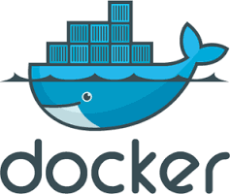
Introduction to Docker
March 2016

Slide 2
What is Docker?
An open platform for developing, deploying and running services with Linux containers.
Process and full file system isolation.
Bundles up services, apps, programs in a standard way.
Deploy your bundles(Containers) to different machines.
‘Light weight VM’... (but not VM!)

Slide 3
Docker vs VMs
"containerization" as Operating System Virtualization, whereas "virtual machines" are Hardware Virtualization.
Speed differences. VM loads the whole os.
Docker - wrapper on the top of host os.
Docker virtualizes the services of the host operating system.
File sharing between two containers, ps commands etc.

Slide 4
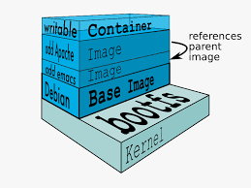
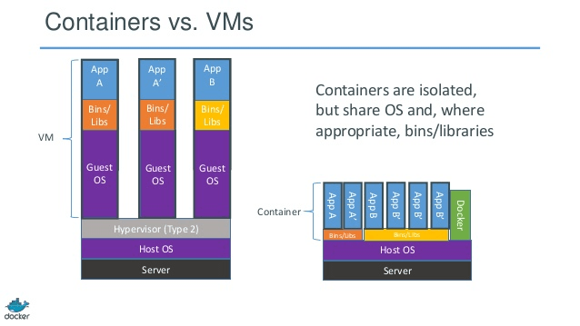

Slide 5
Basic Terms
Docker Image : Static filesystem, potentially with a parent image.
Docker Container : An writable instance of an image. Hosting more then one processes.
To programming metaphor, think of an image as a class and container as a instance.
Containers should be ephmeral.

Slide 6
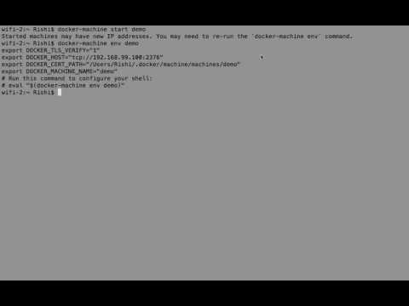
Notes:
https://youtu.be/axTA--B4QDY

Slide 7
What happened?
The Docker client contacted the Docker daemon.
The Docker daemon pulled the "hello-world" image from the Docker Hub.
The Docker daemon created a new container from that image which runs the executable that produces the output you are currently reading.
The Docker daemon streamed that output to the Docker client, which sent it to your terminal.

Slide 8
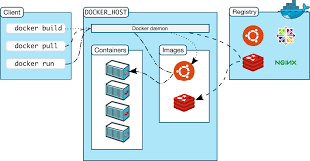

Slide 9
Why Docker?
Lightweight, easy-to-use, standardized way to ship software. Requires only Docker and Linux.
Gather and bundle all system dependencies with your services at dev time. Version and archive it and run it anywhere.
Pretend you’re shipping a single binary.
Useful in development, on build servers, integration testing, continuous delivery.
Run the processes in parallel.
Python version example, DB example.

Slide 10
Why Docker?
Test/QA : Multiple test suites on same machine with no conflicts. Test it and take the snapshot.
Test/QA : Integration tests with known state.
Prod : Limit container’s resources(memory, cpu, device access, read/write speed).
Prod : Manage and monitor containers with Docker remote API, orchestration tools, and dynamic container discovery.

Slide 11
How?
Built on the Linux container technology (LXC) which was released in 2.6.24.
Share the system’s kernel.
Filesystem and process isolation.
No hypervisor.

Slide 12
Docker Artifact Server
Actually called ‘Docker Registry’.
Docker Hub : Public registry - anything you want ! publish your own!
Open Source : Host it locally for your own images.

Slide 13
Docker Registry: Hosted
It’s open source: host your own to host your artifacts.
push/pull versioned images.
Deployments pull images from the registry. Then run the container with secrets and other configuration.

