Slide 1

IXIS Ecommerce Metrics Analysis
Last Months Sessions and AddsToCart Review
Presented to IXIS management
By
Alexandre Verville

Slide 2
Agenda
Report summary
Reviews 2 datasets of your ecommerce metrics:
Data gathered about sessions per Device
Key metrics over the last 2 months
Next Steps / Action Items

Slide 3
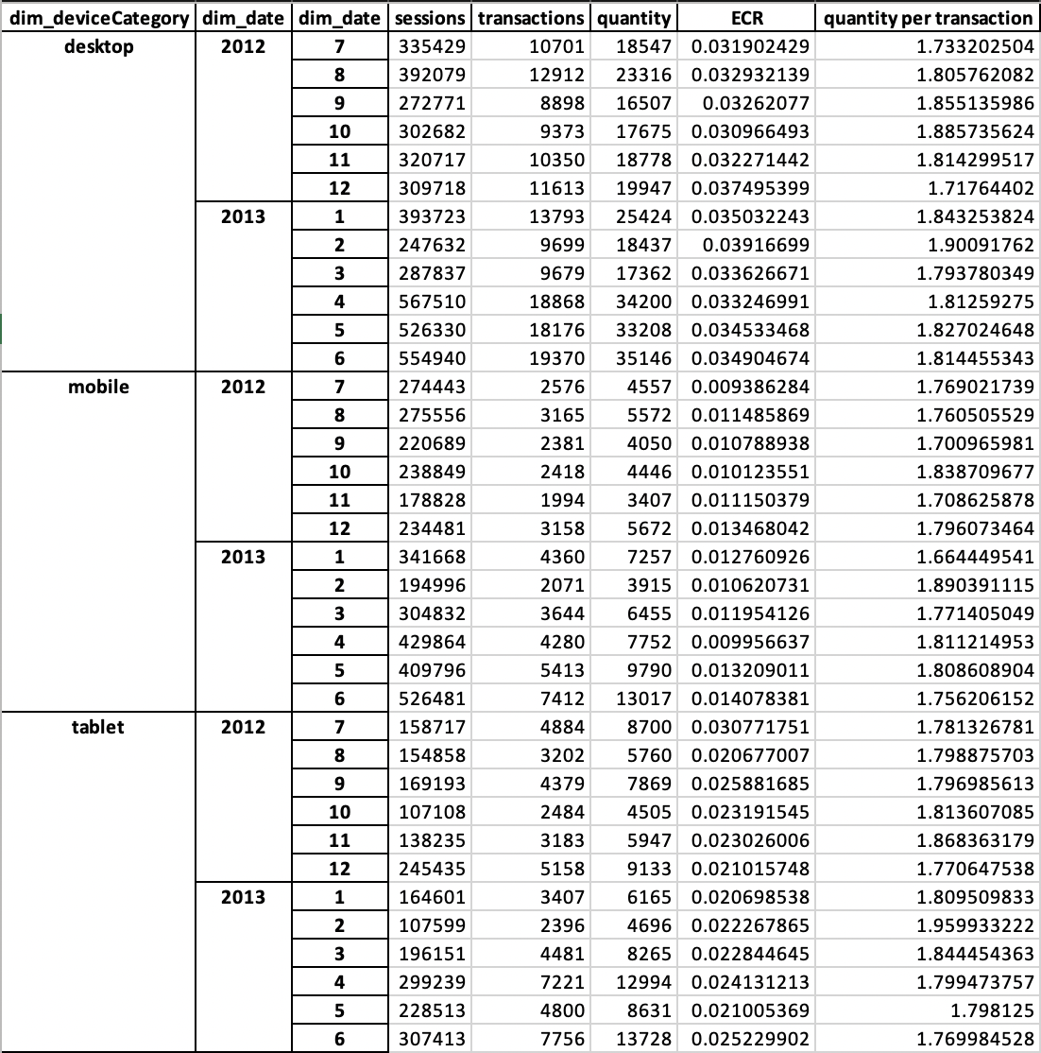
Data gathered about sessions per Device
On a month-to-month basis, the averaged ECR (transactions/sessions) for each device varies depending on the device type:
For Desktop: 3.10% to 3.92%
For Mobile: 0.94% to 1.41%
For Tablet: 2.07% to 3.08%
On a month-to-month basis, the averaged Quantity Ordered per transaction (quantity/transactions) for each device appears quite stable for all device type between 1.66 and 1.96

Slide 4
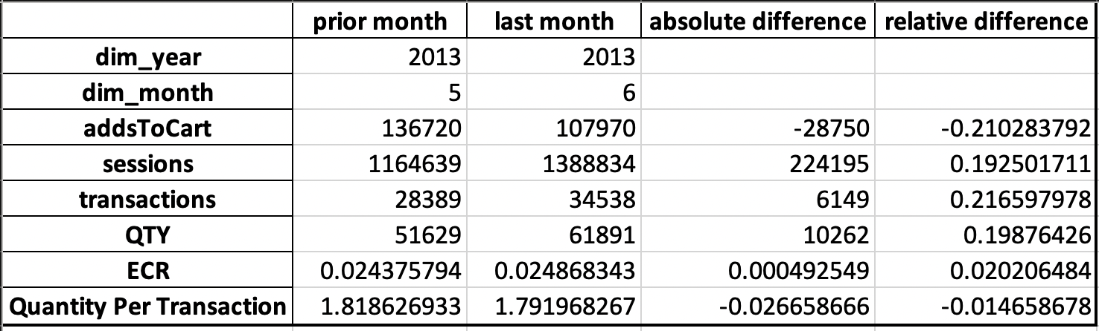
Key metrics over the last 2 months
Focusing on the key metrics over the last 2 months (June 2013 vs. May 2013), we observe:
addsToCart: decrease of 28750 or 21.10%
sessions: increase of 224195 or 19.25%
transactions: increase of 6149 or 21.66%
quantity (QTY): increase of 10262 or 19.88%
ECR (transactions/sessions): slightly decrease by 0.05% (absolute) or relatively by 2%
quantity per transaction: decrease by 2.67% (absolute) or relatively by 1.47%

Slide 5
Next Steps / Action Items
As the following items, I suggest:
Matching the data variation month to prior year to identify some typical patterns month to month or season to season
Correlating the marketing campaigns and events with variation of the data in order to better measure the benefits the the action taken relative the the company effort and investments.
To closely report the key metrics by browser to make sure our users are as effective with each browser relative to the others to ensure our customers are having a good experience among all the browsers supported by our apps.
To add more automatically generated graphs to make slight variations of the key metrics easier to notice by the management team.

