Slide 1

IXIS Ecommerce Metrics Analysis
Last Months Sessions and AddsToCart Review
Presented to IXIS management
By
Alexandre Verville

Slide 2
Agenda
Report summary
Reviews 2 datasets of your ecommerce metrics:
Data gathered about sessions per Device
Key metrics over the last 2 months
Recommendations

Slide 3
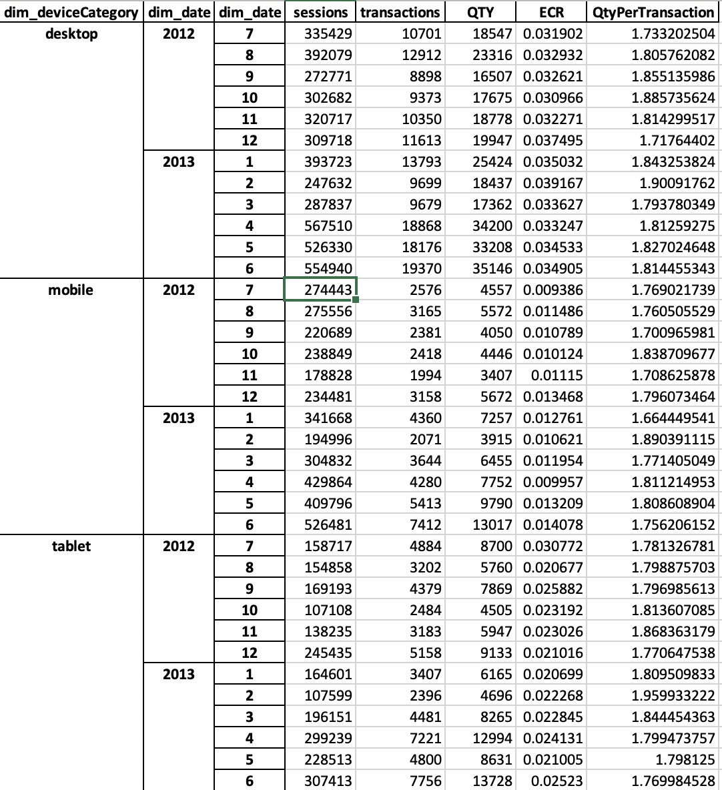
Data gathered about sessions per Device
On a month-to-month basis, the averaged ECR (transactions/sessions) for each device varies depending on the device type:
For desktop: 3.10% to 3.92%
For Mobile: 0.94% to 1.41%
For Tablet: 2.07% to 3.08%
On a month-to-month basis, the averaged Quantity Ordered per transaction (quantity/transactions) for each device appears quite stable for all device type between 1.66 and 1.96

Slide 4
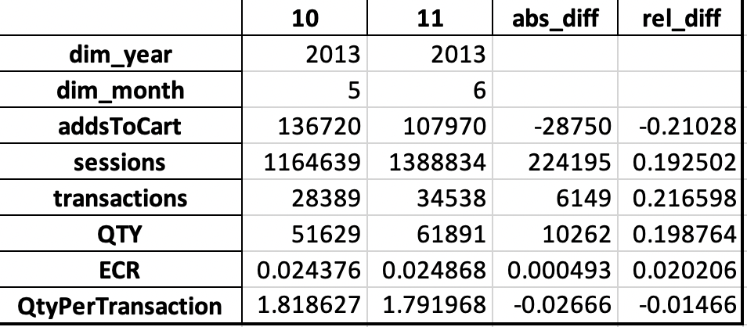
Key metrics over the last 2 months
Focusing on the key metrics over the last 2 months (June 2013 vs. May 2013), we observe:
addsToCart: decrease of 28750 or 21.10%
sessions: increase of 224195 or 19.25%
transactions: increase of 6149 or 21.66%
quantity (QTY): increase of 10262 or 19.88%
ECR (transactions/sessions): slightly decrease by 0.05% (absolute) or relatively by 2%
quantity per transaction: decrease by 2.67% (absolute) or relatively by 1.47%

