Slide 1
JCoZ: A Causal Java Profiler
By David Vernet and Matt Perron

Slide 2
What is causal profiling?

Slide 3
approach to profiling multithreaded programs
a new approach to profiling multithreaded programs
Addresses pitfalls of traditional instrumentation and sampling profilers in profiling multithreaded programs
Uses “virtual speedup” to simulate how speeding up a line of code would improve overall program runtime and throughput
Discovered by Charlie Curtsinger (Grinell College) and emery Berger (Umass Amherst) and awarded best paper at SOSP 16’

Slide 4
Virtual Speedup

Slide 5
How virtual speedup simulates speeding up a single thread
Throughout runtime of program, run “experiments”
Randomly choose a currently executing line
Randomly choose a speedup between 0-100%
Every time a thread hits that line, freeze other threads for the speedup threshold chosen
Too expensive to do in reality, instead we sample threads at some pre-determined frequency
Measure how much throughput is achieved for the given experiment line and speedup
At the end of the program (when enough results have been collected), experiments that indicate biggest throughput increases relative to the experiment runtime are highlighted as lines for optimization

Slide 6
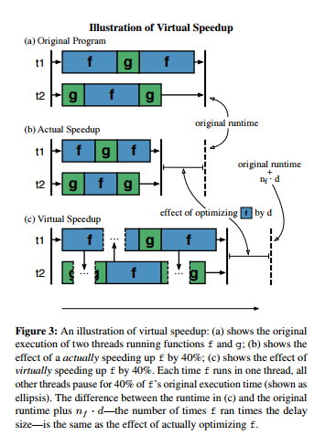
Virtual Speedup visualization
Photo credit: Charlie Curtsinger and Emery Berger
C. Curtsinger, E. Berger. COZ: Finding Code that Counts with Causal Profiling. SOSP '15 ACM SIGOPS

Slide 7
JCOZ in Action
A simple multithreaded program example

Slide 8
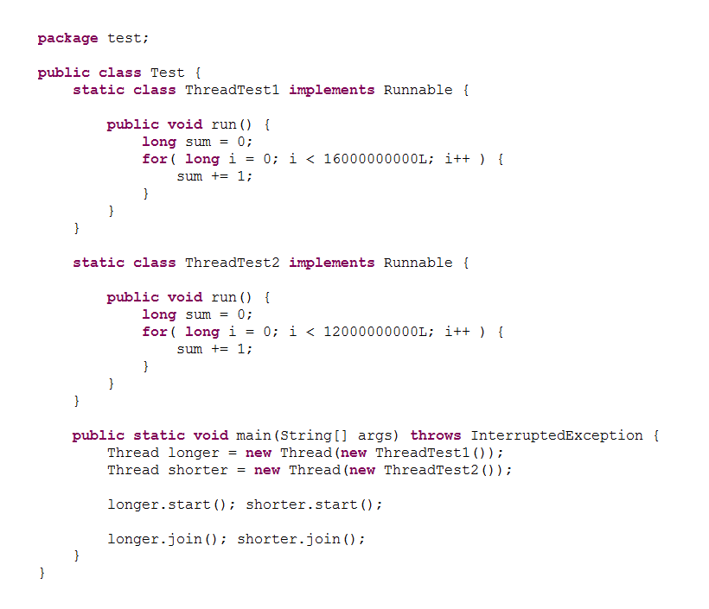
Example program with two threads

Slide 9
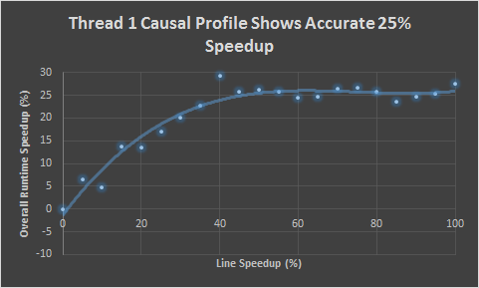
Jcoz gives accurate profile results (I)

Slide 10
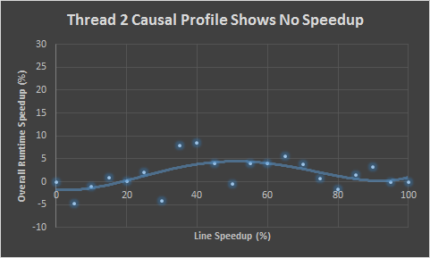
Jcoz gives accurate profile results (II)

Slide 11
Is this more useful than a normal profiler?

Slide 12
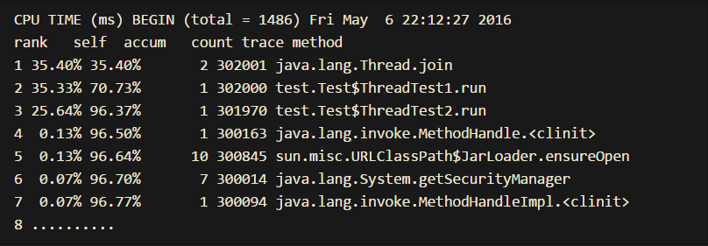
HPROF output gives Misleading Results

Slide 13
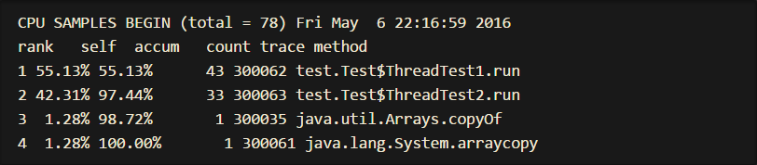
Using a normal sampling profiler isn’t much better

Slide 14
Other examples of where this is useful?

Slide 15
JCOZ works on many different multithreading scenarios
Concurrent threads with different runtimes (example just shown)
Serial thread execution (One thread waiting on a lock before starting execution)
Many threads contending for a single lock
Robust to Amdahl’s law
Can even show a NEGATIVE speedup, i.e. if speeding up a line would cause increased contention at another point in the program
Many, many more

Slide 16
Library optimizations from using JCOZ

Slide 17
Optimized Java h2 Database engine
Using jcoz, we were able to optimize the widely used, mature, high performance Java H2 Database Engine: http://www.h2database.com/html/main.html
Found and implemented optimization within 2 hours of running profiler
No previous knowledge of codebase
Measured optimization using the well established Dacapo Benchmark Suite

Slide 18
H2 database Engine aside
Mature, widely used, multithreaded database
Used in many projects, including Apache Cayenne, Apache Jackrabbit, Jboss JPOR, and the NIH
Full list: http://www.h2database.com/html/links.html

Slide 19
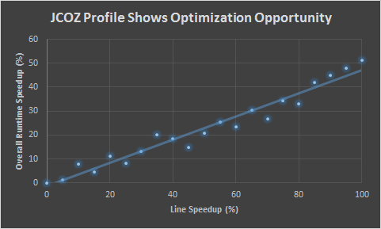
JCOZ profile output for h2

Slide 20
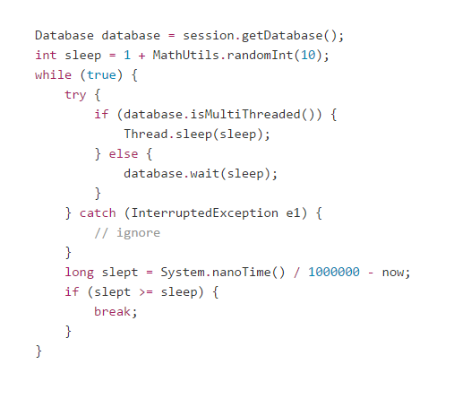
Profiled line Was excessive sleep on transaction failure

Slide 21
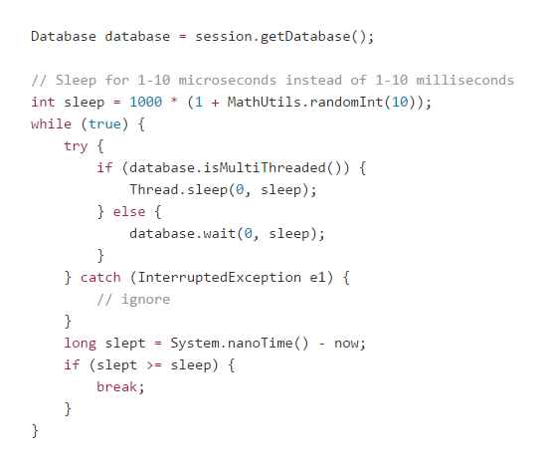
Simple fix – sleep for less time

Slide 22
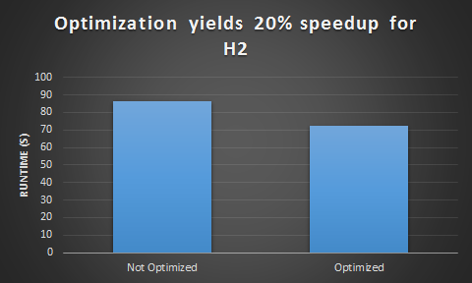
Optimization successful – 20% speedup

Slide 23
JCOZ lived up to its promise
No prior knowledge of codebase needed
Pointed to the exact line of bottleneck
Optimization was not made obvious using other profilers
HPROF did not indicate any optimization opportunity whatsoever for that line (doesn’t even list the function in its output)
Function containing the bottleneck was ranked as #2 runtime overhead in JVisualVM, but line number of bottleneck was not given
Issue: Overall speedup % obtained did not exactly match overall speedup % predicted by JCOZ
Optimization about 10% faster than expected for line speedup % implemented
Likely due to variance in Java / existing bugs in JCOZ

Slide 24
JCOZ runtime overhead

Slide 25
Runtime overhead is important for profilers
Waiting for a really slow profiler is very tedious and time consuming
Can often return incorrect results by masking true functionality / performance of program when run without profiler
Wait time can literally be hours
Tried to profile H2 using HPROF’s CPU timing profiler – essentially no progress had been made after an hour

Slide 26
JCOZ is lightweight
Uses sampling to avoid excessive overhead on the CPU
Each thread checks its own stack trace in a signal handler – happens in parallel
JCOZ written in C++ -- uses low-impact functions for freezing threads such as nanosleep

Slide 27
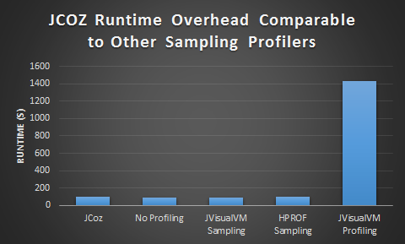
Jcoz runtime overhead matches other sampling profilers

Slide 28
summary

Slide 29
JCOZ works!
Solves serious problems with existing Java profilers
Exposes accurate optimization opportunities for multithreaded programs
Low runtime overhead
JCOZ is the first causal Java profiler!

Slide 30
Future work
Optimize JCOZ to improve accuracy
Don’t accrue sleep debt when waiting on a lock
Inherit parent’s sleep debt – currently assuming no sleep owed on thread creation
Continue optimizing libraries
Another optimization opportunity discovered in the Universal Java Matrix Package (UJMP) (poor cache locality on dense matrix multiplication)
Add more features for tuning profiler
Cooldown period
Listing multiple progress points (points where we measure throughput)
Research ways to extend causal profiling to multi-process and distributed applications

Slide 31
Special thanks
Special thanks to:
Charlie Curtsinger and Emery Berger for discovering causal profiling and making the original COZ program available for reference
David Capwell and Jeremy Manson for their code that we leveraged to use the infamous undocumented AsyncGetStackTraces JVMTI function

Slide 32
Questions?

