Slide 1
JCoZ: A Causal Java Profiler
By David Vernet and Matt Perron

Slide 2
What is causal profiling?

Slide 3
approach to profiling multithreaded programs
a new approach to profiling multithreaded programs
Uses “virtual speedup” to simulate how speeding up a line of code would improve overall program runtime and throughput
Discovered by Charlie Curtsinger (Grinell College) and emery Berger (Umass Amherst) and awarded best paper at SOSP 16’

Slide 4
Using virtual speedup to simulate program speedup

Slide 5
How virtual speedup simulates speeding up a single thread
Throughout runtime of program, run “experiments”
Randomly choose a currently executing line
Randomly choose a speedup between 0-100%
Every time a thread hits that line, freeze other threads for the speedup threshold chosen
Too expensive to do in reality, instead we sample threads
Measure how much throughput is achieved for the given experiment line and speedup
At the end of the program (when enough results have been collected), experiments that indicate biggest throughput increases are highlighted as lines for optimization

Slide 6
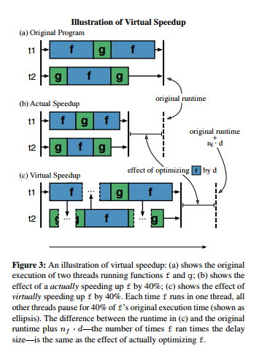
Virtual Speedup visualization
Photo credit: Charlie Curtsinger and Emery Berger
C. Curtsinger, E. Berger. COZ: Finding Code that Counts with Causal Profiling. SOSP '15 ACM SIGOPS

Slide 7
multithreaded program Example

Slide 8
Example program with two threads

