Slide 1

JCoz: A Causal Java Profiler
By David Vernet and Matt Perron
Notes:
Emery Berger and Charlie Curtsinger – UMass Amherst

Slide 2
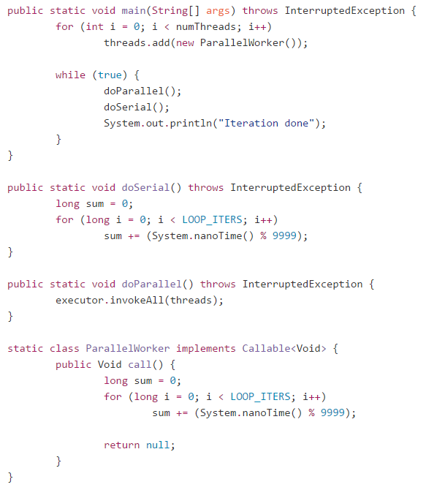
Example program with 32 threads

Slide 3
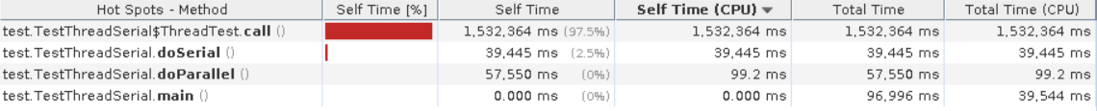
Standard sampling profiler output gives misleading results

Slide 4
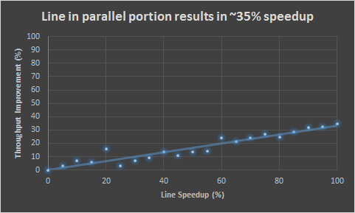
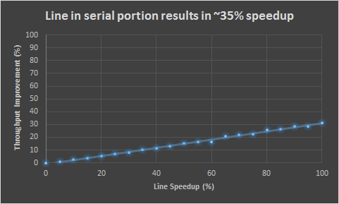
JCoz gives accurate profile results

Slide 5
How does causal profiling work?
Notes:
Uses “virtual speedup” to simulate how speeding up a line of code would improve overall program runtime and throughput
- Discovered by Charlie Curtsinger (Grinell College) and emery Berger (Umass Amherst) and awarded best paper at SOSP ‘15

Slide 6
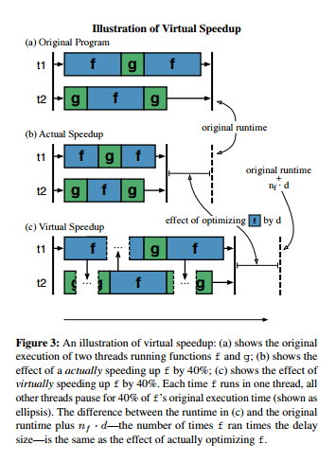
Virtual Speedup
Photo credit: Charlie Curtsinger and Emery Berger
C. Curtsinger, E. Berger. COZ: Finding Code that Counts with Causal Profiling. SOSP '15 ACM SIGOPS

Slide 7
Virtual Speedup implementation
Throughout runtime of program, run “experiments”
Randomly choose a recently executed line
Randomly choose a speedup between 0-100%
Every time a thread hits that line in a sample, freeze other threads for the speedup threshold chosen above
Measure how much throughput is achieved for the given experiment line and speedup
At the end of the program (when enough results have been collected), experiments that indicate biggest throughput increases relative to the experiment runtime are highlighted as lines for optimization

Slide 8
JCoz works on many different multithreading scenarios
Concurrent threads with different runtimes (example just shown)
Serial thread execution (One thread waiting on a lock before starting execution)
Many threads contending for a single lock
Robust to Amdahl’s law
Can even show a NEGATIVE speedup, i.e. if speeding up a line would cause increased contention at another point in the program
Falls back to single threaded profiler on single threaded programs
Many, many more

Slide 9
Library optimizations with JCoz

Slide 10
Optimized Java H2 Database engine
Using JCoz, we were able to optimize the widely used, mature, Java H2 Database Engine: http://www.h2database.com/html/main.html
Found and implemented optimization within 2 hours of running profiler
No previous knowledge of codebase
Measured optimization of TPCC using the Dacapo Benchmark Suite
Used in many projects, including Apache Cayenne, Apache Jackrabbit, Jboss Jopr, and the NIH

Slide 11
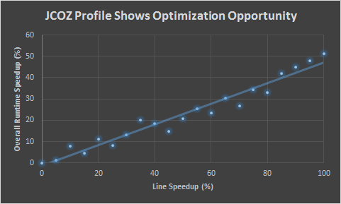
JCoz profile output for a line in H2 codebase

Slide 12
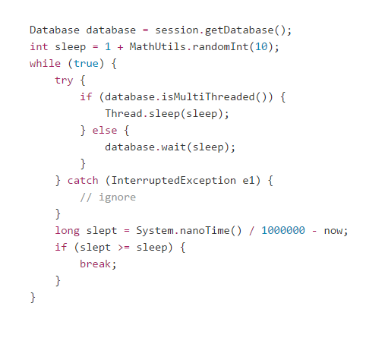
Profiled line was excessive sleep on transaction failure

Slide 13
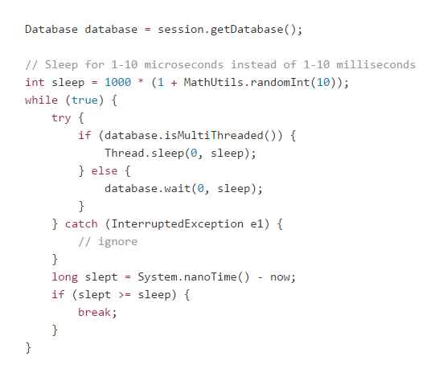
Simple fix – sleep for less time

Slide 14
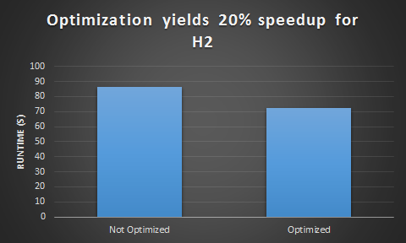
Optimization successful – 20% speedup

Slide 15
JCoz produced expected results
No prior knowledge of codebase needed
Pointed to the exact line of bottleneck
Optimization was not made obvious using other profilers

Slide 16
JCoz runtime overhead

Slide 17
Runtime overhead is important for profilers
Waiting for a really slow profiler is very tedious and time consuming
May return incorrect results by masking true functionality / performance of program when run without profiler
Wait time can literally be hours
Tried to profile H2 using HPROF’s CPU timing profiler – essentially no progress had been made after an hour

Slide 18
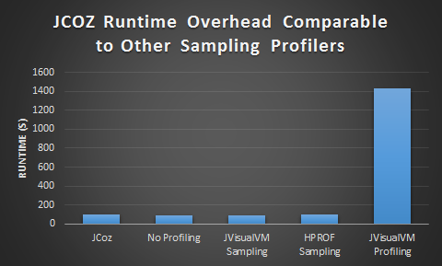
JCoz runtime overhead matches other sampling profilers

Slide 19
Conclusion

Slide 20
JCoz works
JCoz is the first causal Java profiler
Provides more valuable information than existing profilers for multithreaded Java programs
Allows profiling of throughput rather than just runtime
Low runtime overhead

Slide 21
Challenges faced
Issues with Java
Java sometimes perform optimizations under the hood that can obfuscate runtime
Had to use a complicated, undocumented function to get stack traces asynchronously from the JVM
Java has a warmup period that can skew profile results
The JVM Tool Interface can sometimes cause Java to not perform optimizations
When setting benchmarks
Finding proper test cases
Finding benchmarking suites to use to profile libraries

Slide 22
Future work
Continue optimizing libraries
Another optimization opportunity discovered in the Universal Java Matrix Package (UJMP) (poor cache locality on dense matrix multiplication)
Add more features for tuning profiler
Add latency profiling
Explore ways to extend causal profiling to multi-process and distributed applications

Slide 23
Acknowledgements
Special thanks to:
Charlie Curtsinger and Emery Berger for discovering causal profiling and making the original COZ program available for reference
David Capwell and Jeremy Manson for their code that we leveraged to use the infamous undocumented AsyncGetStackTraces JVMTI function
Professor Railing, for giving us guidance during this process

Slide 24
Questions?

Slide 25
Appendix

Slide 26
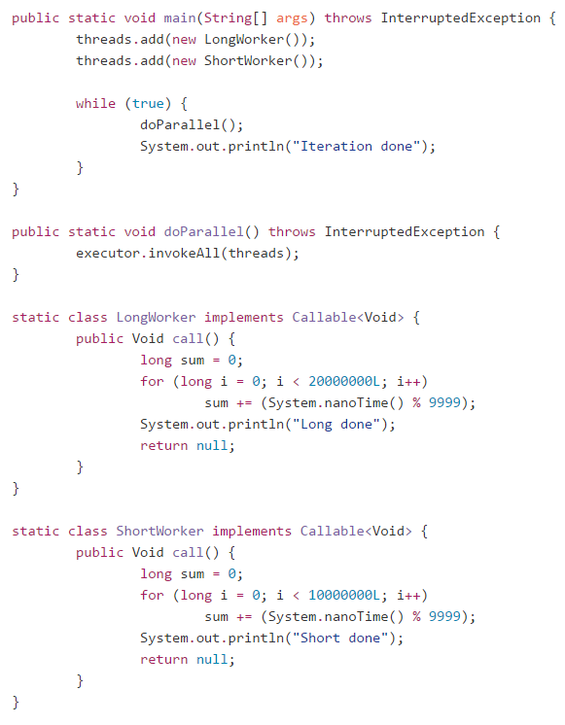
Another simple multithreaded example

Slide 27
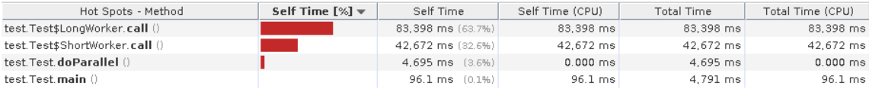
Sampling profile again shows misleading results

Slide 28
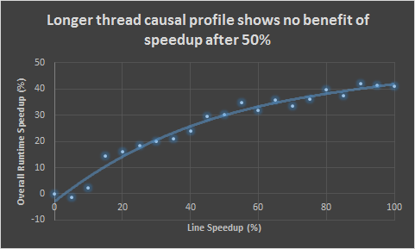
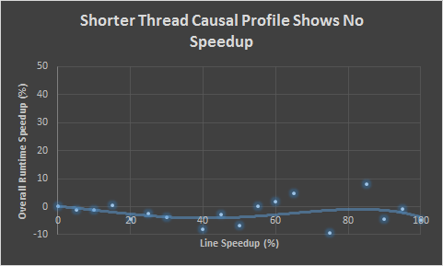
JCoz gives accurate profile results

