Slide 1

Depth map fusion in the presence of vibrations
Alex Veuthey
Supervisor: Marjan Shahpaski
Notes:
check why ICP has to be iterated (recomputes correspondences?)

Slide 2
Outline
1. Objectives
2. Data presentation
3. Algorithms used
4. Our solution
5. Results
6. Discussion
7. Future work
Notes:
merge algos used and our solution
also add box diagram and detail parts afterwards

Slide 3
1. Objectives
Fuse multiple depth-maps for:
- increased resolution
- populating missing data
- noise reduction

Slide 4

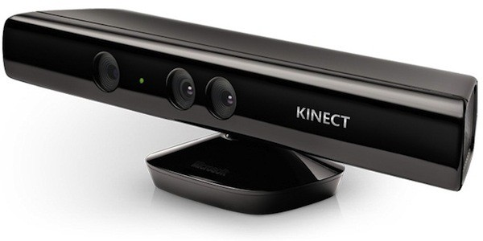
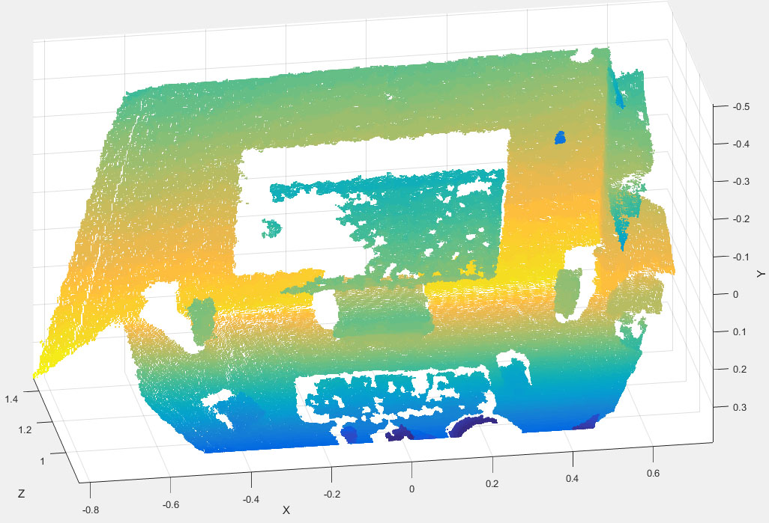
2. Data presentation
[1]
640x480 pixels (color)
320x240 pixels (depth)
→ noisy and imprecise
→ but real time!

Slide 5
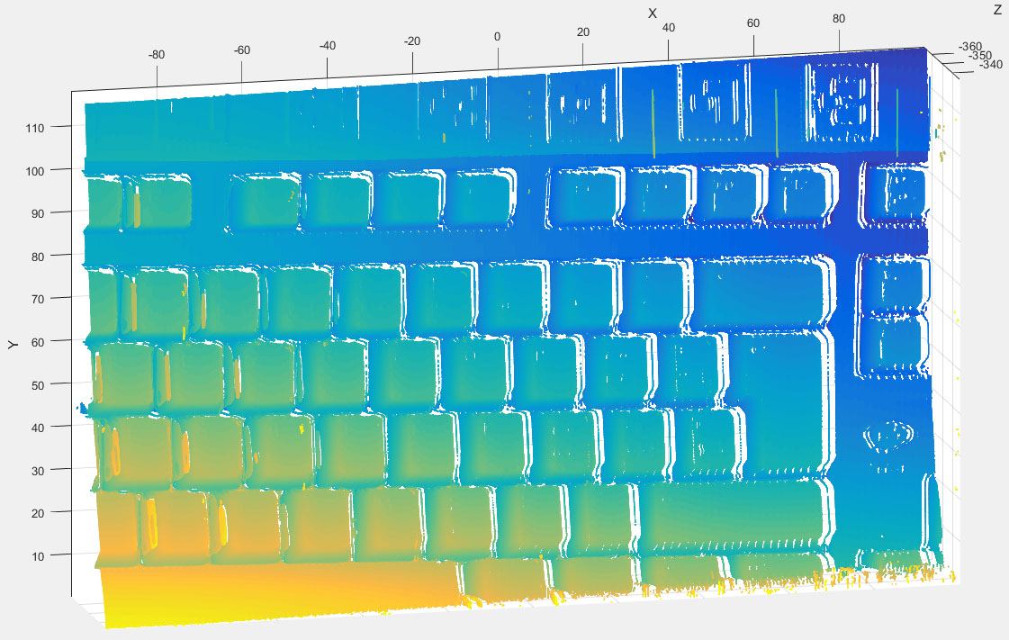
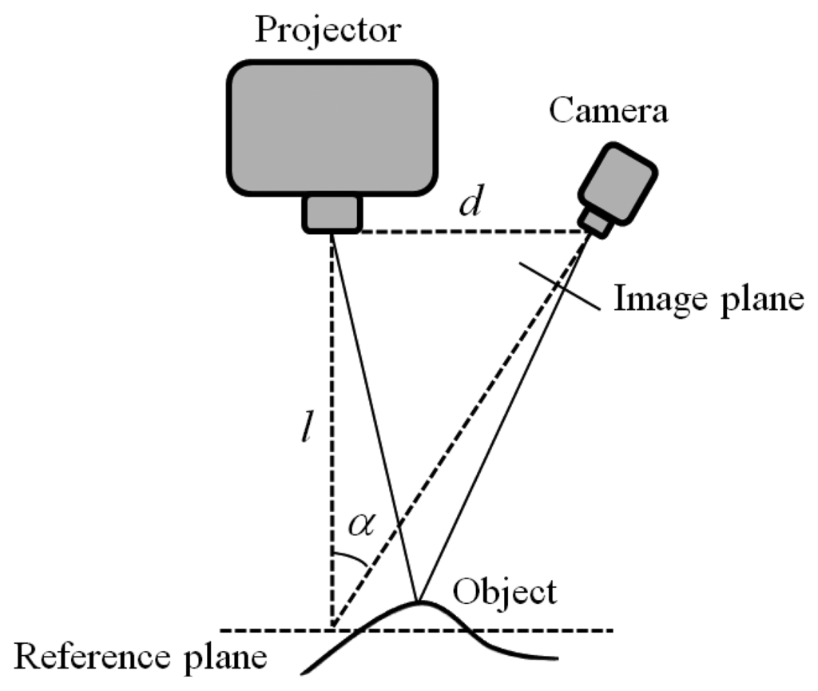
2. Data presentation
Camera / projector pair
→ lengthy calibration
→ lengthy capture!
Proj. 1920x1080
Cam. 4752x3168
[2]
Notes:
proj is not bottleneck!

Slide 6
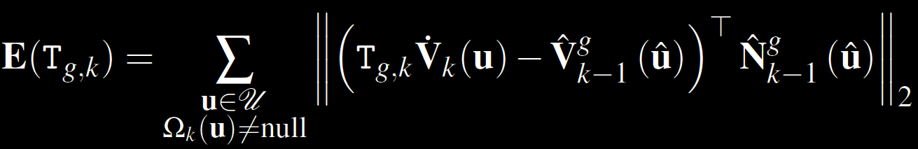
3. Algorithms used
Iterative Closest Point (ICP)
→ finds transform that minimizes E
[3,4]

Slide 7
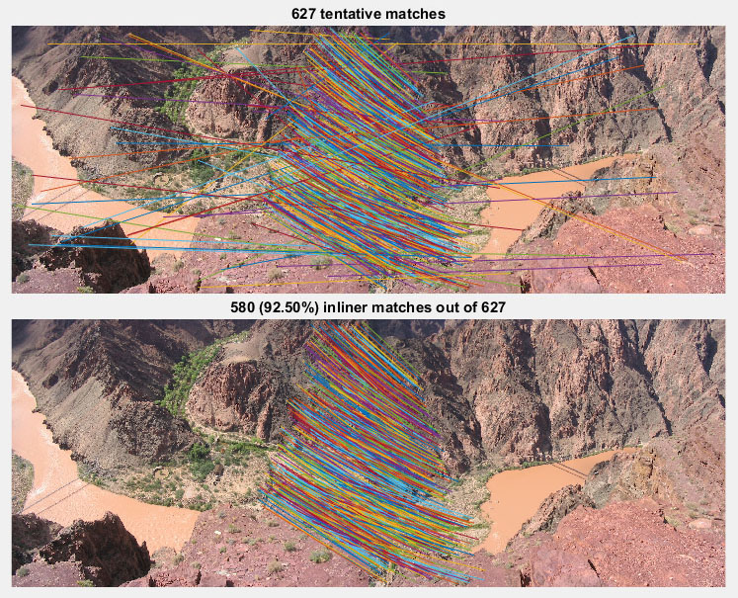
3. Algorithms used
SIFT
Notes:
show for keyboard also (in Results)

Slide 8
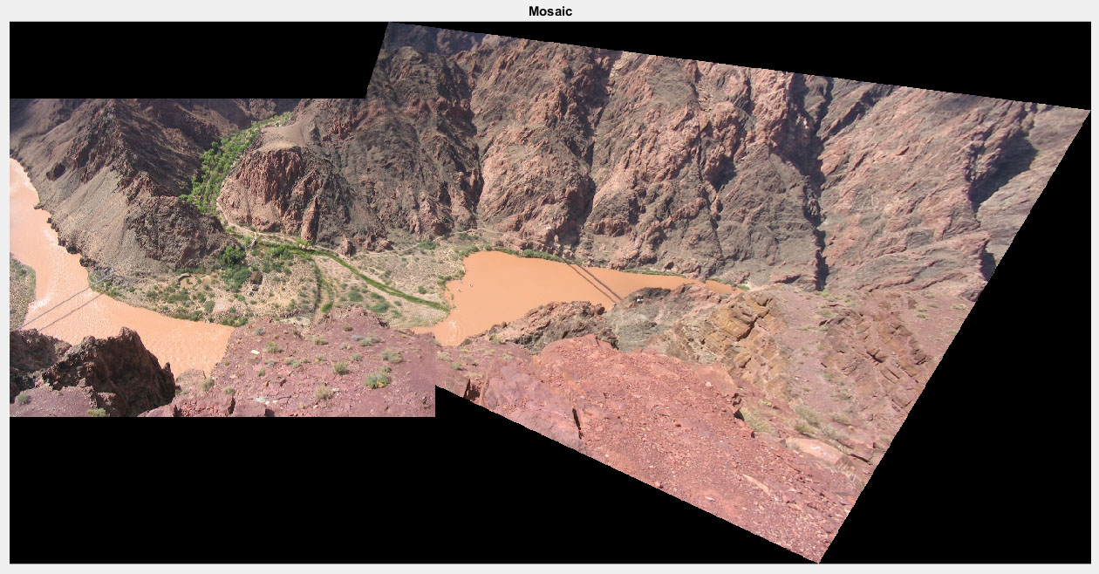
3. Algorithms used
SIFT

Slide 9
4. Our solution
1. SIFT inliers = correspondences → estimate transform with SVD
2. Estimate transform with ICP
3. Fusion with:
- union of points (increases noise)
or
- box grid filter (decreases resolution)
Notes:
mention correspondences here already, say we have to establish
them first before ICP, that's why we used SIFT
explain what type of transform (rigid)

Slide 10
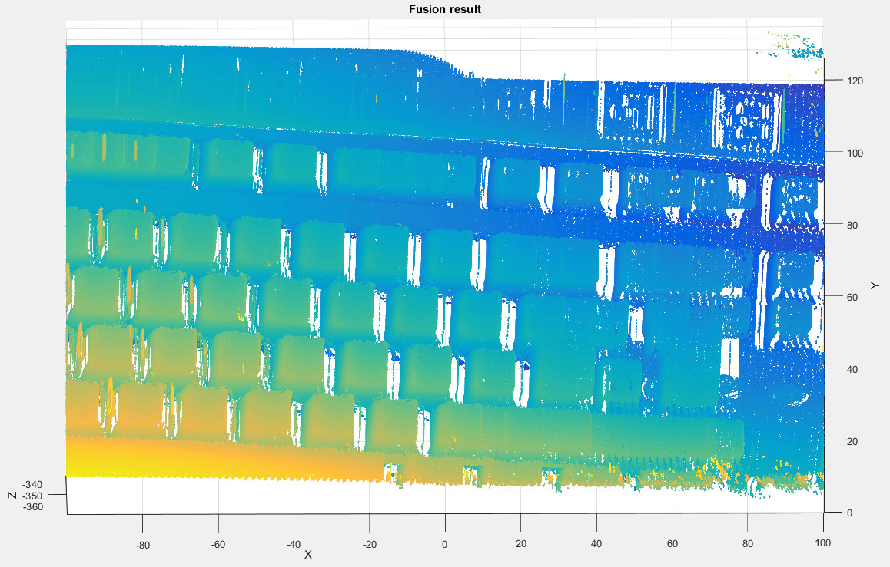
ICP without SIFT...
Notes:
explain why fails (correspondences probably) and why we need
SIFT

Slide 11
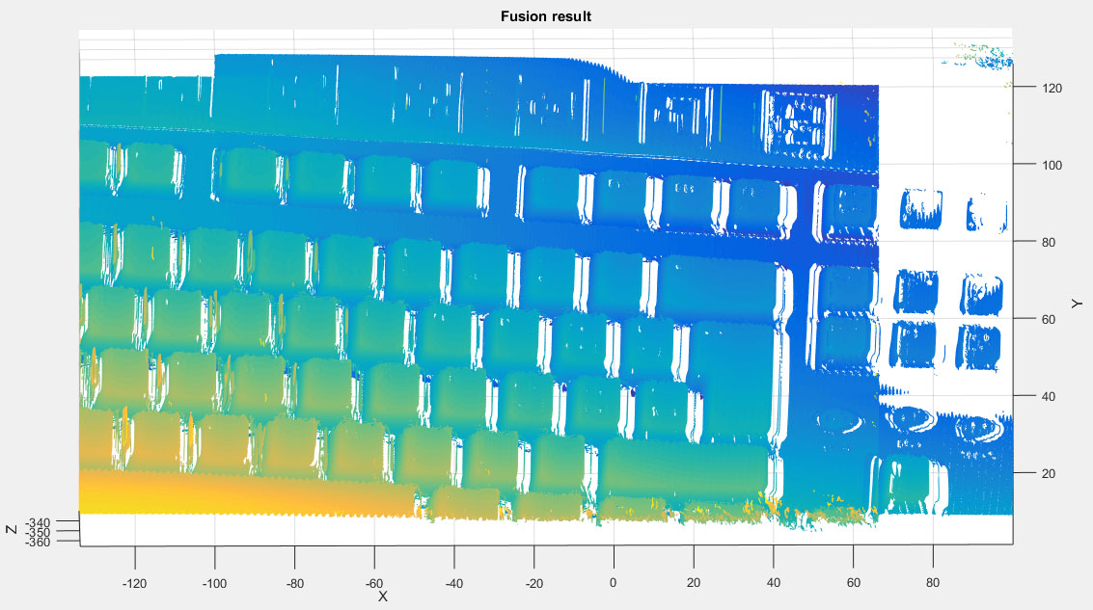
ICP with SIFT!

Slide 12
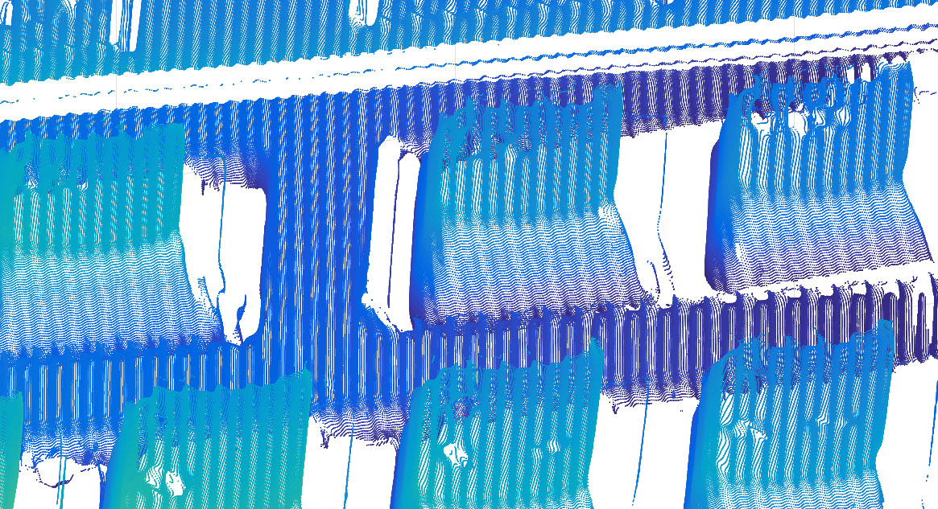
Stitching small pieces together

Slide 13
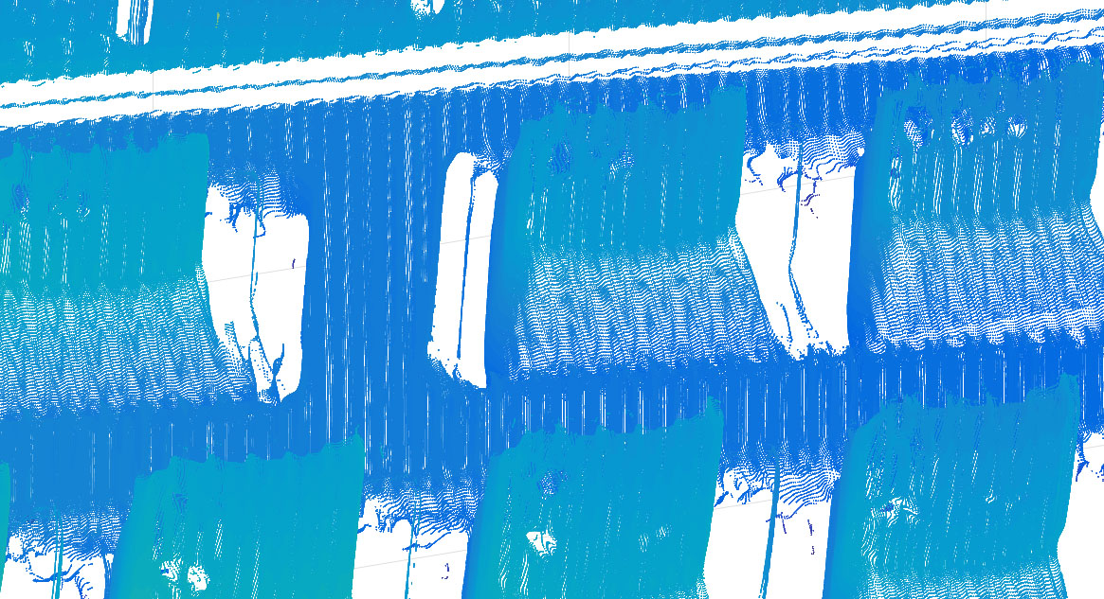
Stitching: after fusion

Slide 14
6. Discussion
(REFORMULATE) ICP fails because non convex optimization

Slide 15
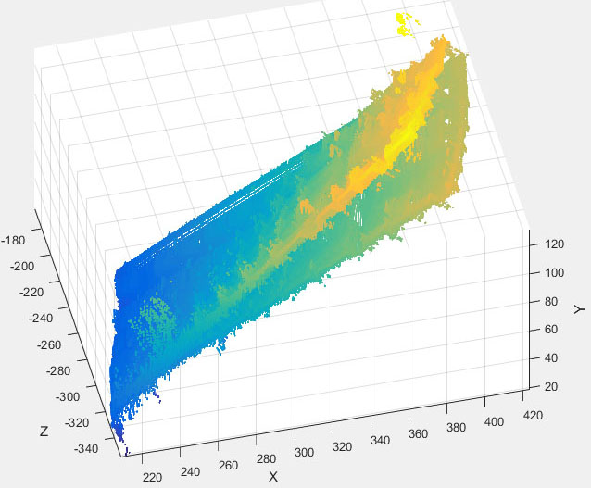
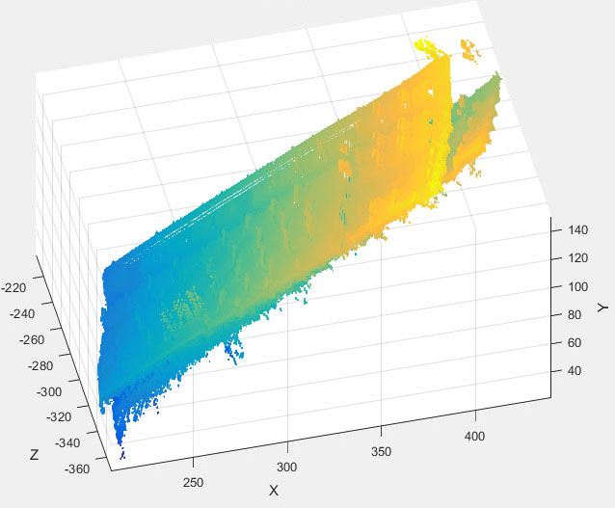
6. Discussion
SIFT transform estimate is not iterated → not robust enough

Slide 16
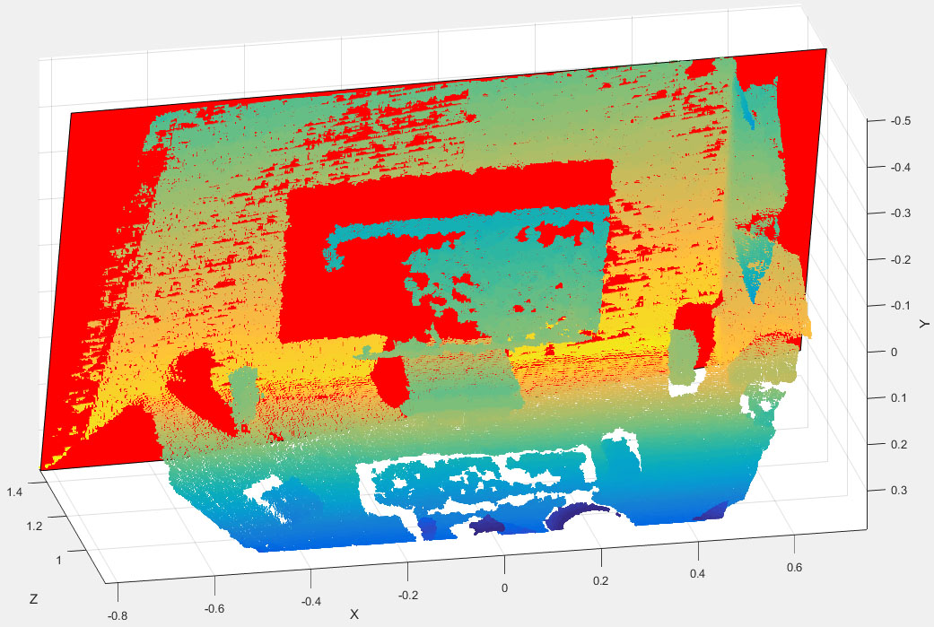
RMSE = 4.99e-5

Slide 17
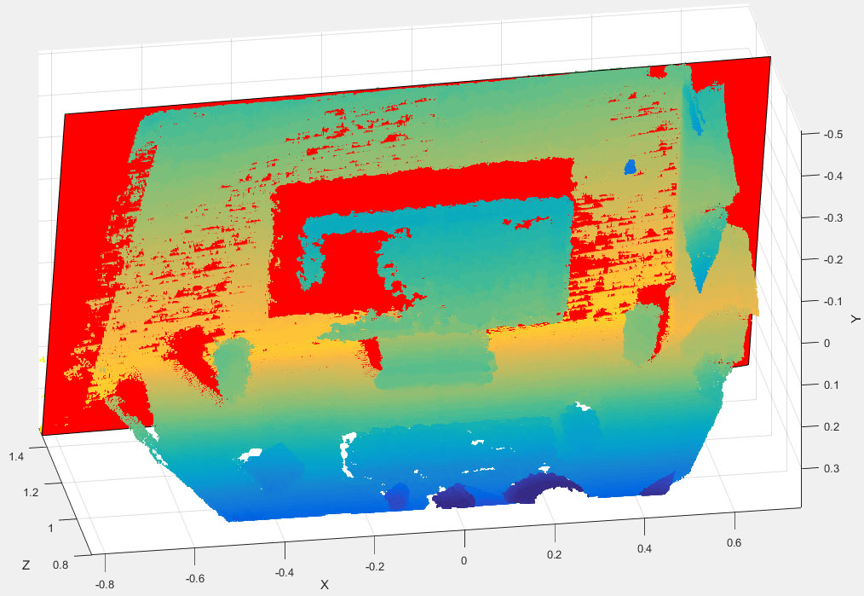
RMSE = 4.65e-5, but...

Slide 18
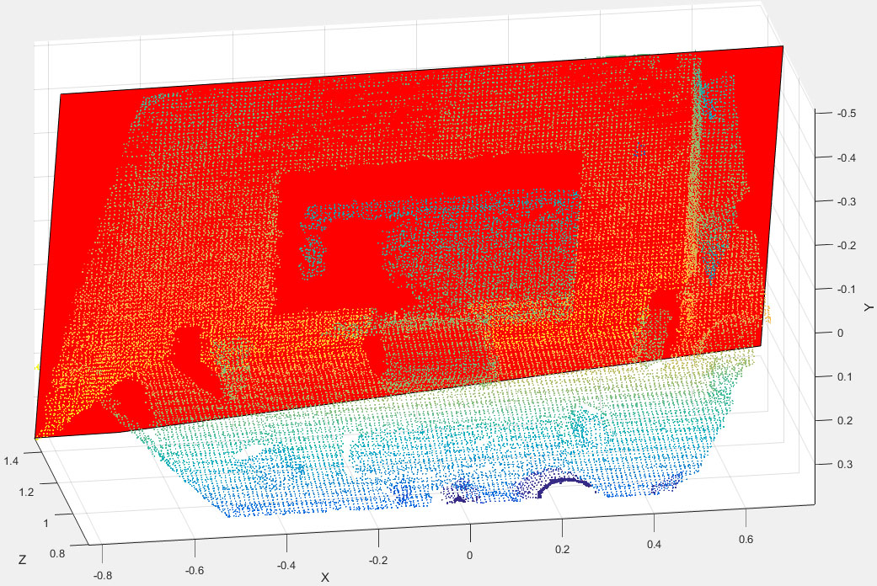
Downsampling → sparse point cloud

Slide 19
7. Future work
- capture more examples with structured-light system (TOO OBVIOUS)
- merge with axis dependent grid step (TOO SPECIFIC)
- use SIFT internally in ICP for better correspondences
- extend to multiple (not only 2 views) fusion

Slide 20
References
[1] IGN http://www.ign.com/articles/2015/01/01/microsoft-to-discontinue-original-kinect-for-windows
[2] A Coded Structured Light System Based on Primary Color Stripe Projection and Monochrome Imaging, Barone s., et al., 2013
http://www.mdpi.com/1424-8220/13/10/13802/htm
[3] KinectFusion: Real-Time Dense Surface Mapping and Tracking, Newcombe R., et al., 2011https://www.microsoft.com/en-us/research/wp-content/uploads/2016/02/ismar2011.pdf
[4] A Method for registration of 3-D Shapes, Besl P., McKay N., 1992
http://dl.acm.org/citation.cfm?id=132022

Slide 21
Questions?

