Slide 1

Depth map fusion in the presence of vibrations
Alex Veuthey
Supervisor: Marjan Shahpaski

Slide 2
Outline
1. Objectives
2. State-of-the-art (KinectFusion)
3. Limitations of KinectFusion
4. Current State
5. Results
6. Discussion
7. Future work

Slide 3
1. Objectives
Fuse multiple depth-maps for:
increased resolution
denoising
populating missing data

Slide 4
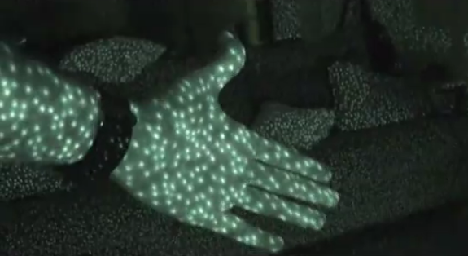
1. Objectives
[1]
Depth estimation algorithms from:
Structured Light
ToF (Time Of Flight)
→ Point Clouds

Slide 5
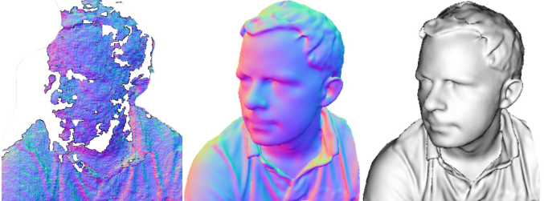
2. State-of-the-art - Examples
raw output normals Phong shaded
KinectFusion
Newcombe R., et al., 2011 [2]

Slide 6
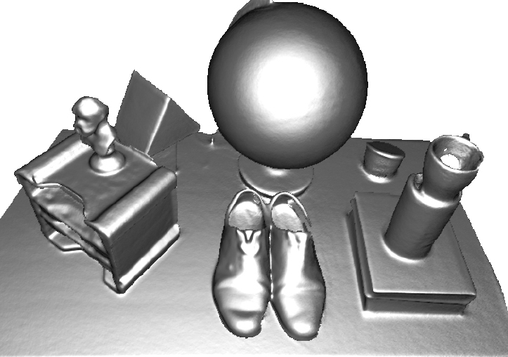
2. State-of-the-art - Examples
raw output normals Phong shaded
multiple circular passes
KinectFusion
Newcombe R., et al., 2011 [2]

Slide 7
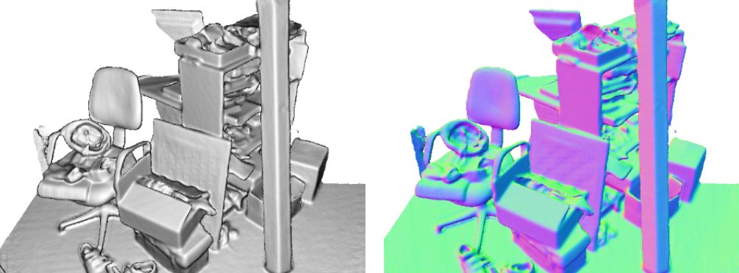
2. State-of-the-art - Examples
raw output normals Phong shaded
multiple circular passes
KinectFusion
Newcombe R., et al., 2011 [2]
Phong shaded normals

Slide 8
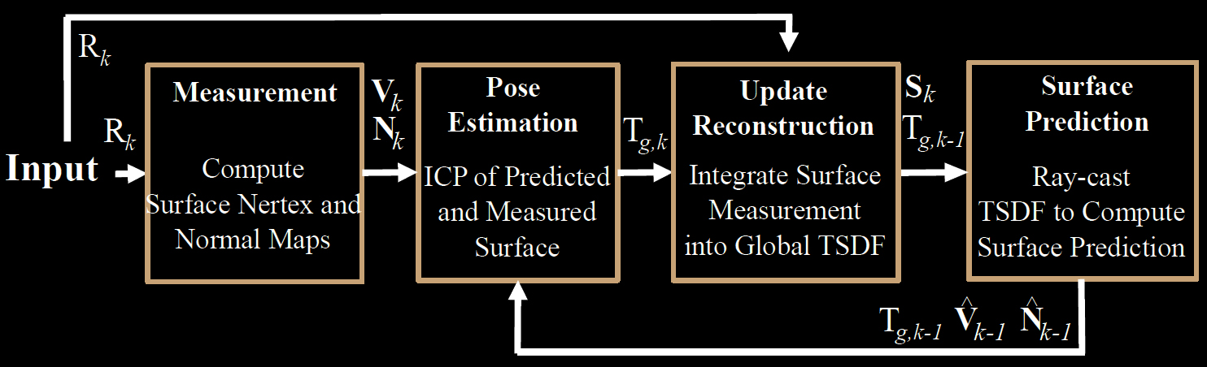
2. State-of-the-art - Method
[2]

Slide 9
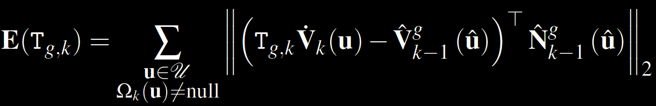
2. State-of-the-art - Features
Global model alignment
Coarse-to-fine ICP (Iterative Closest Point):
GPU processing
→ Real-time processing!
[2]

Slide 10
3. Limitations of KinectFusion
KinectFusion requires:
specific hardware → Kinect
GPU processing → need GPU...
limited resolution → ~256 voxels per meter
small movement between frames

Slide 11


4. Current State
Kinect SDK → code samples
Hidden code in DLLs
Notes:
still a good starting point even with limitations

Slide 12
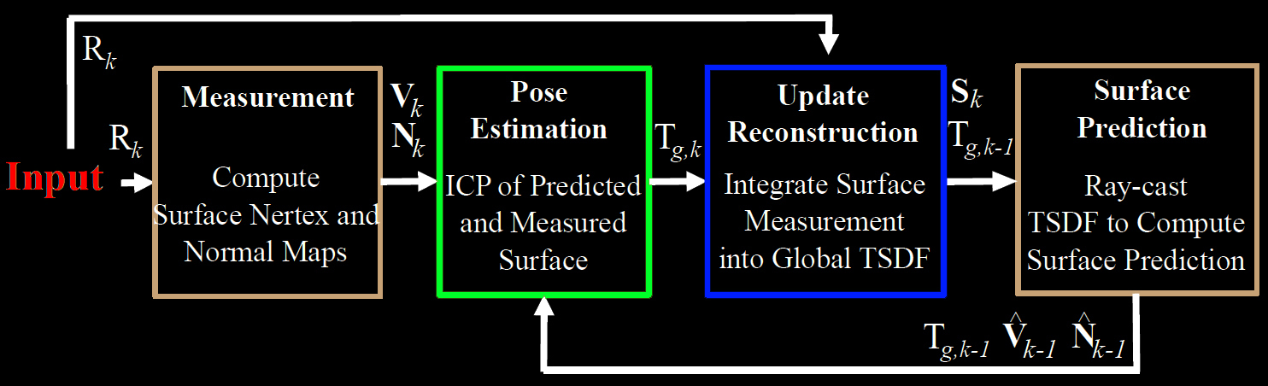
4. Current State
Matlab to the rescue!
pcfromkinect() to capture
pcregrigid() to align → ICP
pcmerge() to fuse → box grid filter
[2]
[3]
[4]
[5]

Slide 13
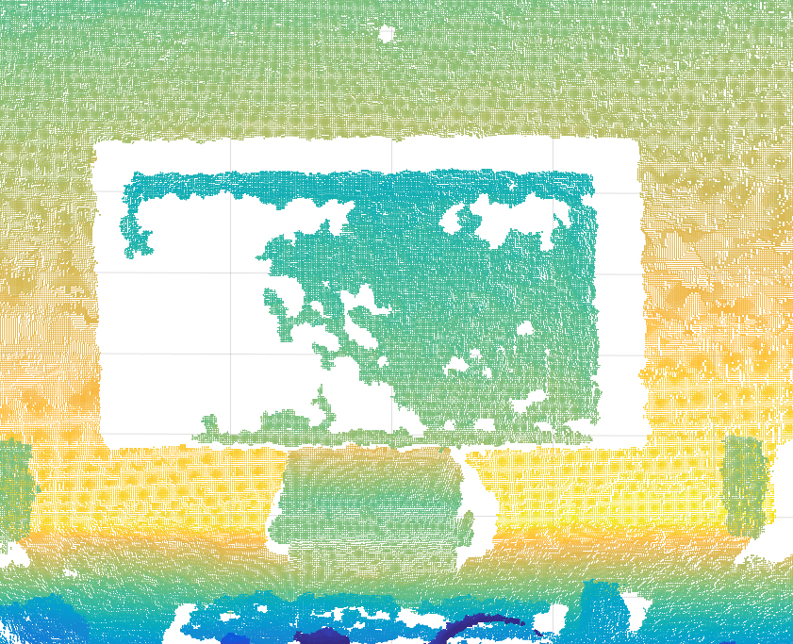
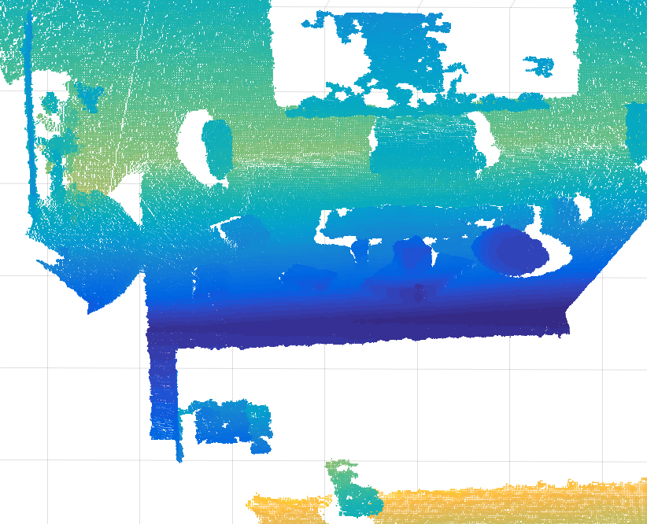
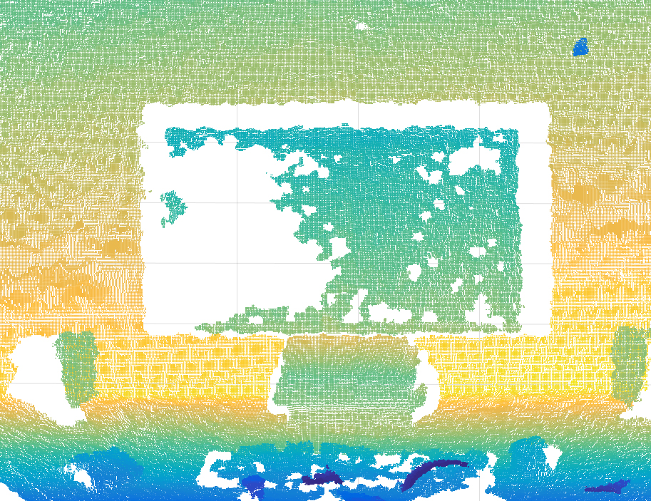
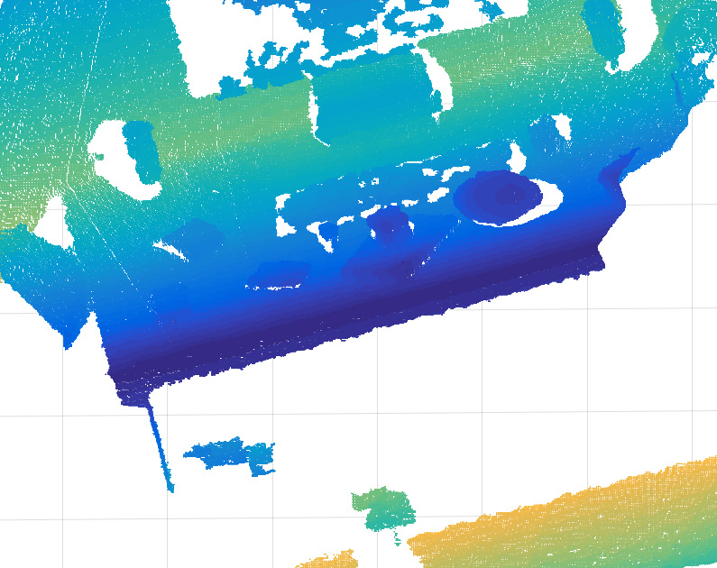
pcfromkinect()
frame 1
frame 10
frame 2
frame 25

Slide 14
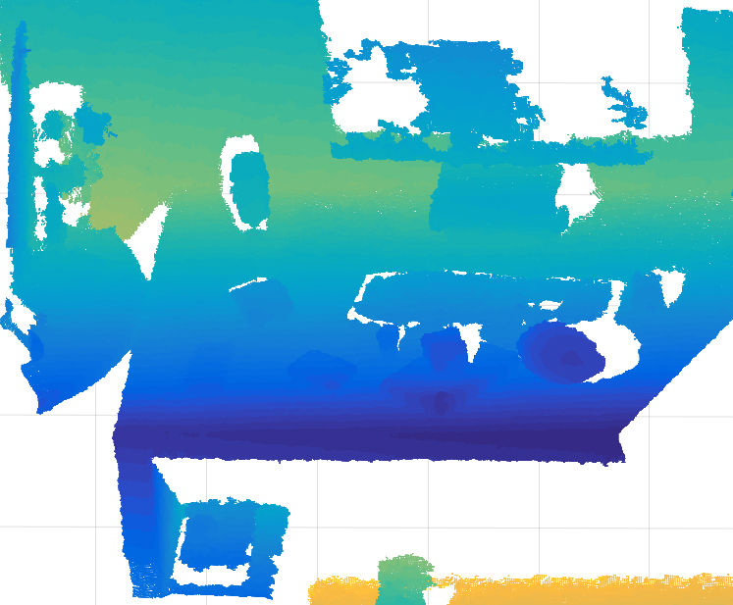
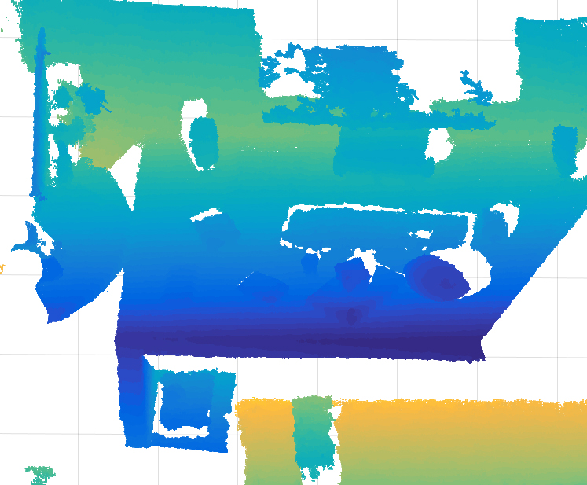
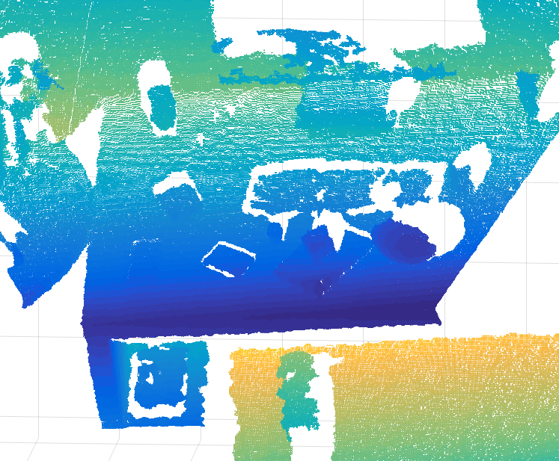
pcregrigid() and pcmerge()
+ =
Notes:
show equation of the fusion (from paper equation 11 + explain) or in the beginning when this shows up first time

Slide 15
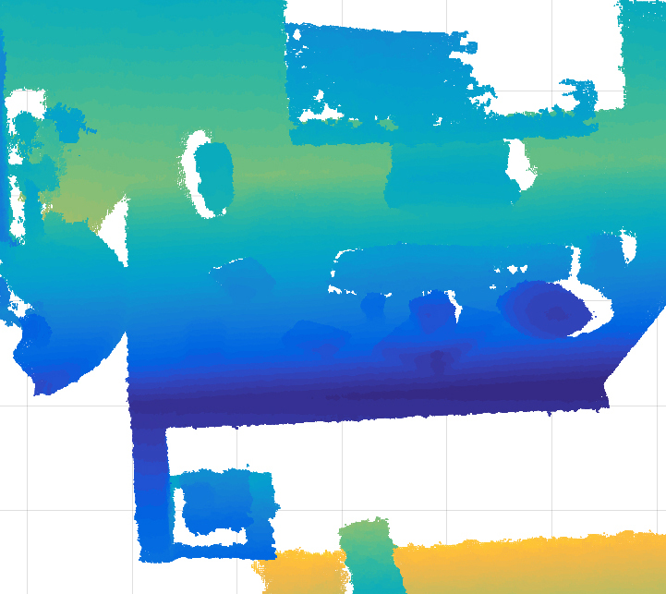
5. Results
Works well with clean data (5 frames are fused)

Slide 16
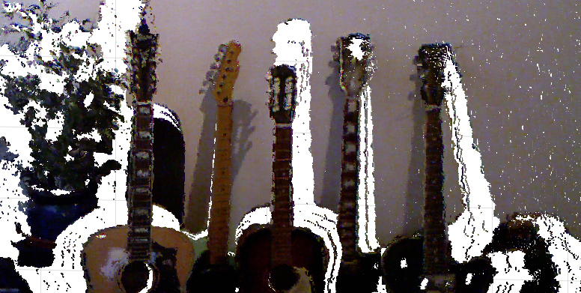
2 frames fused

Slide 17
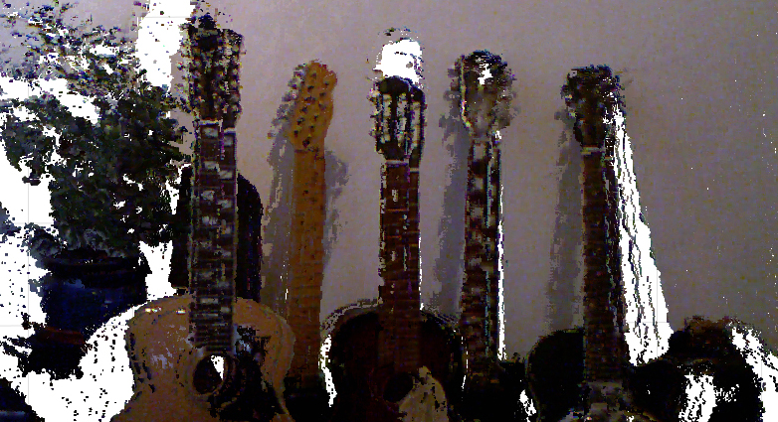
3 frames fused

Slide 18
6. Discussion
Kinect data → very noisy
ICP → local minima
ICP fails with large discontinuities
Data gets huge:
- ~260K points for 1 frame
- >1.6M points for 10 fused frames

Slide 19
7. Future work
Coarse-to-fine implementation
Try GoICP (Global Optimum ICP)
Capture better data

Slide 20
References
[1] Matthew Fisher, 2014
http://graphics.stanford.edu/~mdfisher/Kinect.html
[2] KinectFusion: Real-Time Dense Surface Mapping and Tracking, Newcombe R., et al., 2011
https://www.microsoft.com/en-us/research/wp-content/uploads/2016/02/ismar2011.pdf
[3] pcfromkinect, Matlab
https://ch.mathworks.com/help/vision/ref/pcfromkinect.html
[4] pcregrigid, Matlab
https://ch.mathworks.com/help/vision/ref/pcregrigid.html
[5] pcmerge, Matlab
https://ch.mathworks.com/help/vision/ref/pcmerge.html

Slide 21
Questions?

