Slide 1
Notes:
What is covered in this class:
-Fax service setup
-Fax queues now and future capabilities
-Fax Processor setup
-IR Document Writer – future plans to install with faxing service
-Administering the faxing service using IEMC
-Letterhead setup
-Fax cover page setup
-Free form cover pages
-Fixed form cover pages
-Creating/using fixed form cover page reasons
-Sending a fax in Desktop
-Sending free form cover page vs. fixed form cover page
-Send using Address Book vs. send without using Address Book – see Fax Status window differences.
-Confirmation pages
-Viewing fax status
-Troubleshooting tips
-How to debug?
-General config file knowledge (?)
-Which services can run with faxing service?
-New terminology
-3.x memonum = 4.0 JobId
-Tables names/structure are not the same
-Address Book RecipientID <> lookupval
What is not covered in this class:
Address Books
Features not yet in the outgoing fax system:
-Fax to Email Account
-Print fax job
-Hide Restricted Annotations (restricted annotations are not implemented at all right now)
-Max # of pages to send
-Override for max # of pages to send
-Incoming Faxes – right now, Everest is routing all incoming faxes to an Email Receiver account
-Restricted doctypes

Slide 2
Setup
FACSys Client–only supported client as of today
  FACSys 5.0 (fxmsg32.dll v.5.0.13.0 or higher)
  Installed on pc where Faxing Service will run
Faxing Service Install
  IRFaxingSvc.msi
  Runs as NT Service
ImageRight Document Writer Install
  IRDocumentWriter.msi
  May say “easyPDF SDK 4” in the printers list – name will change in time
Notes:
Components installed on the pc where the fax service will run:
FACSys Client – just like in the past
Faxing Service
ImageRight Document Writer (instead of ImageRight Printer) – future plans: include this install with the faxing service install
Certification of other faxing systems will be done as clients need them. We will only support the latest version of the 3rd party faxing software at the time of implementation.

Slide 3

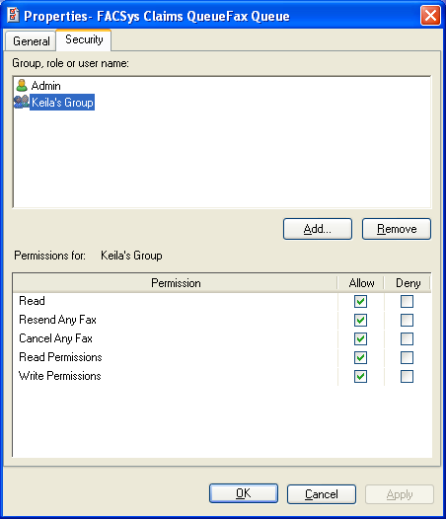
Fax Queues
Fax Queues – User friendly alias that the user sees when sending a fax
Security
  Read – ability to see queue
  Resend/Cancel Any Fax
  Read Permissions (Security tab)
  Write Permissions (Security tab)
Notes:
The entire concept of fax queues is new. The idea is that the users will now have a user friendly alias to see when sending a fax as opposed to the fax server name – which never really meant a lot to the user.
-Security can be assigned to the fax queues so that users only see their queue
-This will be extremely beneficial when remote sites are implemented
-The fax queue is tied to a fax processor on the backend that will process the fax
-Currently, you can only relate one fax queue to a processor, but the vision is that there will be an N:N relationship between fax queues and fax processors – for load balancing purposes.
Security Rights defined:
Read – Ability to see the fax queue and send a fax on that fax queue
Resend Any Fax – Ability to resend any fax on that fax queue – even if you didn’t send it originally
Cancel Any Fax - Ability to cancel any fax on that fax queue – even if you didn’t send it originally
Read Permissions – Ability to SEE the Security tab of the fax queue.
Write Permissions – Ability to MODIFY the fax queue security.
Default queue security: it works exactly as it did in 3.x.
*Can see the fax queue and send faxes on it unless access is denied in IEMC
*Resend/Cansel only your faxes
--i.e. Allow Read security on the fax queue

Slide 4
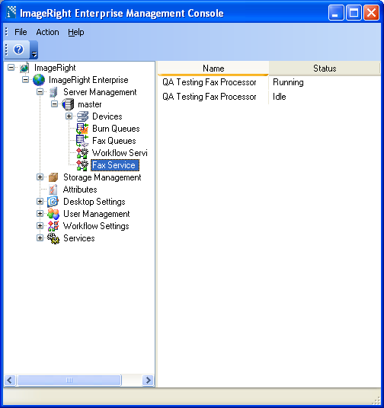
Fax Service
Can create multiple processors
Manage each processor independently within service
Can be managed from IEMC

Slide 5
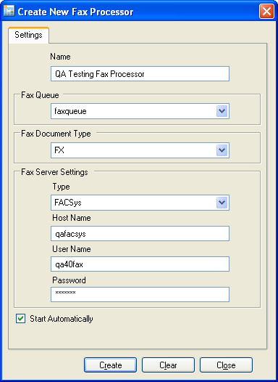
Creating a Fax Processor
Name *
Fax Queue *
Fax Document Type *
  Security reasons
  Backwards compatibility
Fax Server login information *
  Password is case sensitive in FACSys 5.0 and ImageRight 4.0
Start Automatically
* Denotes required fields

Slide 6
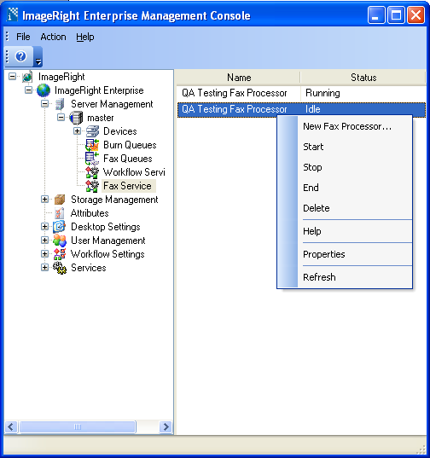
Administer Fax Processors
Right-click to get menu
New Fax Processor
Start
Stop
End
Delete
Help
Properties
Refresh

Slide 7
Terminology
Out with the old, in with the new…
3.x calls it: | 4.x calls it:
Fax memo | Fax cover page
Overlays | Letterhead
Memonum | JobId
Notes:
New terms relating to 4.0:
Fax cover page is standard for the first page of the fax
Letterhead cannot be mistaken for overlays as they were in 3.x
Memonum is now JobId

Slide 8
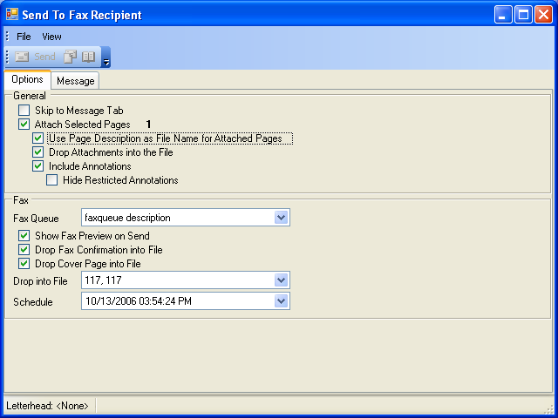
Send fax: Options tab

Slide 9
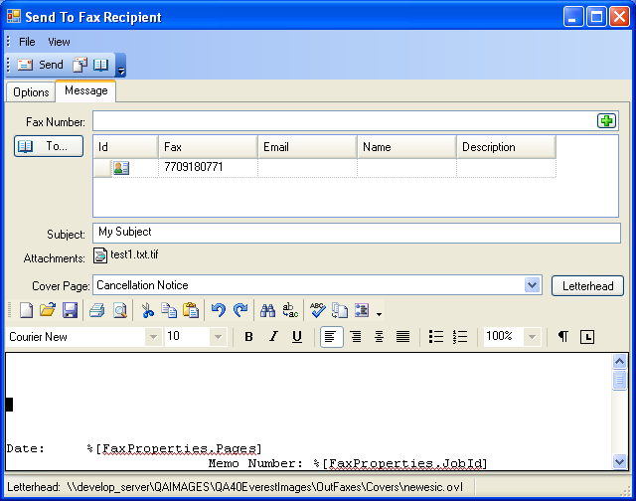
Send fax: Message tab

Slide 10
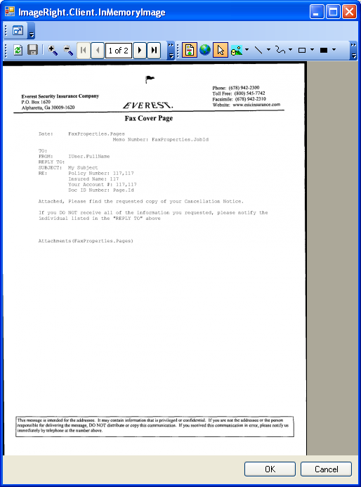

Slide 11
Cover pages
Free form cover pages
  Cover page editor – much like 3.x
  Browse to select letterhead
Fixed form cover pages
  Created exactly like free form cover pages
  Enable checkbox: Protected
Fixed form cover page reasons
  Must belong to a group
  Security

Slide 12
Free form cover pages

Slide 13
Protected cover pages (fixed form)

Slide 14
Desktop – free form vs. protected

Slide 15
Fax Status

Slide 16
Confirmation Pages

