Slide 1

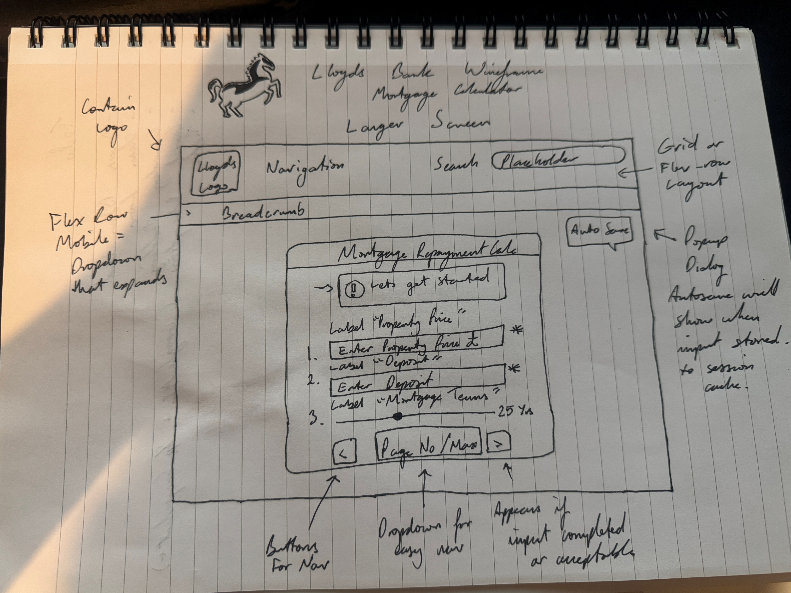
Lloyds Bank Mortgage Calculator Technological Engineering
Design Pitch Task 2 Wireframes
This is my wireframe sketchup that I quickly did based on the actual Lloyds mortgage calculator portal for their first-time buyers route.
The principles of mortgage calculators are pretty basic in what the end result delivers to the user, but in Lloyds case, a large series of inputs you must fill before you actually get to the calculator.
My proposed idea is to have a basic mortgage calculator portal,
Where its clear to the user the steps and page that they are on,
The first page will be inputs “Property Value”, “Deposit Amount”, “Mortgage Terms”. These are the most common inputs that doesn’t require extras to calculate a mortgage estimation.
My wireframe includes the standard Lloyds navigation suite, then the portal underneath, components involve input fields, sliders with min max labelling for clarity, a helper button for tooltips, pagination for portal location, dropdown for quicker portal navigation and a autosave popup to display when inputs are stored in session.

Slide 2
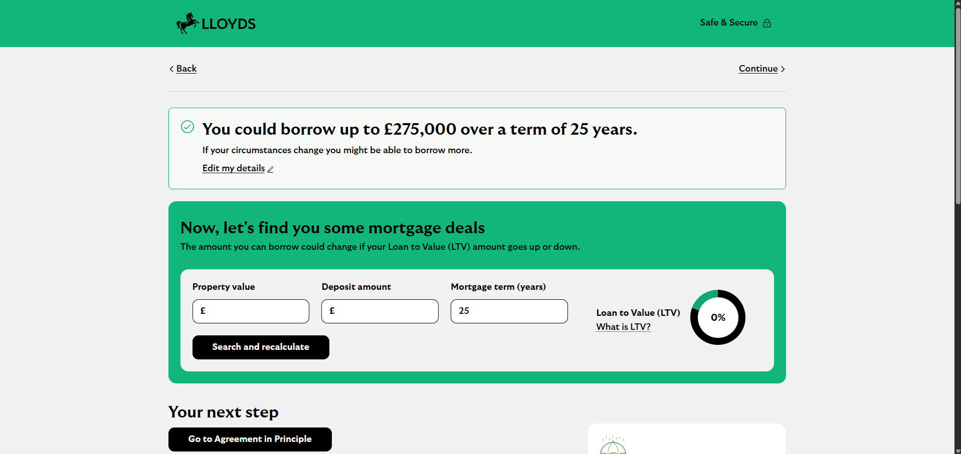
Lloyds Bank Mortgage Calculator Technological Engineering
Design Pitch Task 2 Wireframes
This is the current design of Lloyds, it houses a nice series of containers with basic English text and widgets, with tooltips available as underlined text. Some people may confuse this for just a link or hyperlink.
Also, the calculator is now in a different portal where default navigation cannot be seen.
Also the results and charts, will be displayed on the same instance of the page which may cause confusion, lack of clarity on information, and users can become overwhelmed by this.
I feel like the you could borrow upto 275,000 can be more simplified in getting that output through a different segment in the portal for like a finalised results page.
Then provide AIP (agreement in principle) buttons at the end of calculator usages to setup a Lloyds meeting.

Slide 3
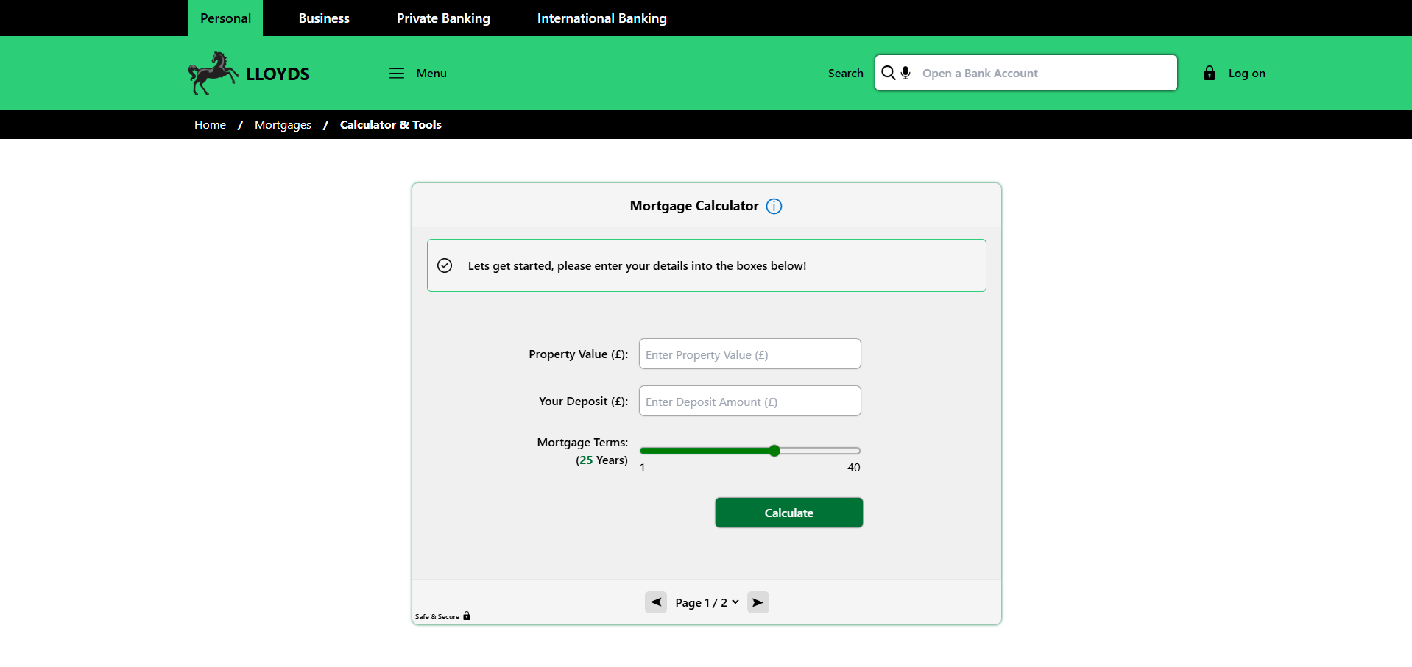
Lloyds Bank Mortgage Calculator Technological Engineering
Design Pitch Task 2 Wireframes
Attempted to reclone the Lloyds bank navigation suite myself with tailwindcss, almost accurate
Help context for opening a responsive tooltip that sticks nearby its button, and has a click open and close and auto-sizes to field area of description.
Breadcrumb bar looks the
Same on desktop screens
But on smaller devices
Turns into a dropdown menu with better link selection rather than just
Press one item back.
Custom input
Component comes with
Auto responsive
Labelling for each input
And full customisation
For required fields.
Nice amount of white
Space for clarity too.
Each field comes with
Session storage
Min & Max
Labels for slider
As Lloyds didn’t include
One for their mortgage
Terms so users won’t know
What is the minimum and maximum years, this will help reduce confusion
Notice component with support for warnings, errors, info and successes with dynamic colour updates and your own text, provided here for visual hierarchy on what to do.
Pagination segment with dropdown select to allow for full control of navigation without losing progress reducing user frustration on accidental reloads

Slide 4
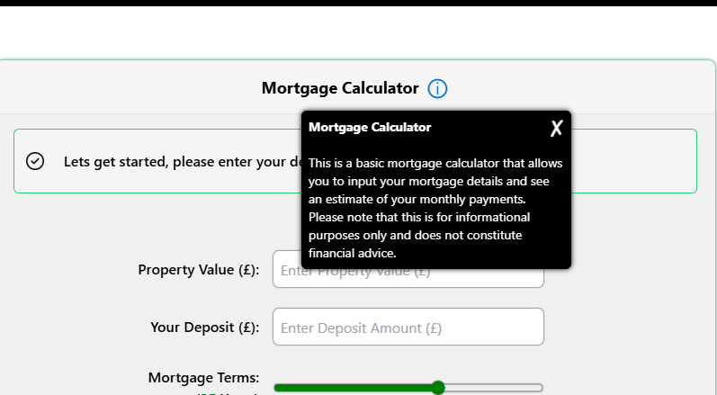
Lloyds Bank Mortgage Calculator Technological Engineering
Design Pitch Task 2 Wireframes
Tooltip for context on item, the helper component is really well coded and performance wise doesn’t hinder anything as it is just a div container with text and a closing button. This itself can provide better help to people as a info icon is more appealing than a hyperlink

Slide 5
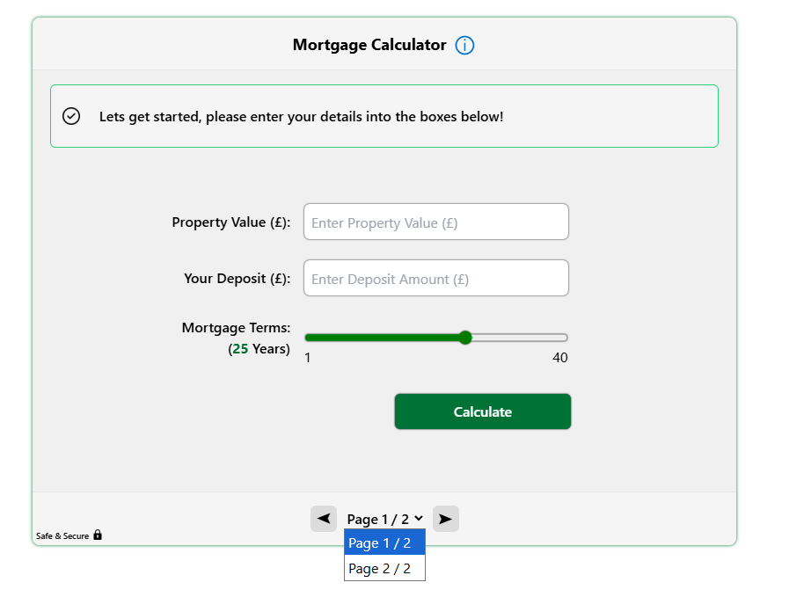
Lloyds Bank Mortgage Calculator Technological Engineering
Design Pitch Task 2 Wireframes
The pagination area for the portal, it also has a dropdown so that users can navigate a little better and this will help prevent loss of progression and any added stress a user may be having from reloading the page fearing their inputs will all disappear.

Slide 6
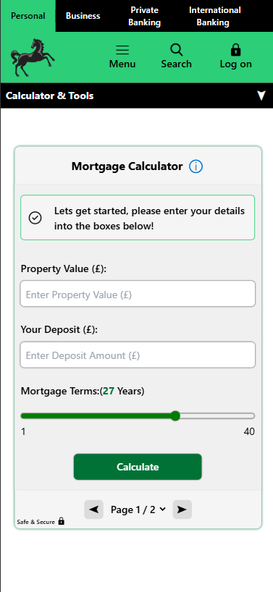
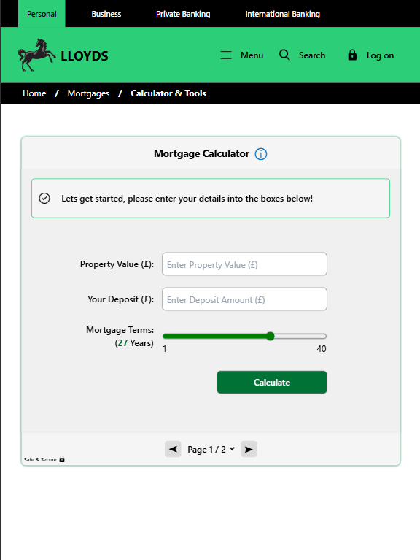
Lloyds Bank Mortgage Calculator Technological Engineering
Design Pitch Task 2 Wireframes
Breadcrumb turns into a
Dropdown menu for mobile
Devices so users can navigate back through their
Path easily without losing
Their navigation history
This is the mobile device layout as you can see its fully responsive and scales down appropriate for the user with everything clear and good enough whitespace for clicking onto things
This is the tablet version
Of the mortgage calculator
And as you can see its fully responsive with no issues so all devices are supported therefore more customers can now access the system.

