Slide 1


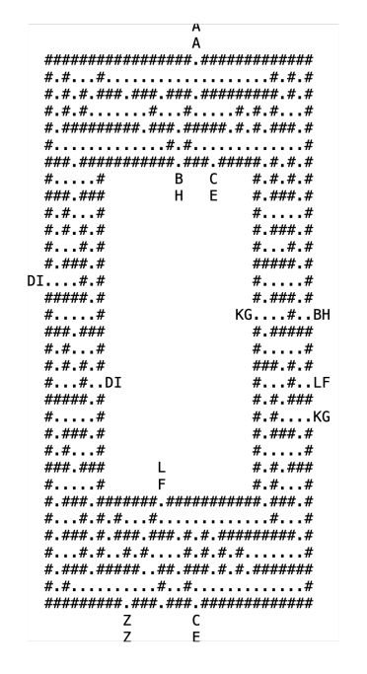


Applied Math Maze Solver
Alex Wan, Brayan Marcial, Marian Zuniga, Patrick Park
University of California Merced
Problem
Method/Algorithm
What we learned
The objective of this challenge is to help Pooh Bear and his friends find the legendary secret picnic spot in the magical Weenie Forest Park. Our group has a mystery map with symbols representing trees, passageways, magical portals, the entrance, and the secret picnic spot. The goal is to determine the path to the picnic spot using the given passageways, shown by the periods, and optional magical portals, shown by each pair of two different letters.
Our group has chosen to use the Breadth-First Search (BFS) method to solve the challenge of finding the secret picnic spot for Pooh Bear and his friends. We have decided to use the BFS algorithm instead of the A* search algorithm for the following reasons:
Simplicity: BFS offers a more straightforward implementation, without the need for selecting and fine-tuning a heuristic function, making it easier to apply for this problem.
Guaranteed Shortest Path: BFS is guaranteed to find the shortest path in an unweighted graph, such as the mystery map, while the effectiveness of A* relies heavily on the choice and accuracy of the heuristic function.
Natural Handling of Portals: BFS can naturally explore all possible paths, including those that use portals, without needing any additional complexity or adjustments to the algorithm.
Predictability and Stability: The performance of BFS is more predictable and stable since it does not depend on the accuracy of a heuristic function, as opposed to A* which may perform poorly if the heuristic is not well-designed. The time complexity of this algorithm is O((width * height)) which means it runs at linear time.
Based on these considerations, we believe that BFS is a more suitable choice for this problem, given its simplicity, guarantees, and ability to handle portals without additional complexity. (Depth First Search can be also used to solve the maze, but it does not guarantee that it will get the best path.)
Throughout this project, our team gained valuable insights into the world of pathfinding algorithms and their applications. Here are some key takeaways from our experience:
Multiple Algorithms: We discovered that there are multiple algorithms, such as Breadth-First Search (BFS) and A* Search, which can be used to solve pathfinding problems. Each algorithm has its unique approach, advantages, and disadvantages.
Trade-offs: We learned that choosing the most suitable algorithm for a particular problem requires careful consideration of various factors, such as the problem's characteristics, the algorithm's complexity, and the desired outcome. In our case, we chose BFS for its simplicity, guaranteed shortest path finding, and natural handling of portals.
Problem Representation: We realized the importance of efficiently representing a problem in code, such as using data structures like 2D arrays or HashMaps to store the mystery map and portals. A well-designed representation can significantly impact the ease of implementation and the algorithm's performance.
Algorithm Adaptation: We learned how to adapt and apply a general algorithm like BFS to a specific problem; this mystery map with magical portals required new ideas further than BFS. This process involved understanding the algorithm's fundamentals and adjusting it to accommodate the unique features of our problem.
Teamwork and Collaboration: This project reinforced the value of effective communication and collaboration within a team. By sharing ideas, discussing strategies, and learning from each other, we were able to develop a better understanding of the problem and devise a more efficient solution.
In conclusion, this project provided us with the opportunity to explore various pathfinding algorithms, understand their pros and cons, and apply them to a unique problem. We gained valuable knowledge and skills in algorithm selection, problem representation, and teamwork, which will be beneficial for our future projects and academic pursuits.
Solution
Read Input File:
Read the mystery map from the input file and store it in a suitable data structure (e.g., 2D array).
Convert all portals into a dictionary(Key -> Value) format, mapping each portal label to its corresponding locations in the map.
Identify the start (AA) and end (ZZ) positions within the map.
Make the maze rectangular to facilitate easier iteration through the map.
Initialize BFS:
Set up an empty queue and visited set.
Enqueue the starting position (AA) and mark it as visited.
Explore Paths:
While the queue is not empty, dequeue the first element (current position) from the queue.
Check neighboring positions (up, down, left, and right) for passageways, magical portals, or the secret picnic spot (ZZ).
If the current position is a portal, find its corresponding positions in the HashMap and treat them as neighbors.
For each valid, unvisited neighbor, enqueue it, mark it as visited, and store its parent position (the current position) in the visited set.
Solution Discovery:
When the secret picnic spot (ZZ) is dequeued from the queue, the path has been found.
Reconstruct the path from the starting position (AA) to the secret picnic spot (ZZ) using the parent positions stored in the visited set.
No Valid Path Scenario:
If the queue becomes empty without dequeuing the secret picnic spot (ZZ), there is no valid path to the destination.
In this case, the algorithm will output a message indicating that no valid path was found.
Acknowledgement
Big picture/Tools
Python Imaging Library - https://pillow.readthedocs.io/en/stable/
Website of Python pathfind visualization example - https://levelup.gitconnected.com/solve-a-maze-with-python-e9f0580979a1
The problem is designed to allow a group of students with varying degrees of expertise in coding languages to work together and complete the maze. There are varying solutions to the problem with each coding language presenting a new solution and approach. Even more so every code writer will have their unique perspective on the problem. The main objective of this challenge is to understand new perspectives and apply to solve a single problem.
We chose Python as our programming language for this project due to its extensive collection of libraries, including the Python Imaging Library (PIL), which enabled us to efficiently implement our pathfinding solution and visualize the results.
References
https://en.wikipedia.org/wiki/Breadth-first_search
Code: https://github.com/AlexWanSchool/SiamChallenge23-Team-2
tinyurl.com/t2amp23
Notes:
‹#›

