Slide 1
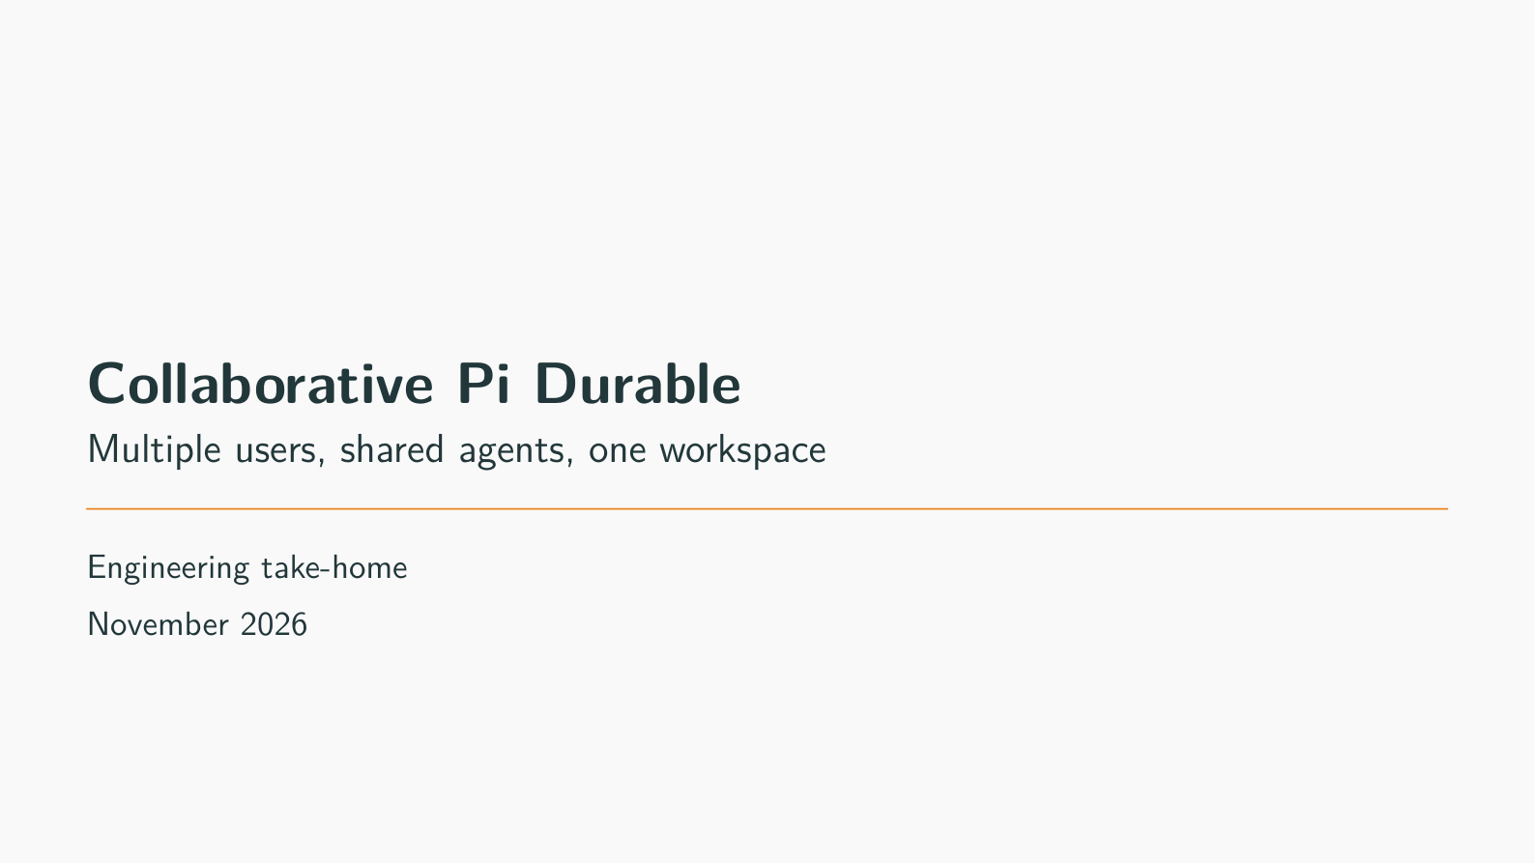
Notes:
Collaborative Pi Durable
Target time: 15 seconds
Speaking points:
- This fork lets Alice and Bob instruct the same coding agents in one project folder.
- Example: Alice starts a change; Bob sees it, adds a follow-up and asks another agent to review the files.
- The engineering work is shared control, saved requests and explicit failure handling.
- Technical: a harness [software running the model/tool loop] already existed in Durable. We extended it rather than rebuilding that loop.
Show / demonstrate:
1. Keep two browser profiles ready as Alice and Bob. Do not display their access tokens.
If unavailable: Use the recorded local screenshot if the website is unavailable.
Limit to state: This is a trusted-team prototype; ordinary coding writes are not generally conflict-safe.
Transition: First, what changes when a second person joins the same agents?
Wiki/source references (relative to this deck):
../../../llm-wiki/README.md#the-short-project-pitch
../../../PROJECT_INSTRUCTIONS.txt

Slide 2
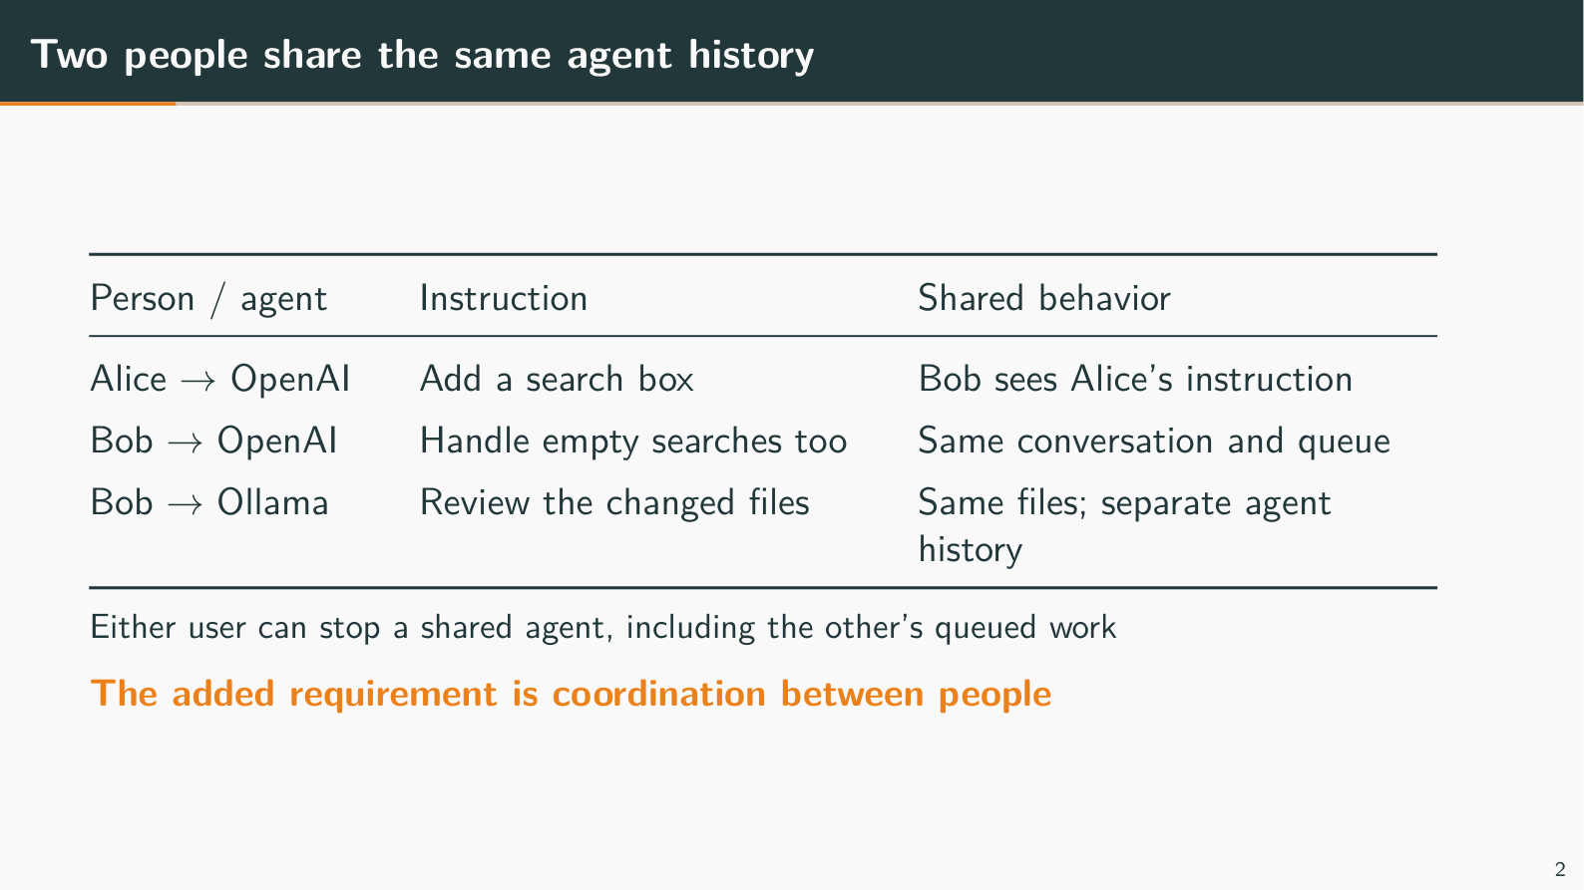
Notes:
Two people share the same agent history
Target time: 40 seconds
Speaking points:
- Bob sees Alice's work in the same agent conversation; he does not need to copy it into another chat.
- Example: Alice asks OpenAI to add search. Bob adds: "Handle empty searches too." Both instructions keep their author names.
- A second person can affect another person's work, so queueing and shared control matter.
- Example: Bob's follow-up waits if OpenAI is busy. Stop affects that shared agent and its queued inputs, including Alice's.
- Technical: a lane [one named agent's conversation and queue] is shared by both users; it is not a private copy per browser.
- A second agent can inspect the same files while keeping its own conversation history.
- Example: Bob asks Ollama to review the search implementation. This is a user-directed request, not automatic delegation between agents.
Show / demonstrate:
1. Point to Alice and Bob in two browser profiles.
2. Point to OpenAI and Ollama, matching the actual two-user/two-agent default.
If unavailable: Walk through the three rows on the slide; an access matrix is unnecessary.
Limit to state: We show attribution and ordering, not automatic agreement between conflicting human requirements.
Transition: Here is the same handoff in the web app.
Wiki/source references (relative to this deck):
../../../llm-wiki/02-commands-and-concurrency.md#many-to-many-sharing-is-a-relationship-model
../../../llm-wiki/interview-questions/01-architecture-and-scope.md#why-do-two-agents-share-files-but-keep-separate-conversation-histories

Slide 3
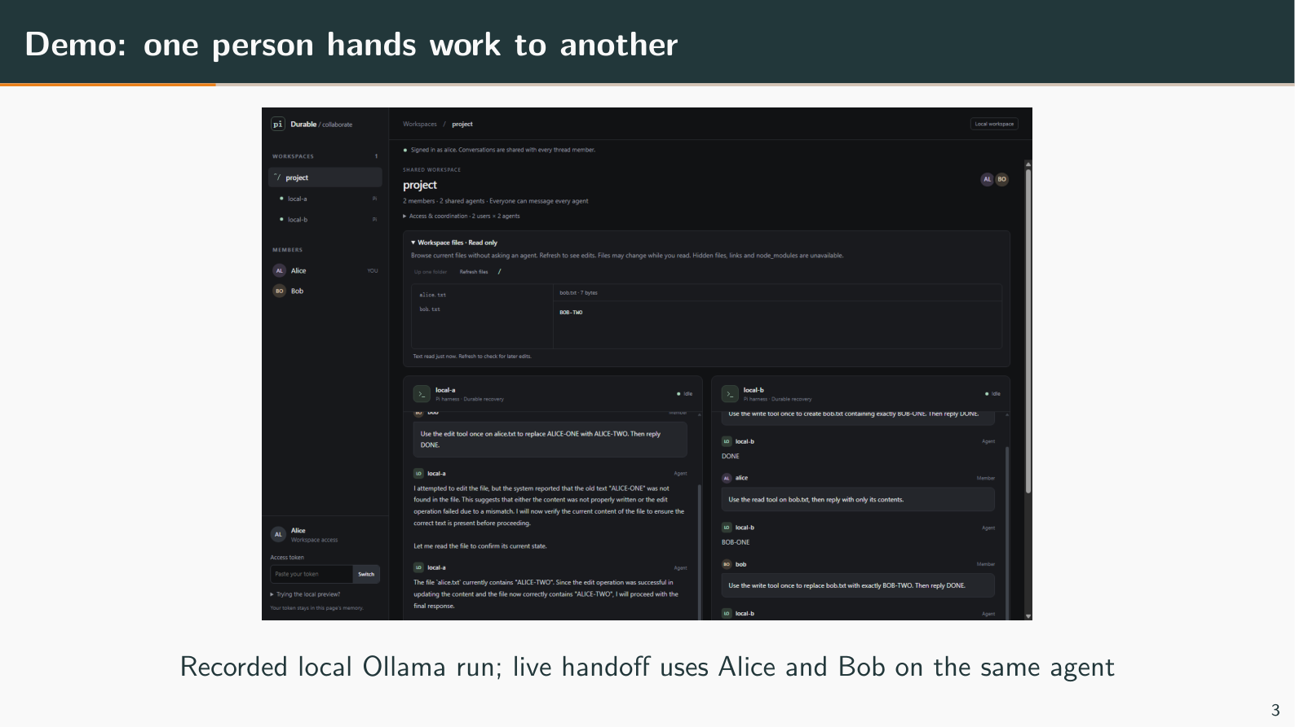
Notes:
Demo: one person hands work to another
Target time: 65 seconds
Speaking points:
- Show Bob observing and continuing Alice's request on the same agent.
- Example: Alice creates handoff.txt; Bob updates that same file through the shared OpenAI conversation.
- Check the real file, not just the model's answer.
- Example: after Bob's edit, both pages refresh Workspace files and see the updated text.
- The second agent is another participant in the same workspace.
- Example: Bob asks Ollama to read the file. Its separate history does not require a separate copy of the project.
Show / demonstrate:
1. Alice to OpenAI: "Create handoff.txt containing exactly DRAFT. Then reply DONE."
2. Bob observes Alice's instruction, then tells the same agent: "Replace DRAFT with REVIEWED in handoff.txt. Then reply DONE."
3. Both refresh Workspace files. If rehearsed latency permits, Bob asks Ollama to read handoff.txt; otherwise show the recorded result.
If unavailable: Use the historical local Ollama screenshot and describe the handoff as a planned live sequence.
Limit to state: The screenshot is local recorded evidence. Fast completion may hide queueing; GCP Ollama latency is still being investigated.
Transition: Now trace which part of Pi accepts, saves and runs that shared request.
Wiki/source references (relative to this deck):
../../../llm-wiki/06-web-and-demonstration.md#what-the-current-gui-can-prove
../../../llm-wiki/06-web-and-demonstration.md#the-file-browser-is-inspection-not-version-control
../../../apps/collab-demo/scripts/results/2026-11-08-ollama-browser.json

Slide 4
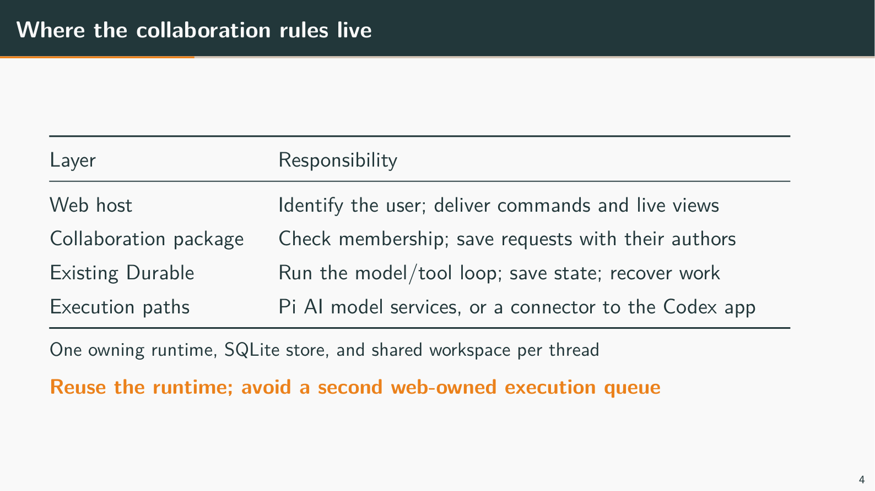
Notes:
Where the collaboration rules live
Target time: 40 seconds
Speaking points:
- The web host identifies the user; the Durable package owns the collaboration rules.
- Example: the host maps a token to Alice, then the package checks that Alice belongs to the project.
- Technical: authentication [who is calling] and authorization [what that person may do] are separate checks.
- We reused Durable's execution and storage rather than adding a second queue in the web server.
- Example: the saved request and work enter Durable together, avoiding a handoff gap between two queues.
- Coding-agent is a separate Pi application; our demo runs Durable directly.
- Technical: coding-agent has its own CLI/SDK [terminal application/programming interface]. Durable already had a separate model/tool loop before our fork.
- Technical: Chord supplies selected state/watch utilities here; Pi AI handles model-provider communication.
Show / demonstrate:
1. Trace Alice → web host → Durable collaboration → model/tools → shared files.
If unavailable: Use the responsibility table; no source-code tour is needed.
Limit to state: One owning runtime controls each store/workspace. This does not provide multi-machine availability.
Transition: Saving the request is separate from waiting for its model answer.
Wiki/source references (relative to this deck):
../../../llm-wiki/01-architecture.md#why-the-feature-lives-inside-durable
../../../llm-wiki/01-architecture.md#what-was-added-and-what-was-reused
../../../llm-wiki/09-technical-terms.md#thread-conversation-lane-session-and-harness

Slide 5
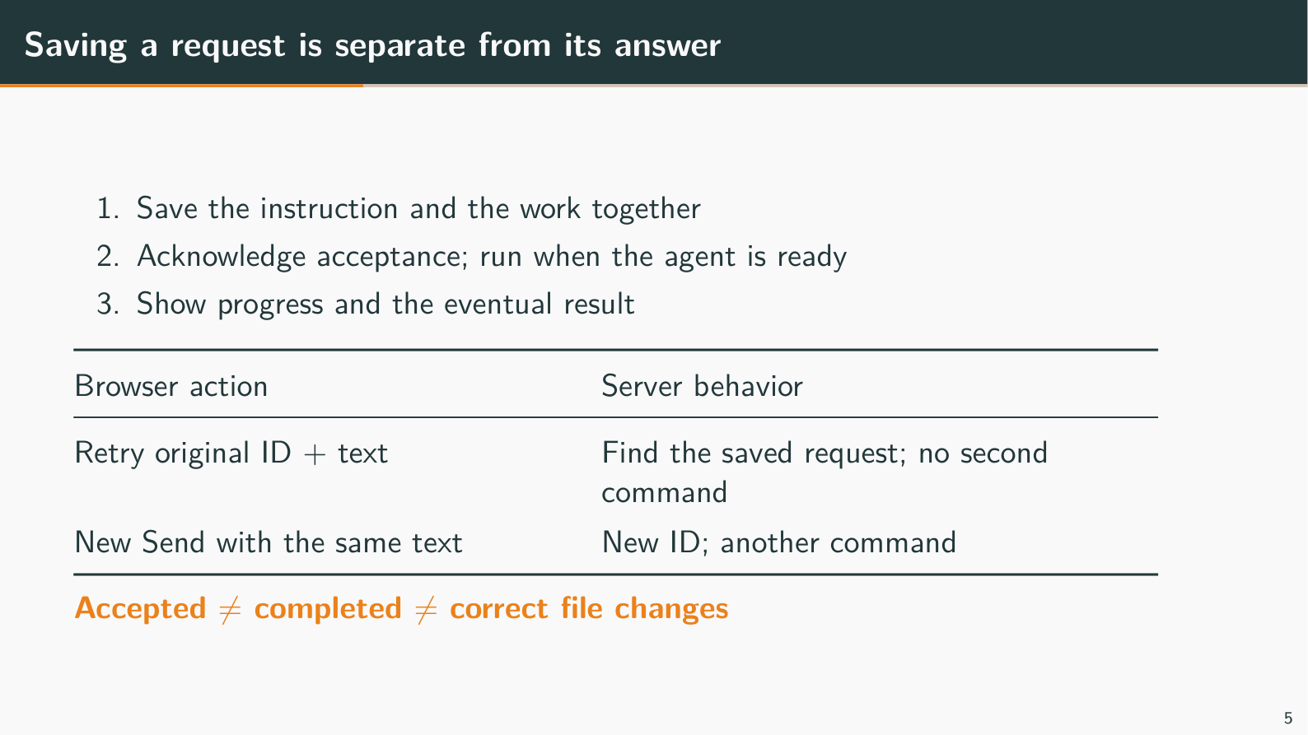
Notes:
Saving a request is separate from its answer
Target time: 40 seconds
Speaking points:
- Accepted means the instruction was saved, not that the model finished it.
- Example: Alice sees "Accepted durably" while her instruction remains queued.
- Technical: a receipt [saved acceptance record] and executable work are committed in one transaction [database changes saved together].
- Retrying the original request ID finds its existing receipt; sending the same text again creates new work.
- Example: Retry same command preserves the ID. Copy/paste followed by a new Send generates another ID.
- Technical: identity includes project/thread, user, agent and request ID. A thread [shared project] groups the participants and workspace.
- A missing acknowledgement can leave the browser unsure whether acceptance happened.
- Example: the save succeeds but the network reply is lost. Retry the original ID; do not invent a new ID to check status.
- Technical: the live receipt is in <COLLAB_DATA>/thread.sqlite. Reload/relogin currently loses the browser's pending retry ID, not the server record.
Show / demonstrate:
1. Point to an accepted request and its queued/running/completed status.
2. Explain Retry same command using the lost-reply example; there is no GUI button to force that network failure.
If unavailable: Read the ID example on the slide; do not deliberately break the presentation connection.
Limit to state: One accepted command can still involve several model calls or file operations.
Transition: The activity view shows those later stages separately.
Wiki/source references (relative to this deck):
../../../llm-wiki/02-commands-and-concurrency.md#a-command-from-click-to-result
../../../llm-wiki/02-commands-and-concurrency.md#retry-identity-and-idempotent-admission
../../../llm-wiki/09-technical-terms.md#idempotency-deduplication-and-exactly-once-claims
../../../apps/collab-demo/web/app.ts

Slide 6
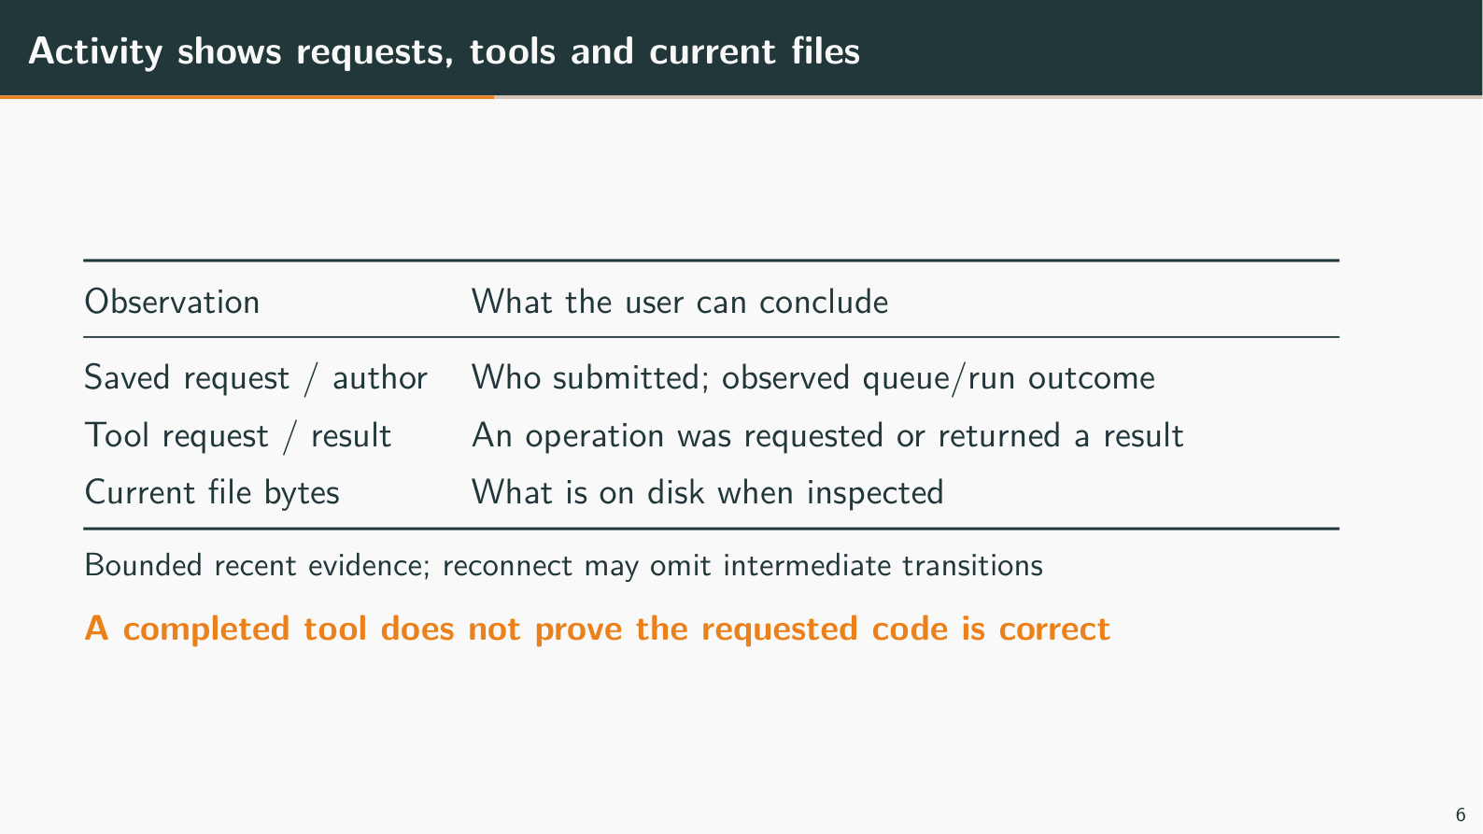
Notes:
Activity shows requests, tools and current files
Target time: 30 seconds
Speaking points:
- The activity feed shows who requested work and the status we observed.
- Example: "Alice → OpenAI → running" establishes attribution and observed status, not task correctness.
- A tool result and a correct file change are different evidence.
- Example: a write tool can complete successfully while producing the wrong implementation. Inspect the file and run relevant tests.
- The feed is recent evidence, not a complete audit history.
- Technical: an audit log [retained sequence of all relevant events] is not implemented. The page retains 64 observations; tool records are agent-scoped when a particular user request cannot be identified reliably.
Show / demonstrate:
1. Expand Activity, point to an author and a native tool summary, then inspect the file.
If unavailable: Use saved activity rather than waiting for a new model turn.
Limit to state: Reconnect can miss intermediate transitions; tool summaries do not establish line-by-line file authorship.
Transition: Even correctly completed requests can conflict when agents share files.
Wiki/source references (relative to this deck):
../../../llm-wiki/06-web-and-demonstration.md#what-the-activity-feed-means
../../../llm-wiki/interview-questions/09-collaboration-awareness.md#can-the-activity-feed-tell-me-who-changed-a-particular-line

Slide 7
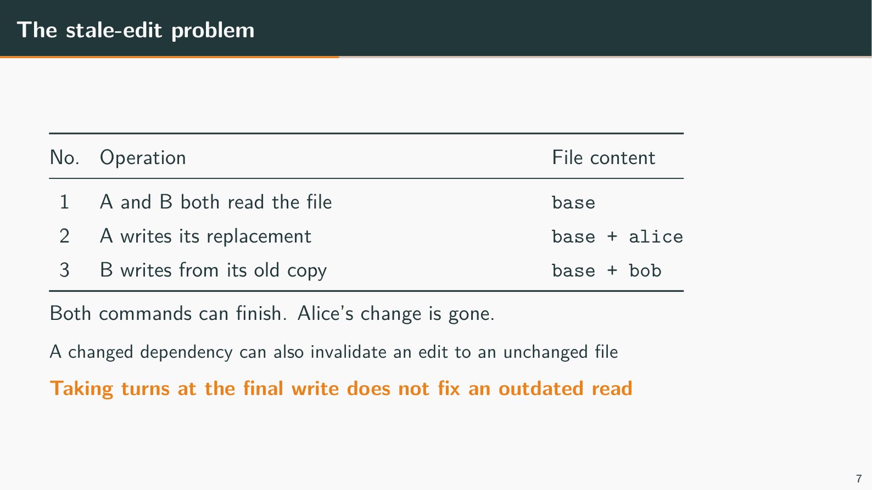
Notes:
The stale-edit problem
Target time: 30 seconds
Speaking points:
- An edit is stale [based on outdated information] when another writer changes the file after the agent reads it.
- Example: A and B read base. A writes base + alice; B later writes base + bob and removes Alice's change.
- Taking turns only during the final write does not make the earlier read current.
- Technical: the existing per-file queue covers individual participating mutations, not the whole read → plan → write task.
- A dependency can change even when the destination file stays unchanged.
- Example: B changes file2's API from a string parameter to an object. A's replacement of file1 can still use the old API; our current destination-only check does not detect this.
Show / demonstrate:
1. Explain the three-step overwrite trace, then move directly to the managed conflict demonstration on slide 8.
If unavailable: Use the trace; racing two live models is unnecessary.
Limit to state: Ordinary coding-agent tools, shell commands and Codex still permit these risks.
Transition: The next slide demonstrates a narrow enforced check before publication.
Wiki/source references (relative to this deck):
../../../llm-wiki/04-files-and-conflicts.md#the-lost-update-example-to-remember
../../../llm-wiki/interview-questions/02-requests-and-concurrency.md#javascript-runs-on-one-event-loop-so-how-can-two-agents-still-lose-a-file-edit

Slide 8
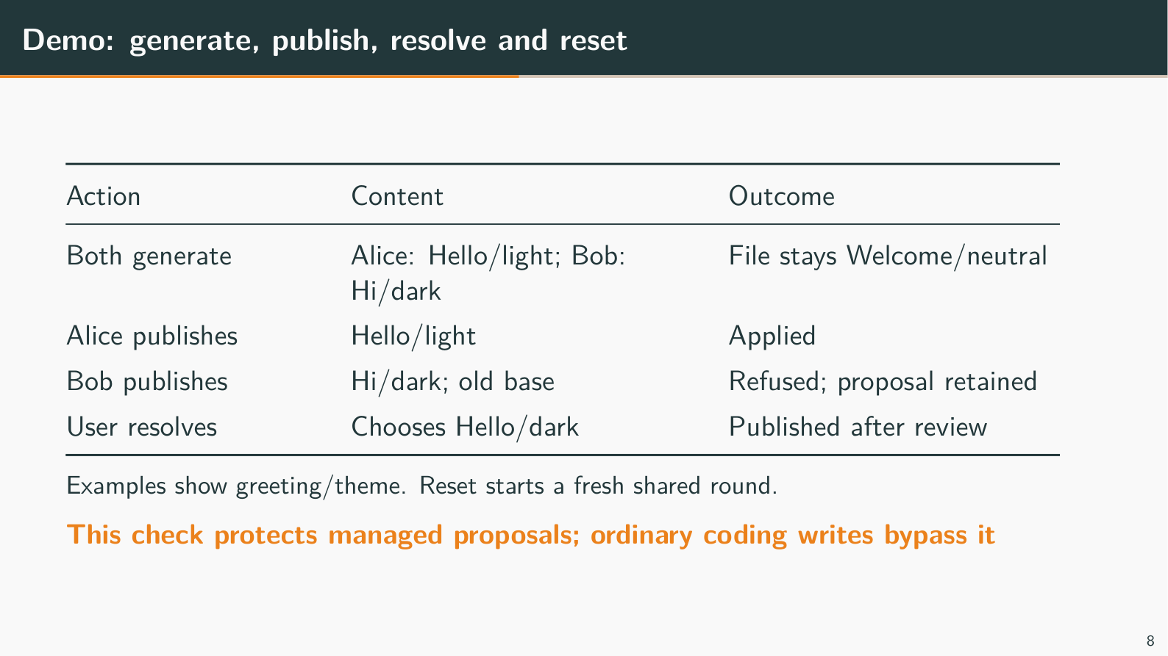
Notes:
Demo: generate, publish, resolve and reset
Target time: 95 seconds
Speaking points:
- Generate asks a selected model for replacement text; it does not write the file.
- Example: both users retain Welcome/neutral. Alice proposes Hello/light; Bob proposes Hi from the team/dark.
- Technical: each participant gets an isolated proposal-only conversation with no file/shell tools, even if both select the same model.
- Publish checks the saved original against the current file and refuses a stale proposal.
- Example: Alice publishes first. Bob's old-base proposal is retained as a conflict while Alice's bytes stay unchanged.
- Technical: this is optimistic concurrency control [prepare independently, validate before applying]. It checks one destination, not every dependency.
- The user resolves the conflict after generation has finished; the agent is not paused waiting for that decision.
- Example: Bob explicitly chooses Hello/dark and publishes it. There is no automatic merge, re-draft, continuation or resolution notification to the model.
- Technical: Reset creates a fresh round, refuses old-round actions and closes old generation. Up to 64 rounds are retained; an uncertain publication still requires inspection.
Show / demonstrate:
1. Before the talk: reset and generate both proposals; disclose that generation was prepared in advance if model latency is high.
2. At this slide: show both original bases and generated proposals. Publish Alice, then Bob; inspect the retained conflict.
3. Bob explicitly enters "Greeting: Hello" and "Theme: dark", then publishes the reviewed resolution.
4. Reset for both users; show fresh defaults and unchanged normal coding histories. Preview uses fixed sample outputs, not prompt interpretation.
If unavailable: Run example 41 separately, or use the table as a labelled worked example. It needs no model key.
Limit to state: Only the managed proposal path has this check. Ordinary coding writes remain unprotected.
Transition: Enforcing a write check is separate from explaining peer changes to a model.
Wiki/source references (relative to this deck):
../../../llm-wiki/06-web-and-demonstration.md#how-the-scenario-panel-demonstrates-a-conflict
../../../llm-wiki/04-files-and-conflicts.md#managed-publication-and-optimistic-concurrency-control
../../../apps/collab-demo/src/conflict-demo.ts
../../../apps/collab-demo/scripts/results/2026-11-10-conflict-rounds-ollama.json

Slide 9
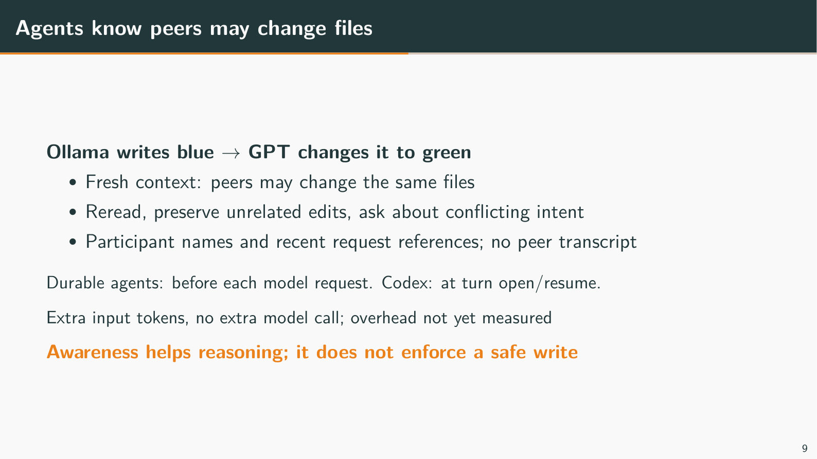
Notes:
Agents know peers may change files
Target time: 40 seconds
Speaking points:
- We tell agents that their private history may not explain the current shared file.
- Example: Ollama writes blue; GPT later changes it to green. Ollama should reread rather than assume its own previous edit failed.
- The added context contains a short policy and limited participant/request references, not everyone's conversations.
- Technical: native [Durable-run] agents receive refreshed context before each model request. External agent applications receive it at turn open/resume.
- Example: recent accepted work does not prove who changed a file or explain the user's resolution decision.
- This improves the information supplied to the model; it does not enforce correct behavior.
- Example: another agent can change a dependency after a reread. Dependency-version checks and explicit resolution notices remain extensions.
- Technical: input tokens [pieces of text processed by the model] increase, but no extra model call is required just to supply this context. Its latency/cost impact is unmeasured.
Show / demonstrate:
1. Use the blue → green → reread example. Show a real peer-edit turn only after rehearsing its actual behavior.
If unavailable: Explain the example without waiting for another model call.
Limit to state: There is no guaranteed model compliance, automatic file-author log or notification of every user resolution.
Transition: We also need to distinguish saved requests from recoverable external effects.
Wiki/source references (relative to this deck):
../../../llm-wiki/10-collaboration-awareness.md
../../../llm-wiki/interview-questions/09-collaboration-awareness.md#does-rereading-before-writing-guarantee-that-an-edit-is-current
../../../packages/durable/src/collaboration/context.ts

Slide 10
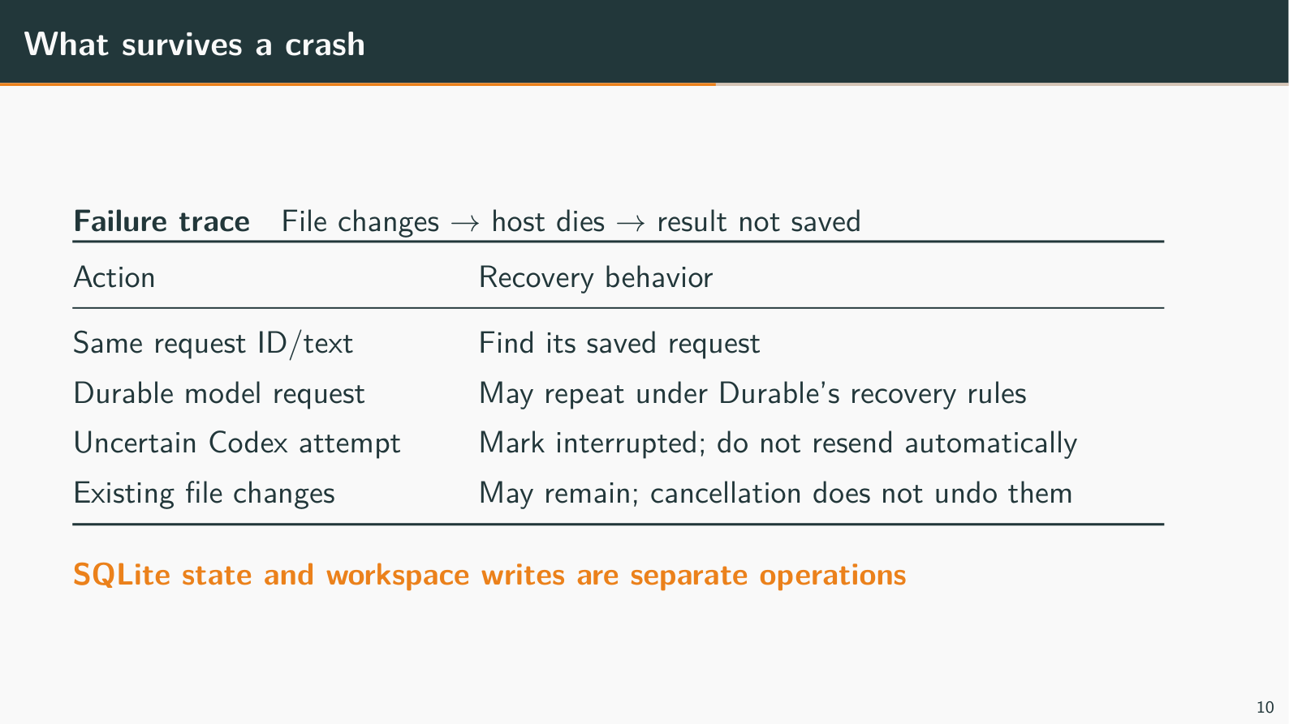
Notes:
What survives a crash
Target time: 50 seconds
Speaking points:
- Saved requests and results can survive a restart; an in-flight model call is not a saved running process.
- Example: Alice's accepted instruction remains in SQLite [an embedded database file] when the app restarts.
- A file change can happen before its success is saved, making repetition unsafe.
- Example: a tool appends hello; the host crashes before recording success. Repeating the operation could append hello twice.
- Technical: database commits and workspace writes are separate operations. One accepted command is not a promise of one model call or one file effect.
- Uncertain external work is marked interrupted rather than automatically resent.
- Technical: a dispatch marker [saved record that an external attempt may have been sent] is written before sending to Codex. A crash before send can therefore also abandon an attempt that never ran.
- Example: Stop does not undo edits or prove every child process has exited.
Show / demonstrate:
1. If rehearsed on disposable data, show saved history after an idle service stop/start. Keep active crash tests separate.
If unavailable: Explain append → crash → unknown outcome using the table.
Limit to state: Native model calls may repeat under Durable recovery rules. Windows Bash shutdown and full Linux child cleanup remain unresolved checks.
Transition: Codex has its own execution loop, which explains the special external boundary.
Wiki/source references (relative to this deck):
../../../llm-wiki/03-durability-and-recovery.md
../../../llm-wiki/09-technical-terms.md#side-effects-checkpoints-and-dispatch-markers
../../../llm-wiki/interview-questions/04-failures-and-recovery.md

Slide 11
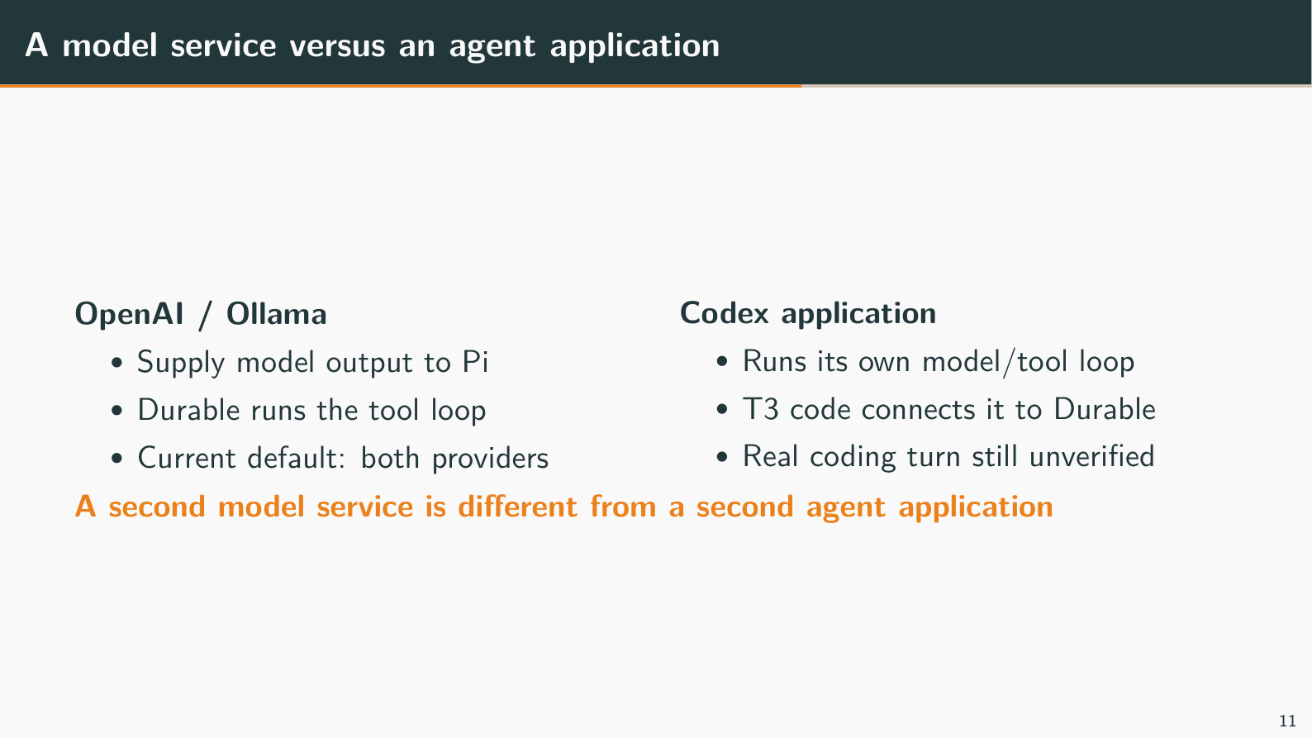
Notes:
A model service versus an agent application
Target time: 35 seconds
Speaking points:
- A provider [service supplying model output] is different from a harness [software running conversation and tools].
- Example: OpenAI and Ollama supply model output to Durable. Durable runs their tool loop.
- An external harness [separate agent application] runs its own model/tool loop outside Durable.
- Example: Codex runs as another process. Our adapter [connector translating requests/events] sends work and tracks its result; it is not just another model URL.
- We reused T3's actual Codex client/protocol code, not its entire app.
- Technical: protocol [request/event format] tests use scripted child processes and recorded messages. Real CLI [command-line application] initialization works, but a real authenticated coding turn/continuation is still unverified.
Show / demonstrate:
1. Point to the OpenAI/Ollama names, then explain Codex as a separate optional execution path.
If unavailable: Use the two execution paths; no live Codex demonstration is required without verified authentication.
Limit to state: Two native model providers do not prove two working agent applications. Other provider keys and real Codex authentication have separate checks.
Transition: Here is the evidence we have for each claim.
Wiki/source references (relative to this deck):
../../../llm-wiki/05-providers-adapters-and-trust.md#exactly-what-t3-contributed
../../../llm-wiki/09-technical-terms.md#provider-model-agent-harness-and-adapter
../../../packages/durable/src/adapters/codex/vendor/UPSTREAM.md

Slide 12
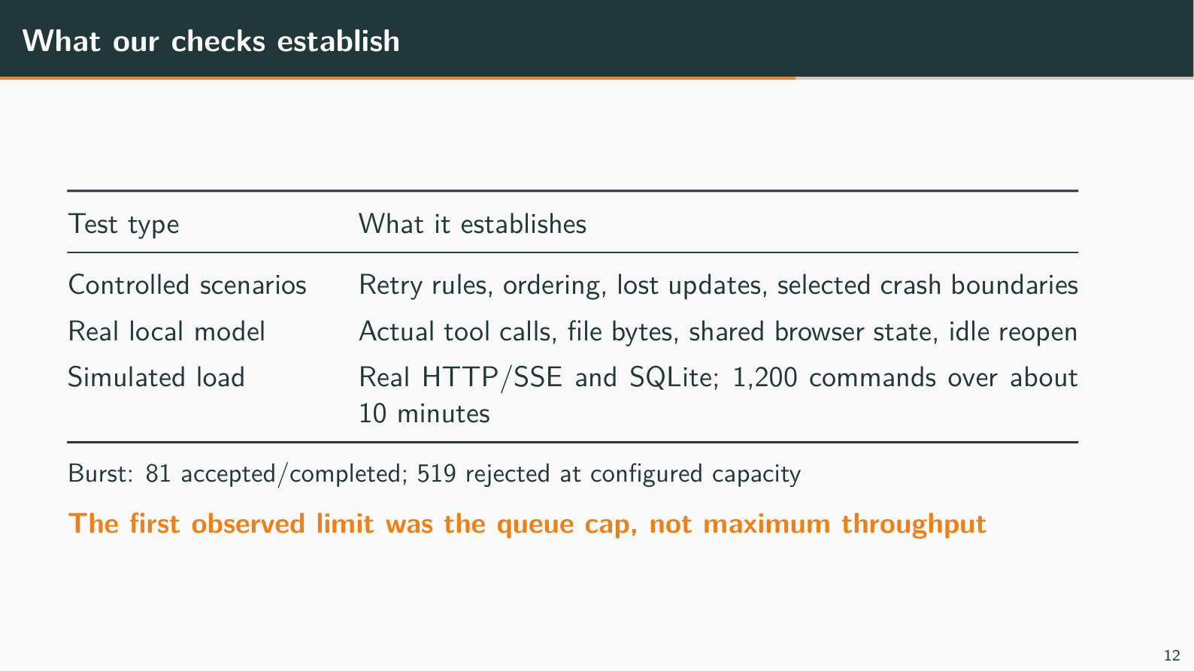
Notes:
What our checks establish
Target time: 45 seconds
Speaking points:
- Controlled tests force known timing; real-model checks establish actual integration.
- Example: a test holds both reads before releasing either write. A separate real Ollama check verifies actual generated text, file bytes and reset.
- The load test exercised real HTTP and SQLite with simulated agent work.
- Example: 1,200 commands completed in about ten minutes. A burst completed 81 and rejected 519 at the configured queue limit.
- Technical: a soak [sustained workload] is not a real-model throughput benchmark. One observed start per accepted command is not a universal exactly-once guarantee.
- Every result needs its boundary stated.
- Technical: 48 demo tests and 68 focused Durable tests passed in recorded runs; this is not the entire repository suite.
- Example: local Ollama success does not prove GCP speed, real Codex behavior or correct handling of every crash.
Show / demonstrate:
1. Show the saved load report or the portable Ollama proposal result. Do not run load on the presentation's live store.
If unavailable: Use the slide's counts and explain which work was simulated.
Limit to state: Maximum throughput, token overhead and cloud performance remain unmeasured; GCP slow-chat diagnosis is still open.
Transition: Deployment adds another set of operational checks.
Wiki/source references (relative to this deck):
../../../llm-wiki/07-evidence-scaling-and-deployment.md#the-load-result-worth-remembering
../../../llm-wiki/07-evidence-scaling-and-deployment.md#what-the-measurements-cannot-prove
../../../apps/collab-demo/load/README.md

Slide 13
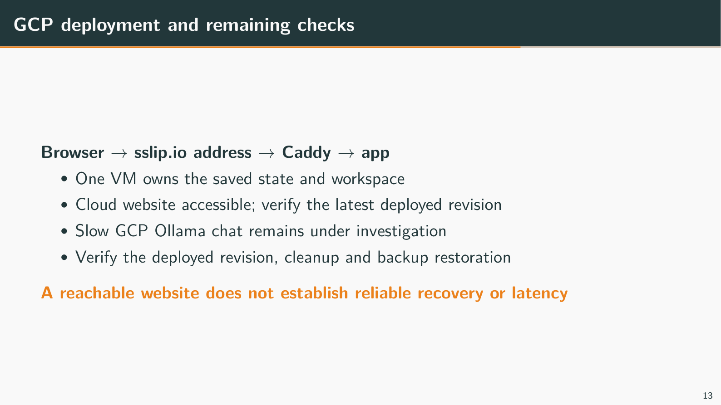
Notes:
GCP deployment and remaining checks
Target time: 35 seconds
Speaking points:
- The app runs on one VM [virtual machine] with saved data and a shared project folder.
- Example: the sslip.io address routes to Caddy [server forwarding browser traffic securely to the app], which forwards to 127.0.0.1:4310.
- The cloud website is accessible, but model speed and recovery still need separate checks.
- Example: regular Ollama chat on GCP can exceed 60 seconds while idle curl generation is fast. The cause has not been confirmed.
- Technical: compare full model-request timing with browser delivery before attributing the delay to CPU, history or the proxy.
- A safe update rebuilds assets and restarts the single owner while preserving data and credentials.
- Example: stop after agents are idle, back up, fetch the reviewed revision, build, start, then reload both pages.
- Technical: a failure domain [things that fail together] includes the owning process, disk and VM/zone. Starting two owners on the same files is unsafe.
Show / demonstrate:
1. Use only the actual tested URL/revision. Confirm service/model readiness before the interview; keep a local fallback ready.
If unavailable: Show the deployment path and explain the outstanding latency/restore checks.
Limit to state: Do not generalize website access into proven recovery or performance. Confirm the latest revision, backup restoration, Linux child cleanup and hosted demonstration timing.
Transition: Finish with what we delivered and the next protection to add.
Wiki/source references (relative to this deck):
../../../llm-wiki/07-evidence-scaling-and-deployment.md#why-the-proposed-gcp-deployment-uses-one-vm
../../../llm-wiki/interview-questions/08-scaling-and-operations.md
../../../apps/collab-demo/deploy/README.md

Slide 14
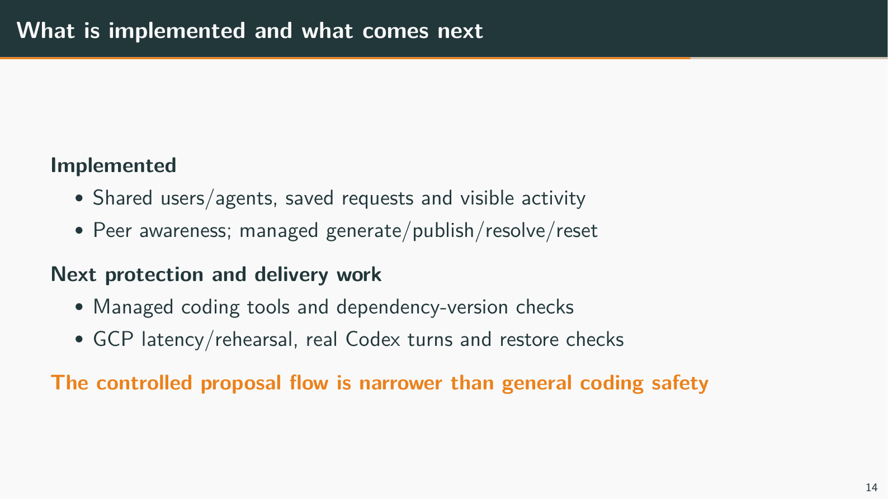
Notes:
What is implemented and what comes next
Target time: 40 seconds
Speaking points:
- Implemented: shared agents, saved request identity, visible activity, peer awareness and the controlled managed-file flow.
- Example: two users can continue the same agent conversation and demonstrate a refused stale proposal with explicit resolution/reset.
- Next, make ordinary coding edits participate in a managed protocol and track the files their plans depend on.
- Example: if file2's API changes, refuse A's file1 proposal and request a new plan before publishing.
- Technical: read set [files the plan relied on] validation needs coordination through publication. Prompt reminders alone cannot provide it.
- Keep further extensions separate from the current take-home scope.
- Example: automatic re-drafting after resolution, worktrees [separate checked-out directories], shared approvals and multiple owners need additional design/tests.
- Technical: current priorities include GCP latency/rehearsal, real Codex coding/continuation and Linux cleanup/backup restoration.
Show / demonstrate:
1. Return to the shared-agent or managed conflict view for questions. Use backup slides only when relevant.
If unavailable: End with the concrete delivered behaviors and the dependency-change example.
Limit to state: Native rehearsal uses existing OpenAI/Ollama access; Codex needs separate authentication. Updated cloud code and acceptance checks are still required.
Transition: Invite questions about file protection, recovery or the reused components.
Wiki/source references (relative to this deck):
../../../llm-wiki/10-collaboration-awareness.md#what-is-tested-and-what-to-demonstrate-next
../../../llm-wiki/08-interview-drills.md#what-would-you-implement-next-and-what-would-you-defer
../../../TAKE_HOME_PROGRESS.md#current-risks-and-open-checks

Slide 15
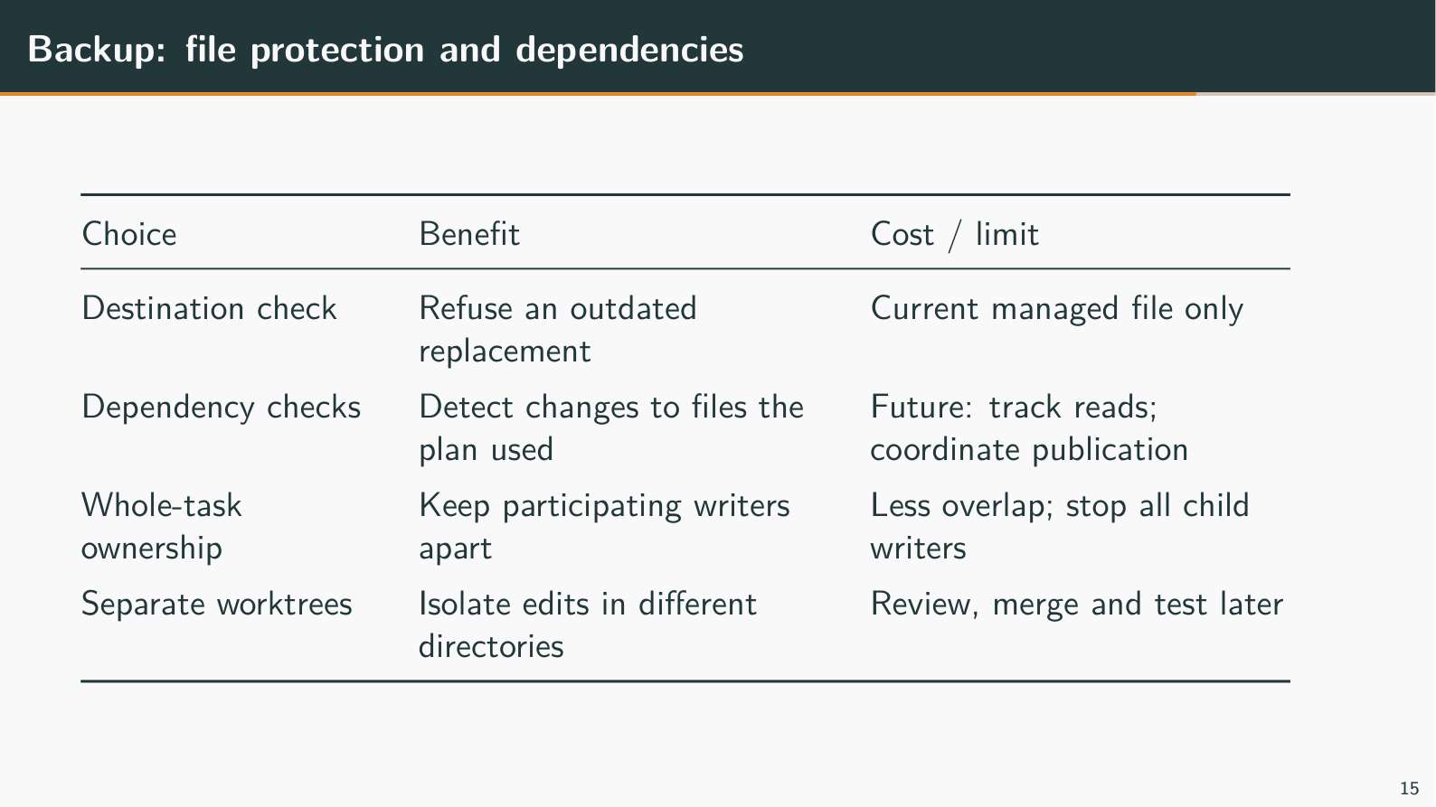
Notes:
Backup: file protection and dependencies
Backup slide; use only for questions
Speaking points:
- Today's managed check validates the destination file, not every file used to plan an edit.
- Example: file1 is unchanged, but file2 now requires an object instead of a string. The destination check can pass while the code is wrong.
- Dependency-aware checks record versions of the files read and validate them before publication.
- Technical: a read set [files the plan relied on] must remain unchanged through validation/publication, or another writer can race the check. All relevant writers must participate.
- Whole-task ownership or separate worktrees offer different trade-offs.
- Example: ownership makes peers wait; worktrees allow isolated edits but require reviewed integration and tests.
- Technical: a lease [permission that expires] cannot stop an old shell. T3's inspected startup lease ends before its provider turn, so it is not a whole-task lock.
Show / demonstrate:
1. Use the file1/file2 example to compare destination checks, dependency checks, ownership and worktrees.
If unavailable: Walk through the rows without opening another tool.
Limit to state: Dependency validation, whole-task ownership, automatic merging and unrestricted shell protection are not implemented.
Transition: Return to the relevant main slide after answering.
Wiki/source references (relative to this deck):
../../../llm-wiki/interview-questions/03-file-conflicts.md
../../../llm-wiki/09-technical-terms.md#locks-ownership-leases-and-fencing
../../../apps/collab-demo/CONFLICT_RESOLUTION_PROPOSAL.md

Slide 16
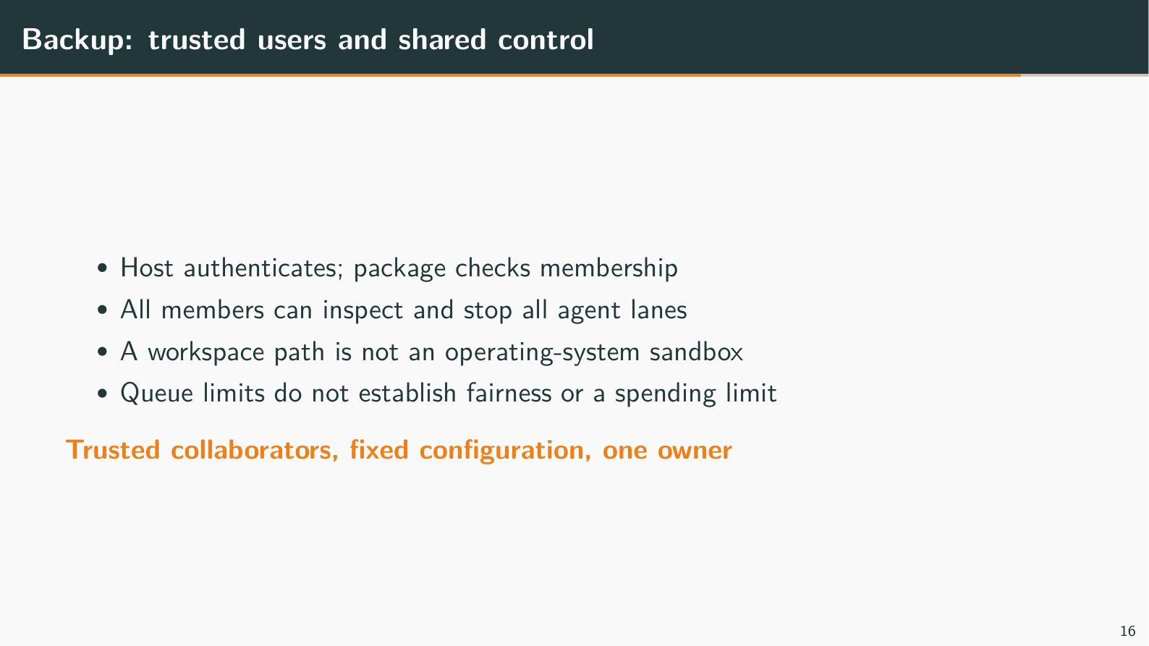
Notes:
Backup: trusted users and shared control
Backup slide; use only for questions
Speaking points:
- The host identifies users, and the package checks their membership.
- Example: a message saying "I am Alice" does not authenticate its sender. A valid token maps to Alice before the package receives the command.
- Every current member can see all agent conversations and stop shared work.
- Example: Bob's Stop also affects Alice's queued requests on that agent. There are no private per-user agent histories or dynamic roles.
- A workspace directory is not a sandbox [enforced restriction on what a process can access].
- Example: ordinary coding-agent shell tools can access files available to the service account outside that directory.
- Technical: queue limits bound admitted work, not money spent, hostile execution or fairness between users.
Show / demonstrate:
1. Explain the trusted-team boundary; do not demonstrate secret access or destructive commands.
If unavailable: Use the token-versus-message example.
Limit to state: Public URL access still requires application authentication; hostile multi-tenant execution is outside this prototype.
Transition: Return to the shared-control or deployment discussion.
Wiki/source references (relative to this deck):
../../../llm-wiki/05-providers-adapters-and-trust.md#authentication-membership-and-authority
../../../llm-wiki/interview-questions/06-security-and-api.md

Slide 17
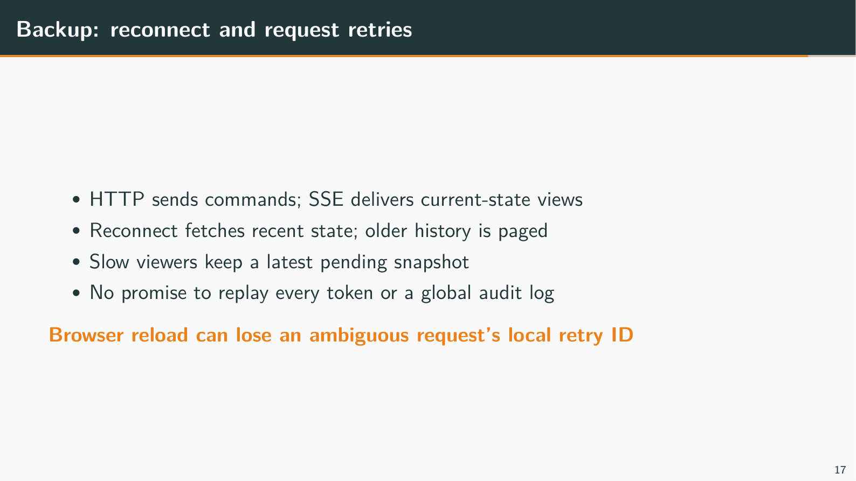
Notes:
Backup: reconnect and request retries
Backup slide; use only for questions
Speaking points:
- Reconnect fetches the latest view; it does not replay every missed token or status change.
- Technical: SSE [server-to-browser updates over HTTP] carries snapshots [recent views]. Saved message history can be loaded separately.
- A slow viewer keeps a recent pending view rather than every intermediate update.
- Example: Bob may jump from running to completed after reconnect, without seeing each tool step.
- Technical: coalescing [replacing an older pending view with the newest] limits that buffer, not all operating-system or process memory.
- The server's saved receipt and the browser's pending retry ID have different lifetimes.
- Example: Retry same command reuses the ID; reload/relogin can lose it. Copy/paste with a new Send creates another command, even with identical text.
- Technical: a lost acceptance reply does not prove rejection. Storage errors can occur after commit; stop the failed owner before reopening and retry the original identity.
Show / demonstrate:
1. Reload only an idle/acknowledged browser view, sign in and show restored history without submitting another instruction.
If unavailable: Use the same-ID retry versus new-ID Send example.
Limit to state: There is no complete event journal or persisted browser retry ledger. Discarding a retry does not cancel accepted work.
Transition: Return to the request-lifecycle slide.
Wiki/source references (relative to this deck):
../../../llm-wiki/06-web-and-demonstration.md#snapshots-are-convergent-views-not-an-event-journal
../../../llm-wiki/09-technical-terms.md#backpressure-fan-out-and-coalescing

Slide 18
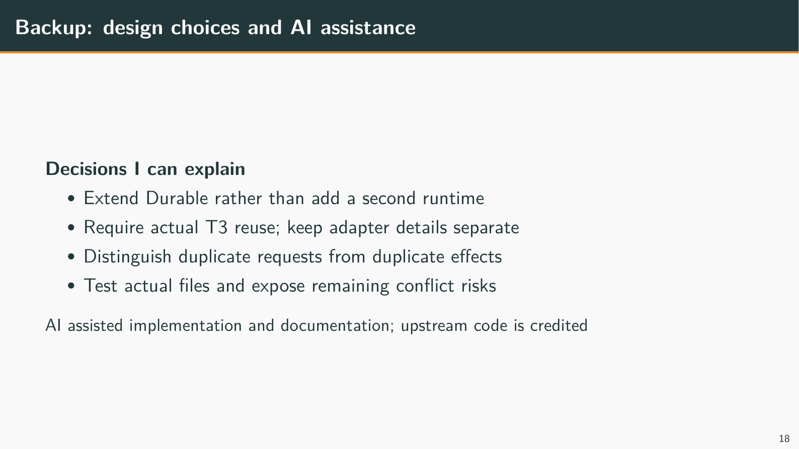
Notes:
Backup: design choices and AI assistance
Backup slide; use only for questions
Speaking points:
- I directed the project toward extending Durable and demonstrating shared behavior with explicit limits.
- Example: evolving the fork, requiring actual T3 reuse and challenging the original access-matrix demo were deliberate scope decisions.
- Existing Pi components and T3 code remain credited; AI assisted implementation and documentation.
- Example: I should be able to explain the receipt transaction and stale-edit trace without relying on an assistant's wording.
- The original twenty-hour target shaped scope; it is not a measured elapsed-time claim.
- Technical: one owner, fixed membership and one managed file reduce delivery complexity. Broader protection requires additional work and evidence.
Show / demonstrate:
1. Answer with one design choice, one concrete trace and one test boundary.
If unavailable: Use the file conflict or lost-reply example.
Limit to state: Phrase personal ownership truthfully; do not imply all upstream code or validation was written manually.
Transition: Return to the question being discussed.
Wiki/source references (relative to this deck):
../../../llm-wiki/08-interview-drills.md#how-do-you-explain-ai-assisted-development
../../../llm-wiki/interview-questions/01-architecture-and-scope.md#how-would-you-explain-your-own-judgment-when-much-of-the-implementation-used-ai-assistance

