Slide 1
Steel Production Value Chain-Data Analysis
Jinghui Wang, Ph.D.
Aramco Research Center-Detroit, Aramco Americas
June, 2026

Slide 2
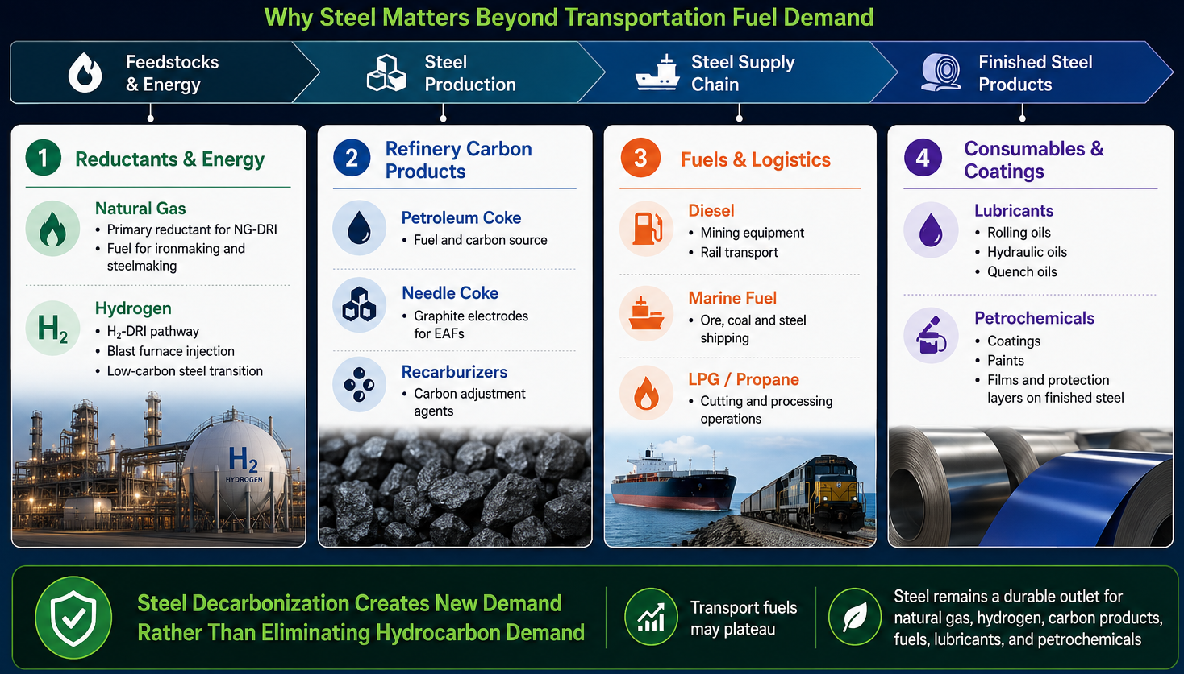
Background—Why Aramco Looks at Steel
Notes:
Hydrogen is a key element that enables clean-energy pathways across various sectors. This slide is divided into two parts: production and end-use.
On the left side, we have the production of hydrogen. Hydrogen can be produced through various methods, including electrolysis using green electricity, and steam methane reforming or methane pyrolysis with CCS.
On the right side, we see the end-use applications of hydrogen. For example, in transportation, synthetic and e-fuels, ammonia for fertilizer, metal production, commercial and residential heat. On top of those, hydrogen’s ability to store energy makes it a valuable solution for balancing the intermittent renewable energy sources like wind and solar. And it does not require a ton of critical minerals.

Slide 3
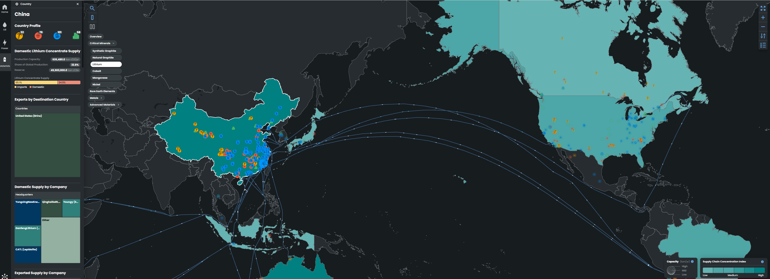
Background—Archie Material
Iron & Steel Trade Flow
Steel will be one of the materials integrated with Archie
Notes:
Hydrogen is a key element that enables clean-energy pathways across various sectors. This slide is divided into two parts: production and end-use.
On the left side, we have the production of hydrogen. Hydrogen can be produced through various methods, including electrolysis using green electricity, and steam methane reforming or methane pyrolysis with CCS.
On the right side, we see the end-use applications of hydrogen. For example, in transportation, synthetic and e-fuels, ammonia for fertilizer, metal production, commercial and residential heat. On top of those, hydrogen’s ability to store energy makes it a valuable solution for balancing the intermittent renewable energy sources like wind and solar. And it does not require a ton of critical minerals.

Slide 4
Data Sources—Iron and Steel
Global Tracker Dataset
Iron mine/steel property data—plant ID/name/operator/parent company/location/operating status/capacity/production
900+ iron ore mines, 1200+ steel plants
S&P Capital IQ Dataset
Iron mine property data—plant ID/name/operator/parent company/location/capacity
Iron mine cost and emissions data—product type, production cost, scope1/scope2/transportation emissions, production for a specific product type, Fe content
900+ iron ore mines
TransitionZero Dataset
Crude steel production cost ($/tonne)
400+ steel plants
Kpler Dataset
Iron ore port-to-port trade flow
Other potential datasets
Metalinfo cost database
World Steel Associate statistical dataset
Steel-on-The-Net (SOTN)
Notes:
Hydrogen is a key element that enables clean-energy pathways across various sectors. This slide is divided into two parts: production and end-use.
On the left side, we have the production of hydrogen. Hydrogen can be produced through various methods, including electrolysis using green electricity, and steam methane reforming or methane pyrolysis with CCS.
On the right side, we see the end-use applications of hydrogen. For example, in transportation, synthetic and e-fuels, ammonia for fertilizer, metal production, commercial and residential heat. On top of those, hydrogen’s ability to store energy makes it a valuable solution for balancing the intermittent renewable energy sources like wind and solar. And it does not require a ton of critical minerals.

Slide 5
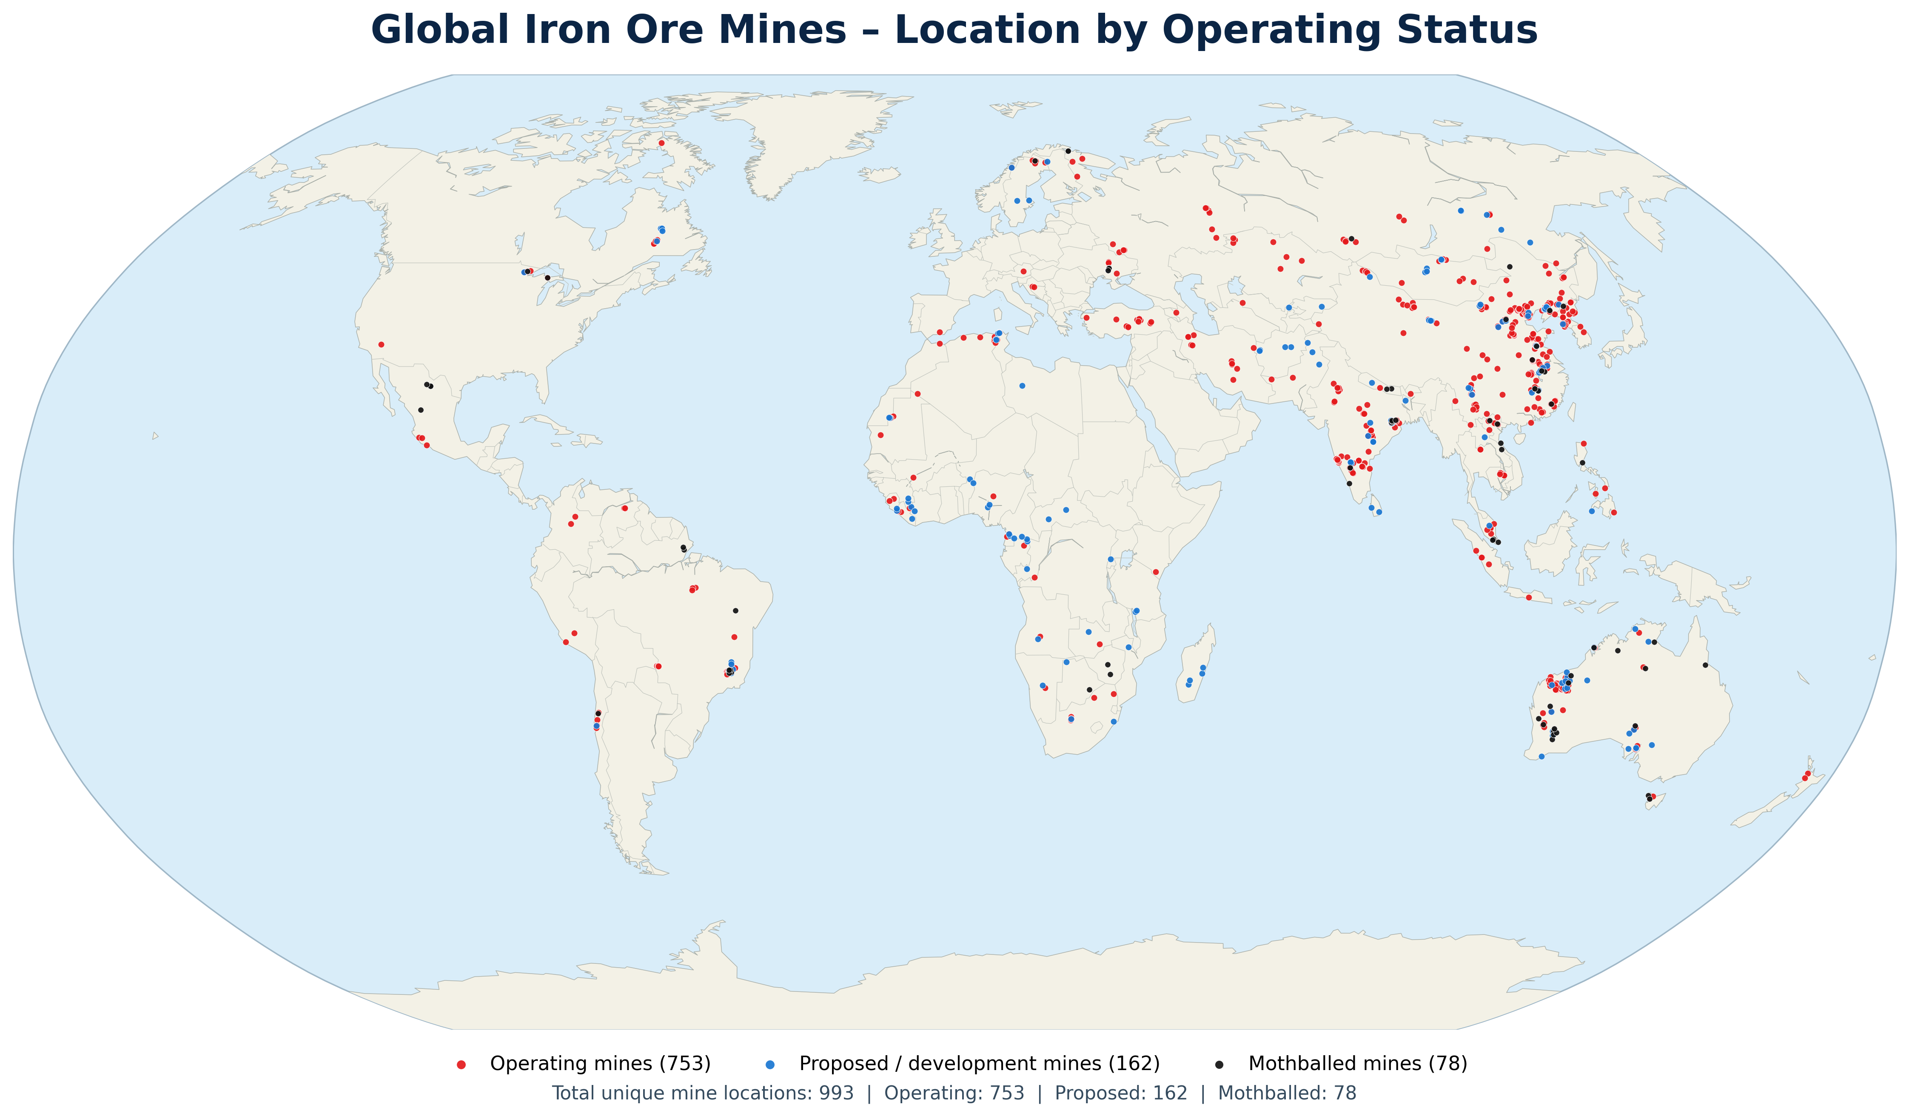
Iron Ore Mine—Global Tracker Merges with S&P Capital IQ
Data processing
Merge the two datasets upon plant name and GPS coordinates
Join the product type, production volume, total production cost ($/tonne), GHG emissions from Cap IQ to Global Tracker
Results in a total of 993 mine plants
Notes:
Hydrogen is a key element that enables clean-energy pathways across various sectors. This slide is divided into two parts: production and end-use.
On the left side, we have the production of hydrogen. Hydrogen can be produced through various methods, including electrolysis using green electricity, and steam methane reforming or methane pyrolysis with CCS.
On the right side, we see the end-use applications of hydrogen. For example, in transportation, synthetic and e-fuels, ammonia for fertilizer, metal production, commercial and residential heat. On top of those, hydrogen’s ability to store energy makes it a valuable solution for balancing the intermittent renewable energy sources like wind and solar. And it does not require a ton of critical minerals.

Slide 6
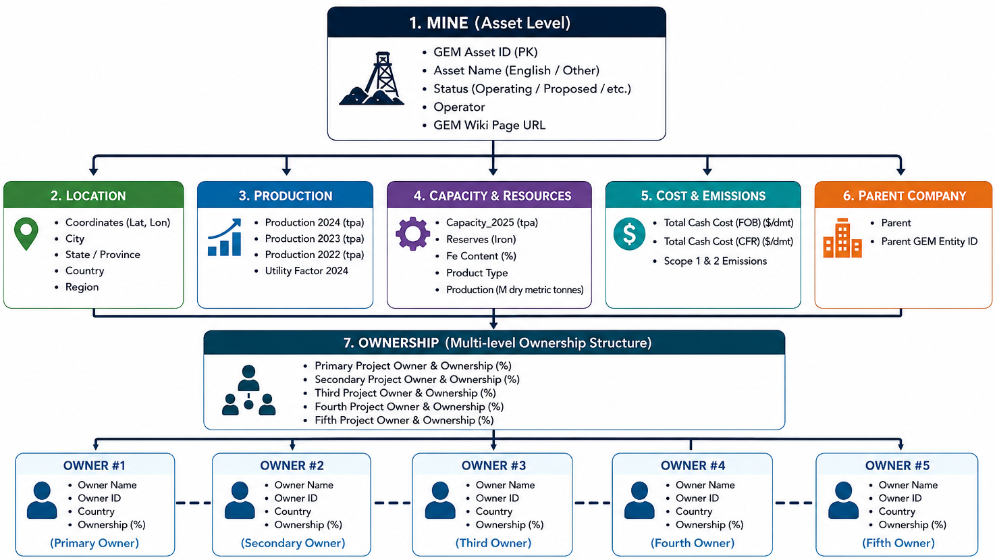
Structure of the Resulting Iron Ore Mine Dataset
Notes:
Hydrogen is a key element that enables clean-energy pathways across various sectors. This slide is divided into two parts: production and end-use.
On the left side, we have the production of hydrogen. Hydrogen can be produced through various methods, including electrolysis using green electricity, and steam methane reforming or methane pyrolysis with CCS.
On the right side, we see the end-use applications of hydrogen. For example, in transportation, synthetic and e-fuels, ammonia for fertilizer, metal production, commercial and residential heat. On top of those, hydrogen’s ability to store energy makes it a valuable solution for balancing the intermittent renewable energy sources like wind and solar. And it does not require a ton of critical minerals.

Slide 7
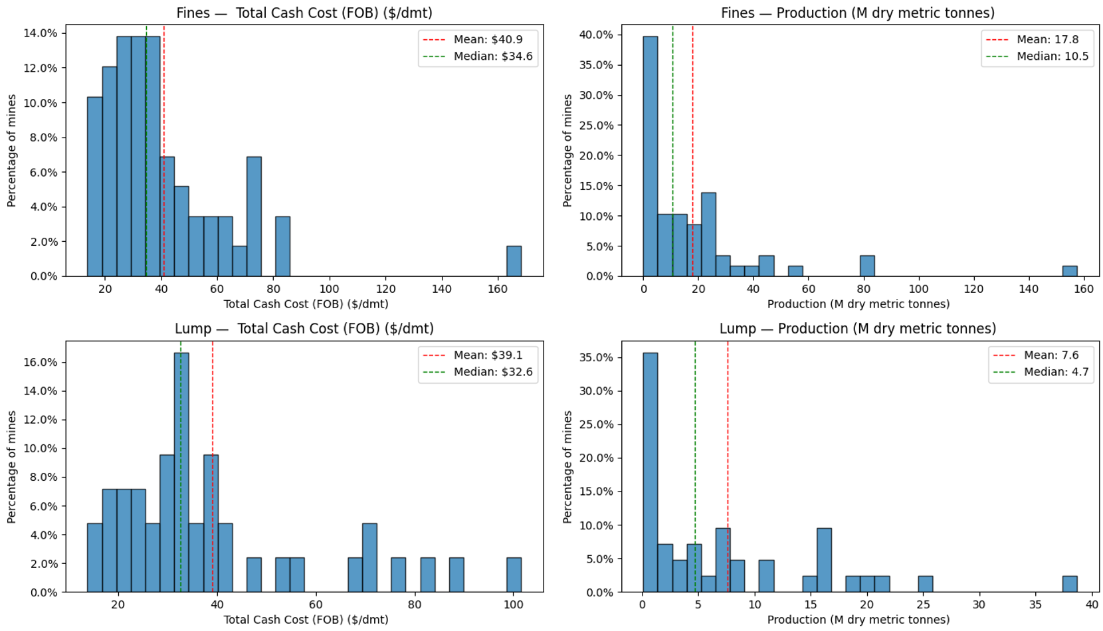
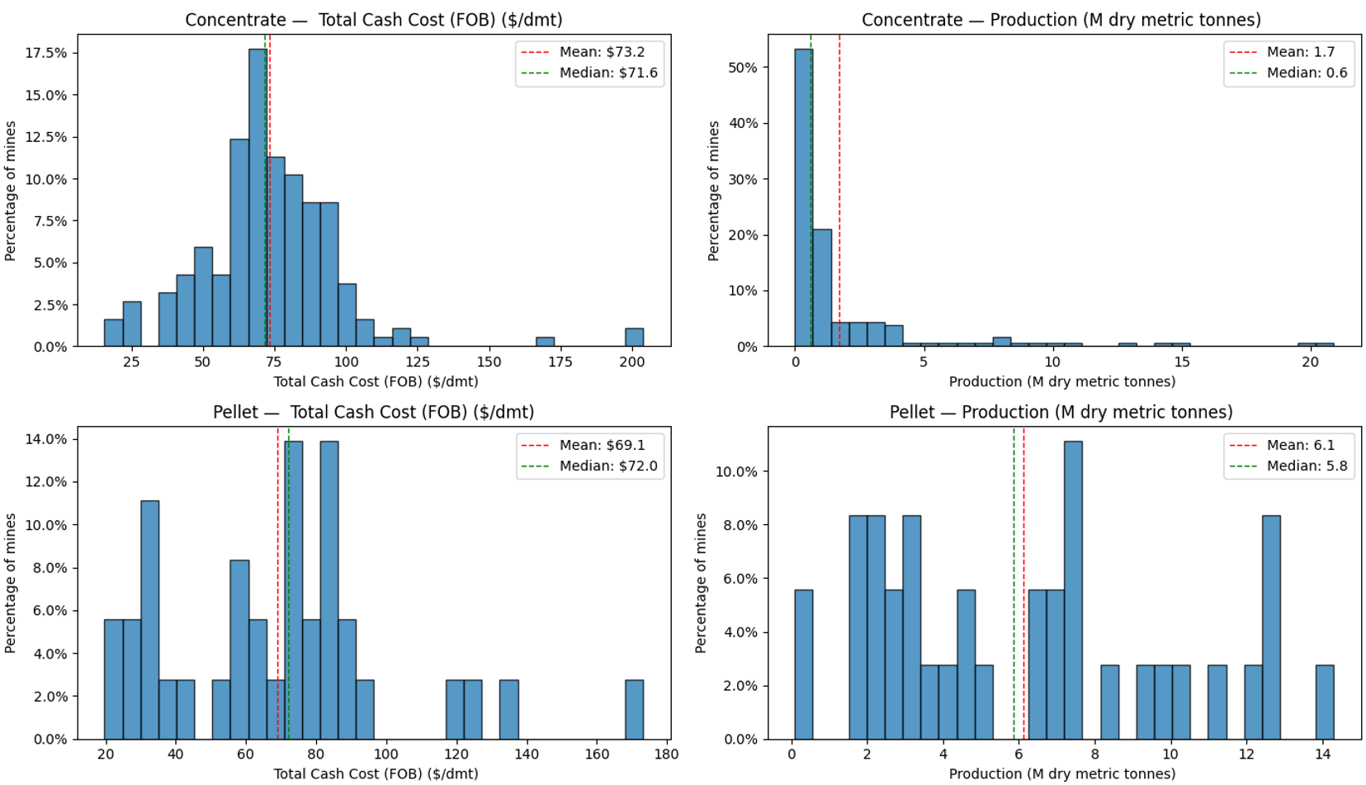
Iron Ore Mine—Preliminary Results
—Total cash cost and production volume (from 200+ mines)
A total of 200+ mines have cost and production data available
Concentrate and Pellet cost much higher than Fines and Lump
Annual production of Fines and Lump is higher than Concentrate and Pellet
Notes:
Hydrogen is a key element that enables clean-energy pathways across various sectors. This slide is divided into two parts: production and end-use.
On the left side, we have the production of hydrogen. Hydrogen can be produced through various methods, including electrolysis using green electricity, and steam methane reforming or methane pyrolysis with CCS.
On the right side, we see the end-use applications of hydrogen. For example, in transportation, synthetic and e-fuels, ammonia for fertilizer, metal production, commercial and residential heat. On top of those, hydrogen’s ability to store energy makes it a valuable solution for balancing the intermittent renewable energy sources like wind and solar. And it does not require a ton of critical minerals.

Slide 8
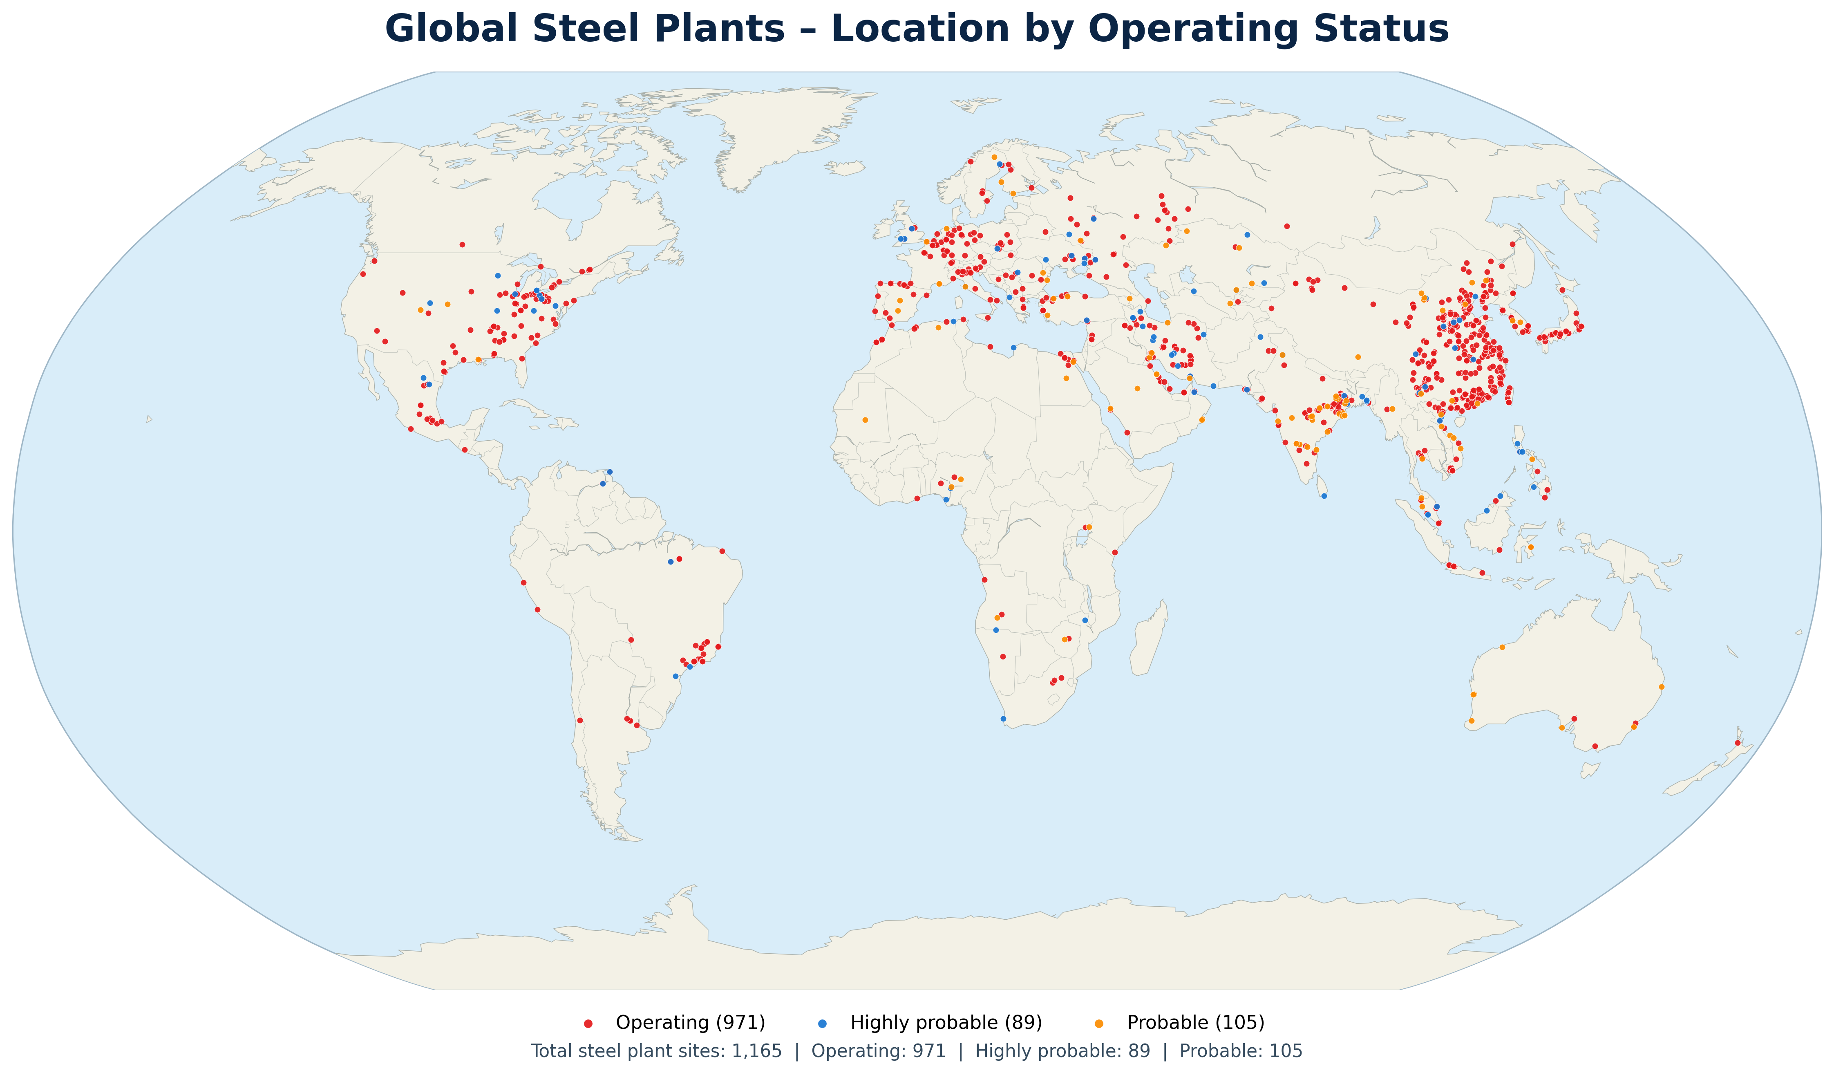
Iron & Steel Plant-level database—Global Tracker Merge with TransitionZero
Data processing
Merge the two datasets upon plant name and GPS coordinates
Join the unit-level production cost ($/tonne crude steel) from TransitionZero to Global Tracker
Results in a total of 1,165 steel plants
The current plants in the dataset account for 51.7% of global production and 90% of global capacity
Notes:
Hydrogen is a key element that enables clean-energy pathways across various sectors. This slide is divided into two parts: production and end-use.
On the left side, we have the production of hydrogen. Hydrogen can be produced through various methods, including electrolysis using green electricity, and steam methane reforming or methane pyrolysis with CCS.
On the right side, we see the end-use applications of hydrogen. For example, in transportation, synthetic and e-fuels, ammonia for fertilizer, metal production, commercial and residential heat. On top of those, hydrogen’s ability to store energy makes it a valuable solution for balancing the intermittent renewable energy sources like wind and solar. And it does not require a ton of critical minerals.

Slide 9
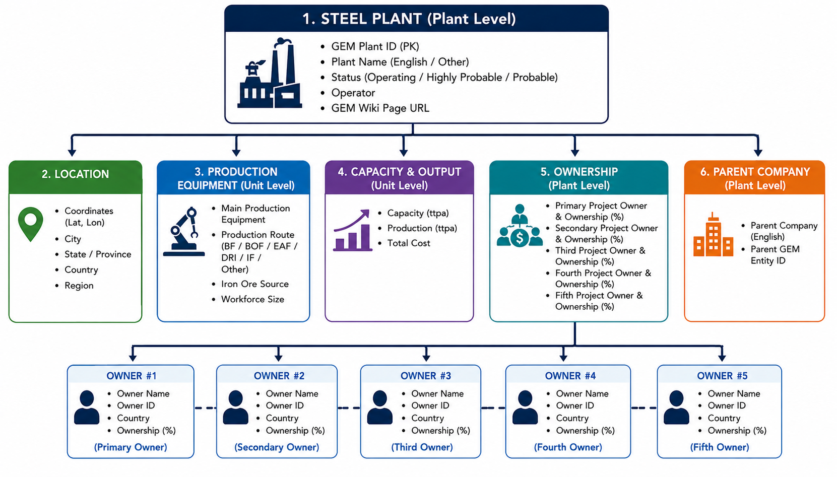
Structure of the Resulting Plant-level Steel database
Notes:
Hydrogen is a key element that enables clean-energy pathways across various sectors. This slide is divided into two parts: production and end-use.
On the left side, we have the production of hydrogen. Hydrogen can be produced through various methods, including electrolysis using green electricity, and steam methane reforming or methane pyrolysis with CCS.
On the right side, we see the end-use applications of hydrogen. For example, in transportation, synthetic and e-fuels, ammonia for fertilizer, metal production, commercial and residential heat. On top of those, hydrogen’s ability to store energy makes it a valuable solution for balancing the intermittent renewable energy sources like wind and solar. And it does not require a ton of critical minerals.

Slide 10
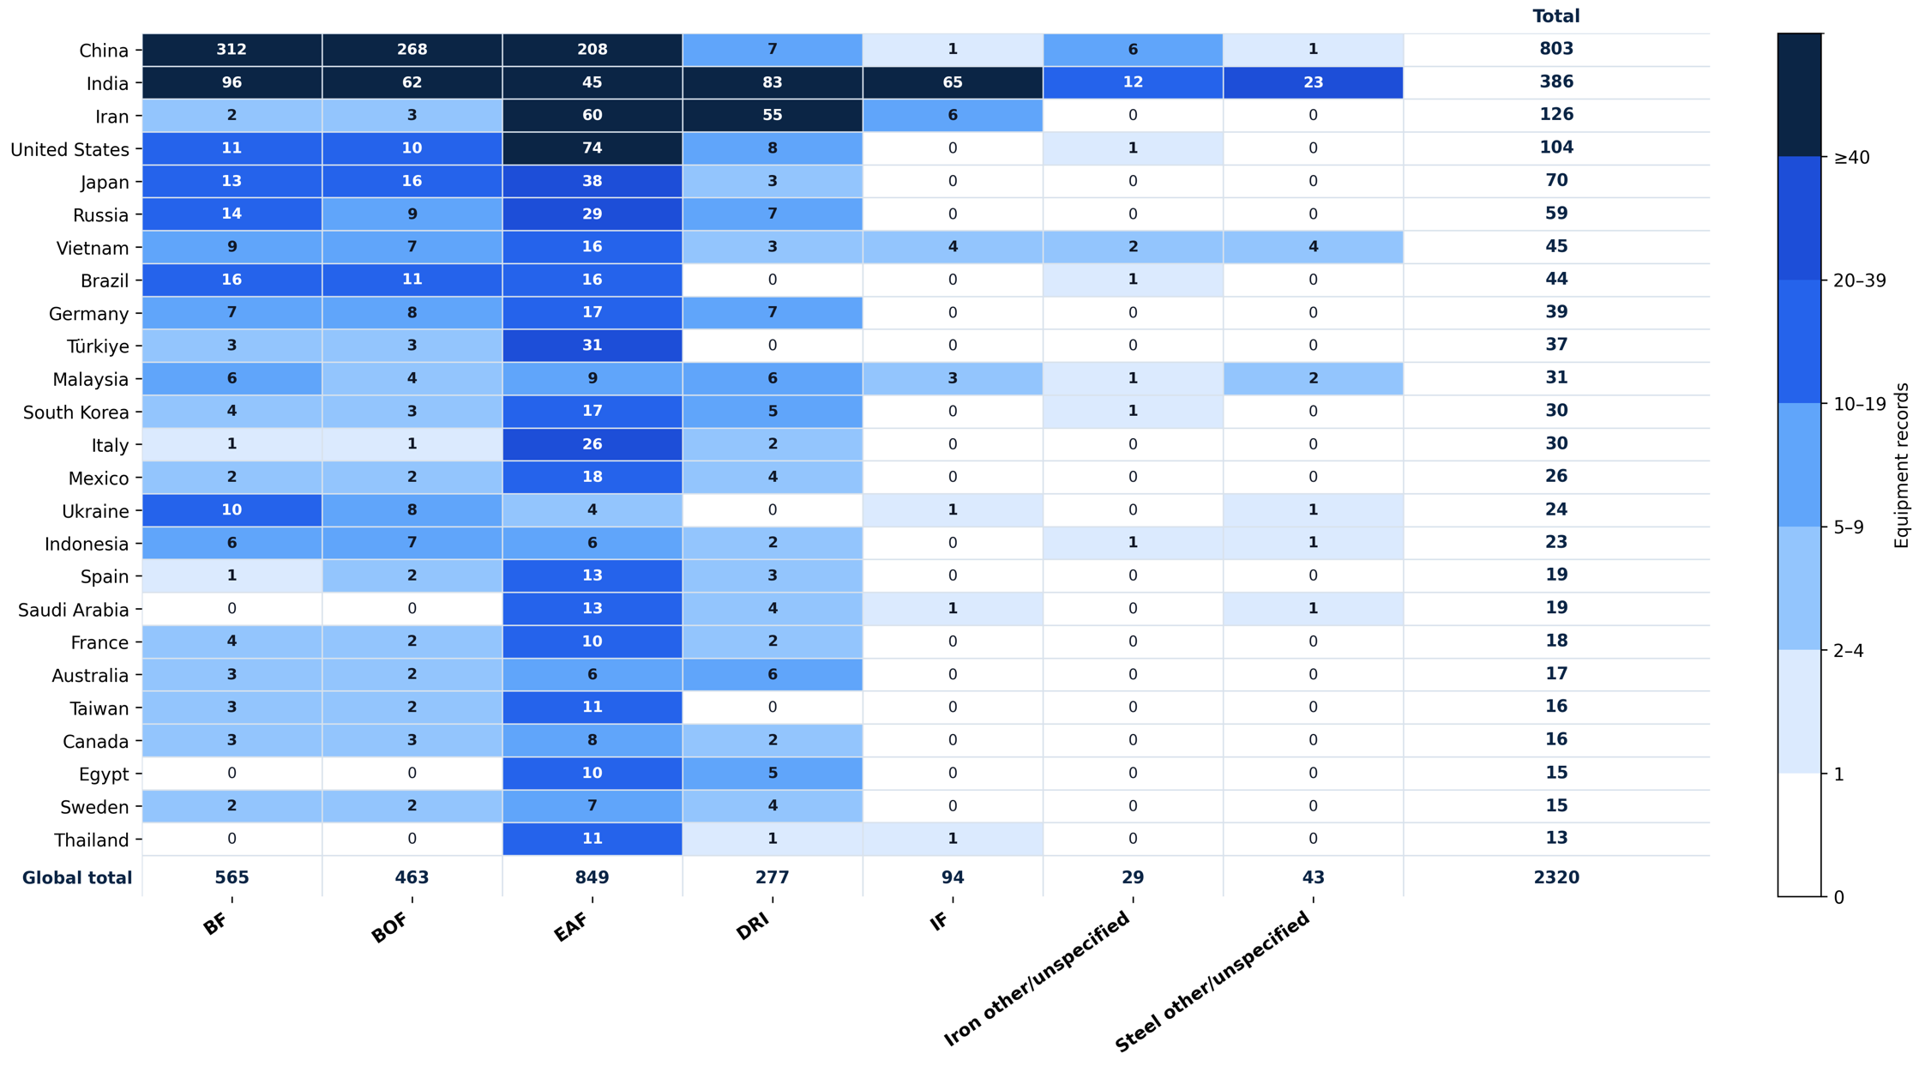
Iron & Steel Plant—Preliminary Results
Equipment distribution across countries
Notes:
Hydrogen is a key element that enables clean-energy pathways across various sectors. This slide is divided into two parts: production and end-use.
On the left side, we have the production of hydrogen. Hydrogen can be produced through various methods, including electrolysis using green electricity, and steam methane reforming or methane pyrolysis with CCS.
On the right side, we see the end-use applications of hydrogen. For example, in transportation, synthetic and e-fuels, ammonia for fertilizer, metal production, commercial and residential heat. On top of those, hydrogen’s ability to store energy makes it a valuable solution for balancing the intermittent renewable energy sources like wind and solar. And it does not require a ton of critical minerals.

Slide 11
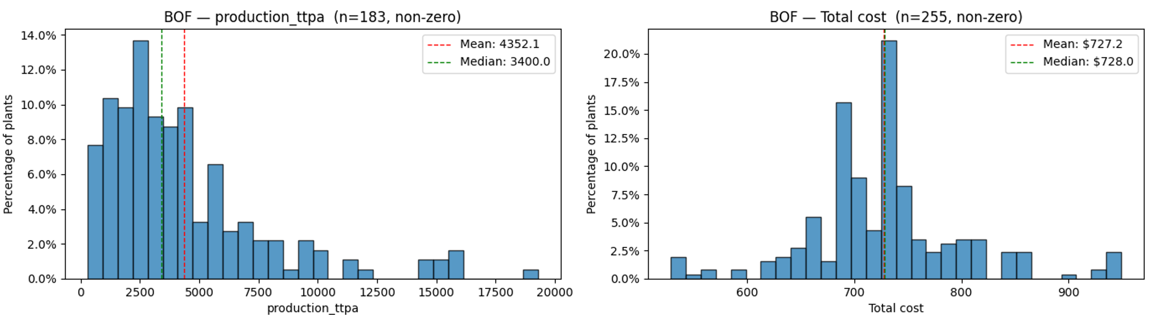
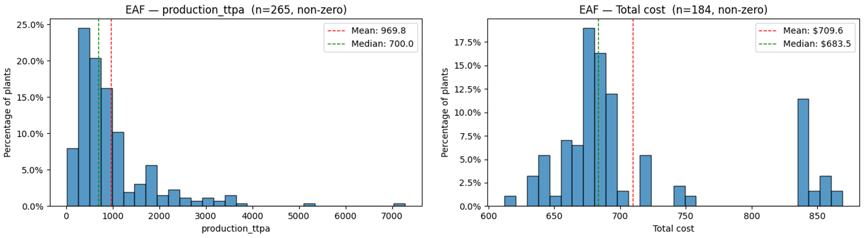
Iron & Steel Plant—Preliminary Results
A total of 1,165 steel plants with 422 units having production volume data and 380 production cost data
Mean production of BOF is much higher than EAF globally
Mean production cost is close between the two technology routes
Notes:
Hydrogen is a key element that enables clean-energy pathways across various sectors. This slide is divided into two parts: production and end-use.
On the left side, we have the production of hydrogen. Hydrogen can be produced through various methods, including electrolysis using green electricity, and steam methane reforming or methane pyrolysis with CCS.
On the right side, we see the end-use applications of hydrogen. For example, in transportation, synthetic and e-fuels, ammonia for fertilizer, metal production, commercial and residential heat. On top of those, hydrogen’s ability to store energy makes it a valuable solution for balancing the intermittent renewable energy sources like wind and solar. And it does not require a ton of critical minerals.

Slide 12
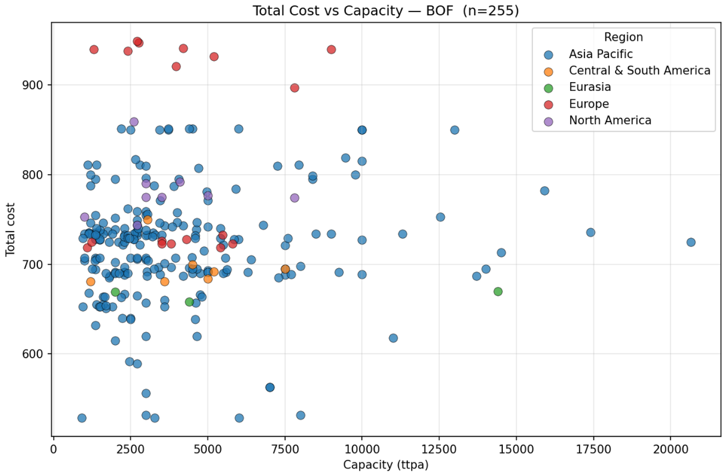
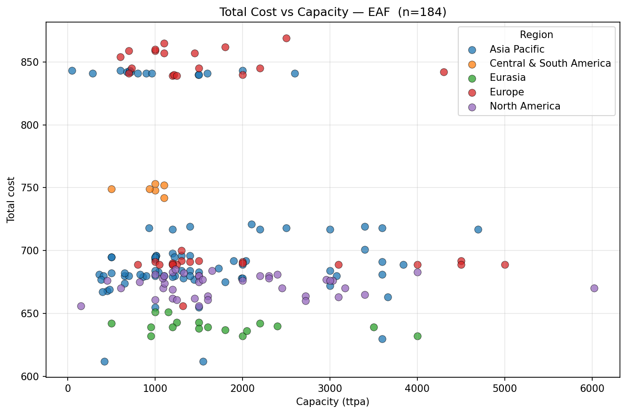
Iron & Steel Plant—Preliminary Results
Production Costs vs. Capacity
Notes:
Hydrogen is a key element that enables clean-energy pathways across various sectors. This slide is divided into two parts: production and end-use.
On the left side, we have the production of hydrogen. Hydrogen can be produced through various methods, including electrolysis using green electricity, and steam methane reforming or methane pyrolysis with CCS.
On the right side, we see the end-use applications of hydrogen. For example, in transportation, synthetic and e-fuels, ammonia for fertilizer, metal production, commercial and residential heat. On top of those, hydrogen’s ability to store energy makes it a valuable solution for balancing the intermittent renewable energy sources like wind and solar. And it does not require a ton of critical minerals.

Slide 13
Next Step
Kpler data for iron ore trade flow
Prepare steel dataset for Archie
Process plant-level CO₂ emission data
Steel value chain decarbonization analysis
Notes:
Hydrogen is a key element that enables clean-energy pathways across various sectors. This slide is divided into two parts: production and end-use.
On the left side, we have the production of hydrogen. Hydrogen can be produced through various methods, including electrolysis using green electricity, and steam methane reforming or methane pyrolysis with CCS.
On the right side, we see the end-use applications of hydrogen. For example, in transportation, synthetic and e-fuels, ammonia for fertilizer, metal production, commercial and residential heat. On top of those, hydrogen’s ability to store energy makes it a valuable solution for balancing the intermittent renewable energy sources like wind and solar. And it does not require a ton of critical minerals.

Slide 14

Thank You!
For further information, please contact:
Jinghui Wang, Ph.D., Lab Scientist
Aramco Research Center – Detroit
46535 Peary Court
Novi, MI 48377 – USA
Tel: +1 248 896 3937
Email: Jinghui.wang@aramcoamericas.com

Slide 15
Backup Slides

Slide 16
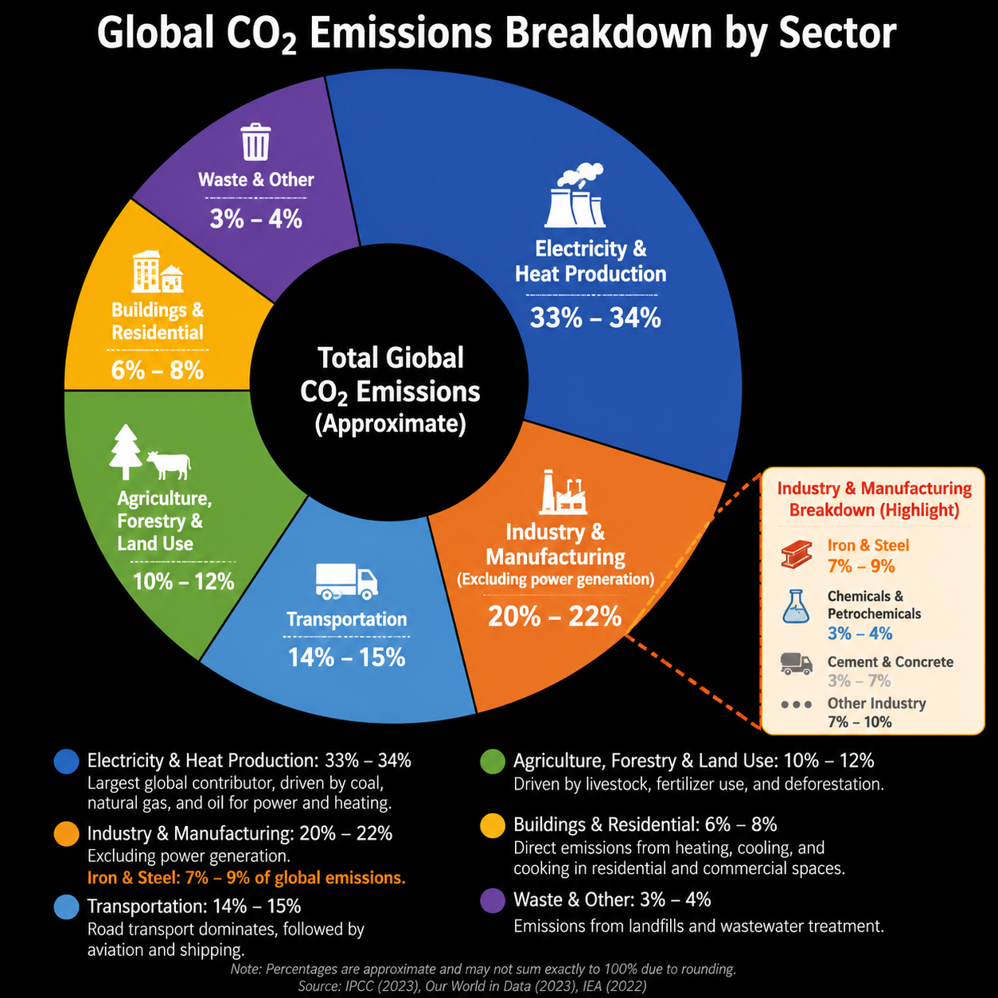
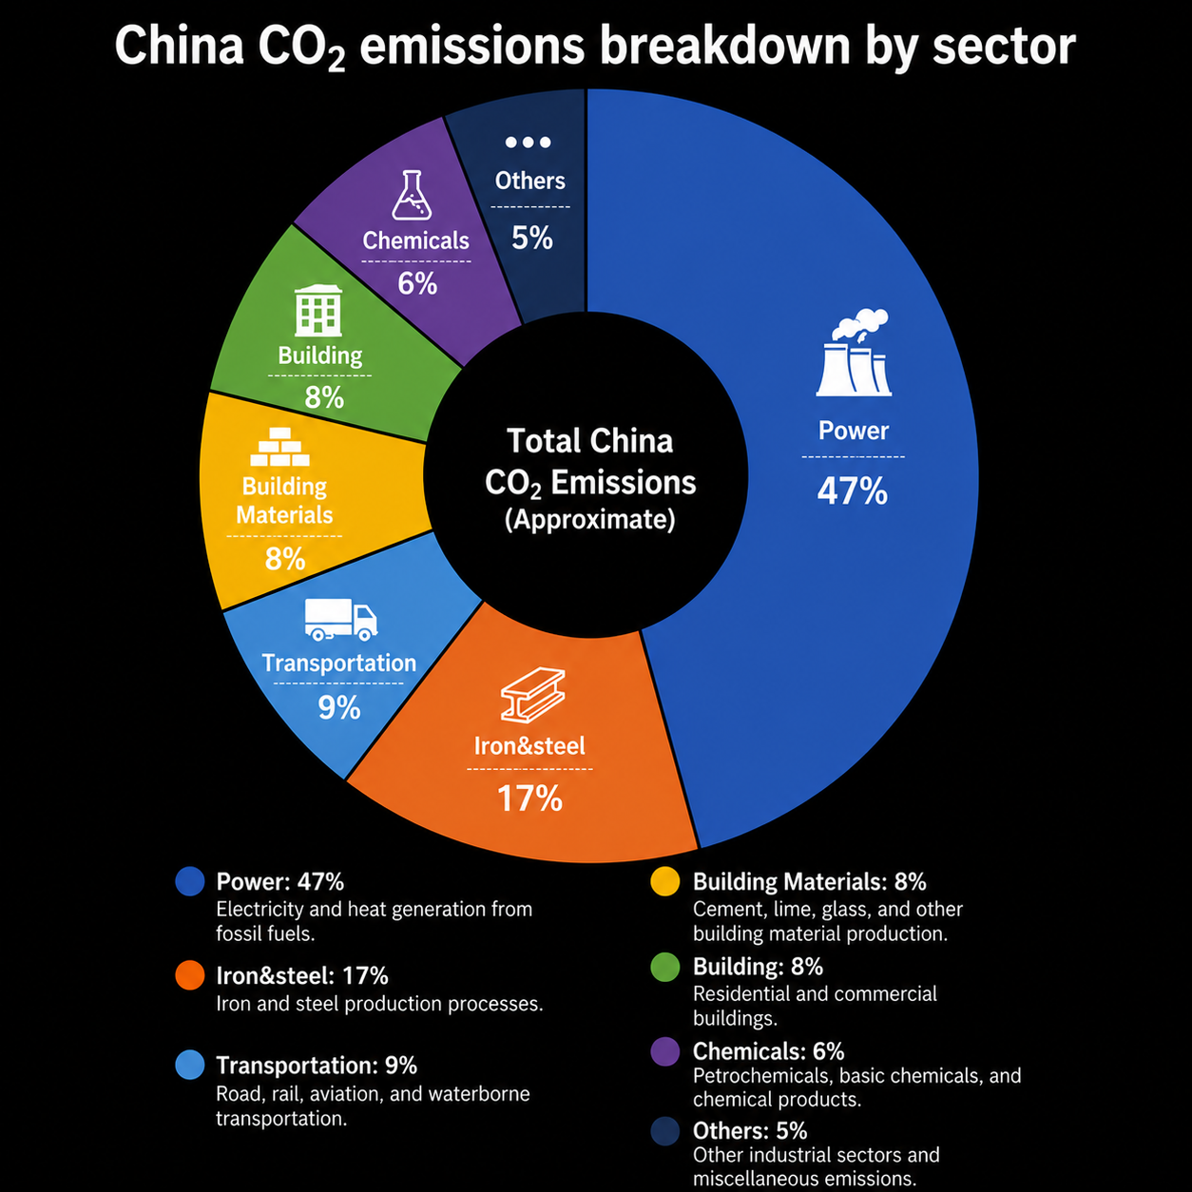
Background—Decarbonization
Iron & Steel industry is the major contributor to CO₂
Notes:
Hydrogen is a key element that enables clean-energy pathways across various sectors. This slide is divided into two parts: production and end-use.
On the left side, we have the production of hydrogen. Hydrogen can be produced through various methods, including electrolysis using green electricity, and steam methane reforming or methane pyrolysis with CCS.
On the right side, we see the end-use applications of hydrogen. For example, in transportation, synthetic and e-fuels, ammonia for fertilizer, metal production, commercial and residential heat. On top of those, hydrogen’s ability to store energy makes it a valuable solution for balancing the intermittent renewable energy sources like wind and solar. And it does not require a ton of critical minerals.

