Slide 1
Steel Production Value Chain-Data Analysis
Jinghui Wang, Ph.D.
Aramco Research Center-Detroit, Aramco Americas
June, 2026

Slide 2
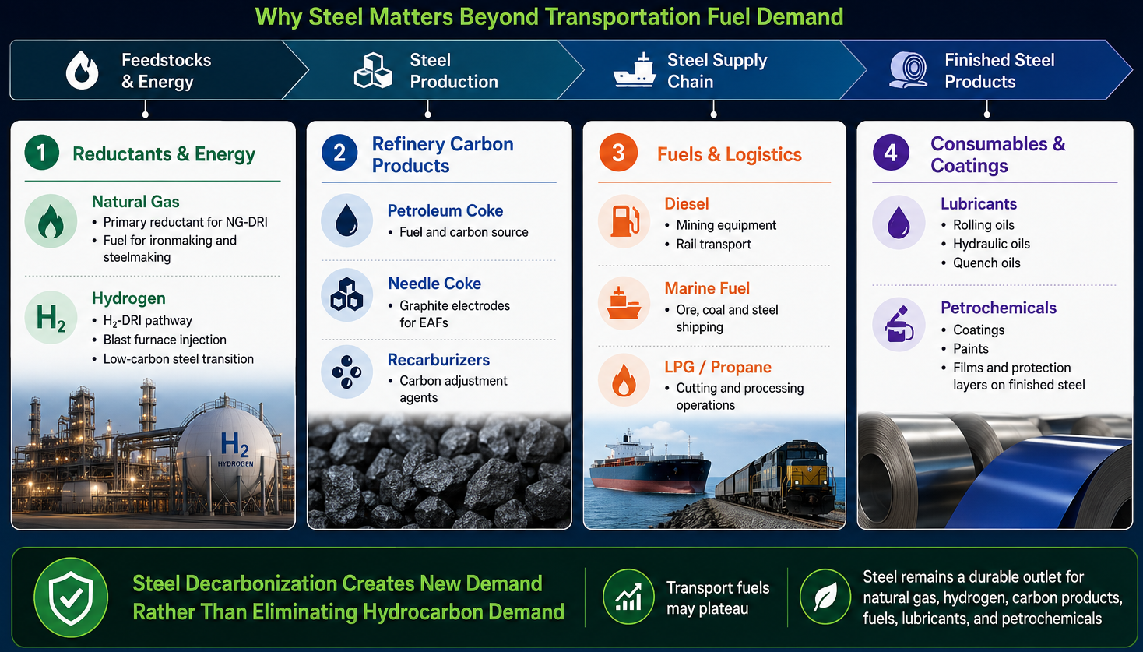
Background—Why Aramco Looks at Steel
Notes:
Hydrogen is a key element that enables clean-energy pathways across various sectors. This slide is divided into two parts: production and end-use.
On the left side, we have the production of hydrogen. Hydrogen can be produced through various methods, including electrolysis using green electricity, and steam methane reforming or methane pyrolysis with CCS.
On the right side, we see the end-use applications of hydrogen. For example, in transportation, synthetic and e-fuels, ammonia for fertilizer, metal production, commercial and residential heat. On top of those, hydrogen’s ability to store energy makes it a valuable solution for balancing the intermittent renewable energy sources like wind and solar. And it does not require a ton of critical minerals.

Slide 3
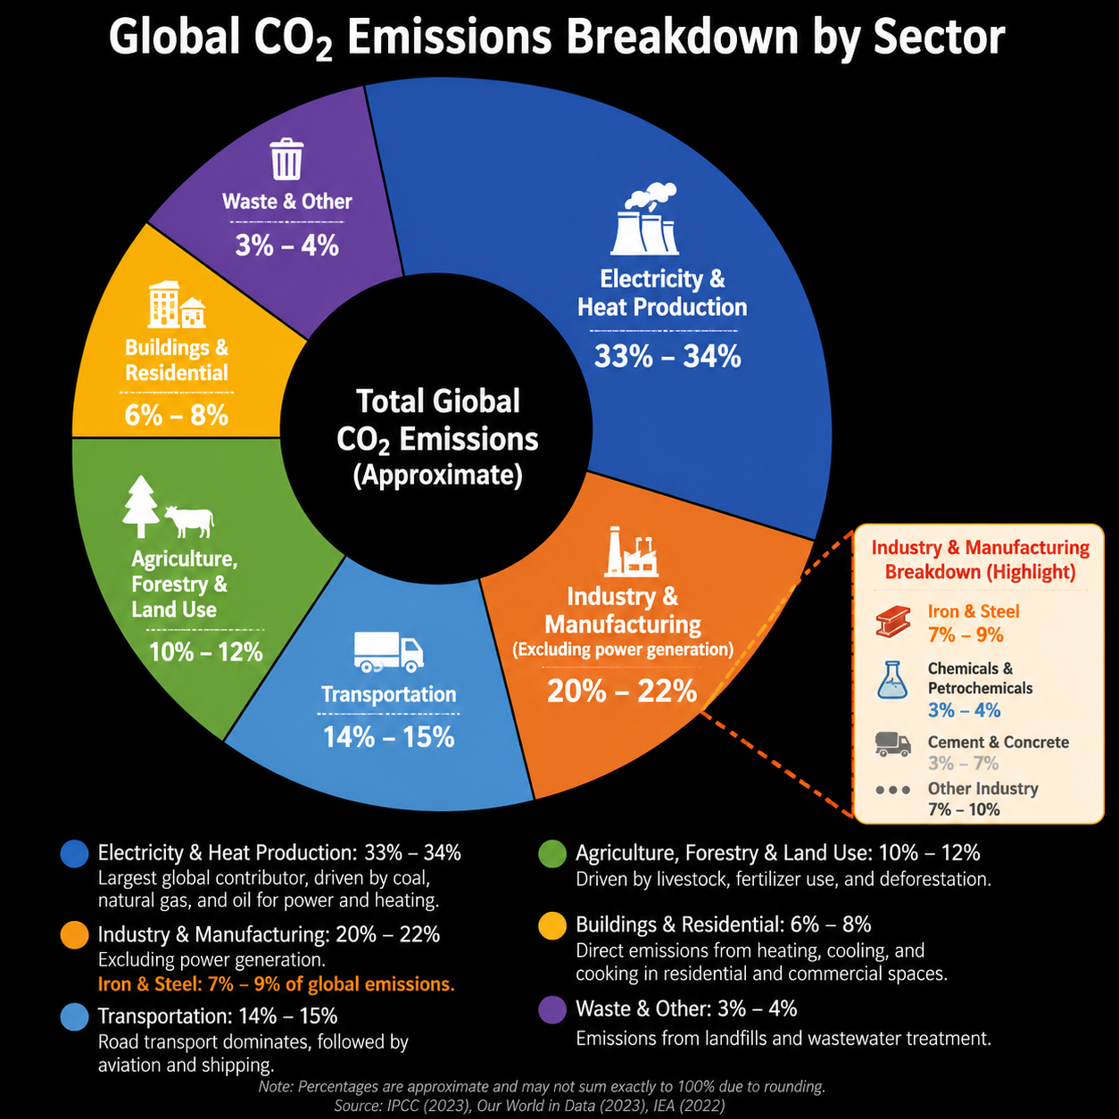
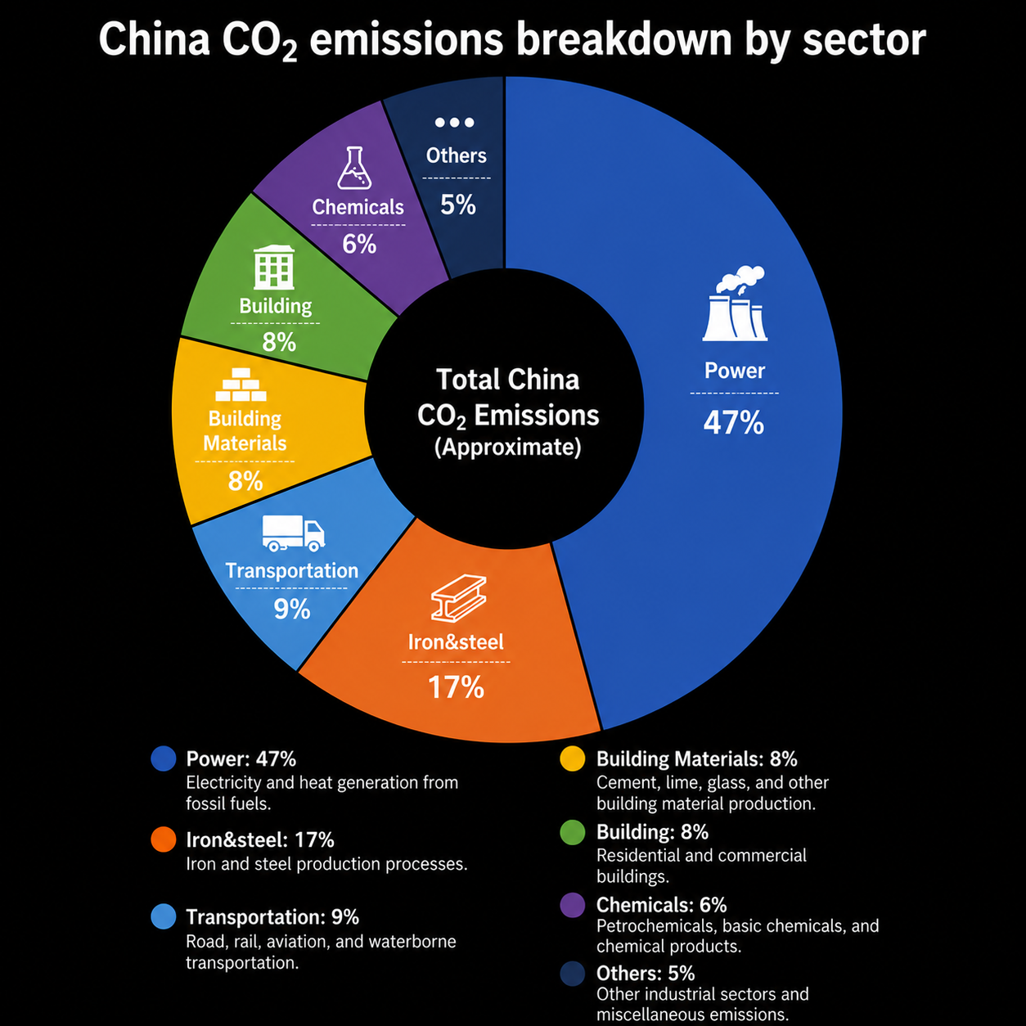
Background—Decarbonization
Iron & Steel industry is the major contributor to CO₂
Notes:
Hydrogen is a key element that enables clean-energy pathways across various sectors. This slide is divided into two parts: production and end-use.
On the left side, we have the production of hydrogen. Hydrogen can be produced through various methods, including electrolysis using green electricity, and steam methane reforming or methane pyrolysis with CCS.
On the right side, we see the end-use applications of hydrogen. For example, in transportation, synthetic and e-fuels, ammonia for fertilizer, metal production, commercial and residential heat. On top of those, hydrogen’s ability to store energy makes it a valuable solution for balancing the intermittent renewable energy sources like wind and solar. And it does not require a ton of critical minerals.

Slide 4
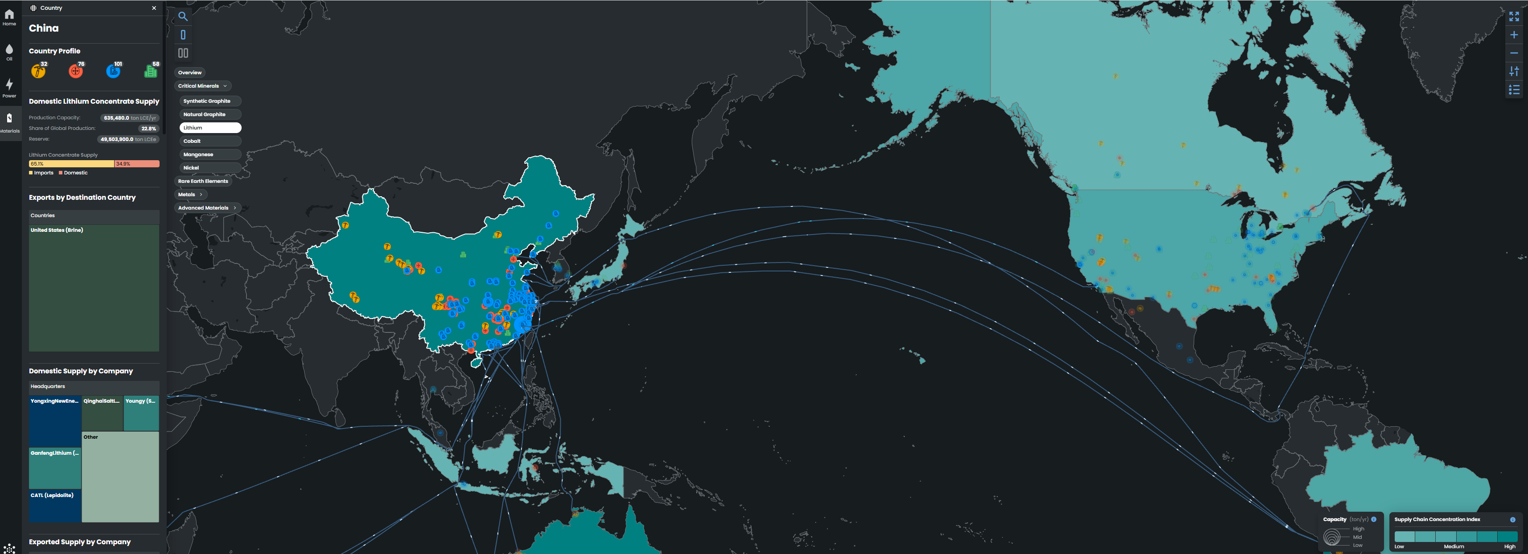
Background—Archie Material
Iron & Steel Trade Flow
Steel will be one of the materials integrated with Archie
Notes:
Hydrogen is a key element that enables clean-energy pathways across various sectors. This slide is divided into two parts: production and end-use.
On the left side, we have the production of hydrogen. Hydrogen can be produced through various methods, including electrolysis using green electricity, and steam methane reforming or methane pyrolysis with CCS.
On the right side, we see the end-use applications of hydrogen. For example, in transportation, synthetic and e-fuels, ammonia for fertilizer, metal production, commercial and residential heat. On top of those, hydrogen’s ability to store energy makes it a valuable solution for balancing the intermittent renewable energy sources like wind and solar. And it does not require a ton of critical minerals.

Slide 5
Data Sources—Iron and Steel
Global Tracker Dataset
Iron mine/steel property data—plant ID/name/operator/parent company/location/operating status/capacity/production
900+ iron ore mines, 1200+ steel plants
S&P Capital IQ Dataset
Iron mine property data—plant ID/name/operator/parent company/location/capacity
Iron mine cost and emissions data—product type, production cost, scope1/scope2/transportation emissions, production for a specific product type, Fe content
900+ iron ore mines
TransitionZero Dataset
Crude steel production cost ($/tonne)
400+ steel plants
Kpler Dataset
Iron ore port-to-port trade flow
Other potential datasets
Metalinfo cost database
World Steel Associate statistical dataset
Steel-on-The-Net (SOTN)
Notes:
Hydrogen is a key element that enables clean-energy pathways across various sectors. This slide is divided into two parts: production and end-use.
On the left side, we have the production of hydrogen. Hydrogen can be produced through various methods, including electrolysis using green electricity, and steam methane reforming or methane pyrolysis with CCS.
On the right side, we see the end-use applications of hydrogen. For example, in transportation, synthetic and e-fuels, ammonia for fertilizer, metal production, commercial and residential heat. On top of those, hydrogen’s ability to store energy makes it a valuable solution for balancing the intermittent renewable energy sources like wind and solar. And it does not require a ton of critical minerals.

Slide 6
Global Tracker Iron Mine Data
Data processing
Select the data in the Global Tracker folder named Global-Iron-Ore-Mines-Tracker-August-2025-V1.xlsx
Filter the mines with status operating, mothballed, proposed, resulting a total of 917 mines
Separate the Parent column into individual columns each of which contains one parent company
Calculate utility factor by having production divided by capacity, for those unknown cells, use the world average for now
The results are presented in the file iron_mines_data.xlsx
Asset name (mine plant name) and coordinates are used matching with S&P Capital IQ data
Future work: try to find out production/capacity for the mines with “unknown”
Notes:
Hydrogen is a key element that enables clean-energy pathways across various sectors. This slide is divided into two parts: production and end-use.
On the left side, we have the production of hydrogen. Hydrogen can be produced through various methods, including electrolysis using green electricity, and steam methane reforming or methane pyrolysis with CCS.
On the right side, we see the end-use applications of hydrogen. For example, in transportation, synthetic and e-fuels, ammonia for fertilizer, metal production, commercial and residential heat. On top of those, hydrogen’s ability to store energy makes it a valuable solution for balancing the intermittent renewable energy sources like wind and solar. And it does not require a ton of critical minerals.

Slide 7
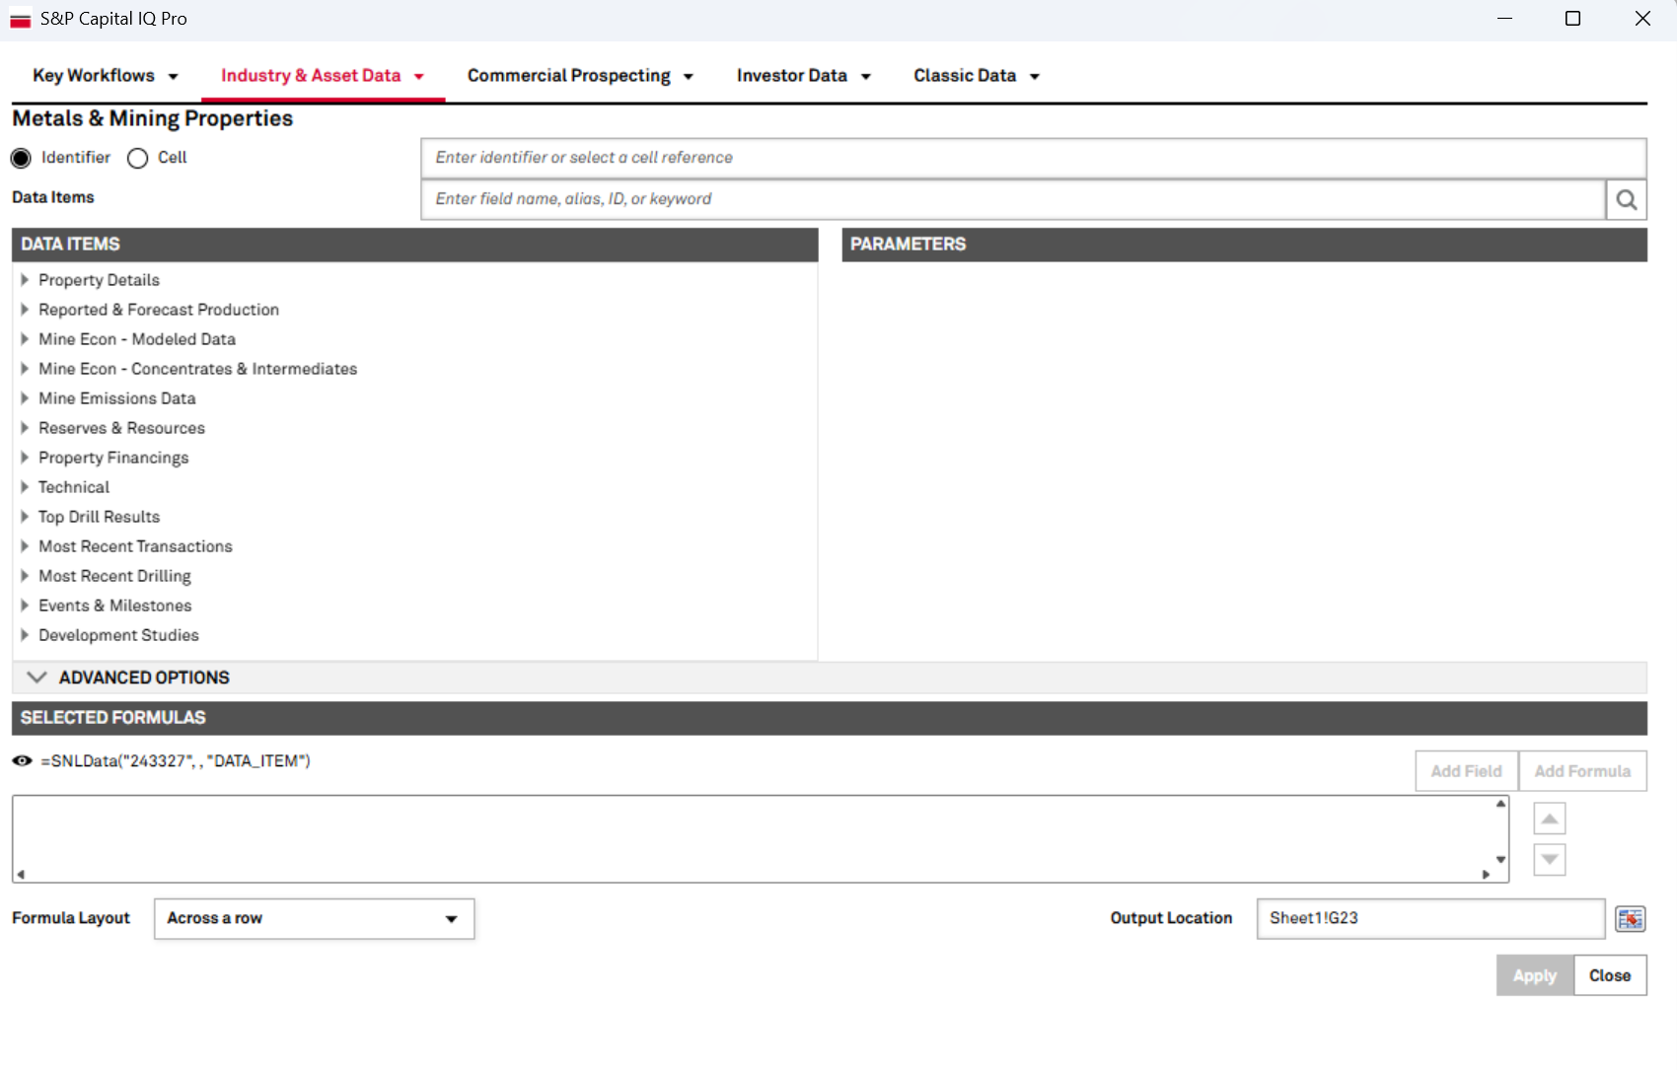
S&P Capital IQ Data
Mine Economics data
Contains all mines with Fe content(%), production, FOB, CFR costs
A total of 243 mines available
One mine may produce different types of products including Fines, Concentrate, Lump, and Pellet
The data is available in SPGlobal_MineEconomics_22-Apr-2026.xlsx in the S&P Capital IQ folder
Mine Property data
Retrieve property data via S&P Cap IQ Pro Excel Add-in (see screenshot below)
The raw output is provided in iron_ore_property.xlsx in the S&P Capital IQ folder
Melt the raw table based on columns related to Fe content, cost and emissions
Filter the mines with available Fe content, cost and emissions
Results provided in melted_capital_iq_data.xlsx
Notes:
Hydrogen is a key element that enables clean-energy pathways across various sectors. This slide is divided into two parts: production and end-use.
On the left side, we have the production of hydrogen. Hydrogen can be produced through various methods, including electrolysis using green electricity, and steam methane reforming or methane pyrolysis with CCS.
On the right side, we see the end-use applications of hydrogen. For example, in transportation, synthetic and e-fuels, ammonia for fertilizer, metal production, commercial and residential heat. On top of those, hydrogen’s ability to store energy makes it a valuable solution for balancing the intermittent renewable energy sources like wind and solar. And it does not require a ton of critical minerals.

Slide 8
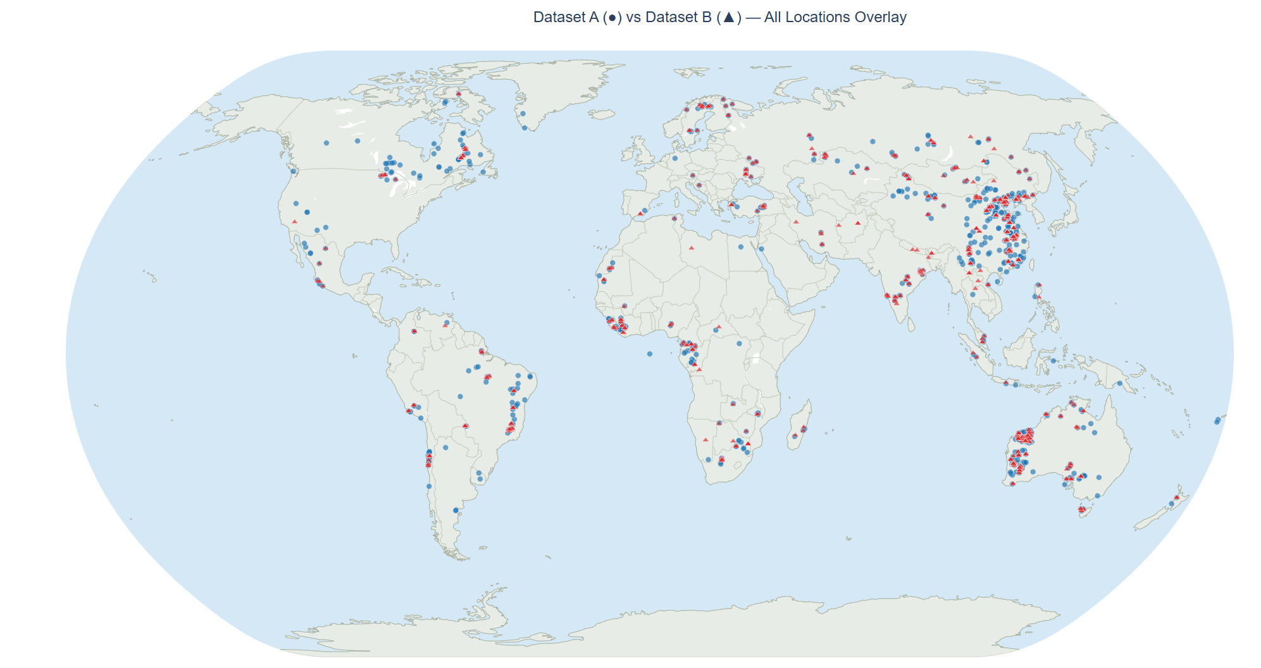
S&P Capital IQ Data Matching with Global Tracker
Visualization
Dataset A is Capital IQ
Dataset B is Global Tracker
Notes:
Hydrogen is a key element that enables clean-energy pathways across various sectors. This slide is divided into two parts: production and end-use.
On the left side, we have the production of hydrogen. Hydrogen can be produced through various methods, including electrolysis using green electricity, and steam methane reforming or methane pyrolysis with CCS.
On the right side, we see the end-use applications of hydrogen. For example, in transportation, synthetic and e-fuels, ammonia for fertilizer, metal production, commercial and residential heat. On top of those, hydrogen’s ability to store energy makes it a valuable solution for balancing the intermittent renewable energy sources like wind and solar. And it does not require a ton of critical minerals.

Slide 9
Merge Capital IQ Data with Global Tracker Data
Merge the two datasets using mine name and coordinates
Retrieve mine names and coordinates from both datasets and upload to Cloude to match, first use name to match then distance
Manual check if the matching reliability especially for those with matching scores lower than 90
Results presented in mine_asset_matches_v4.xlsx and mine_distance_matches (mines with cost data).xlsx
Retrieve operator names from Global Tracker dataset based on matched mines
Merge the mine_asset_matches_v4.xlsx and mine_distance_matches (mines with cost data).xlsx with the Mine Economics data and add mine and operator names to the Economics dataset
Merge Economics data with Global Tracker data based on mine and operator names, resulting in globaltracker_w_cost_FeContent.xlsx
Notes:
Hydrogen is a key element that enables clean-energy pathways across various sectors. This slide is divided into two parts: production and end-use.
On the left side, we have the production of hydrogen. Hydrogen can be produced through various methods, including electrolysis using green electricity, and steam methane reforming or methane pyrolysis with CCS.
On the right side, we see the end-use applications of hydrogen. For example, in transportation, synthetic and e-fuels, ammonia for fertilizer, metal production, commercial and residential heat. On top of those, hydrogen’s ability to store energy makes it a valuable solution for balancing the intermittent renewable energy sources like wind and solar. And it does not require a ton of critical minerals.

Slide 10
Merge Kpler Data
Combine the one year data files into one data frame, results in kpler data/kpler_trade_flow_data/processed_data/kpler_trade_flow_data_combined.xlsx
Aggregate trade flow between ports by summing up the cargo (tons) column for each seller-origin port-buyer-destination port-product type pair, results in kpler data/kpler_trade_flow_data/processed_data/kpler_aggregated_trade_flow_exploded.xlsx
Match kpler data with Global Tracker based on Seller/buyer name, installation/destination origin (port terminal), Zone origina/Destination (port zone), and country origin/destination, results in kpler data/kpler_trade_flow_data/kpler_seller_city_mine_operator.xlsx
Notes:
Hydrogen is a key element that enables clean-energy pathways across various sectors. This slide is divided into two parts: production and end-use.
On the left side, we have the production of hydrogen. Hydrogen can be produced through various methods, including electrolysis using green electricity, and steam methane reforming or methane pyrolysis with CCS.
On the right side, we see the end-use applications of hydrogen. For example, in transportation, synthetic and e-fuels, ammonia for fertilizer, metal production, commercial and residential heat. On top of those, hydrogen’s ability to store energy makes it a valuable solution for balancing the intermittent renewable energy sources like wind and solar. And it does not require a ton of critical minerals.

Slide 11

Thank You!
For further information, please contact:
Jinghui Wang, Ph.D., Lab Scientist
Aramco Research Center – Detroit
46535 Peary Court
Novi, MI 48377 – USA
Tel: +1 248 896 3937
Email: Jinghui.wang@aramcoamericas.com

