Slide 1
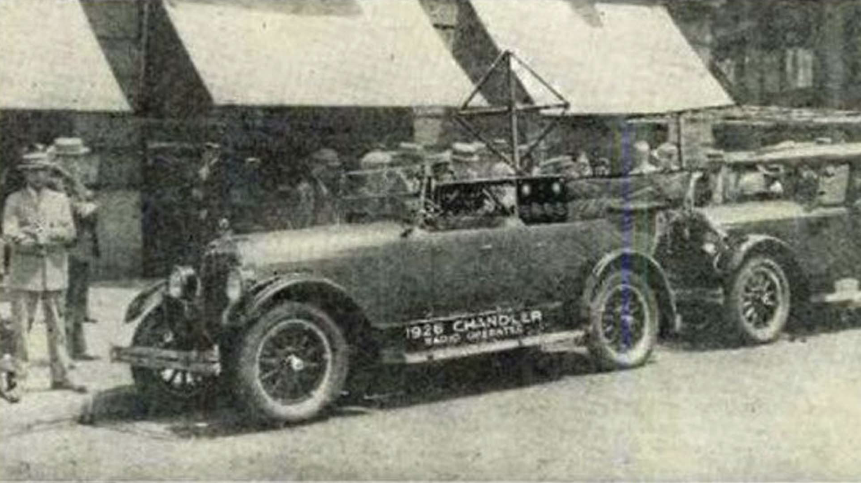
History of Automated Vehicles
1991| U.S. Congress requested DOT to demonstrate an automated vehicle and highway system
2014| SAE announced six levels of vehicle automation
2016| U.S. DOT announced the first AV plan; the first fatal crash involving a self-driving vehicle was reported
1998 | Toyota became the first to commercialize ACC system
1986| First use of LiDAR, computer vision, and autonomous robotic control to direct an automated vehicle
2018| Waymo launched the first commercial Robotaxi in the world
1925| The first “automated vehicle” in the world—radio controlled
1958| Sensor was first used to move steering wheel left or right
2009| Google started its autonomous driving program
2020| Tesla launched FSD program
1925
1935
1955
1965
1985
1995
2005
2015
2025
1939| “Automated Vehicle” first time propelled via electromagnetic field
1961| First use of camera in “automated vehicle”
2004| Defense Advanced Research Projects Agency (DARPA) launched projects to test AVs in off-road terrain
2014 | Tesla Autopilot program kick-off
1989| First use of neural network in the autonomous driving industry
2011| First legislation in the United States
2021| Level 3 start commercialization

Slide 2
History of Automated Vehicles
CMU: Carnegie Mellon University
DARPA: Defense Advanced Research Projects Agency
SAE: Society of Automotive Engineers
FSD: Fully Self-Driving
1995| CMU’s NavLab5 steered autonomously 98% of the time with throttle and brake control (U.S.)
By mid of 2010s|Toyota, Audi, Benz, Ford, BMW, Uber, Tesla started AV commercialization program
1997 | The first major demonstration of automated highway system (U.S.)
2016| The first fatal crash involving a self-driving vehicle was reported (U.S.)
2009| Google (Waymo) started its commercial autonomous driving program (U.S.)
2018| Waymo launched the first commercial Robotaxi in the world
1961| Stanford cart with sensors built to drive autonomously on the moon (U.S.)
1987| Self-driving with dynamic object detection (Germany)
1925| The first radio-controlled car (U.S.)
2011| First AV law in the world (U.S.)
2020| Tesla launched FSD program
1925
1940
1960
1980
1990
2000
2010
2015
2025
1939| autonomous magnetized freeway concept (U.S.)
2004-2007| DARPA Grand Challenge kicks AV development into high gear (U.S.)
1977| Self-driving vehicle with two cameras recognizing street markings (Japan)
2014| SAE announced six levels of vehicle automation (U.S.)
2023|First National AV commercial operation regulation (China)
1989| Neural network first time used in the AV industry (U.S.)
Conception
Foundational Research
Commercial Development
2021| Level 3 start commercialization

