Slide 1
Retrieval-Augmented Generation (RAG) For Supply Chain Material
Jinghui Wang

Slide 2
RAG Workflow
Query: User inputs a search request.
Retrieval: Relevant documents fetched from databases or public sources.
Context Injection: Inject retrieved content into the LLM.
Generation: Model generates context-aware answers or insights.
Output: Final results delivered to the user via reports or dashboards.
Notes:
<number>

Slide 3
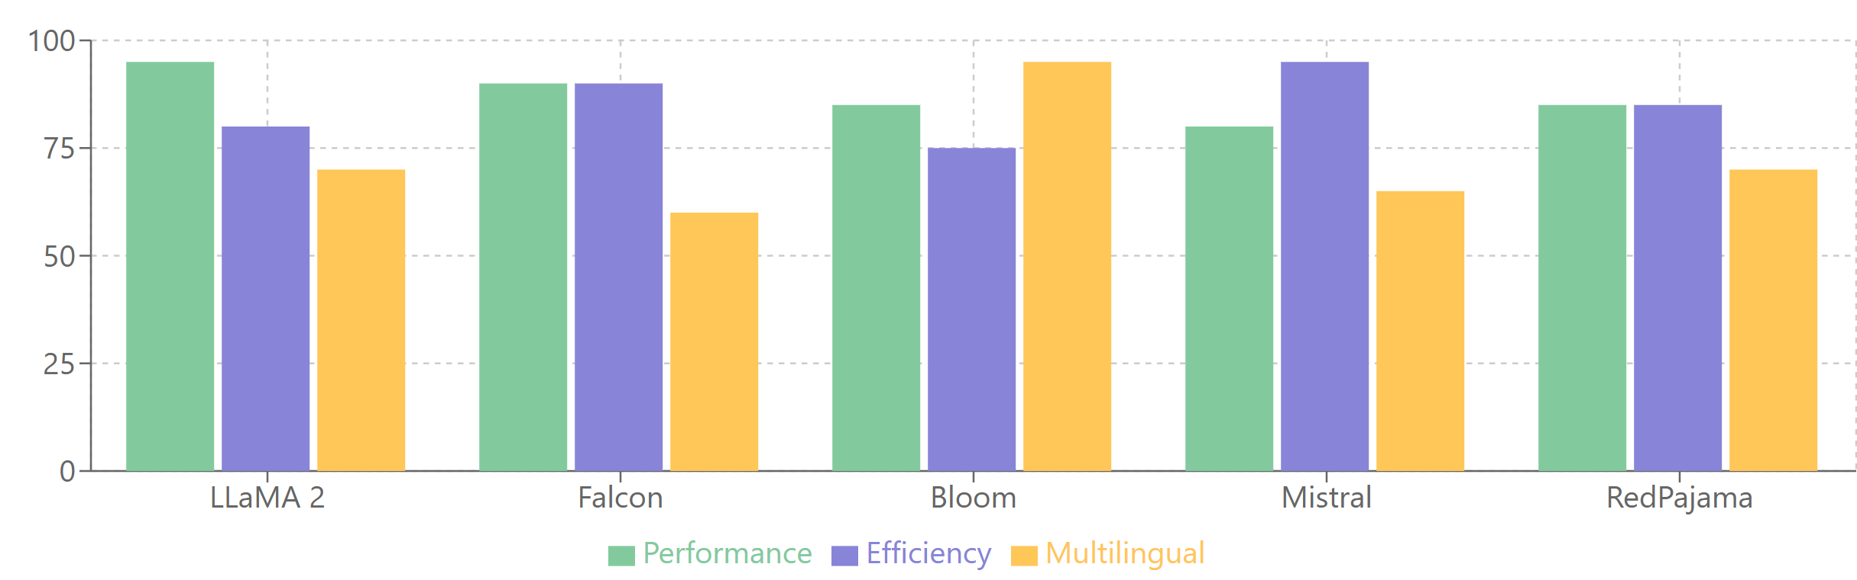
Comparison of Open Source LLM
LLaMA 2: Best overall for performance and domain-specific customization.
Falcon: Ideal for real-time analysis and cost-effective deployment.
Bloom: Recommended for multilingual applications in global supply chains.
Notes:
<number>

Slide 4
Development Pipeline Summary
Data Collection: Automated retrieval from public sources using APIs and web scraping.
Data Processing: Clean, normalize, and store in a structured database.
Insight Analysis: Utilize fine-tuned LLMs to generate actionable insights.
Automation: Schedule periodic updates and ensure seamless workflow.
Notes:
<number>

Slide 5
LangChain vs. Hugging Face
Feature | LangChain | Hugging Face
Support for Open-Source LLMs | Indirect support through integrations (e.g., Hugging Face, OpenAI, Cohere). | Direct support with a vast repository of open-source LLMs like GPT-NeoX, BLOOM, Falcon, etc.
Pretrained Models | Does not provide pretrained models directly but can integrate models from platforms like Hugging Face. | Hosts thousands of pretrained models for various tasks, including transformers for NLP.
Fine-Tuning Capabilities | Limited; relies on external tools (e.g., Hugging Face, PyTorch, TensorFlow) for fine-tuning. | Strong support for domain-specific fine-tuning and training pipelines (transformers and datasets).
Retrieval and Workflow Management | Strong focus; provides ready-to-use components for retrieval, embeddings, and chaining. | Limited to model interaction; retrieval requires third-party tools or custom implementation.
Ease of Pipeline Development | Optimized for building RAG workflows by integrating retrieval, generation, and user interaction. | Requires manual assembly of retrieval workflows; best suited for model training and experimentation.
27/10/2014
Copyright note text (8pt)

Slide 6
Tools to Be Used
Langchain: real-time data retrieval, more specific to LLM than Apache Airflow
Hugging Face: LLM and pre-trained models, fine-tuning
PostgreSQL: structured data
MongoDB and spark: both structured and unstructured data
Pinecone, Weaviate, or FAISS for semantic search
Tool | Structured Data | Unstructured Data | Geospatial Analysis | Integration | Scalability
PostgreSQL + PostGIS | Excellent | Moderate | Advanced (PostGIS) | Python (GeoPandas, psycopg2) | Moderate
MongoDB | Good | Excellent | Basic (built-in geospatial queries) | Python (Pymongo) | High (sharded clusters)
Elasticsearch | Good | Excellent | Moderate (geodistance, bounding box) | REST APIs, Python | High (distributed)
BigQuery with GIS | Excellent | Excellent | Advanced (GIS functions) | Cloud-based Python APIs | High (cloud-native)
Apache Spark + GeoSpark | Excellent | Excellent | Moderate to Advanced (GeoSpark) | PySpark, GeoPandas | Very High (distributed)
27/10/2014
Copyright note text (8pt)
Notes:
<number>

Slide 7
Feature/Capability | Pinecone | Weaviate
Ease of Use | Simple, managed solution; focuses solely on vector search | Open-source, customizable; includes more features like hybrid search
Deployment Options | Fully managed cloud service (no on-premise support) | Open-source (self-hosted) or managed cloud service
Supported Data Types | Vectors only (e.g., embeddings for text, images) | Vectors, hybrid (vector + symbolic), integrates with schemas
Scalability | Scales seamlessly with large datasets; optimized for performance | Scales well; requires more configuration for very large datasets
Integration with ML Models | Compatible with external model-generated embeddings | Includes built-in modules for generating embeddings (e.g., text2vec, image2vec)
Flexibility | Focused exclusively on semantic search | Highly flexible, supporting complex queries and hybrid search
Search Functionality | Optimized for high-speed, large-scale vector search | Supports vector search, symbolic search, and hybrid approaches
Cost | Subscription-based pricing; simpler cost structure | Free for self-hosted; paid for managed service
Community and Ecosystem | Smaller community; robust for dedicated vector search | Larger open-source community; supports broader use cases
Geospatial Search | Limited support | Native geospatial search support
Data Management | No built-in schema or rich metadata handling | Includes schema and metadata handling capabilities
| Use Case | Need Database? | Suggested Tool |
|-------------------------------|----------------------|--------------------------|
| Simple LLM prompts | ❌ No | None |
| Document search / RAG | ✅ Yes | Weaviate, Qdrant, FAISS |
| Logging / storage | ✅ Optional | MongoDB, Postgres |
| Chat history / user sessions | ✅ Optional | MongoDB, Redis, SQLite |
27/10/2014
Copyright note text (8pt)

Slide 8
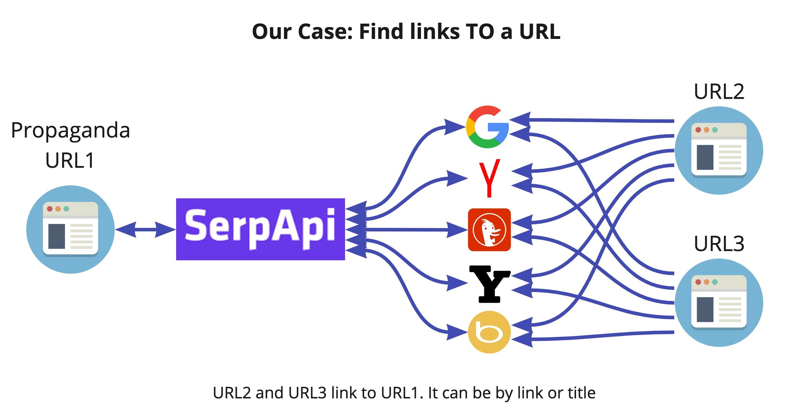
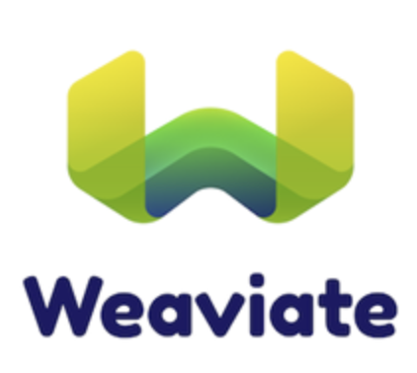
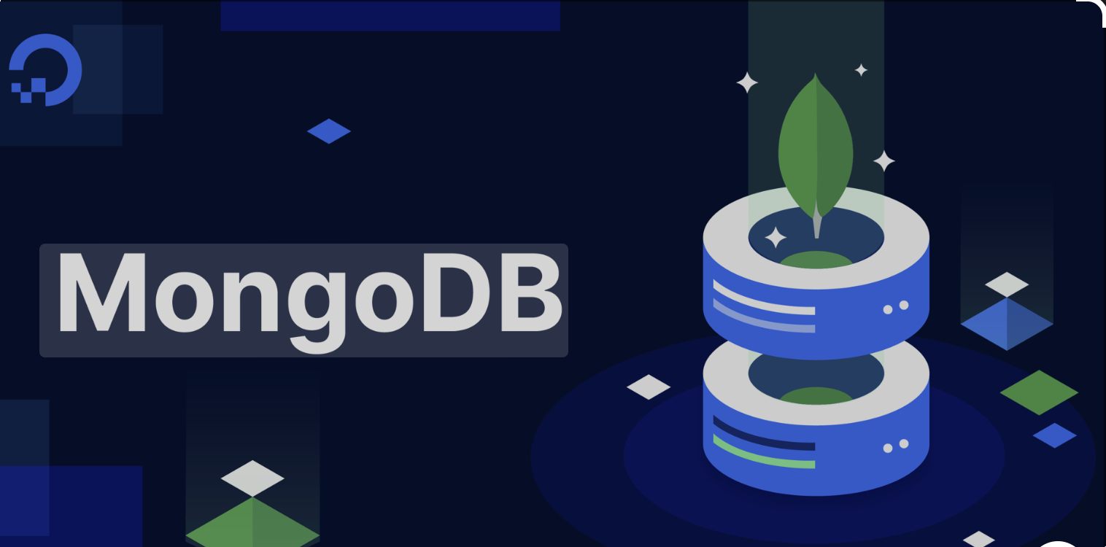
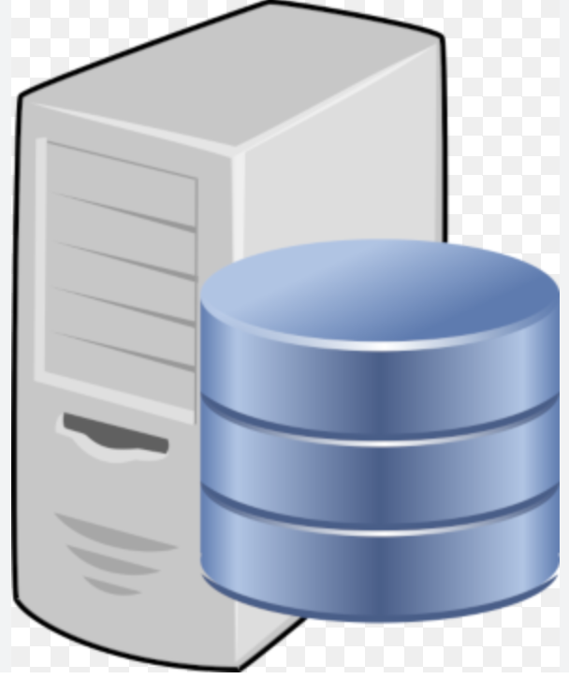
Langchain-based Retrieval-Augmented Generation (RAG)
1. SerpAPI/DuckDuckGo
Search
2. local stored web pages
Raw Data
MongoDB
Splitting
Vector Database: Weaviate
Splitting
Embedding
Training
Application
Responses
HuggingFace: LLaMA
Query
Send questions

Slide 9
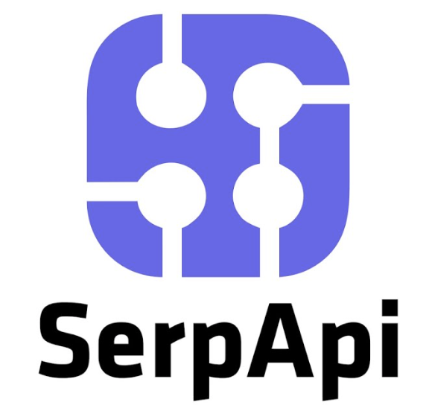


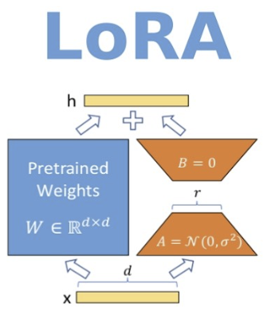
Langchain-based Retrieval-Augmented Generation (RAG)
SerpAPI search
Local stored data sources
Text embedding
Text splitting
Weaviate
vector database
Vectorize
Raw Data
MongoDB
Context
Responses
Query
Gemini-Flash 2.0
HuggingFace—LLaMA
Prompt
Questions
Model fine-tuning Algorithm

Slide 10
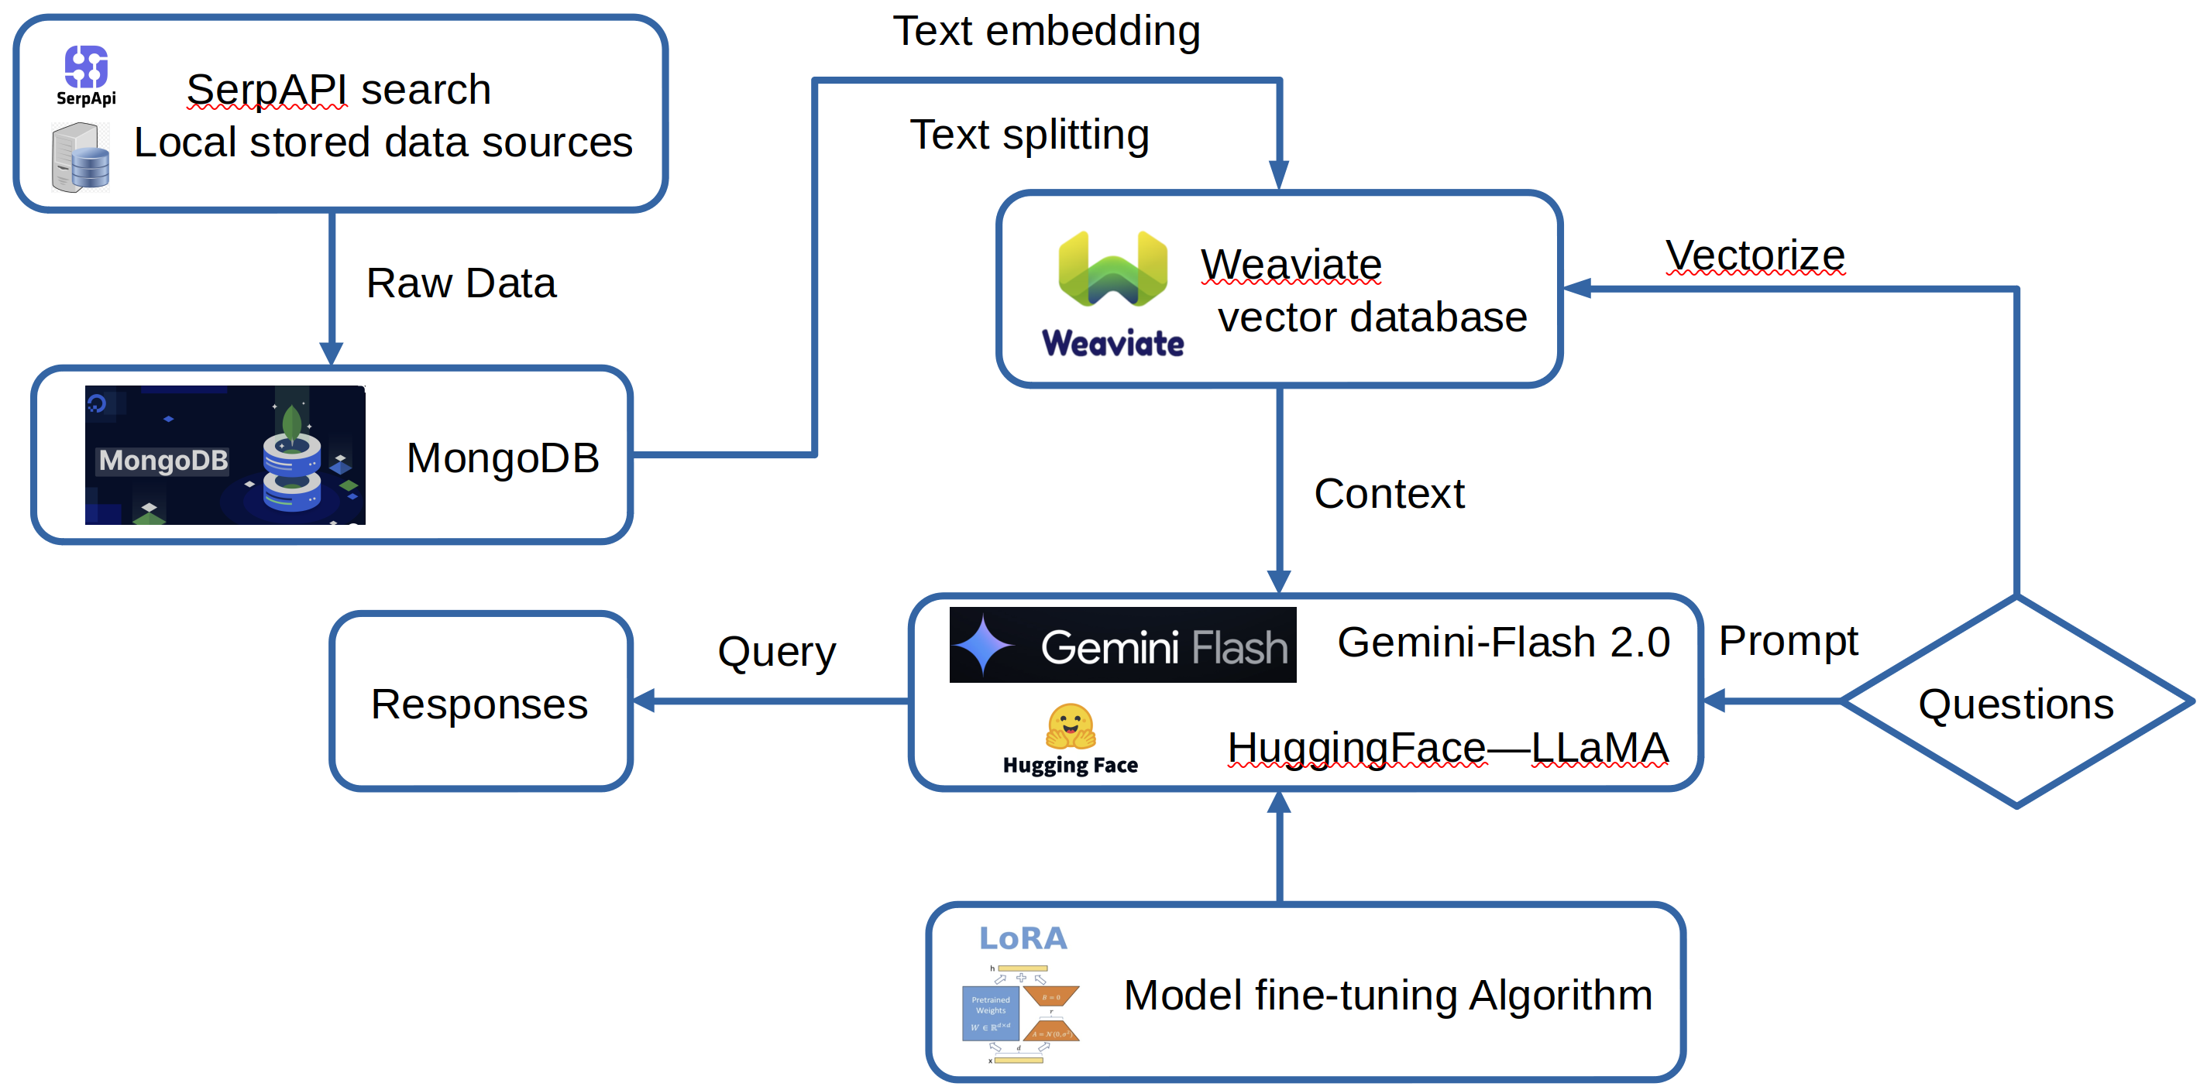

Slide 11
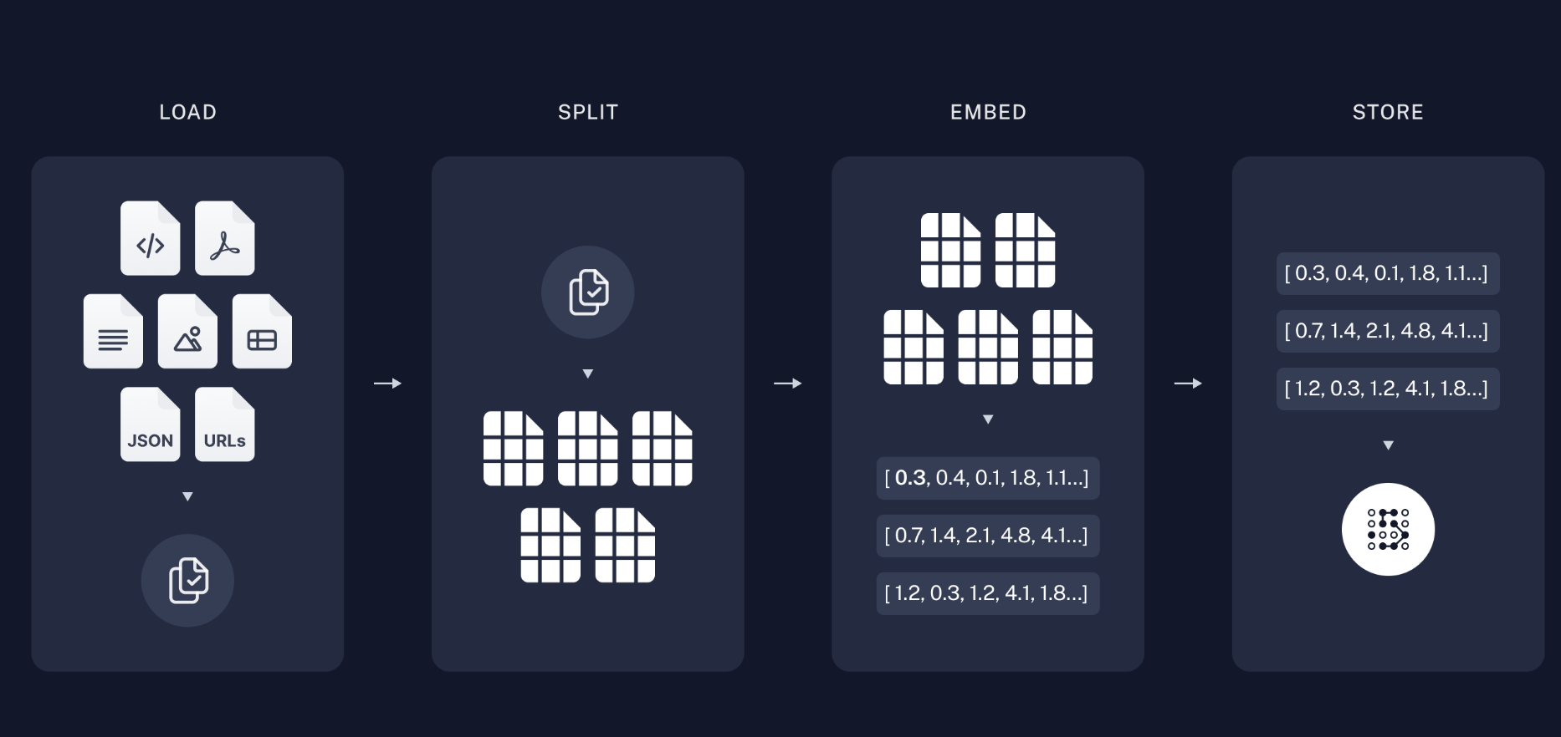
Langchain-based RAG Workflow
[1] Automated Data Ingestion (Scheduled)
↓
[2] LangChain Loads & Parses Data (e.g., Web/PDF/API)
↓
[3] Raw Data Stored in MongoDB (raw text + metadata)
↓
[4] LangChain Loads from MongoDB → Text Chunking
↓
[5] Embedding Generation via Hugging Face Transformers
↓
[6] Store Embeddings in Weaviate (Vector DB)
↓
[7] LangChain RAG: Query Weaviate for Semantic Context
↓
[8] LLaMA2 via HuggingFace (Context-Aware Answering or Fine-Tuning)
27/10/2014
Copyright note text (8pt)
Notes:
<number>

Slide 12
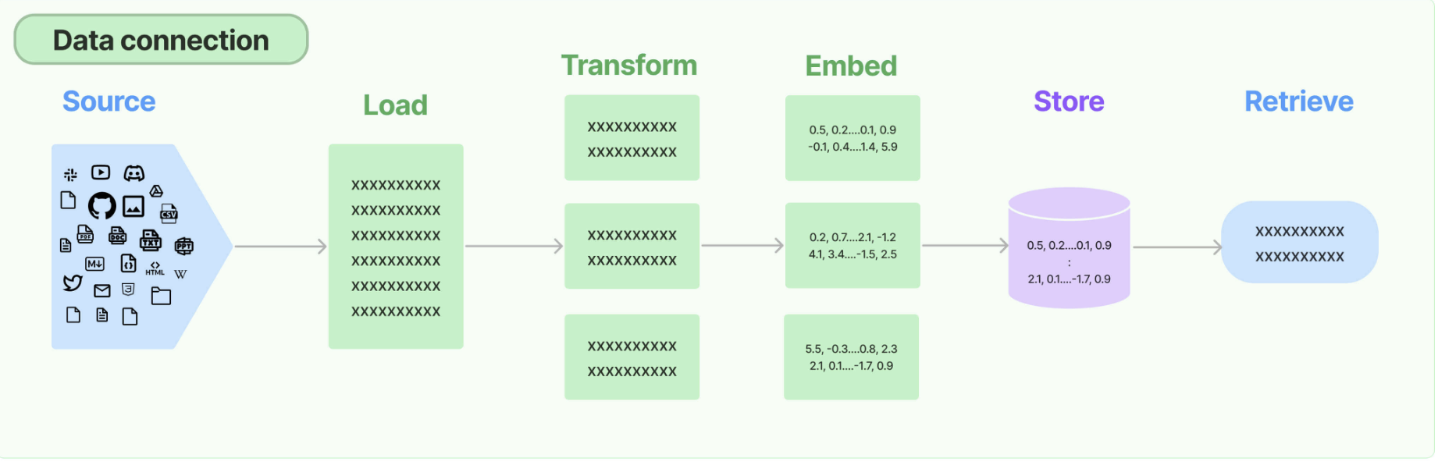
Langchain-based RAG Workflow
27/10/2014
Copyright note text (8pt)
Notes:
<number>

Slide 13
| Splitter | Best For | How It Works |
|----------------------------------|--------------------------------------------|------------------------------------------------------|
| `RecursiveCharacterTextSplitter`| ✅ General-purpose (most used) | Breaks text by paragraphs → sentences → chars |
| `CharacterTextSplitter` | Simple, fast splitting | Splits only by fixed-size character chunks |
| `TokenTextSplitter` | When you must control token limits | Splits based on token count (e.g., for OpenAI LLMs) |
| `SpacyTextSplitter` | Structurally correct sentence-based splits | Uses spaCy NLP for sentence-level chunking |
| `MarkdownTextSplitter` | Markdown docs (retain structure) | Splits by headers, sections, and lines |
| `NLTKTextSplitter` | Linguistically-aware chunking | Sentence-level splitting using NLTK tokenizer |
| `LanguageTextSplitter` | Code documents | Splits by function, class, etc., using tree-sitter |

Slide 14
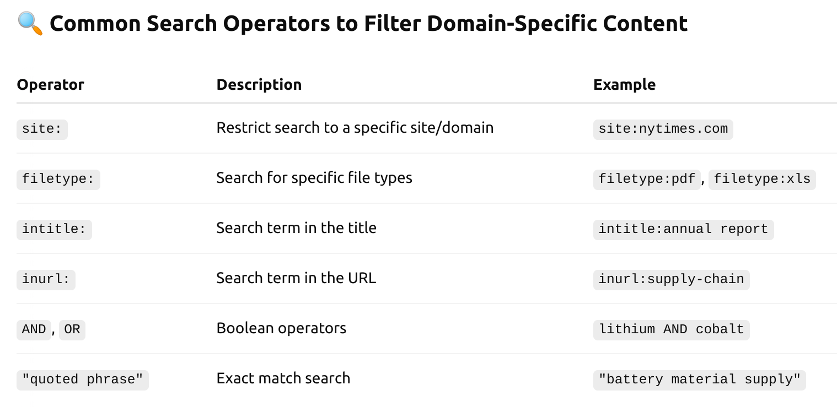
DuckDuckGoSearch Operators

Slide 15
Pros and Cons Between ChatGPT and LLaMA
| Feature | ChatGPT-4o | LLaMA-2 |
|--------------------------|----------------------------------|-----------------------------------------|
| Open-source | ❌ No | ✅ Yes (via request/license from Meta) |
| Multimodal | ✅ Yes (native text/image/audio) | ❌ No (text only by default) |
| Fine-tuning control | ❌ Not user-controlled | ✅ Can fine-tune (e.g. with LoRA) |
| API availability | ✅ Yes (OpenAI API) | ❌ No built-in API, self-hosted needed |
| Instruction-tuned chat | ✅ Yes | ✅ Yes (e.g. LLaMA-2-Chat) |
| Real-time inference | ✅ Fast and efficient | ⚠️ Depends on hardware & quantization |

