Slide 2
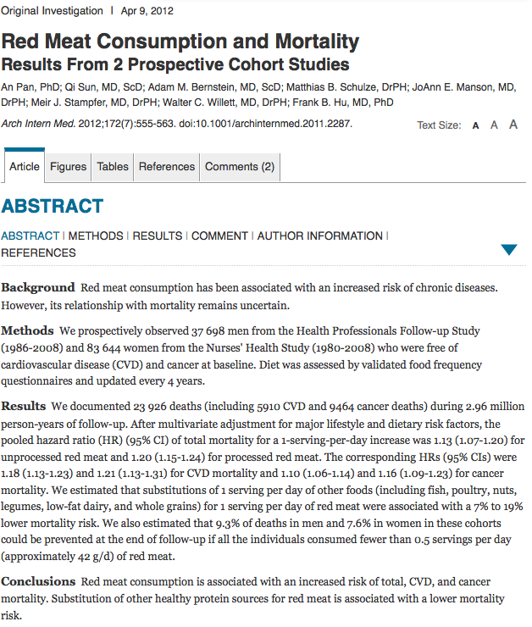

Slide 3
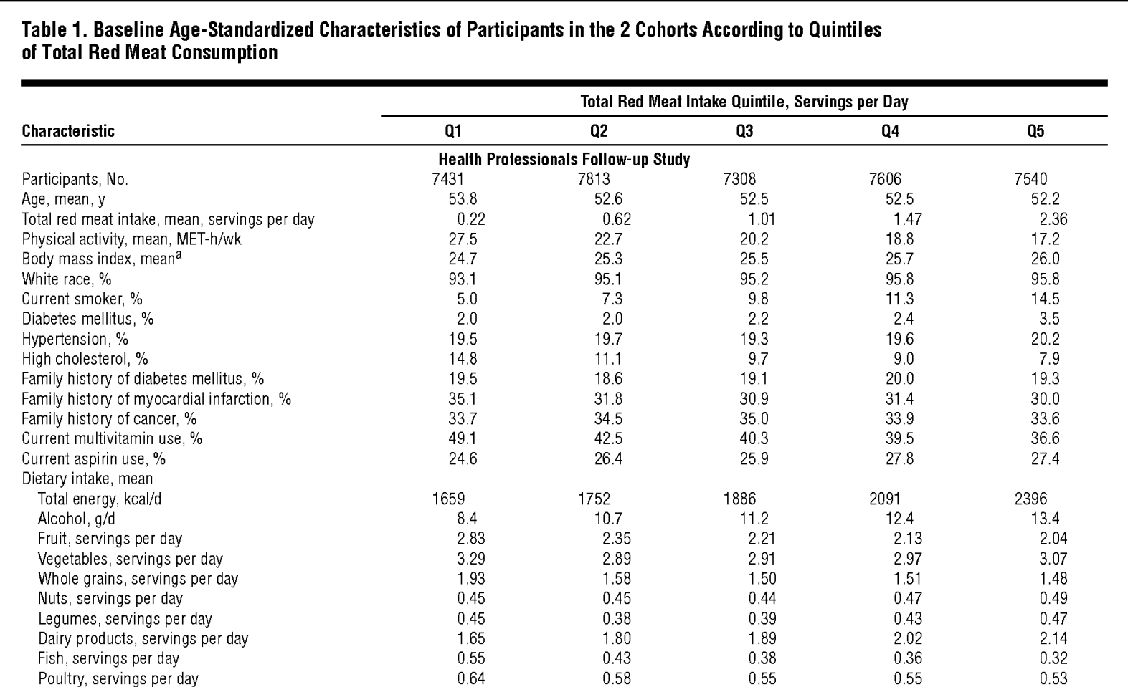
Relative risk of death 1 1.12 1.21 1.25 1.37

Slide 4
Relative risk of death 1 1.12 1.21 1.25 1.37

Slide 7
Causal claim!
The study design can only tell about associations, not causation

Slide 8
