Slide 1
CMM 262 / BIOM 262
Quantitative Genetics / Genomics

Slide 2
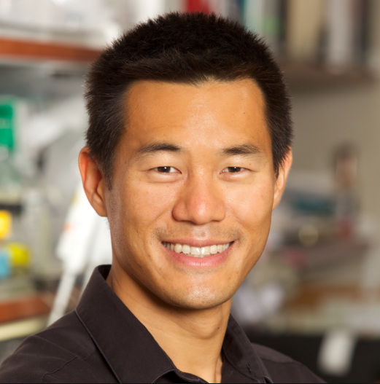
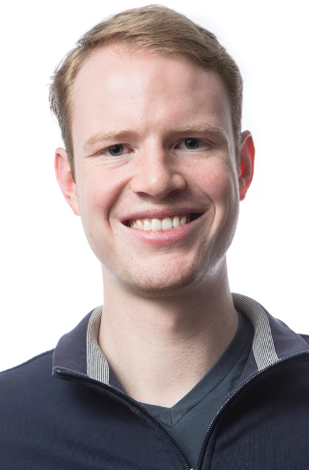
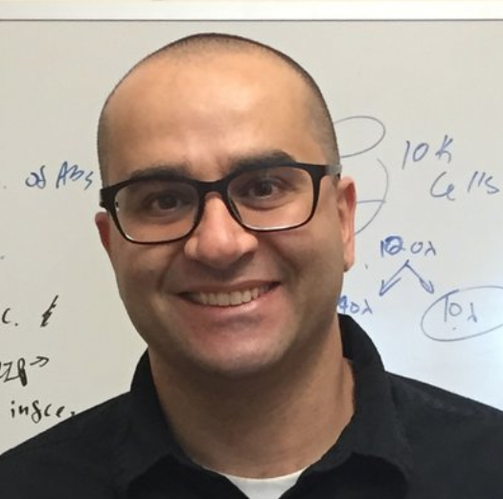
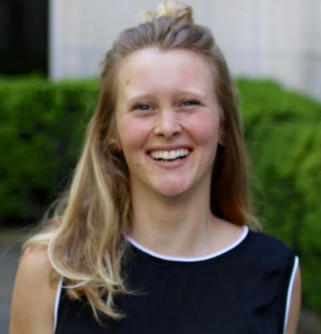
Instructors
Dr. Gene Yeo
Dr. Alon Goren
Patrick Fiaux
Dana Nachmanson

Slide 3
Why to take this course
Important background for all biology students
Will provide broad overview of:
Programming
Bioinformatics pipelines and tools
Genetics
Networks

Slide 4
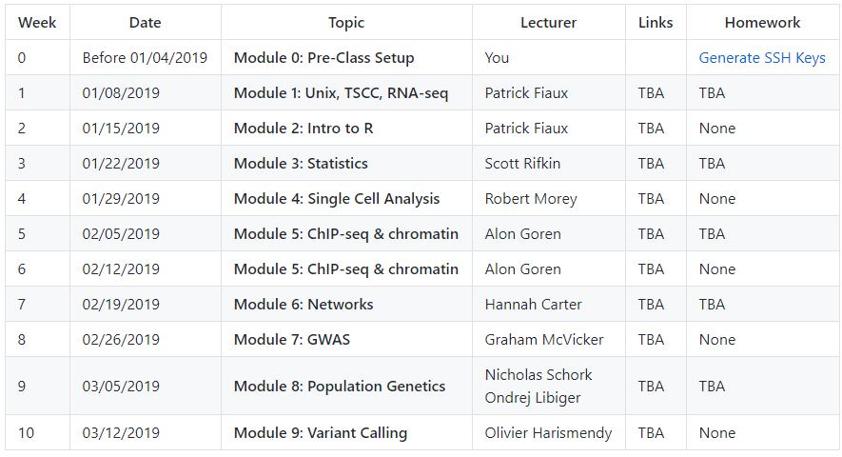
Course overview

Slide 5
Homework
Assigned every other week on Thursday
01/10, 01/24, 02/21, 03/07
Due the following Thursday at 8:59am (just before class)
Needs to be placed in folder within your account
Will show you where..
Follow homework guidelines!

Slide 6
Exams
Midterm:
Assigned: 02/07
Due: 02/18
Final:
Assigned : 03/14
Due : 03/24

Slide 7
Office hours
Patrick: Tuesday after class
Dana: TBD
If you have questions, email Patrick or Dana

Slide 8
Module
Each module has learning objectives
Slides and notebooks will uploaded after each class
We might ask you to install specific packages before a class
We will ask for feedback after each module

Slide 9
Class Communication
Announcements via list serve
Let us know if you didn’t get the emails!
Questions go to Patrick or Dana
pfiaux@ucsd.edu
dnachman@ucsd.edu

Slide 10
Questions
Ask questions!
This course is for you
Makes it more interactive
Practice for asking questions in talks
Tells instructor if they were clear or need to expand om something

