Slide 1
Ngrams with Cuda
Parallel Computing
Alessandro Bianco 7147240
A.A. 2025/2026

Slide 2
Introduction
N-gram counting is a fundamental operation in NLP, essential for Language Modeling, Machine Translation, and Sentiment Analysis.
The problem: Processing billions of N-grams in modern text corpus creates a massive computational bottleneck for traditional CPUs.
The identified solution: Modern GPUs offer a massively parallel architecture ideal for this workload.
The challenge: Harnessing this parallelism is non-trivial. It introduces a critical trade-off between atomic memory contention and exponential memory complexity.

Slide 3
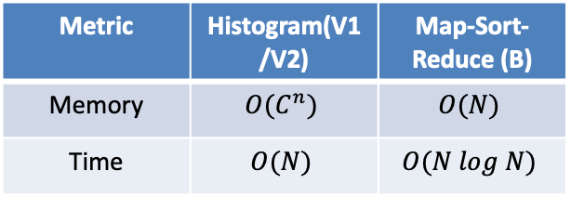
Proposed approach
In this report, we implement and analyze three GPU algorithms that embody this conflict:
V1 (Global Atomic Histogram)
V2 (Private Histograms)
B (Map-Sort-Reduce).
The final objective is to demonstrate that no single solution prevails, but rather an optimal hybrid strategy that selects the most suitable algorithm for each specific scenario.
Metric | Histogram(V1/V2) | Map-Sort-Reduce (B)
Memory | $$O(C^{n})$$ | $$O(N)$$
Time | $$O(N)$$ | $$O(N log N)$$

Slide 4
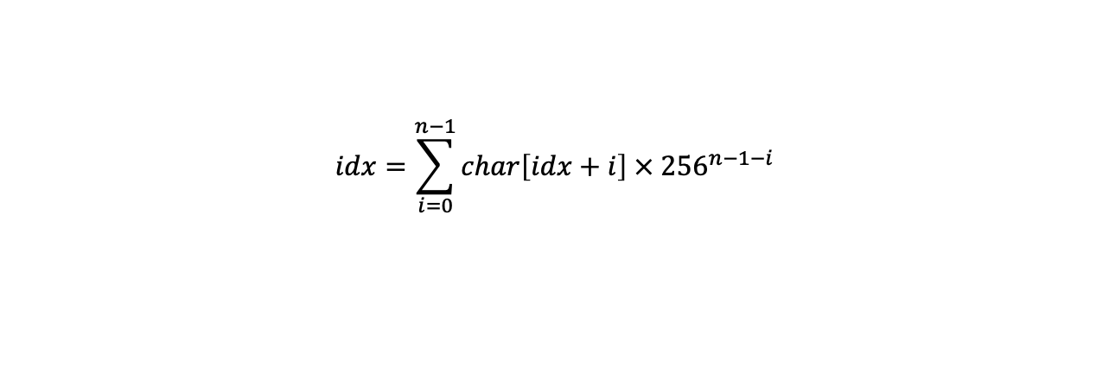
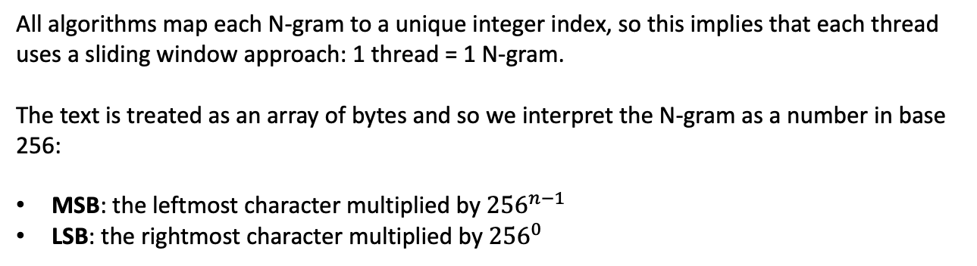
Core methodology: Flat indexing
All algorithms map each N-gram to a unique integer index, so this implies that each thread uses a sliding window approach: 1 thread = 1 N-gram.
The text is treated as an array of bytes and so we interpret the N-gram as a number in base 256:
MSB: the leftmost character multiplied by ${256}^{n−1}$
LSB: the rightmost character multiplied by ${256}^{0}$
$$idx=\sum_{i=0}^{n−1}{char\left[idx+i\right] × {256}^{n−1−i}}$$

Slide 5
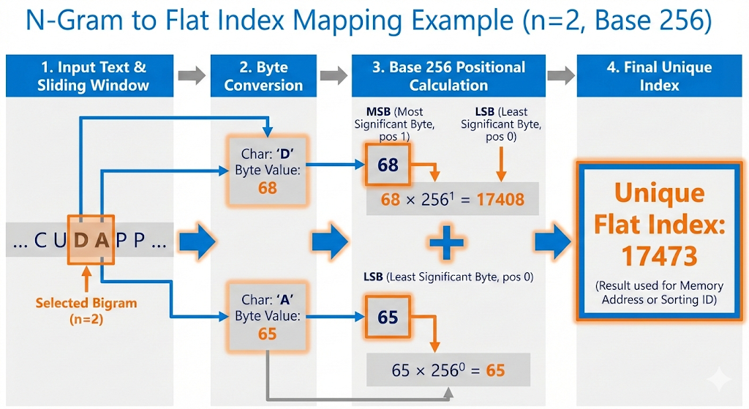
Core methodology: Flat indexing
So in the V1/V2 histogram algorithms the index represents the memory address to atomically increment, while in the B algorithm (Map-Sort-Reduce) it represents the numeric ID that is being written inside the array.

Slide 6
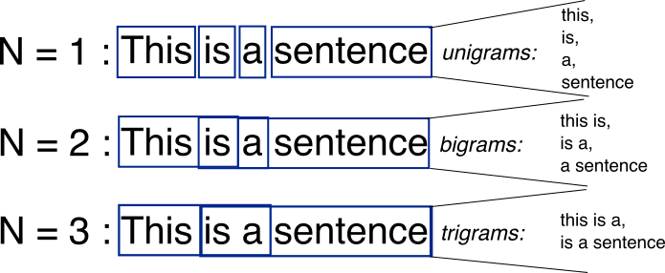
Sequential Baseline
The standard workflow for counting the n-grams is the following:
Iterate linearly through the corpus byte array
Extract the N-gram at each position using a sliding window
Decode bytes to string and update the frequency count in the dictionary

Slide 7

V1 Algorithm
V1 algorithm uses a direct parallelization strategy mapping 1 thread to 1 N-gram. The structure is a single shared global histogram in VRAM.
We allocate a contiguous memory block of size ${256}^{n}$ and calculate the flat index for the specific N-gram performing an atomicAdd on the global counter.
The main bottleneck is the memory constraint given by histogram array allocation which has an exponential complexity:
n=2: size ≈ 256kb
n=4: size ≈ 16gb

Slide 8
V2 Algorithm
In V2 we want to mitigate the traffic on single memory addresses so we replace the global histogram with K separate private histograms.
There is a two stage implementation:
Private population: threads compute the flat index and instead of writing globally, they select a specific private histogram based on their block Id
Global Reduction: A synchronization barrier separates the kernels and a second kernel iterates through the k private histograms summing the partial counts into the global result
We eliminate the global atomic contention but there is now a multiplied memory factor by K.
This results in faster results for small n but causes OOM errors for greater values

Slide 9
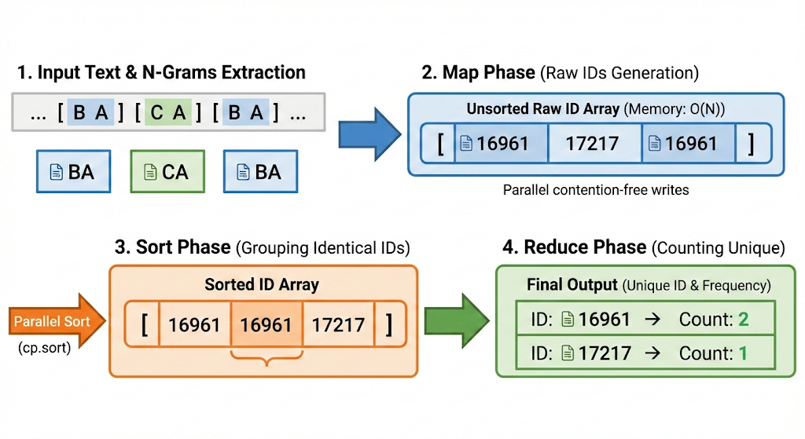
B Algorithm
We use a Map-Sort-Reduce strategy where now the memory footprint is ruled by the number of N-grams O(N).
Phase 1 Map: each thread computes the flat index not using the atomicAdd but using a contention-free write of the ID into the array
Phase 2 Sort: sorts group identical N-grams IDs contiguously
Phase 3 Reduce: parallel reduction that counts the lenghts of contiguous segments to determine the frequency

Slide 10
Test suite structure
Each algorithm receives a text input (corpus) that is duplicated in memory by an amplification factor to simulate different workload sizes and its also converted to an array of bytes to ensure a 1:1 mapping between characters and 8-bit values.
Two core experiments:
Experiment A: the goal is to test the impact of exponential memory requirements varying the N-gram size while keeping the corpus size fixed
Experiment B: tests the performance by varying the corpus size while keeping n fixed to test the throughput scalabilty

Slide 11
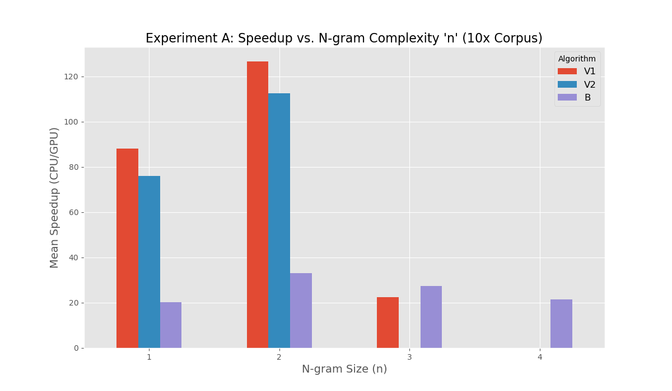
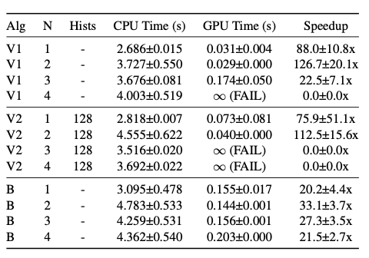
Experiment A: Scalability vs Complexity (n)

Slide 12
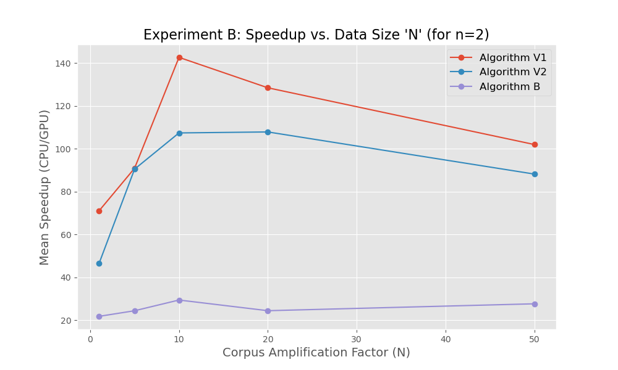
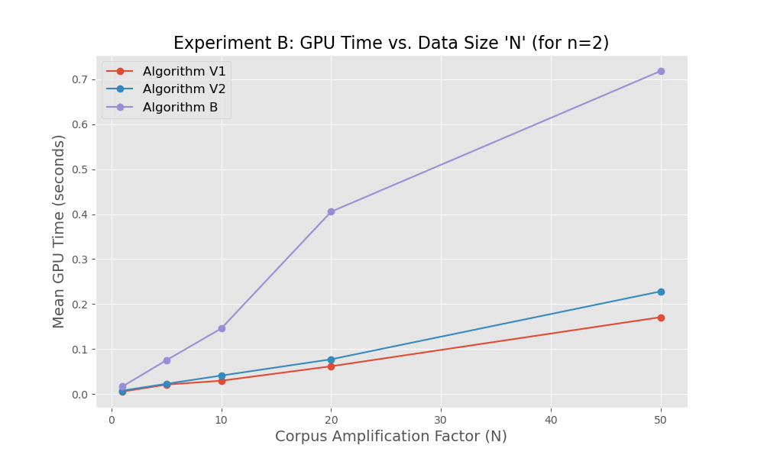
Experiment B: Scalability vs Data Size (N)

Slide 13
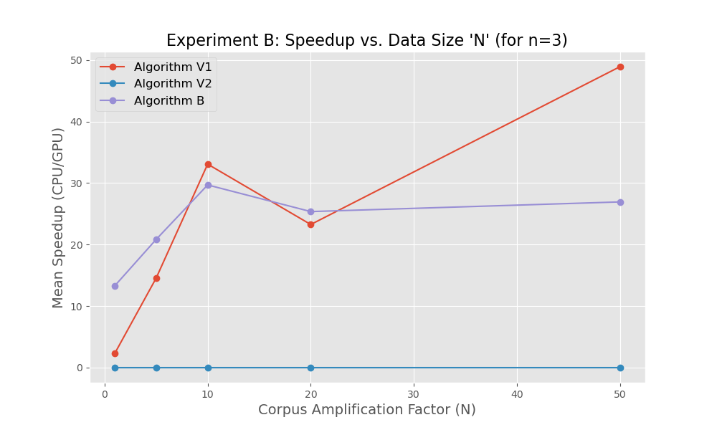
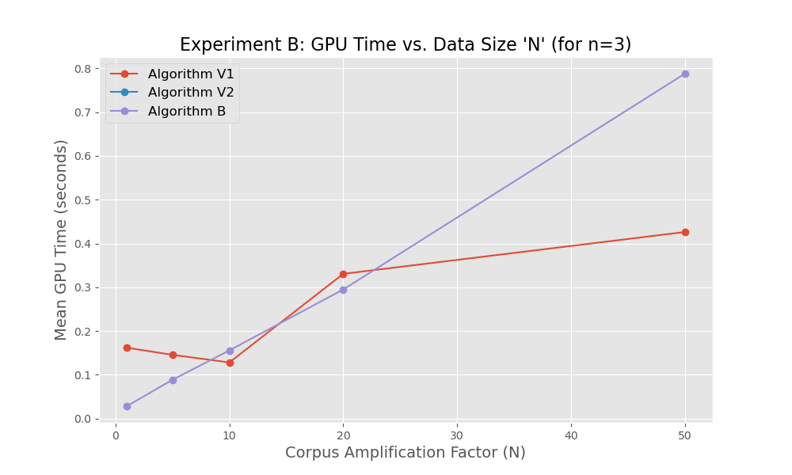
Experiment B: Scalability vs Data Size (N)

Slide 14
Conclusions
There is no single best algorithm; efficiency depends strictly on problem complexity (n).
V1: Dominates for n≤3 due to linear time complexity, but fails at large values of n due to exponential memory limits.
V2: The memory multiplier causes early OOM failures (n≥3) and overhead slows down low-complexity cases.
B: The only viable option for high-complexity domains (n≥4) thanks to linear memory complexity.

