Slide 1
https://github.com/MalikaIhle/simulation_course
Fork and Clone
Session based on materials from Joel Pick, Hadley Wickham, Kevin Hallgren

Slide 2
Simulations – definition
“A computer simulation (or "sim") is an attempt to model a real-life or hypothetical situation on a computer so that it can be studied to see how the system works. By changing variables in the simulation, predictions may be made about the behavior of the system. It is a tool to virtually investigate the behavior of the system under study”
Wikipedia
→ Create fake random data to build up an understanding of the real data and the statistical models we use to analyze them

Slide 3
Simulations – purposes
Test your statistical intuition or demonstrate mathematical properties you cannot easily anticipate
e.g. test whether when supposedly random data are generated, there is no more than 5% of significant effects for a variable in a model
Understand sampling theory, probability distributions or test whether you understand the underlying processes of your system
e.g. see whether simulated data drawn from specific distribution are comparable to real data
Perform power analyses
e.g. assess whether the sample size (within a replicate) is high enough to detect an effect simulated, in more than 80% of the cases.
bootstrap to get confidence intervals for a parameter estimates
i.e. bootstrap means to sample with replacement in an observed dataset. After doing this multiple time (which generate new ‘simulated’ datasets), analyzing these datasets, and saving each time the parameter estimates of the model, one can calculate the confidence interval of the parameter estimates.
Notes:
worksheet 2nd question

Slide 4

Simulations – basic concepts
generate random numbers from known distributions
repeat that process multiple times
→ Open https://github.com/MalikaIhle/simulation_course/slides_code.R

Slide 5
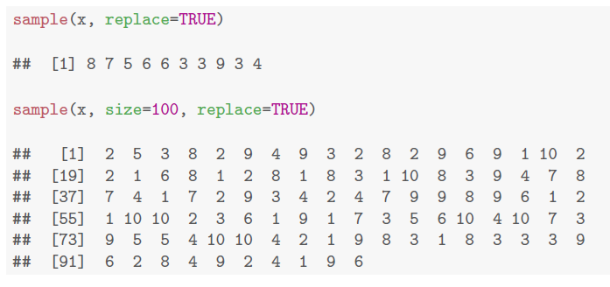
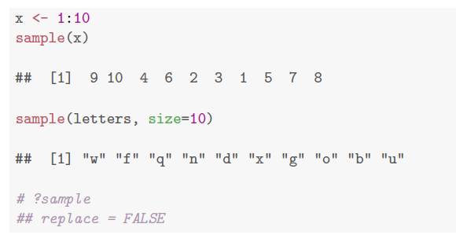
Random number generators
sample() draws from a given vector

Slide 6
Random number generators
R random number generators draws n numbers from distributions with specified parameters:
runif(n, min, max) uniform
rpois(n, lambda) poisson
rnorm(n, mean, sd) normal
rbinom(n, prob) binomial
type ?function to get information of the functions arguments

Slide 7
Your turn
Generate 100 numbers ~ N(0, 1)
Generate 50 numbers ~ N(10, 5)
Generate 1000 numbers ~ Poisson(50)
Generate 30 numbers ~ Uniform(0, 10)
rnorm(n=100, mean=0, sd=1)
rnorm(sd=5, mean=10, n=50)
rpois(n=1000, lambda=50)
runif(n=30, min=0, max=10)
rnorm(100, 0, 1)
rnorm(50, 10, 5)
rpois(1000, 50)
runif(30, 0, 10)
rnorm(100)

Slide 8
Repetition
replicate(nrep, expression)
e.g. replicate(10, mean(rnorm(100)))

Slide 9
Your turn
replicate 1000 x the mean of 10 unif(0, 10)
replicate 100 x the mean of 50 numbers ~ N(10, 5)
replicate (1000 , mean(runif(10, 0, 10)))
replicate (100 , mean(rnorm(50, 10, 5)))

Slide 10
Simulations – basic concepts
generate random numbers from known distribution
repeat the process multiple times
→ what sample size n within simulation?
→ how many repeats nrep?

Slide 11
Reproducibility in simulation: set the seed
set.seed()
Pseudo-random number generators
- generate numbers according to an algorithm
- given the same seed it will produce the same numbers
i.e. repeat exactly the same simulation
- good for sharing code and simulations, as well as debugging code

Slide 12
Simulations – basic concepts
generate random numbers from known distribution
repeat the simulation multiple times
→ what sample size within simulation?
→ how many repeats?

Slide 13
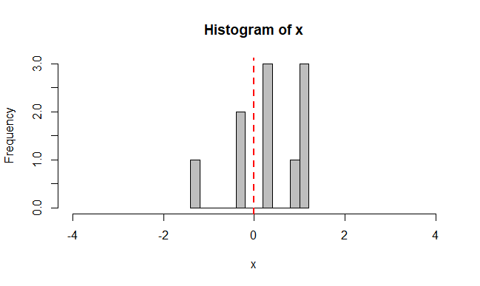
single random sample of normal distribution N(0,1) with n=10

Slide 14
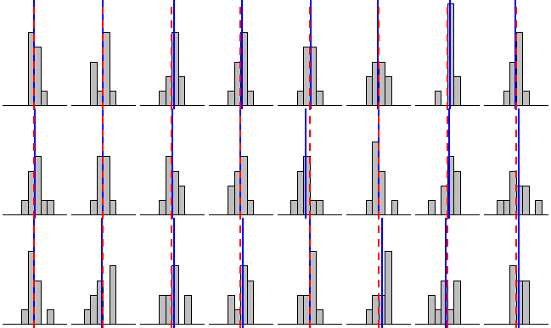
24 sims of same distribution N(0,1) with n=10
mean(x)
0

Slide 15
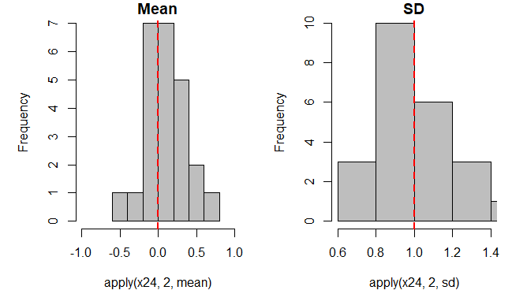
distribution of mu and sd from 24 sims N(0,1) with n=10

Slide 16
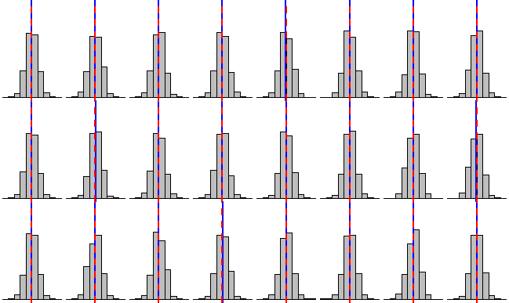
24 sims of same distribution N(0,1) with n=1000
mean(x)
0

Slide 17
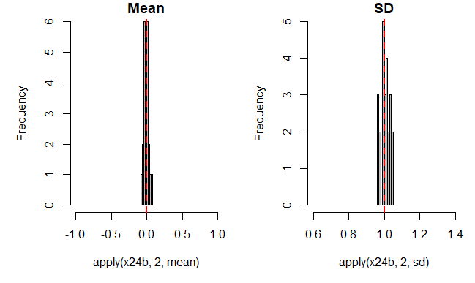
distribution of mu and sd from 24 sims N(0,1) with n=1000

Slide 18
Sample size within simulation
Affects the precision with which the parameters of that distribution can be estimated
What should determine the sample size within a simulation?
a sample size that is relevant to the context of the simulation,
i.e. the sample size you can reach in your study
Sampling theory applies to the number of simulations nrep just as much as the sample size within a simulation n

Slide 19
distribution of mu and sd from 24 sims N(0,1) with n=10

Slide 20
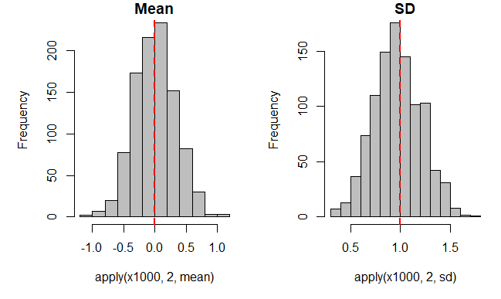
distribution of mu and sd from 1000 sims N(0,1) with n=10

Slide 21
Simulation – Sample sizes
Samples size within a simulation vs. number of simulations
sampling theory applies to both
sample size within a simulation is relevant to the particular question or context of what is being simulated e.g. particular sample size of an experiment
- number of simulations: a big enough number to obtain a good representation of distribution of simulation results e.g. 1000

Slide 22
Do not repeat yourself
Dry rule vs. Wet rule
Write everything twice
Increases the difficulty of change
May decrease clarity
Leads to opportunities for inconsistency

Slide 23
Functions – to reduce duplication
AwesomeFunctionName <- function(argument1, argument2,…){
# do stuff here
}
→ to build up a function: start by writing the # do stuff to test that it works outside the function

Slide 24
Your turn
Create a function that draws a histogram of nrep draws of mean(rnorm(100))

Slide 25
Your turn
Modify your function to draw a histogram of nrep draws of mean(rnorm(n))

Slide 26
Real simulation – Testing probability assumption
statistical assumption: with alpha = 0.05, it means that 1 in 20 statistical tests will give a false positive result
→ draw from the same distribution twice and see if the sample differ from each other: will they differ significantly in 5% of the cases?

Slide 27
Your turn
Figure out how to do a t.test in R
Generate two vectors of 10 N(0,1) and compare them with a t test
Figure out how to extract the p-value from that object (use str and your subsetting skills)

Slide 28
Your turn
Write a function simT that generates two vectors of n random normals, compare them with a t.test and return the p-value
Repeat nrep =20 and draw a histogram for n=10
Repeat nrep =100 and draw a histogram for n=10

Slide 29
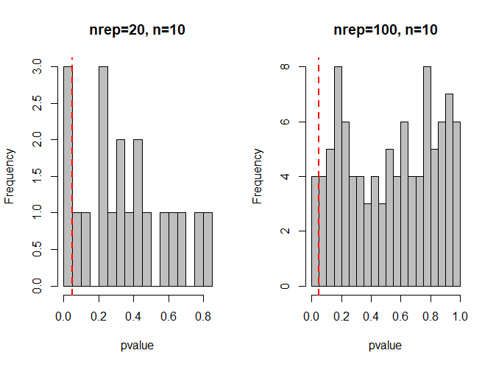

Slide 30
Your turn
plot function simT with nrep =1000 and n=10
plot function simT with nrep =1000 and n=100

Slide 31
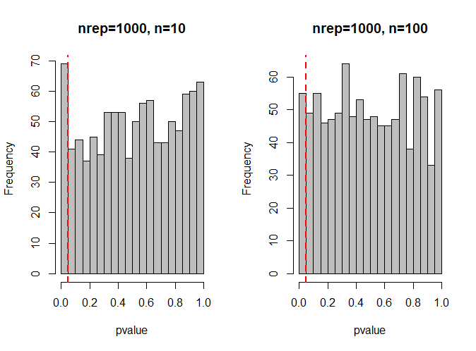

Slide 32
Your turn
what happens if you use non-normal data?
e.g. Poisson distributed data?

Slide 33
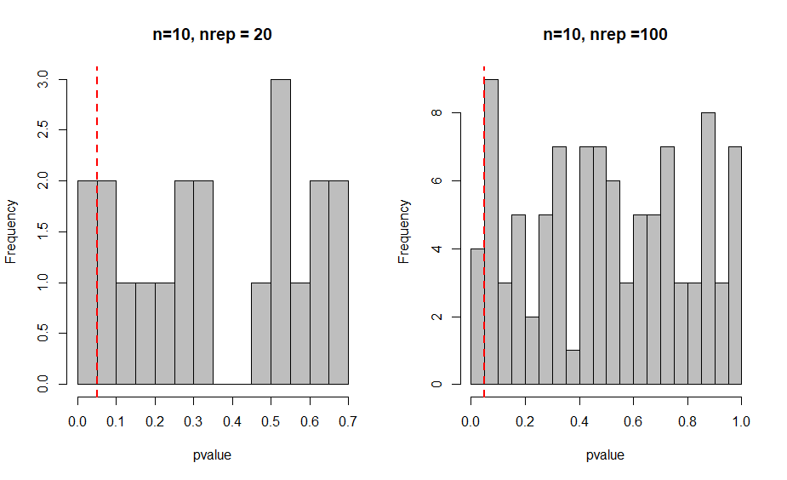
rpois

Slide 34
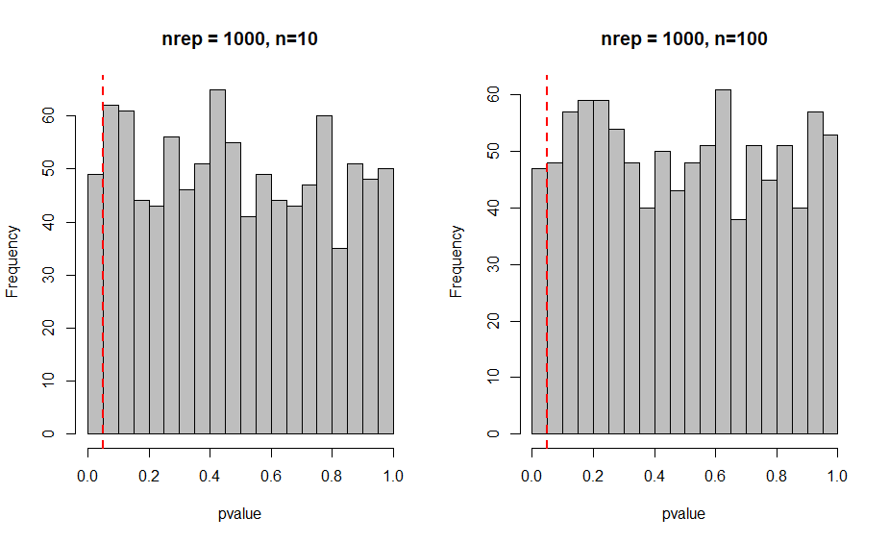
rpois

Slide 35
Simulations – General structure
define what type of data and variables need to be simulated, i.e. their distribution, their class (e.g. factor vs numerical value), sample sizes (within a dataset, and number of replicates), what will need to vary (e.g. the strength of relationship, two alternative for one scenario)
generate data, random data or data including an effect (e.g. an impose correlation between two variables)
run the statistical test we think is most ideal, check that the results are random (significant in only 5% of the case) or picking up the effect imposed/simulated in 80% of the cases (power), and save the parameter estimate of interest for that iteration
replicate step 2 and 3 to get the distribution of the parameter estimates
try out different parameter sets (explore the parameter space for which results are similar)
analyze and interpret the combine results of many simulations within each set of parameters
Notes:
worksheet question 1

Slide 36
Simulations – Limitations
assumptions made regarding variables might not be true, e.g. the distribution of supposedly normally distributed data may not be quite normal
parameter space unknown (explore it a bit, use previous observations to be at least in a relevant range)
computational power and time (use research software engineer staff on campus to optimize code, use parallel core processing, use server services on campus, ect)
simulations might be redundant with mathematical demonstrations (as I am bad at math I don’t mind proving principles again as this finally explain mathematical concepts to me, + these also allows us to think and create the analyses script for our data to prepare the preregistration)
Notes:
worksheet question 3

Slide 38
Your personal activity pick for 3/18/19
Simulate my data
Write my preregistration statistical plan (due 3/25)
Research and read more about - simulations in my discipline - possible statistical approaches to my project
Prepare presentation (due 4/8)
Prepare interview (due 4/22)
Other course-related topic for which you could use feedback / dedicated time to avoid procrastination

Slide 40
Accuracy: the proximity of measurement results to the true value.
Assumption: an idea that is taken to be true, and often used as the basis for other ideas, although it is not known for certain. Here, can refer to the presumed distribution, mean, variance of some parameters.
Loops: control flow statement that allows code to be executed repeatedly based on a given Boolean condition. The while loop can be thought of as a repeating if statement. (‘do this as long as x is true’).
Random number generator: device that generates a sequence of numbers or symbols that cannot be reasonably predicted better than by a random chance.
Branching: When a program makes a choice to do one of two (or more things). The most common programming "statement" used to branch is the "IF" statement (‘if something is true do this, else do that’)
Bootstrap: random sampling of a dataset with replacement, to create 'new' datatsets of similar sample size.
Parametric bootstrapping: random numbers sampling from a fitted model (with a similar sample size) to run the statistical model on several of these ‘simulated data’ and calculate a confidence interval around the effect estimate.
Statistical power: probability that the test rejects the null hypothesis when a specific alternative hypothesis is true.
R object: recipient of values (numbers, characters, etc), vectors, matrices, data frame, model output, list, ect. In the example ‘alpha <- c(1,2,3)’ the object alpha is a vector of length 3. It is better syntax to assign objects with the symbol ‘<-’ rather than ‘=‘ as used in this paper, as to avoid confusion on which side of the symbol is the object (for instance in case both are strings of characters).

