Slide 1
Alternative Metrics for Virtual Screening

Slide 2
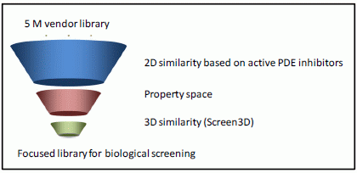
What is a Virtual Screening?
Computational technique to search libraries of small molecules in order to identify structures which are most likely to bind to a drug target

Slide 3
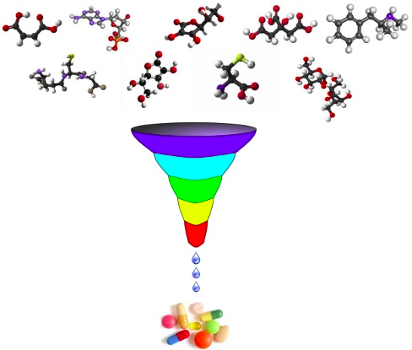
What is a Virtual Screening?
Library of small molecules
Protein receptor or anzyme
Computational technique
Evaluation metrics

Slide 4

What is expected from Virtual Screening?
Very small compounds will be tested experimentally
Approach works

Slide 5

What is expected from Virtual Screening?
Early recognition
Rank actives very early
Works with larger set of compounds
Very small set of the compounds will be tested experimentally

Slide 6
What is expected from Virtual Screening?
What about point 2 (Approach works) ?

Slide 7
Traditional Measures
Area under Receiver Operating Characteristic
Area under Accumulation Curve
Enrichment Factor

Slide 8
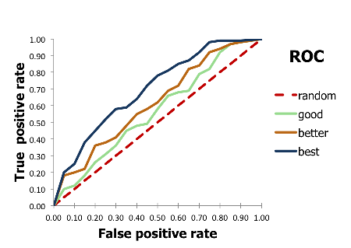
Receiver operating characteristic (ROC)

Slide 9
Receiver operating characteristic (ROC)
TP – true positive
TN – true negative
FP – false positive
FN – false negative

Slide 10
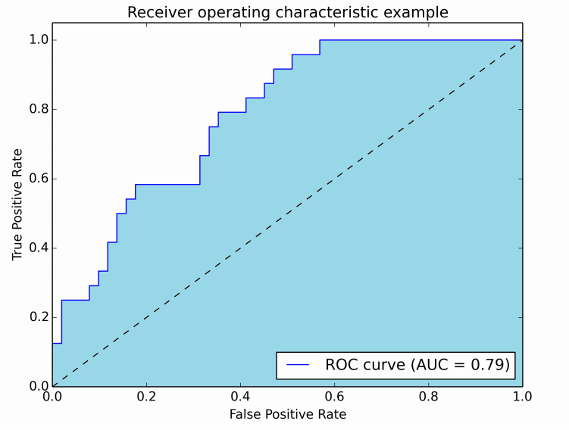
Area unter ROC

Slide 11
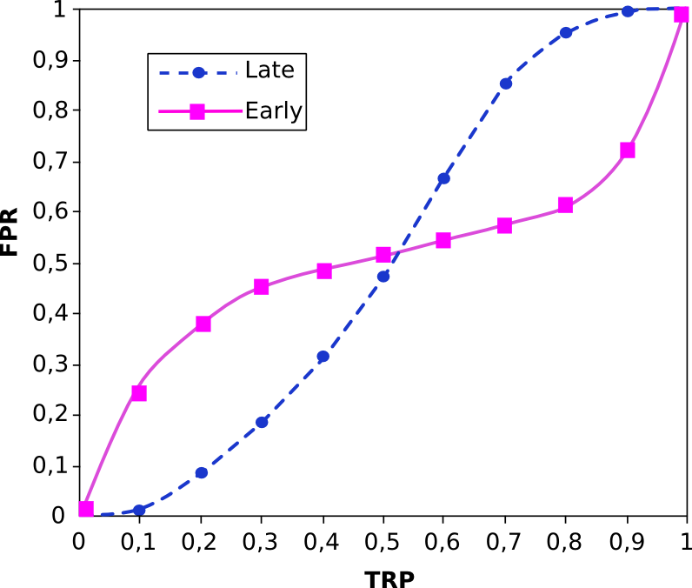
Why is AUC not enough?
Area under ROC = 0.5

Slide 12
Alternatives
Robust Initial Enhancement (RIE)
  developed by Sheridan
Boltzmann-Enhanced Discrimination of ROC (BEDROC)
  developed by Truchon

Slide 13
Robust Initial Enhancement (RIE)
Metric using a continuously decreasing exponential weight as a function of rank
r_{i} is the rank of the i-th active
N – Anzahl der Elements
n – Anzahl der Actives
a – factor
angle brackets means averaging
subscript r means that it is over a uniform distribution.

Slide 14
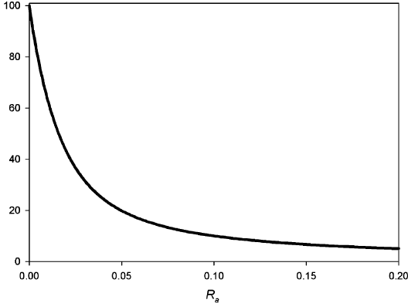
Robust Initial Enhancement (RIE)
Maximum RIE
RIE maximum as a function of the ratio
of actives R_{a} with a=100.

Slide 15
Boltzmann-Enhanced Discrimination of ROC (BedROC)
Values from 0 to 1

Slide 16
RIE and BedROC Properties
RIE
Give early rankings more weight
Weight depending on their position in the list
Exponential factor
Normalized by the RIE of a random distribution of actives
Sensitive to the total number of inactives
BedROC
Give early rankings more weight
Weight depending on their position in the list
Exponential factor
Normalization is by the maximum dynamic range
Sensitive to the total number of inactives
Rate from 0.0 to 1.0

Slide 17
Are they perfect?
RIE
Have the RIE values a absolute meaning?
Are the RIE values interpretable?
How good the RIE value 5.35 is?
BedROC
Have the BedROC values a absolute meaning?
BedROC scaliert the values from 0 to 1, how understandable is it?
Can you compare the BedROC values with different alpha-factors ?

Slide 18
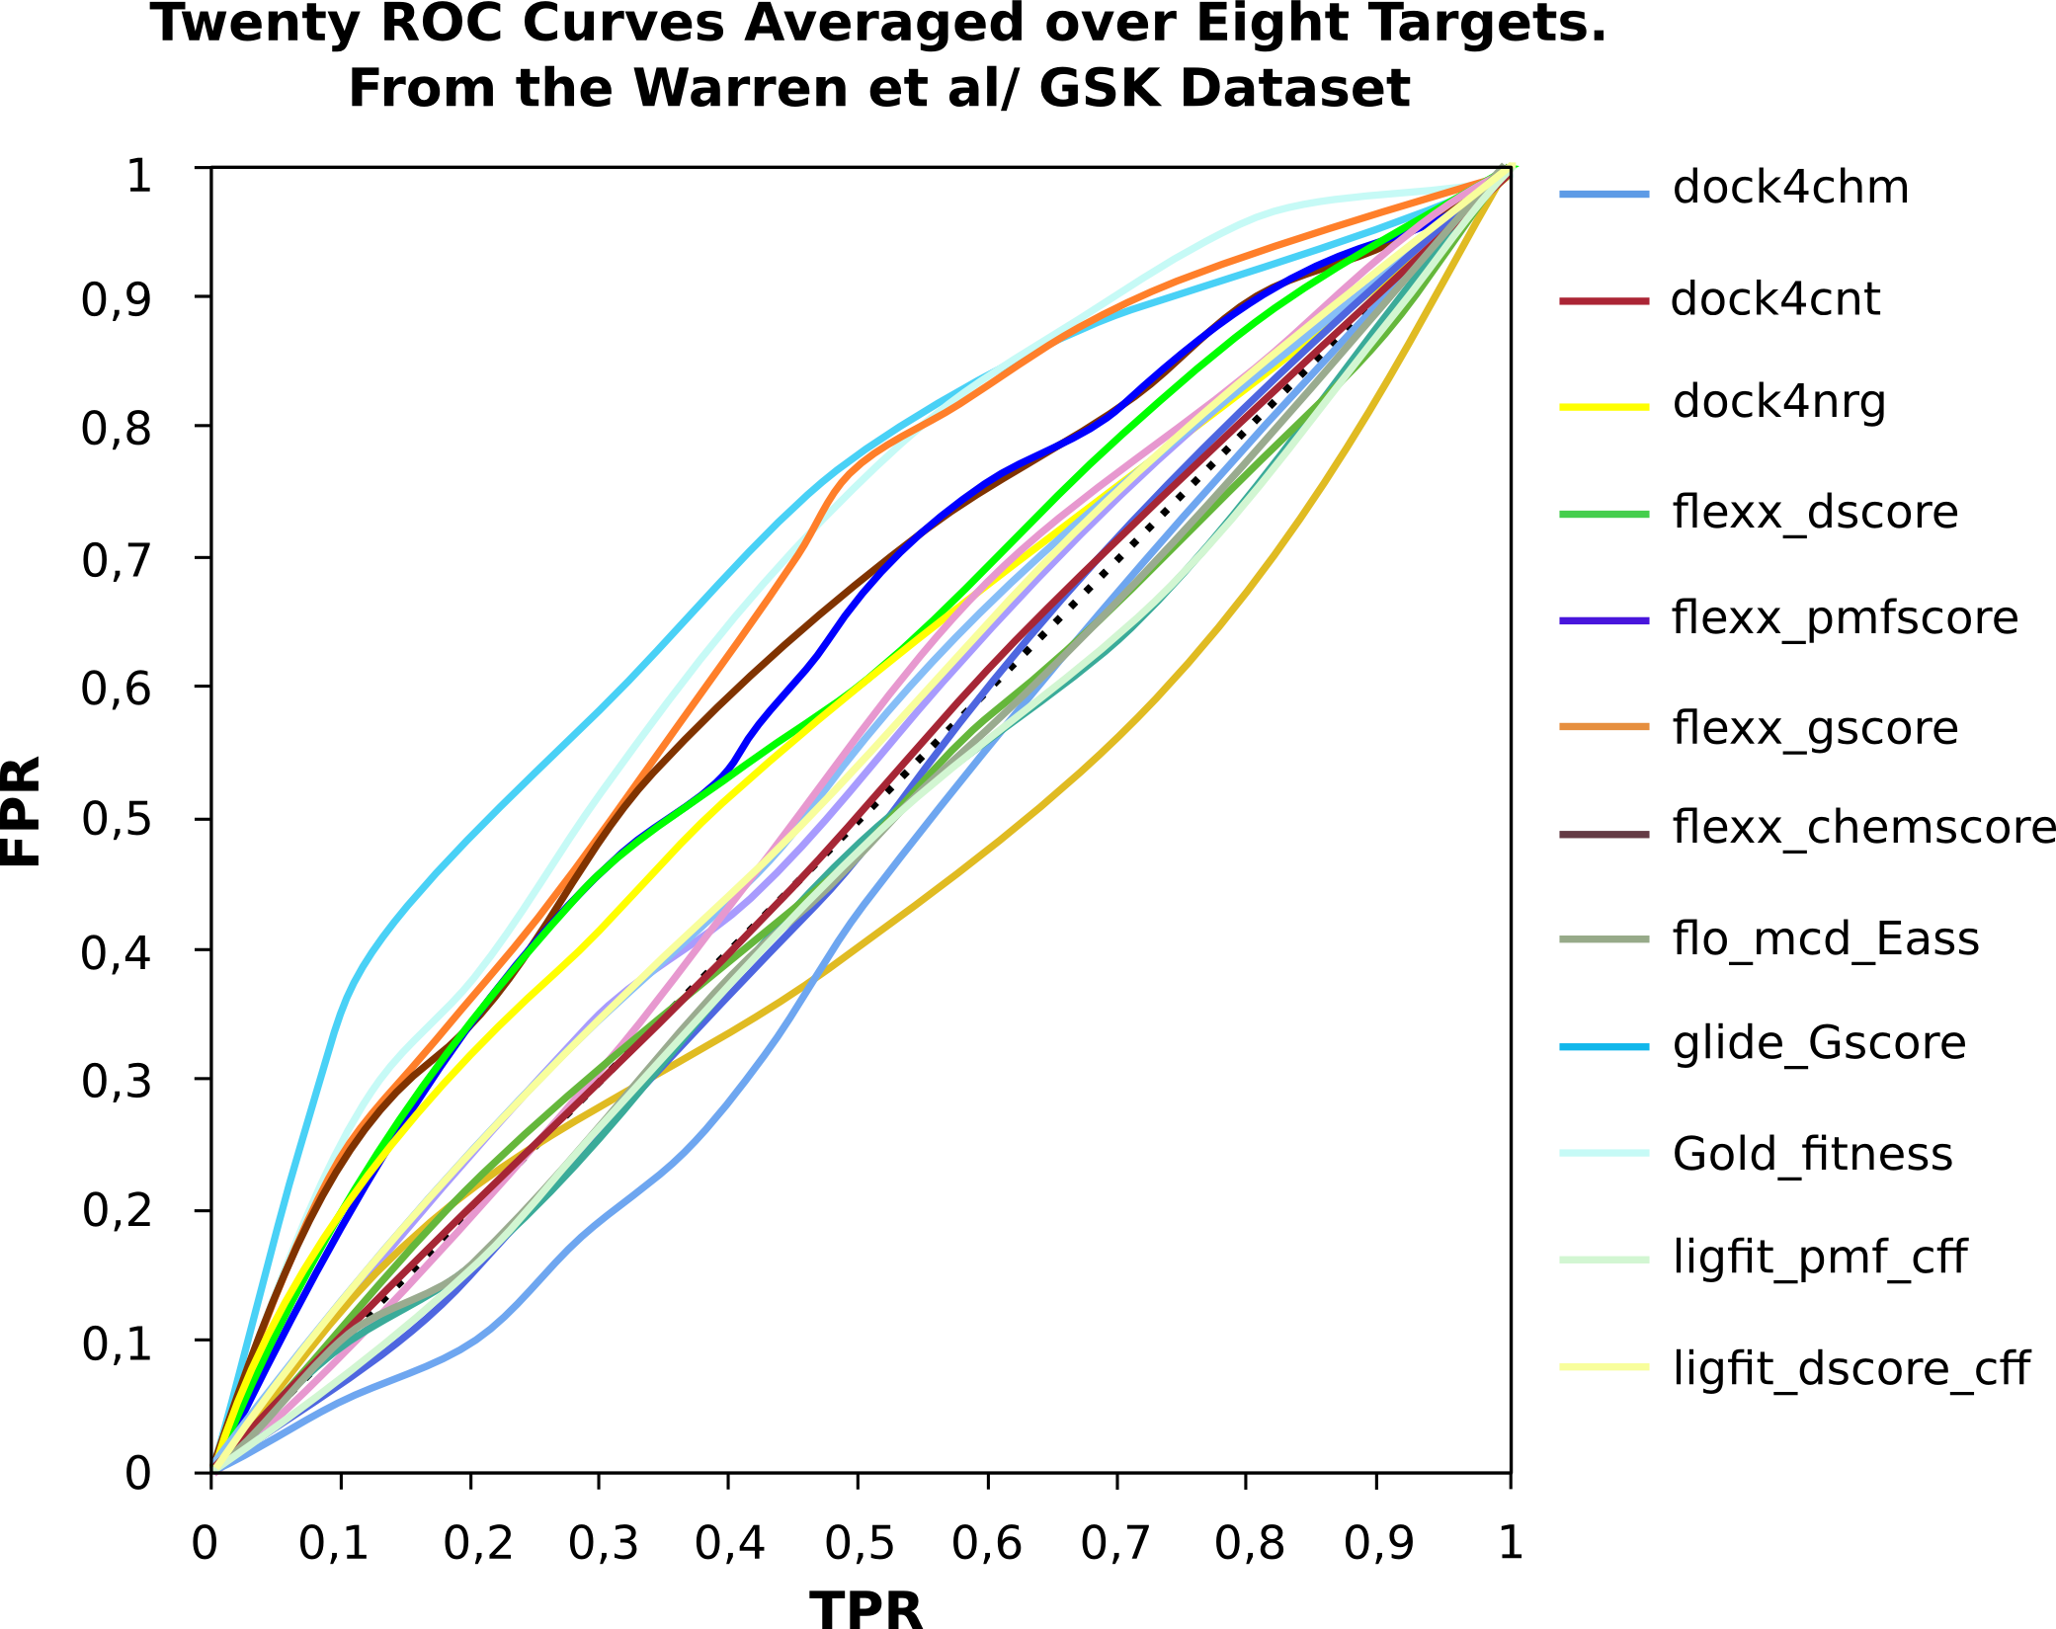
Are they better as AUC?
No biphasic nature.

Slide 19
Why no biphasic nature?
The individual curves are not biphasic.
The averaging dilutes this characteristic.

Slide 20
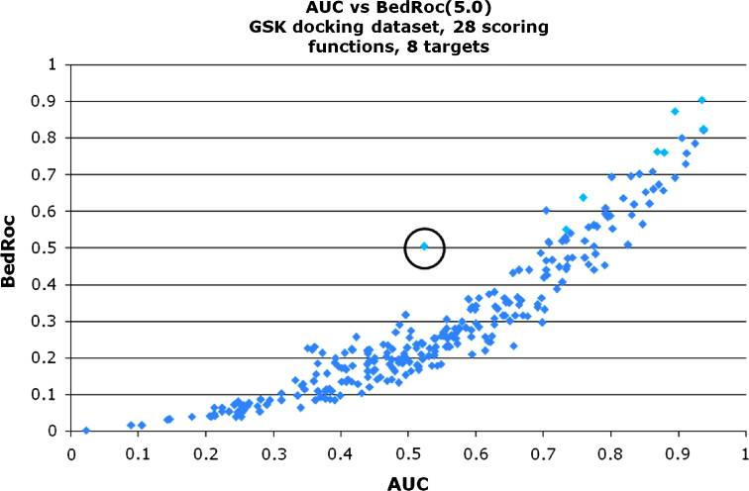
270 Virtual Screenings
Low AUC
High BedROC
No evidence for biphasic behavior

Slide 21
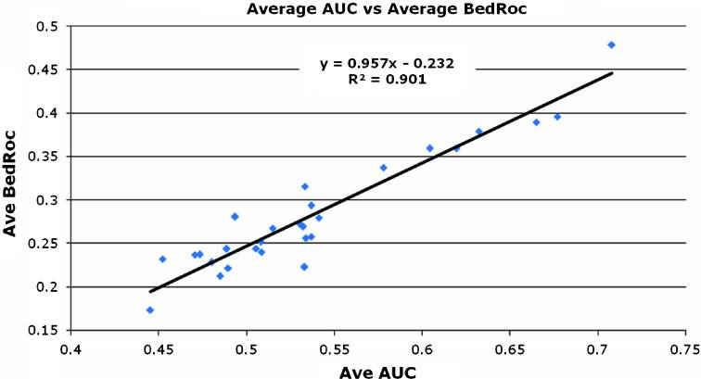
Average biphasic behavior?
The better the AUC value, the better the BedROC value (strongly correlated).

Slide 22
What is that mean?
No evidence for biphasic nature
The better the AUC value, the better the BedROC value
In avegage case RIE and BedROC not better than AUC

Slide 23
Gibt es was besseres?
Practice-orientated
Easy to understand
Give a answer why the solid curve represents a better method than the dashed curve

Slide 24
Is there something better?
Cost structure of Virtual Screening
Easy to understand
  for outsider too
Industry oriented

Slide 25
What is a cost structure of Virtual Screening?
A true positive values - successful diagnosis
  Fast results
  Save time
  Save money

Slide 26
What is a cost structure of Virtual Screening?
A false positive values - false diagnosis
  Costly tests
  Spend time
  Spend money

Slide 27
What is a cost structure of Virtual Screening?
A false negative values - more severe condition develops
  May cost a lot
  Spend time
  Spend money

Slide 28
What is a cost structure of Virtual Screening?
A true negative values – no false diagnosis
  Save money
  Save time

Slide 29
What is a cost structure of Virtual Screening?
To transform to real costs
Expected number of actives and inactives
Or the ratio of the two

Slide 30
Cost structure of Virtual Screening
True positives = 8.0
True negatives = 0.02
False positives = -0.16
False negatives = -2.0

Slide 31
Cost structure of Virtual Screening
N_{a}/N_{i} = 1/100

Slide 32
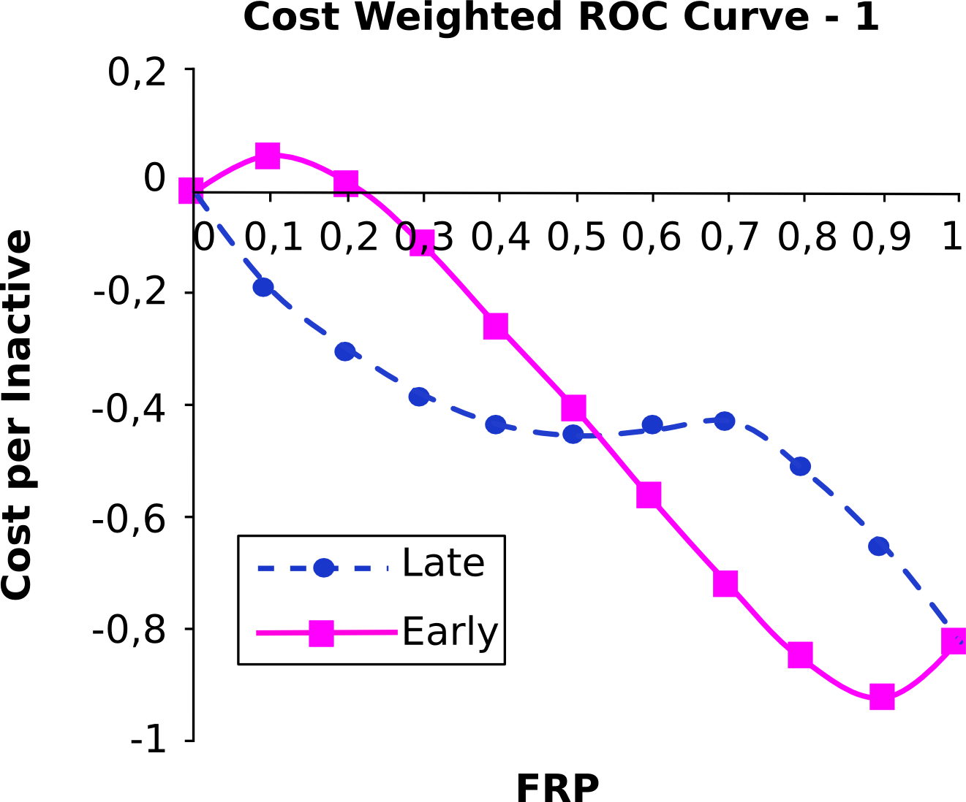
Cost weighted versions of ROC
TP = 8.0
FN = −2.0
FP = −0.16
TN = 0.02

Slide 33
What is that mean?
Early recognition besser als late recognition
Late recognition ist never cost effective

Slide 34
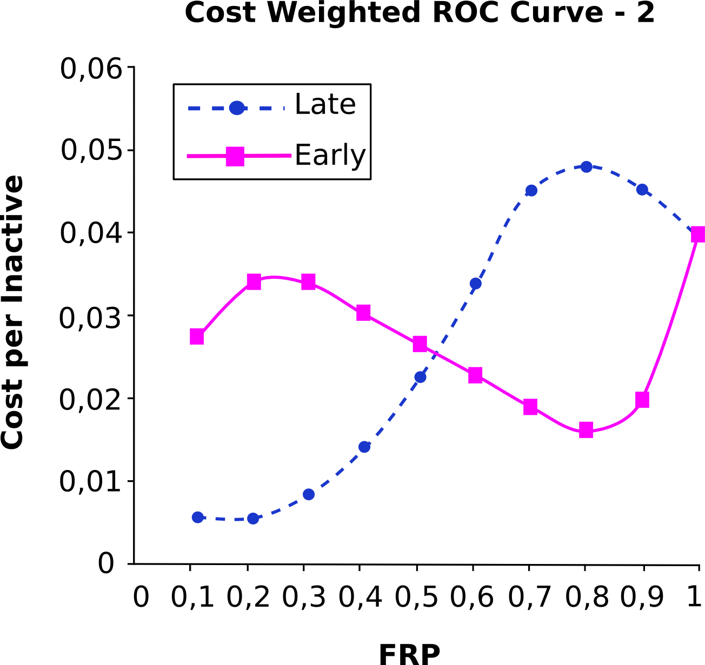
Reducing the cost of a FP by 75%
TP = 8.0
FN = −2.0
FP = −0.04
TN = 0.03

Slide 35
What is that mean?
By reducing the cost of a false positive by 75% late recognition is also cost effective.

Slide 36
Assumptions
These examples are obviously only illustrative.
Early recognition is important only because of an assumed cost structure.
It is an only assumption that early recognition is better.

Slide 37
Summary
Virtual screening is a important part of a drug-discovery
Metrics for Virtual Screening is a common problem
Cost structure of Virtual Screening might be a solution
That is a open field for research

Slide 38
Questions ?

