Slide 1
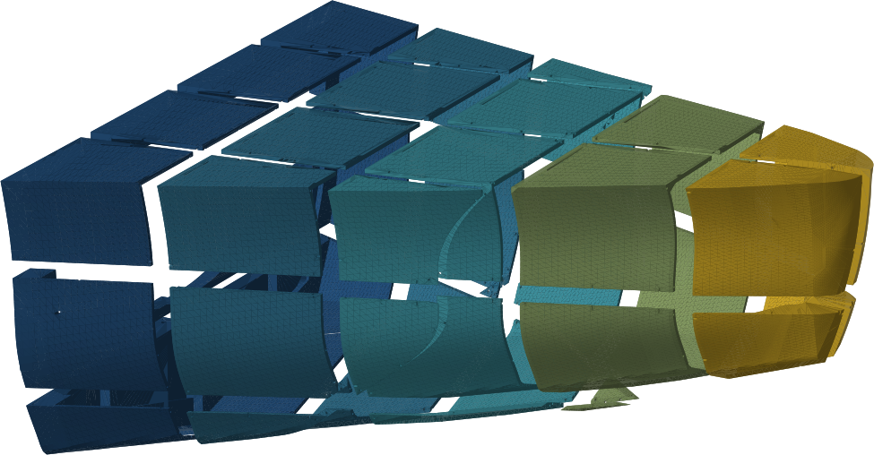
HERESTUCK LABS · CBA BUILD DAY
Today we finish
the bow
Forty-four chunks make the nose of an eight-foot dinghy. Ten are already printed. Six machines and a working day gets the other thirty-four.
ASA OVER GYROID, FIBERGLASSED AFTER · REV-3.4 · ALEXWYNN-AM.GITHUB.IO/BOAT-DESIGN

Slide 2
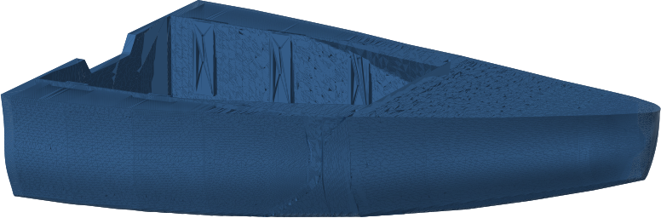
CONTEXT
The boat the bow belongs to
8 ft 1 in long, 5 ft 1 in beam
A shallow-V dinghy with a wide transom, sized around an outboard and a beach landing.
21.5 kg of ASA, one perimeter over gyroid
The print is the core. The glass is the structure.
About 53 lb built
The plywood version it replaces is 120 to 130 lb, and it oil-canned.
Every number here comes out of the geometry. The whole model regenerates
from one command.
HERESTUCK LABS · CBA BUILD DAY
02

Slide 3
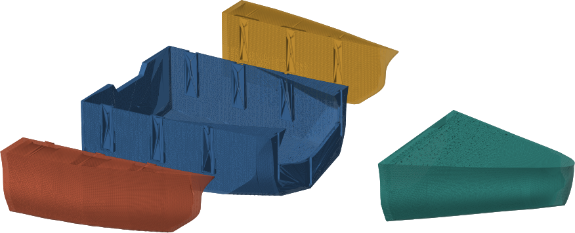
FIRST CUT
Why the boat is four pieces
It has to fit in a car. That one constraint set the whole architecture.
Centre barge, 42 in wide
A complete watertight boat on its own. This is the load.
Two wedge pods
Sealed buoyancy carrying the outer skin and the beam. They travel separately.
Bow
A hollow nose with storage. It nests inside the cockpit with 0.7 in to spare.
HERESTUCK LABS · CBA BUILD DAY
03

Slide 4
SECOND CUT
The bow, in 44 chunks
The printer is a 256 mm cube. The bow is not.
It gets cut on an axis-aligned grid with 8 mm of margin, and every cut face carries printed ASA dowels, so a chunk can only go back one way.
232
4.0 mm
printed dowels
in the bow alone
pins in 4.2 mm holes,
6 mm into each side
HERESTUCK LABS · CBA BUILD DAY
04

Slide 5
THE ARITHMETIC
Six printers finish the bow
The longest chunk left is 2.5 hours. The median is 1.1.
Of the 34 remaining bow chunks, how many land
printers | 8 h day | 10 h day
4 | 28 | 32
6 | 34 | 34
8 | 34 | 34
12 | 34 | 34
That is why this is a build day. Nobody babysits a forty-hour print, and a machine that dies at hour two costs one chunk out of thirty-four.
Six machines is the whole remaining bow inside eight hours. Four machines leaves six chunks over, and they are the small ones.
34
40 h
chunks still to print
(#011 through #044)
of machine time,
3.1 kg of ASA
Print 000_dowel.stl before anything else.
HERESTUCK LABS · CBA BUILD DAY
05

Slide 6
THE PLAN
What we are doing today
01
Load the queue, dowels first
000_dowel.stl, then bow chunks in file order. The numbering runs bottom layer up, so a chunk only ever bonds to lower-numbered neighbours that already exist.
02
Dry fit as they come off
Do not wait for a full set. A chunk goes to the bench the moment the plate cools, and #001 through #010 are already there waiting.
03
Dowel and bond
Abrade, solvent wipe, epoxy. The ASA to epoxy bond is the least forgiving joint on the boat, and it is the one we make by hand.
04
Abrade for glass
Everything that will be glassed gets keyed while there are spare hands to do it.
HERESTUCK LABS · CBA BUILD DAY
06

Slide 7
HOMEWORK
Which way up
Standing each chunk on a flat cut face cut the bow's support by 98 percent.
The bow, as cut and as it now prints
 | as cut | oriented
support | 9,966 cm² | 223 cm²
envelope | 72.6 L | 0.25 L
print time | about 200 h | 54 h
needs support | most of 44 | 6 of 44
The chunks were being exported in the boat's own frame, which lays most of them curved side down. A hull has no flat face. A chunk cut off a grid has six of them.
Support would have cost more ASA than the boat.
Roughly four times faster, for a rotation.
HERESTUCK LABS · CBA BUILD DAY
07

Slide 8
ASSEMBLY
How the pieces find each other
232 printed ASA dowels in the bow
Joint clearance is 2.0 mm per face, which sounds loose until you count the glass going into it. Both mating walls are exterior surfaces, they both take 6 oz cloth, and that ate the original 0.6 mm on its own.
Tongues take cloth. Sockets take neat epoxy, because cloth only bridges a 16 mm flared slot and traps air behind itself.
4.0 mm pins in 4.2 mm holes, 6 mm into each side of every cut face.
Vertical dovetail keys
The four big pieces drop together from above and lock against pulling apart.
16 bolts, all above the waterline
They clamp. The keys resist lift. Nothing structural sits below the water.
Loose is nearly free. The bolts do the clamping.
HERESTUCK LABS · CBA BUILD DAY
08

Slide 9
AFTER THE PLASTIC
The print is not the boat yet
A 0.5 mm wall over 8 percent gyroid weeps through its own layer lines. The glass is what makes it a boat.
The printed wall carries about the same weight per unit area as the plywood it replaces, so the thickness is close to free. The mass lives in perimeters and glass.
Infill is half the boat's mass, perimeters are 30 percent, glass is 20. One percent of infill is 2.7 lb.
Fifty pounds is reachable. Forty is not, without a smaller boat.
6 oz cloth everywhere
One fabric for the whole boat, chosen for wet-out and for drape over printed layer lines.
Doubled on the bottom, second layer at 45 degrees
Beaching and slamming loads land there.
HERESTUCK LABS · CBA BUILD DAY
09

Slide 10
EXPECT THIS
What will go wrong
ASA lifts off the plate
Door shut, chamber warm before layer one, 8 mm brim on every chunk. This is the failure you will actually see today.
Six bow chunks still want support
#043 and #044 at 52 cm², #027 and #028 at 24, #013 and #016 at 10. Use normal supports at threshold 30, with 'on build plate only' and 'support critical regions only' both OFF.
#034 and #035 stand 13.7:1 tall
They sit on 17 cm² of plate, and that stance is what makes them support-free. Watch the first layer, then leave them alone.
286 of the bow's 464 dowel bores print horizontally
They bridge their own roof and can droop into a 4.2 mm hole. Dry fit before glue. If they bind, reprint the dowels thinner.
HERESTUCK LABS · CBA BUILD DAY
10

Slide 11
Take a chunk.
Bring it back bonded.
Forty-four chunks, 232 dowels, one bow. manifest.csv says which chunk mates to which, and PROFILE.txt in the bow folder says how to print all of it.
alexwynn-am.github.io/boat-design
000_DOWEL.STL FIRST · THEN #011 UPWARD · BRIM EVERYTHING

