Slide 1
Race for the Senate
Using Machine Learning to Predict Election Outcomes
Alex Zadel

Slide 2
Research Question
Primary Question: Which party will win the contest seats in the United States Senate in the 2018 elections?
Methodology Question: How can well can machine learning techniques be adapted to make election predictions?

Slide 3
Background
We usually think of using polling data to predict elections.
In 2012, the Obama and Romney campaigns each spent $5 million in polling alone. Clinton 2016 spent $9 million.
But some political observers argue that the candidate and electoral idiosyncrasies are largely irrelevant in predicting voter behavior. Instead of looking at micro-shifts in opinion, we should be looking at macro-trends in political behavior.

Slide 4
Background
One of the most successful predictive models is the “time for change model” developed by Alan Abramowitz, which calculates Presidential popular vote using data on economic trends and political popularity.
Nate Silver and his website FiveThirtyEight became famous in 2012 for correctly predicting outcomes in all 50 states. They too used macro information to inform their models, while also incorporating polling data.

Slide 5
Goal of This Project
My goal in this project was to build a political prediction model in this tradition, using publicly available data on economic trends, demographic changes, and political trends.
I limited my scope to the U.S. Senate elections, but plan to build a house and gubernatorial model as well.
Looking from an academic perspective, not strategy.

Slide 6
Data Overview

Slide 7
Data Overview
I decided on three “themes” of data to use in the model:
Political Trends
Economic Trends
Demographic Trends

Slide 8
Data: Political Trends
Data on political trends and political history are critical in capturing public sentiment toward each political party and the party’s vision for the country.
Political Trend Data:
Incumbent candidates
Incumbent party
Presidential approval

Slide 9
Data: Economic Trends
State by state economic data was difficult to find going back in time far enough for meaningful analysis. I was forced to limit sources for this iteration of the model.
Economic Trend Data:
National unemployment rate
State unemployment rate

Slide 10
Data: Demographic Trends
Given the distinct political divides between different demographic gropus, it was key to incorporate these voting blocs—and how they’ve evolved—into the model.
Demographic Trend Data:
Age Groups (Total population and percentage of total)
Gender (Total population and percentage of total)
Racial background (Total population and percentage of total)

Slide 11
Data Sources
Political Trends
Election Outcomes : Wikipedia (scraped)
Presidential Approval Ratings : Presidential Project UCSB
Economic Trends
Unemployment Data (National/State) : Bureau of Labor Statistics
Demographic Trends
Gender/Age/Racial Demographic Trends : U.S. Census Bureau

Slide 12
Data Engineering
Several variables had to be transformed to be effectively incorporated into the model.
Census Data:
Age groups were consolidated from detailed breakdown in raw form to bundled age ranges (under 18, 18 to 29, 30 to 59, 60 and over)
Data released as aggregate values – transformed into percentages of the whole population to emphasize balance of groups as a key political attribute of a state.

Slide 13
Data Engineering
Variables had to be transformed to be effectively incorporated into the model.
Political Trends:
Incumbency Effects: Information on incumbent parties and candidates treated through binary variables.
Presidential Approval : Created interaction terms so that GOP presidents have one set of effects, Democratic have another.
Election Results : Extensive data cleaning with regular expressions

Slide 14
Exploratory Data Analysis

Slide 15
Distribution of Key Variables
Variable | Mean | Percentage
GOP Win | 0.496847 | 49.6%
GOP Predecessor | 0.518285 | 51.8 %
Percent Female Citizens | 0.508948 | 50.9 %
GOP President in Office | 0.602774 | 60.3%
GOP Incumbent Running | 0.409836 | 41.0%
DEM Incumbent Running | 0.360656 | 36.1 %
Unopposed | 0.005044 | 0.5 %
Balance
Incumbency Prevalence
Outliers

Slide 16
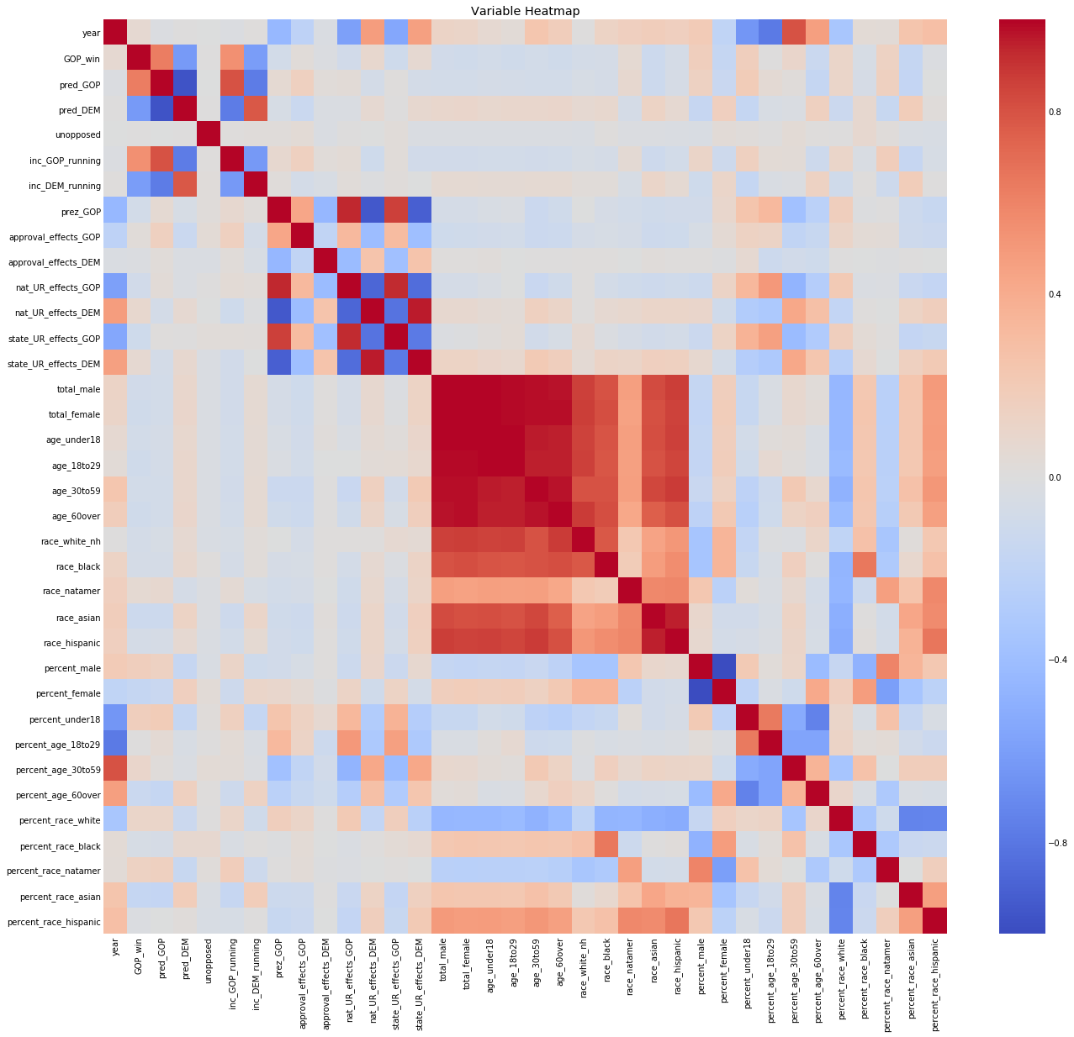
Correlation between Variables
Effects over time
Strong correlation between population variables
“Checkerboard” Pattern
Presidential Approval
Incumbency Effects

Slide 17
Modeling

Slide 18
Classification vs. Regression
An important decision to make on this project was whether to treat the question as a regression or classification?
Classification: Did this candidate win? Which candidate won this race?
Regression: How many votes did the candidate receive? How many did the winner of this race get?

Slide 19
Unit of Analysis: Race or Candidate?
Since we are looking at election results, we can look at two different units of analysis: the race/election between the candidates as a whole or each candidate as an individual data point.
Candidate Unit
Classification: Did the candidate win?
Regression: How many votes did the candidate get?
Race Unit
Classification: Which candidate won?
Regression: How many votes did the winner get?

Slide 20
Which Question?
Ultimately, I chose to do a classification problem because it better fit the data I was able to obtain. More detail needed for regression.
I also chose to consider an entire race as the unit of analysis to better capture the pseudo-zero-sum dynamics. Treating the election as the unit also captures the “relative to each other” nature of elections rather than implying an absolute score.

Slide 21
Modeling Process
In the interest of leaving no stone unturned, I implemented and evaluated several different classification methods and used the same tinkering and optimization process with each.
Process:
Regularize Data
Theoretical Fit (How well should this model work?)
Cross Validation Score
GridSearchCV for optimal parameters
Manual tinkering to correct overfitting and test other parameter combinations.

Slide 22

Modeling Process: Key Metric
Since this is an academic model, we do not value false positives or false negatives differently. Incorrect is incorrect.
Given that perspective, I used Accuracy as my key metric in training and evaluating the models.

Slide 23
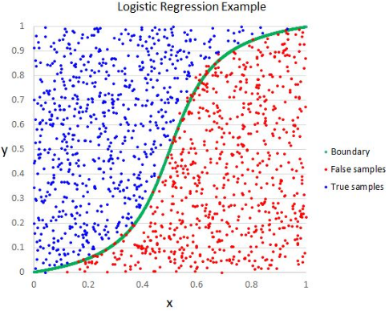
Logistic Regression
Advantages:
Interpretability
Compare importance of variables
Output in terms of probability
Disadvantages:
Lack of flexibility
Thinking in One Dimension
Score | Train Score | Test Score
Cross Validation Score | .8138
GridSearchCV Score | .8305 | .85
Final Model Score | .8326 | .85
Vincent Granville

Slide 24
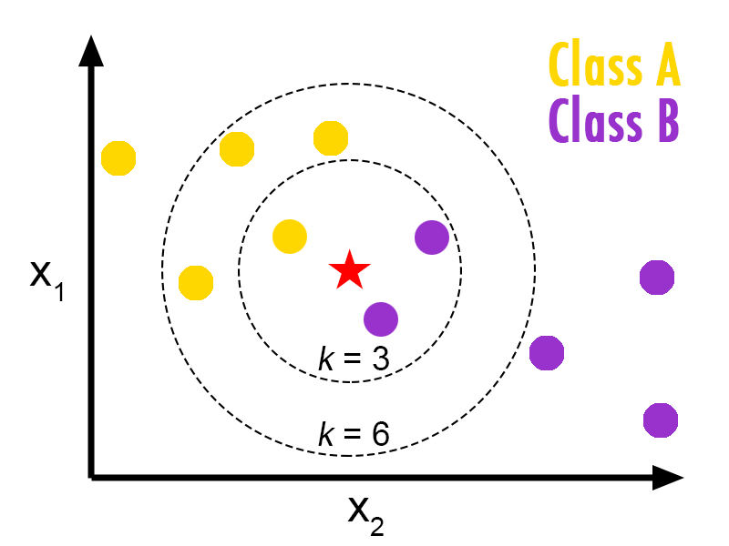
KNeighbors Classification
Advantages:
Mimics political analysis
Captures election similarity
Time drops as a key feature
Disadvantages:
Overfitting
Score | Train Score | Test Score
Cross Validation Score | .8220
GridSearchCV Score | .9958 | .85
Final Model Score | .9958 | .8667
Savan Patel

Slide 25
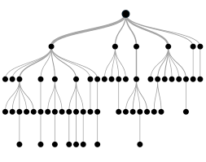
Decision Tree Classification
Advantages:
“naturally model non-linear decision boundaries” --Elite Data Science
Disadvantages:
Overfitting
Score | Train Score | Test Score
Cross Validation Score | .7344
GridSearchCV Score | .9958 | .7333
Final Model Score | .8285 | .8417
Analytics Vidhya

Slide 26
Bagging Classification
Advantages:
Captures the advantages of the Decision Tree structure
Corrects for issues of overfitting trees
Disadvantages:
Debatable if it simulates a voter-decision logic
Score | Train Score | Test Score
Cross Validation Score | .7907
GridSearchCV Score | .8285 | .8417
Final Model Score | .8285 | .85

Slide 27
Random Forest Classification
Advantages:
Captures advantages of decision trees
Removes tree correlation to imitate learning from multiple, diverse voters
Disadvantages:
Cannot follow the logic in great detail
Score | Train Score | Test Score
Cross Validation Score | .8116
GridSearchCV Score | .9937 | .85
Final Model Score | .9184 | .8558

Slide 28
Adaboost Classification
Advantages:
Captures advantages of decision trees (or any other classifier)
Disadvantages:
Not really necessary to boost it
Score | Train Score | Test Score
Cross Validation Score | .8117
GridSearchCV Score | .8368 | .8417
Final Model Score | .8724 | .8417

Slide 29
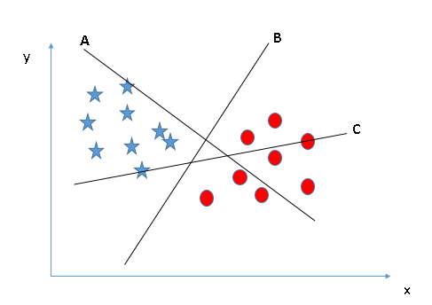
Support Vector Machine
Advantages:
Can capture non-linear trends and clustering
Disadvantages:
Assumes separability, which is not strictly realistic
Need to integrate time to use properly
Score | Train Score | Test Score
Cross Validation Score | .7990
GridSearchCV Score | .8431 | .8417
Final Model Score | .8431 | .8417
Analytics Vidhya

Slide 30
Modeling Summary
Final Model Score | Train Score | Test Score | Logic
Logistic Regression | .8326 | .85 | X
KNeighbors | .9958 | .8667 | ✔
Decision Tree | .8285 | .8417 | ✔
Bagging | .8285 | .85 | ✔ -
Random Forest | .9184 | .8558 | ✔
Adaboost | .8724 | .8417 | ✔
Support Vector Machine | .8431 | .8417 | X

Slide 31
Final Model: Voting Classifier
Cannot resist the pun of using a Voting Classifier.
Dropped the models with questionable logic
Final Model Score | Train Score | Test Score
KNeighbors | .9958 | .8667
Decision Tree | .8285 | .8417
Bagging | .8285 | .85
Random Forest | .9184 | .8558
Adaboost | .8724 | .8417
Final Model Score:
Train: .8640
Test: .85

Slide 32
Final Model: Predictions
States
Arizona*
California
Connecticut
Delaware
Florida
Hawaii
Indiana
Maine
Maryland
Massachusetts
Michigan
Mississippi
Mississippi (Sp)
Winning Party
GOP ~
DEM
DEM
DEM
DEM
DEM
DEM
DEM
DEM
DEM
DEM
GOP
GOP
States
Minnesota
Minnesota (Sp)
Missouri
Montana
Nebraska
Nevada
New Jersey
New Mexico
North Dakota
Ohio
Pennsylvania
Rhode Island
Tennessee
Winning Party
DEM
DEM
DEM
DEM
GOP
GOP ~?
DEM
DEM
DEM
DEM
DEM
DEM
GOP
States
Texas
Utah
Virginia
Washington
West Virginia
Wisconsin
Wyoming
Winning Party
GOP
GOP
DEM
DEM
DEM
DEM
GOP
* Battleground States
~ Disagrees with FiveThirtyEight

Slide 33
The Next Iteration
Model:
Expand the current model to include gubernatorial and House of Representatives races.
Incorporate more economic data, campaign finance data
Area Under Curve Metric
What races are being predicted incorrectly?
Kneighbors Distance Models with Weight Function
Deep dive into a single state (incorporate polling data)
Presentation
Background Data and Results Visualization (interactive?!)
Own Visualizations on the Model
Predict Proba Values, Gradation of Likelihood

