Slide 1
Weird Science: Reddit Edition

Slide 2
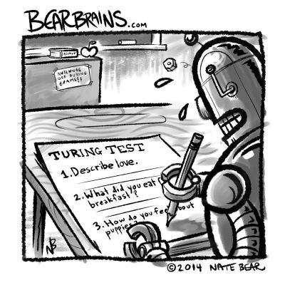
Subreddits of Interest:
r/AskWomen
“Your window into the female mind. This is a subreddit dedicated to asking women questions about behavior, anatomy, habits or anything else that might baffle you. We welcome inquiries from everyone into the mysteries of the feminine.”
Posts by any reddit users and monitored by moderators.
n = 1482
u/AskWomen_SS
Part of Subreddit_SS project: “A fully-automated subreddit that generates random submissions and comments using markov chains (see below for more info), with each bot account creating text based on comments from a different subreddit.”
Bots are built using Markov chains, similar to predictive text on phones
This particular bot is trained on r/Ask Women
n = 798
Goal: Build a classifier that can tell them apart!

Slide 3
What does our data look like?
“How do you decipher between criticism vs. someone coming from a place of love/concern?”
-mundanecuriosity in r/AskWomen
“My husband and I went to a party just for being a woman and the book is a classic. I don't save anything because I am seriously paranoid when I have my glasses on. I'm 5'9" (~175 cm) and I want more kids so I don't forget ya!”
-AskWomen_SS
“Basically, you feed in a bunch of sentences, and even though it has no understanding of the meaning of the text, it picks up on patterns like "word A is often followed by word B". Then when you want to generate a new sentence, it "walks" its way through from the start of a sentence to the end of one, picking sequences of words that it knows are valid based on that initial analysis. So generally short sequences of words in the generated sentences will make sense, but often not the whole thing.”
-Deimorcz, Moderator, r/Subreddit Simulator

Slide 4
Starting with…Two Basic Models
Model Type | n-gram range | Cross Val Score | Model Score
Count Vectorizer (stop words included) | (1, 1) | 0.8722 | 0.8730
 | (1, 2) | 0.8783 | 0.8770
 | (2, 2) | 0.8669 | 0.8569
 | (2, 4) | 0.8709 | 0.8629
Count Vectorizer (stop words included) | (1, 1) | 0.7949 | 0.8145
 | (1, 2) | 0.7983 | 0.8125
 | (2, 2) | 0.6086 | 0.6129
 | (2, 4) | 0.4983 | 0.5222
TF – IDF Vectorizer (stop words included) | (1, 1) | 0.8561 | 0.8810
 | (1, 2) | 0.8514 | 0.8911
 | (2, 2) | 0.7875 | 0.8145
 | (2, 4) | 0.7673 | 0.8085
TF – IDF Vectorizer (stop words eliminated) | (1, 1) | 0.7330 | 0.7681
 | (1, 2) | 0.6651 | 0.6714
 | (2, 2) | 0.6120 | 0.6088
 | (2, 4) | 0.6046 | 0.6088

Slide 5
Advanced Classifiers
Model Type | Parameters | Train Accuracy | Test Accuracy
Decision Tree | Baseline | 1.0* | 0.8690
 | Grid Search Optimized max depth: 60 max leaf nodes: 8 | 0.8480 | 0.8609
Random Forest | Baseline | 0.9960* | 0.8528
 | Grid Search Optimized n_estimators = 40 max_leaf_nodes = 14 max_depth = 12 | 0.8298 | 0.8085
Multinomial Naïve Bayes | Smoothing | 0.9704* | 0.8266
 | No Smoothing | 1.0* | 0.7681
Voting Classifier | CountVectorizer Tuned Decision Tree Tuned Random Forest | 0.9254 | 0.8891
* MIGHT be a little overfit….

Slide 6
Key Lessons
Stop Words
The Count Vectorizer and TF-IDF model results show that stop words are important in this case. (They were also tested in later models, but were clearly still critical).
Given the nature of Markov chains, not entirely surprising since those over-used words would probably get used different by humans and computers!
Sweet and Simple
Some of the advanced models could be tuned to achieve a balance in fit, but they could not outperform the simplicity of the CountVectorizer approach.
Good example of the data science principle of seeking the simplest best solution.
Markov and Trees
I think these results show a weak spot in decision trees and random forest models. The Markov chains relate probabilities and the decision trees will think about decreasing entropy.
I am not familiar enough with the math of each, but it is an interesting area for future research.

Slide 7
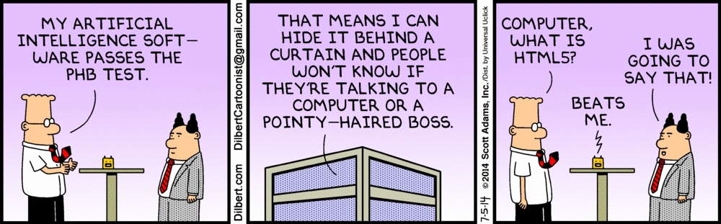
Questions?

