Slide 1
Using DORIS for extracting ionospheric information at satellite altimetry observation points
Ke Zhang, Denise Dettmering, Michael Schmidt
Deutsches Geodätisches Forschungsinstitut (DGFI-TUM)
Technische Universität München
IAG 2025 Scientific Assembly J01: Geodetic Space Weather Research
Notes:
Good morning, everyone. It is my pleasure to present the work I have conducted over the past six months, focusing on Using DORIS for extracting ionospheric information at satellite altimetry observation points

Slide 2
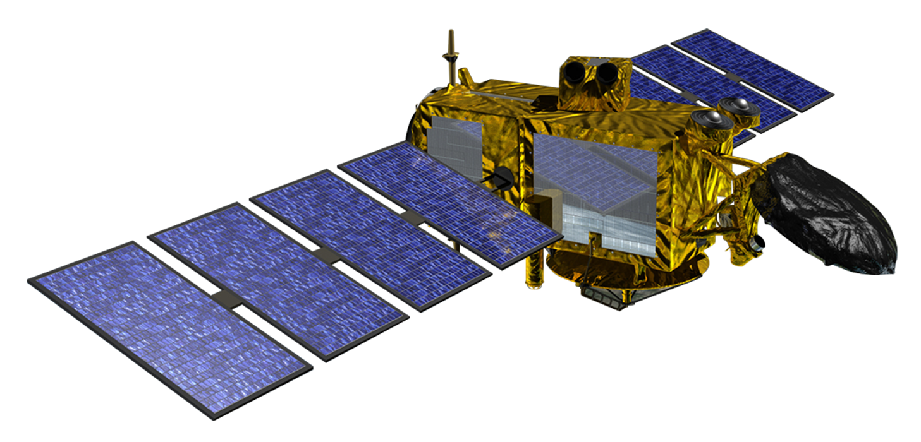
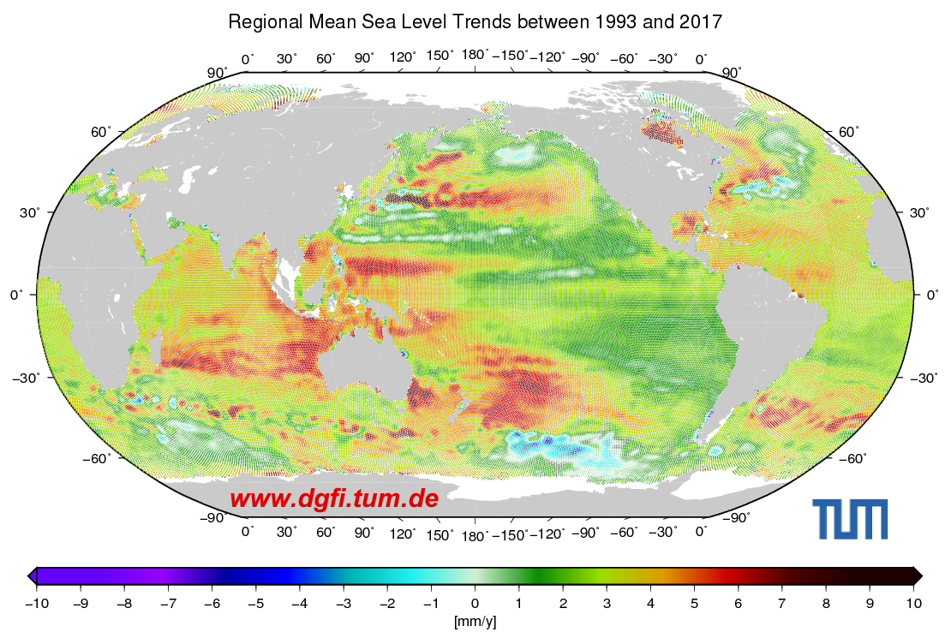
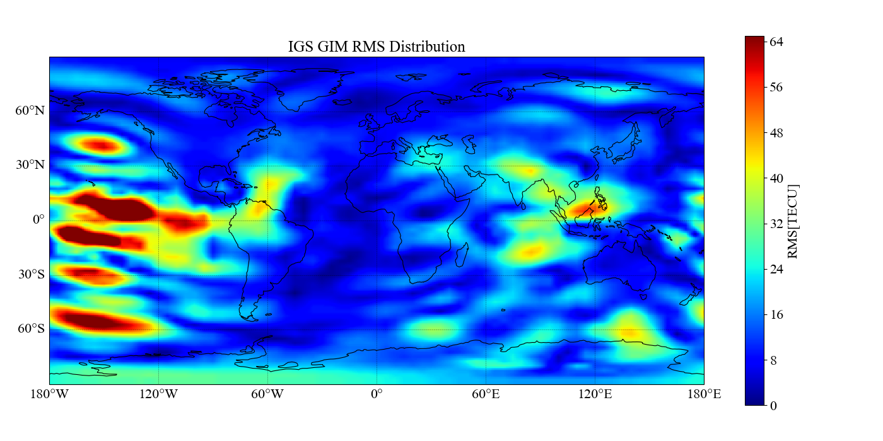
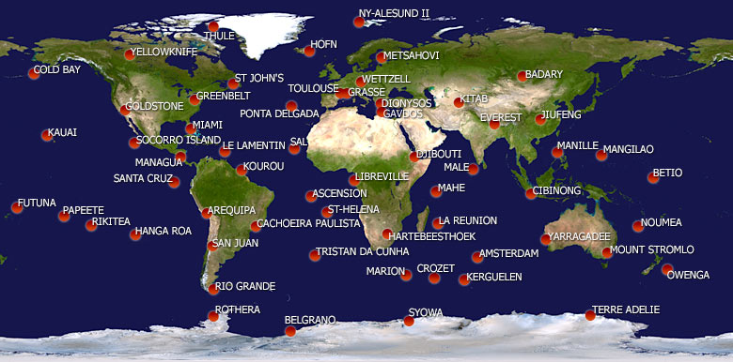
Motivation
Ionospheric correction for Satellite Altimetry: millimeter-level accuracy required
Jason-3 (NASA/JPL Image)
GNSS ionospheric maps: sparsely distributed over the oceans
Altimetry satellites carry DORIS receivers
DORIS provides wide oceanic coverage
Ionospheric correction for single-frequency altimetry using DORIS
Comparison with IGS GIM corrections
Validation with Jason-3 dual-frequency data
Notes:
Satellite altimetry requires high accuracy in its observations. As shown here, the global mean sea level has varied over the past three decades, with changes measured at the millimeter scale. Among the major error sources affecting altimeter signals, ionospheric delay is important, as its impact can reach up to the meter level.
For single-frequency altimeters, ionospheric corrections are usually derived from GNSS-based global ionospheric maps, or GIMs. However, GNSS receivers are unevenly distributed and relatively sparse over the oceans compared to land. By contrast, all altimetry satellites are equipped with DORIS receivers for precise orbit determination. Since the DORIS network provides wide coverage across oceanic regions, it also offers the potential to improve ionospheric delay corrections for altimetry measurements.
Therefore, this study investigates the use of DORIS observations to correct ionospheric delay in single-frequency altimetry. The results are compared with those derived from GIM, while Jason-3 dual-frequency altimetry data serve as the ground truth for validation.

Slide 3
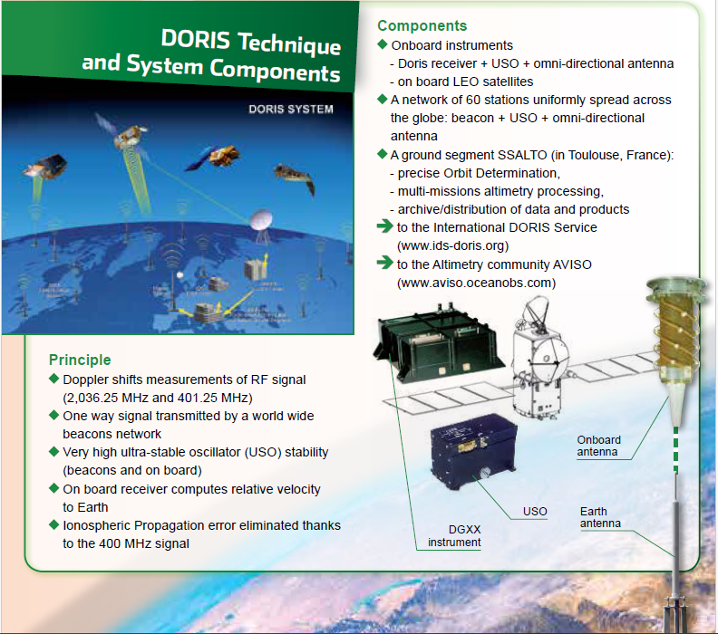
DORIS
Doppler Orbitography and Radiopositioning Integrated by Satellite
Designed for precise orbit determination of altimeter satellites
One-way signals transmitted by a global network of ground beacons
DORIS receivers on board all altimetry missions
Two frequencies (2 GHz & 400 MHz) for ionospheric correction
Notes:
DORIS, which stands for Doppler Orbitography and Radiopositioning Integrated by Satellite, was originally developed for the precise orbit determination of altimeter satellites. Unlike GNSS, the signals are transmitted from a global network of ground beacons to the satellite, and then relayed to the control center. Many of these beacons are located in remote regions, enabling global coverage without relying on internet infrastructure. Each receiver onboard altimetry missions records two frequencies, 2 GHz and 400 MHz, which allow ionospheric delay correction. Importantly, the data are provided in RINEX format, similar to GNSS, which makes the integration and processing straightforward.

Slide 4
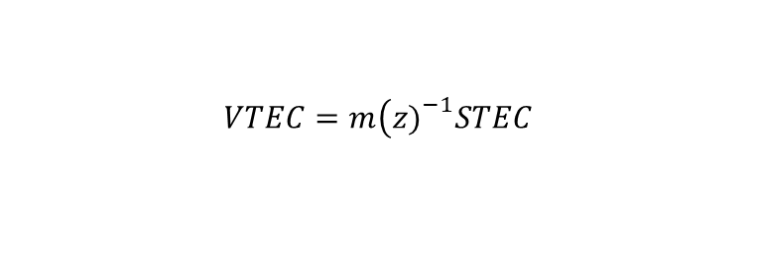


DORIS Vertical Total Electron Content (VTEC)
DORIS RINEX files contain code and phase observations at two frequencies
Code data are highly noisy (km-level): not usable
$$d_{ion}=\frac{f_{1}^{2}f_{2}^{2}}{f_{1}^{2}−f_{2}^{2}}\left(λ_{1}Φ_{t,1}^{r}−λ_{2}Φ_{t,2}^{r}\right)$$
Phase data can be used for ionospheric information (similar to GNSS)
Absolute level missing without code: taken from GIM
Result: slant delay → STEC → mapped to VTEC at DORIS observation points
$$d_{ion}=−\frac{40.3}{f^{2}}STEC$$
$$VTEC=m\left(z{\left.)\right.}^{−1}STEC\right.$$
Notes:
DORIS RINEX files contain both code and phase observations at two frequencies. The code measurements, however, suffer from very large noise—up to the kilometer level—and are therefore unusable for precise range determination. Phase measurements, on the other hand, are sufficiently precise to extract ionospheric information, much like in GNSS processing.
A key limitation is that without reliable code data, the absolute ionospheric delay cannot be derived directly from phase alone. To overcome this, GNSS-based GIMs are used to provide the absolute reference level, after downscaling to the orbit height of altimeter satellites. In this way, DORIS phase observations are converted into slant total electron content, which is then mapped into vertical TEC at the DORIS observation points.

Slide 5
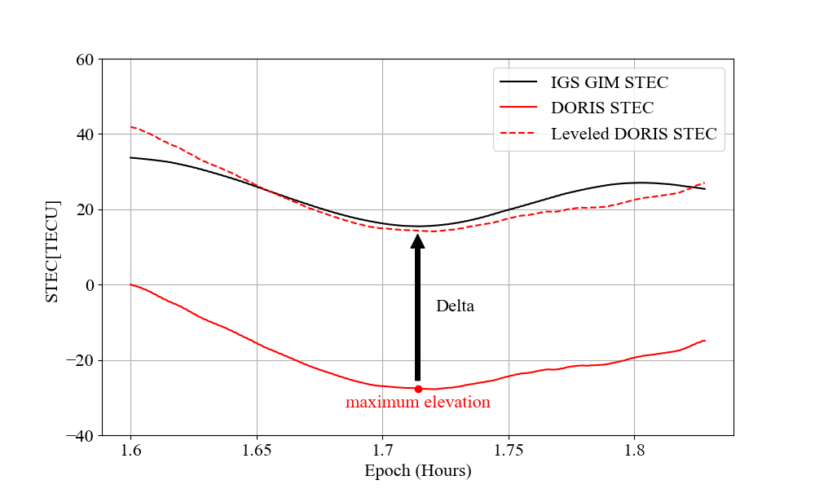
DORIS STEC Leveling
DORIS only provides relative information due to unreliable code information
Unknown phase ambiguities will be derived from GNSS GIM maps
Height scaling is necessary: different orbit heights of GNSS and LEO satellites have to be taken into account!

Slide 6
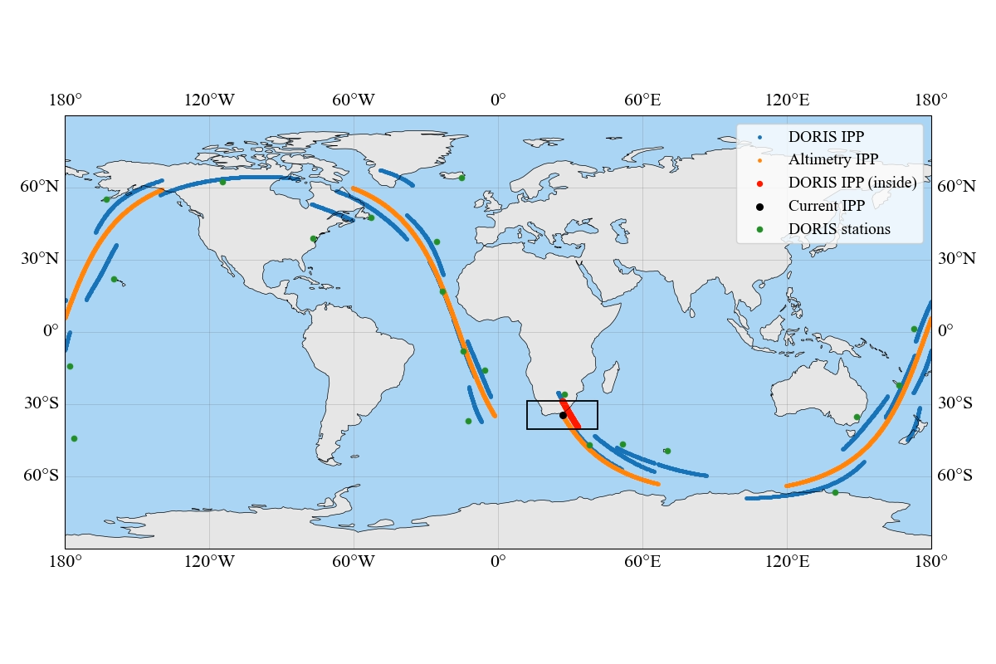
DORIS VTEC Selection and Interpolation
DORIS VTEC observation points must be selected and interpolated onto the altimetry observation points
Selection based on spatial proximity to the altimetry IPP
Interpolation performed using weighted averaging
Approach tested in Master’s Thesis (Zhang, 2024)
Notes:
To obtain DORIS-based VTEC values at the altimeter observation points, two steps are required: point selection and interpolation. First, DORIS VTEC observations within a defined spatial window around each altimeter observation point are selected. Then, these values are interpolated to the observation location using a weighted averaging method. This procedure, as illustrated in the video shown here, was first tested during my Master’s Thesis in 2024 and provides a practical way to link DORIS observations with altimetry measurements.

Slide 7
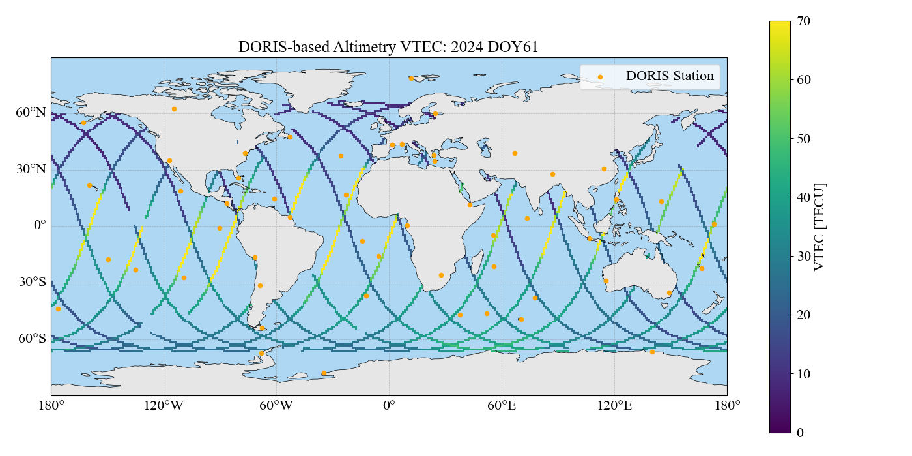
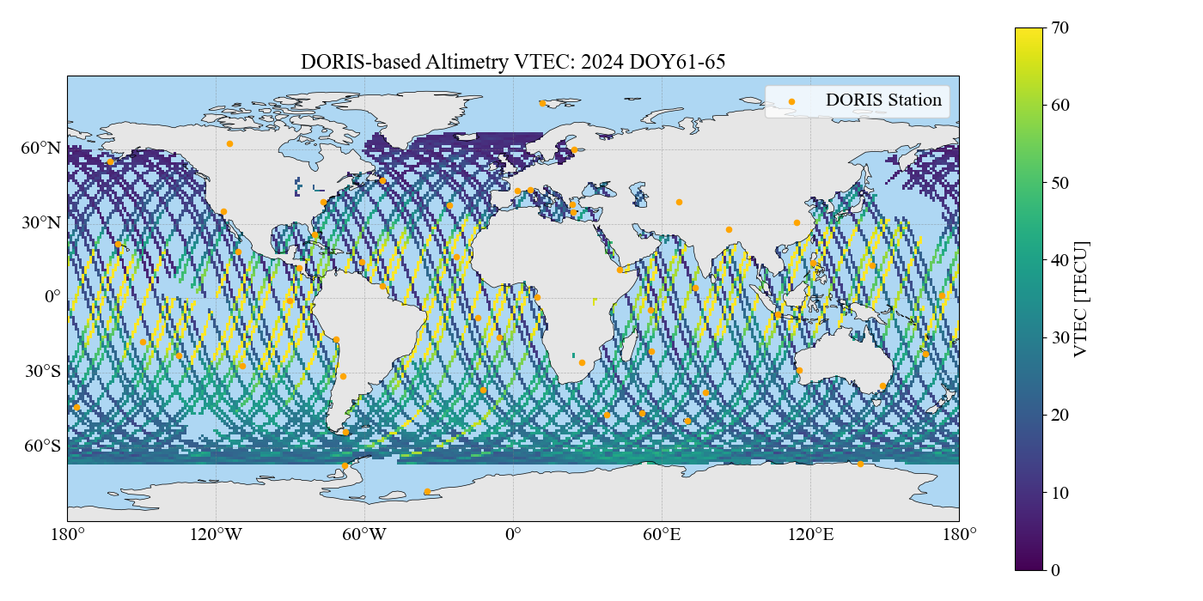
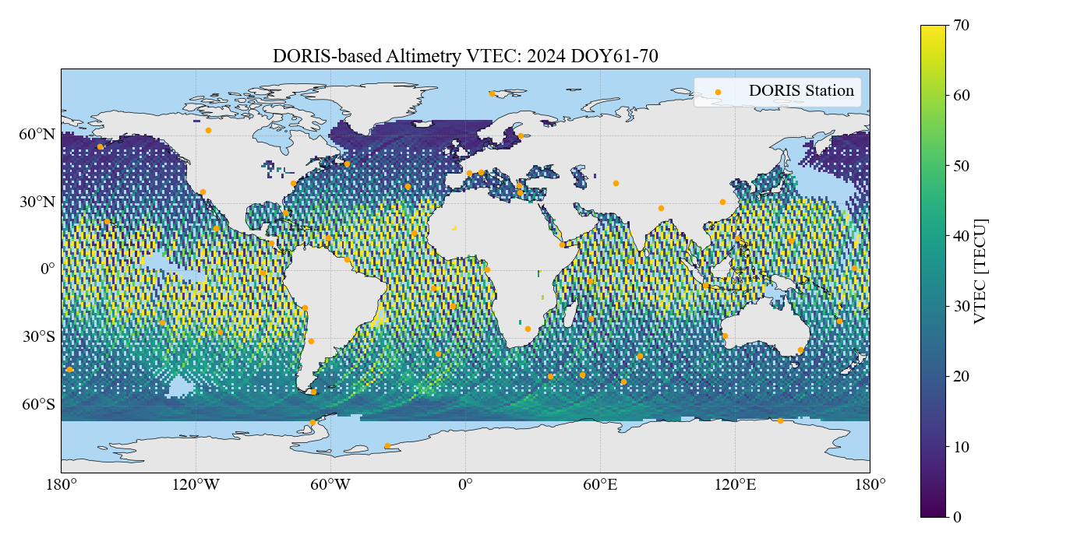
DORIS-based Altimetry VTEC in Global Region
Daily DORIS-based VTEC along Jason-3 ground track
Blank regions without DORIS results in Pacific
Notes:
This figure shows the VTEC values derived from DORIS observations during a single day in 2024. As we can see, ionospheric activity is significantly higher in the equatorial regions , highlighted in yellow. Also the different local times of ascending and descending passes can be spotted. Over longer time spans, the altimetry ground tracks gradually cover the globe.

Slide 8
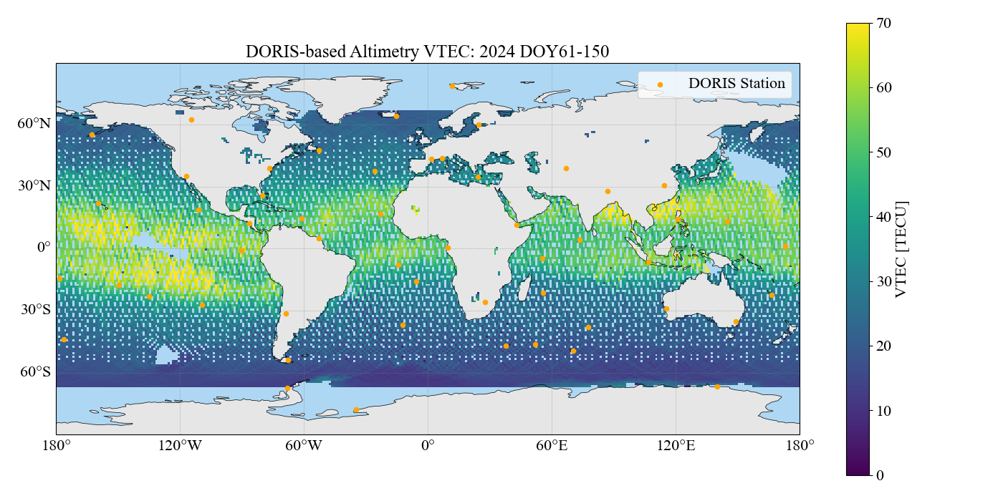
DORIS-based Altimetry VTEC in Global Region
Daily DORIS-based VTEC along Jason-3 ground track
Blank regions without DORIS results in Pacific
Notes:
After averaging over 90 days , we obtain the DORIS-based VTEC map shown here. It is important to note that there are still missing regions, particularly over the Pacific and other areas with sparse DORIS coverage, where no data are available . Naturally, the coverage will expand as more DORIS stations are deployed worldwide.

Slide 9
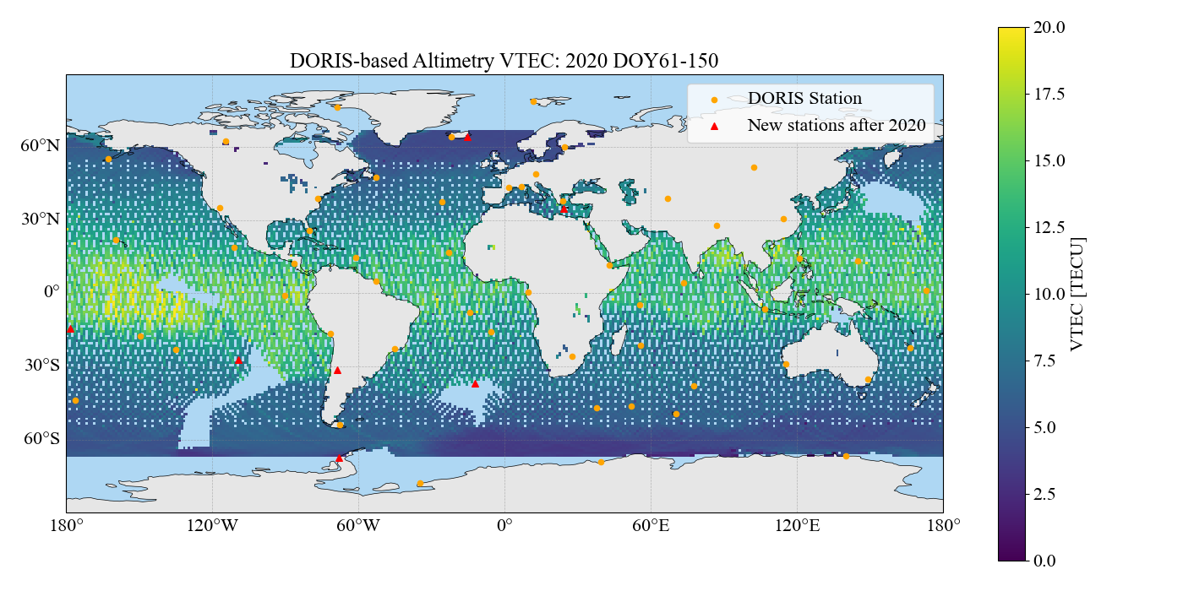
DORIS-based Altimetry VTEC in Global Region
Daily DORIS-based VTEC along Jason-3 ground track
Demonstration takes mean VTEC values for each geolocation
Blank regions: decreased from 2020 to 2024
Notes:
For instance, this figure shows the situation in 2020, where the blank regions were even larger. The improvement in coverage in recent years is due to the addition of new stations, shown here in red, which were established after 2020.

Slide 10
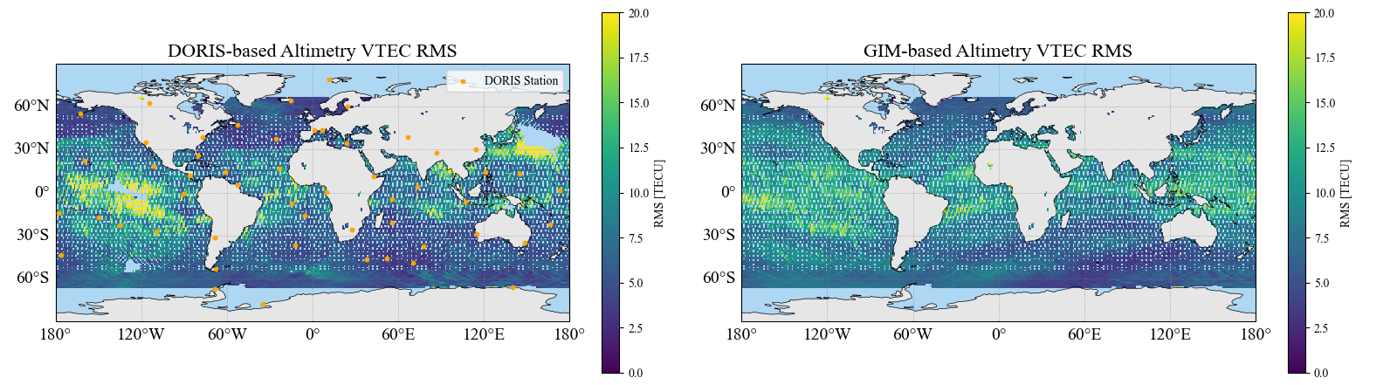
Comparison with Altimetry VTEC
DORIS-based vs. GIM-based altimetry VTEC in 2024 (ground truth: Jason-3 altimetry)
DORIS: high RMS near blank regions, clusters of peaks (especially equator)
Better performance near DORIS stations (backup slide)
Notes:
This figure shows the RMS values obtained by comparing DORIS-based and GIM-based altimetry VTEC against Jason-3 dual-frequency measurements, which serve as the ground truth. For DORIS, the highest RMS values are clearly concentrated near the blank regions, especially along the equatorial belt where ionospheric activity is strongest. At high latitudes above 30°, DORIS shows relatively good performance, especially in regions close to its stations.
In addition, several clusters of elevated RMS can be seen in other regions. These are also linked to large distances from the nearest DORIS stations
By contrast, GIM exhibits complete global coverage and a more uniform RMS distribution. Nevertheless, DORIS is not without strengths. In high-latitude regions above 30 degrees, as well as over the Indian Ocean near the African continent where near stations are sufficient, DORIS corrections actually perform better than GIM.
This suggests that the performance of DORIS is strongly related to the distribution of stations , in addition to the absolute VTEC.

Slide 11
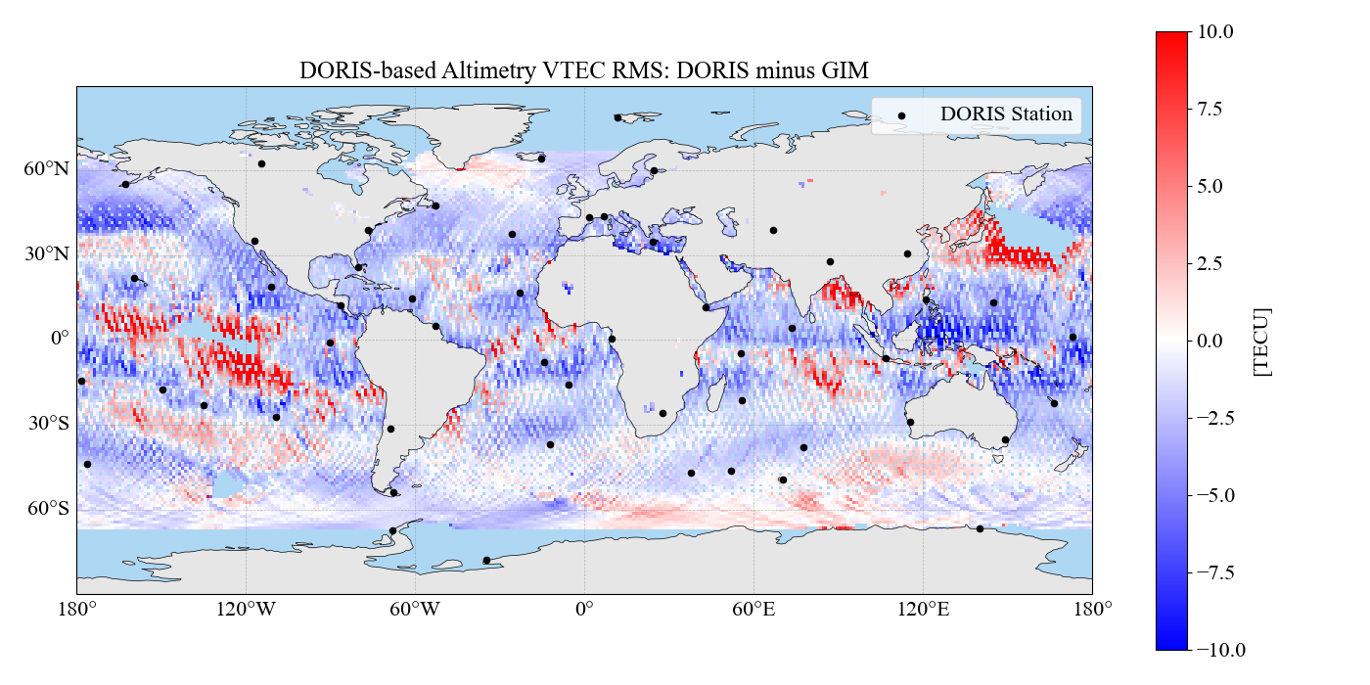
Comparison with Altimetry VTEC
DORIS-based vs. GIM-based altimetry VTEC (ground truth: Jason-3 altimetry)
DORIS: high RMS near blank regions, clusters of peaks (especially equator)
Better performance near DORIS stations (backup slide)
Notes:
This figure shows the RMS values obtained by comparing DORIS-based and GIM-based altimetry VTEC against Jason-3 dual-frequency measurements, which serve as the ground truth. For DORIS, the highest RMS values are clearly concentrated near the blank regions, especially along the equatorial belt where ionospheric activity is strongest. At high latitudes above 30°, DORIS shows relatively good performance, especially in regions close to its stations.
In addition, several clusters of elevated RMS can be seen in other regions. These are also linked to large distances from the nearest DORIS stations
By contrast, GIM exhibits complete global coverage and a more uniform RMS distribution. Nevertheless, DORIS is not without strengths. In high-latitude regions above 30 degrees, as well as over the Indian Ocean near the African continent where near stations are sufficient, DORIS corrections actually perform better than GIM.
This suggests that the performance of DORIS is strongly related to the distribution of stations , in addition to the absolute VTEC.

Slide 12
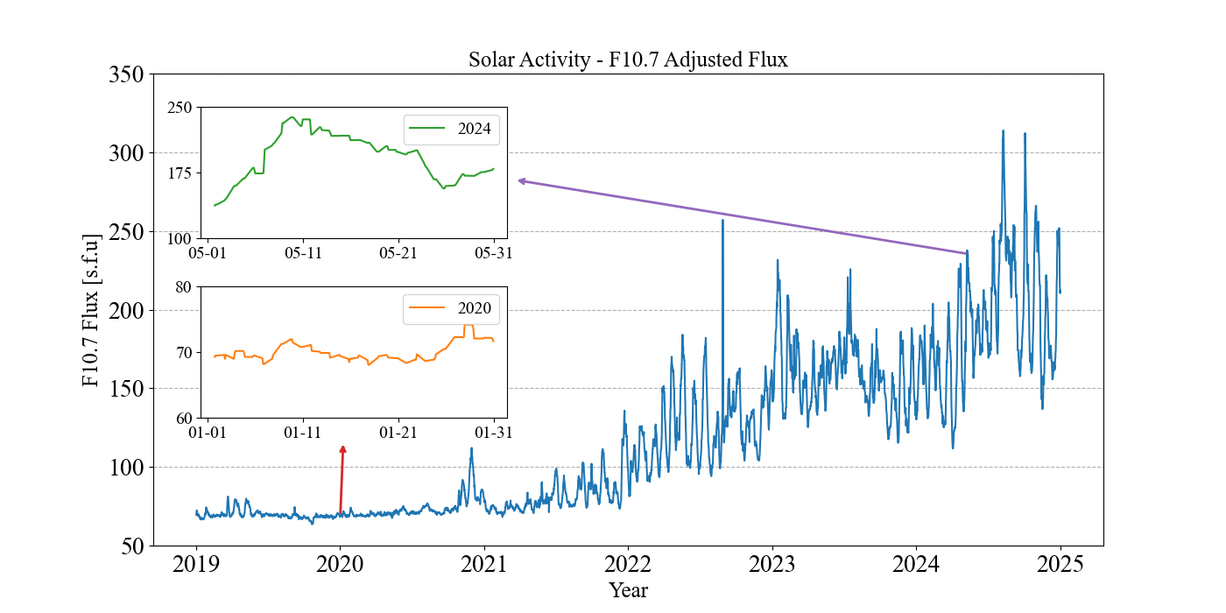
DORIS-based Altimetry VTEC : Time Period
2019–2024: six years validation
Quiet 2020 vs. Active 2024 (Ionospheric storm around 10 May 2024)
Notes:
After looking at the geographical distribution of RMS values, I will now move on to the temporal perspective, showing the comparison of RMS between DORIS and GIM over long time span.
The validation period spans six years, from 2019 to 2024, covering very different levels of solar activity. This figure shows the F10.7 solar flux. We can clearly see the transition from quiet conditions in 2019 to highly active conditions in 2024. In particular, May 2024 included a strong ionospheric storm, which is also part of the dataset used in this study.

Slide 13
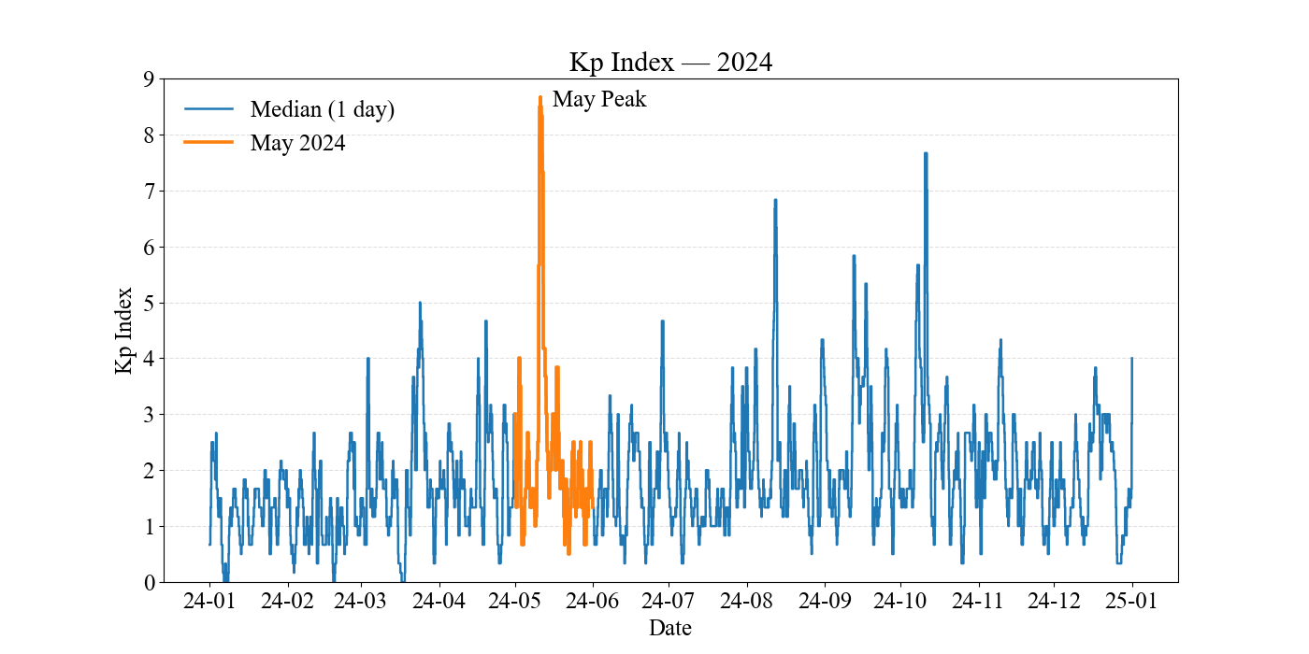
DORIS-based Altimetry VTEC : Time Period
2019–2024: six years validation
Quiet 2020 vs. Active 2024 (Ionospheric storm around 10 May 2024)
Notes:
Kpindex: planetary K index: geomagnetic activity index Kp ≥ 8: severe to extreme ionospheric storm event

Slide 14
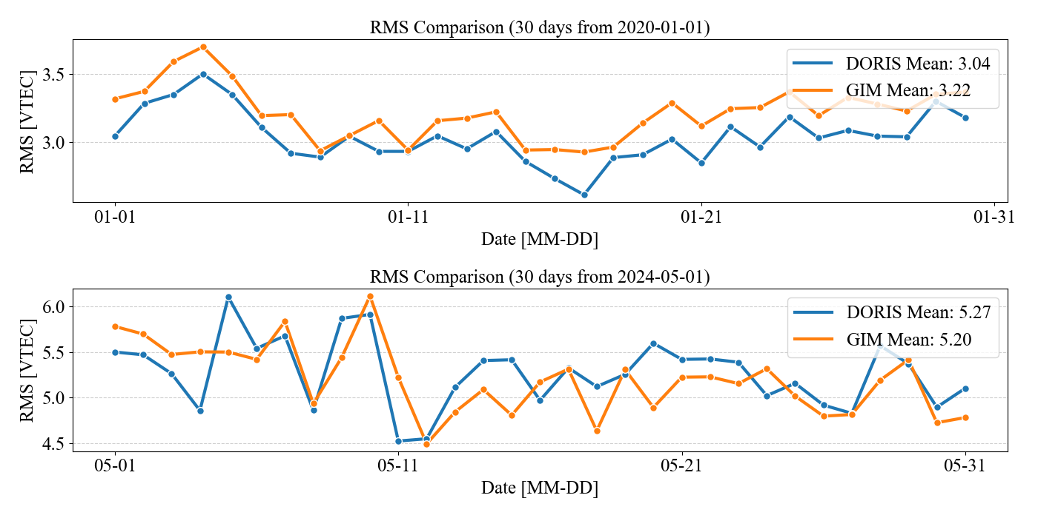
DORIS-based Altimetry VTEC Time Series
Analysis restricted to altimetry IPP within 1800 km of DORIS stations (~40%)
2020 (quiet ionosphere): DORIS RMS better than GIM
2024 (active ionosphere): similar performance between DORIS and GIM
Notes:
If we focus only on altimeter observation points located within 1800 kilometers of DORIS stations, and compare the RMS values of DORIS-based and GIM-based corrections on a daily basis, we obtain the time series shown here. The results indicate that in 2020, during relatively quiet ionospheric conditions, DORIS corrections consistently outperformed GIM. However, in 2024, under much more active ionospheric conditions, the performance of the two became comparable. This demonstrates that the relative performance of DORIS is closely linked to the level of ionospheric activity.

Slide 15
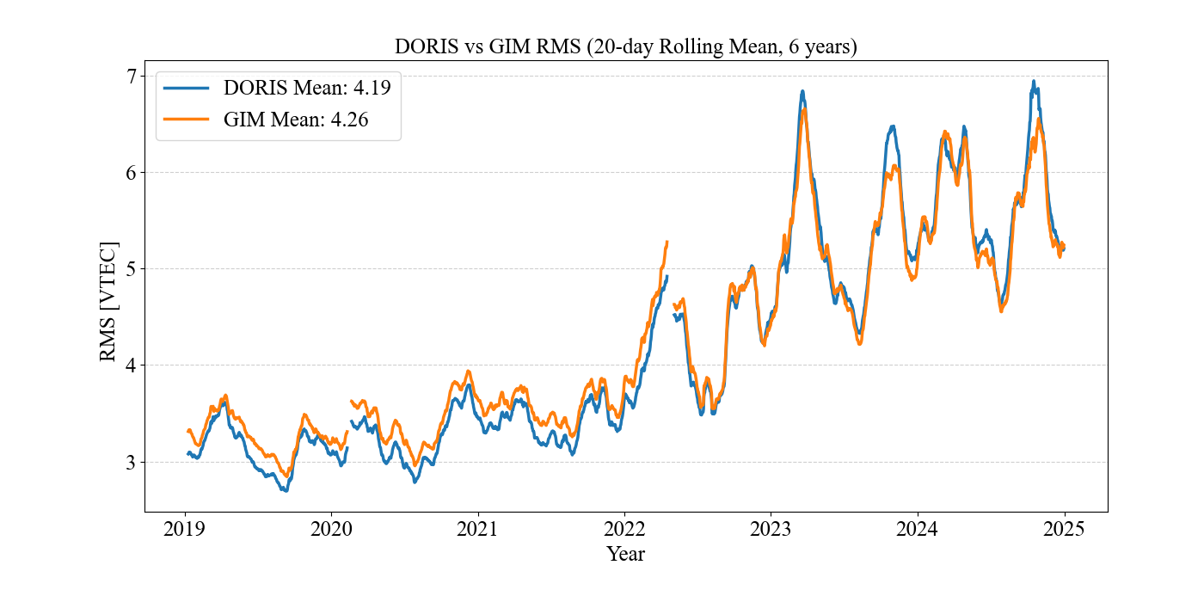
DORIS-based Altimetry VTEC Time Series
Analysis restricted to altimetry IPP within 1800 km of DORIS stations (~40%)
Six-year trend shows DORIS gradually “caught up” by GIM
Notes:
Looking at the six-year trend, we can also observe how the initial advantage of DORIS gradually diminishes, with GIM corrections “catching up” over time . I should also note that these are global averaged results each day, and the performance in single regions/local times can differ

Slide 16
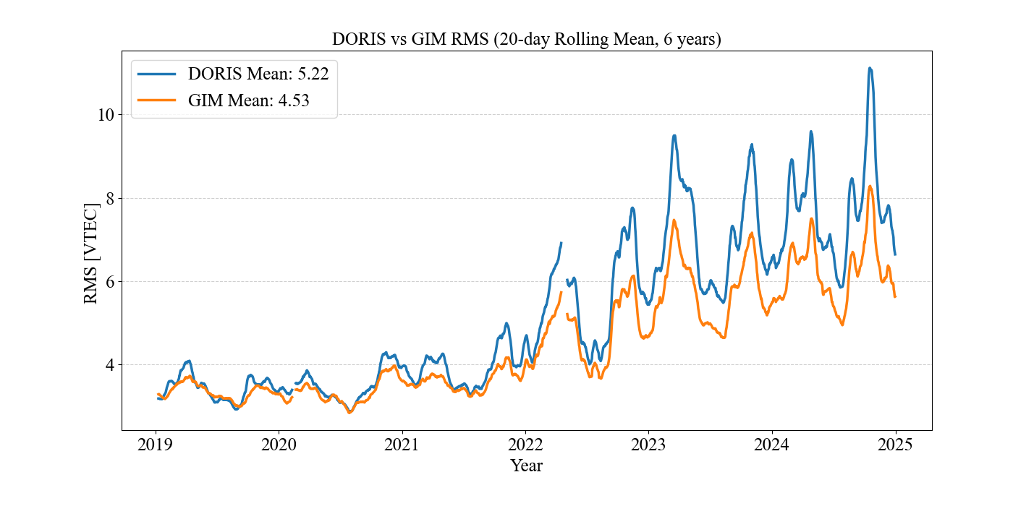
DORIS-based Altimetry VTEC Series: Full Coverage
Analysis extended to ~95% of global altimetry IPP
DORIS not better than GIM
Difference obvious during active ionospheric conditions in 2024
Notes:
If we extend the analysis to nearly the full altimeter observation coverage—about 95% globally—the performance of DORIS cannot compete with that of GIM. This is strongly related to the distribution and the limited number of DORIS stations. The performance gap is especially large during the highly active ionospheric conditions in 2024.

Slide 17
Conclusion
DORIS provides reliable ionospheric corrections for satellite altimetry
Correction quality strongly depends on ionospheric activity and station distribution
Outperforms GIM locally when data (near station) is sufficient
DORIS can improve the accuracy of ionospheric corrections for satellite altimetry
However: stand-alone DORIS corrections are not recommended
Combination with GNSS observations or GIM is recommended (and will be worked on soon)
Notes:
The results of this study show that DORIS is able to provide reliable ionospheric corrections for satellite altimetry. The correction quality, however, strongly depends on both the level of ionospheric activity and the spatial distribution of DORIS stations. In regions where the network coverage is sufficient—particularly over the oceans—DORIS can even outperform GIM and deliver corrections of higher accuracy.
In conclusion, while DORIS can play an important role in ionospheric correction for altimetry, its use as a stand-alone solution is not recommended. The best performance can be expected when DORIS is combined with GNSS or GIM data, thereby taking advantage of the complementary strengths of each system. Future work will focus on developing such integrated approaches in order to improve both the global coverage and the robustness of ionospheric corrections for satellite altimetry.

Slide 18
Backup Slides

Slide 19
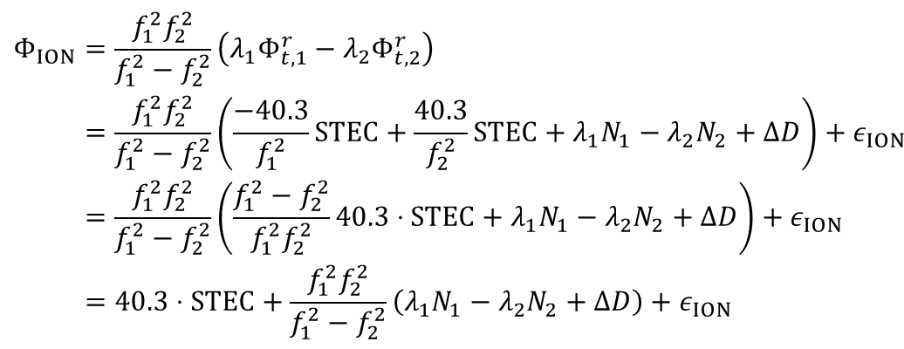
DORIS Observation Equation
Ionosphere combination of two frequencies:
$$\begin{aligned}&Φ_{ION}&&=\frac{f_{1}^{2}f_{2}^{2}}{f_{1}^{2}−f_{2}^{2}}\left(λ_{1}Φ_{t,1}^{r}−λ_{2}Φ_{t,2}^{r}\right) \\ &&&=\frac{f_{1}^{2}f_{2}^{2}}{f_{1}^{2}−f_{2}^{2}}\left(\frac{−40.3}{f_{1}^{2}}STEC+\frac{40.3}{f_{2}^{2}}STEC+λ_{1}N_{1}−λ_{2}N_{2}+ΔD\right)+ε_{ION} \\ &&&=\frac{f_{1}^{2}f_{2}^{2}}{f_{1}^{2}−f_{2}^{2}}\left(\frac{f_{1}^{2}−f_{2}^{2}}{f_{1}^{2}f_{2}^{2}}40.3⋅STEC+λ_{1}N_{1}−λ_{2}N_{2}+ΔD\right)+ε_{ION} \\ &&&=40.3⋅STEC+\frac{f_{1}^{2}f_{2}^{2}}{f_{1}^{2}−f_{2}^{2}}\left(λ_{1}N_{1}−λ_{2}N_{2}+ΔD\right)+ε_{ION}\end{aligned}$$

Slide 20
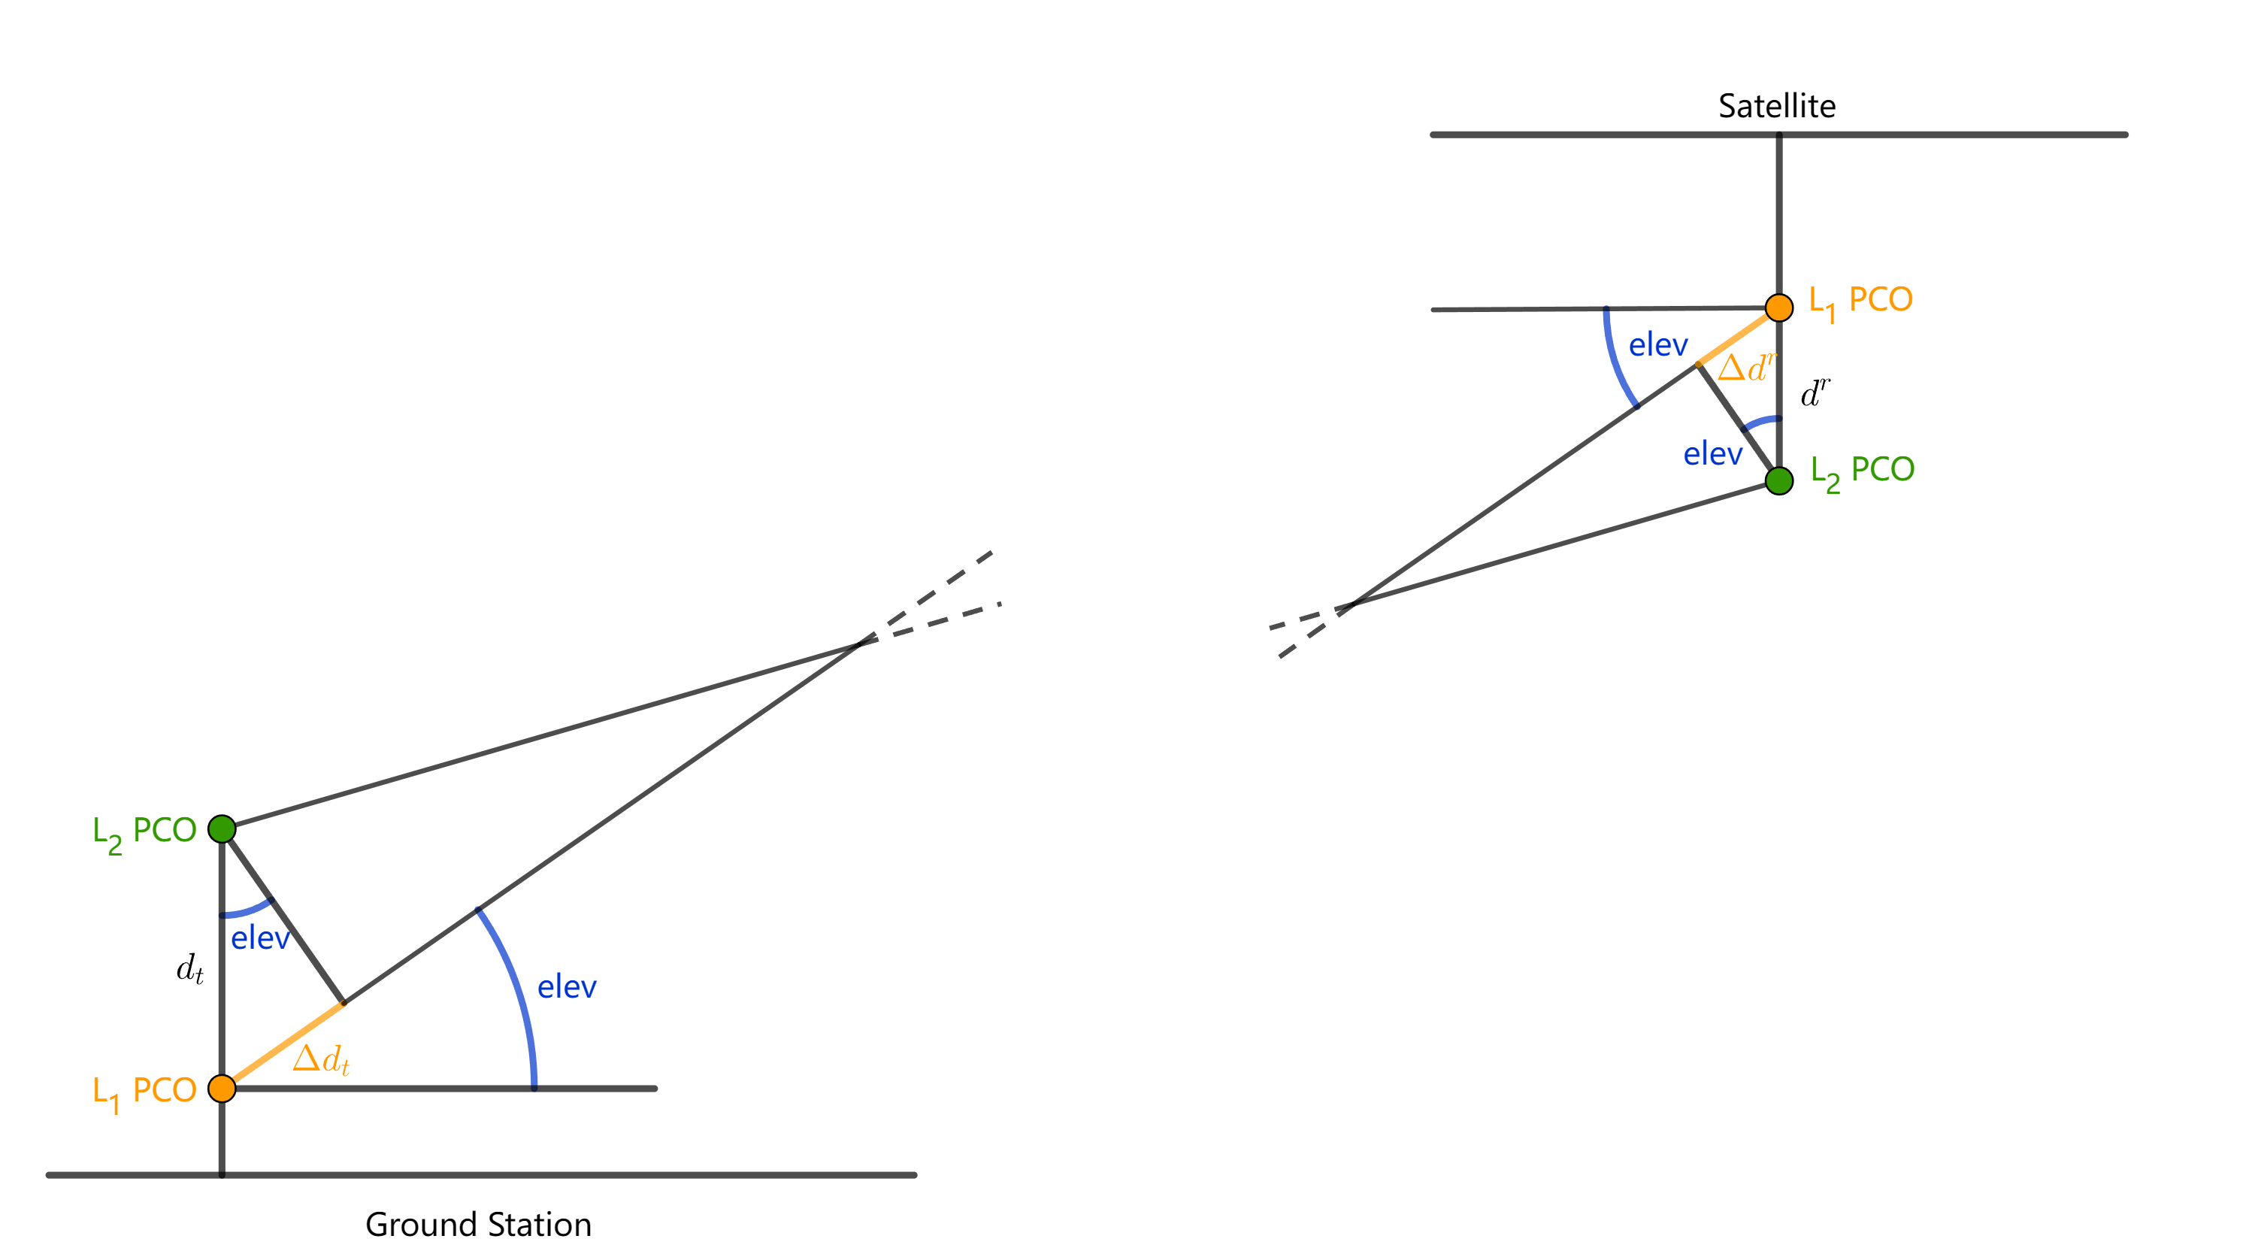
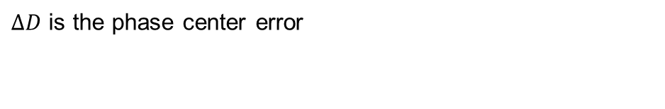
DORIS Observation Equation
$ΔD$ is the phase center error
Satellite | Offset [m]
Jason-2 | 0.164
Jason-3 | 0.168
Beacon | Offset [m]
Alcatel | 0.175
STAREC | 0.487

Slide 21
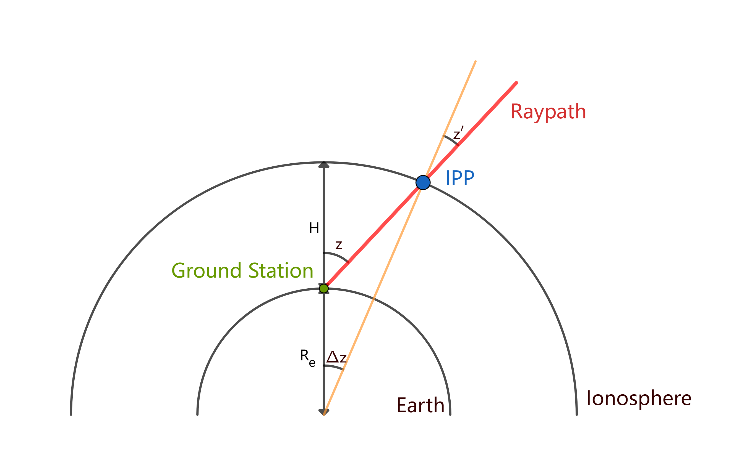
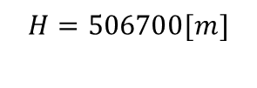

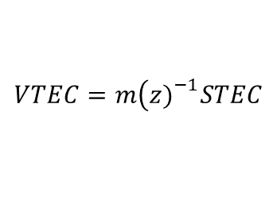
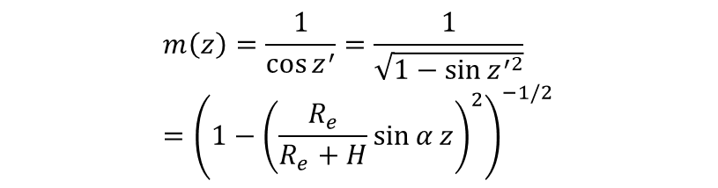
Single-Layer model and VTEC mapping
$$VTEC=m\left(z{\left.)\right.}^{−1}STEC\right.$$
$$m\left(z\right)=\frac{1}{\cos{z^{′}}}=\frac{1}{\sqrt{1−\sin{z^{′2}}}}={\left(1−{\left(\frac{R_{e}}{R_{e}+H}\sin{α}z\right)}^{2}\right)}^{−1/2}$$
$$α=0.9782$$
$$H=506700[m]$$

Slide 22
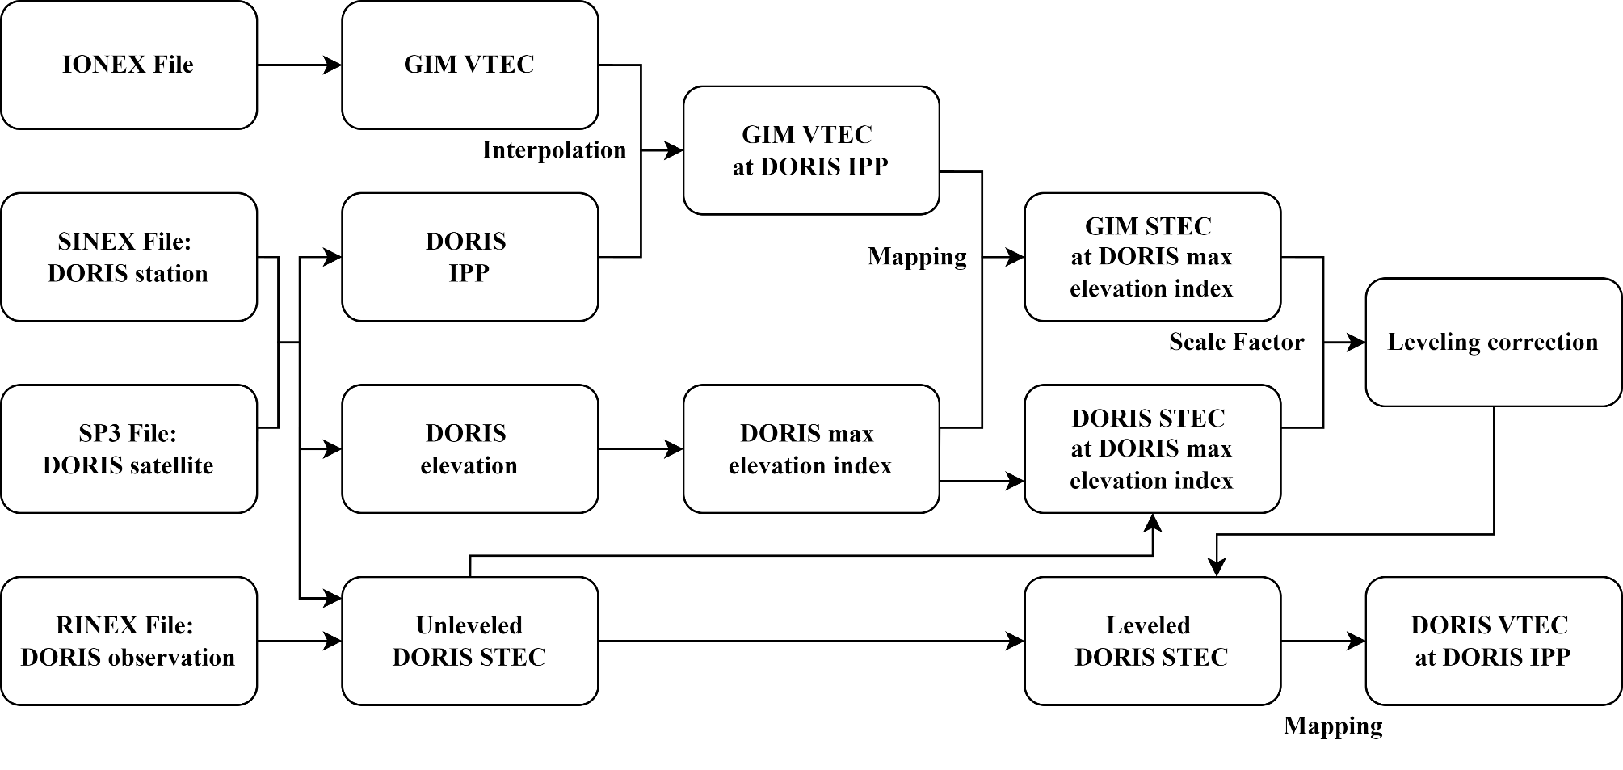
DORIS VTEC processing: Work Flow

Slide 23
DORIS Elevation Mask
Notes:
Residuals are calculated by compensation for phase observations with geometric correction, satellite clock correction and estimation of station clock correction.
Nothing below 10 degree as they are too noisy with more than one cycle residuals which makes cycle slip detection impossible;
No cycle slip points in this particular figure.

Slide 24
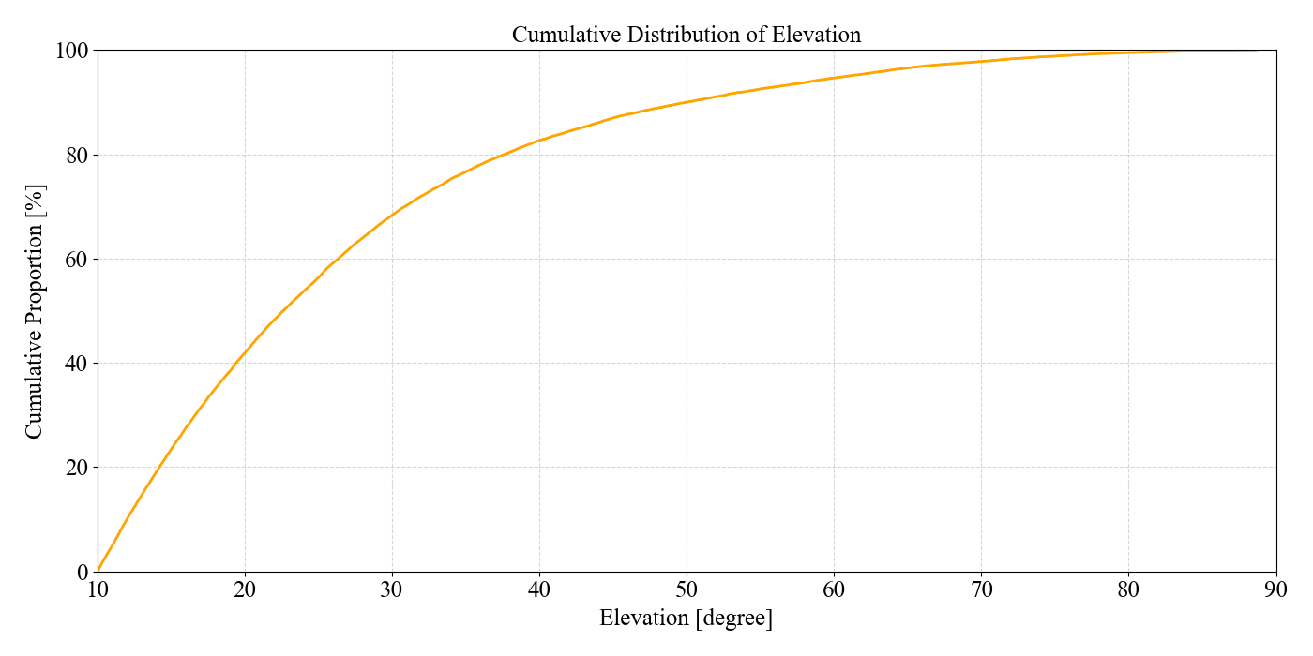
DORIS Elevation Mask
Notes:
Residuals are calculated by compensation for phase observations with geometric correction, satellite clock correction and estimation of station clock correction.
Nothing below 10 degree as they are too noisy with more than one cycle residuals which makes cycle slip detection impossible;
No cycle slip points in this particular figure.

Slide 25
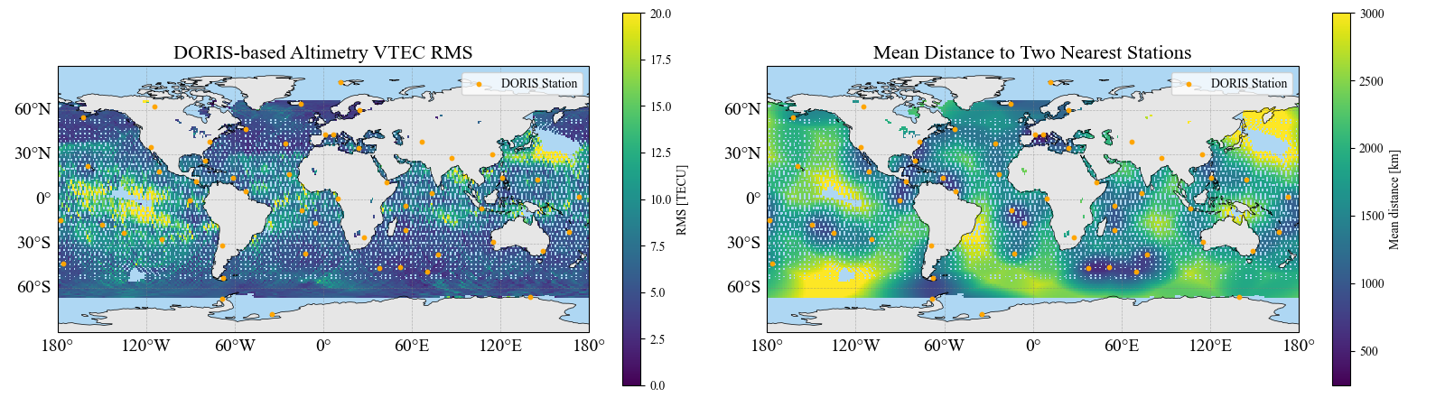
DORIS Station Distribution
IPPs with longer distances to nearest DORIS stations show higher RMS
Effect most visible in low-latitude active ionospheric regions
High-latitude regions show weaker correlation (e.g., Bering Strait)
Notes:
As anticipated from the previous slide, the spatial pattern of RMS is closely linked to station distribution. This figure illustrates the global distribution of DORIS stations by showing, for each altimeter observation point, the mean distance to its two nearest stations. Blank regions indicate even larger distances, where no DORIS corrections are available, and are not plotted here. This explains why we observed higher RMS values in the earlier results : regions with larger distances, shown in yellow, correspond to areas with larger RMS values.
The quality of DORIS-based ionospheric corrections is therefore strongly linked to station proximity, or equivalently to the density of available observations. The effect is particularly evident in low-latitude regions, where ionospheric activity is stronger. At higher latitudes, however, the correlation is less consistent—for example, the two sides of the Bering Strait blank region show very different RMS values.

Slide 26
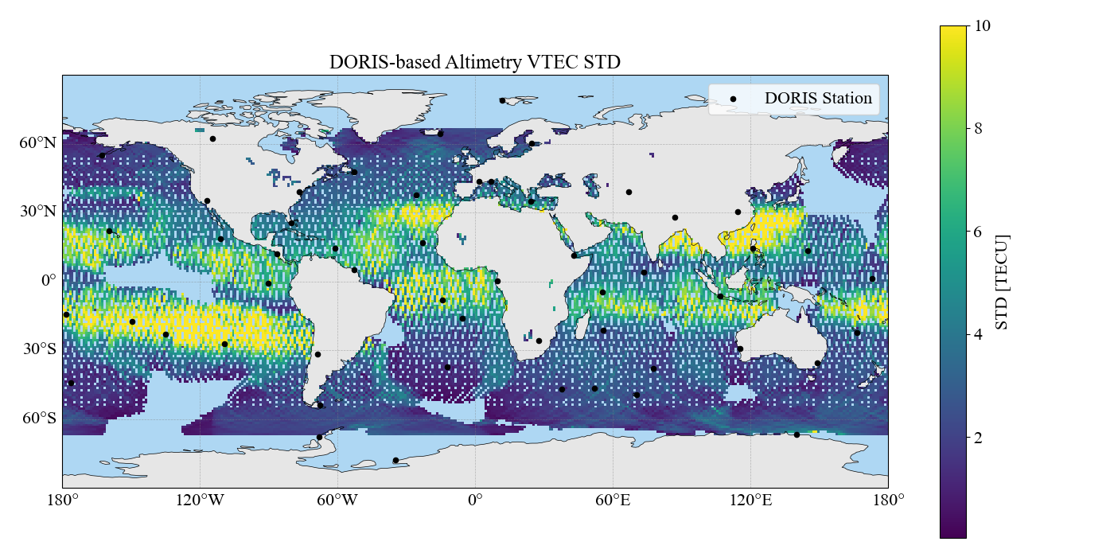
DORIS-based Altimetry VTEC STD
Notes:
For instance, this figure shows the situation in 2020, where the blank regions were even larger. The improvement in coverage in recent years is due to the addition of new stations, shown here in red, which were established after 2020.

