Slide 1

Directed Network Embedding with Virtual Negative Edges
09.08.2022
Hyunsik Yoo
* This is a joint work with Prof. Sang-Wook Kim and Dr. Yeon-Chang Lee at Hanyang Univ., and Prof. Kijung Shin at KAIST, published in ACM WSDM 2022

Slide 2
Table of Contents
Background
Network Embedding (NE)
Directed Network Embedding (DNE)
Motivation
Proposed Approach
STEP 1: Inferring the Degree of Negativity
STEP 2: Selecting Virtual Negative Edges
STEP 3: Modeling a Signed Directed Network
STEP 4: Learning Source and Target Embeddings
Evaluation
Conclusions

Slide 3
Background
Network embedding (NE)
Represents nodes in a given network as low-dimensional vectors that preserves the structural properties of the network
e.g., proximity between nodes
Can be used as informative features of nodes in various downstream network mining tasks
Link prediction
Node clustering/classification
Recommendation

Slide 4




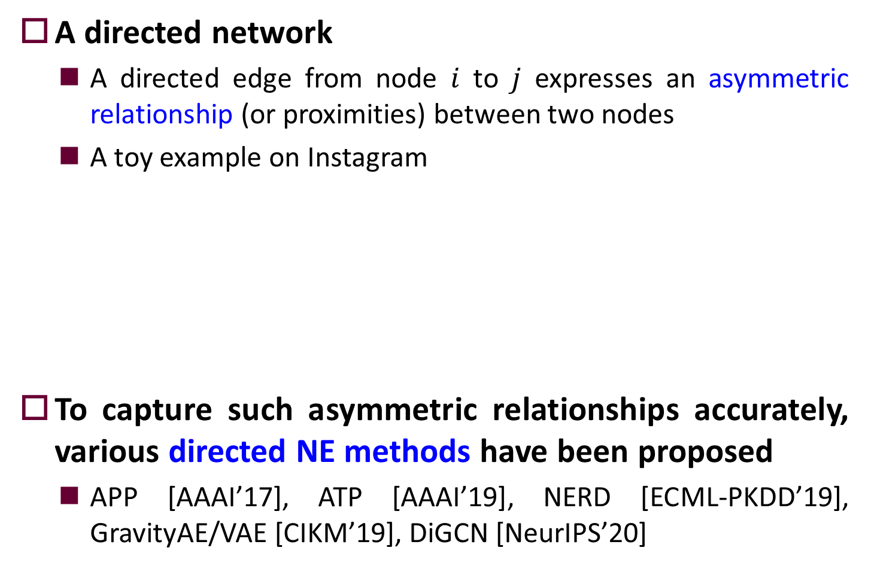
Background (cont’d)
A directed network
A directed edge from node $i$ to $j$ expresses an asymmetric relationship (or proximities) between two nodes
A toy example on Instagram
To capture such asymmetric relationships accurately, various directed NE methods have been proposed
APP [AAAI’17], ATP [AAAI’19], NERD [ECML-PKDD’19], GravityAE/VAE [CIKM’19], DiGCN [NeurIPS’20]
follow
not follow
User $i$
Influencer $j$

Slide 5

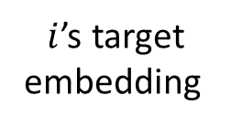
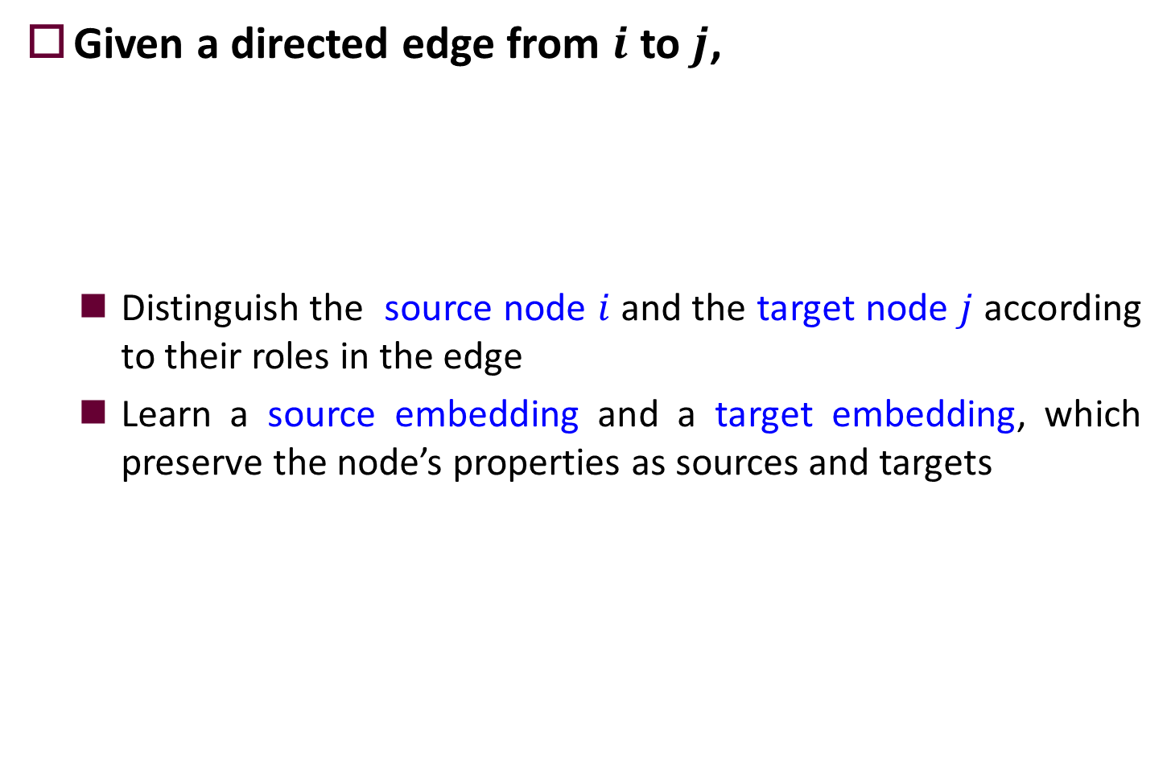

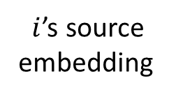

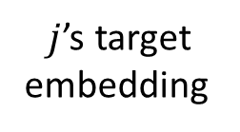

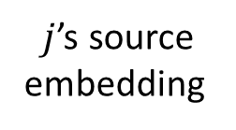
Directed NE Methods
Given a directed edge from $i$ to $j$,
Distinguish the source node $i$ and the target node $j$ according to their roles in the edge
Learn a source embedding and a target embedding, which preserve the node’s properties as sources and targets
User $i$
Influencer $j$
$i$’s source
embedding
$j$’s source
embedding
$i$’s target
embedding
$j$’s target
embedding
Source Node $i$
Target Node $j$
learn!

Slide 6
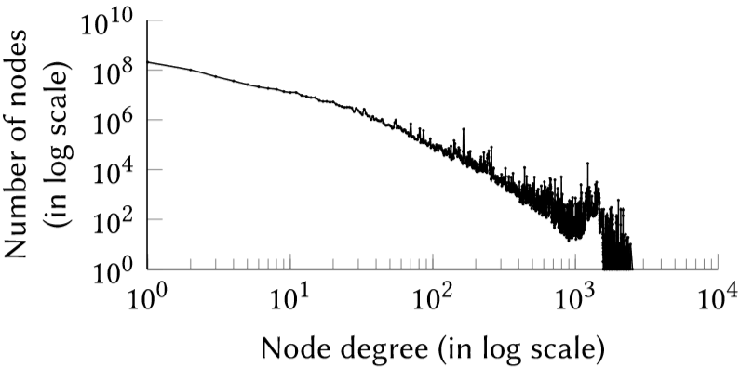
Motivation
Sparsity of real-world networks
Follow power-law degree distribution, which indicates there are a small number of hub nodes and a large number of non-hub nodes
Most nodes have extremely low out- and in-degrees!

Slide 7
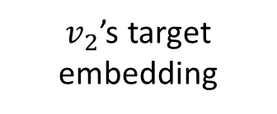

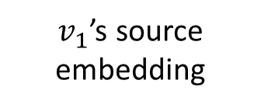

Motivation (cont’d)
Challenge of directed NE methods
They hardly learn the source/target embedding of low out-/in- degree nodes
Thus, they easily fail to capture the properties of low out- and in-degree nodes as sources and targets, respectively
Since a considerable fraction (34.86%/34.29%) of nodes have a zero out- and in-degree, it aggravates the above challenge
zero in-degree
node
$v_{2}$’s target embedding
$$v_{2}$$
not learn!
$v_{1}$’s source embedding
not learn!
$$v_{1}$$
zero out-degree
node

Slide 8
Our Idea: Data Augmentation
NE’s intrinsic difficulty is its lack of information when embedding low out- and in-degree nodes in a sparse directed network
New concept: Virtual Negative Edges (VNEs)
Represent latent negative relationships between nodes
We propose a novel DIrected NE approach with VIrtual Negative Edges, named DIVINE
Carefully determine the number and location of VNEs to be added to the input network
Learn embeddings by exploiting both edge types

Slide 9
Why Virtual Negative Edges?
Adding virtual edges (VEs) facilitates the utilization of information expressed in the form of VEs
It has been proven useful for various graph mining tasks
e.g., node classification [Klicpera et al. NeurIPS’19, Zhao et al. AAAI’21], community detection [Kang et al. CIKM’20]
They only focused on positive edges (VPEs)
However, we confirmed that VNEs provide information more useful to directed NE methods than VPEs
The information inherent in VNEs is more difficult for directed NE methods to utilize (than that in VPEs) unless it is explicitly provided in the form of VEs

Slide 10



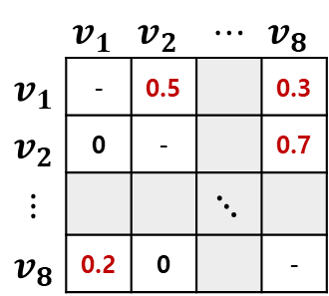






















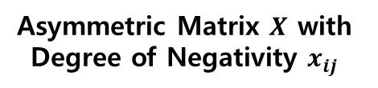

Overview of DIVINE
$$v_{1}$$
Positive Edges
Potential VNEs
 | $$v_{1}$$ | $$v_{2}$$ | $$⋯$$ | $$v_{8}$$
$$v_{1}$$ | - | 0.5 |  | 0.3
$$v_{2}$$ | 0 | - |  | 0.7
$$⋮$$ |  |  | $$⋱$$
$$v_{8}$$ | 0.2 | 0 |  | -
$$v_{4}$$
$$v_{2}$$
$$v_{1}$$
STEP 1
STEP 2
 |  |  |  |  | 0.7 | 0.6 | 0.5 | 0.3 | 0.2 | 0.1
$$v_{3}$$
$$v_{2}$$
 |  |  |  |  | 0.9 | 0.7 | 0.4 | 0.3 | 0.2
$$v_{5}$$
$$v_{6}$$
$$⋮$$
$$v_{8}$$
$$v_{8}$$
 |  |  |  |  | 0.8 | 0.2 | 0.1
$$v_{7}$$
VNEs
Directed Network $𝓖$
Asymmetric Matrix $X$ with Degree of Negativity $x_{ij}$
Descending Order of $x_{ij}$
STEP 3
$$v_{1}$$
$$v_{2}$$
Balanced!
$$v_{4}$$
+
-
$$v_{3}$$
+
+
+
-
$$v_{6}$$
$$v_{5}$$
Unbalanced!
STEP 4
+
-
$$v_{8}$$
-
+
-
-
$$f_{v}$$
$$g_{v}$$
$$v_{7}$$
Source/Target Embeddings
Signed Directed Network $𝓢$
Structural Balance

Slide 11


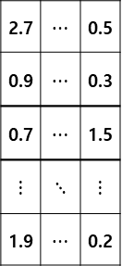






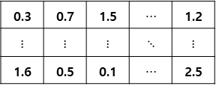





STEP1: Inferring the Degree of Negativity
Quantify the degree of positivity of all pairs of nodes based on weighted regularized matrix factorization
Consider that the lower the degree of positivity is, the higher the degree of negativity is
Adjacency
Matrix $A$
$$\hat{A}$$
 | $$v_{1}$$ | $$v_{2}$$ | $$⋯$$ | $$v_{8}$$
$$v_{1}$$ | - | 0 |  | 0
$$v_{2}$$ | 1 | - |  | 0
$$⋮$$ |  |  | $$⋱$$
$$v_{8}$$ | 0 | 1 |  | -
$$d$$
Target
 | $$v_{1}$$ | $$v_{2}$$ | $$⋯$$ | $$v_{8}$$
$$v_{1}$$ | - | 0.5 |  | 0.3
$$v_{2}$$ | 1 | - |  | 0.7
$$⋮$$ |  |  | $$⋱$$
$$v_{8}$$ | 0.2 | 1 |  | -
2.7 | $⋯$ | 0.5
0.9 | $⋯$ | 0.3
0.7 | $⋯$ | 1.5
$⋮$ | $⋱$ | $⋮$
1.9 | $⋯$ | 0.2
0.3 | 0.7 | 1.5 | $⋯$ | 1.2
$⋮$ | $⋮$ | $⋮$ | $⋱$ | $⋮$
1.6 | 0.5 | 0.1 | $⋯$ | 2.5
$$=$$
$$×$$
$$d$$
Source
WRMF
$$Q^{T}$$
 | $$v_{1}$$ | $$v_{2}$$ | $$⋯$$ | $$v_{8}$$
$$v_{1}$$ | - | 0.1 |  | 0.1
$$v_{2}$$ | 1 | - |  | 0.1
$$⋮$$ |  |  | $$⋱$$
$$v_{8}$$ | 0.1 | 1 |  | -
 | $$v_{1}$$ | $$v_{2}$$ | $$⋯$$ | $$v_{8}$$
$$v_{1}$$ | - | 0.5 |  | 0.7
$$v_{2}$$ | 1 | - |  | 0.3
$$⋮$$ |  |  | $$⋱$$
$$v_{8}$$ | 0.8 | 1 |  | -
$$P$$
Weight
Matrix $W$
$$X$$

Slide 12
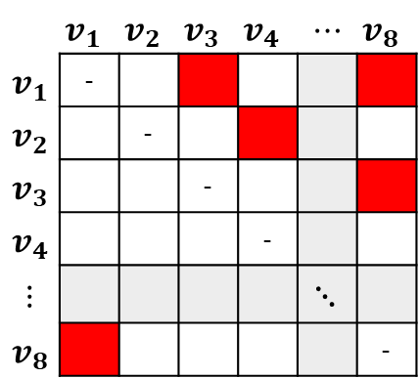
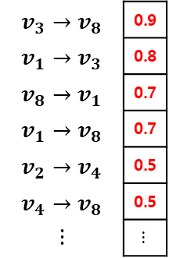
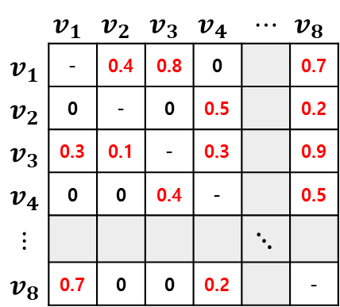
STEP 2: Selecting VNEs
Propose two strategies: global/local selection
Global selection
Select VNEs with high degrees of negativity among all potential VNEs (i.e., non-existent edges)
VNEs
 | $$v_{1}$$ | $$v_{2}$$ | $$v_{3}$$ | $$v_{4}$$ | $$⋯$$ | $$v_{8}$$
$$v_{1}$$ | - | 0.4 | 0.8 | 0 |  | 0.7
$$v_{2}$$ | 0 | - | 0 | 0.5 |  | 0.2
$$v_{3}$$ | 0.3 | 0.1 | - | 0.3 |  | 0.9
$$v_{4}$$ | 0 | 0 | 0.4 | - |  | 0.5
$$⋮$$ |  |  |  |  | $$⋱$$
$$v_{8}$$ | 0.7 | 0 | 0 | 0.2 |  | -
Potential VNEs
 | $$v_{1}$$ | $$v_{2}$$ | $$v_{3}$$ | $$v_{4}$$ | $$⋯$$ | $$v_{8}$$
$$v_{1}$$ | -
$$v_{2}$$ |  | -
$$v_{3}$$ |  |  | -
$$v_{4}$$ |  |  |  | -
$$⋮$$ |  |  |  |  | $$⋱$$
$$v_{8}$$ |  |  |  |  |  | -
$$v_{3}→v_{8}$$ | 0.9
$$v_{1}→v_{3}$$ | 0.8
$$v_{8}→v_{1}$$ | 0.7
$$v_{1}→v_{8}$$ | 0.7
$$v_{2}→v_{4}$$ | 0.5
$$v_{4}→v_{8}$$ | 0.5
$$⋮$$ | $$⋮$$
(1) Sorting in descending order of the degree of negativity
(2) Selecting VNEs (e.g., a pre-defined number=5)

Slide 13












STEP 2: Selecting VNEs (cont’d)
Local selection
Select an equal number of VNEs with high degrees of negativity for each node
Positive Edges
Potential VNEs
Positive Edges
VNEs
$$v_{1}$$
 |  |  |  |  | 0.7 | 0.6 | 0.5 | 0.3 | 0.2 | 0.1
$$v_{1}$$
$$v_{2}$$
 |  |  |  |  | 0.9 | 0.7 | 0.4 | 0.3 | 0.2
$$v_{2}$$
$$v_{3}$$
 |  |  |  |  | 0.9 | 0.7 | 0.6 | 0.5 | 0.2 | 0.2 | 0.1
$$v_{3}$$
$$v_{4}$$
 |  |  |  |  | 0.5 | 0.4 | 0.4 | 0.3 | 0.2
$$v_{4}$$
$$⋮$$
$$⋮$$
$$v_{8}$$
 |  |  |  |  | 0.8 | 0.2 | 0.1
$$v_{8}$$
(1) Sorting in descending order of the degree of negativity
(2) Selecting VNEs per source node (e.g., a pre-defined number=1)

Slide 14
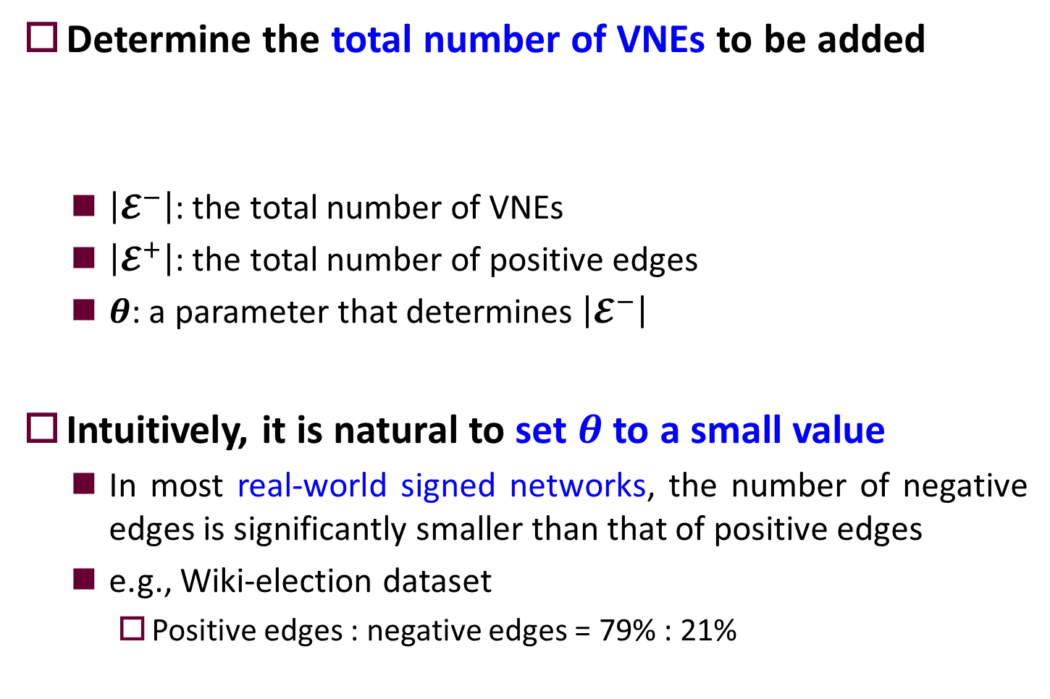

Step 3: Modeling a Signed Directed Network
Determine the total number of VNEs to be added
$\left|𝓔^{−}\right|$: the total number of VNEs
$\left|𝓔^{+}\right|$: the total number of positive edges
$θ$: a parameter that determines $\left|𝓔^{−}\right|$
Intuitively, it is natural to set $θ$ to a small value
In most real-world signed networks, the number of negative edges is significantly smaller than that of positive edges
e.g., Wiki-election dataset
Positive edges : negative edges = 79% : 21%
$$\left|𝓔^{−}\right|=|𝓔^{+}|×θ$$

Slide 15












How to determine the number of VNEs?
Deal with this issue based on a well-known property of signed networks, i.e., structural balance
How well the edge signs in a given signed network follow the balance theory?
$$v_{x}$$
$$v_{z}$$
$$v_{x}$$
-
$$v_{z}$$
+
+
+
+
-
(R1) A friend of my friend
is my friend
(R2) An enemy of my friend
is my enemy
$$v_{y}$$
$$v_{y}$$
$$v_{x}$$
-
$$v_{z}$$
$$v_{x}$$
+
$$v_{z}$$
-
+
-
-
(R3) A friend of my enemy
is my enemy
(R4) An enemy of my enemy
is my friend
$$v_{y}$$
$$v_{y}$$

Slide 16
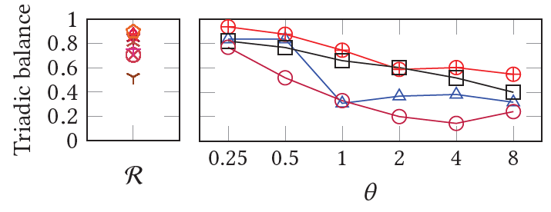
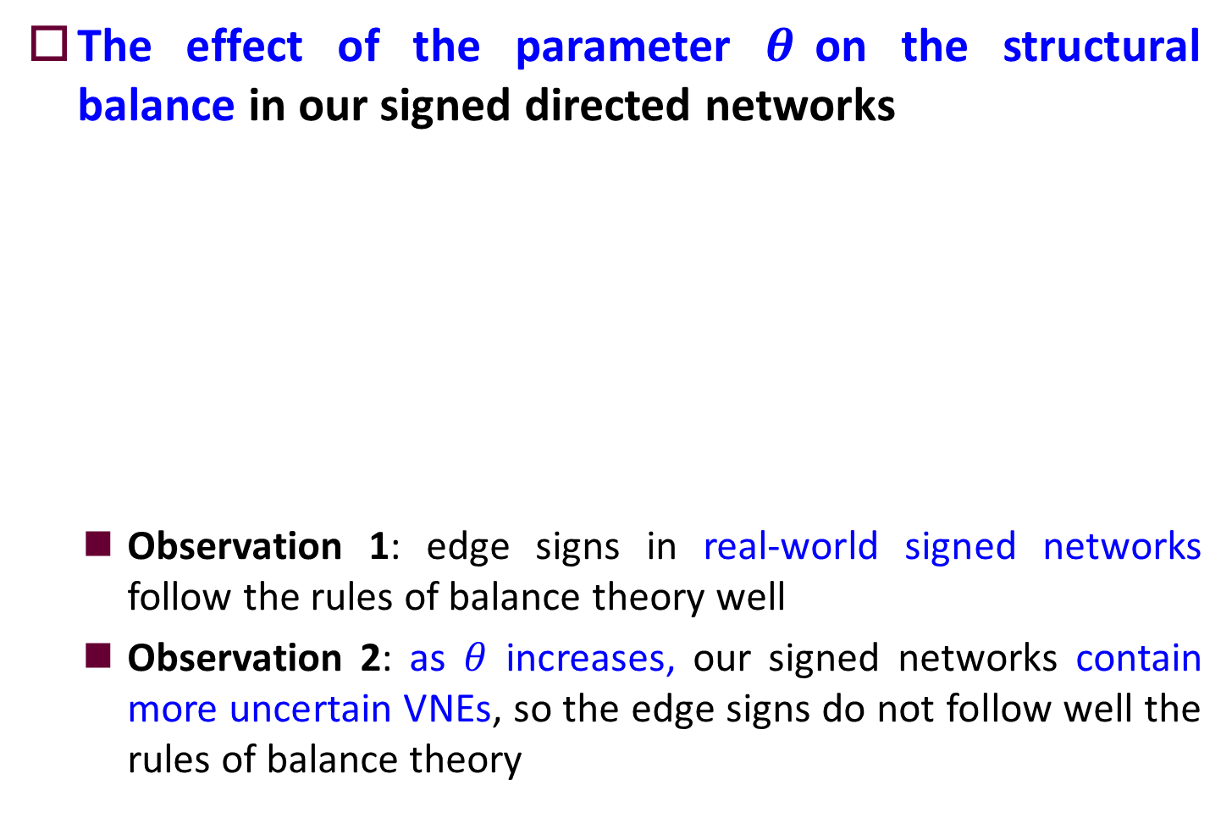
How to determine the number of VNEs?
The effect of the parameter $θ$on the structural balance in our signed directed networks
Observation 1: edge signs in real-world signed networks follow the rules of balance theory well
Observation 2: as $θ$ increases, our signed networks contain more uncertain VNEs, so the edge signs do not follow well the rules of balance theory
Real-world
signed networks
Our signed networks modeled by DIVINE

Slide 17

How to determine the number of VNEs?
Based on this observation,
We set $θ$ to a value around 0.25 or 0.5 where the structural balance of both real-world and our signed networks become similar
We will also show empirically that such values of $θ$ lead to high accuracy of DIVINE in link prediction tasks.
Real-world
signed networks
Our signed networks modeled by DIVINE

Slide 18














Step 3: Modeling a Signed Directed Network
Build a signed directed network composed of both the existent positive edges and the VNEs
$$v_{1}$$
$$v_{1}$$
$$v_{2}$$
$$v_{2}$$
$$v_{4}$$
$$v_{4}$$
$$v_{3}$$
$$v_{3}$$
$$v_{6}$$
$$v_{6}$$
$$v_{5}$$
$$v_{5}$$
$$v_{8}$$
$$v_{8}$$
$$v_{7}$$
$$v_{7}$$
Directed Network $𝓖$
Signed Directed Network $𝓢$

Slide 19




Step 4: Learning Source/Target Embeddings
Incorporate recent signed NE methods into our DIVINE
Nodes with the positive edges to be close to each other
Nodes with the negative edges to be distant from each other
positive
positive
negative
DIVINE can be equipped with any signed NE methods!

Slide 20
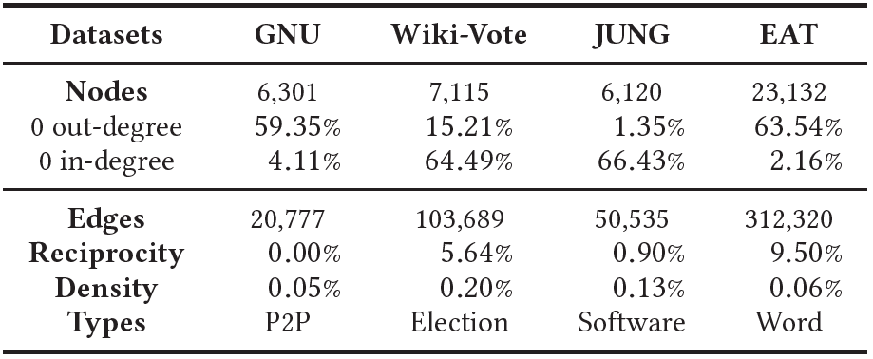
Experimental Setup
Datasets
Gnutella (GNU): a peer-to-peer network
Wiki-Vote: an online voting network
JUNG: a software class dependency network
Edinburgh Associative Thesaurus (EAT): a lexical network

Slide 21
Experimental Setup
Two variants of DIVINE
DIVINE-I employing SIDE [WWW’18]
DIVINE-T employing STNE [ICDM’19]
Nine competitors
3 undirected NE methods
DeepWalk [KDD’14]
LINE [WWW’15]
Node2Vec [KDD’16]
6 directed NE methods
APP [AAAI’17]
ATP [AAAI’19]
NERD [ECML-PKDD’19]
GravityAE [CIKM’19]
GravityVAE [CIKM’19]
DiGCN [NeurIPS’20]

Slide 22
Evaluation Task: Link Prediction (LP)
How accurately we can predict the directed edges removed from the input directed network?
Evaluation protocol
Split the edges into training (80%) and test (20%) sets
Consider the existent edges as positive examples
Consider the same number of randomly-sampled non-existent edges as negative examples
Measure classification accuracy using area under curve (AUC)
?

Slide 23
LP Task for Directed Networks
How accurately the directions of the unidirectional edges in the input network can be predicted?
Evaluation protocol (sampling negative examples)
Sample k% of the unidirectional positive examples and consider the edges with the opposite directions as negative examples
Sample the remaining (100-k)% of negative examples uniformly at random among non-existent edges
Three types of LP task according to the ratio (i.e., k%)
(1) k=0, Uniform LP (U-LP) (2) k=50, Mixed LP (M-LP)
(3) k=100, Biased LP (B-LP)

Slide 24








































LP Task for Directed Networks
Example of M-LP (i.e., k=50)
50% of the unidirectional
positive examples
Training Set (80%)
Test Set
(20%)
$$v_{1}$$
$$v_{2}$$
$$v_{5}$$
$$v_{2}$$
$$v_{1}$$
$$v_{4}$$
$${ v}_{1}$$
$$v_{3}$$
$${ v}_{7}$$
$$v_{4}$$
$${ v}_{3}$$
$$v_{5}$$
Existent edges
(i.e., positive examples)
$$v_{4}$$
$${ v}_{2}$$
$$v_{7}$$
$${ v}_{6}$$
negative examples with the opposite directions
$${ v}_{3}$$
$${ v}_{4}$$
$${ v}_{2}$$
$${ v}_{6}$$
Non-existent edges
(i.e., negative examples)
$${ v}_{2}$$
$v_{1}$
$${ v}_{9}$$
$v_{1}$
$$v_{4}$$
$$v_{1}$$
$${ v}_{3}$$
$$v_{1}$$
$${ v}_{8}$$
$$v_{1}$$
$$v_{9}$$
$$v_{7}$$
$${ v}_{2}$$
$$v_{4}$$
$${ v}_{7}$$
$$v_{3}$$
randomly-sampled negative examples
$$v_{4}$$
$${ v}_{3}$$
$$v_{1}$$
$${ v}_{9}$$

Slide 25
Questions to Be Answered
RQ1: How should the degree of negativity be inferred in DIVINE?
RQ2: How should the locations of VNEs be decided in DIVINE?
RQ3: How should VNEs be distributed to nodes in DIVINE?
RQ4: How many VNEs should be added in DIVINE?
RQ5: Does DIVINE outperform its competitors for directed NE?
RQ6: Is DIVINE effective for embedding low-degree nodes?

Slide 26
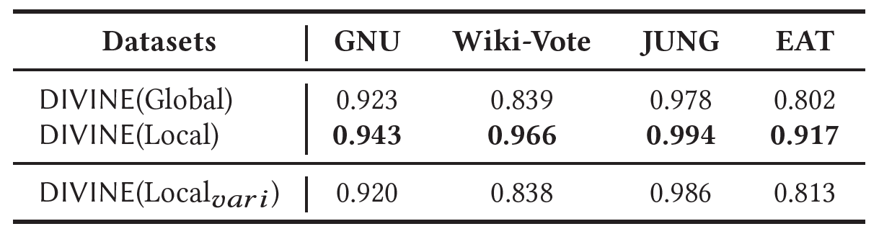
Results for RQ2
Effectiveness of the local selection strategy
DIVINE(Global) vs DIVINE(Local)
Giving VNEs to all nodes (i.e., local) is more beneficial than giving those to only a small fraction of nodes (i.e., global)
Found that DIVINE(Global) added VNEs to only 35%, 44%, 53%, and 34% of nodes in GNU, Wiki-Vote, JUNG, and EAT, respectively
Employing the global selection
Employing the local selection

Slide 27

Results for RQ2 (cont’d)
Effectiveness of the local selection strategy
DIVINE(Local) vs DIVINE(${\text{Local}}_{vari}$)
Giving VNEs to all nodes including zero out-degree nodes effectively mitigates the lack of information
Employing the local selection, but not selecting VNEs from zero out-degree nodes

Slide 28
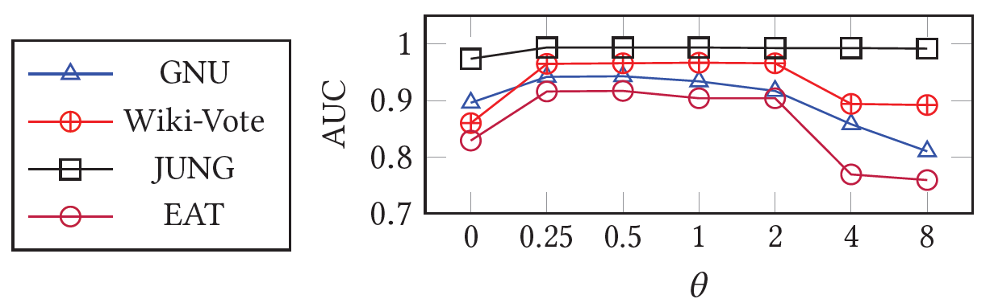
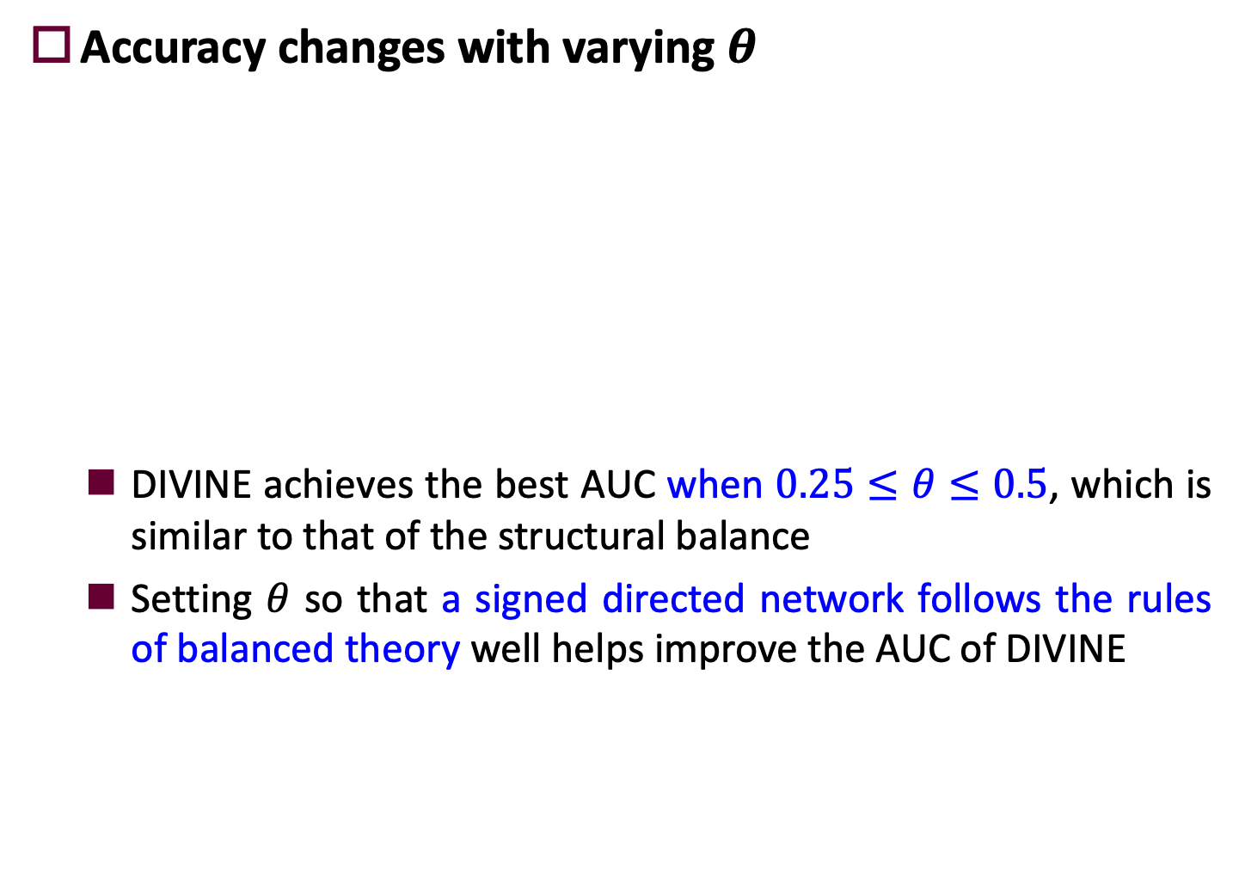
Results for RQ4
Accuracy changes with varying $θ$
DIVINE achieves the best AUC when $0.25≤θ≤0.5$, which is similar to that of the structural balance
Setting $θ$ so that a signed directed network follows the rules of balanced theory well helps improve the AUC of DIVINE

Slide 29
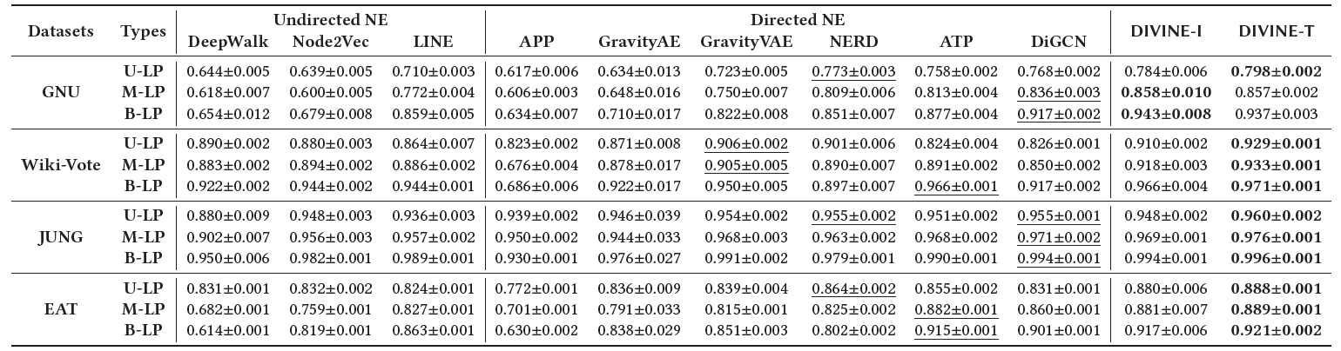
Results for RQ5
Comparison with nine competitors
No single competitor consistently outperforms the other competitors

Slide 30
Results for RQ5
Comparison with nine competitors
Both versions of DIVINE significantly and consistently outperform all competitors in all LP tasks on all datasets
DIVINE is most accurate in the task of predicting the edge directions (i.e., B-LP)

Slide 31
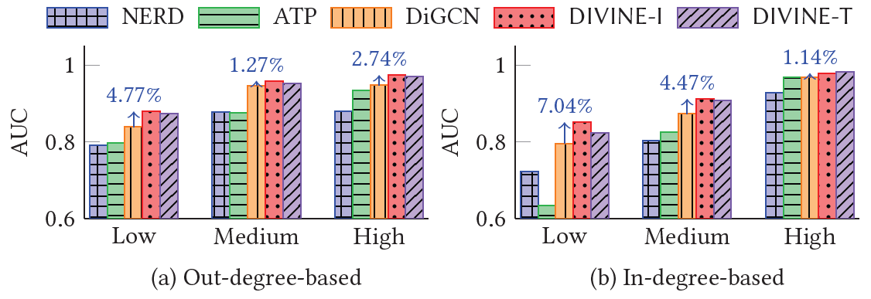
Results for RQ6
Effectiveness in embedding low-degree nodes
Out-degree-based: divide all nodes in the test set into low, medium, and high groups according to their out-degree
In-degree-based: divide all nodes in the test set into low, medium, and high groups according to their in-degree

Slide 32
Results for RQ6 (cont’d)
Effectiveness in embedding low-degree nodes
DIVINE consistently outperform all the competitors
The performance gain is largest in the low-degree groups
DIVINE successfully address the lack of information about low out- and in-degree nodes

Slide 33
Conclusions
We pointed out that the existing directed NE methods face difficulties in accurately preserving asymmetric proximities between nodes in a sparse network
Under DIVINE, we proposed three ideas to selectively add VNEs
Inferring the degree of negativity
Using the local selection strategy to distribute VNEs to all nodes
Determining the number of VNEs based on the theory of structural balance
DIVINE significantly outperforms its 9 state-of-the-art competitors in 3 LP tasks on 4 real-world datasets

Slide 34
Thank You !
Contact: hy40@Illinois.edu

Slide 35
Appendix

Slide 36
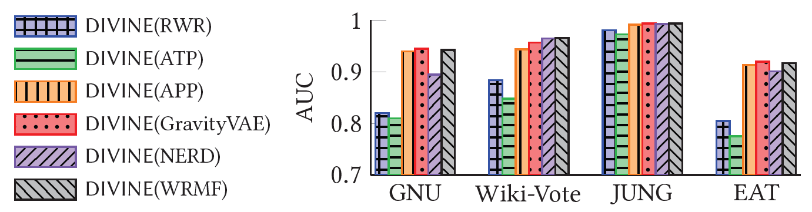
Results for RQ1
Comparisons of methods for inferring the degree of negativity
When it is equipped with WRMF, DIVINE consistently achieves high AUC in all datasets

Slide 37
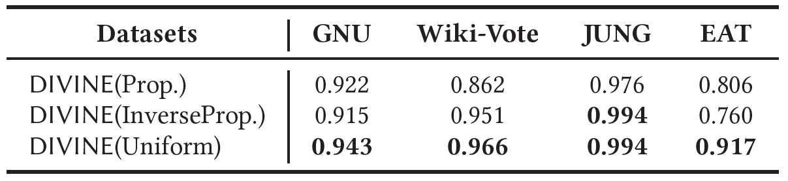
Results for RQ3
Effectiveness of adding an equal number of VNEs to each source node
DIVINE(Prop.) sets the number of VNEs from each node proportionally to its out-degree
DIVINE(InverseProp.) sets the number of VNEs from each node inverse proportionally to its out-degree
DIVINE(Uniform) sets an equal number of VNEs to all nodes

Slide 38
Results for RQ3 (cont’d)
Effectiveness of adding an equal number of VNEs to each source node
DIVINE(Uniform) consistently outperforms the others
Treating all source nodes equally by adding an equal number of VNEs to them helps learn accurate embeddings most

Slide 39
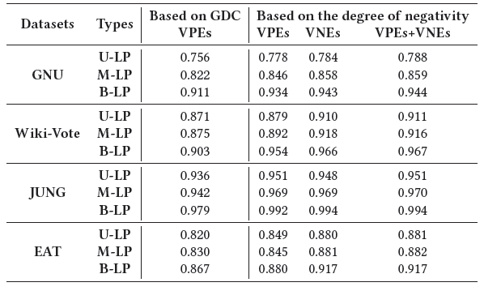
Why Virtual Negative Edges? (cont’d)
Comparisons of several methods for adding VEs
Adding VNEs achieves superior AUC over adding VPEs
Adding VPEs in addition to VNEs resulted in marginal additional gains.

Slide 40
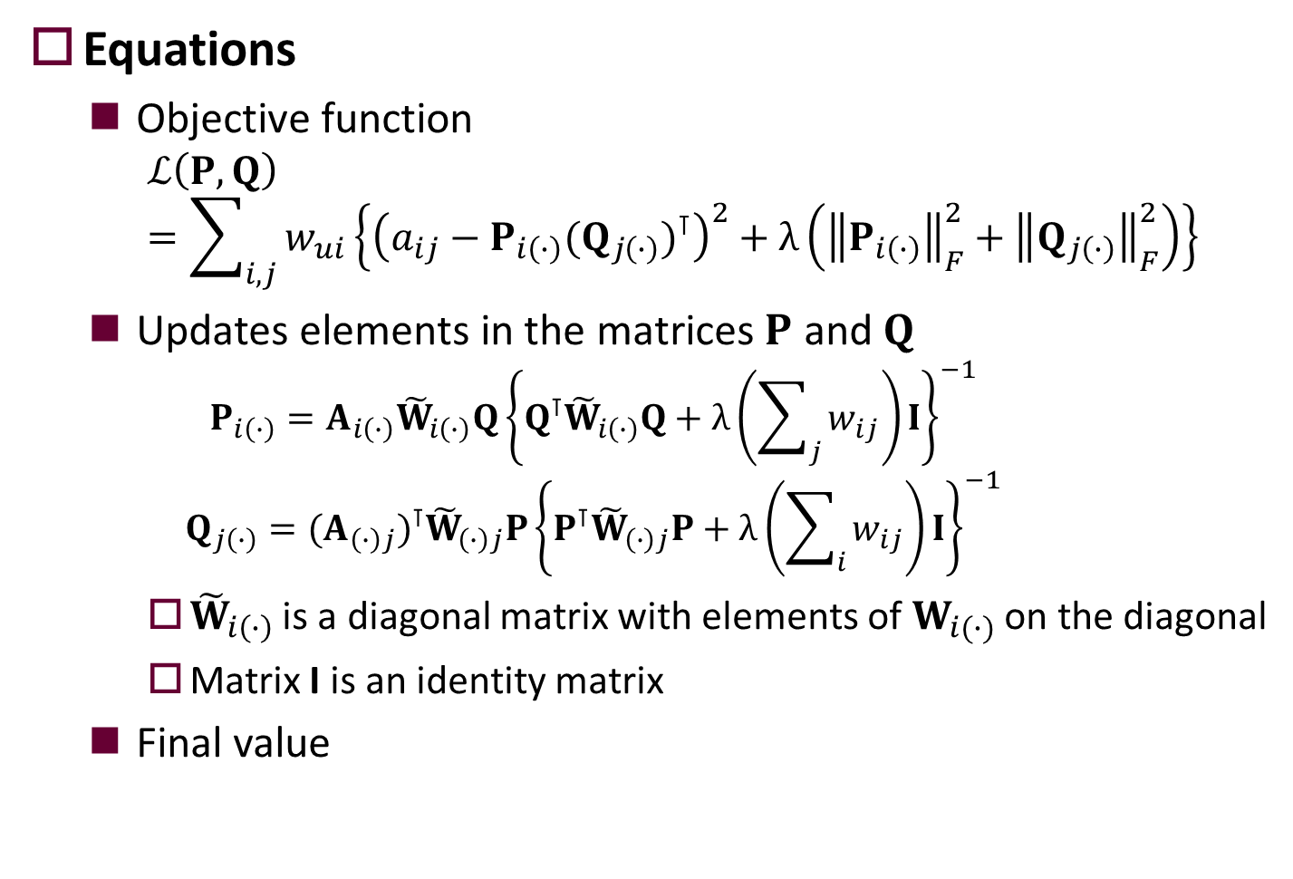

Inferring the Degree of Negativity (cont’d)
Equations
Objective function
$$ℒ\left(P,Q\right)=\sum_{i,j}{w_{ui}\left\{{\left(a_{ij}−P_{i\left(∙\right)}(Q_{j\left(∙\right)})^{⊺}\right)}^{2}+λ\left({\left\|P_{i\left(∙\right)}\right\|}_{F}^{2}+{\left\|Q_{j\left(∙\right)}\right\|}_{F}^{2}\right)\right\}}$$
Updates elements in the matrices $P$ and $Q$
$$P_{i\left(∙\right)}=A_{i\left(∙\right)}{\tilde{W}}_{i\left(∙\right)}Q{\left\{Q^{⊺}{\tilde{W}}_{i\left(∙\right)}Q+λ\left(\sum_{j}{w_{ij}}\right)I\right\}}^{−1}$$
$$Q_{j\left(∙\right)}=(A_{\left(∙\right)j})^{⊺}{\tilde{W}}_{\left(∙\right)j}P{\left\{P^{⊺}{\tilde{W}}_{\left(∙\right)j}P+λ\left(\sum_{i}{w_{ij}}\right)I\right\}}^{−1}$$
${\tilde{W}}_{i\left(∙\right)}$ is a diagonal matrix with elements of $W_{i(∙)}$ on the diagonal
Matrix I is an identity matrix
Final value
$\hat{A}≈A=PQ^{⊺}$ $x_{ij}=1−\frac{{\hat{a}}_{ij}−{\left\|\hat{A}\right\|}_{min}}{{\left\|\hat{A}\right\|}_{max}−{\left\|\hat{A}\right\|}_{min}}$

Slide 41
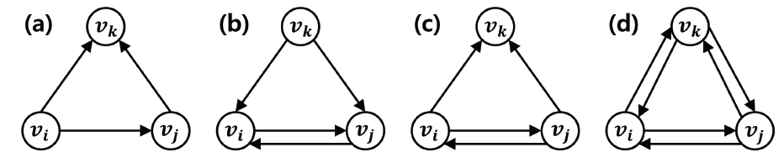
Triadic Balance [Aref et al. Sci. Rep.’20]
New measure that assesses the structural balance of the signed “directed” network
Collect all the transitive triads consisting of at least one or multiple triangles where the directions of three edges satisfy the transitivity
Measure the ratio of balanced ones among all the collected transitive triads
* Triad: a set of three nodes with at least one directed edge between each pair of them

Slide 42
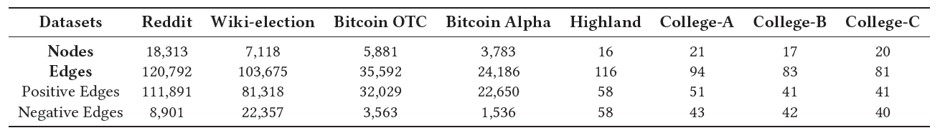
How to determine the number of VNEs?
Real-world signed networks
Reddit represents connections between users of two subreddits from Jan 2014 to April 2017
Wiki-election contains approval/disapproval votes for electing admins in Wikipedia from 2003 to 2013
Bitcoin OTC and Bitcoin Alpha represent the record of reputation/trust of users on a Bitcoin trading platform
Highland represents alliance structure among three tribal groups
College-A, College-B, and College-C represent preference rankings of a group of girls in an Eastern college

Slide 43



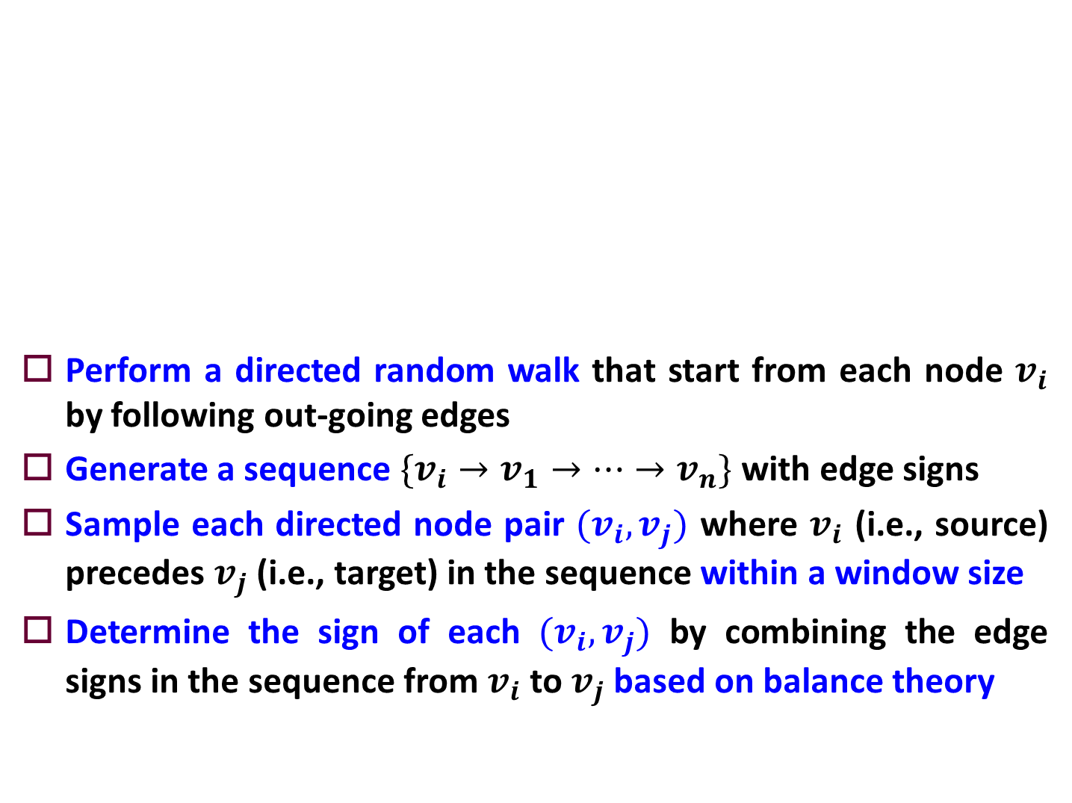










SIDE [Kim et al. WWW’18]
Perform a directed random walk that start from each node $v_{i}$ by following out-going edges
Generate a sequence $\{v_{i}→v_{1}→⋯→v_{n}\}$ with edge signs
Sample each directed node pair $(v_{i},v_{j})$ where $v_{i}$ (i.e., source) precedes $v_{j}$ (i.e., target) in the sequence within a window size
Determine the sign of each $(v_{i},v_{j})$ by combining the edge signs in the sequence from $v_{i}$ to $v_{j}$ based on balance theory
$$v_{i}$$
positive edges
+
Window Size = 2
$$v_{1}$$
$$(v_{i},v_{1})$$
$$(v_{1},v_{3})$$
$$(v_{3},v_{n})$$
$$v_{3}$$
-
+
$$(v_{i},v_{2})$$
$$(v_{1},v_{2})$$
$$(v_{2},v_{3})$$
$$(v_{2},v_{n})$$
$$v_{2}$$
-
$$v_{n}$$
negative edges

Slide 44
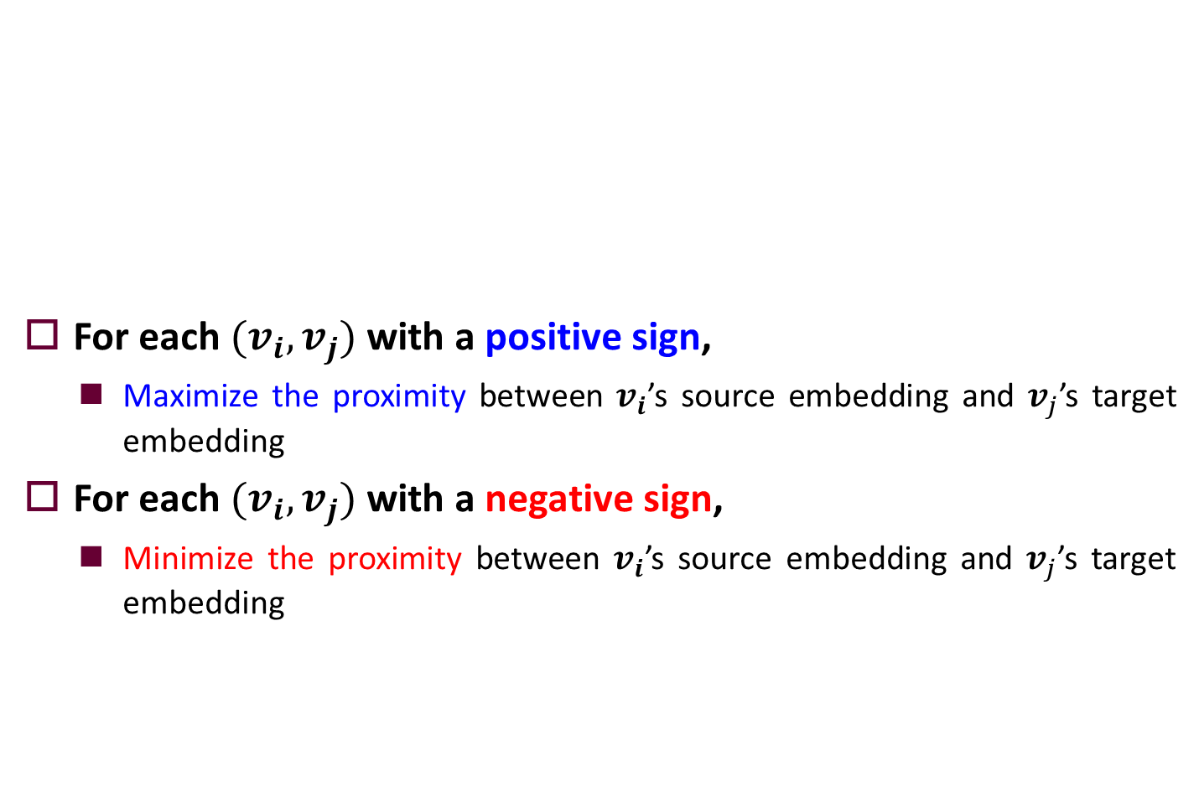
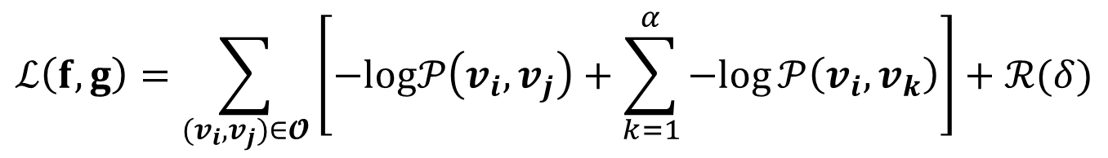
SIDE [Kim et al. WWW’18] (cont’d)
For each $(v_{i},v_{j})$ with a positive sign,
Maximize the proximity between $v_{i}$’s source embedding and $v_{j}$’s target embedding
For each $(v_{i},v_{j})$ with a negative sign,
Minimize the proximity between $v_{i}$’s source embedding and $v_{j}$’s target embedding
$$ℒ\left(f,g\right)=\sum_{(v_{i},v_{j})∈𝓞}{\left[−log𝒫\left(v_{i},v_{j}\right)+\sum_{k=1}^{α}{−log}𝒫\left(v_{i},v_{k}\right)\right]+ℛ(δ)}$$

