Slide 1
Predicting Traffic Accident Severity

Slide 2
Introduction
This project aims to predict accident severity so that driver’s can better plan their route.

Slide 3
Data
Independent Variable: Severity Code
Dependent Variables: Weather Conditions (Index), Road Condition (Index), Light Condition (Index)

Slide 4
Methodology
Data Processing:
1- Clean the data to include only the dependent and three independent variables
2- Drop unknown columns
3- Index the three independent variables on a scale that increases as the severity of the condition increases
4- Balance the data

Slide 5
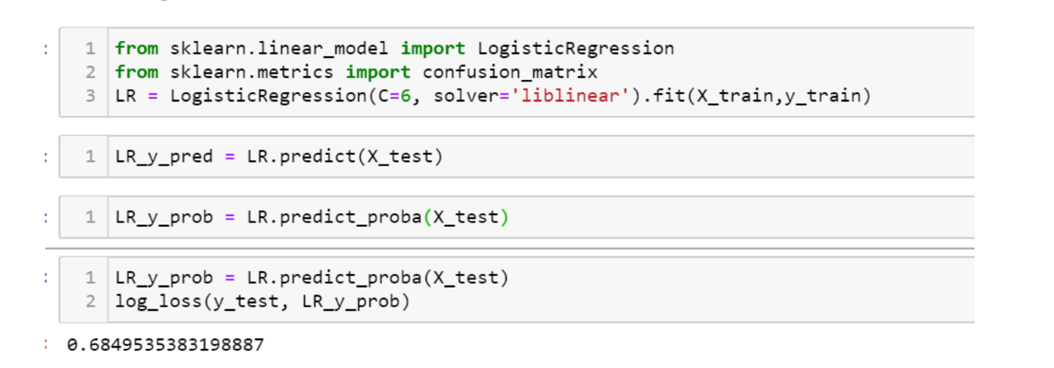
Methodology : Model One
Model 1: Examined the linear relationship between a change in Weather Conditions and a change in the severity of the accident

Slide 6
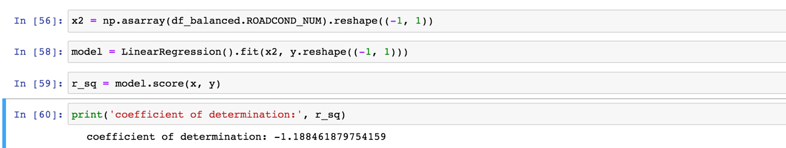
Methodology : Model Two
Model 2: Examined the linear relationship between a change in light conditions and the severity score.

Slide 7
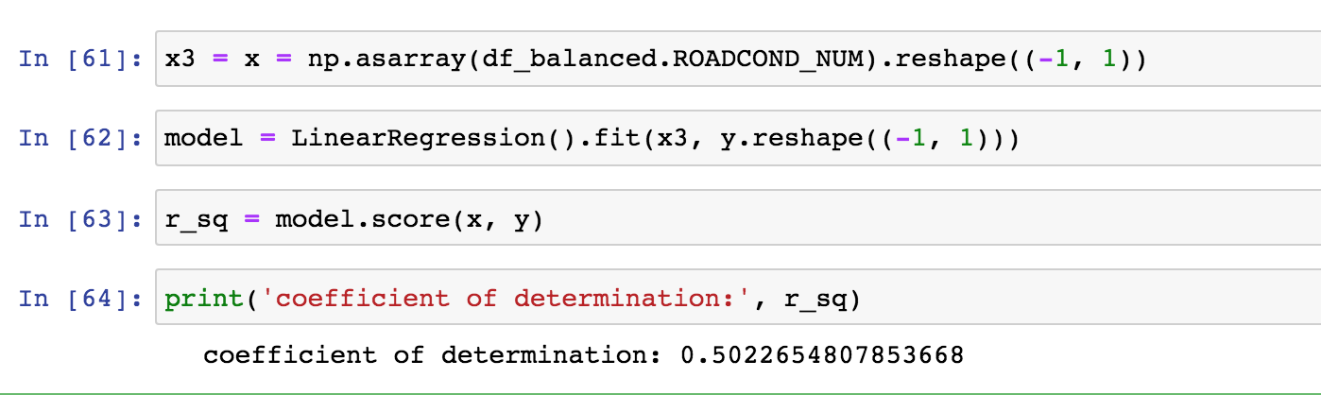
Methodology: Model Three
Model 3: Examined the linear relationship between a change in road conditions and the severity score.

Slide 8
Results
These three models represent the change in severity depending on weather conditions, light conditions, and road conditions.
As weather conditions become more sever there is a 68% change in the severity of the accident.
As light conditions increase there is a -1.18% decrease in the severity of the accident.
As road conditions became less favorable there was a .50% increase in the severity score.

Slide 9
Discussion
As weather conditions, light conditions, and road conditions become more dangerous the severity of the accident also rises.
We know this by creating an index of these three conditions and determining their linear relationship with the severity score.

Slide 10
Conclusion
We can conclude that the three independent conditions have an impact on travel safety. As these conditions become more unstable drivers may wish to take a different route.

