Slide 1
prefig
github.com/rjsmethurst/prefig
a python figure class for producing presentation & poster worthy plots
#myfirsthack

Slide 2
plt.figure()
plt.errorbar(x,y, yerr, xerr=None, fmt=' ', marker='D')
plt.plot(x, (m*x+c))
plt.xlabel('measured')
plt.ylabel('observed')
plt.savefig('test_orig.png’)

Slide 3
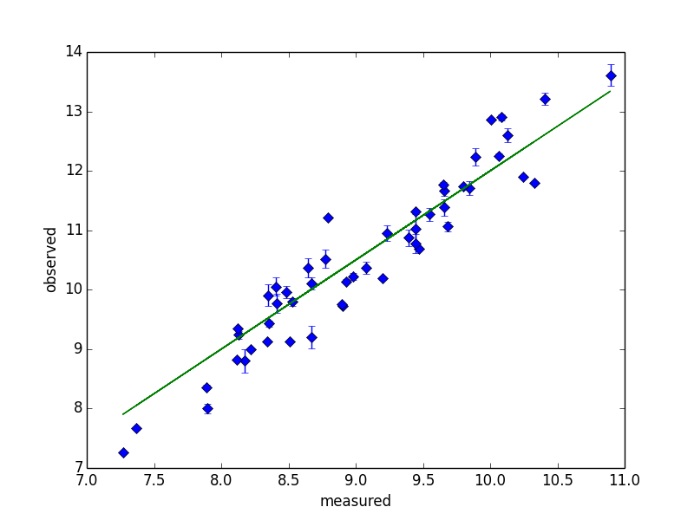

Slide 4
plt.figure()
plt.errorbar(x,y, yerr, xerr=None, fmt=' ', marker='D')
plt.plot(x, (m*x+c))
plt.xlabel('measured')
plt.ylabel('observed')
plt.savefig('test_orig.png’)

Slide 5
Prefig(axcol=‘w’, fontcol=‘w’)
plt.errorbar(x,y, yerr, xerr=None, fmt=' ', marker='D')
plt.plot(x, (m*x+c))
plt.xlabel('measured')
plt.ylabel('observed')
plt.savefig('test_orig.png’)

Slide 6
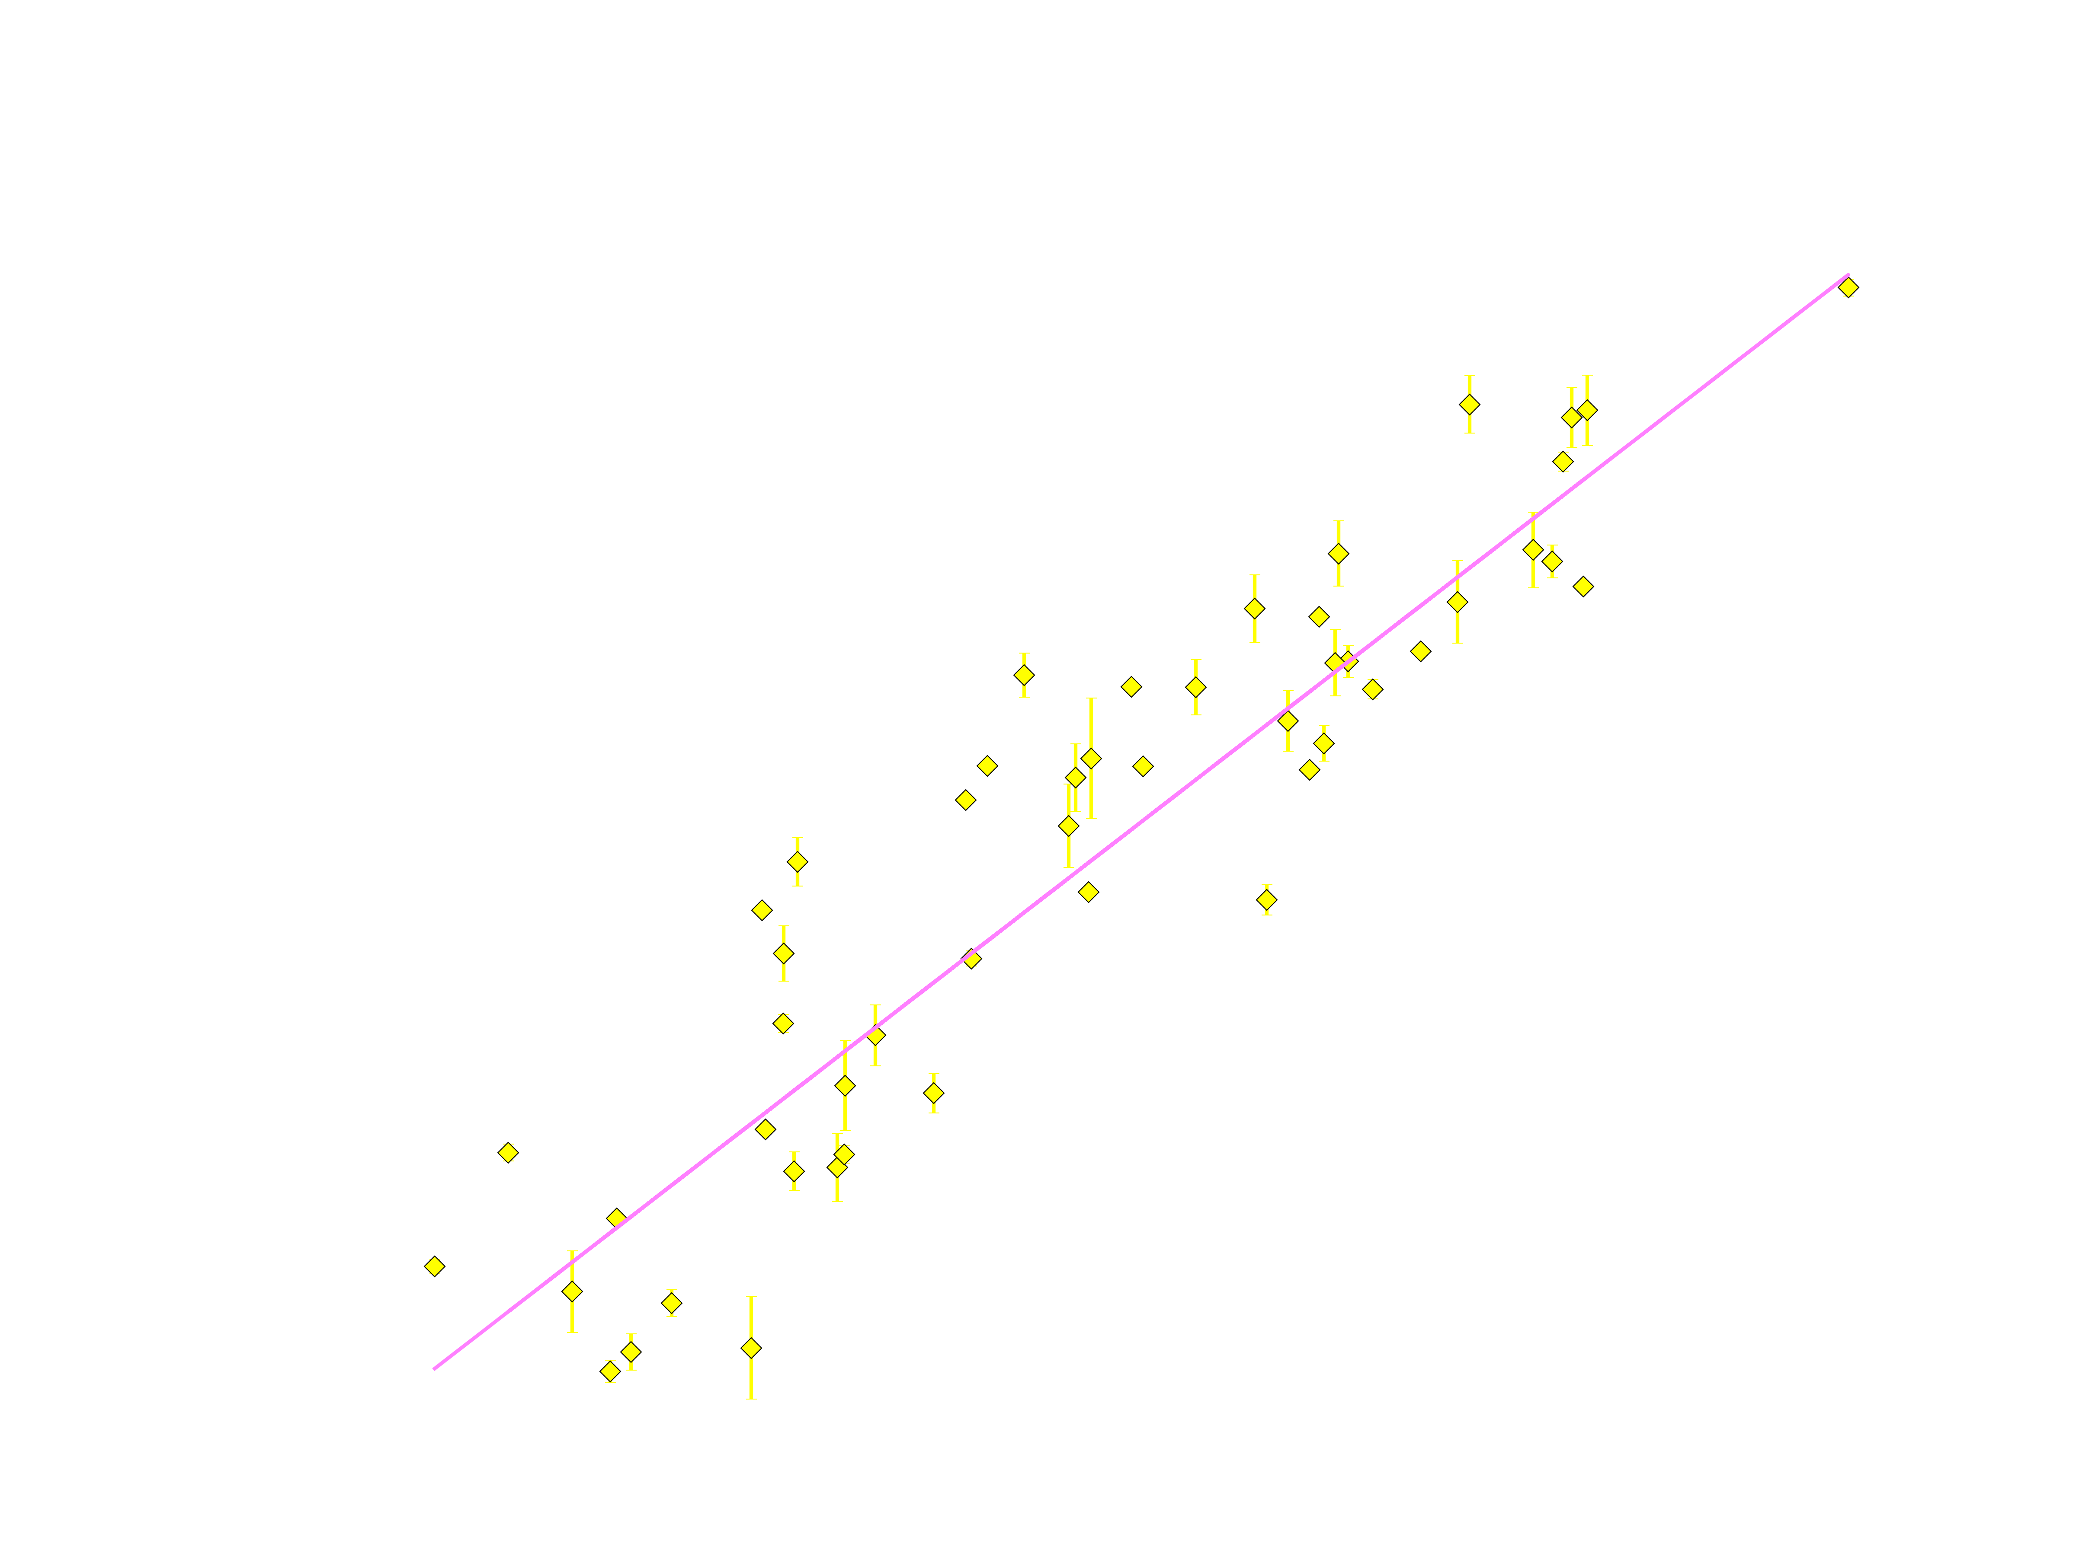

Slide 7
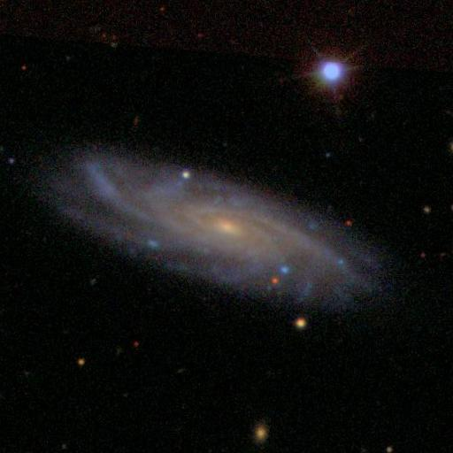

Slide 8
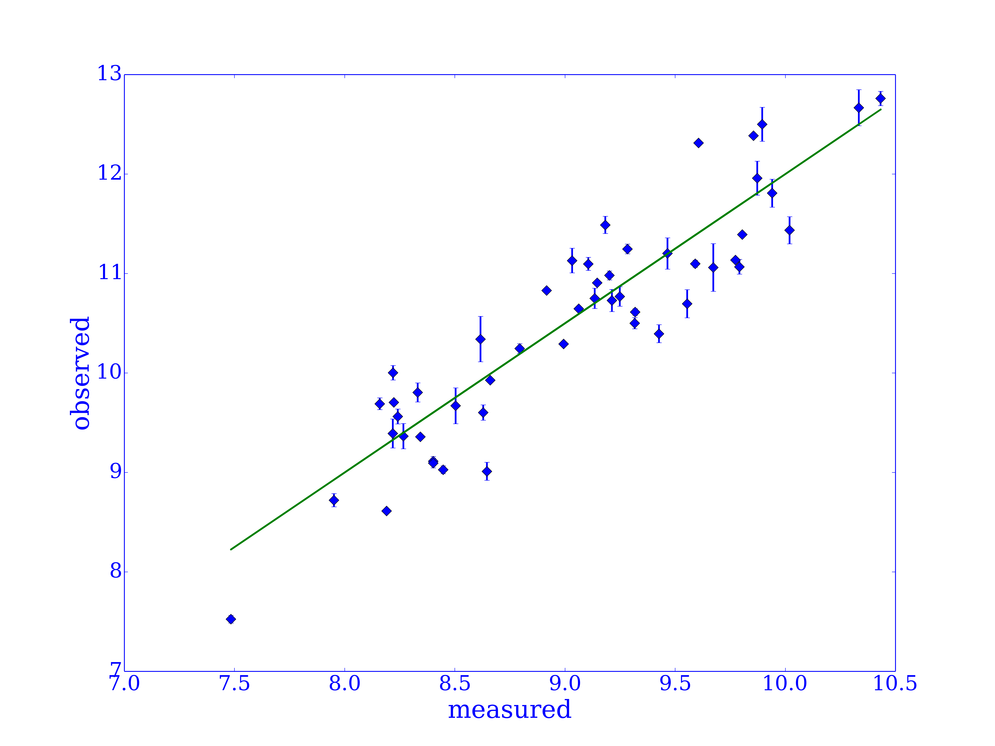

Slide 10
