Slide 1

База от данни за хотел

Slide 2
Предметната област, върху която нашият екип е избрал да работи е хотелиерство. Ще създадем база данни, която подпомага управлението на хотела. Нашият проект ще спести време и усилия на целия екип на хотела. Автоматизацията на съхранението на данни ще подобри ефективността на персонала и ще оптимизира работния процес, което ще донесе повече приходи в бъдеще.

Slide 3
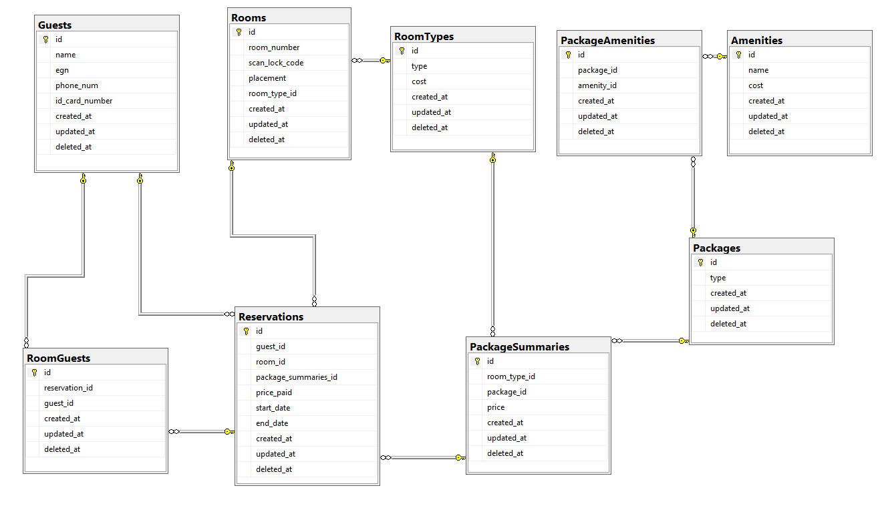
Схема на релациите
*при натискане на плюс се отваря съдържанието на дадената таблица

Slide 4
Прости заявки
1
1)
SELECT id,guest_id,room_id,package_summaries_id,price_paid,start_date,end_date FROM Reservations
WHERE start_date >= '2020-05-03' AND end_date <= '2020-05-09’
2)
SELECT room_id FROM Reservations
WHERE start_date <= '2020-05-04' AND end_date >='2020-05-04’
3)
SELECT guest_id,room_id,price_paid,start_date,end_date FROM Reservations
WHERE guest_id=2
4)
SELECT room_number FROM Rooms
WHERE placement LIKE '%viewing the sea%‘
5)
SELECT room_type_id,package_id,price FROM PackageSummaries
WHERE price <= 100
ORDER BY price

Slide 5
Прости заявки
1
6)
SELECT room_number,scan_lock_code,placement,room_type_id FROM Rooms
WHERE placement LIKE '%3rd floor%’
7)
SELECT name,cost FROM Amenities
WHERE cost<=1000

Slide 6
Заявки върху две и повече релации
2
1)
SELECT DISTINCT id FROM Rooms
EXCEPT
SELECT room_id FROM Reservations
WHERE start_date <= '2020-05-07' AND end_date >='2020-05-07’
2)
SELECT name, phone_num
FROM Guests
LEFT JOIN Reservations
ON Guests.id = Reservations.guest_id
INTERSECT
SELECT name,phone_num
FROM Guests
RIGHT JOIN Reservations
ON Guests.id = Reservations.guest_id

Slide 7
Заявки върху две и повече релации
2
3)
SELECT Reservations.guest_id,name,Reservations.end_date,price_paid FROM Reservations
JOIN RoomGuests
ON RoomGuests.id = Reservations.guest_id
JOIN Guests
ON Guests.id = Reservations.guest_id
WHERE Reservations.end_date <= '2020-05-09'
EXCEPT
SELECT Reservations.guest_id,name,Reservations.end_date,price_paid FROM Reservations
JOIN RoomGuests
ON RoomGuests.id = Reservations.guest_id
JOIN Guests
ON Guests.id = Reservations.guest_id
WHERE price_paid < 250

Slide 8
Заявки върху две и повече релации
2
4)
SELECT COUNT(id) AS NumberOfGuests
FROM RoomGuests
WHERE reservation_id IN
(
SELECT Reservations.id FROM Reservations
JOIN PackageSummaries ON package_summaries_id = PackageSummaries.id
JOIN Packages ON package_id = Packages.id
WHERE NOT Packages.type = 'Standart'
INTERSECT
SELECT id FROM Reservations
WHERE start_date <= '2020-05-03'
AND end_date >= '2020-05-03'
)

Slide 9
Заявки върху две и повече релации
2
5)
SELECT room_id,price_paid,start_date,end_date
FROM Reservations
WHERE id IN
(SELECT reservation_id FROM RoomGuests
WHERE guest_id = 4
INTERSECT
SELECT id FROM Reservations
WHERE package_summaries_id IN
(SELECT id FROM PackageSummaries
WHERE package_id = 3))
6)
SELECT DISTINCT Guests.id, Guests.name FROM Guests
EXCEPT
SELECT DISTINCT Guests.id, Guests.name FROM Guests
JOIN Reservations on Guests.id= Reservations.guest_id

Slide 10
Подзаявки
3
1)
SELECT room_number,scan_lock_code,placement,room_type_id FROM Rooms
WHERE Rooms.placement LIKE '%1st floor%' AND room_number in
(SELECT DISTINCT room_id FROM Reservations
JOIN Rooms
ON Rooms.id=Reservations.room_id)
2)
SELECT DISTINCT Guests.id,name,egn from RoomGuests
JOIN Guests ON RoomGuests.guest_id = Guests.id
WHERE reservation_id IN
(SELECT id from Reservations
WHERE room_id = 9)

Slide 11
Подзаявки
3
3)
SELECT AVG(price_paid) as AVG_PAID_PRICE FROM Reservations
WHERE room_id IN
(
SELECT id FROM Rooms
WHERE room_type_id IN
(SELECT id FROM RoomTypes
WHERE type = 'Single')
)
AND start_date >= '2020-05-10’
4)
SELECT DISTINCT name,egn,phone_num from Guests
WHERE id IN
(SELECT guest_id FROM RoomGuests
WHERE reservation_id IN
(SELECT id FROM Reservations
WHERE package_summaries_id IN
( SELECT id FROM PackageSummaries
WHERE package_id = 2)
))

Slide 12
Подзаявки
3
5)
SELECT scan_lock_code FROM Rooms
WHERE id IN
(SELECT room_id FROM Reservations
WHERE package_summaries_id IN
(SELECT id FROM PackageSummaries
WHERE price <= 100))
6)
SELECT id,name,egn,phone_num FROM Guests
WHERE id IN
(SELECT guest_id FROM RoomGuests
WHERE reservation_id IN
(SELECT id FROM Reservations
WHERE room_id IN
(SELECT id FROM Rooms
WHERE placement LIKE '5%')
AND
package_summaries_id IN
(SELECT id FROM PackageSummaries
WHERE package_id IN
(SELECT id FROM Packages
WHERE type = 'All Inclusive'))
AND price_paid > 500))

Slide 13
Съединения
4
1)
SELECT room_number FROM Rooms
LEFT JOIN Reservations ON Rooms.id=Reservations.room_id
WHERE Reservations.room_id is NULL
2)
SELECT DISTINCT Guests.id, Guests.name FROM Reservations
JOIN RoomGuests
ON RoomGuests.reservation_id = Reservations.id
JOIN Guests
ON Guests.id = RoomGuests.guest_id
WHERE start_date <= '2020-05-04' AND end_date >= '2020-05-04'
ORDER BY id

Slide 14
Съединения
4
3)
SELECT room_number, placement,cost FROM Rooms
JOIN RoomTypes
ON room_type_id = RoomTypes.id
WHERE cost <= 20
4)
SELECT DISTINCT Reservations.id,guest_id,room_id,price_paid,Packages.type, start_date,end_date
FROM Reservations
  JOIN PackageSummaries ON package_summaries_id = PackageSummaries.id
  JOIN RoomTypes
  ON RoomTypes.id = PackageSummaries.room_type_id
  JOIN Rooms
  ON Rooms.room_type_id = RoomTypes.id
  JOIN Packages
  ON package_id = Packages.id
  WHERE RoomTypes.type = 'Double'
  AND (Packages.type = 'All Inclusive'
  OR Packages.type = 'Ultra All Inclusive')
  ORDER BY Reservations.id

Slide 15
Съединения
4
5)
SELECT DISTINCT Guests.name FROM RoomGuests
JOIN Reservations ON reservation_id = Reservations.id
JOIN PackageSummaries ON package_summaries_id = PackageSummaries.id
JOIN Guests ON RoomGuests.guest_id = Guests.id
JOIN PackageAmenities ON PackageSummaries.package_id = PackageAmenities.package_id
JOIN Amenities ON Amenities.id = PackageAmenities.amenity_id
WHERE Amenities.name = 'Spa procedures'

Slide 16
Групиране и агрегация
5
1)
SELECT COUNT(id) as number_of_guests,room_id
FROM Reservations
GROUP BY room_id
2)
SELECT COUNT(DISTINCT Guests.id) as number_of_guests, package_id
FROM
Guests
JOIN RoomGuests on guests.id=roomguests.guest_id
JOIN Reservations on RoomGuests.reservation_id=Reservations.id
JOIN PackageSummaries on Reservations.package_summaries_id= PackageSummaries.id
GROUP BY package_id
3)
SELECT AVG(Reservations.price_paid) as average_price, package_id
FROM
Reservations
JOIN PackageSummaries on Reservations.package_summaries_id= PackageSummaries.id
GROUP BY package_id

Slide 17
Групиране и агрегация
5
4)
SELECT MAX(price_paid) as price, package_id
FROM RESERVATIONS
JOIN PackageSummaries on reservations.package_summaries_id=PackageSummaries.id
GROUP BY package_id
5)
SELECT COUNT(amenity_id) as number_of_amenities, package_id
FROM PackageAmenities
GROUP BY package_id
6)
SELECT SUM(price_paid) AS total_income
FROM Reservations
7)
SELECT SUM(price_paid) AS turnover
FROM Reservations
WHERE start_date >= '2020-01-01'
AND
end_date <= '2020-06-01'

Slide 18
Групиране и агрегация
5
8)
SELECT COUNT (DISTINCT id) as number_of_guests
FROM Guests
WHERE id NOT IN
(SELECT DISTINCT Guests.id FROM Guests
JOIN Reservations on Guests.id= Reservations.guest_id)

Slide 19
Изгледи и индекси
6
1)
CREATE VIEW GuestInfo
AS SELECT Guests.id, name , room_id
FROM Guests
JOIN RoomGuests on guests.id=RoomGuests.guest_id
JOIN Reservations on RoomGuests.reservation_id=Reservations.id
2)
CREATE VIEW RoomInfo
AS SELECT room_number,placement,type
FROM Rooms
JOIN RoomTypes ON room_type_id=RoomTypes.id
3)
CREATE VIEW ReservationContacts
AS SELECT Reservations.room_id, Reservations.start_date, Reservations.end_date,Guests.name,Guests.phone_num
FROM Reservations
JOIN Guests on Guests.id=Reservations.guest_id
4)
CREATE INDEX booked_guest_idx ON Reservations(guest_id);
5)
CREATE INDEX guest_name_idx ON Guests(name);

Slide 20
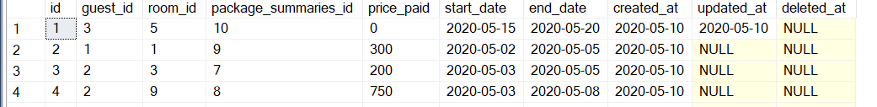
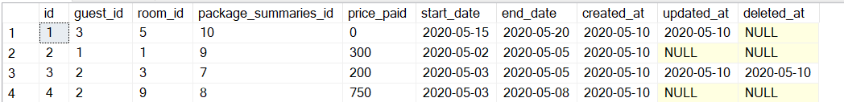
Тригери
7
1)
CREATE TRIGGER delete_reservations_date
ON Reservations
INSTEAD OF DELETE
AS
BEGIN
SET NOCOUNT ON;
Update Reservations set deleted_at = GETDATE()
FROM deleted
WHERE Reservations.id = deleted.id
END
before
after

Slide 21
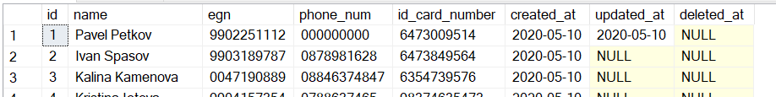
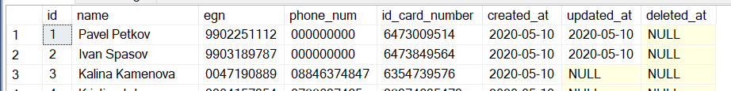
Тригери
7
2)
CREATE TRIGGER update_guests_date
ON Guests
AFTER UPDATE
AS
BEGIN
SET NOCOUNT ON;
Update Guests set updated_at = GETDATE()
FROM inserted
WHERE Guests.id = inserted.id
END
before
after

Slide 22
Благодарим!
?
Въпроси?
Изготвили:
Александър Найденов, 62251
Иван Спасов, 62303
Калина Каменова, 62313
Кристина Йотова, 62247
Павел Петков, 62302

Slide 23
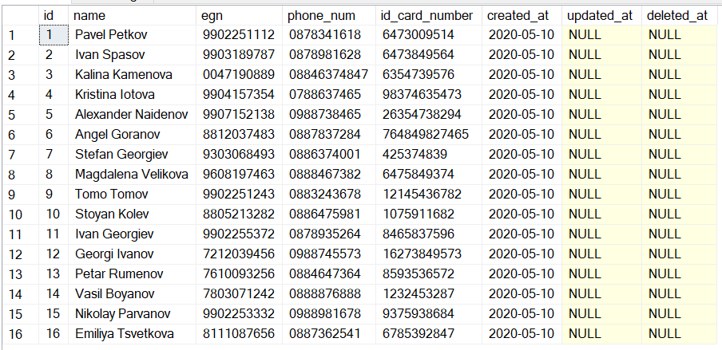
Таблица Guests

Slide 24
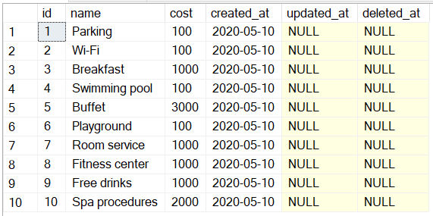
Таблица Amenities

Slide 25
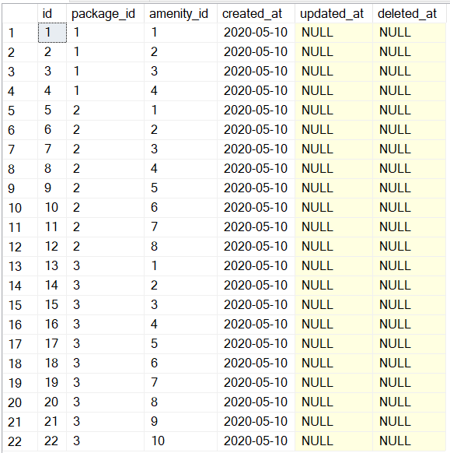
Таблица PackageAmenities

Slide 26
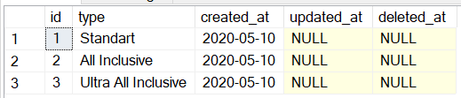
Таблица Packages

Slide 27
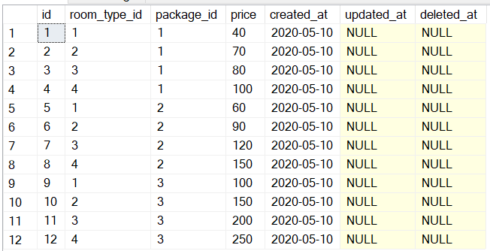
Таблица PackageSummaries

Slide 28
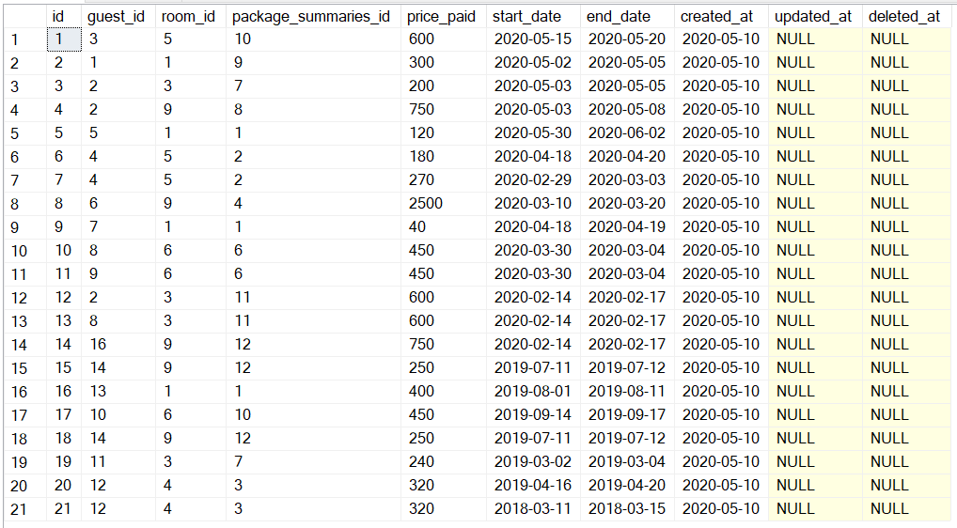
Таблица Reservations

Slide 29
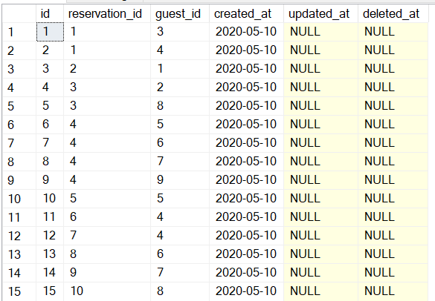
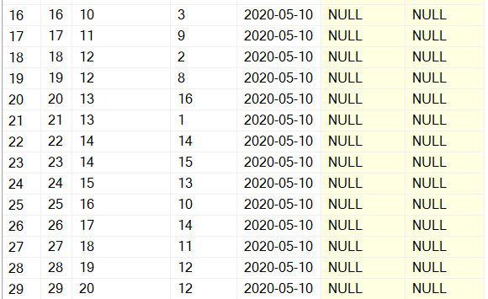
Таблица RoomGuests

Slide 30
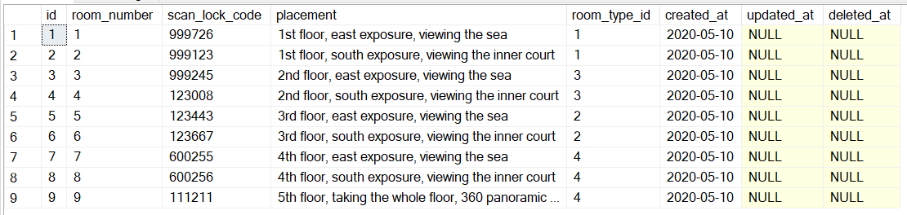
Таблица Rooms

Slide 31
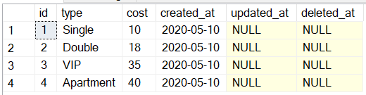
Таблица RoomTypes

