Slide 1
ECEN 5283 Project 2: Camera Calibration
Alexander Rose
Oklahoma State University
3/2/2024

Slide 2
Objective
For this project, two retina images were provided and edge detection methods were implemented to find the blood vessels on the images.
A comparison of edge detection methods between Canny, Laplace of Gaussian (LoG), and Matched filtering with length filtering is shown.
A variety of parameters must be tested to find the best edge detection results

Slide 3
Technical Background
Edge detection is important for finding features and borders in images
These can range from the retina blood vessels in this project, to animals or other objects
The noise effect of an image must be reduced with pre-filtering
Canny (1986) established critical criteria in selecting an edge detection filter:
Signal to Noise Ratio must be high, that is, stronger response to edge than noise
Edge Localization: The filter response should be strong at x = 0 and not elsewhere
Low False Positives: There must only be one maximum within the neighborhood
From these criteria, three prominent edge detection filters emerged
Canny, LoG, and Matched Filtering

Slide 4
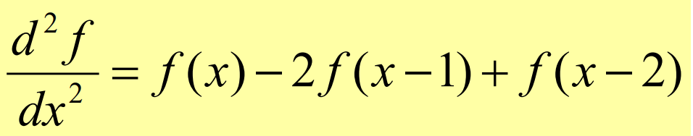
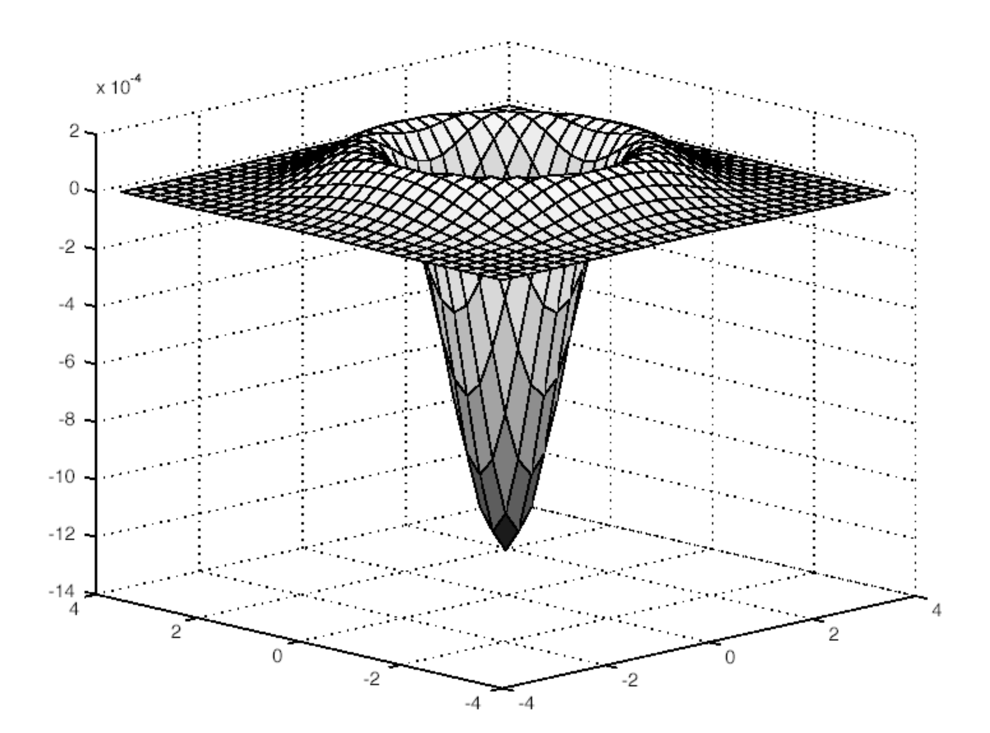
Technical Background
The Laplace of Gaussian (LoG) is a Laplace function with a Gaussian pre-filter, shown below.
The Canny method utilizes the gradient of two first order derivatives corresponding to the rows and columns of an image.
Compute the first order derivatives of the rows and columns
Compute the magnitude and direction of the gradient
Apply non-maximum suppression to the gradient magnitude, finding maximum along the gradient direction
Weak edges can be linked after implementing a connectivity analysis.

Slide 5
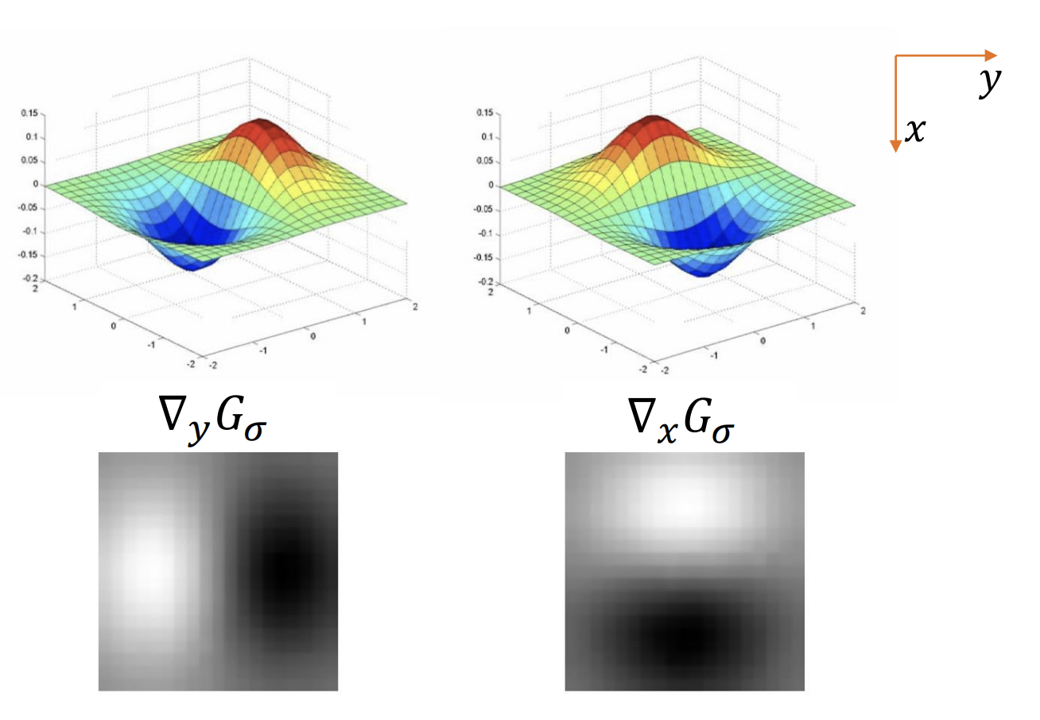
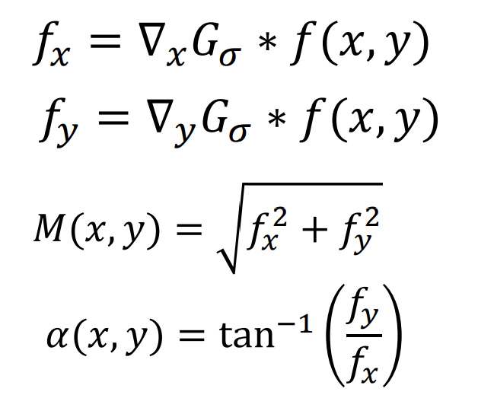
Technical Background – Canny continued
Relevant equations
Canny Gradient
M(x,y) and α(x,y) represent the magnitude and direction of the gradient respectively.

Slide 6
Technical Background – Matched Filter
The matched filter implements a gaussian filter along one direction, rotating it, then applying the rotated filter. This is repeated until a bank of filtered images is completed.
The filtered image bank is then checked pixel by pixel to find the strongest response to filtering with a new image formed from these responses.
After a threshold is chosen, pixel gray values below the threshold are set to 0 (black) and above are set to 1 (white).
Lastly, to eliminate small, weak edges, a length filtering technique is applied to the image.

Slide 7
Experimental Results

Slide 8
Retina 1

Slide 9
Discussion and Conclusion
I

Slide 10
Appendix – Code – Main file

Slide 11
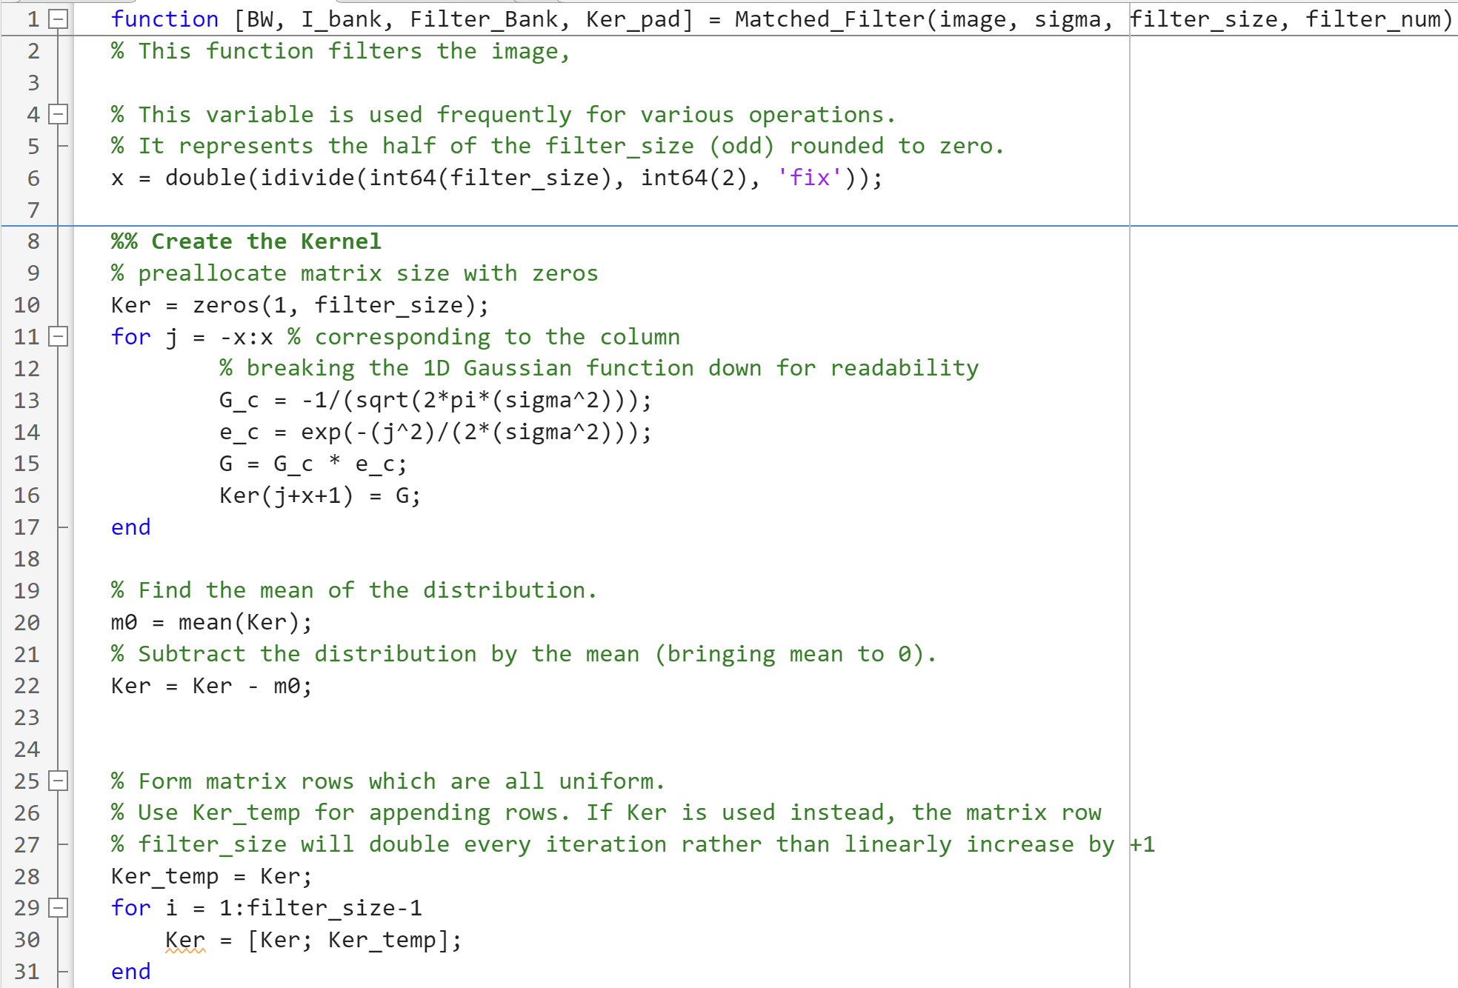
Appendix – Code – Matched Filter

Slide 12
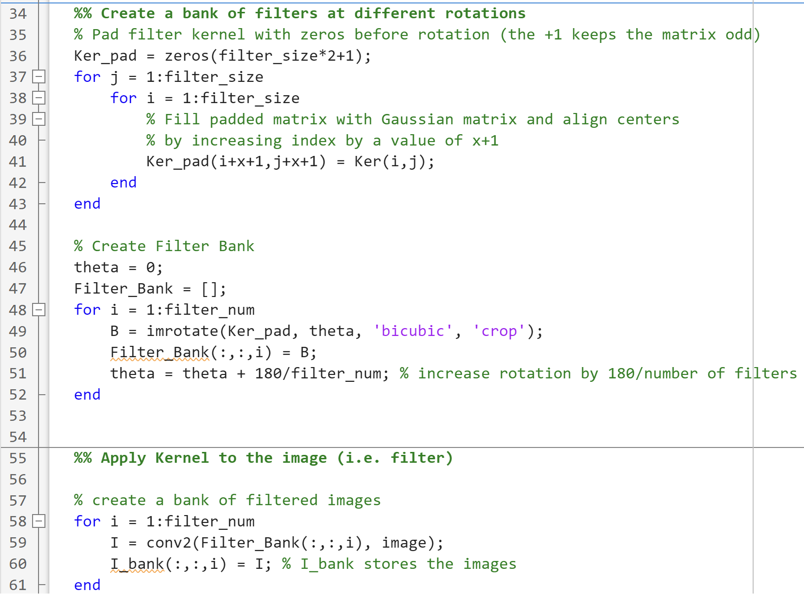
Appendix – Code – Matched Filter

Slide 13
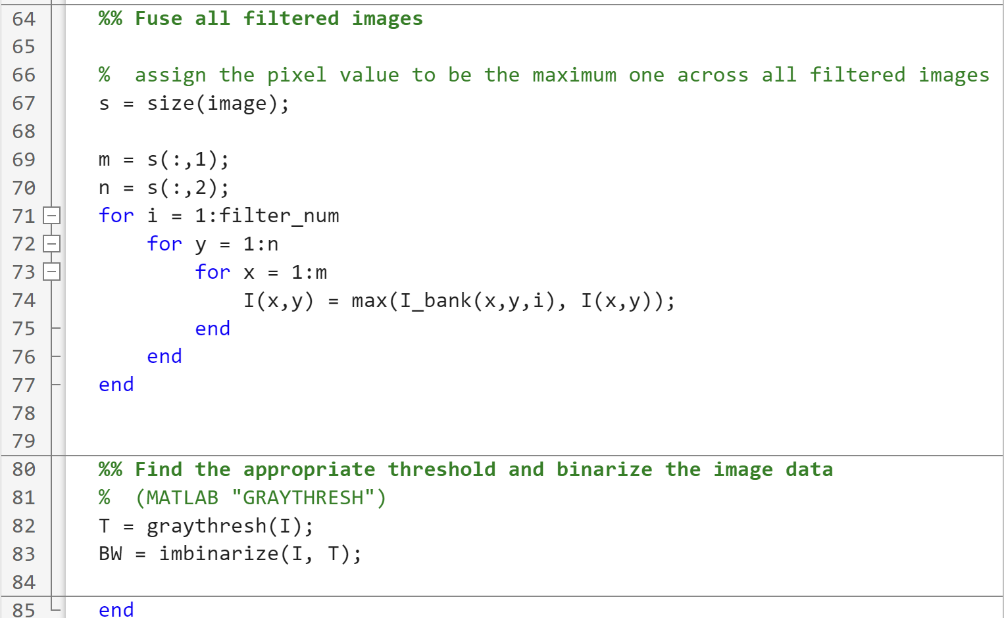
Appendix – Code – Matched Filter

Slide 14
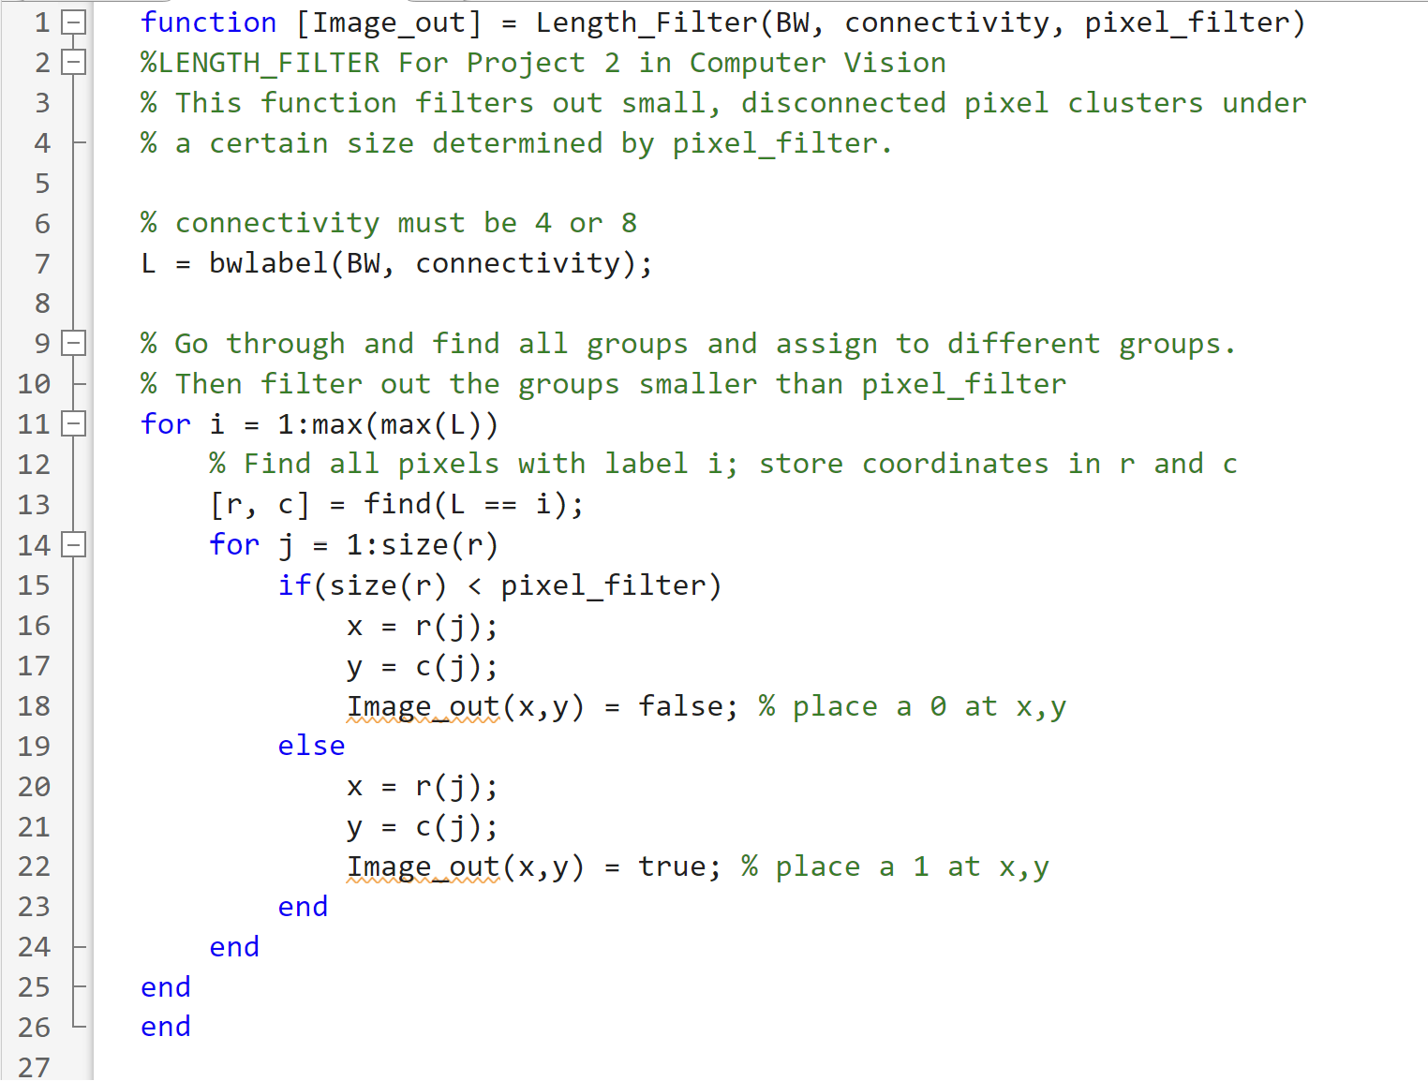
Appendix – Code – Length Filtering

