Slide 1
ECEN 5283 Project 2: Camera Calibration
Alexander Rose
Oklahoma State University
3/2/2024

Slide 2
Objective
For this project,

Slide 3
Technical Background
Objects

Slide 4
Experimental Results

Slide 5
Retina 1
Sigma = 1; filtersize =

Slide 6
Discussion and Conclusion
I

Slide 7
Appendix – Code – Main file

Slide 8
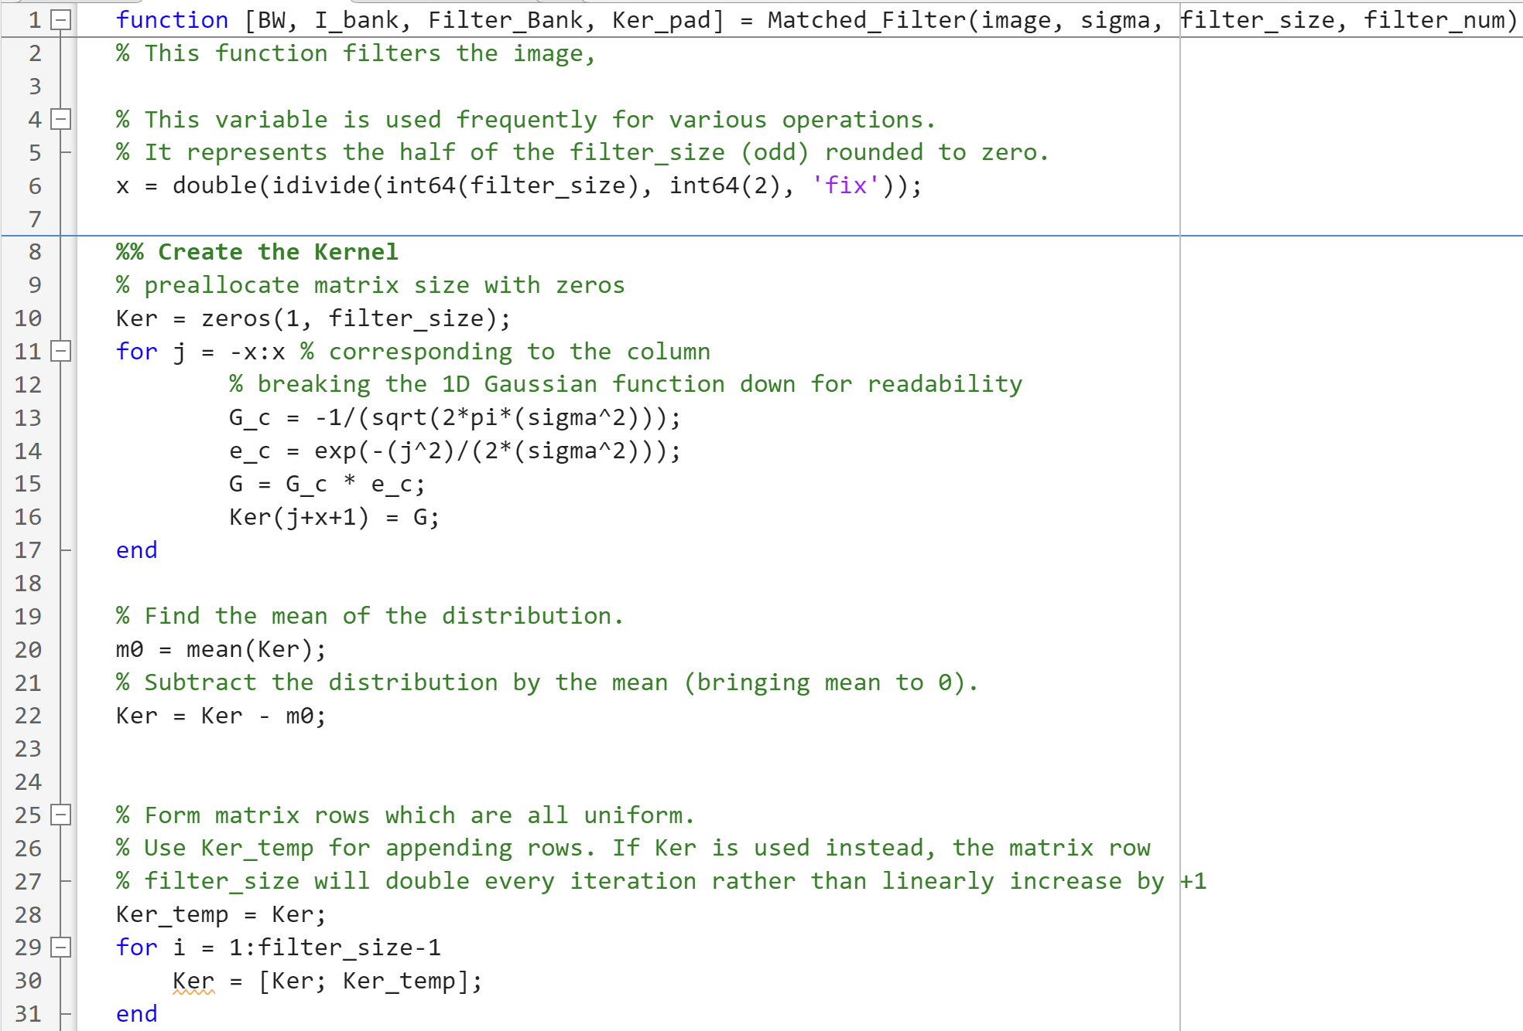
Appendix – Code – Matched Filter

Slide 9
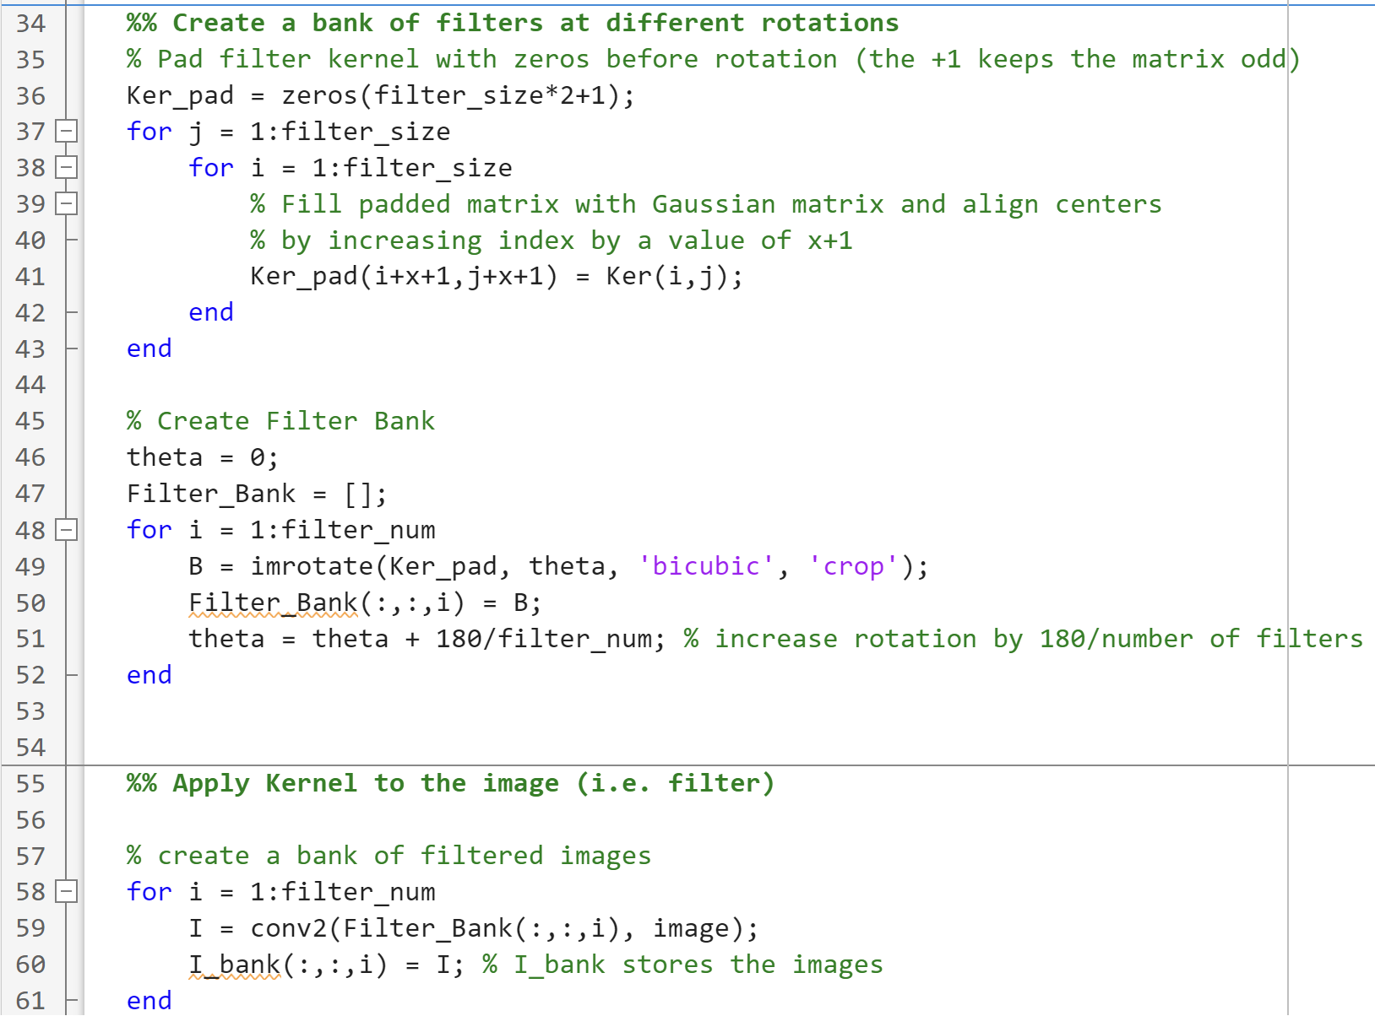
Appendix – Code – Matched Filter

Slide 10
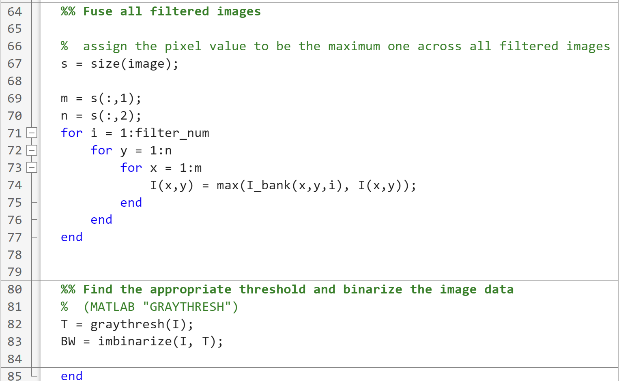
Appendix – Code – Matched Filter

Slide 11
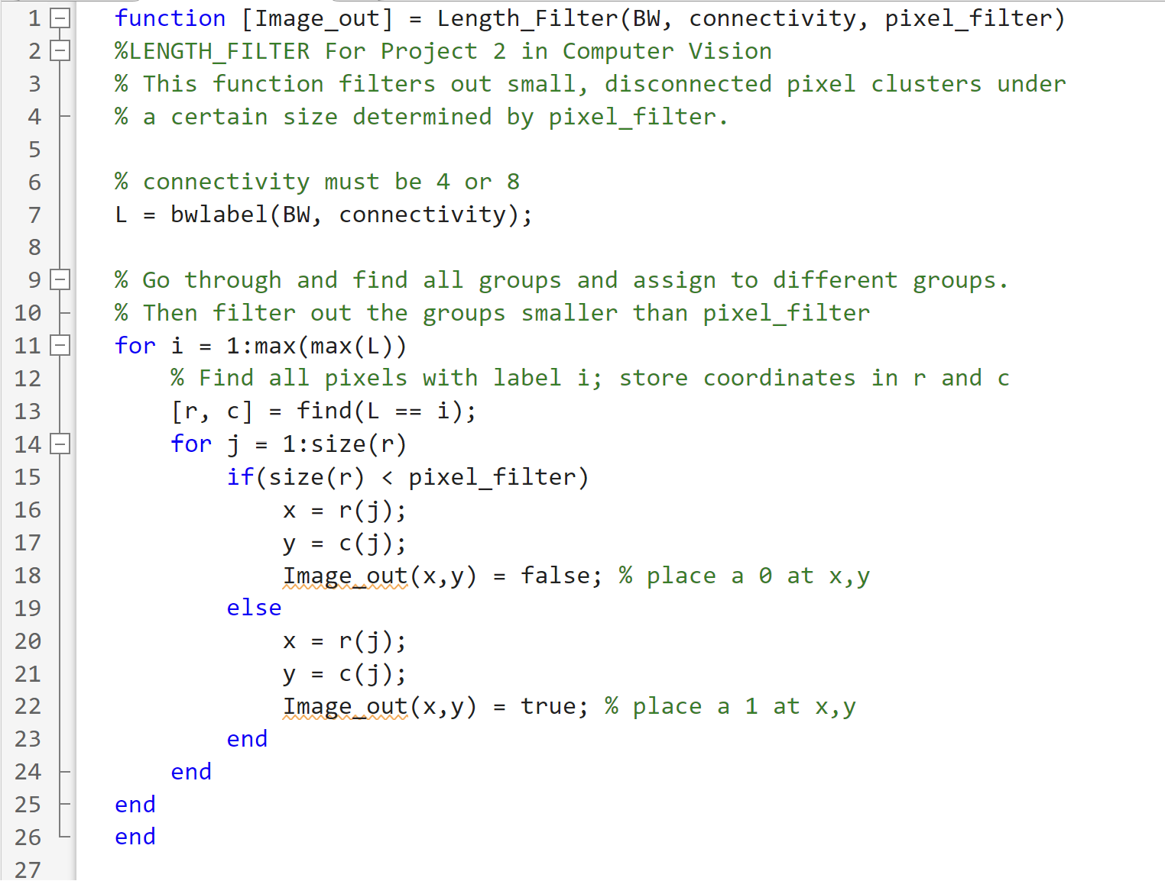
Appendix – Code – Length Filtering

