Slide 1

Evaluating cost and imbalance ratio in loss surfaces

Slide 2
Intro stats
Train – P1 – 1:57.6
Val – P2 – 1:62
Test – P3 – 1:28
40 features
Network -> 40 – 16 – 16 – 1
BCE logit loss
80 epochs

Slide 3
Goal
Let r denote the class-imbalance ratio, and c denote the cost.
  This cost is what domain experts give us.
  We can assume any number to showcase its impact.
Use r as class weight to adjust the loss function.
  We verify this by ensuring that the loss surface is un-warped back to when r=1.
Use c as class weight to further adjust the loss function.
  This could be either added to r or subtracted from r.

Slide 4
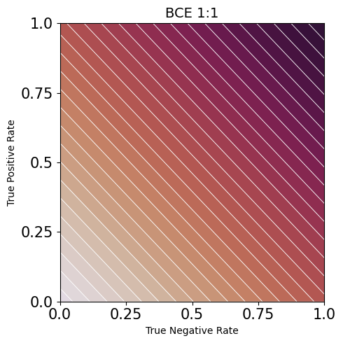
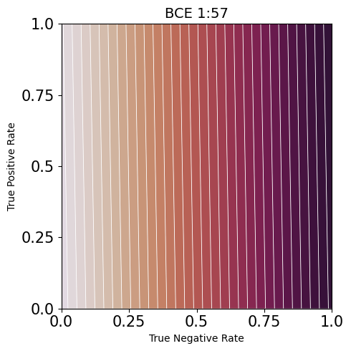
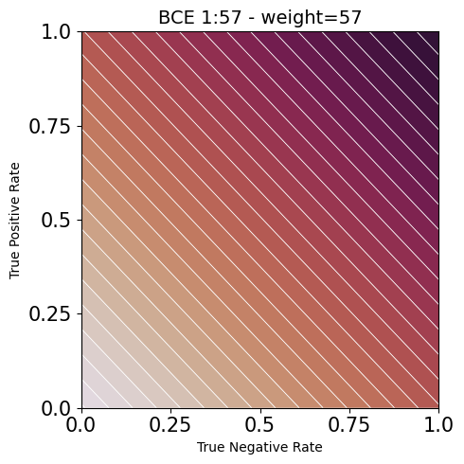
Recap on loss surface

Slide 5
Learning paths
With no weighting to counter the imbalance ratio, r, and no cost, c, the model favors TNR
Leaving r = 1 and simply adding a cost, c = 20, the goal is to push the model to the upper right hand corner and penalize misses more
Goal – find out values of r and c such that the model moves along the BCE surface toward the upper right hand corner while having favorable TSS and HSS values
Surfaces for loss are generated based on training set ratio and weight (if applied)
Surfaces for metrics and metric values are based on test set ratio

Slide 6
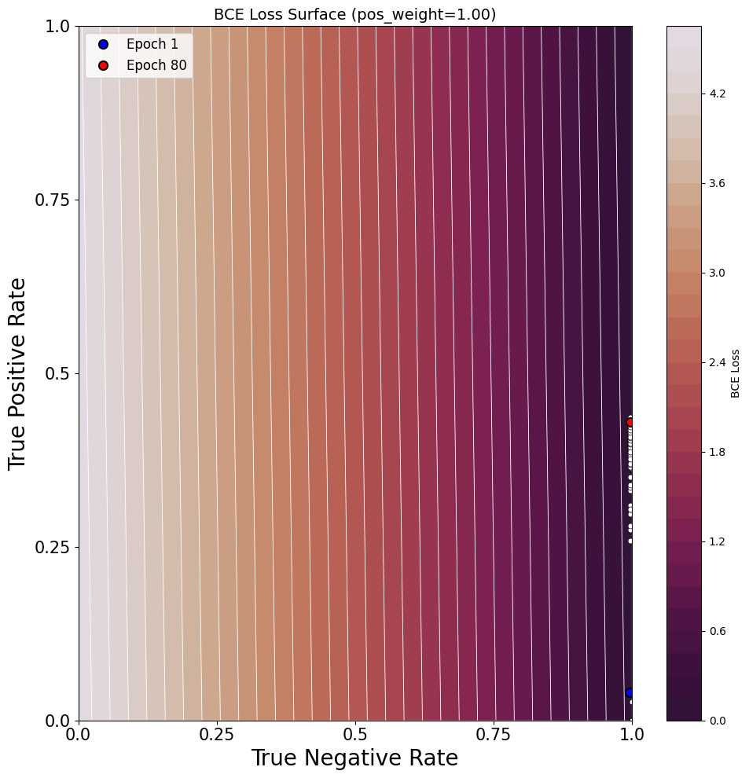
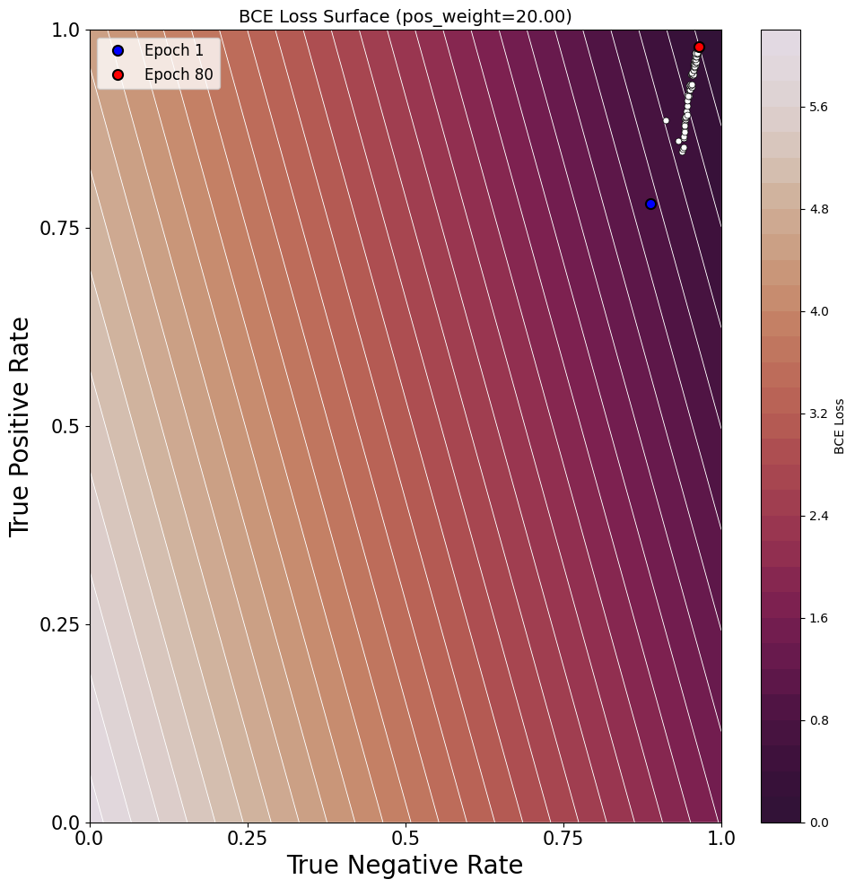
BCE learning paths

Slide 7
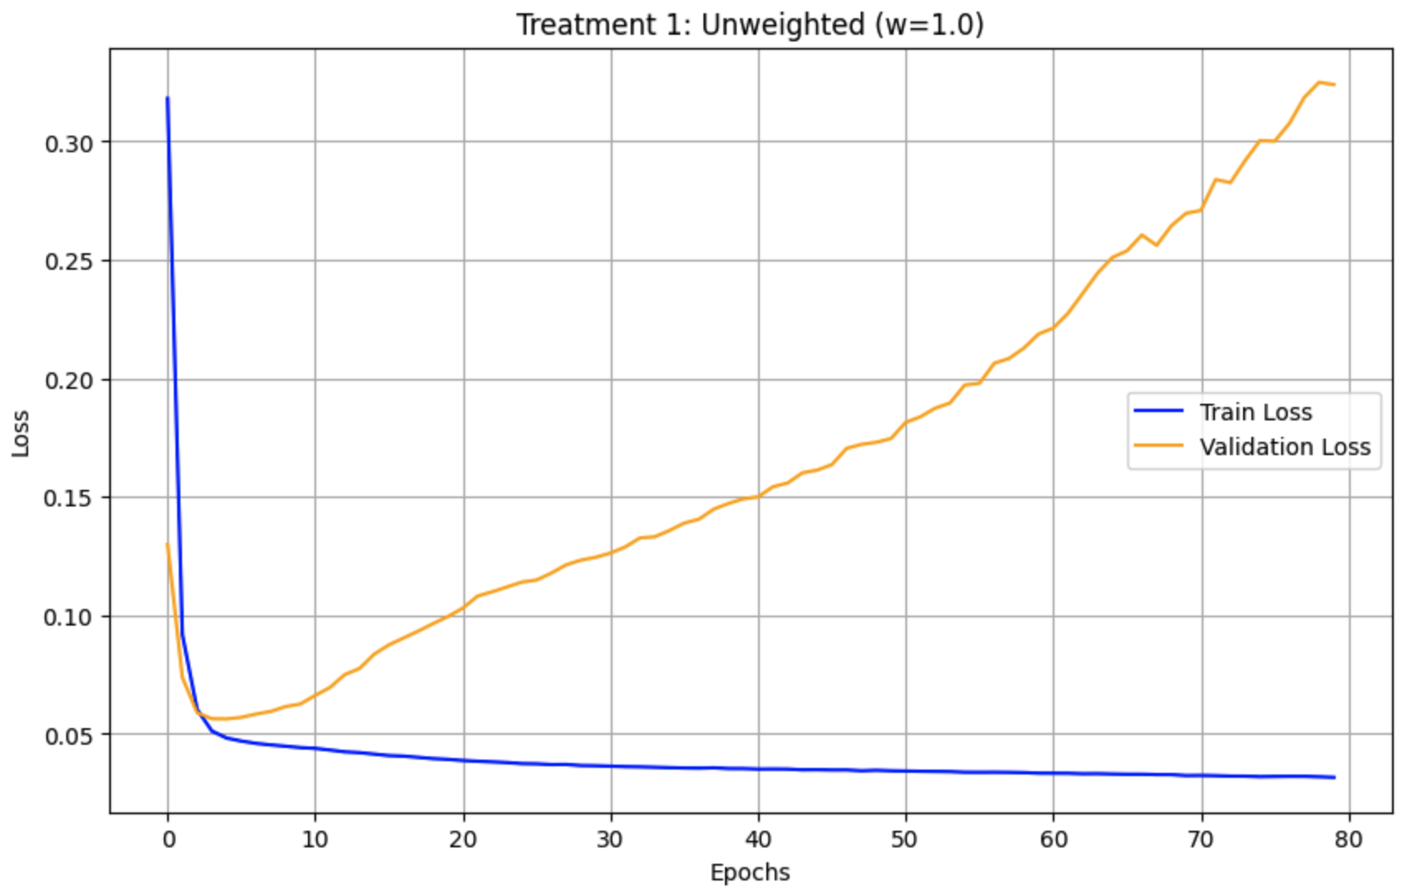
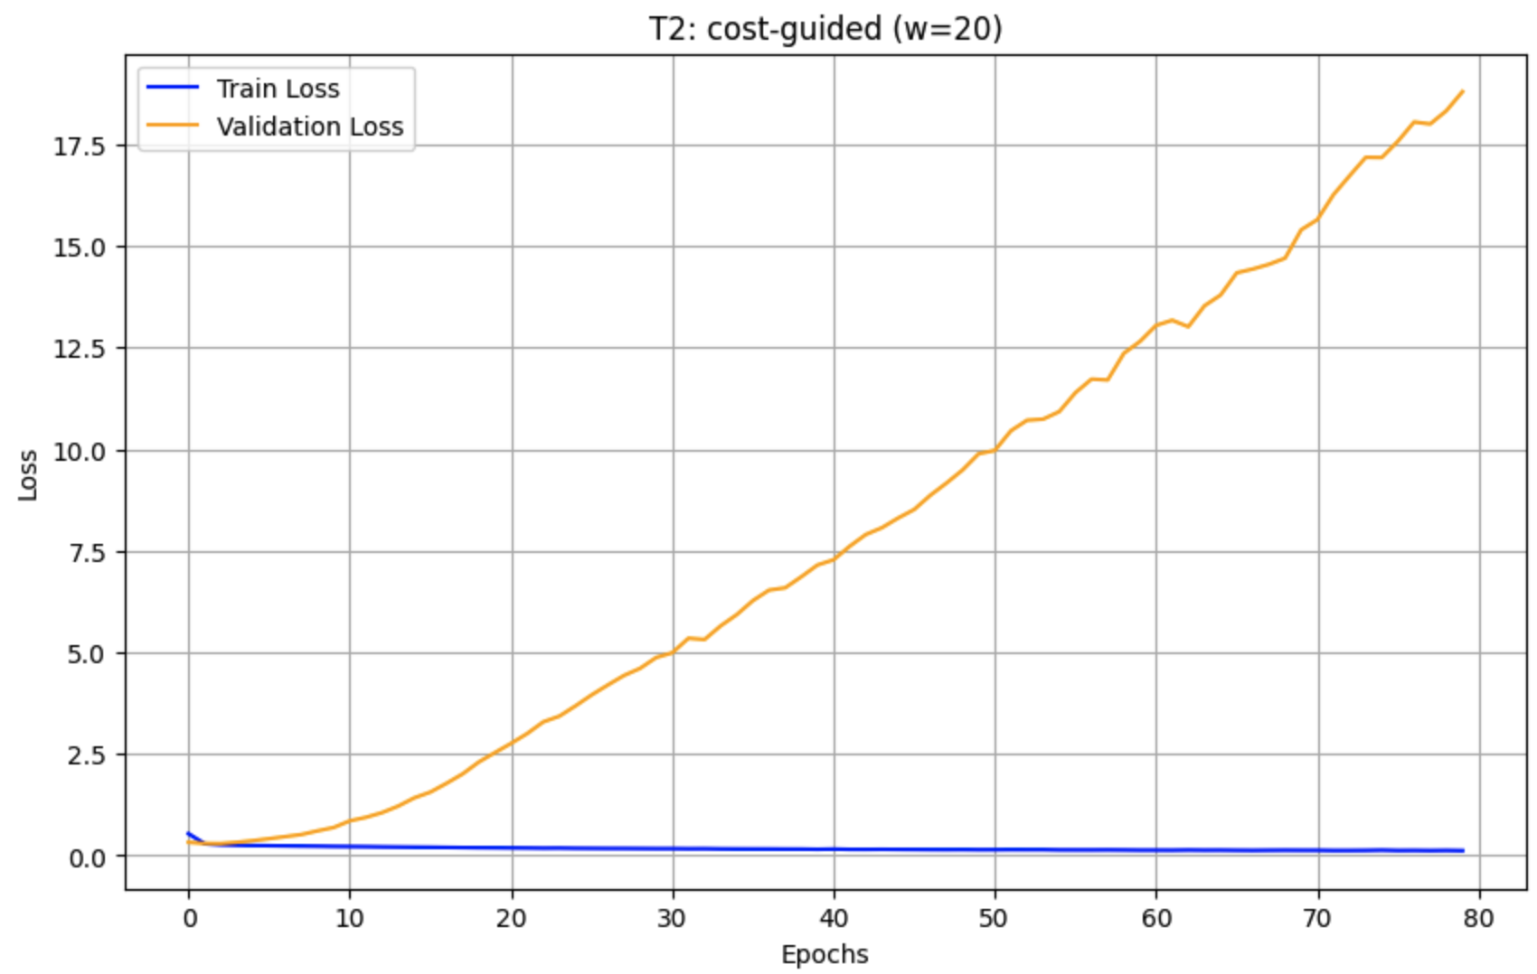
Validation loss

Slide 8
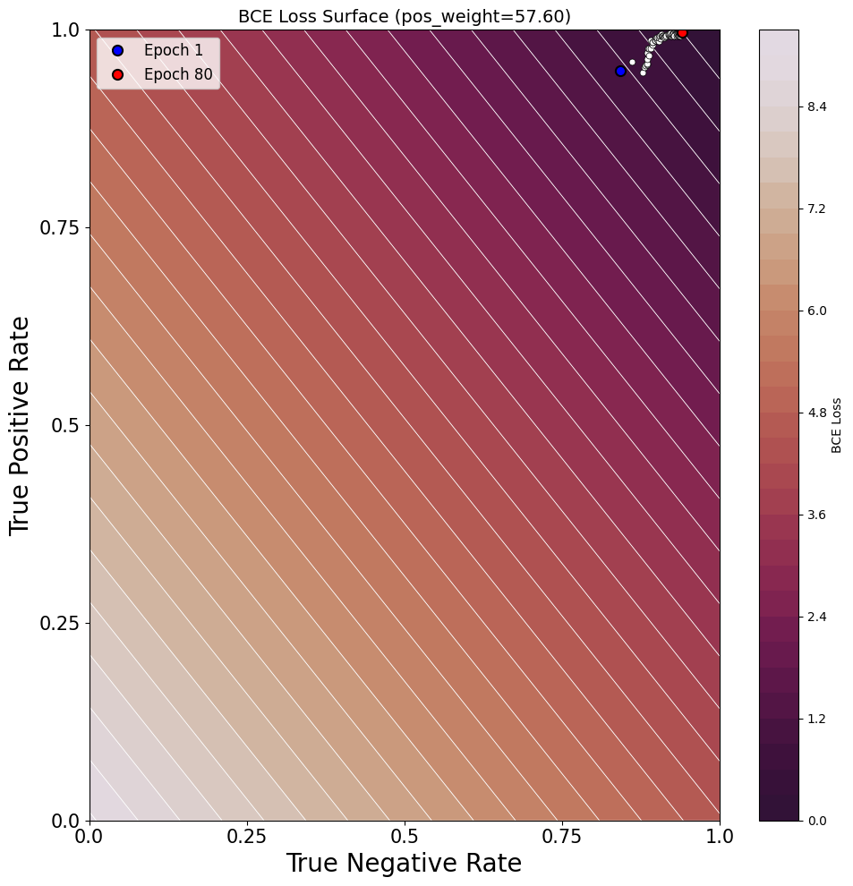
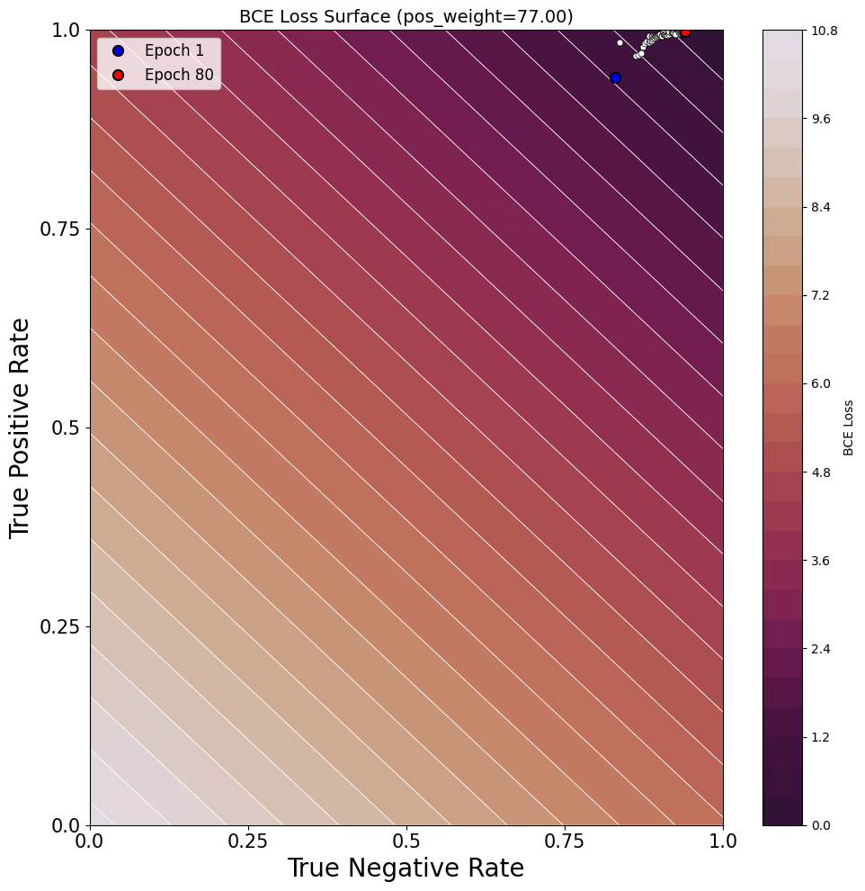
BCE learning paths

Slide 9
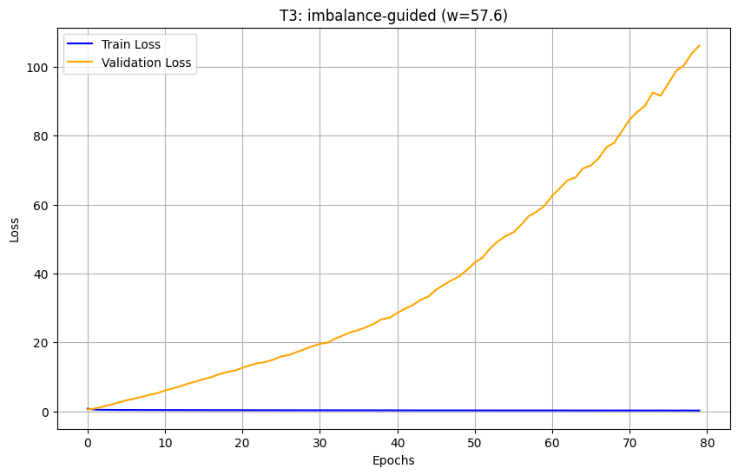
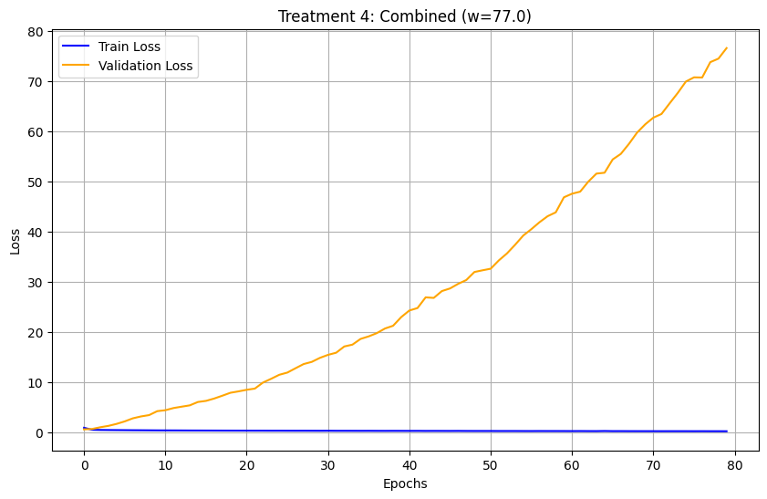
Validation loss

Slide 10
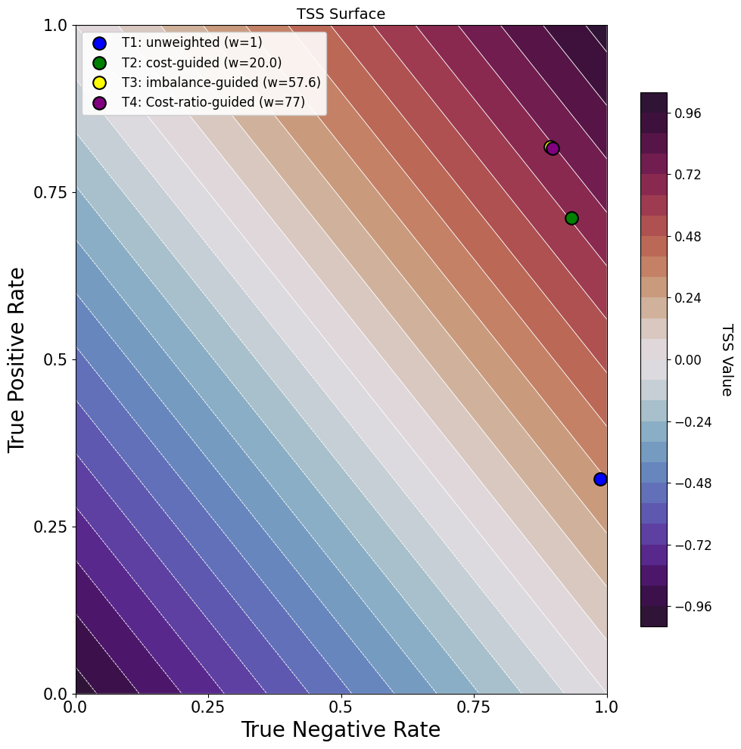
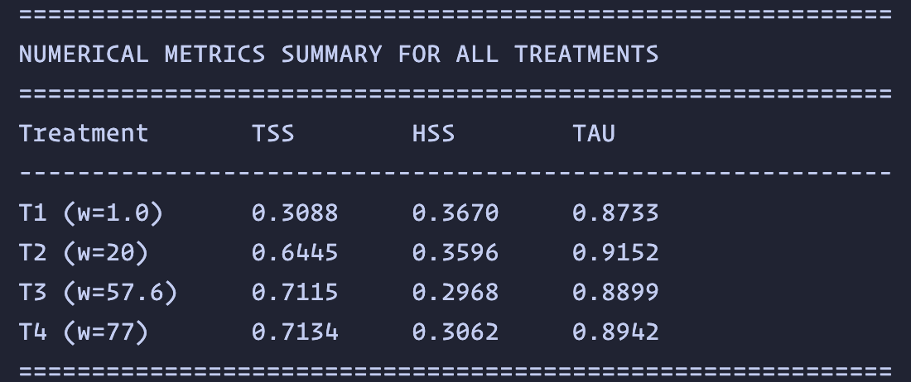
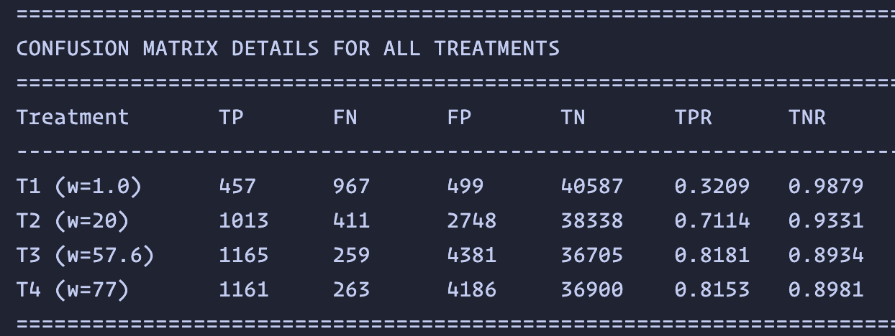
TSS

Slide 11
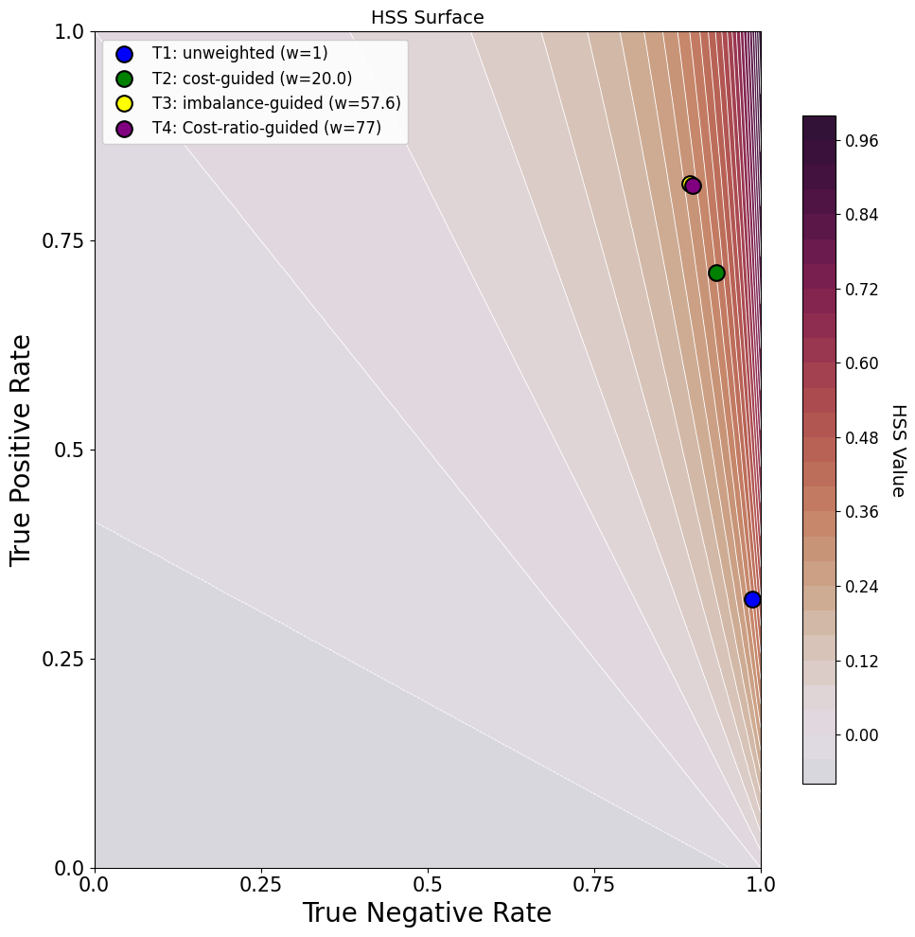
HSS

Slide 12
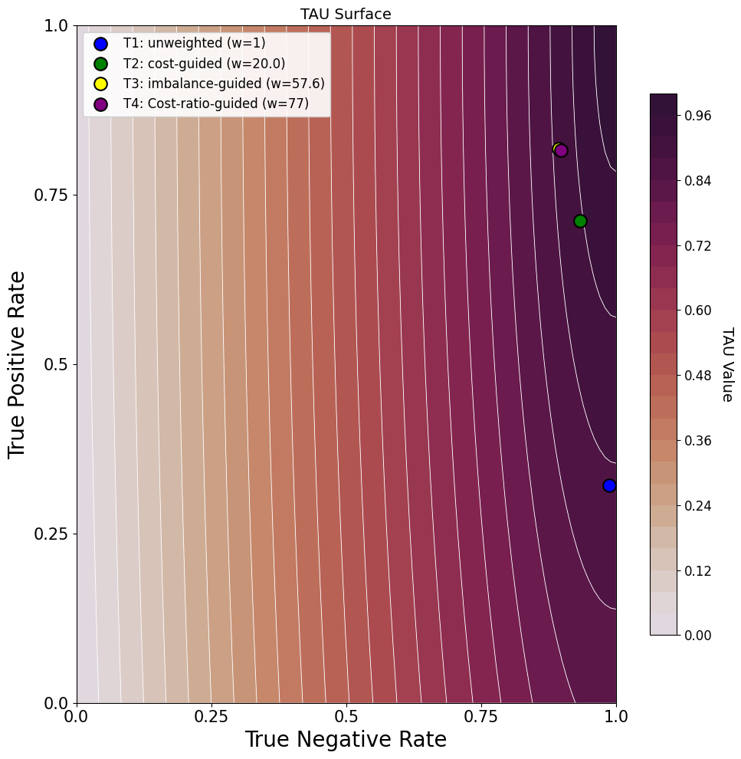
Tau

