Slide 1

Come up with a nice title

Slide 2
Intro stats
Train – P1 – 1:57.6
Val – P2 – 1:62
Test – P3 – 1:28
40 features
Network -> 40 – 16 – 16 – 1
BCE logit loss

Slide 3
Goal
Let r denote the class-imbalance ratio, and c denote the cost.
  This cost is what domain experts give us.
  We can assume any number to showcase its impact.
Use r as class weight to adjust the loss function.
  We verify this by ensuring that the loss surface is un-warped back to when r=1.
Use c as class weight to further adjust the loss function.
  This could be either added to r or subtracted from r.

Slide 4
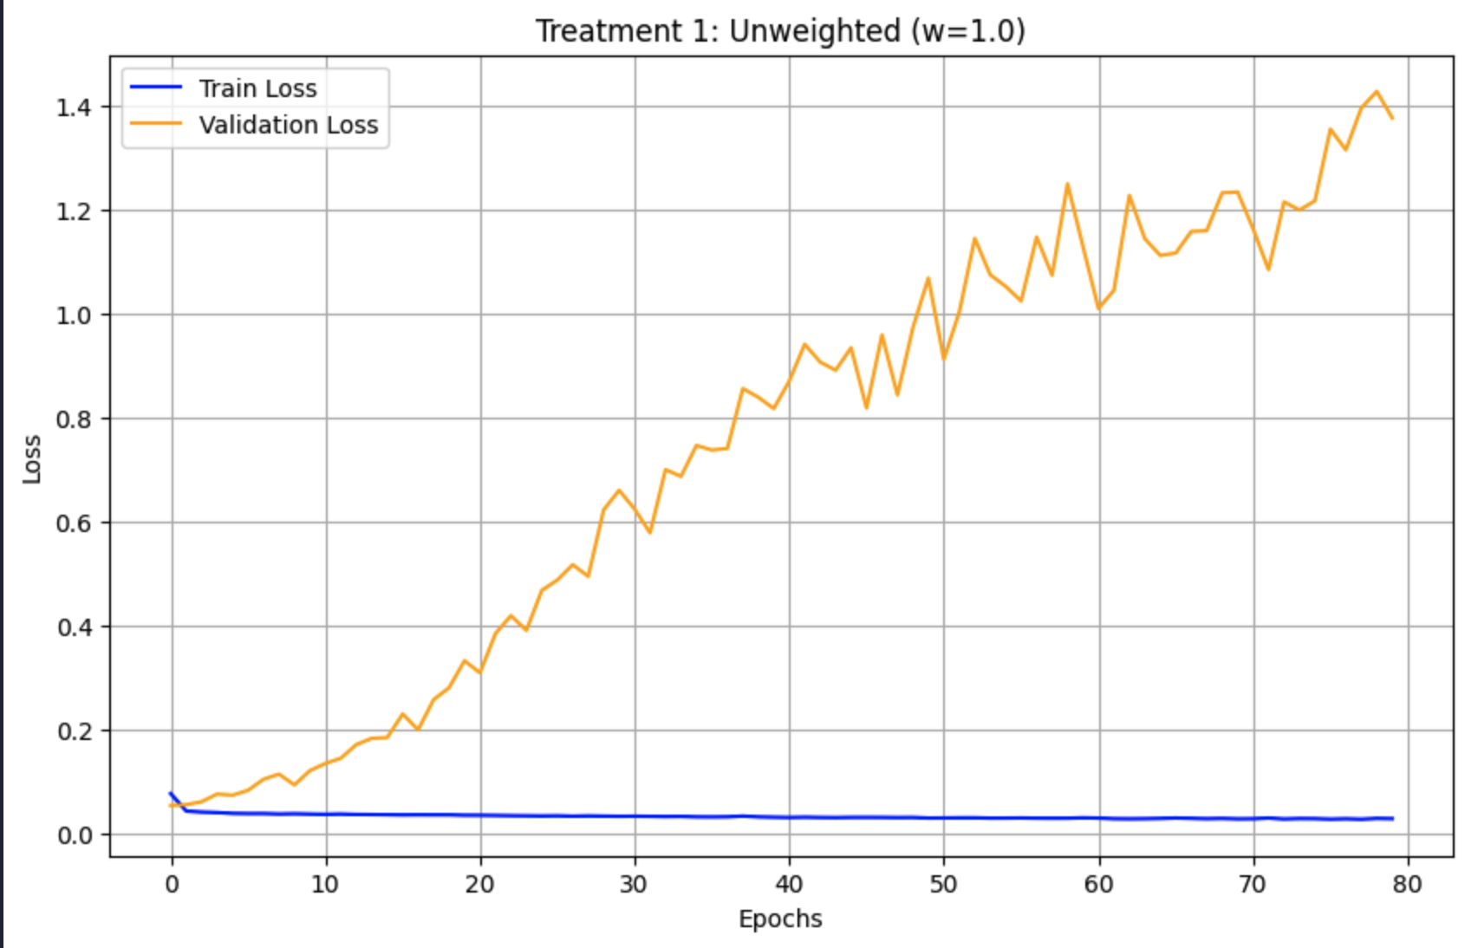
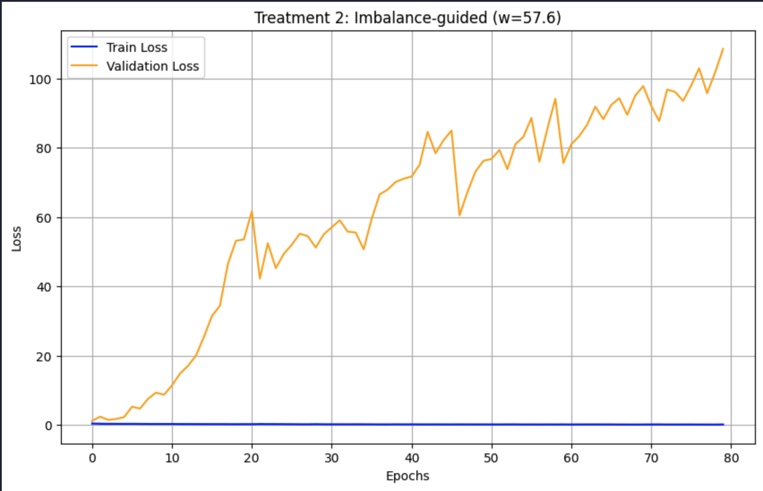
Validation loss

Slide 5
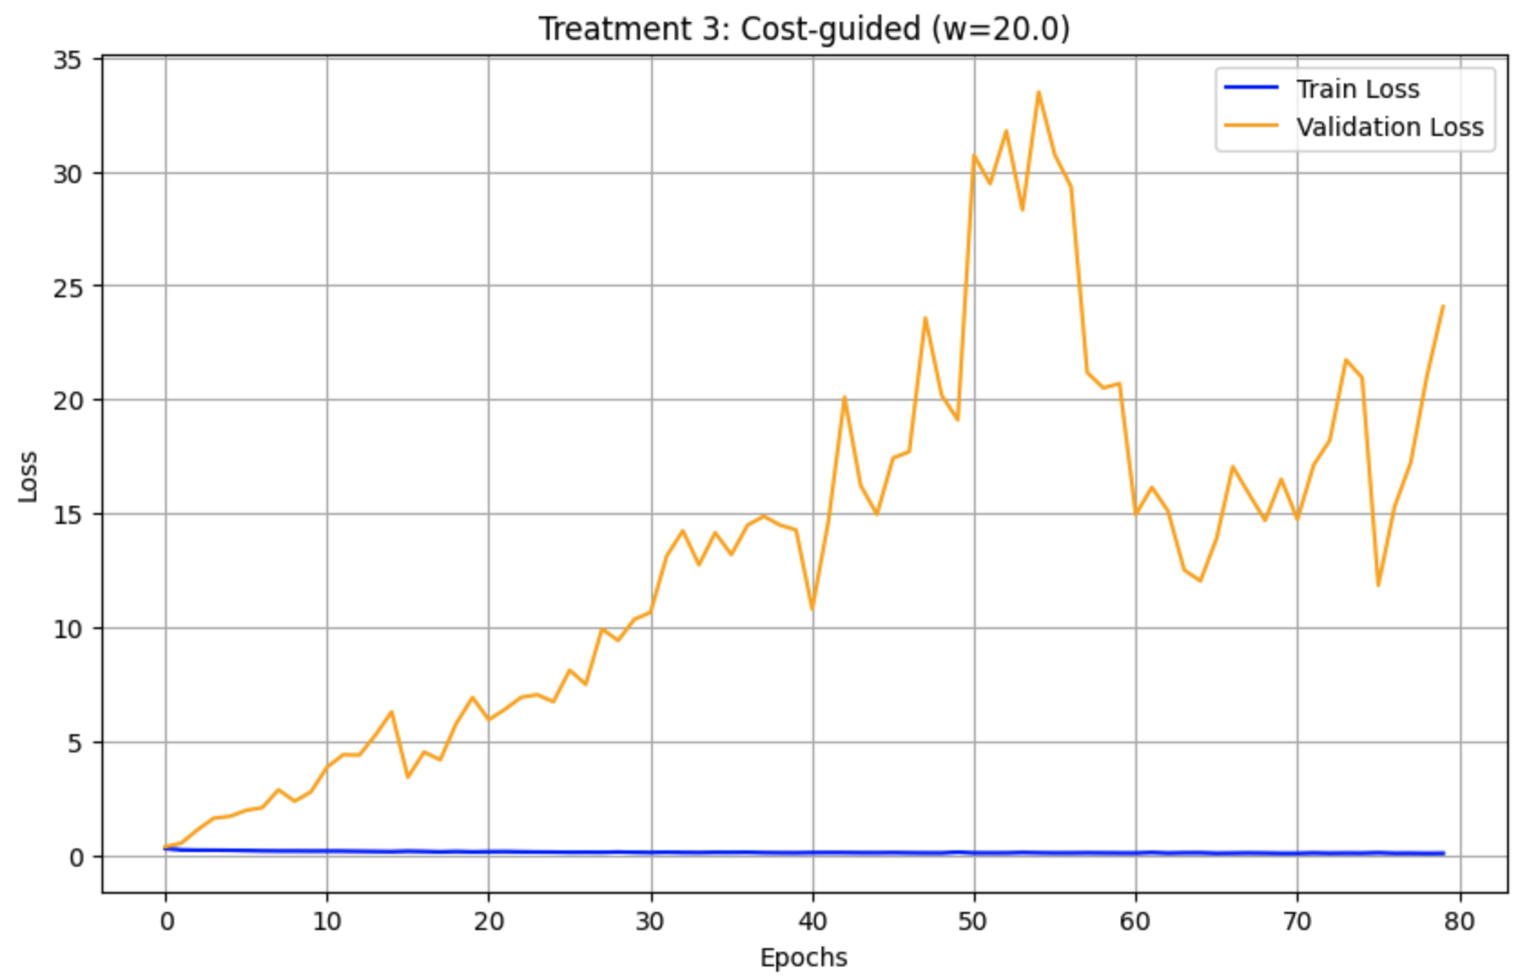
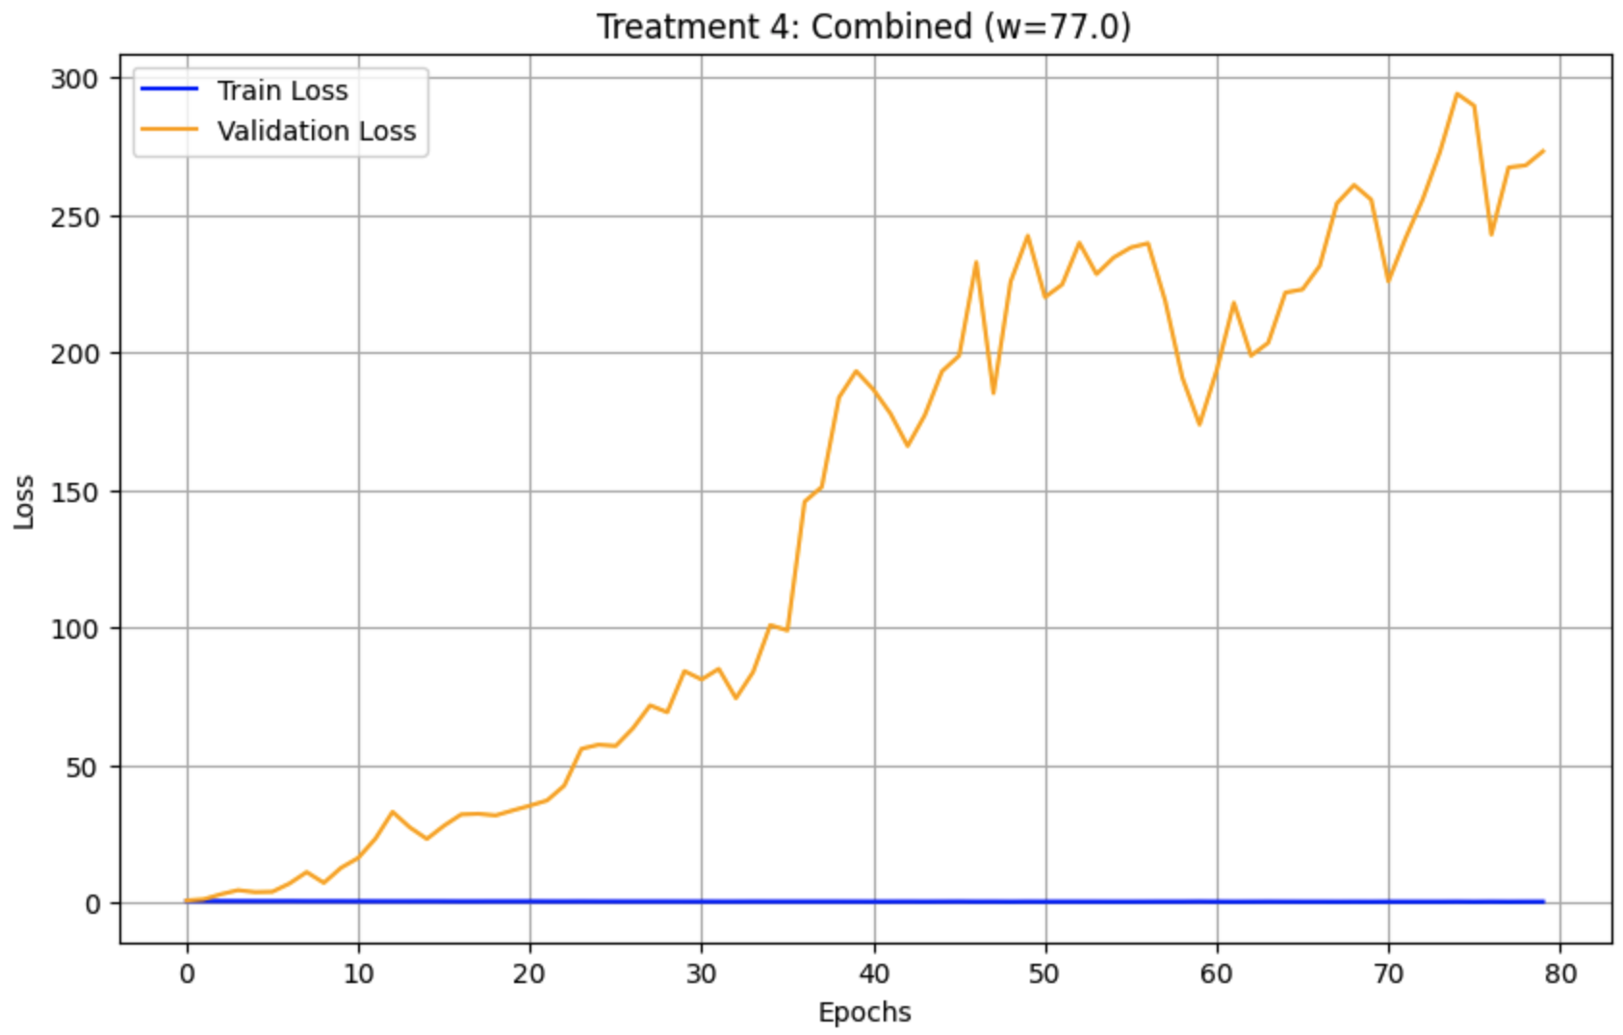
Validation loss

Slide 6
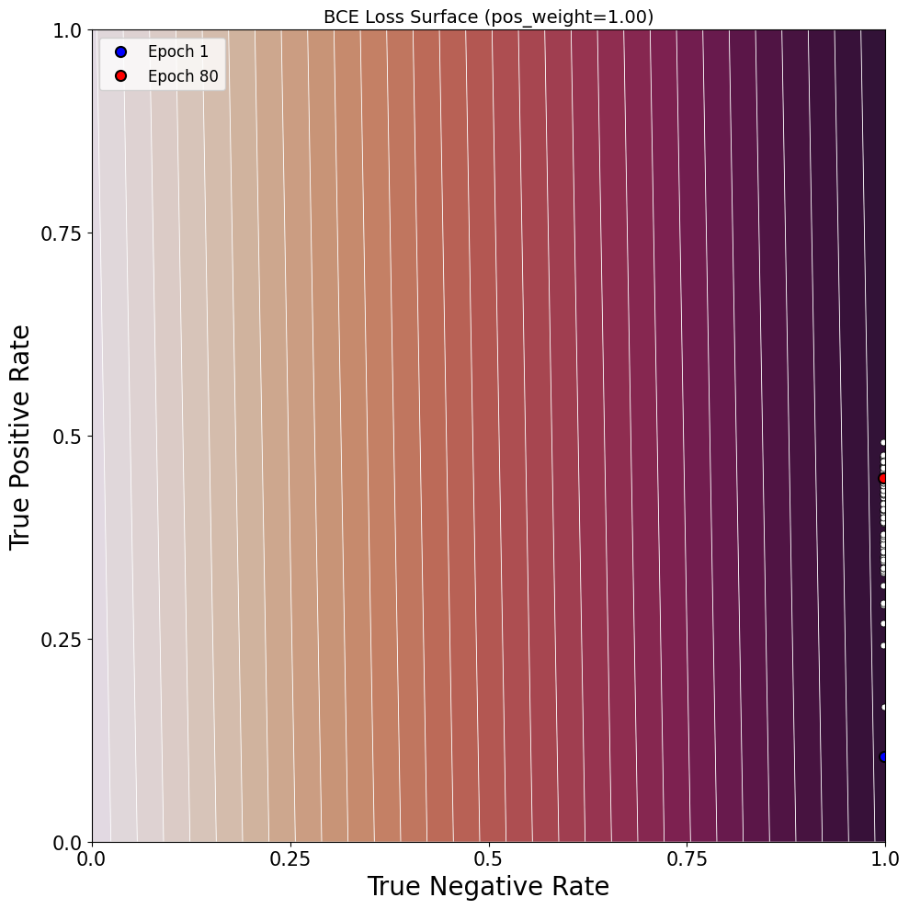
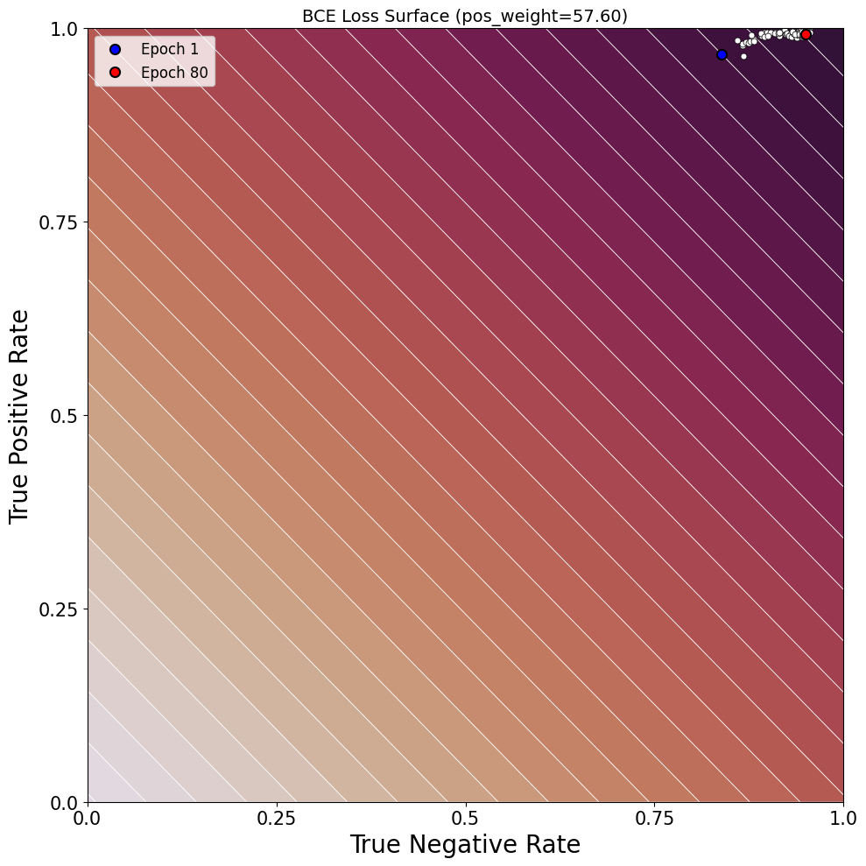
BCE learning paths

Slide 7
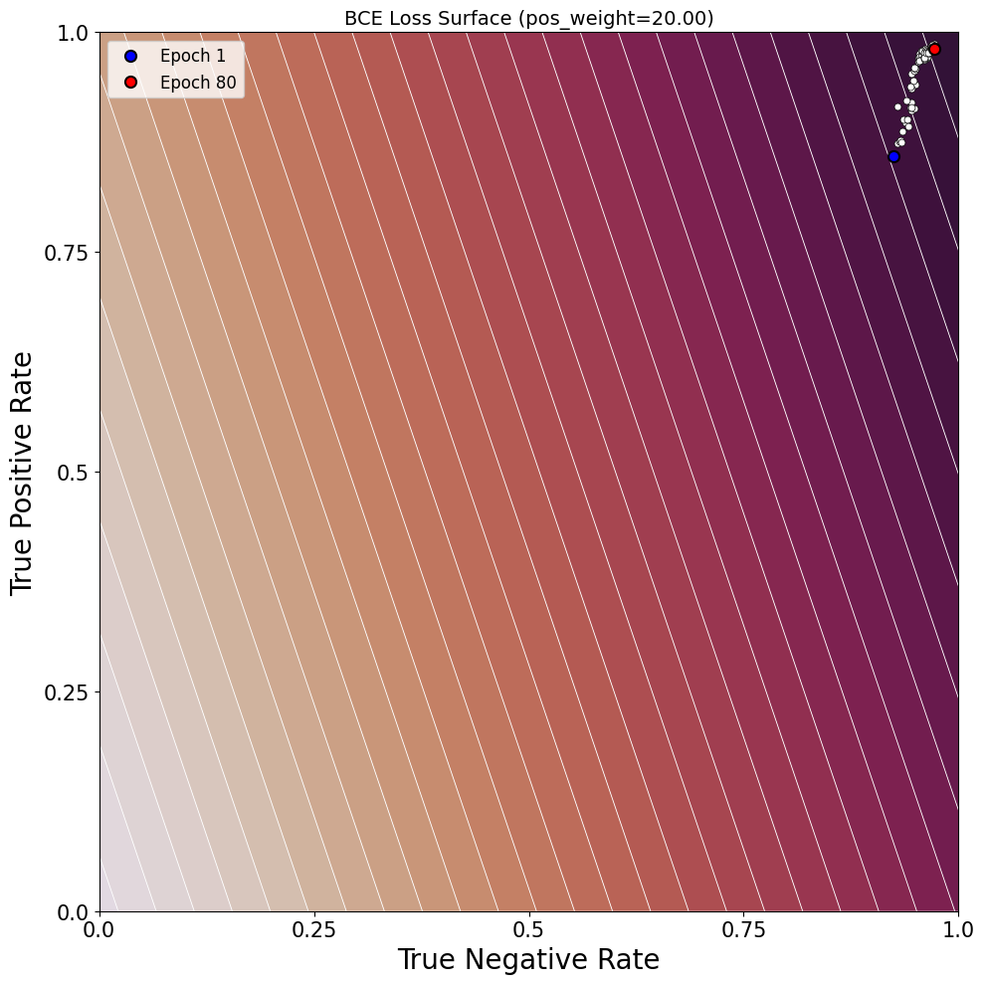
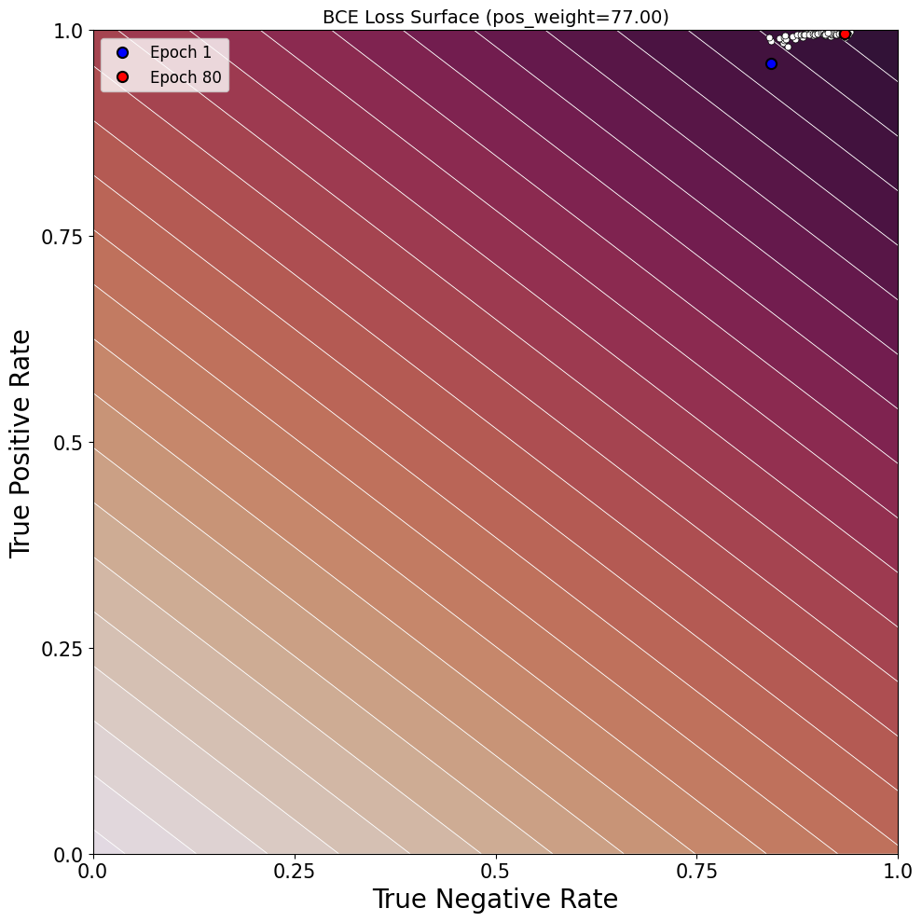
BCE learning paths

Slide 8
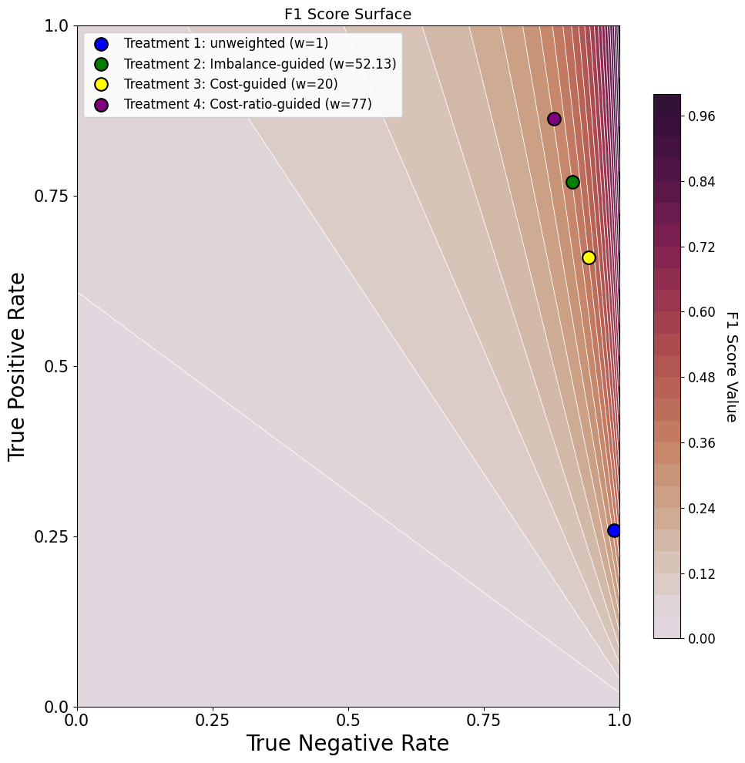
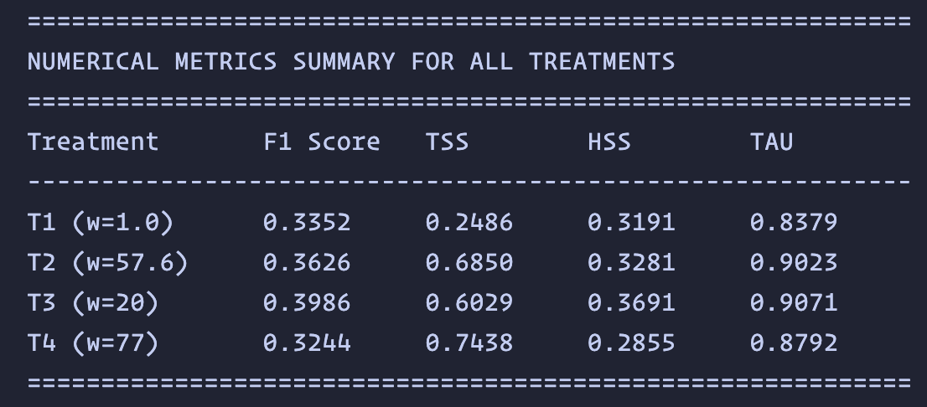
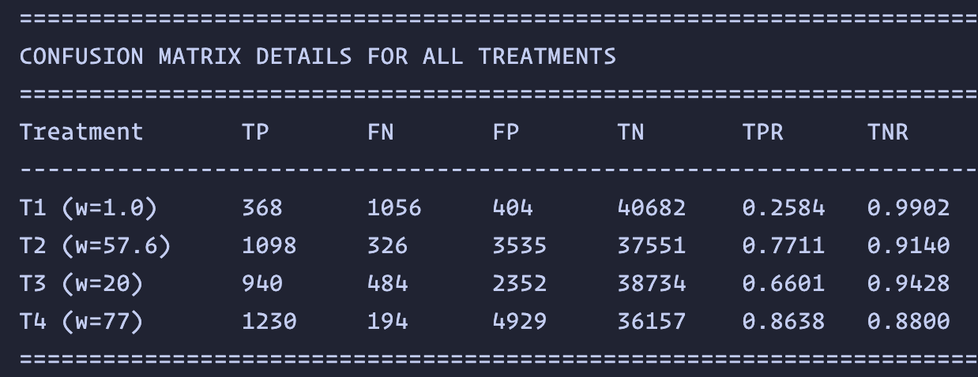
F1

Slide 9
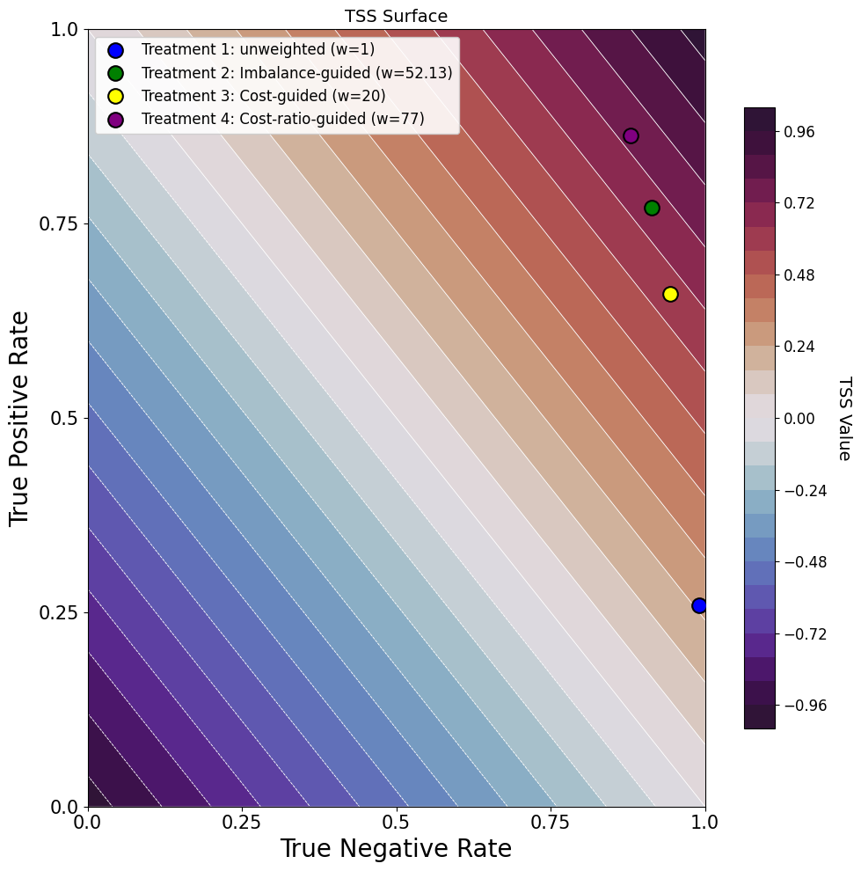
TSS

Slide 10
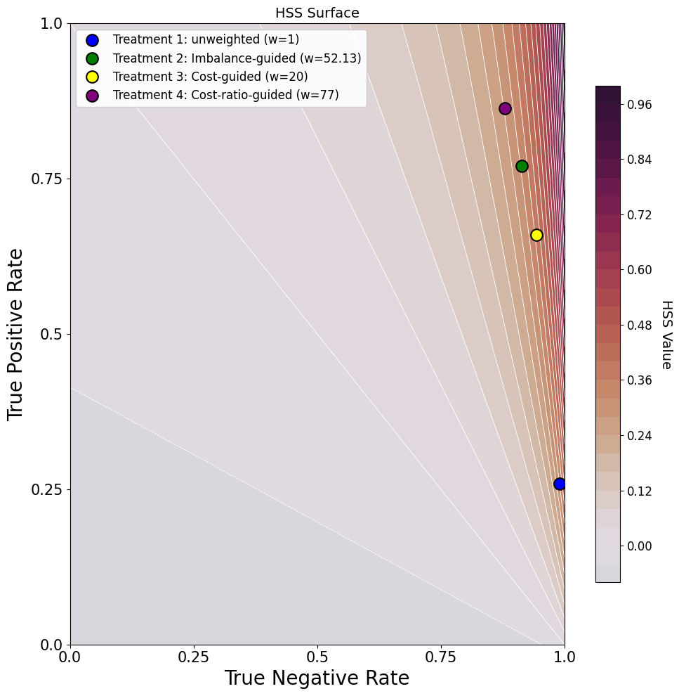
HSS

Slide 11
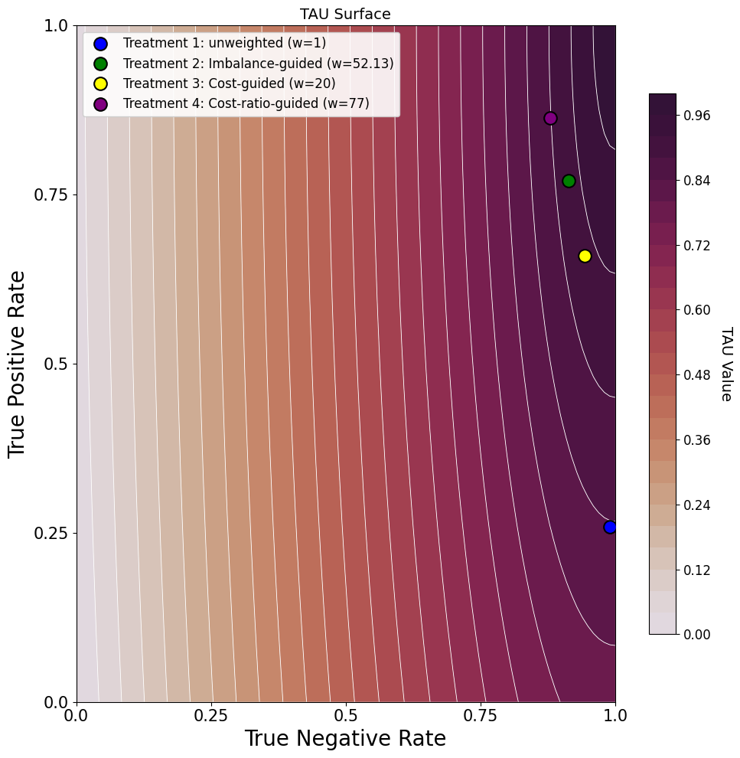
Tau

